Slide 1

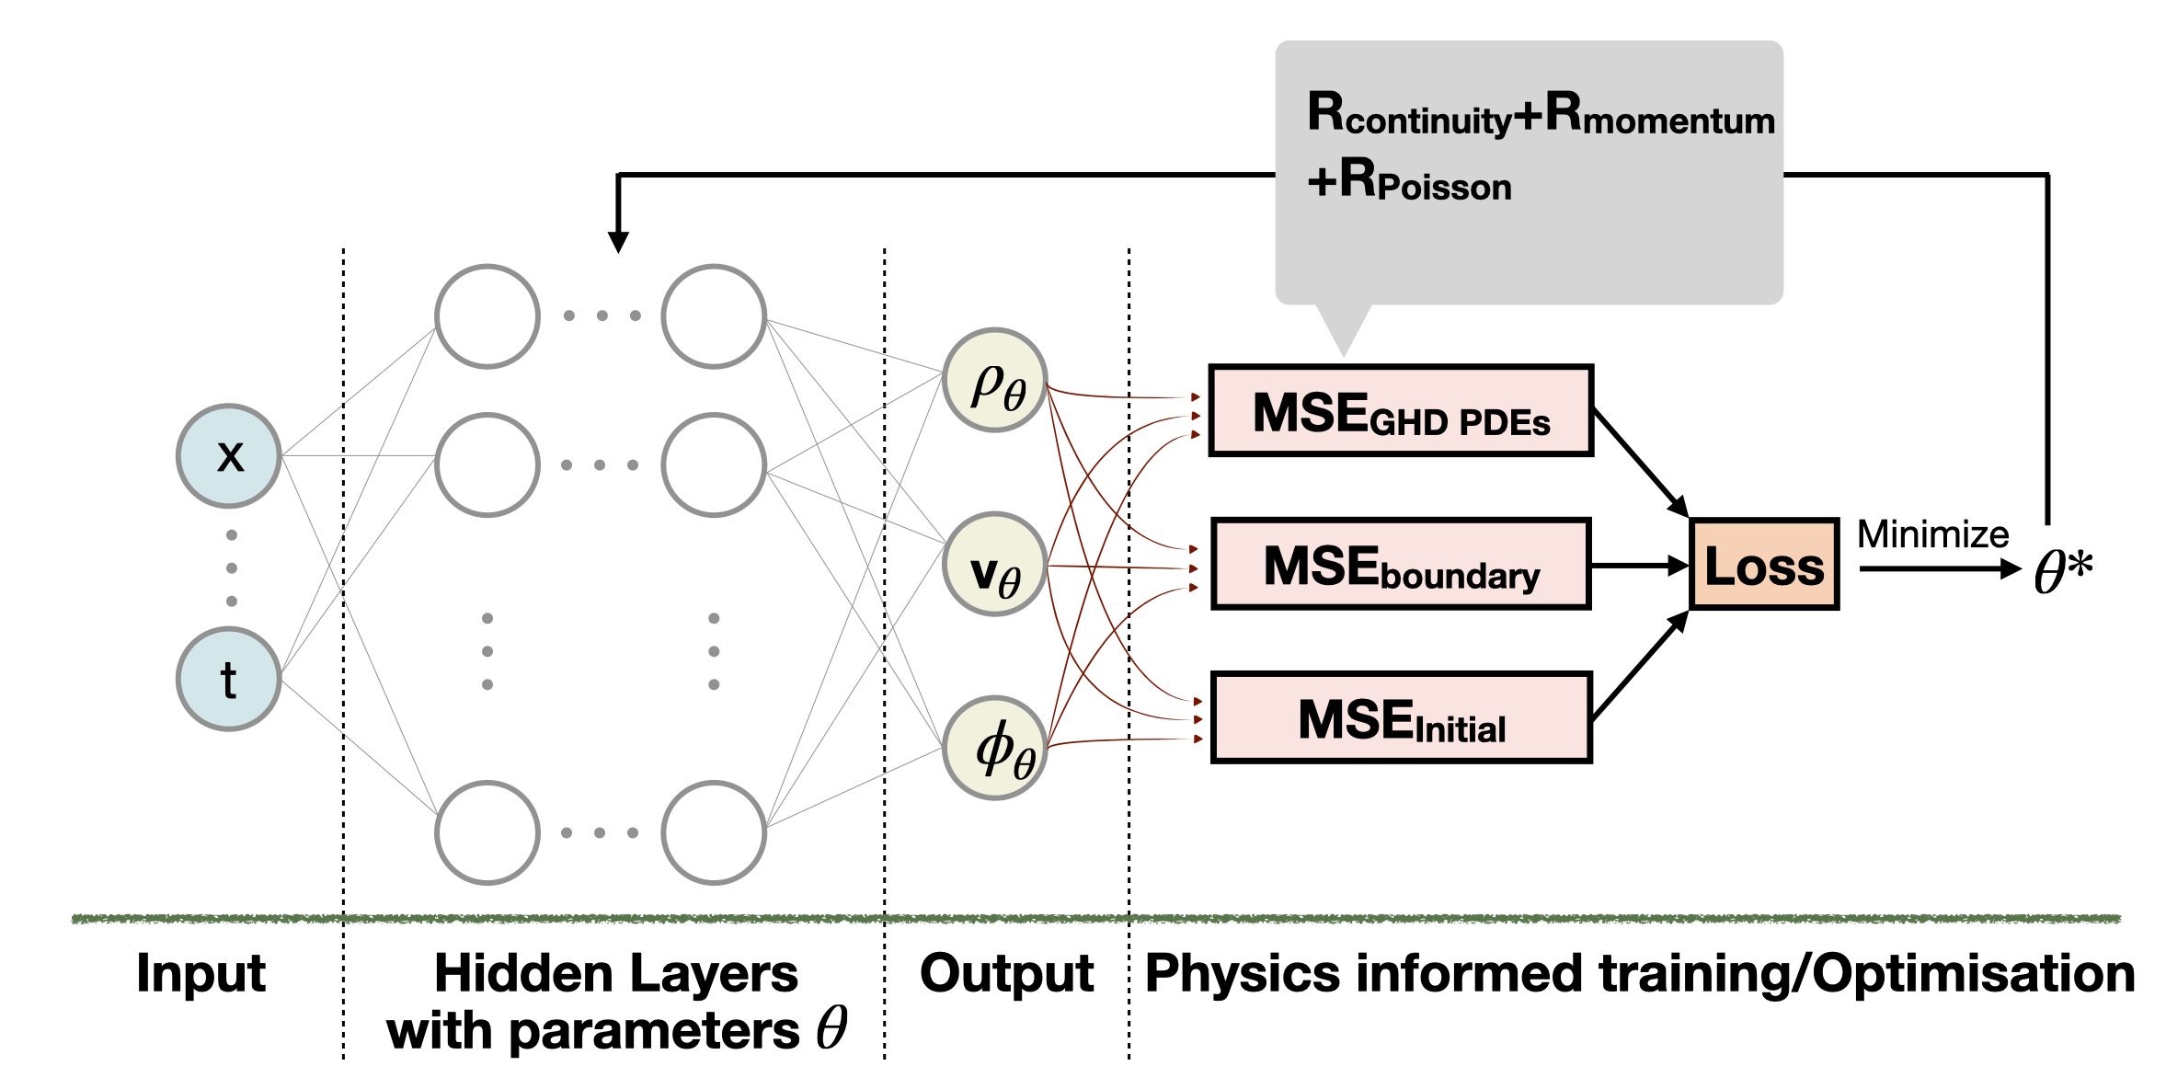
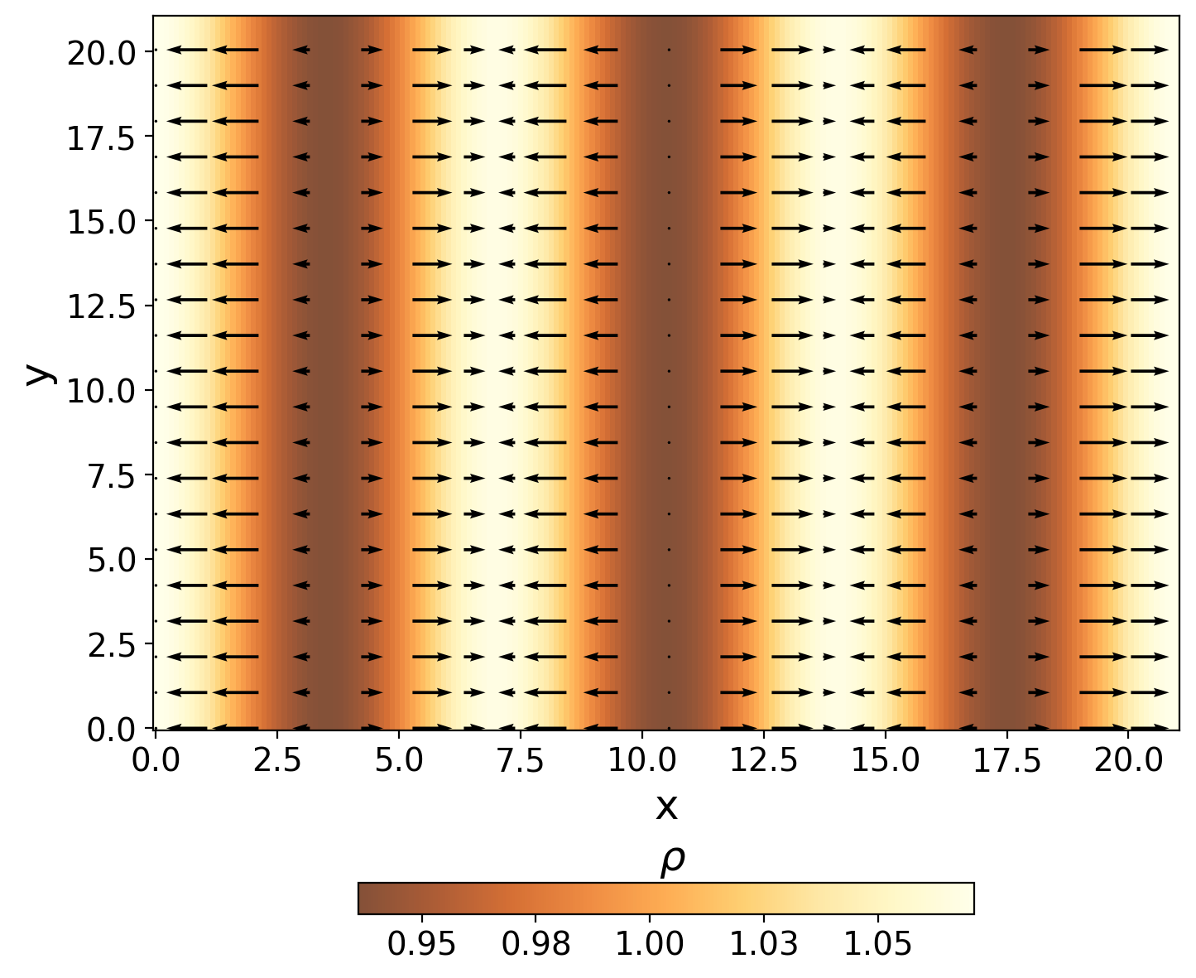

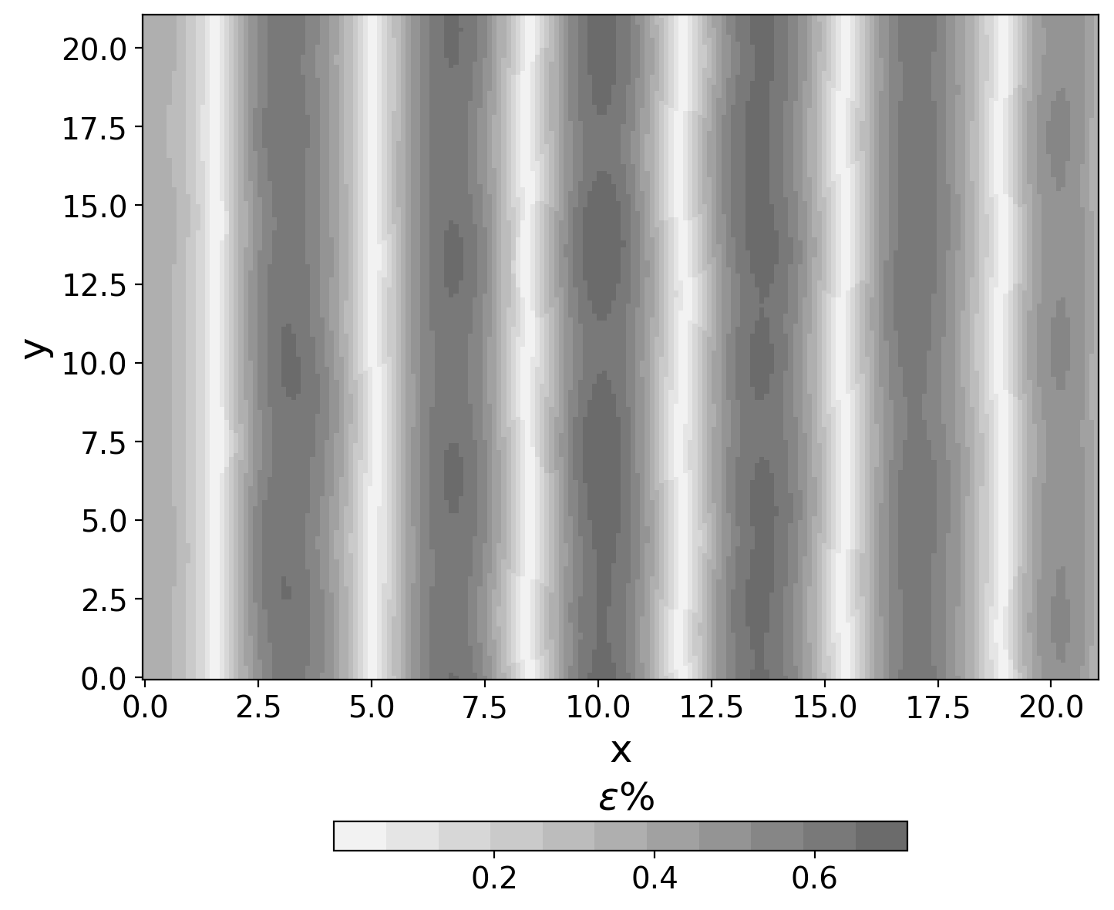
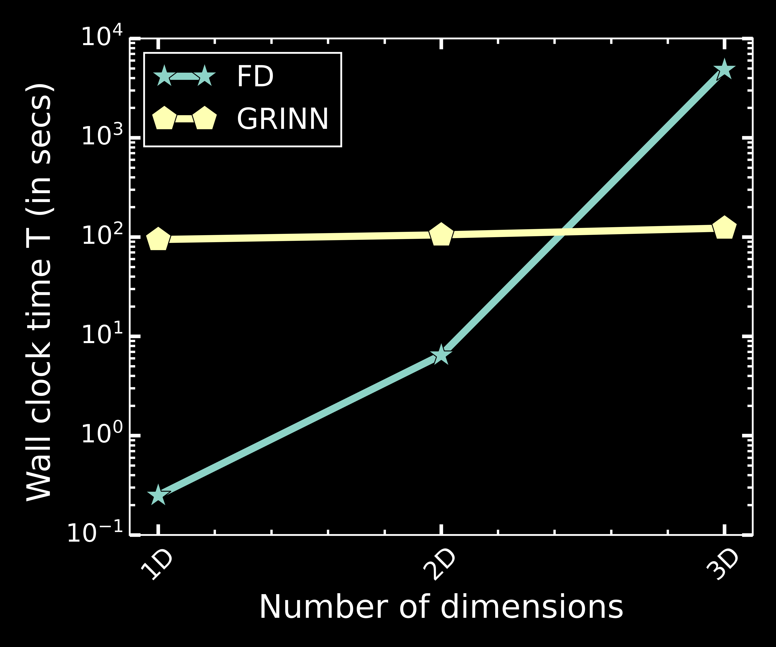



National Aeronautics and Space Administration
Using Physics Informed Neural Networks to solve hydrodynamic systems
Author: Sayantan Auddy, Nasa Postdoctoral Fellow (3263)
Ramit Dey (UWO), Neal J. Turner (3263) and Shantanu Basu (UWO)
Background
Modeling self-gravitating gas flows is essential to answering many fundamental questions in astrophysics. The self-gravity of (dark or visible) matter is the essential force that drives the dynamics and development of the cosmic web of structures, the formation of galaxies and stars, as well as the instabilities within protoplanetary disks . This nonlinear interaction between gravity and fluid dynamics is modelled using time-dependent partial differential equations (PDEs). The complexity of the system offers a formidable challenge to solving the resulting equations in three dimensions (3D).
Hydrodynamic equations
Objectives
We introduce the novel gravity-informed neural network (GRINN), a PINN-based code to study the evolution of self-gravitating hydrodynamic systems. This mesh-free framework addresses several limitations of grid-based methods like Finite Difference (FD) while solving the problem 10 times faster with similar accuracy. This will revolutionized the study of star and planet formation, enabling long term evolution of gas density with a large dynamic range of variation.
1. Continuity Equation
2. Momentum Equation
3. Poisson Equation
$ρ→$ Density, v → velocity, P → Pressure
G → Gravitational Constant,$φ→potential$
Approach and Results
What are PINNs ?
The key idea behind Physics Informed Neural Networks (PINNs) is to train a neural network to approximate a solution to a PDE while ensuring that the learned solution adheres to the governing physics.
A PINN is a neural network configured to simulate a dynamical system by incorporating the physics equations in to the loss function.
Architecture
GRINN consists of a fully connected neural network with 3 hidden layers having 32 neurons in each layer. A set of collocation points randomly sampled in space and time are given as input. The approximated solutions 𝜌, v, and 𝜙 of the PDEs are obtained as the outputs of the network.
MSE is the mean square error
Case Study
We model the growth of the gravitational instability in a cloud of molecular hydrogen gas filling a cube defined in Cartesian coordinates. The plots show the 2D projection of the density profile along with the velocity vectors as compared with the FD method.
Finite Difference Method
GRINN solutions
Mismatch
Mismatch %
%
Significance of Results/Benefits to NASA/JPL
GRINN provide a new mesh-free framework for solving 3D astrophysical gas flow problems 10 times faster compared to traditional numerical methods like FD with similar accuracy.
In traditional numerical methods like FD, increasing dimensionality increases memory requirements geometrically, and increased resolution requires smaller time stepping in order to maintain accuracy or stability. These enhance the computation cost for 3D calculations with a high enough resolution to achieve sufficient fidelity. PINNs can adapt to varying resolutions in a more flexible way and will not necessarily follow these constraints.
Thus GRINN and other physics-informed neural networks hold the potential to substantially increase JPL’s capability to model the most complex astrophysical flows. This will improve our understanding of the formation and evolution of stars and planets.
Future Work
Extension of GRINN will enable long time evolution of astrophysical systems such as protoplanetary disks, young growing stars, etc., beyond the current limits of grid-based simulations. Implementing more sophisticated neural network architecture can further improve GRINN to solve magnetohydrodynamic systems and prove deeper into the non-linear regime. PINN-based solvers will not only revolutionize astrophysics simulations but can be adapted to solve partial differential equations in other areas of physics and engineering.
National Aeronautics and Space Administration
Jet Propulsion Laboratory
California Institute of Technology Pasadena, California
www.nasa.gov
Publications and Acknowledgements:
https://arxiv.org/pdf/2308.08010.pdf
Computer resources: Digital Research Alliance of Canada
Author Contact Information:
(ph: 515 708 4599 email:sayantan.auddy@jpl.nasa.gov )
Clearance Number: CL#00-0000
Poster Number: PRD-
Copyright 2023. All rights reserved.

