Slide 1
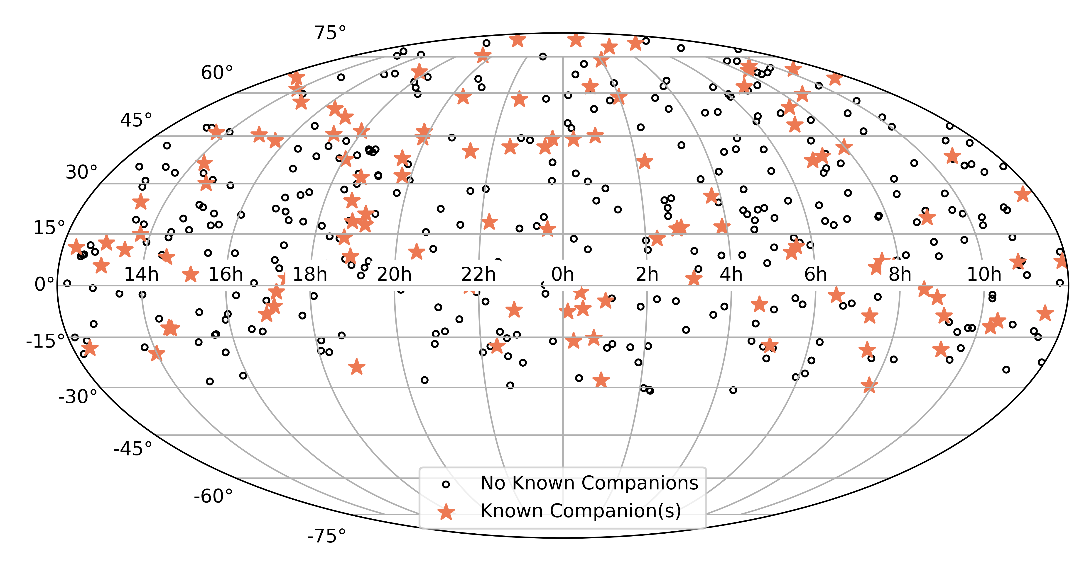
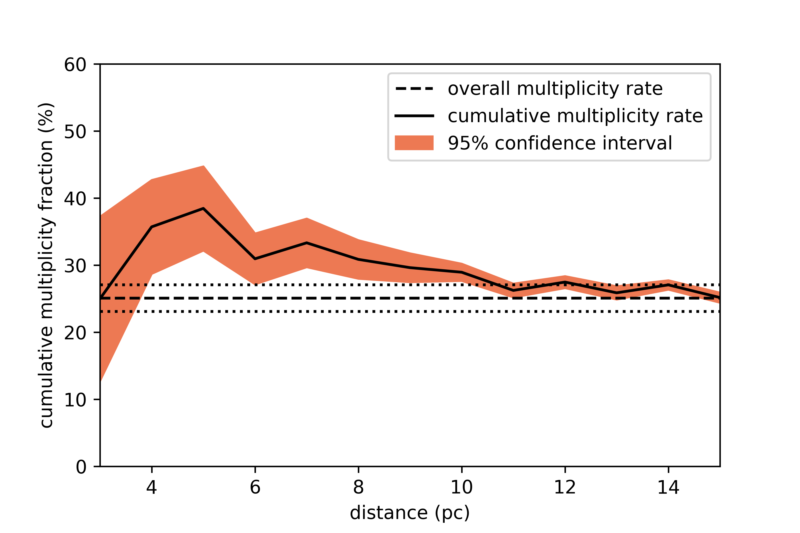
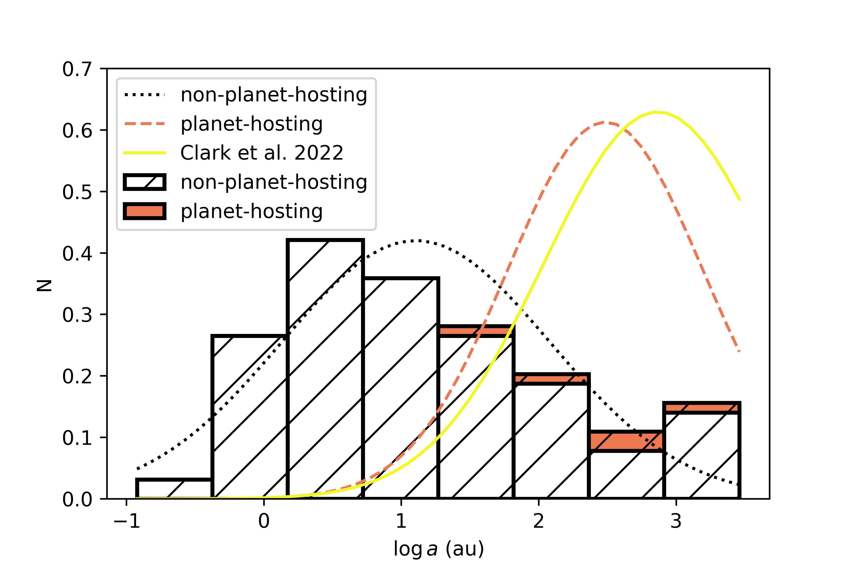
National Aeronautics and Space Administration
Postdoc Research
Planet-Hosting M Dwarfs Have Fewer Close-In Stellar Companions
Authors: Catherine A. Clark, JPL Postdoctoral Fellow in Section 326
Gerard T. van Belle, Elliott P. Horch, David R. Ciardi, Kaspar von Braun, Brian A. Skiff,
Michael B. Lund, Mark E. Everett
Background, Objectives, and Approach
The Pervasive Overview of Kompanions of Every M dwarf in Our Neighborhood (POKEMON) survey is a volume-limited speckle study of nearby M dwarfs through M9V out to 15pc. Our sample consists of 454 M dwarfs in the Solar Neighborhood (Figure 1).
Recent studies on data from Kepler, K2, and TESS have shown that when we detect stellar companions to planet-hosting FGK stars, the companions have projected separation distributions that peak at larger values than what has been found for field stars. The volume-limited nature of the POKEMON sample enables an exploration of this idea for the M dwarfs in a systematic manner.
Figure 1. The sky locations of the 454 targets in the volume-limited, 15-pc POKEMON sample. Targets with no known companions are marked with open black circles, and targets with known companions are marked with larger, orange stars.
The Stellar Multiplicity Rate of M Dwarfs within 15 pc
In total, we find that 114 of the 454 POKEMON primaries within 15 pc host M-dwarf companions known to the literature. Of these, 94 are double, 18 are triple, one is quadruple, and one is quintuple. 339 of the POKEMON primaries within 15 pc are therefore single. Using these values, we calculate a multiplicity rate of 25.1±2.0% and a companion rate of 30.2 ±2.2% (Figure 2). The multiples have a broad projected separation distribution with a peak at 14.6 au and a tail toward larger separations. This is in reasonable agreement with Winters et al. 2019, which found a peak at 20 au for their sample of M dwarfs within 25 pc.
Figure 2. Cumulative stellar multiplicity rate as a function of distance, binned by one parsec. One would expect this function to remain flat as a function of distance. The overall stellar multiplicity rate (and errors) is shown for comparison. The 95% Poisson confidence interval is shown as well. The larger errors at smaller distances are due to small number statistics.
The Stellar Multiple Gap
However, the peak we find for the POKEMON multiples that host planet is quite different from the Winters et al. (2019) distribution. When the non-planet-hosting and planet-hosting multiples in the POKEMON sample are assessed separately, the non-planet-hosting multiples have a projected separation distribution that peaks at 12.8, while the planet-hosting POKEMON multiples have a peak at 305 au (Figure 3). While only a small number of POKEMON multiples host known planets, the planet-hosting distribution is in reasonable agreement with the results from a recent survey of TOIS in M-dwarf binaries, which found a peak at 735 au. The number of planet-hosting systems with stellar companions in both the POKEMON (5) and TOI (11) samples is relatively small, but it is telling that the two planet-hosting distributions have peaks at relatively consistent values, whereas the peaks of the planet-hosting and non-planet-hosting distributions differ by more than an order of magnitude. We therefore conclude that planet-hosting multiples have larger projected separations than non-planet-hosting multiples, indicating that the presence of a stellar companion impacts the formation and evolution of any planets in the system.
Figure 3. Projected separation distributions for various populations of M-dwarf multiples. The histogram shows the distribution of projected separations for the targets in the 15-pc POKEMON sample that are known to be multiple. Gaussian fits to the non-planet-hosting, planet-hosting, and Clark et al. 2022 distributions are also shown.
Publications and Acknowledgements:
Clark, C.A., et al. 2022, AJ, 163, 232
Clark, C.A., et al. 2022, AJ, 164, 33
Clark, C.A., et al. 2023, submitted to AAS Journals
Horch, E.P., et al. 2009, AJ, 137, 5057
Scott, N.J., et al. 2018, PASP, 130 054502
Winters, J.G., et al. 2019, AJ, 157, 216
Author Contact Information:
catherine.a.clark@jpl.nasa.gov
National Aeronautics and Space Administration
Jet Propulsion Laboratory
California Institute of Technology
Pasadena, California
www.nasa.gov
Clearance Number: CL#00-0000
Poster Number: PRD-A-003
Copyright 2023. All rights reserved.

