Slide 1
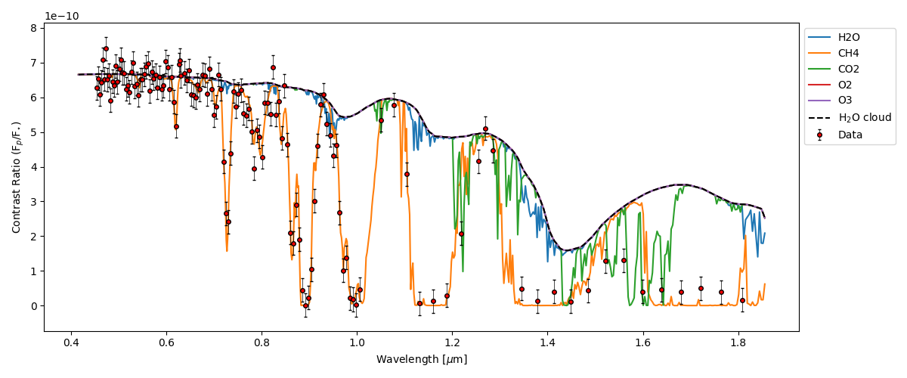
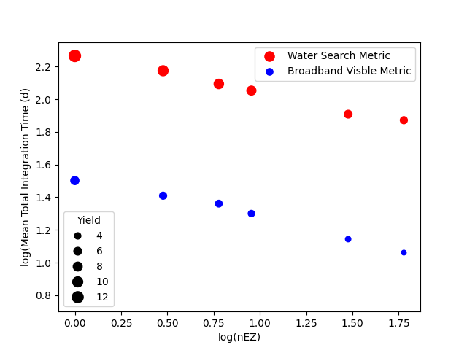
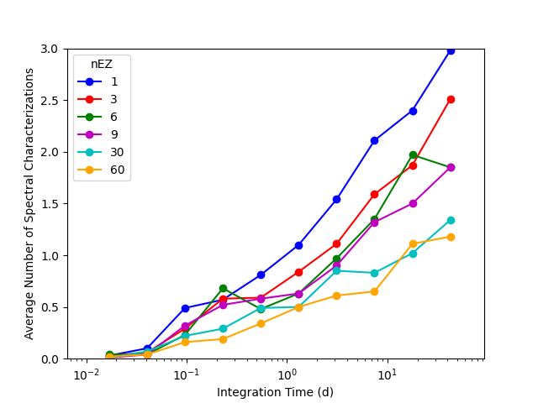
National Aeronautics and Space Administration
Postdoc Research
Archean Earth and Exozodi Studies using
Bayesian Retrieval Code ExoReL(R) and
Mission Yield Simulator ExoSims
Author: Armen Tokadjian, JPL Postdoctoral Fellow (3262)
Renyu Hu (3262), Rhonda Morgan (7000)
Background
In the 2020 Decadal Survey, NASA recommended a large space telescope devoted primarily to imaging small Earth-like exoplanets. This mission concept, the Habitable Worlds Observatory (HWO), will aim to gain critical insights into the habitability of worlds in the solar neighborhood. In order to make the most well-informed decisions regarding the design and application of the new telescope, several studies need to be employed regarding subjects such as forward modeling, retrievals of reflection spectra, and mission yield modeling. To this end, I have recently started working with Dr. Renyu Hu to assess clues of habitability in the reflection spectrum of an Earth analog and with Dr. Rhonda Morgan to analyze the effects of exozodiacal dust on the number of Earth-like planets that can potentially be found with HWO.
Objectives
Detecting and characterizing exoplanets and assessing their habitability is a complex and nontrivial endeavor. Nevertheless, steps can be taken towards this goal by estimating the number and quality of potential Earth-like exoplanet detections and determining the planet’s atmospheric constituents. My objective is to contribute to both of these separate but intertwined puzzles. I use ExoReL, a Bayesian retrieval framework designed for reflection spectroscopy and direct imaging of exoplanets [1] and ExoSims, a mission yield simulator tool that estimates the number of detectable and characterizable exoplanets [2].
Approach and Results
In this preliminary work, I take two approaches corresponding to the two programs mentioned above. I use ExoReL to model Archean Earth (Earth as it was 2.5 to 4 billion years ago) which has a much different atmospheric makeup compared to today, high in methane and carbon dioxide and low in molecular oxygen. By running a forward model of Archean Earth parameters, performing a retrieval of reflected light, and fitting chemical contributions to the data, I find that HWO can likely correctly retrieve this molecular makeup (Figure 1).
Figure 1: Molecular contribution for retrieval on Archean Earth
I use ExoSims to model the effect of exozodiacal light (exozodi) on mission yield and integration time (the time spent observing the targets). The results are as expected: the number of planets that are characterized decreases with increasing exozodi while the integration time also decreases, due to less planets being observed (Figure 2). The integration time histogram shows that we can find more planets if we increase the time spent on targets (Figure 3), a give-and-take on cost and benefit that should be addressed in mission optimizing. The histogram also clearly summarizes that for a given integration time, larger exozodi levels lead to less yield.
Figure 2: Exozodi vs integration time
Figure 3: Number of characterizations for bins of integration time
Significance
By studying Archean Earth, we analyze the implications of searching for an Archean Earth analog, a pre-oxygenated atmosphere where certain kinds of life thrived. These results demonstrate that HWO is capable of detecting high levels of CH₄ and CO₂, which together may act as a biosignature for life such as methanogens. The exozodi study is important for assessing the limitations that exozodiacal dust can place on number of characterized planets and time spent on targets, helping us decide which direction to take when searching for exo-Earths and overall mission design.
Future Work
The next step for Archean Earth studies is to assess false positive scenarios, such as abiotic methane sources. One key molecule to include in the study is carbon monoxide, which often accompanies carbon dioxide and methane from sources such as volcanoes. In addition to exozodi, we must consider other factors like orbital inclination and how they affect mission yield. Future published work on these projects will communicate to JPL and the broader astronomical community and together we can better constrain the conditions of habitability and search for life outside the solar system.
National Aeronautics and Space Administration
Jet Propulsion Laboratory
California Institute of Technology
Pasadena, California
www.nasa.gov
References
[1] Mario Damiano and Renyu Hu 2020 AJ 159 175
[2] Dmitry Savransky and Daniel Garrett 2016 JATIS 2(1) 011006
Author Contact Information:
Armen.Tokadjian@jpl.nasa.gov (626) 379-7995
Clearance Number: CL#00-0000
Poster Number: PRD-A-010
Copyright 2023. All rights reserved.

