Slide 1

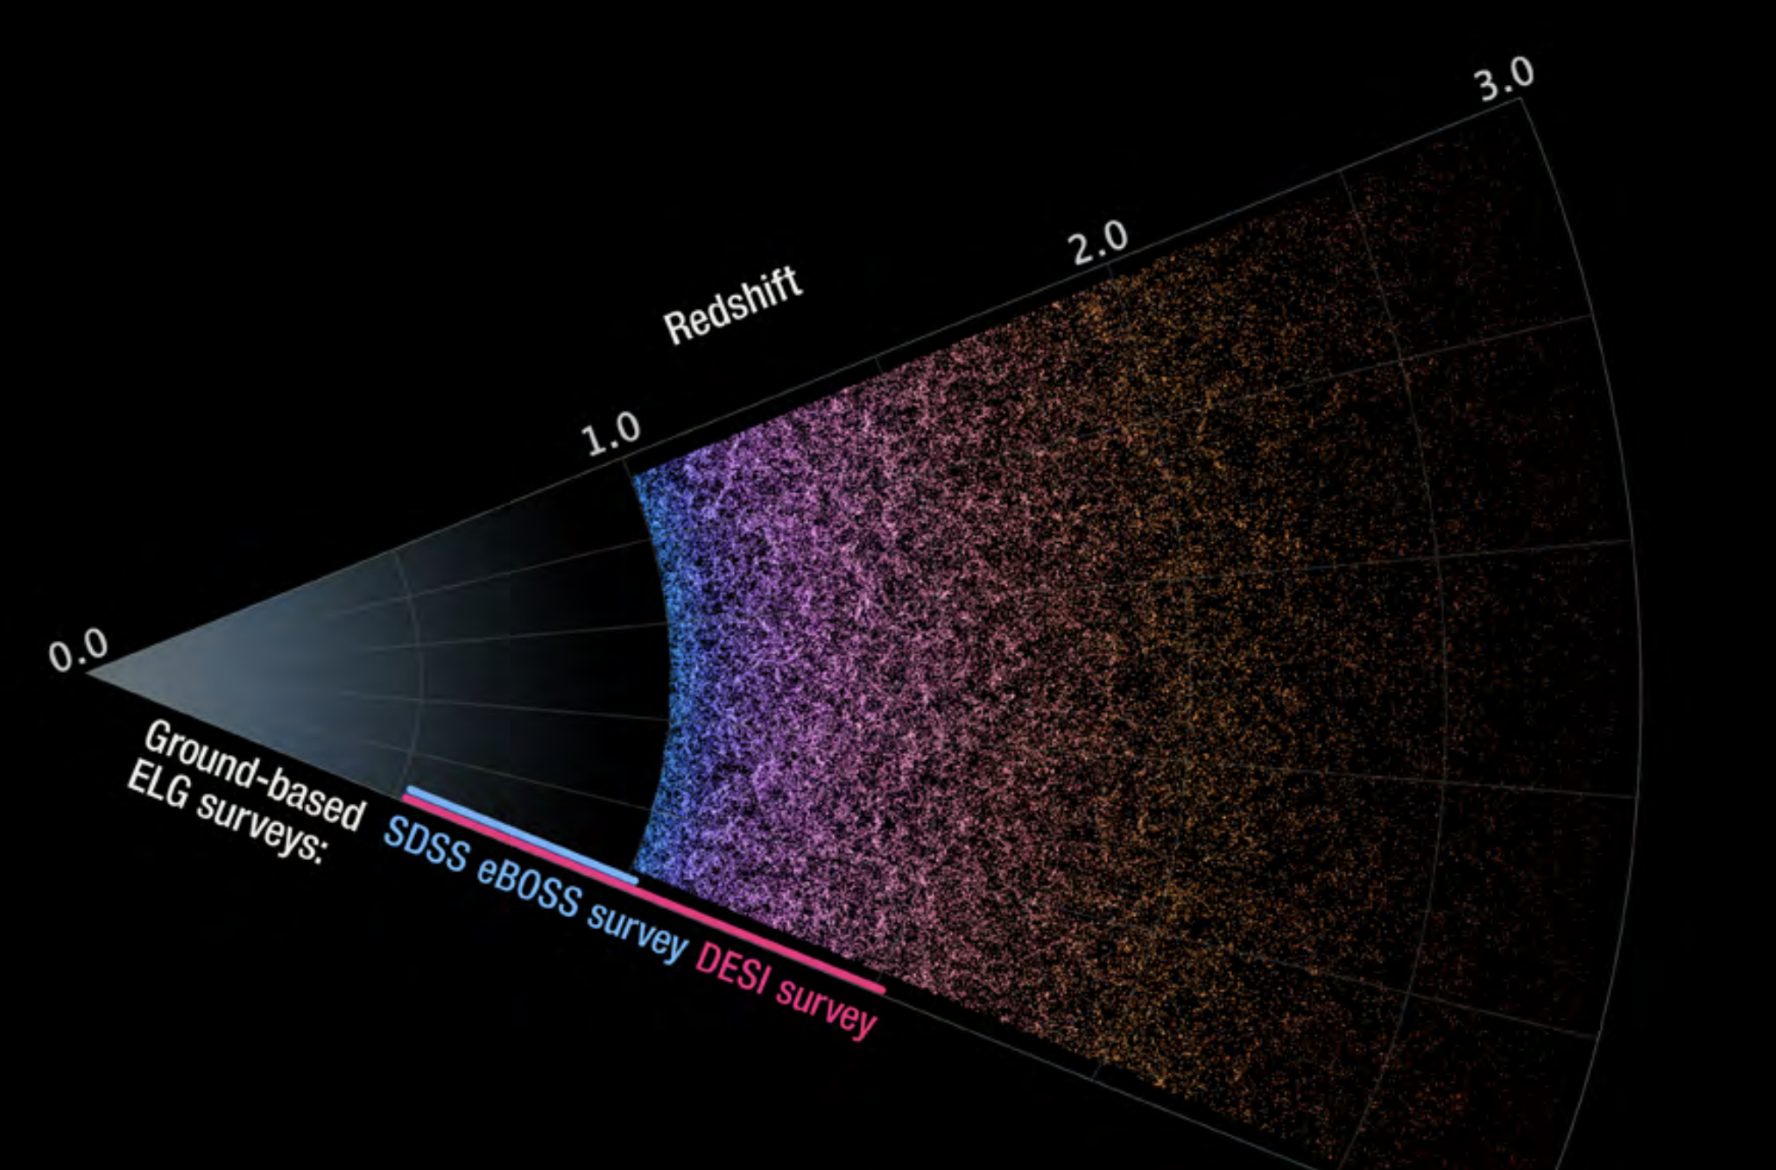
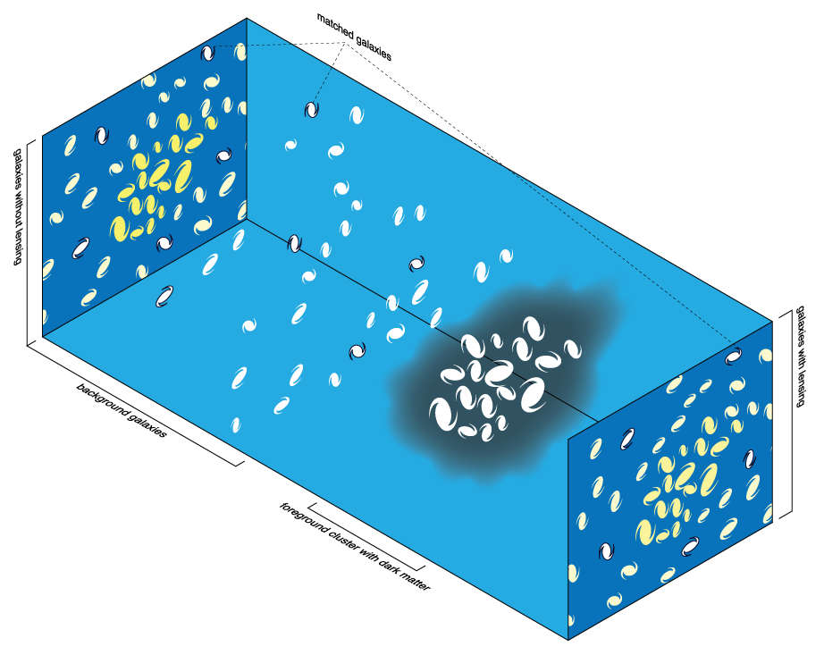
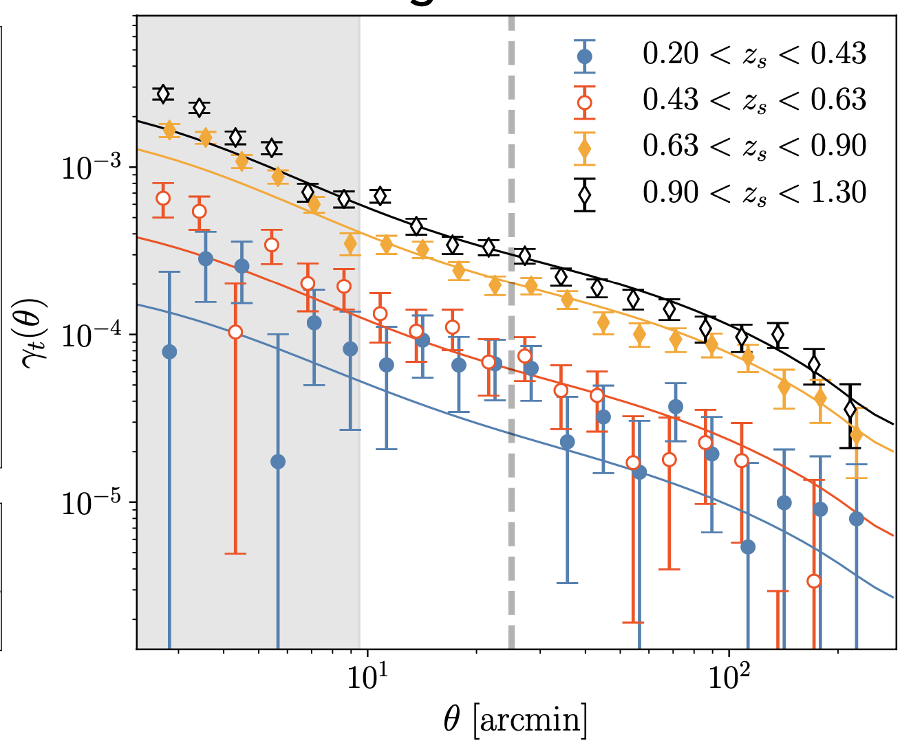
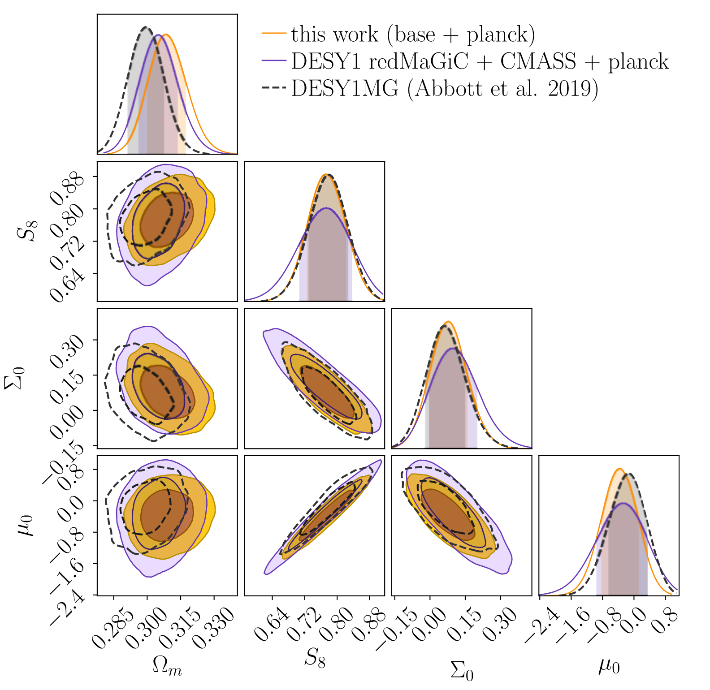
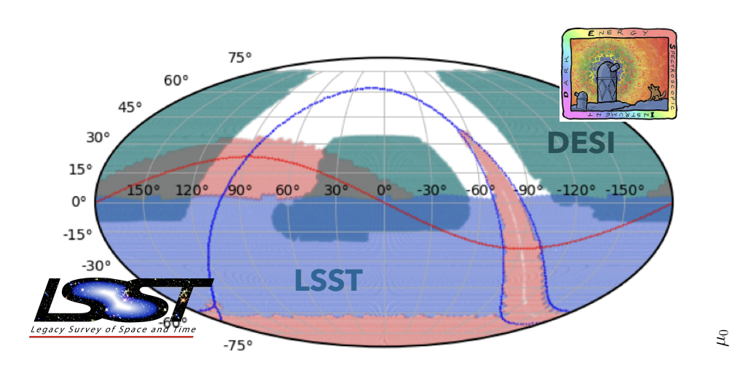
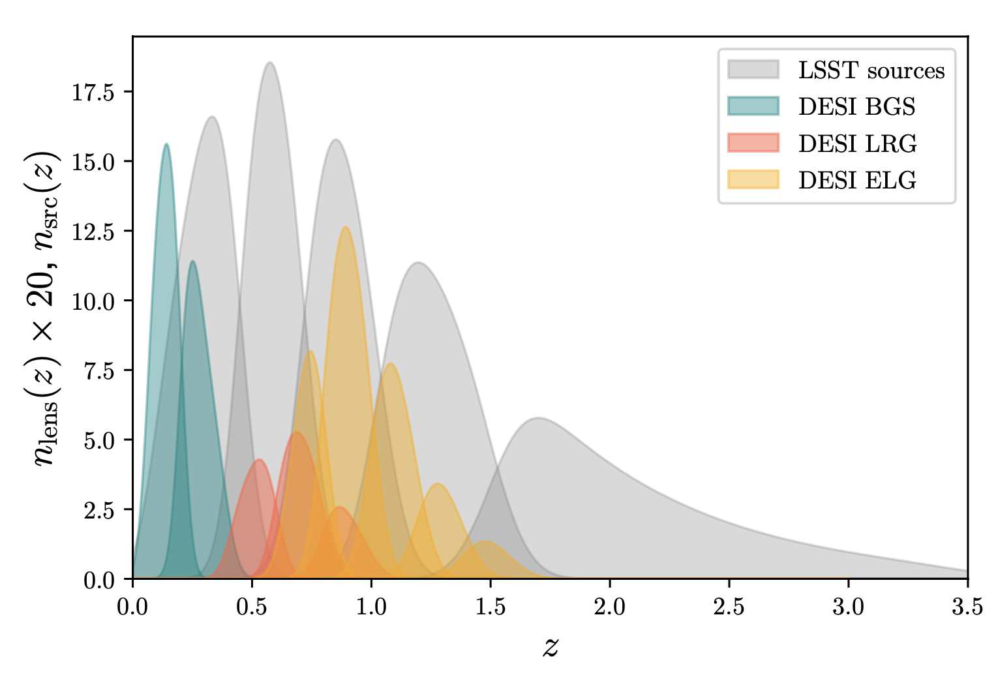
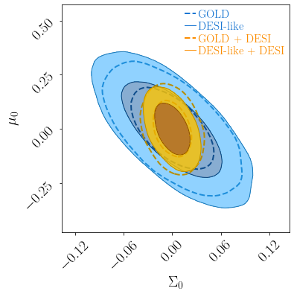
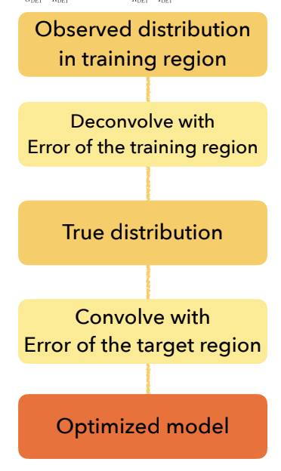
National Aeronautics and Space Administration
Postdoc Research
Combining spectroscopic and photometric data
with an optimal galaxy sample
Application to DESI and Rubin-LSST
Author: Sujeong Lee, JPL Postdoctoral Fellow (3268)
Katarina Markovic (3268), Eric Huff (3268), Michael Troxel (Duke U.), DES Collaboration
Background
Application to the Dark Energy Survey (DES)
Figure 1: 3D map of galaxies measured from spectroscopic surveys (left) and the weak lensing measured from photometric surveys (right)
Figure 2: Left: Galaxy-galaxy lensing signals measured with the selected lenses by the algorithm and DES background galaxies. The solid lines are the theory assuming the true spectroscopic galaxies as lenses. Right: cosmological constraints obtained with the DES fiducial galaxy sample and the new galaxy sample selected by the algorithm.
Spectroscopic survey
Provides the spatial distribution of galaxies (galaxy clustering) in the three-dimensional map.
The spatial distribution of galaxies is used to trace the underlying structure in matter.
Galaxies do not perfectly trace matter. The discrepancy between the galaxy and the underlying matter distribution is a major limitation in analyzing galaxy clustering.
Photometric survey
Images shape distortions of distant galaxies by foreground matter (weak lensing)
Directly probes the underlying matter distribution.
Due to the subtle size of the effect, a substantial number of distant galaxies need to be stacked to achieve small statistical errors.
By using the selection algorithm, we generated a galaxy sample that replicates the properties of the spectroscopic galaxy sample from the BOSS survey. The new sample improved the constraints of modified gravity by ~30% compared to the DES fiducial galaxy sample.
Application to Stage-IV surveys: Rubin-LSST and DESI
This combining method can be easily extended to Stage IV surveys such as Rubin-LSST and DESI with a few advantages.
DES and Rubin share common philosophies from data calibration methods to reference design.
The selection algorithm will benefit from the improved accuracy of the Rubin photometry and larger overlap between Rubin and DESI.
DESI ELG galaxies can probe more distant Universe than the Rubin’s fiducial galaxy sample
Can utilize the power of multi-tracers of DESI ELG and LRG galaxies in Rubin.
Challenges
Combining large, high-quality spectroscopic and imaging data sets overcomes the limitation of each data set. However, combining two surveys in this manner is only possible in the areas where those surveys overlap. One can utilize different galaxy samples for each survey, but that requires the modeling of the discrepancy in galaxy and matter distributions for each sample, which introduces additional errors
Algorithm with the Extreme Deconvolution
We developed an algorithm that creates consistent galaxy samples for both surveys.
The algorithm is trained with the density estimation in color and magnitude of sources in the overlapping area
Generates a consistent galaxy sample in the full area of the photometric survey.
The resulting galaxies produce signals of galaxy clustering and weak gravitational lensing that are consistent with those of target spectroscopic galaxies.
Figure 3: Left: The survey areas of Rubin-LSST (purple) and DESI (Green). Right: The redshift distributions of DESI-like galaxy samples named as BGS (green), ELG (yellow), and LRG (red), and LSST background galaxies (grey)
Our simulated galaxy sample alone produces weaker constraints than the Rubin’s fiducial sample but starts to harness its power when combined with the DESI data.
10% gain with the new sample compared to the Rubin’s fiducial galaxy sample. This improvement is comparable to the improvement that would have been obtained with an area increase by XX %.
Figure 4: Forecasted constraints on modified gravity with simulated DESI-like galaxy samples in the Rubin area and the Rubin fiducial galaxy sample. Blue contours show constraints obtained with the simulated LSST data alone. Yellow shows the constraints obtained with Rubin + DESI. Dashed line indicates the Rubin fiducial sample and the solid line indicates our simulated DESI-like galaxy sample
To ensure a uniform selection across the survey, we use the Extreme Deconvolution technique. The selection model inferred from the training data is convolved with the observational error in the target region to account for varying observational conditions across the survey area.
Significance of Results/Benefits to NASA/JPL
The scientific opportunities from the combination of multiple surveys (such as Roman, Rubin, Euclid and JWST) far exceed the contributions of any single data sets on its own. Therefore, greater efforts will be required to coordinate multiple surveys to maximize the joint science return. Specifically, Roman, positioned as one of the NASA’s next generation flagship missions, will map ~13 millions of distant galaxies up to redshift z=3 with its slitless spectroscopy. Roman’s investigative power will synergize significantly when combined with Rubin, which will encompass more than 20 billion galaxies, reaching depths unparalleled by any previous photometric surveys to date.
National Aeronautics and Space Administration
Jet Propulsion Laboratory
California Institute of Technology
Pasadena, California
www.nasa.gov
Publications and Acknowledgements:
Lee S., Markovic K., Huff E. M., Troxel M. A., et al., ”Combining spectroscopic and photometric data with the optimal galaxy sample: Application to LSST and DESI,” in prep., 2023
Lee S., Huff E. M., Choi A., Elvin-Poole J., Hirata C., Honscheid K., MacCrann N., et al., ”Probing gravity with the DES-CMASS sample and BOSS spectroscopy”, 2022, MNRAS. doi:10.1093/mnras/stab3129
Author Contact Information: sujeong.lee@jpl.nasa.gov
Clearance Number: CL#00-0000
Poster Number: PRD-A-013
Copyright 2023. All rights reserved.

