Slide 1
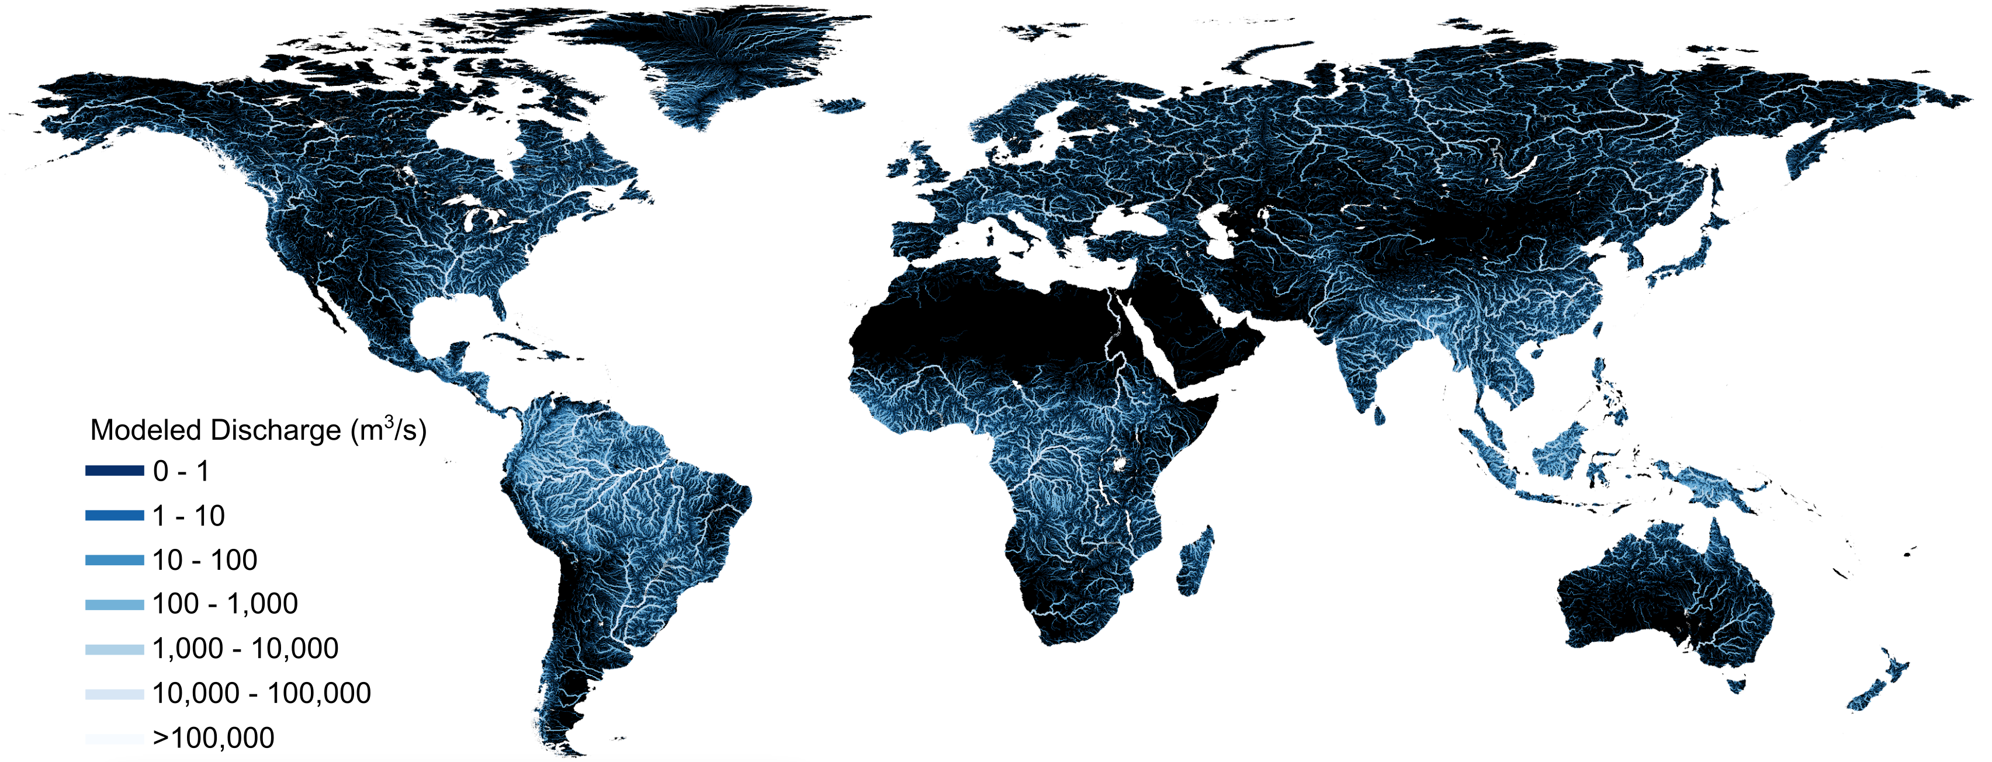
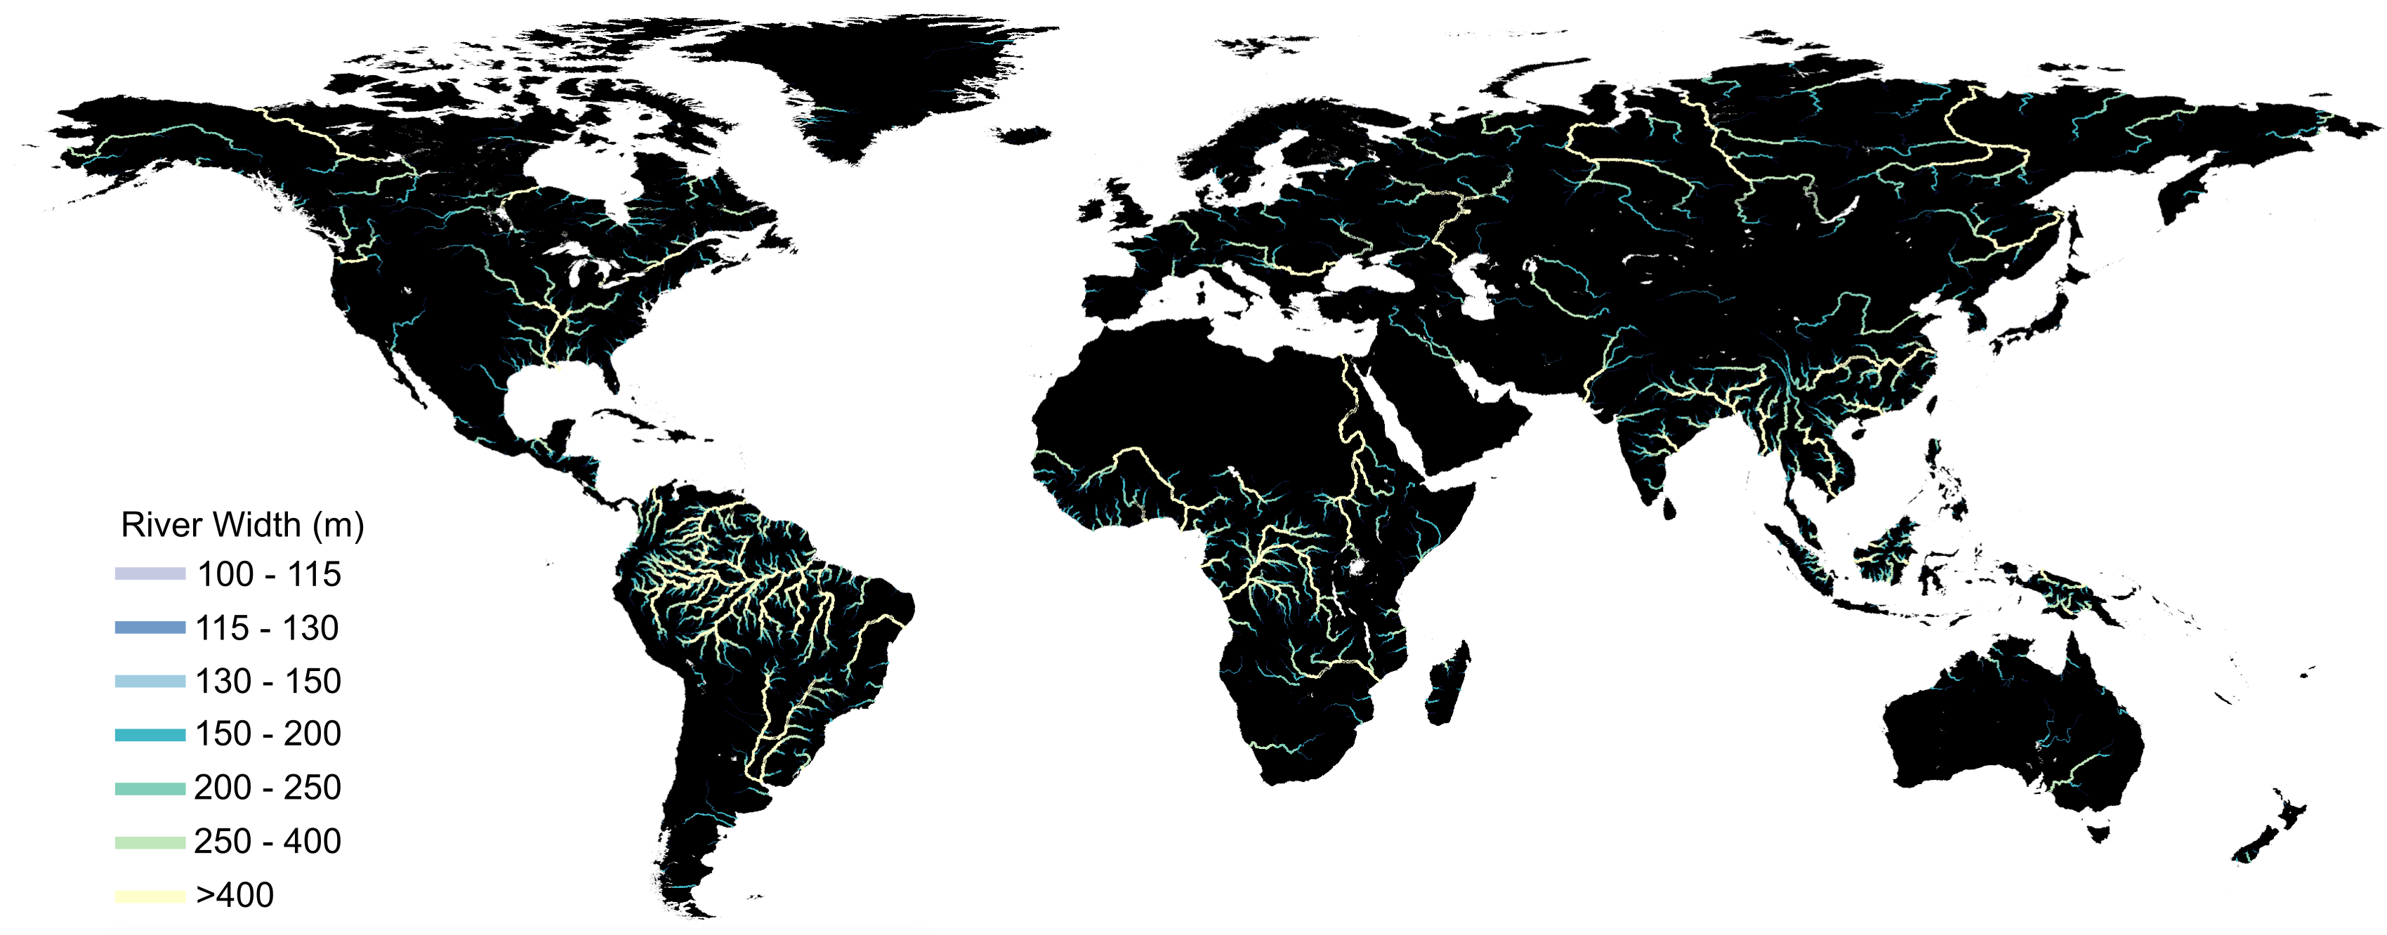
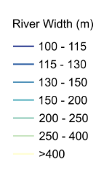
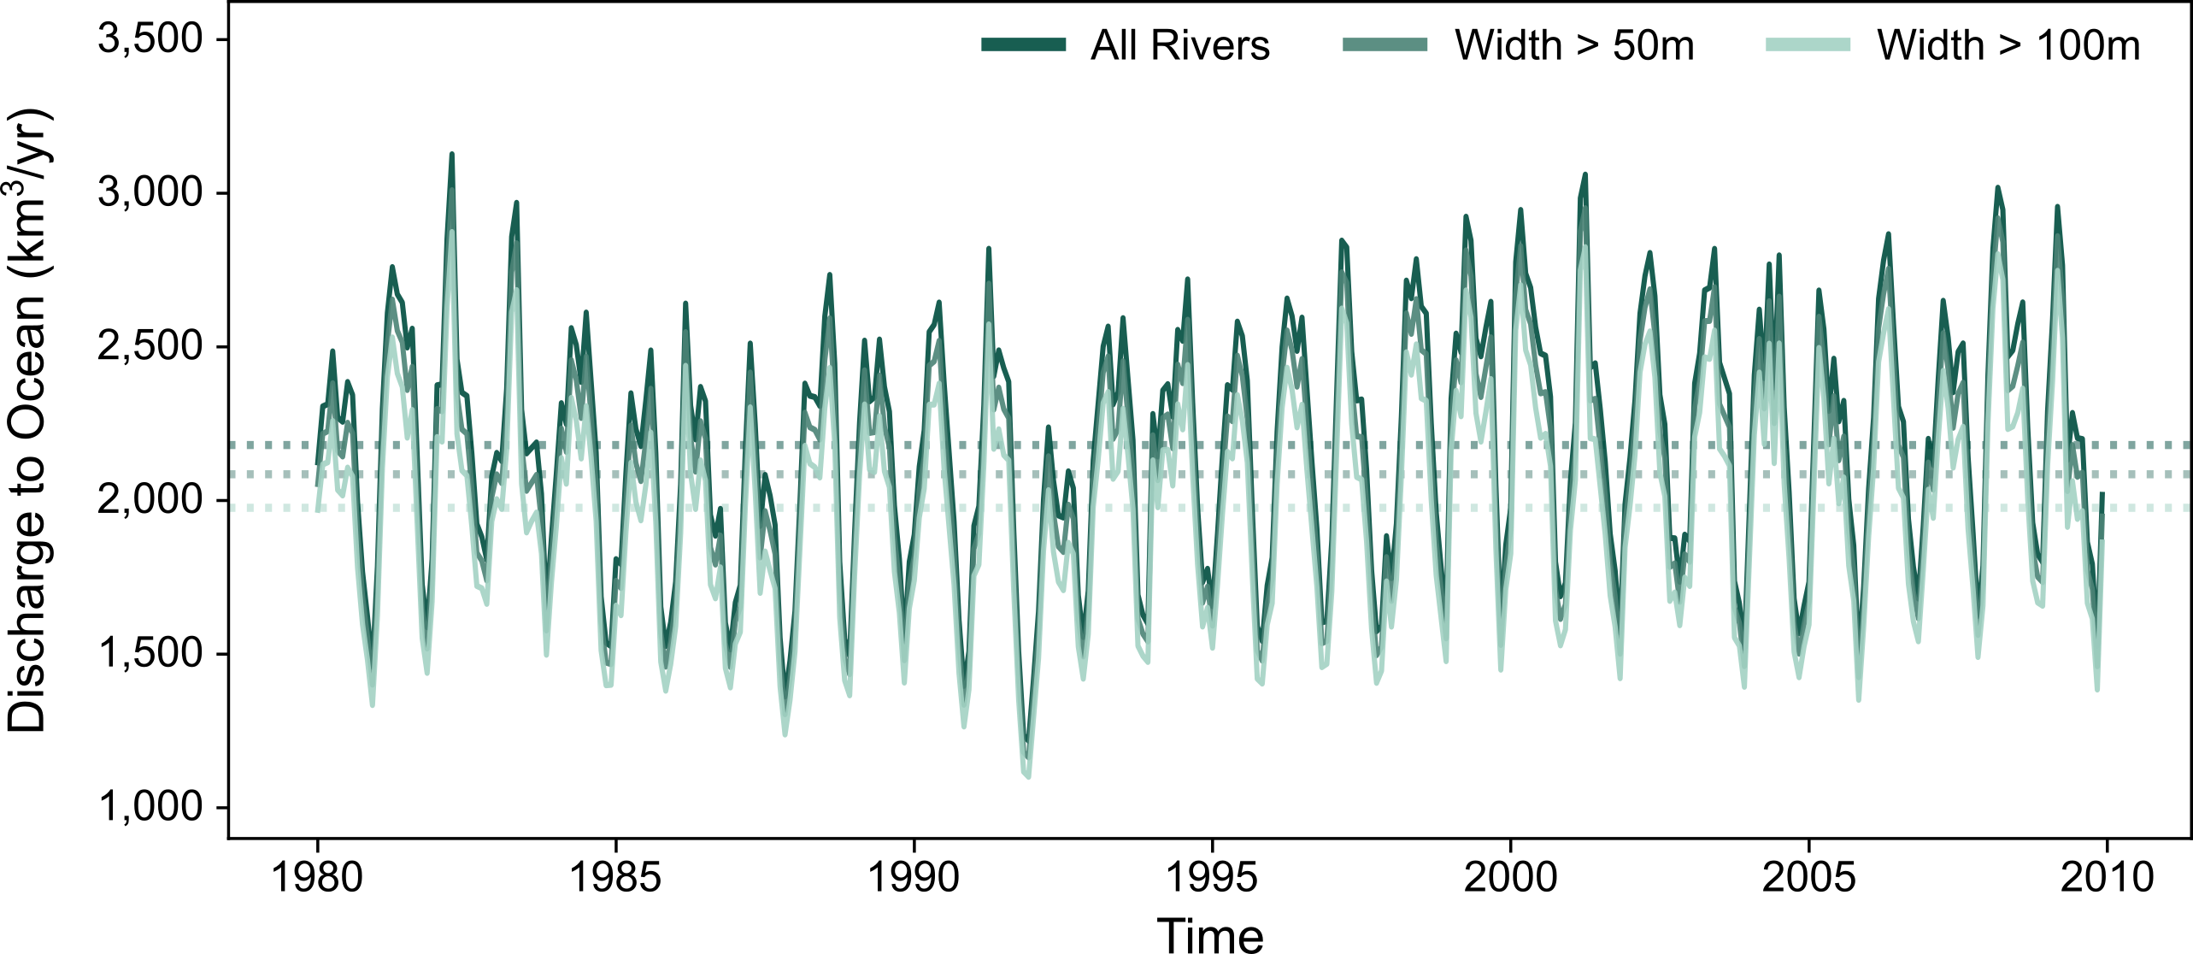
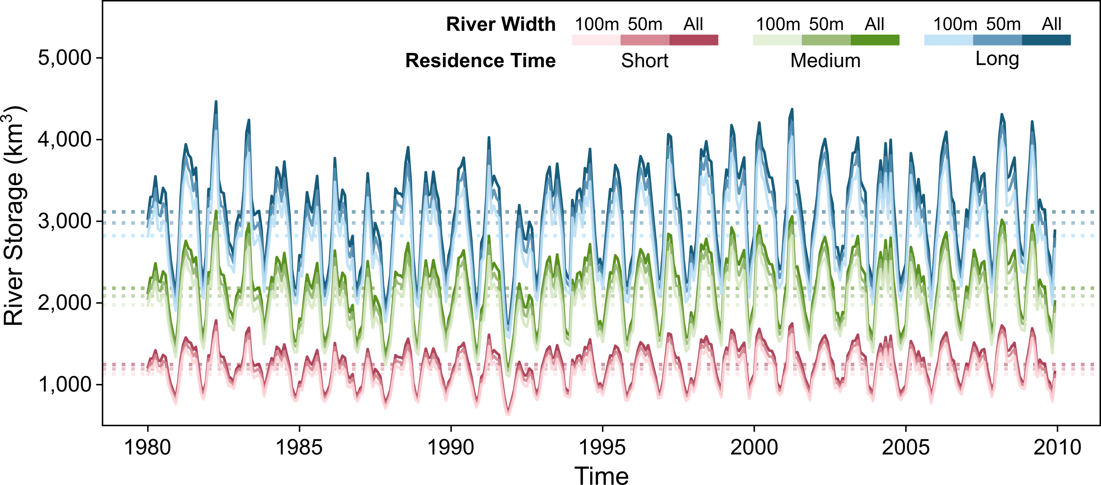
National Aeronautics and Space Administration
Postdoc Research
Model-Driven Insights into SWOT Observations of Global Hydrologic Variability
Authors: Jeffrey Wade, Postdoctoral Researcher (329F)
Cédric H. David (329F), Michelle M. Gierach (329F)
Objectives
Apply a global routing model to estimate continental river storage and discharge to the ocean from rivers observable by the recently-launched Surface Water and Ocean Topography (SWOT) mission
Background
Rivers are a critical renewable freshwater resource, yet high-resolution global monitoring faces several challenges.
The Surface Water and Ocean Topography (SWOT) mission will observe the extent, elevation, and variability of river networks, providing unprecedented insight into global hydrological dynamics.
Global hydrologic models allow us to predict modes of river variability that SWOT may observe.
Approach
We leverage global discharge and storage model simulations over 30 years at 3 million reaches (Collins et al., In Review^{[1]}) to predict quantitative metrics of the global river water cycle. Using estimated river widths at all modeled reaches, we prune the river network to approximate the network that may be observable to SWOT given two effective minimum observable river width scenarios (50m and 100m). Under these scenarios, we aggregate continental river storage and discharge to the ocean at a monthly time scale for global river reaches.
30-year Simulated Global Discharge
Estimated Global River Widths > 100m
Collins et al. (In Review)^{[1]} simulates discharge globally by correcting a river routing model using gage observations.
We estimate global river widths using modeled discharge by:
$W=7.2(Q^{0.5})$ ^{[2]}
We approximate the river network SWOT may observe using 50m and 100m width thresholds. We then estimate river storage and discharge.
Results
SWOT will likely observe a considerable fraction of global river water cycle!
All Rivers: 2,938,141 reaches
Width>50m: 192,339 reaches
Width>100m: 89,144 reaches
Discharge to Ocean
We estimate that SWOT will likely capture between 83.3% (100m) and 91.6% (50m) of global discharge to the ocean.
Continental River Storage
We estimate that SWOT will likely capture between 90.6% (100m) and 95.6% (50m) of global terrestrial river storage.
Future Work
Produce discharge and volume estimates at SWORD reaches corresponding to SWOT vector products
Derive global river storage variability from initial SWOT observations of river width using trapezoidal approximation
Significance of Results/Benefits to NASA/JPL
Model results give first guess at fraction of global terrestrial water cycle observable by SWOT
Adjustment factors could be used to estimate full network fluxes and variability from SWOT observations
National Aeronautics and Space Administration
Jet Propulsion Laboratory
California Institute of Technology
Pasadena, California
www.nasa.gov
Publications and Acknowledgements:
We would like to thank Elyssa Collins and coauthors for access to the global hydrologic modeling dataset used in this work.
[1] Collins, E.L., David, C.H., Riggs, R., Allen, G.H., Lin, P., Ming, P. Yamazaki, D., Meentemeyer, R.K., Sanchez, G.M. (In Review). Residence time revealed as key driver of global river water storage.
[2] Moody, J.A., & Troutman, B.M. (2002). Characterization of the spatial variability of channel morphology. Earth Surface Processes and Landforms, 27(12), 1251–1266. https://doi.org/10.1002/esp.403
Author Contact Information:
Email: Jeffrey.s.wade@jpl.nasa.gov
Clearance Number: CL#00-0000
Poster Number: PRD-E-010
Copyright 2023. All rights reserved.

