Slide 1
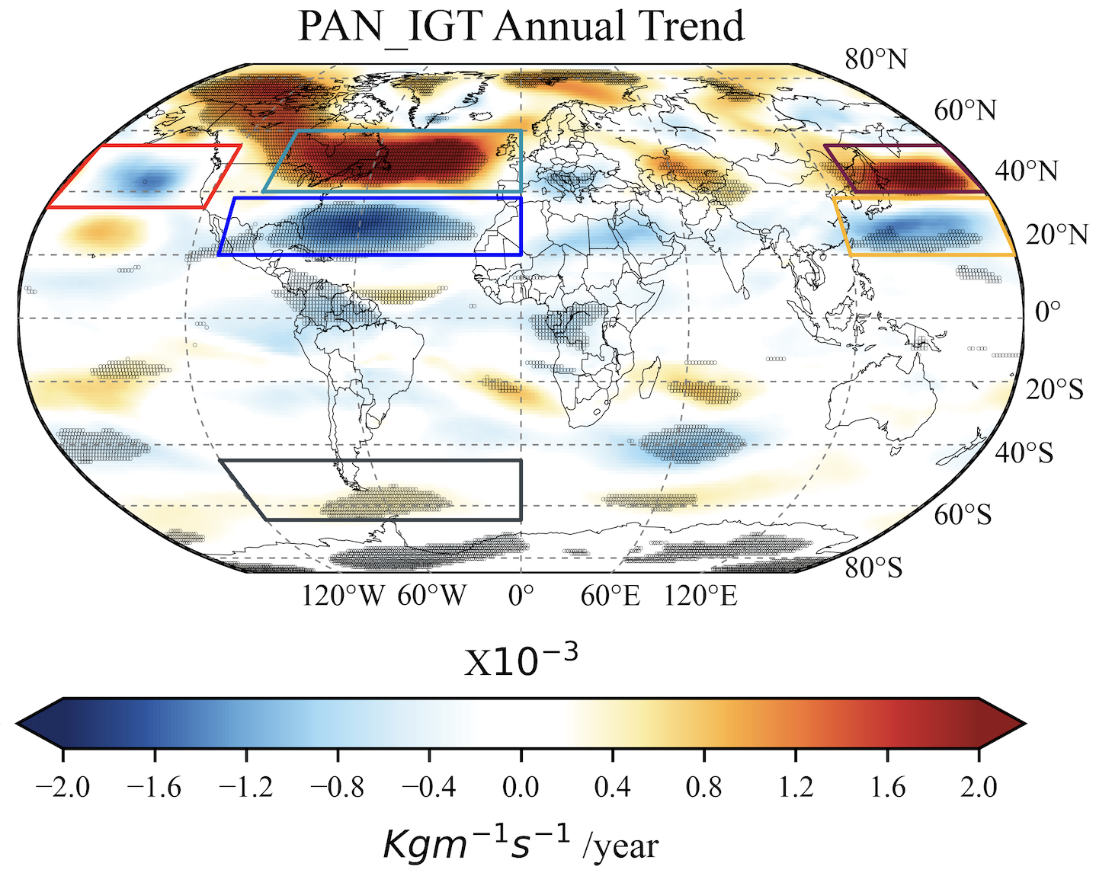
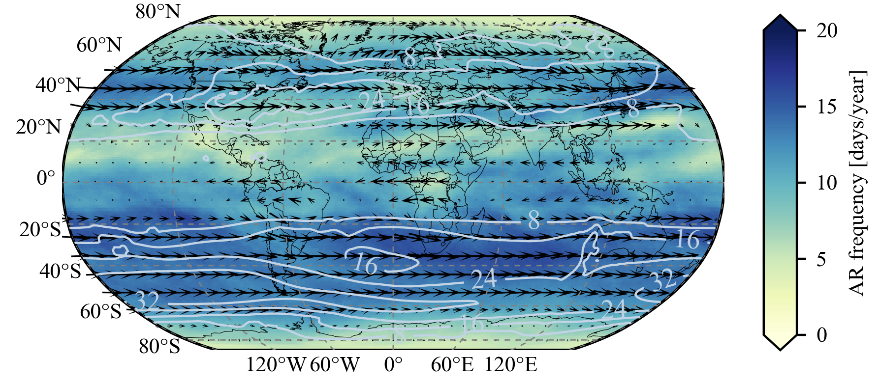
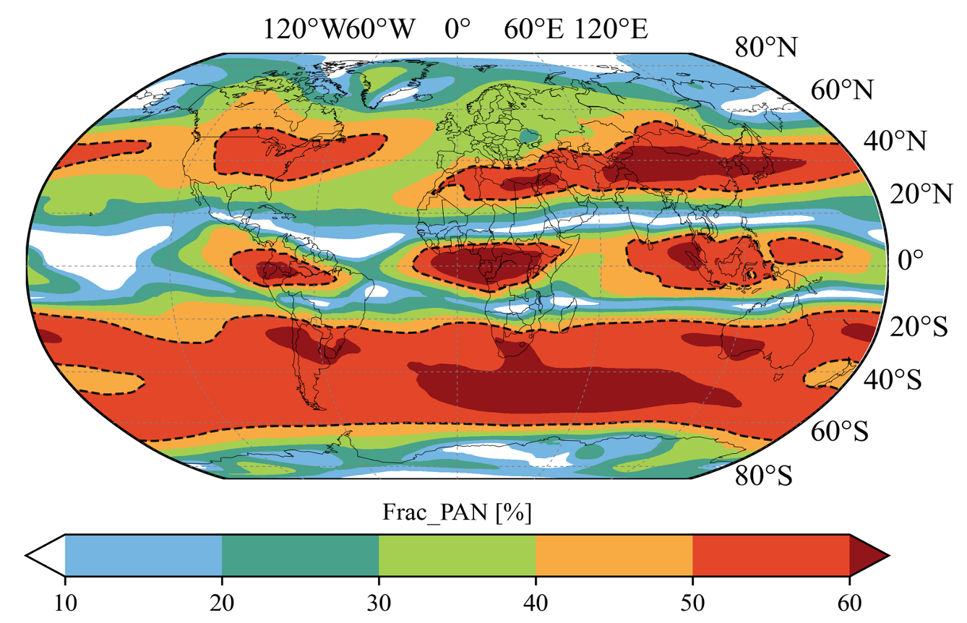
National Aeronautics and Space Administration
Postdoc Research
Trace gas atmospheric rivers: remote drivers of air pollutants
Author: Mukesh Rai, JPL Postdoctoral Fellow (329I)
Kazuyuki Miyazaki (329I) , Vivienne Payne (329I) , Bin Guan (329J) , Duane Waliser (8000)
Context
Data
Air quality in a given location may be impacted by local sources or by transport from afar. Understanding extreme air pollution transport events is crucial from the perspectives of human health and the environment. Here, we use a chemical reanalysis dataset (which ingests multiple satellite trace gas products) to (1) identify and track pollution transport events and (2) evaluate changes in pollution transport over time.
Tropospheric Chemical Reanalysis version-2 (TCR-2) was produced under the TROPESS project using the JPL MOMO-Chem system
Ingests multiple satellite trace gas products using a data assimilation technique.
3 long-lived pollutants: Ozone, Peroxyacetyl Nitrate (PAN), Carbon Monoxide (CO)
2005-2019 @1.1°X1.1° [Global], 6 hourly]
1000-60 hpa, 27 levels
Objective
Extend the concept of “atmospheric rivers (ARs)” to “trace gas atmospheric rivers (TGARs)” to quantify the contribution of extreme transport events to total air pollution transport.
Results
Fig 1. Interannual trend of IGT PAN
Fig 2. TGARs frequency PAN
Fig 4. Snapshot of AR features detected in each timestamp by TGARs algorithm. The first, second, and third column represent the AR features observed over Atlantic, Pacific, and poles respectively. The red dashed line indicate AR axis, and vectors represent the intensity.
Significance of study
Over the period 2005-2019, the TGAR algorithm detected about 300, 000 events globally, which corresponded to up to 20 days yr⁻¹ and was responsible for up to >60 % of the annual total transport over North Atlantic Ocean, South temperate zone, central Asia, Africa, Pacific Ocean.
Analyzing TGARs of various chemical species with different characteristics can provide a comprehensive understanding of the impact of human and natural activities on the global environment and climate through long-range transports.
This framework can also help understand the factors that control local extreme air pollution events.
Fig 3. Fractional contribution accounted by TGARs events for CO. Dashed black line indicate TGARs contribution above 50%.
Future work
In future, we will focus on understanding the influence of specific events on air quality in selected regions
National Aeronautics and Space Administration
Jet Propulsion Laboratory
California Institute of Technology
Pasadena, California
www.nasa.gov
Publications and Acknowledgements:
Rai, M., Miyazaki, K., Payne, V., Guan, B., Waliser, D. (2023). Trace gas atmospheric rivers: remote drivers of air pollutants. (In prep).
Author Contact Information:
Phone: 213-505-1750,
Email: mukesh.rai@jpl.nasa.gov
Clearance Number: CL#00-0000
Poster Number: PRD-E-011
Copyright 2023. All rights reserved.

