Slide 1

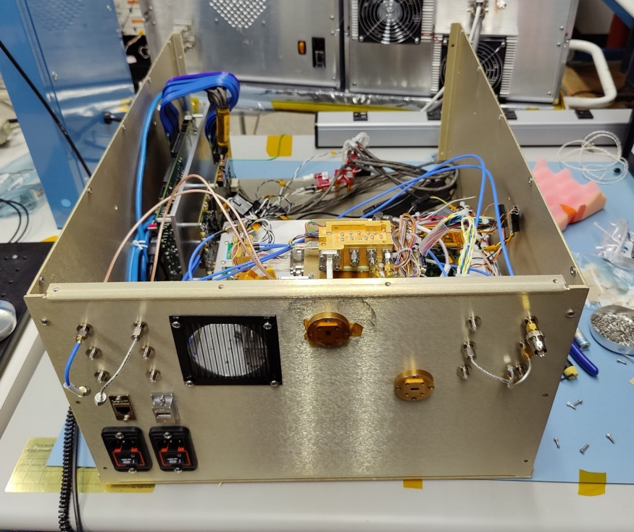
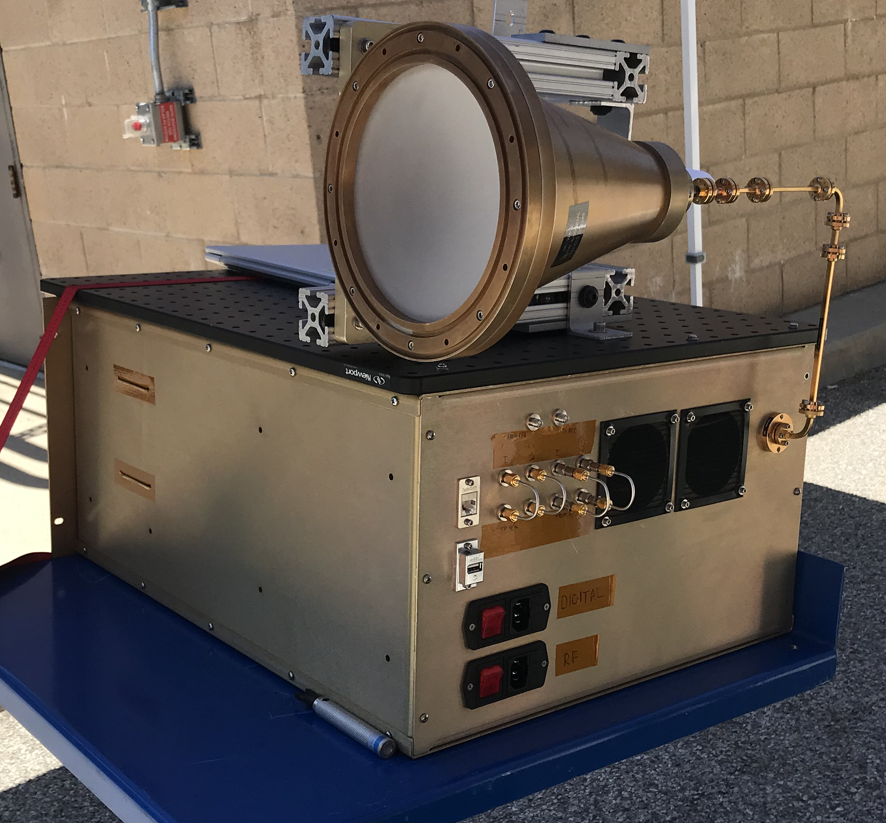
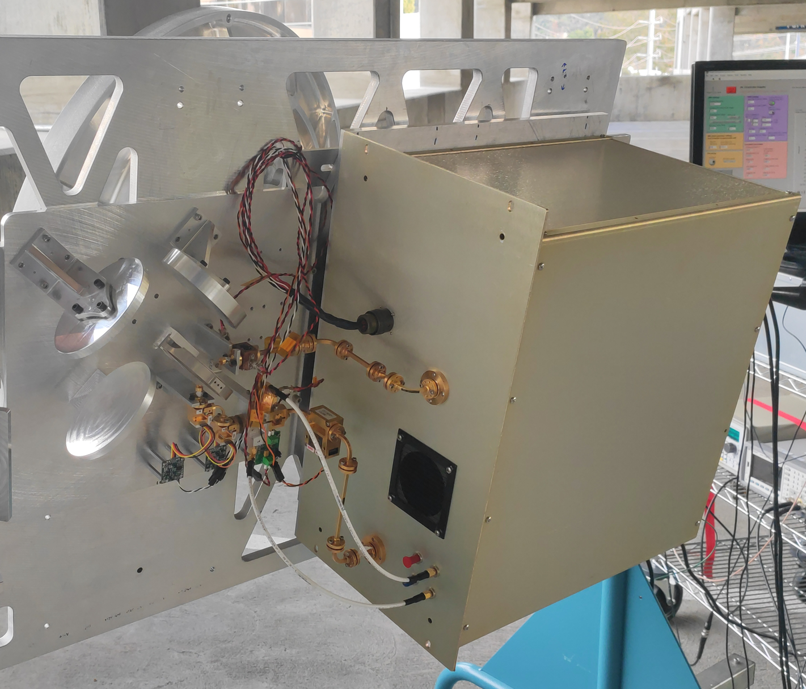
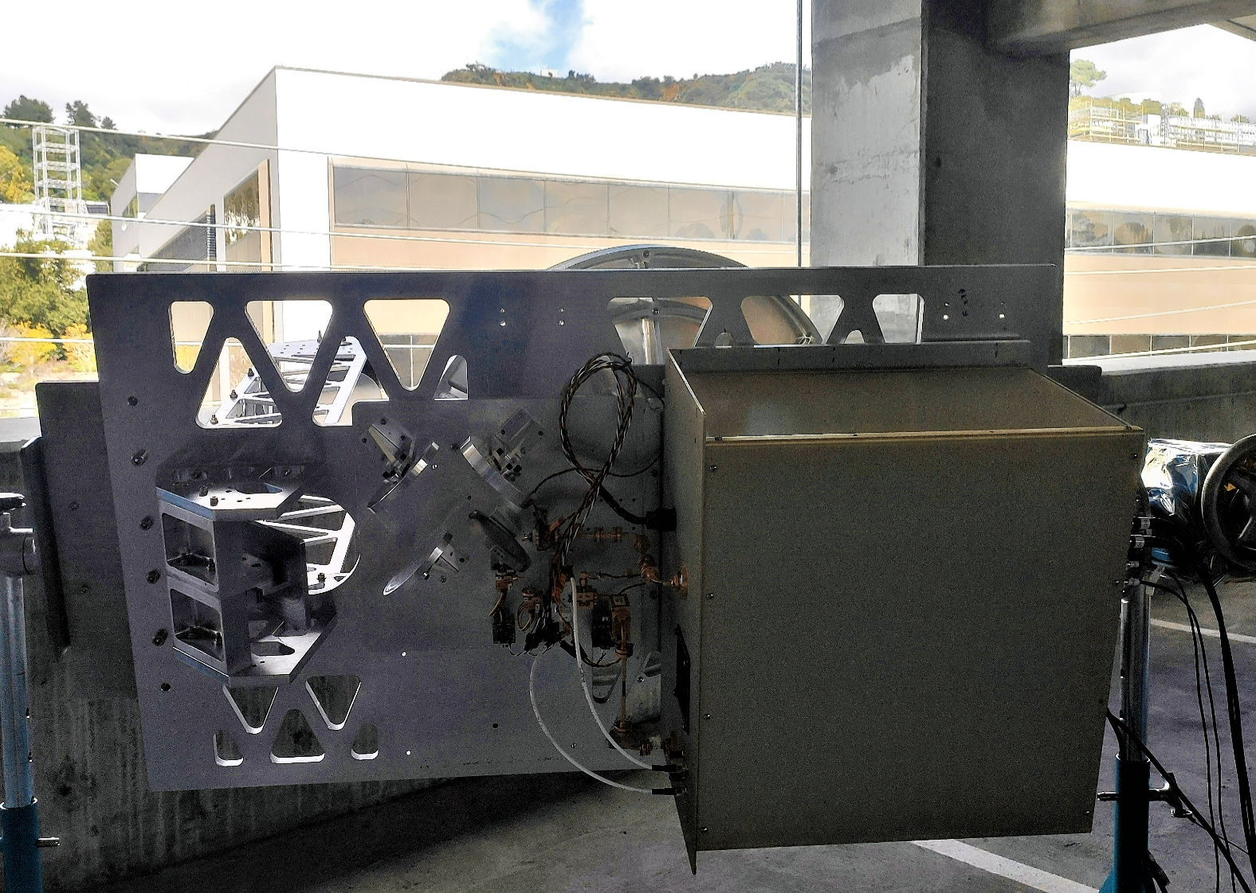
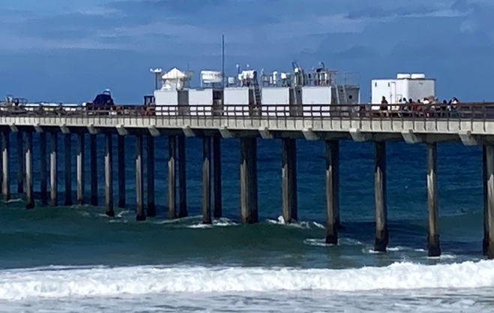
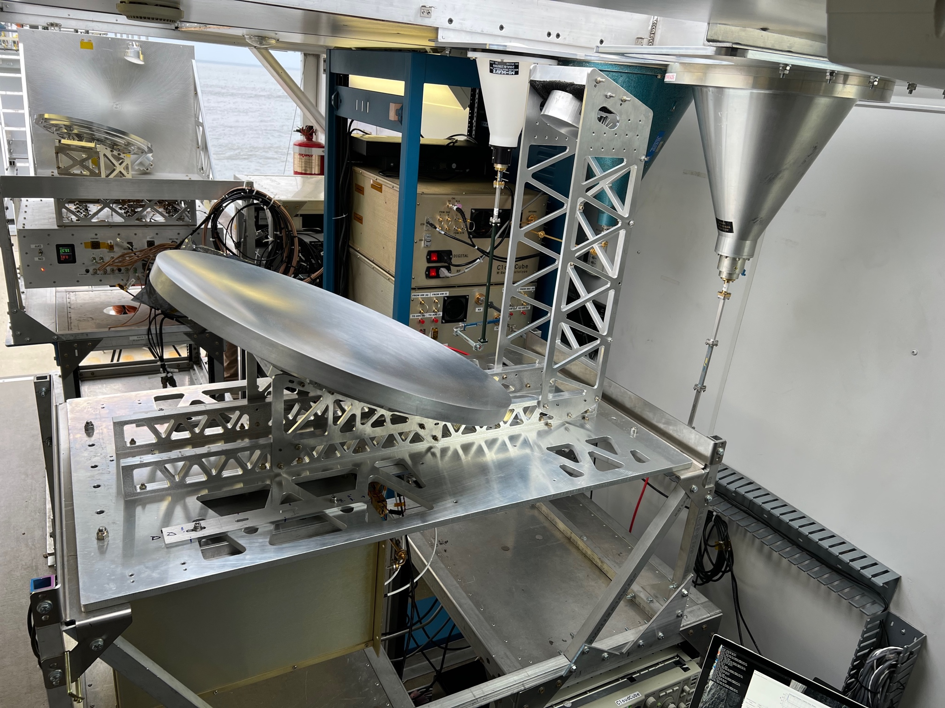
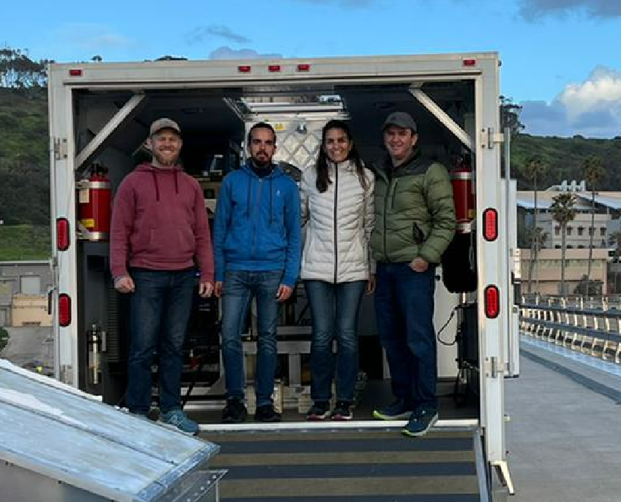
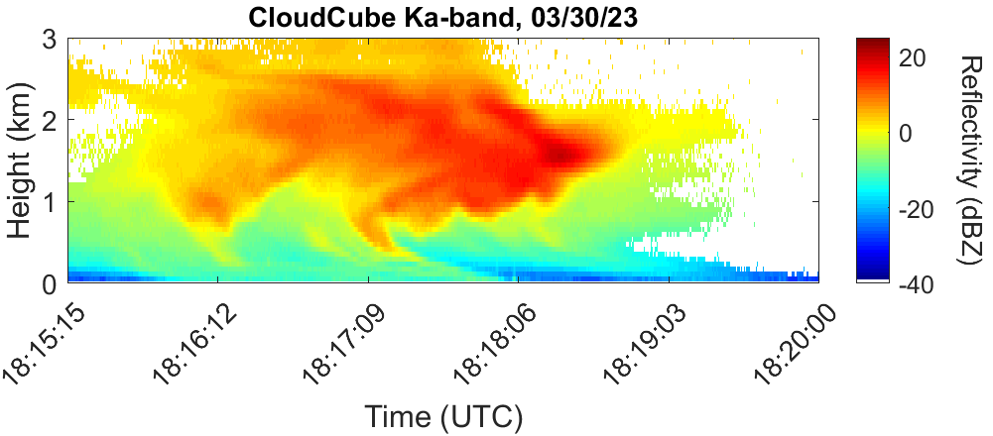
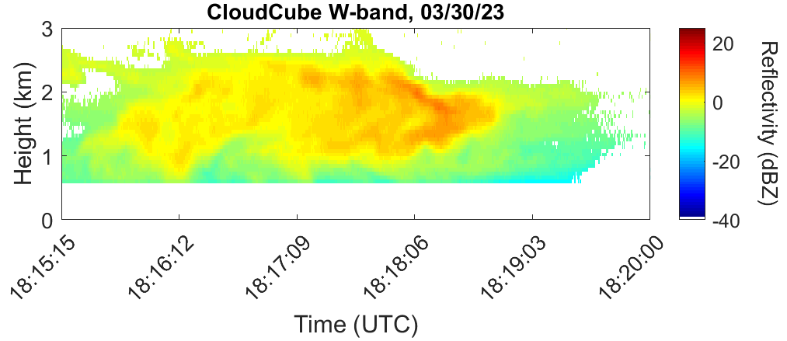
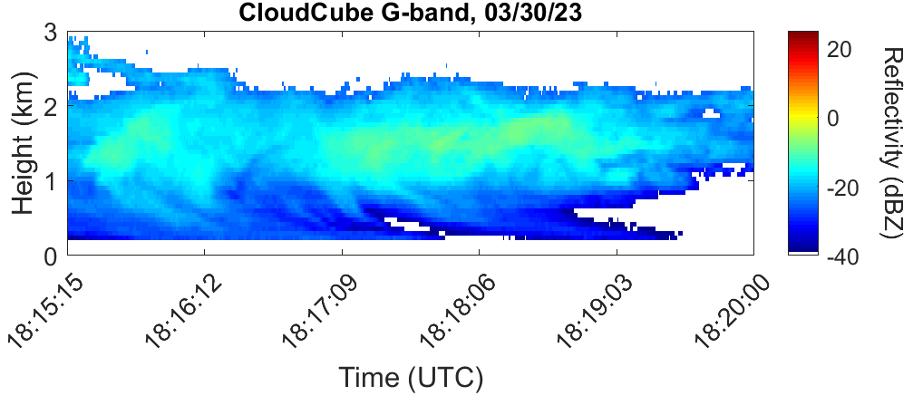
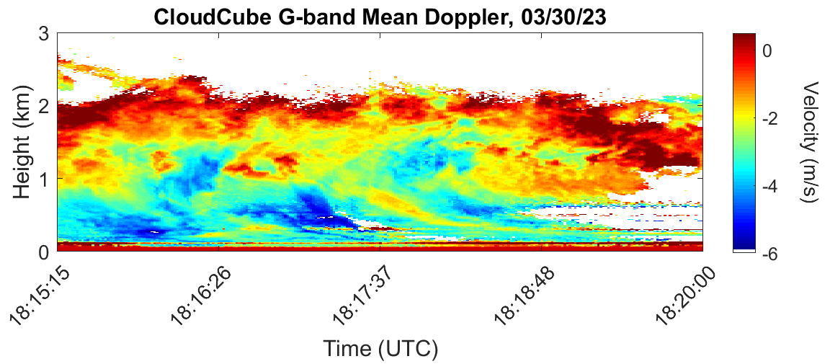
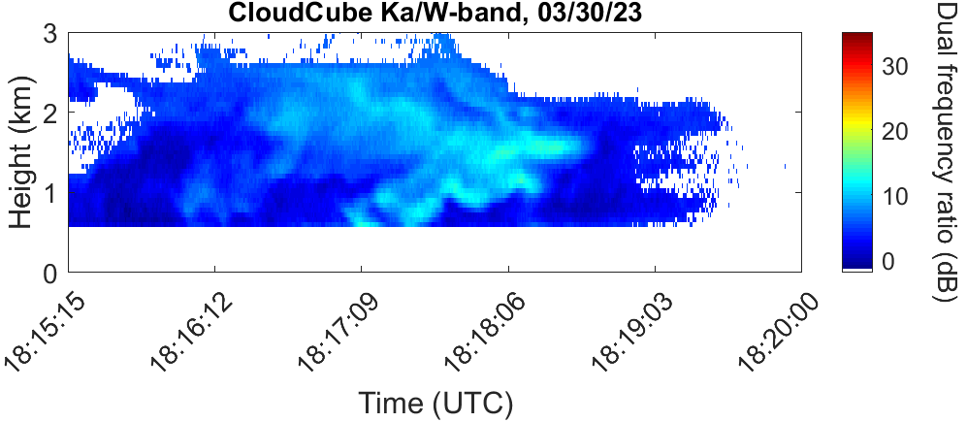
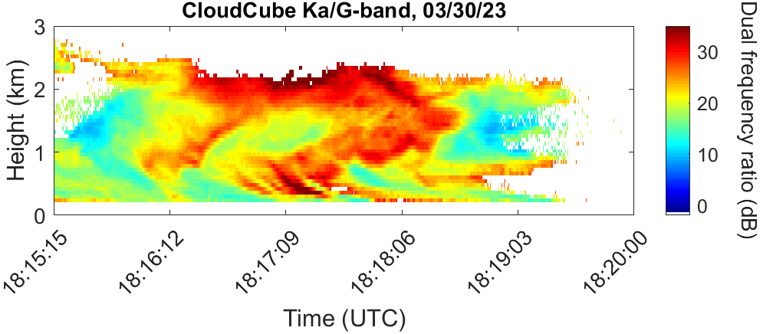
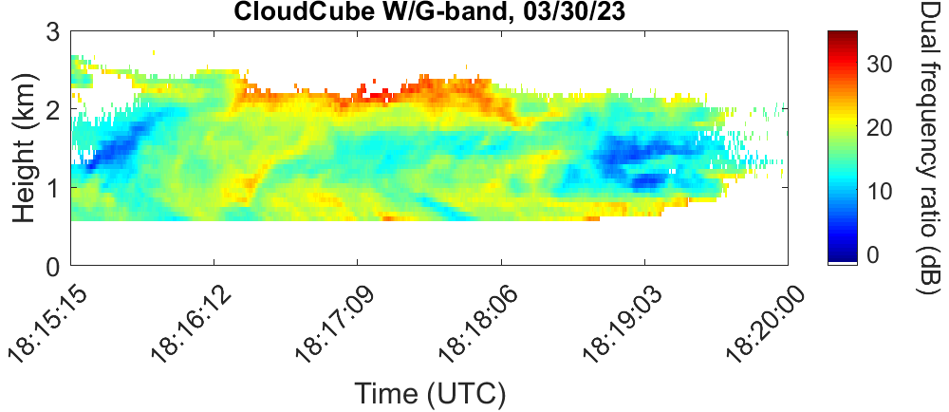
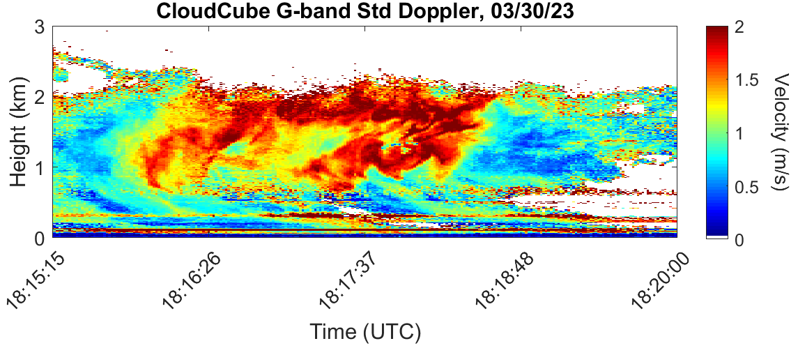
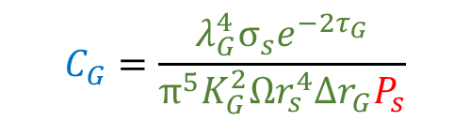
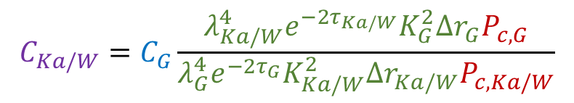
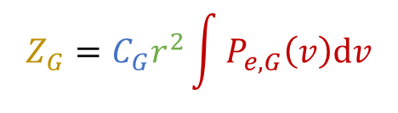

National Aeronautics and Space Administration
Postdoc Research
Revealing the Cloud Structure and Precipitation Initiation with a Multifrequency Radar
Author: Juan Socuellamos (334), JPL Postdoctoral Fellow
Advisor: Raquel Rodriguez Monje (334)
Background
The simultaneous use of multiple millimeter-wave bands in active remote sensing of the atmosphere offers a remarkable opportunity to study the differential scattering and attenuation properties of hydrometeors in clouds and precipitation, that can be exploited to identify and model diverse weather phenomena and provide new insight into their microphysics and dynamics.
Our team has developed a novel multifrequency (35/94/238 GHz) radar, named CloudCube, that tackles some of the most relevant atmospheric questions, with a focus on convective clouds and precipitation. CloudCube also follows a compact and low-cost architecture that will make it attractive for future spaceborne deployments from limited-resources platforms.
Objectives
We recently concluded the development of the three CloudCube module prototypes. The next step was to get them ready to participate in a field campaign and retrieve simultaneous measurements of atmospheric structures for the first time. This included the calibration of the three instruments, the installation and operation of the radars during the deployment and developing a code to process the raw data obtained from the measurements.
Ka-band (35 GHz)
W-band (94 GHz)
G-band (238 GHz)
EPCAPE deployment
The CloudCube team participated in the Eastern Pacific Cloud Aerosol Precipitation Experiment (EPCAPE) in La Jolla, CA, during six weeks in March and April 2023. The instruments were installed inside a trailer that was stationed at the Scripps Institute Pier.
Calibration
A radar is typically calibrated pointing the instrument towards a target with a well-known cross-section. Then, a calibration factor can be deduced to be later applied to measurements of atmospheric targets with unknown cross-section.
Ka-band
W-band
Ball target
Scripps pier
JPL trailer
We suspended an spherical metal target at the Mesa facility at JPL and carefully pointed the G-band radar. We calculated the G-band calibration factor as:
G-band calibration factor
$$C_{G}=\frac{λ_{G}^{4}σ_{s}e^{−2τ_{G}}}{{π^{5}K}_{G}^{2}{Ωr}_{s}^{4}Δr_{G}P_{s}}$$
Echo power from ball target
CloudCube G-band
Radar parameters
G-band
The Ka/W-band radars were cross-calibrated with the
Data processing
During operation, the target echo power is obtained as a function of range. The G-band radar also provides Doppler velocity information.
After matching the range and temporal resolution between the three radars’ observations, and once the calibration factors are known, reflectivity profiles can be obtained as:
G-band instrument using simultaneous recordings of convenient clouds with small-enough hydrometeors such that the scattering effects due to particle size were negligible:
$$C_{Ka/W}=C_{G}\frac{{λ_{Ka/W}^{4}e^{−2τ_{Ka/W}}K}_{G}^{2}Δr_{G}P_{c,G}}{{λ_{G}^{4}e^{−2τ_{G}}K}_{Ka/W}^{2}Δr_{Ka/W}P_{c,Ka/W}}$$
Echo power from simultaneous measurements
Ball target
$Z_{Ka/W}=C_{Ka/W}r^{2}$ $P_{e,Ka/W}$
$$Z_{G}=C_{G}r^{2}\int{P_{e,G}\left(v\right)dv}$$
Velocity-integrated echo power
Ka/W/G-band calibration factors
Reflectivity
Range
Reflectivity
Range
Radar parameters
Calibration factor
Echo power
Calibration factor
Results
While single-frequency reflectivity plots are limited in the information they can provide, dual-frequency reflectivity ratio profiles can reveal unique hydrometeor features such as size, distribution and phase. For the particular stratocumulus formation shown here, we can observe how the dual-frequency plots identify the cloud boundaries with respect to precipitation, and provide insight into precipitation initiation, corresponding to a top cloud region with large hydrometeors that end up reaching the surface. The G-band Doppler profiles confirm the location of the precipitation streaks and spatially correlate the large dual-frequency ratio regions with highly turbulent areas.
Cloud boundaries
Large hydrometeor region
Light precipitation
Turbulent region
Precipitation streaks
Significance of Results/Benefits to NASA/JPL
These results demonstrate the synergies between different frequencies in a multifrequency radar to provide novel insight into the complex physics and dynamics of atmospheric processes. CloudCube enables new science in a compact instrument that could potentially be adopted in future atmospheric missions as part of a constellation to increase the global coverage or as a multi-instrument platform to enhance the scientific returns.
Future Work
Next steps are focused on processing the remaining datasets from the field campaign and achieving more compact instruments.
National Aeronautics and Space Administration
Jet Propulsion Laboratory
California Institute of Technology
Pasadena, California
www.nasa.gov
Publications:
J. M. Socuellamos et al., “A G-band Radar with Doppler Capability to Profile Atmospheric Phenomena”, submitted to IEEE Trans. Geosci. Remote Sens., Aug. 2023.
Raquel Rodriguez Monje et al., “CloudCube: a compact, low-cost radar for vertical profiling of clouds and precipitation”, in proc. 40th Conference on Radar Meteorology, Minneapolis, MN, Aug. 2023.
Raquel Rodriguez Monje et al., “CloudCube: A Compact, Multifrequency Radar for Improving Our Understanding of Atmospheric Processes”, in proc. IEEE IGARSS 2023, Pasadena, CA, July 2023.
J. M. Socuellamos et al., “Airborne and Ground Measurements of a Compact Multifrequency Cloud and Precipitation Radar”, in proc. 1st Space Microwave Week, Noordwijk, The Netherlands, May 2023.
Author Contact Information:
8183541629, juan.m.socuellamos@jpl.nasa.gov
Clearance Number: CL#00-0000
Poster Number: PRD-E-013
Copyright 2023. All rights reserved.

