Slide 1
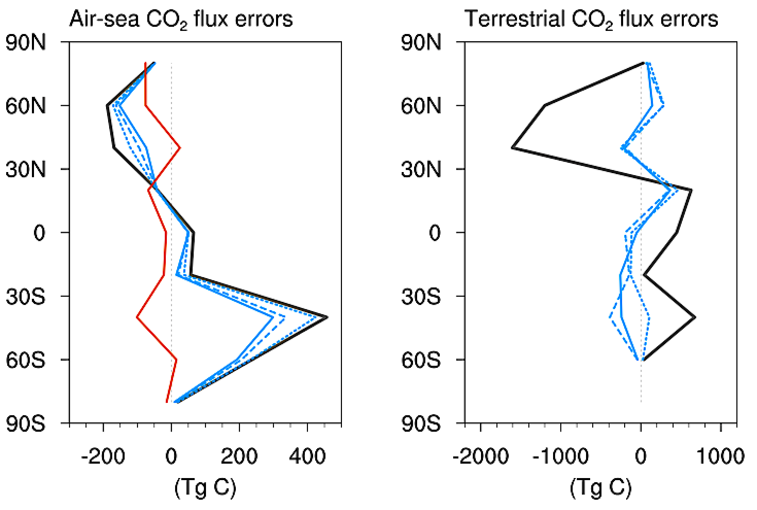
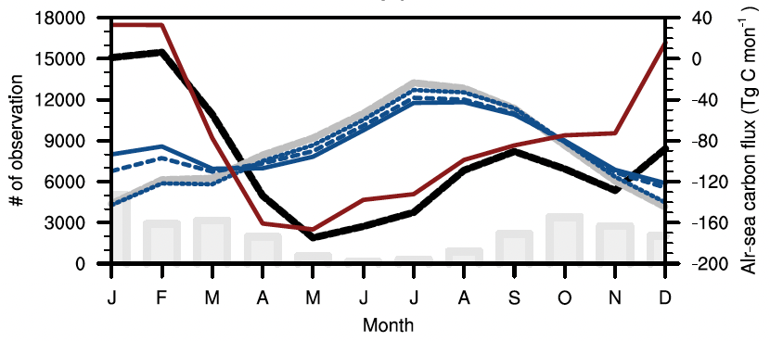
National Aeronautics and Space Administration
Postdoc Research
The potential of the Orbiting Carbon Observatory-2 (OCO-2) column CO₂ measurements to constrain air-sea CO₂ fluxes
Author: Jeongmin Yun, JPL Postdoctoral Fellow (329G)
Advisor: Junjie Liu (329G)
Key points
Constraining air-sea fluxes through inverse models assimilating OCO-2 XCO₂ data remains challenging due to the smaller magnitude of air-sea CO₂ flux compared to terrestrial CO₂ flux.
Sequentially optimizing terrestrial CO₂ flux first and then air-sea CO₂ flux can improve the inversion performance for constraining air-sea CO₂ flux in the Southern Ocean.
Introduction
Approach
Accurately estimating air-sea CO₂ flux is crucial to monitor changes in the carbon uptake ability of oceans, but this remains challenging.
Carbon Monitoring System Flux global inverse modeling system
OSSEs (observing system simulation experiments)
to evaluate the utility of OCO-2 XCO₂ observations for constraining air-sea CO₂ flux through the inversion system
OCO-2 satellite has monitored total column CO₂ concentration (XCO₂) over the globe since 2014.
Exp_1
Prior terrestrial flux
Optimize using true XCO₂ over ocean and/or land
Posterior terrestrial flux
Assessing inversion performance by comparing posterior flux to true flux
This study introduces a way for constraining air-sea CO₂ flux through a global inverse model assimilating OCO-2 XCO2 data.
Exp_2
Prior air-sea flux
Posterior air-sea flux
Posterior terrestrial flux using true land XCO₂
Optimize using true XCO₂ over ocean
Posterior air-sea flux
Time period: 2018, monthly
Prior flux: MOM6, CLM5
True flux: ECCO-Darwin, CARDAMOM
Prior air-sea flux
Results
< Seasonal difference (JJA minus DJF) of flux errors >
Potential solution: Sequentially optimizing terrestrial CO₂ flux first and then air-sea CO₂ flux only ➔ more than 50% improvement of air-sea flux estimates in the Southern Ocean
Prior terrestrial flux error
Posterior terrestrial flux error (E1)
3
OG
LNLG
LNLGOG
(gC m⁻² d⁻¹)
Prior
Posterior (E1)
Posterior (E2)
< Monthly variations of total air-sea flux in the Southern Ocean >
Prior air-sea flux error
Posterior air-sea flux error (E1)
Posterior air-sea flux error (E2)
Observation number
LNLGOG XCO₂
LNLG XCO₂
OG XCO₂
True flux
Prior flux
Posterior flux (E1)
Posterior flux (E2)
(gC m⁻² d⁻¹)
Flux error (RMSE) reduction
E1: 2–22% (2–19 Tg C mon⁻¹)
E2: 54% (47 Tg C mon⁻¹)
Current problem: Typical inverse modeling, which simultaneously optimizes terrestrial and air-sea fluxes using XCO2 observations, rarely minimizes air-sea flux errors.
Problem cause: Too small contributions of air-sea flux to observed atmospheric XCO2 changes compared to terrestrial flux
< Contributions of terrestrial and air-sea fluxes to observed atmospheric XCO₂ changes >
1
2
(a) OG XCO₂ (JJA)
(b) LNLG XCO₂ (JJA)
< Seasonal difference (JJA minus DJF) of flux errors >
< Mean contributions for JJA >
(unit: Pg C )
 | Terrestrial CO₂ flux |  |  |  | Air-sea CO₂ flux
 | Prior | Posterior (E1) |  |  | Prior | Posterior (E1)
 |  | LNLG | OG | LNLGOG |  | LNLG | OG | LNLGOG
NH | -2.90 | 0.08 | -0.06 | 0.10 | -0.40 | -0.33 | -0.26 | -0.30
Tropics | 1.07 | 0.28 | 0.12 | 0.11 | 0.06 | 0.03 | 0.02 | 0.02
SH | -0.95 | 0.49 | -0.22 | 0.27 | 0.39 | 0.38 | 0.25 | 0.28
XCO₂ data | LNLG (Land) |  | OG (Ocean)
CO₂ flux | Terrestrial | Air-sea | Terrestrial | Air-sea
NH | 0.81 | 0.04 | 0.19 | 0.03
Tropics | 0.27 | 0.01 | 0.21 | 0.04
SH | 0.44 | 0.02 | 0.16 | 0.03
(c) OG XCO₂ (DJF)
(d) LNLG XCO₂ (DJF)
(unit:10⁻² ppm)
(10⁻² ppm)
(10⁻² ppm)
Implication
Our research contributes to the OCO-2 science mission objectives by introducing a new approach for constraining air-sea CO2 flux through a global inverse model that assimilates OCO-2 XCO2 data.
The introduced approach would enhances our understanding of carbon flux dynamics, especially in the Southern Ocean, aiding in the mission's goal of monitoring carbon sources and sinks and quantifying their spatio-temporal variability.
National Aeronautics and Space Administration
Jet Propulsion Laboratory
California Institute of Technology
Pasadena, California
www.nasa.gov
Publications and Acknowledgements:
The potential of the Orbiting Carbon Observatory-2 column CO₂ measurements to constrain air-sea CO₂ fluxes, Yun and Liu, Biogeoscience, in prep
Author Contact Information:
Phone: (747) 367 – 1415 Email: jeongmin.yun@jpl.nasa.gov
Clearance Number: CL#00-0000
Poster Number: PRD-E-016
Copyright 2023. All rights reserved.

