Slide 1
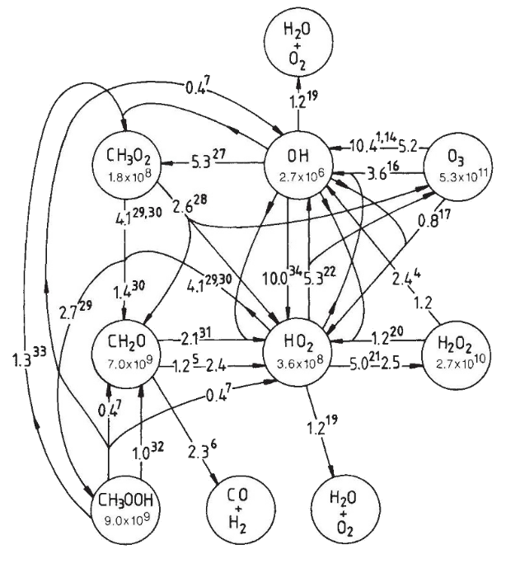
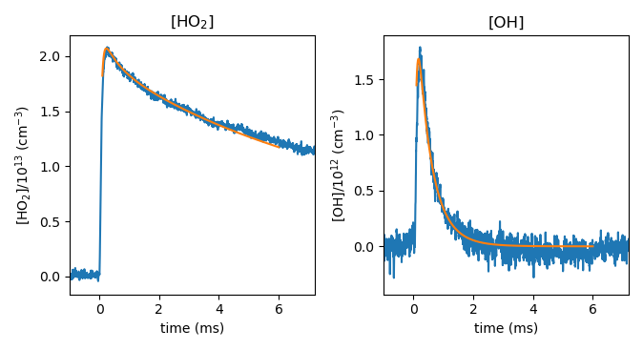

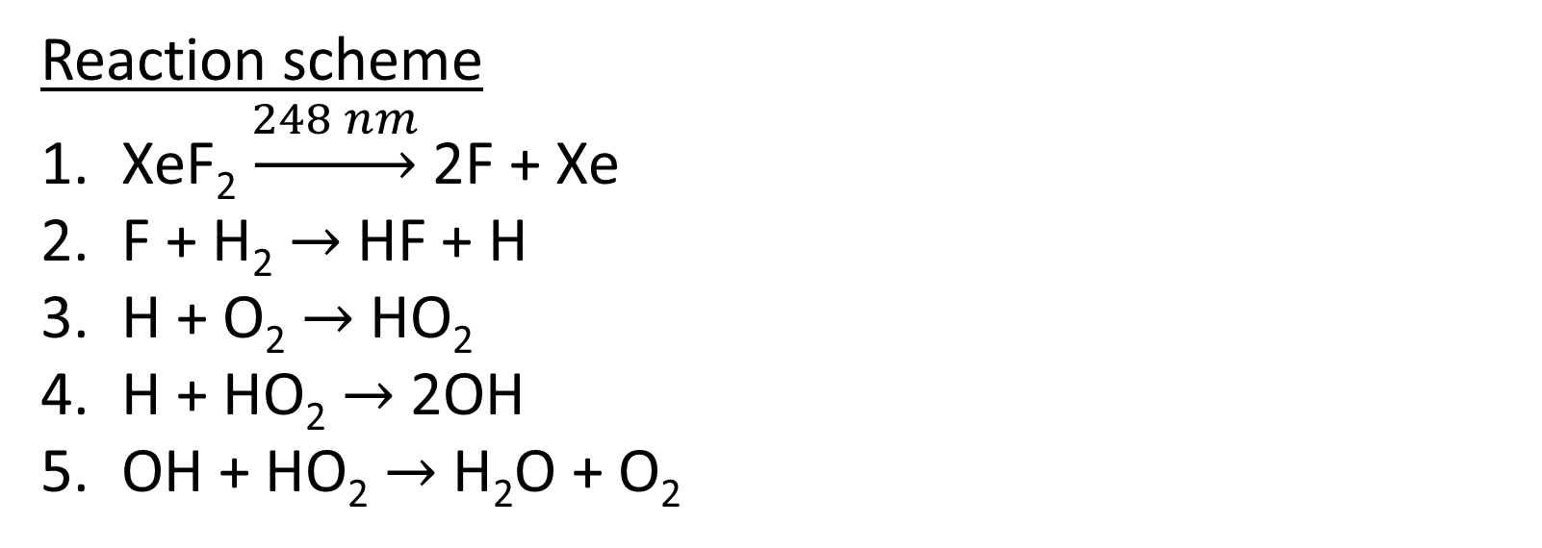
National Aeronautics and Space Administration
Postdoc Research
Determining the rate OH + HO₂ with Infrared Kinetic Spectroscopy
Author: Charles R. Markus, NASA Postdoctoral Fellow (329H)
Carl Percival and Stanley P. Sander (329H)
IRKS Instrument
XeF₂, O₂, H₂
Background
The free radicals OH and HO₂ are two of the most reactive species in the atmosphere, which process volatile organic compounds. The reaction OH + HO₂ is the ultimate sink of odd hydrogen species (HO_{x}) in the middle atmosphere. New measurements of the reaction rate are needed to validate our current understanding tropospheric chemistry.
IR lasers
248 nm
Reaction scheme
XeF₂ $\underset{→}{248 nm}$ 2F + Xe
F + H₂ $→$ HF + H
H + O₂ $→$ HO₂
H + HO₂ $→$ 2OH
OH + HO₂ $→$ H₂O + O₂
Results
Preliminary results give:
k = 9.4(30)$×$10⁻¹¹ cm⁻³ s⁻¹
Previous value:
k = 1.1(2)$×$10⁻¹⁰ cm⁻³ s⁻¹
- Experiment
J. Lelieveld & P.J. Crutzen, Nature, 343, 227 (1990).
- Model fit
- Experiment
Objectives
Use high-resolution infrared spectroscopy to monitor OH and HO₂ in a photochemical reactor
Develop clean chemical scheme to avoid secondary and interfering chemistry
Accurately determine the rate of OH + HO₂ under atmospheric conditions
- Model fit
Significance of Results/Benefits to NASA/JPL
JPL oversees the evaluation for chemical kinetics and photochemical data for use in atmospheric studies. Atmospheric modelers rely on this for accurate data on reaction rates. These new results will be included in the NASA/JPL data evaluation and improve atmospheric chemical models.
Approach and Results
Measurements were done with the Infrared Kinetic Spectroscopy (IRKS) Instrument. This uses sensitive infrared spectroscopy to monitor HO₂ and OH after a high-energy UV laser pulse initiates the reaction in a laboratory reactor.
Future Work
This will work will be extended to a wider temperature range (250-350 K). In addition, systematic errors will be investigated to improve the accuracy of the results.
National Aeronautics and Space Administration
Jet Propulsion Laboratory
California Institute of Technology
Pasadena, California
www.nasa.gov
Author Contact Information:
charles.r.markus@jpl.nasa.gov
(818)354-5752
Clearance Number: CL#00-0000
Poster Number: PRD-E-021
Copyright 2023. All rights reserved.

