Slide 1
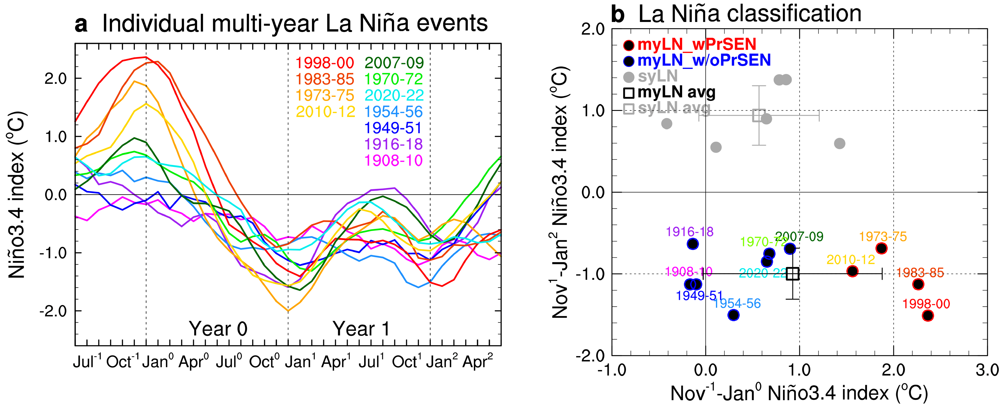
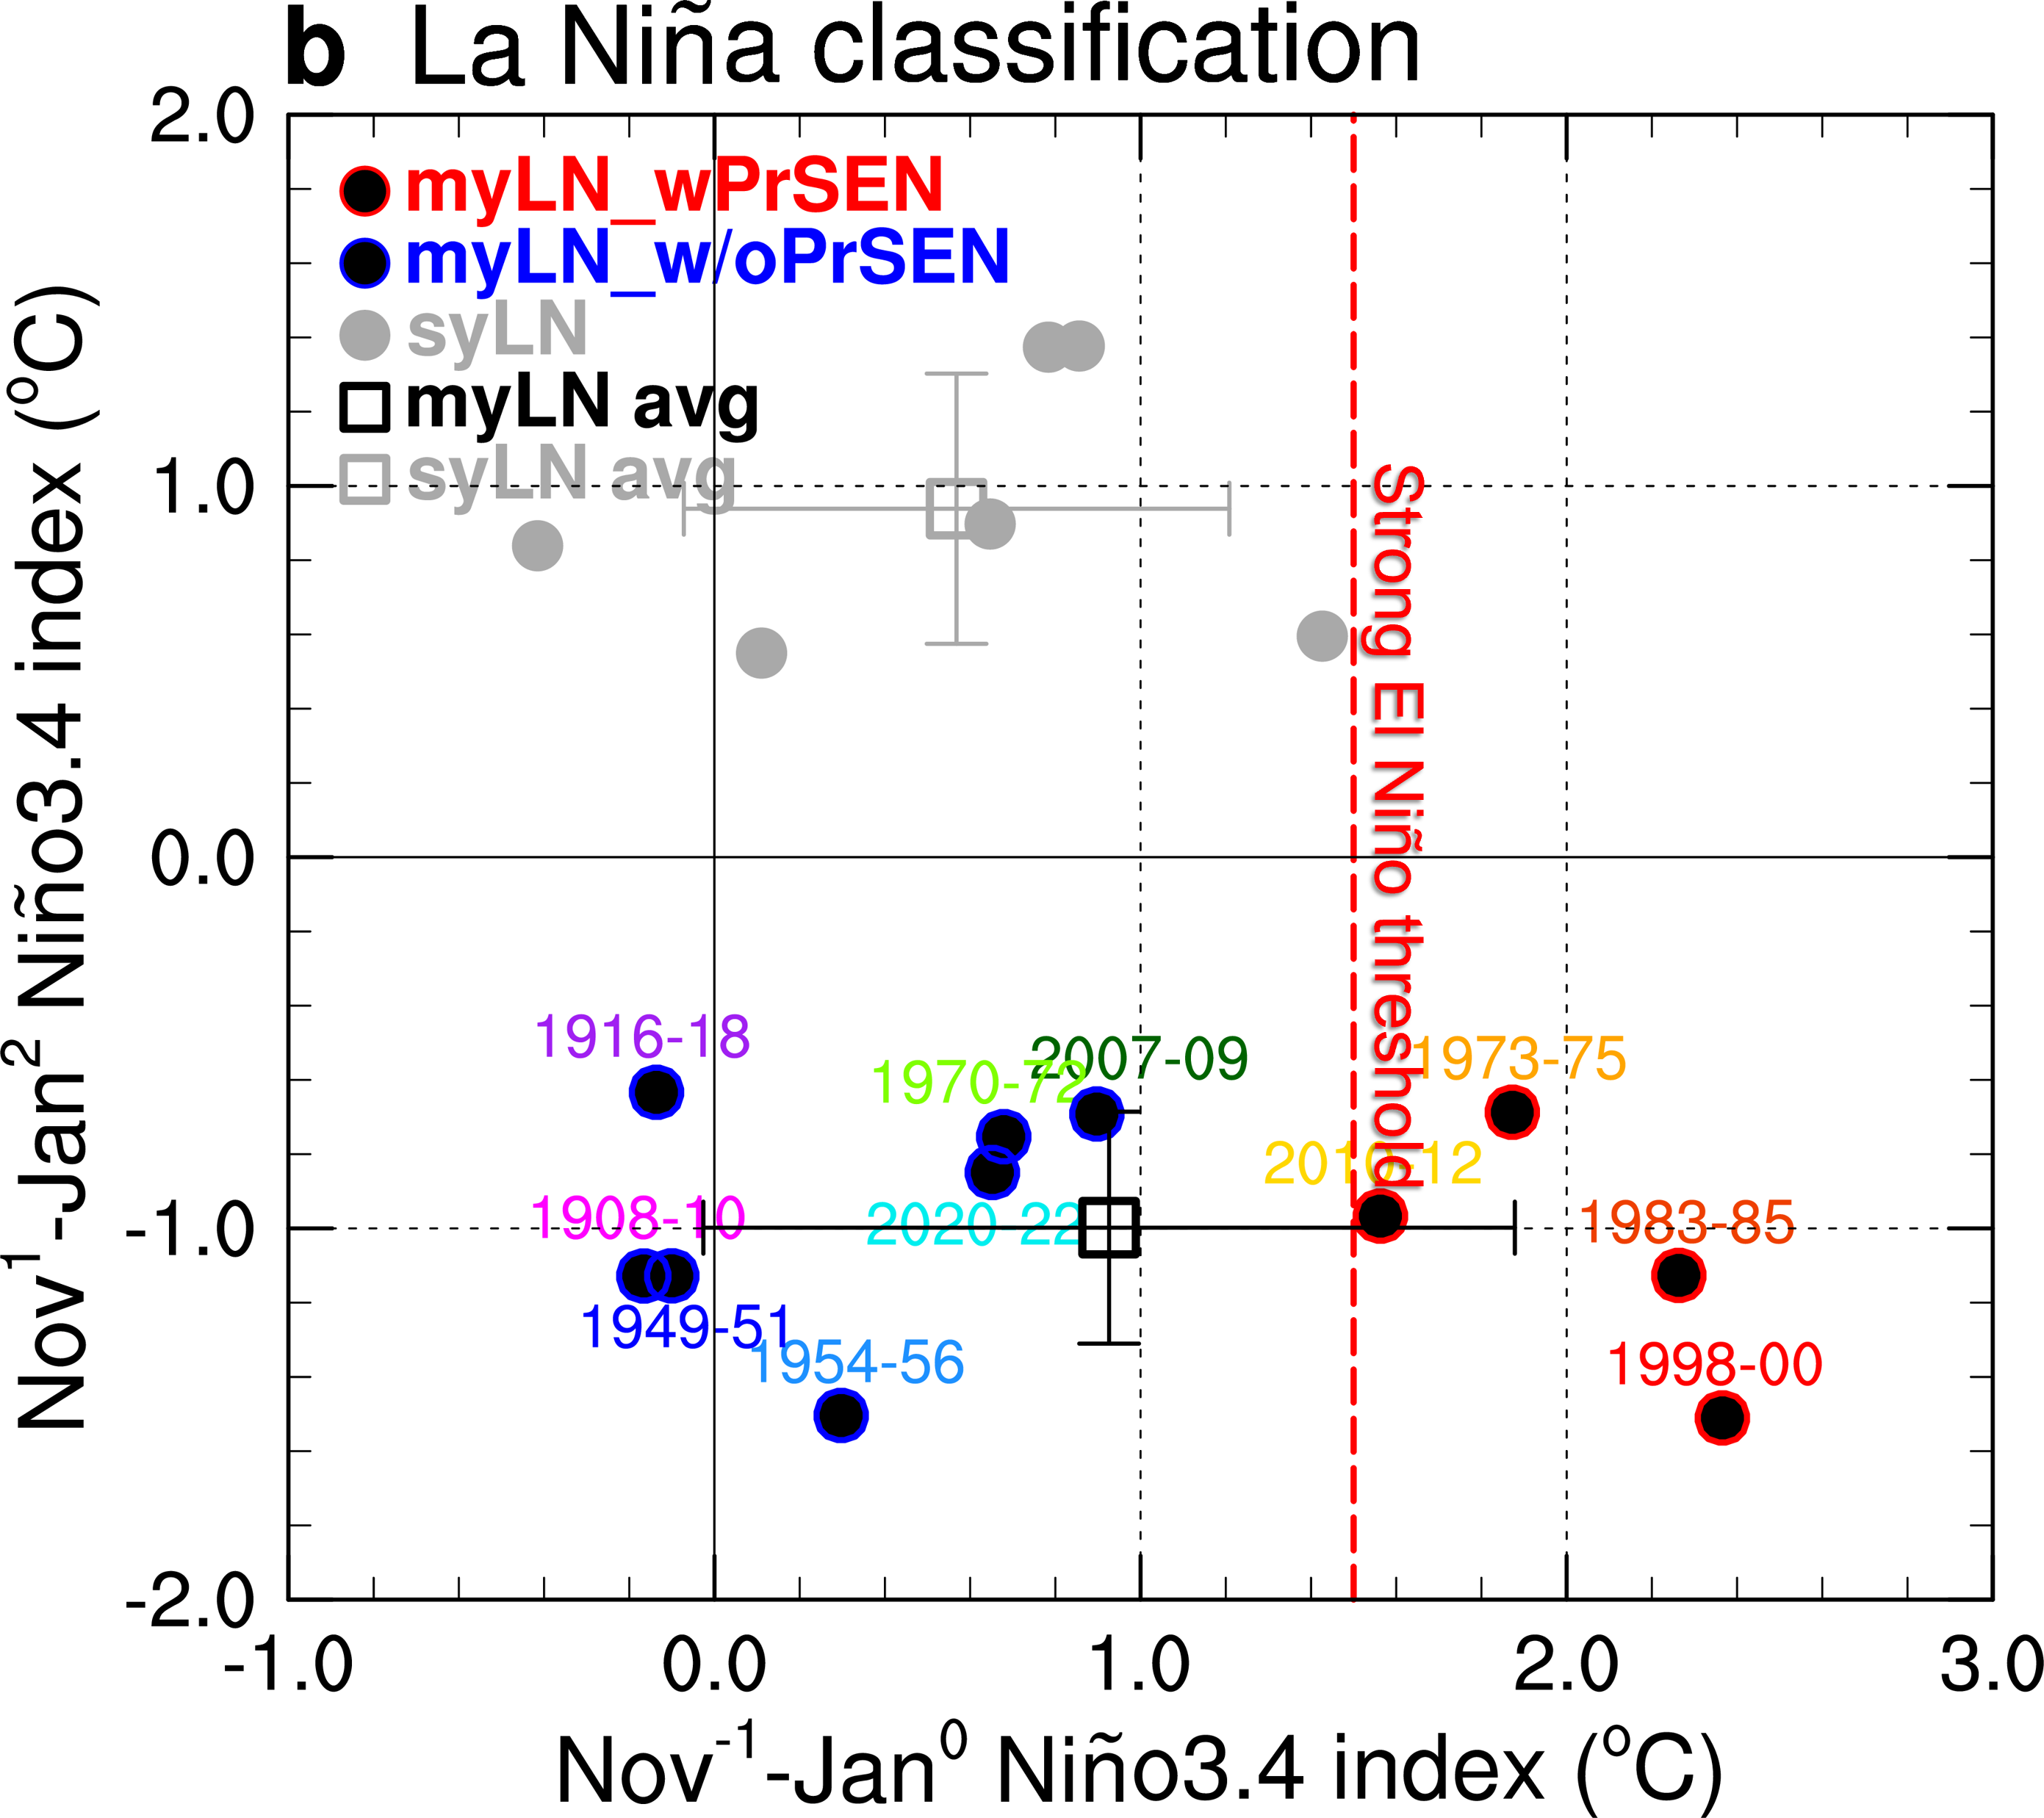
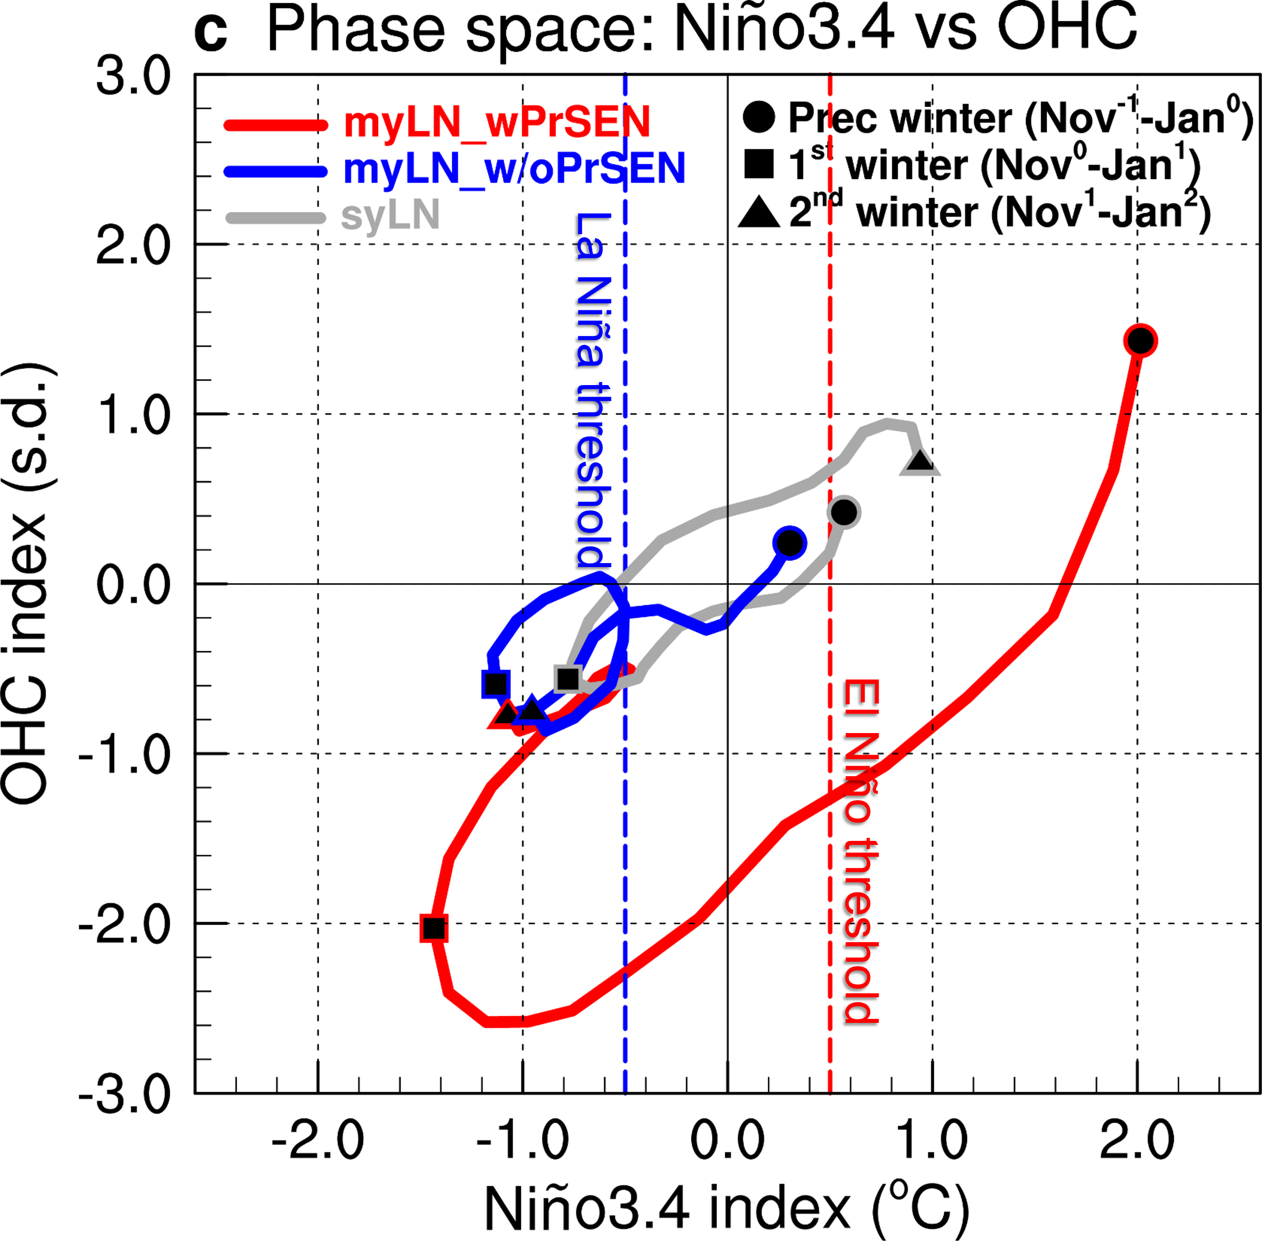
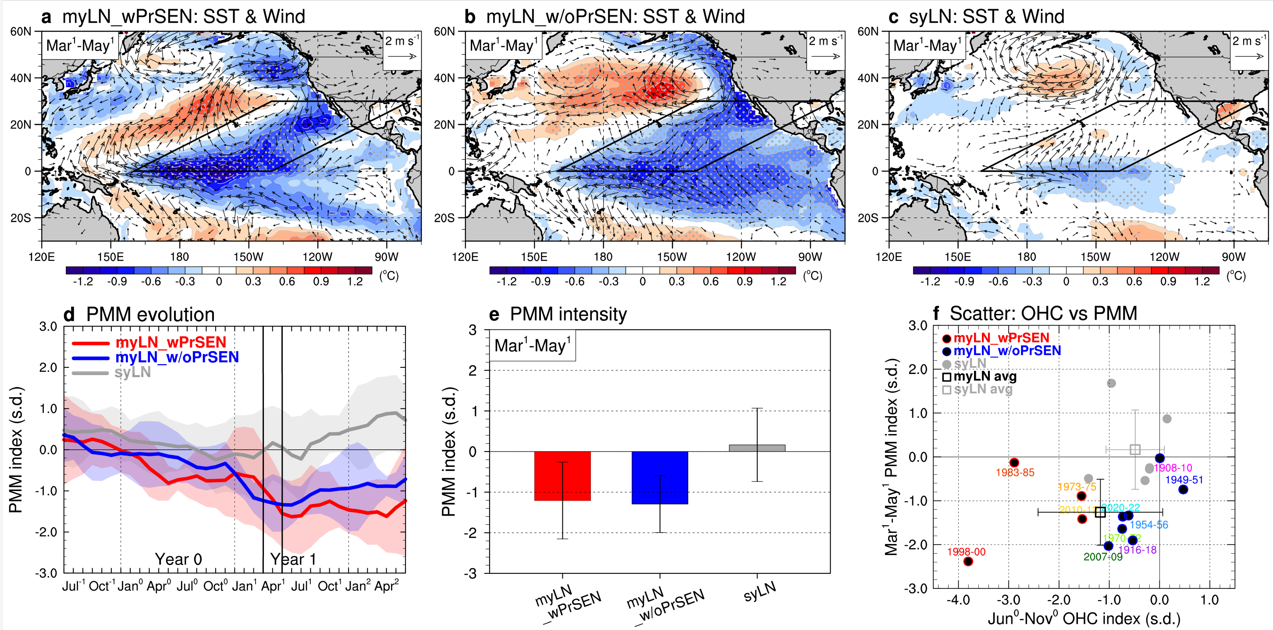
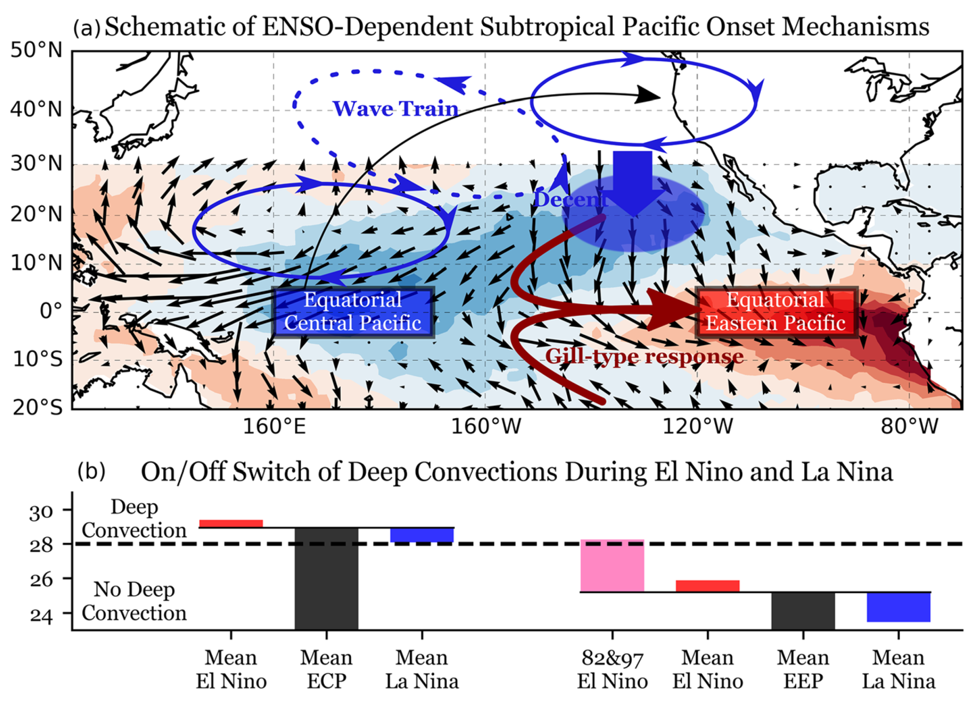
National Aeronautics and Space Administration
Postdoc Research
Revisiting the Formation of Multi-year La Niña Events:
Is a Preceding Strong El Niño Necessary?
Author: Ji-Won Kim (329E, NASA Postdoctoral Fellow)
Co-authors: Jin-Yi Yu (UC Irvine) and Baijun Tian (329E)
Background
The latest multi-year La Niña event, spanning from 2020 to 2022, has drawn particular attention from climate research community because the event was not preceded by a strong El Niño but by a very weak one. This contradicts with the traditional views, which emphasized the significance of a preceding strong El Niño in generating multi-year La Niña events. In this study, we revisit the generation mechanism of multi-year La Niña events.
Objectives
To achieve a better understanding of the generation mechanism of multi-year La Niña events
Approach and Results
We analyzed various observational data covering the 20th century, from 1900 to 2022: HadISSTv1.1 (1900-2022) for sea surface temperature (SST) data; NOAA 20CRv2 (1900-1947) + NCEP/NCAR R1 (1948-2022) for atmospheric data; SODAv2.2.4 (1900-1979) + GODAS (1980-2022) for oceanic data.
We demonstrated that the role of preceding strong El Niño has been overemphasized, as the majority of multi-year La Niña events did not actually require a strong El Niño in the preceding year (see Fig. 1).
We proposed an alternative mechanism, termed the ‘PMM’ mechanism, which comprehensively explains the generation of multi-year La Niña events, regardless of the El Niño conditions in their preceding years (see Fig. 2); PMM = Pacific Meridional Mode, the leading ocean-atmosphere coupled mode over the subtropical North Pacific.
(=Ocean Heat Content)
Fig. 1 | Role of preceding strong El Niño in generating multi-year La Niña: Overemphasized
A
A
C
Fig. 1 of Fang & Yu (2020, GRL), Fang, S. W., & Yu, J. Y. (2020). A control of ENSO transition complexity by tropical Pacific mean SSTs through tropical‐subtropical interaction. Geophysical Research Letters, 47(12), e2020GL087933.
Fig. 2 | Role of negative PMM in generating multi-year La Niña: Crucial
Significance of Results/Benefits to NASA/JPL
The findings of this study not only contribute to advancing our understanding of multi-year ENSO dynamics (benefits to science and NASA/JPL) but also hold substantial socio-economic relevance, given the prolonged global climate impacts associated with multi-year La Niña events (benefits to society).
Future Work
We need to provide an answer as to whether cutting-edge contemporary climate models, such as those participated in the CMIP6 project, can properly reproduce our observational findings.
National Aeronautics and Space Administration
Jet Propulsion Laboratory
California Institute of Technology, Pasadena, California
www.nasa.gov
Publications and Acknowledgements:
Kim, J.-W., J.-Y. Yu, and B. Tian: Is a preceding strong El Niño necessary to generate multi-year La Niña events? Nature Communications, under revision
Author Contact Information: Ji-Won Kim (jiwon.kim@jpl.nasa.gov)
Clearance Number: CL#00-0000
Poster Number: PRD-E-023
Copyright 2023. All rights reserved.

