Slide 1
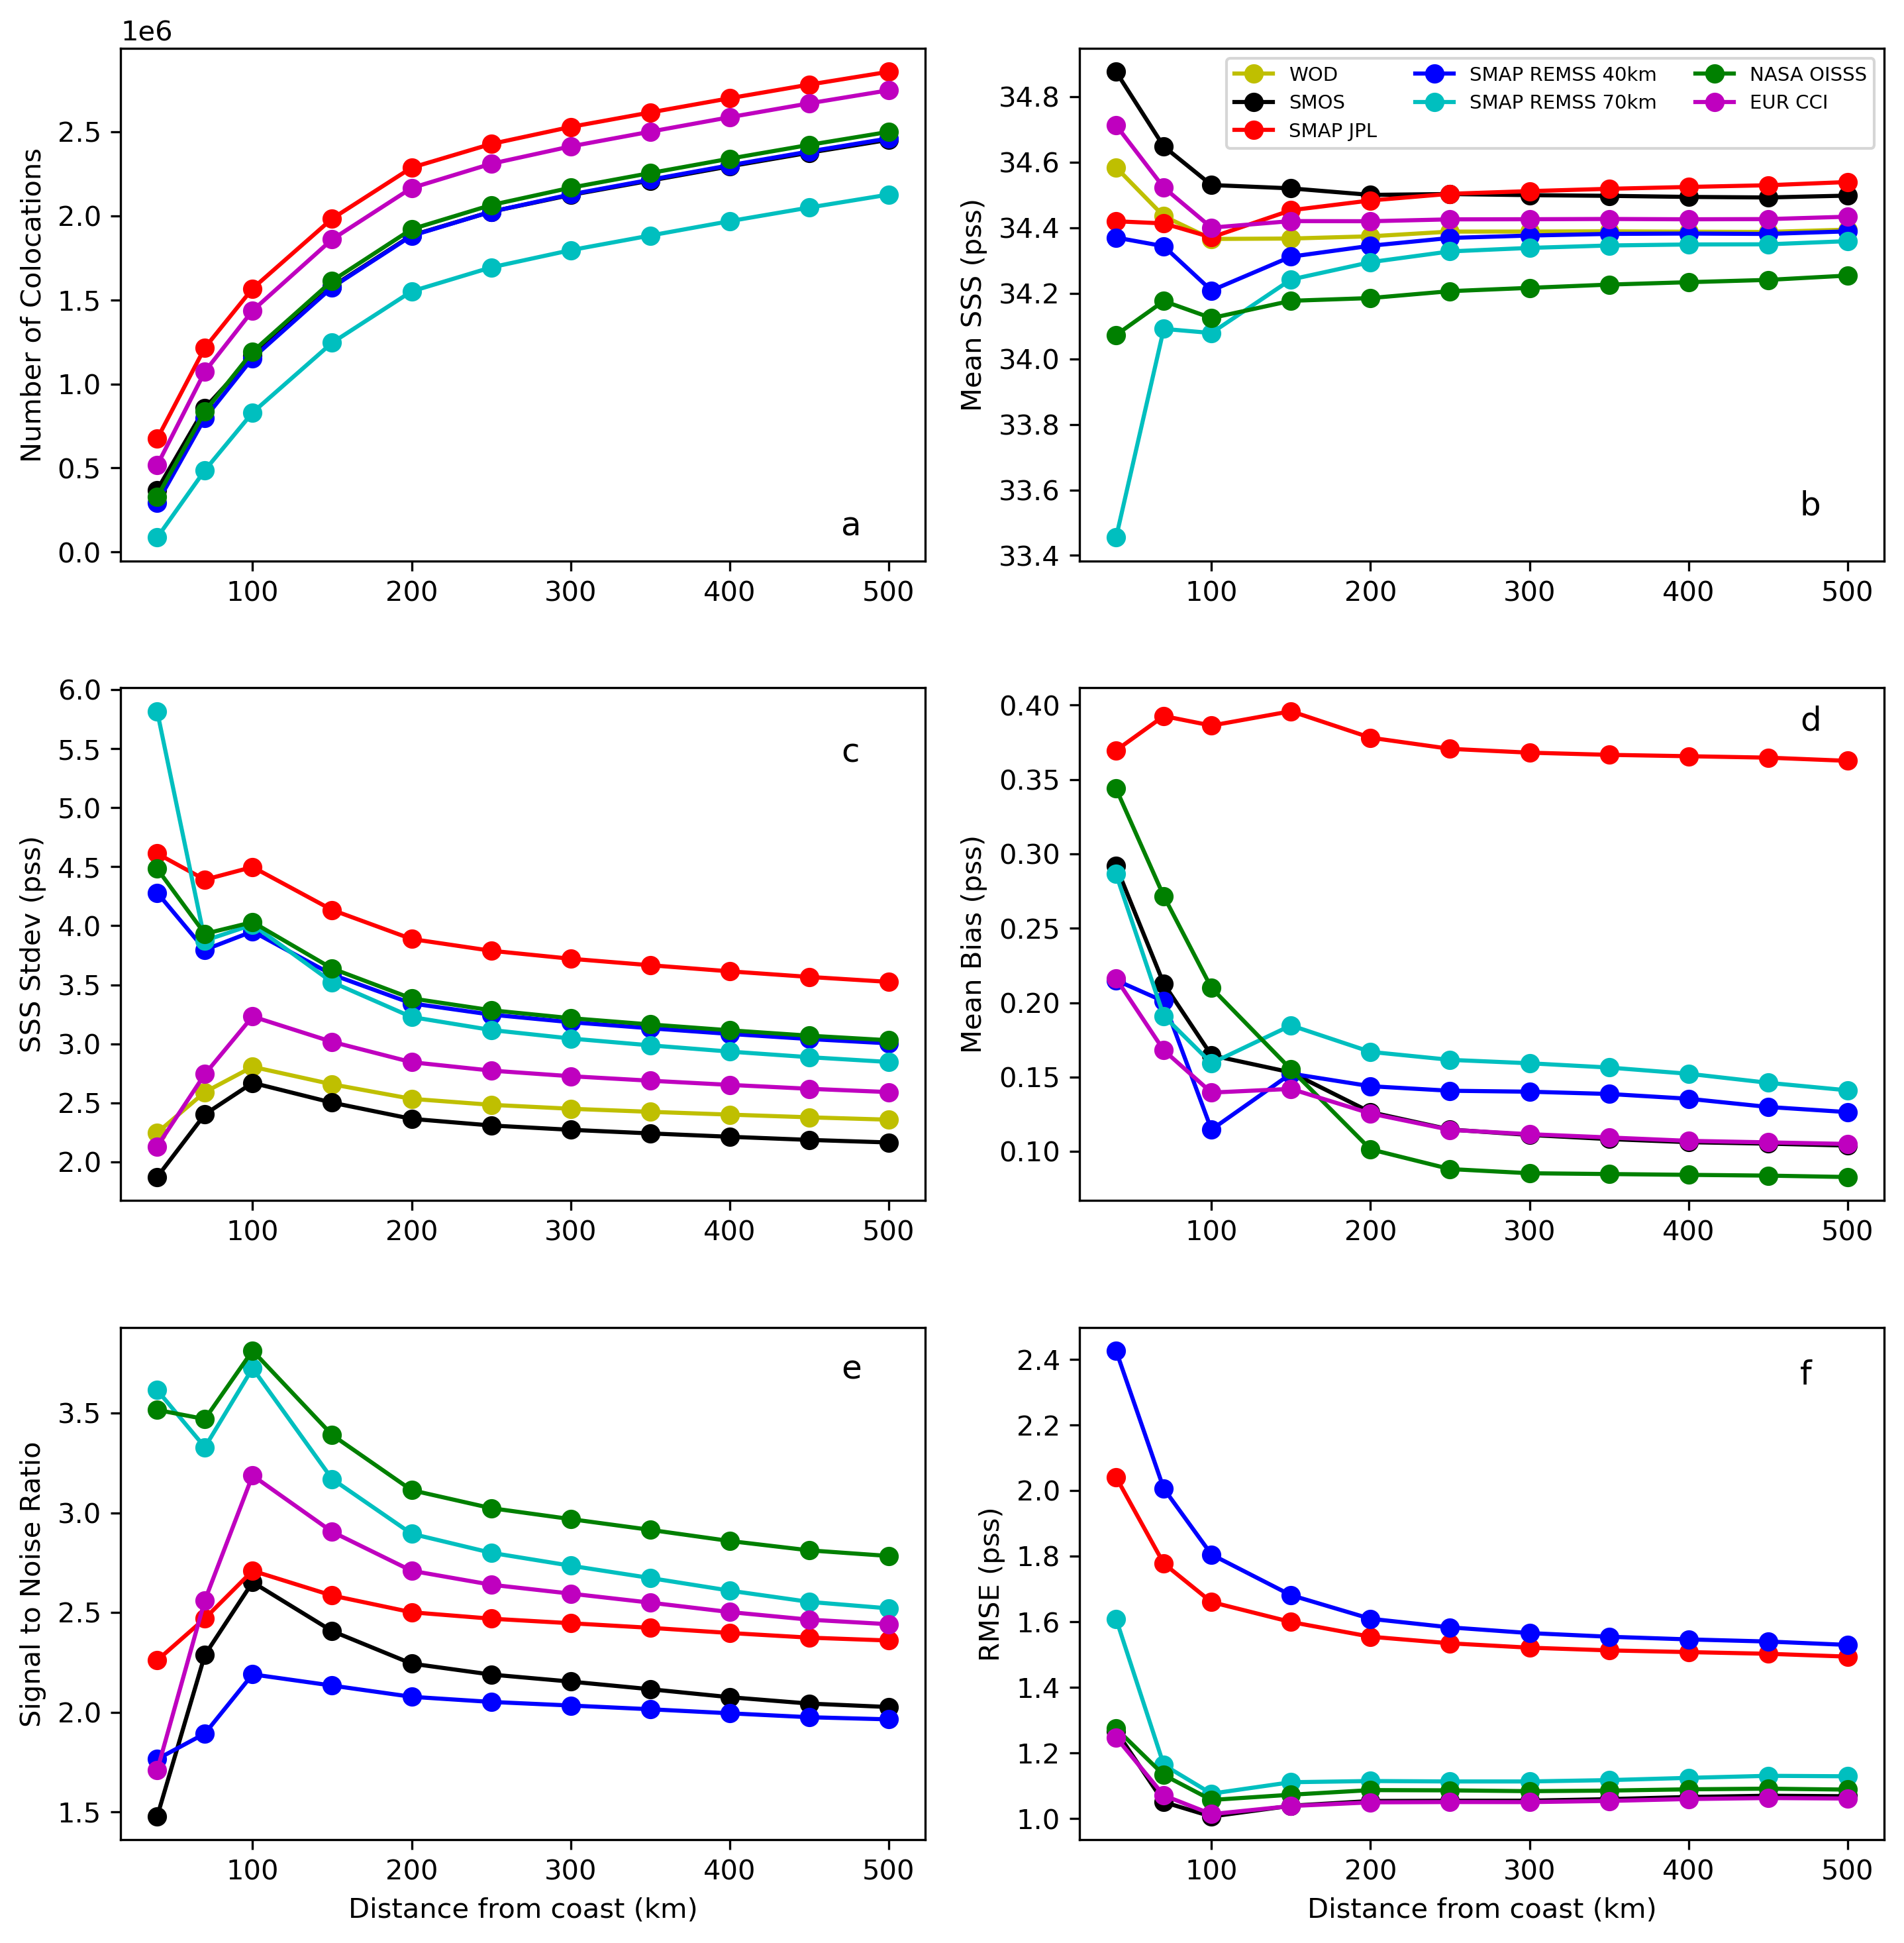
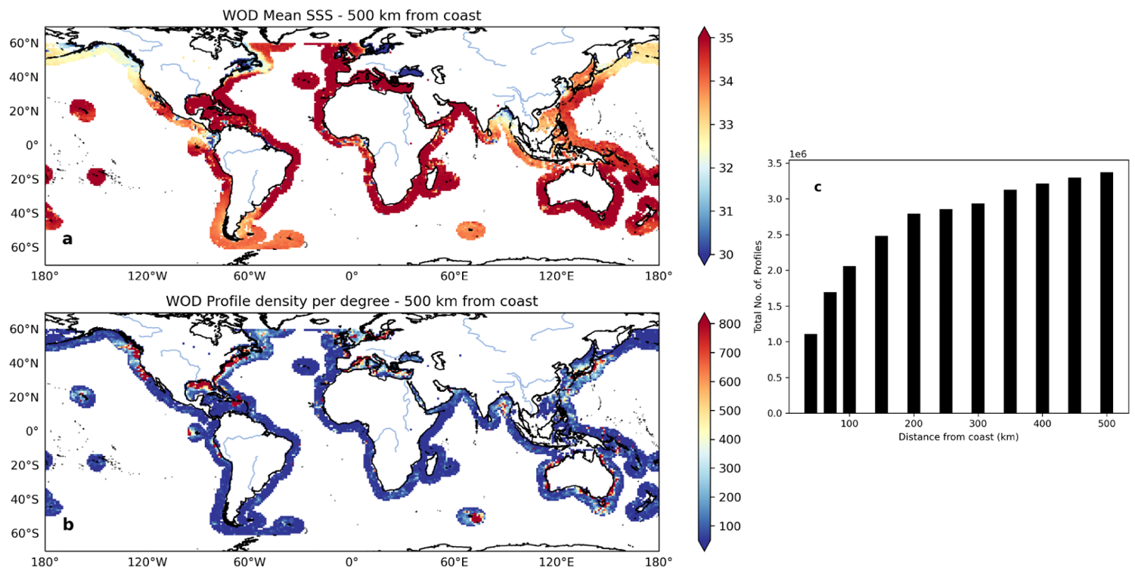
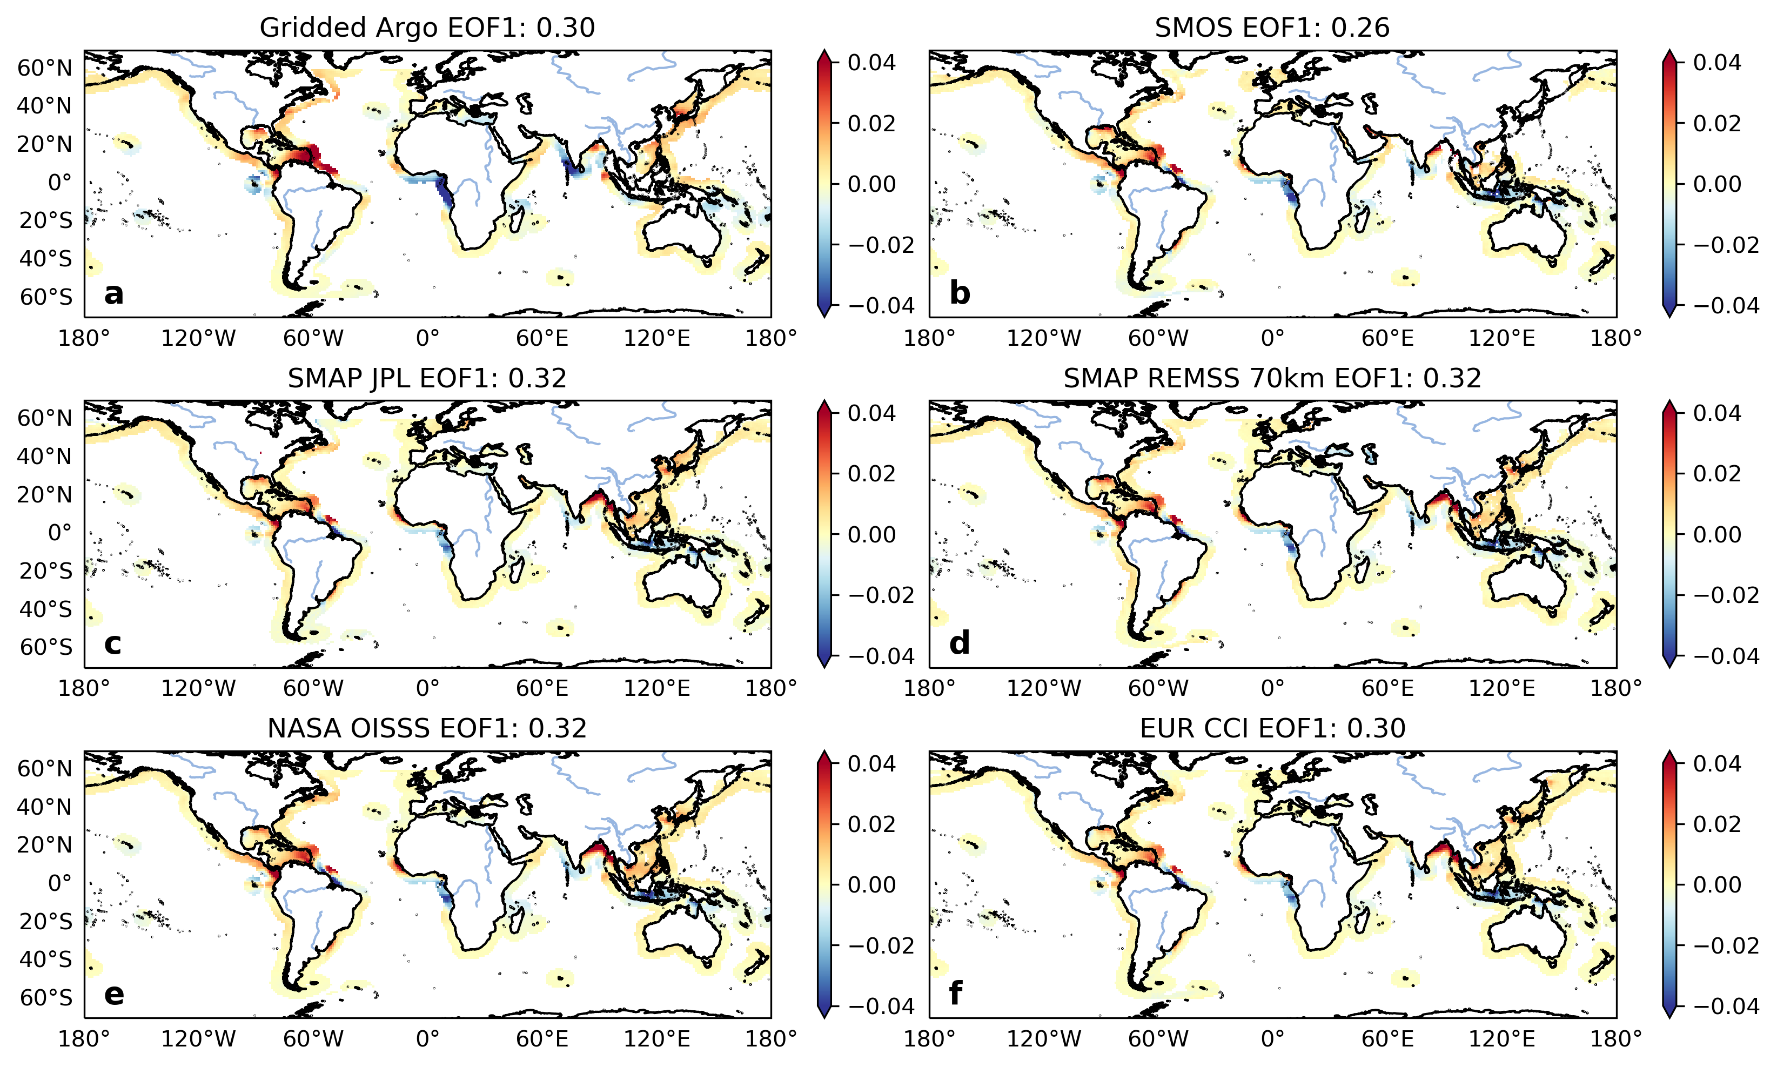
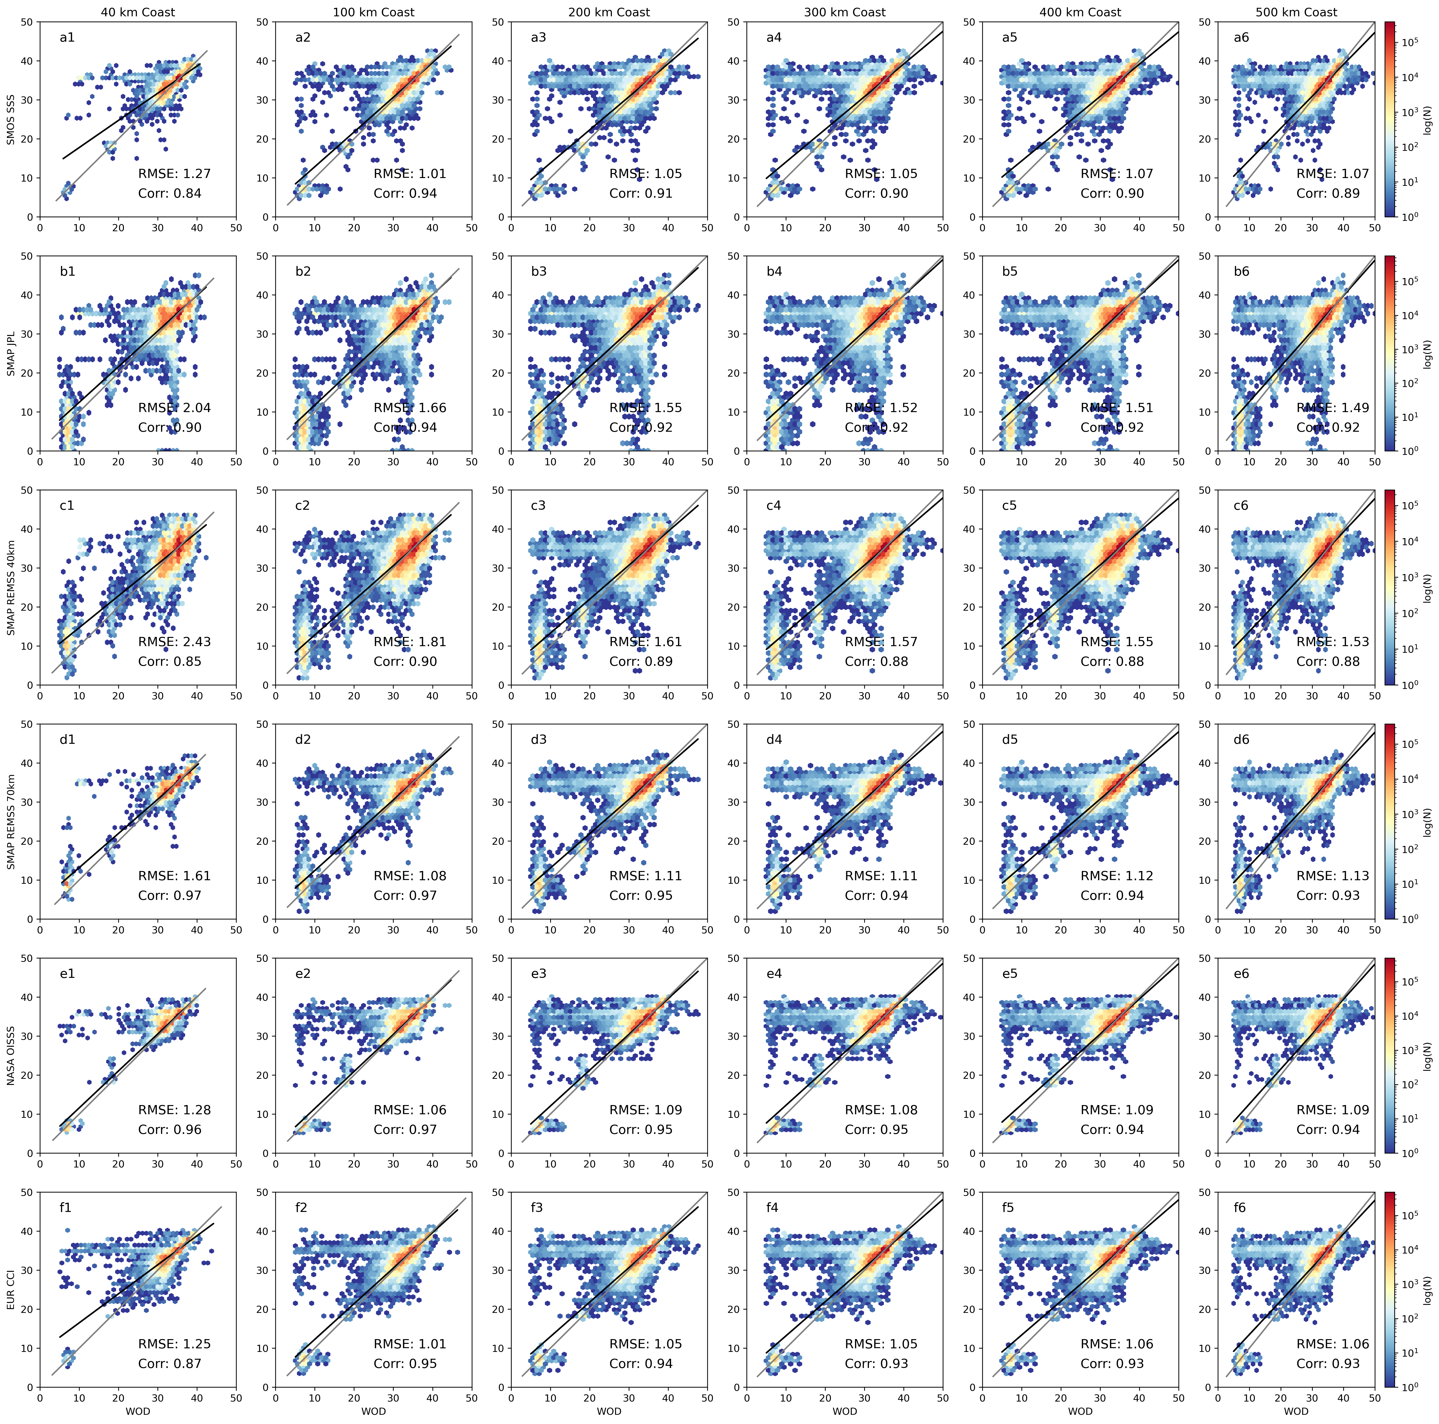
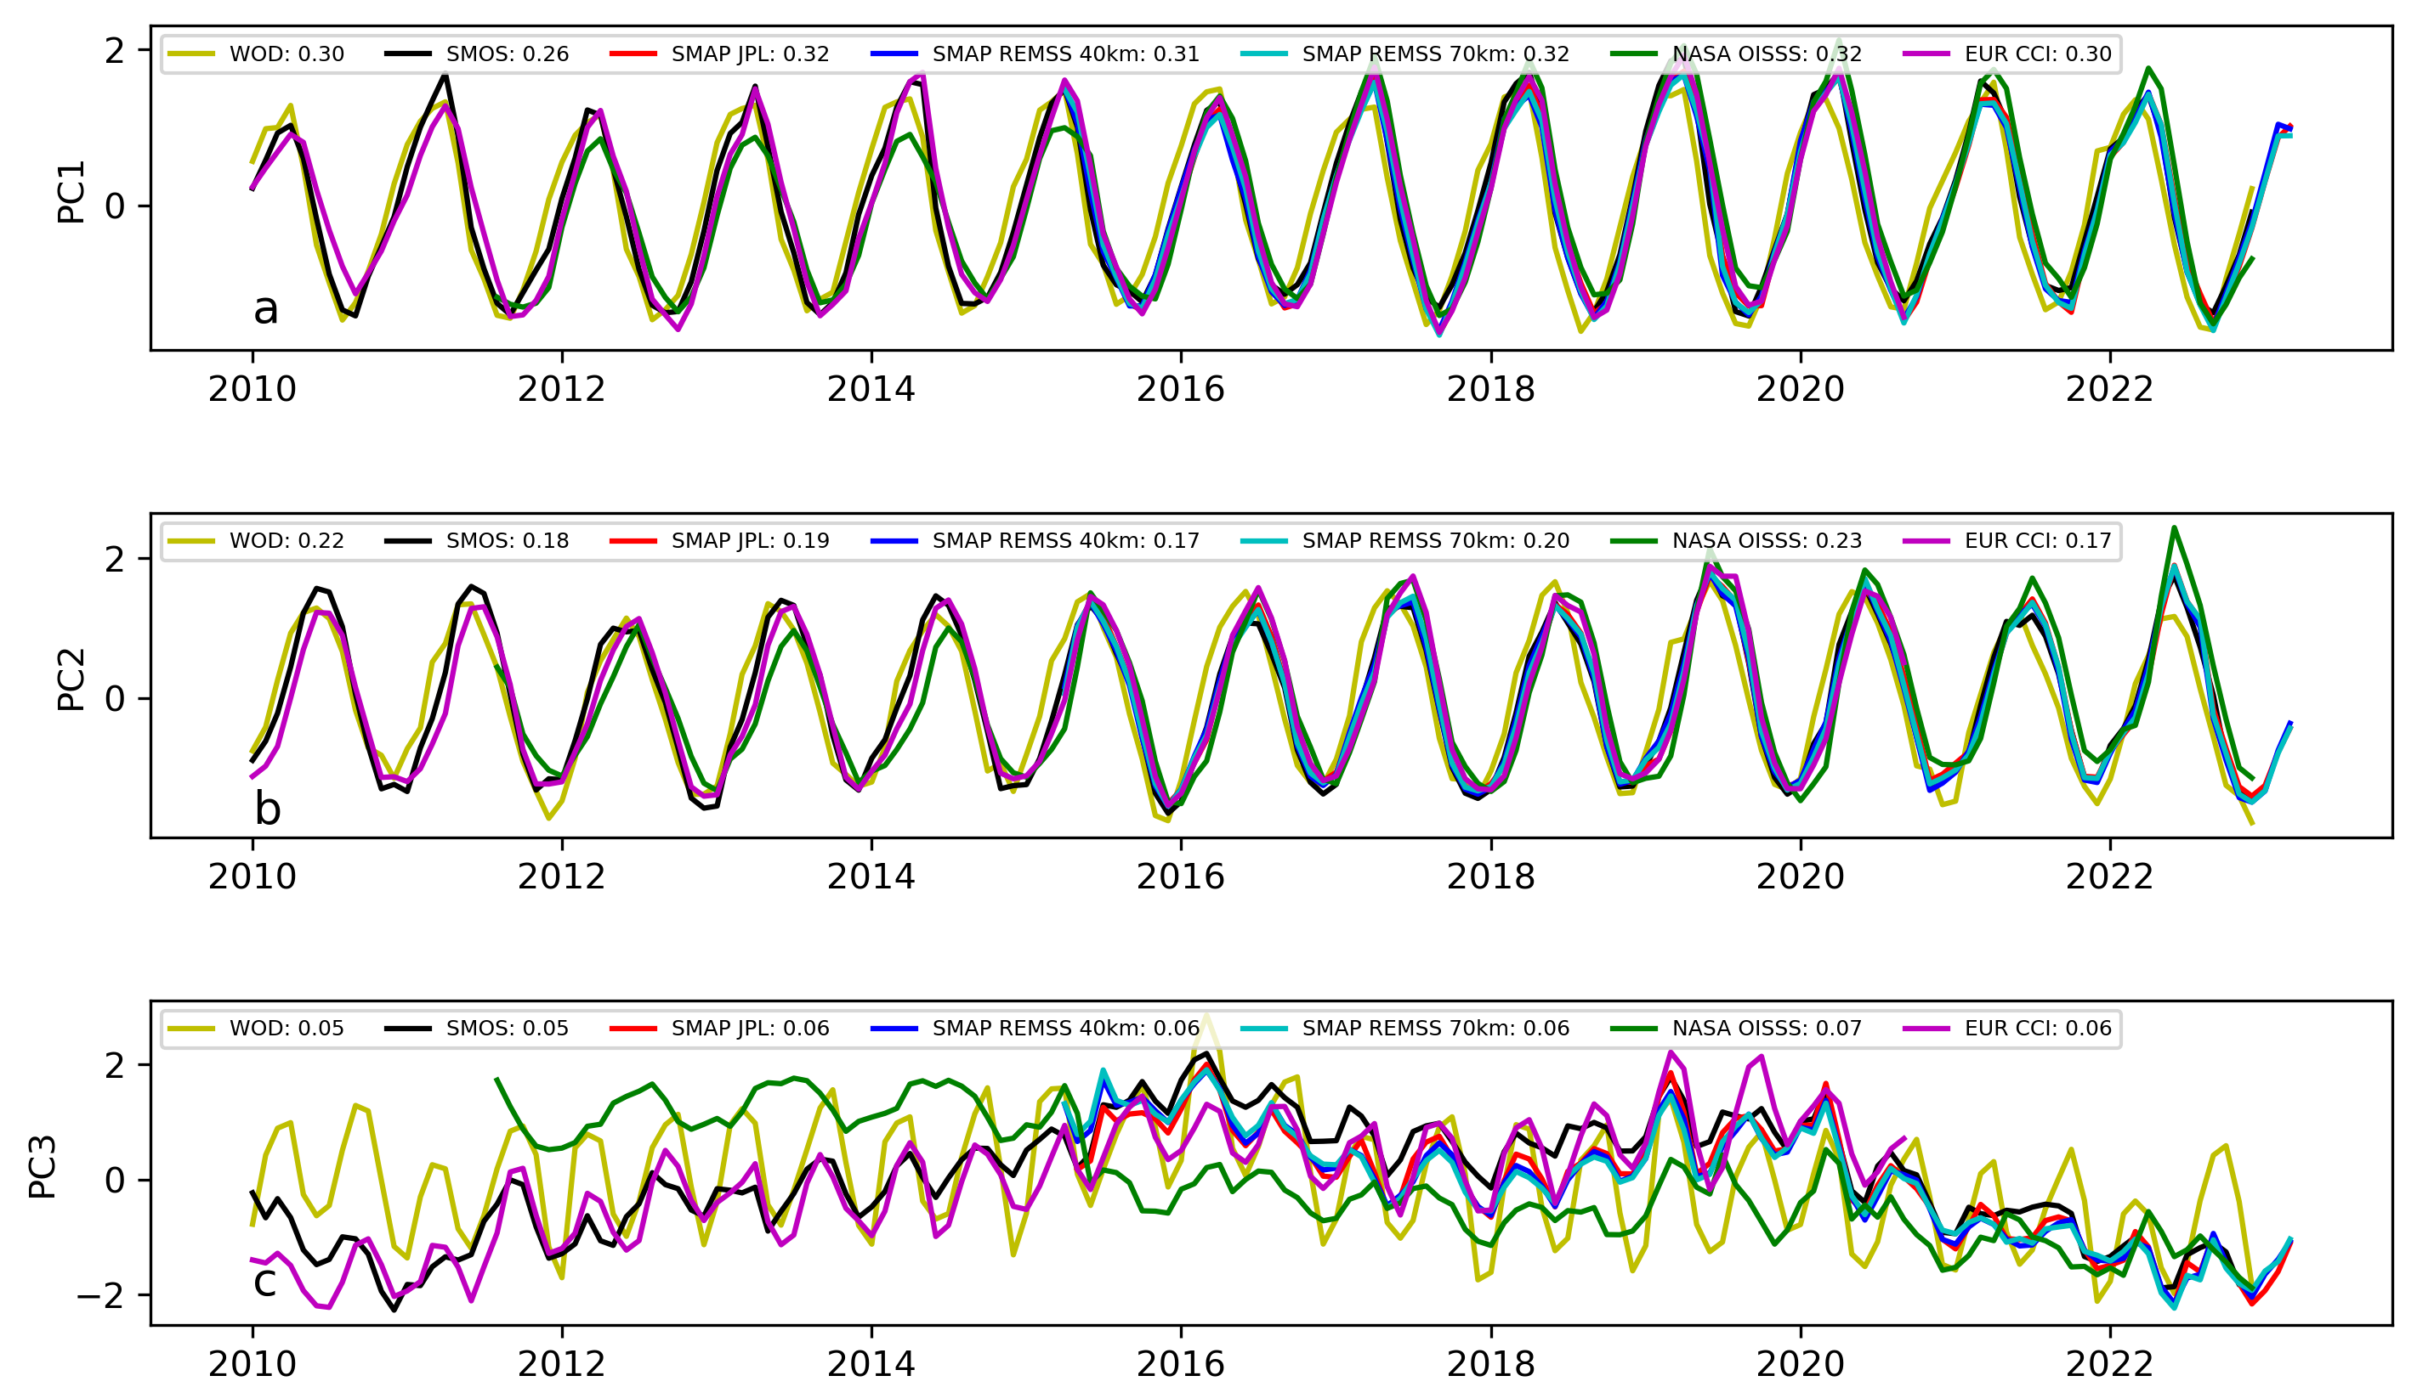
National Aeronautics and Space Administration
Intercomparison of in situ and remote sensing surface salinity products in the global coastal ocean.
Authors: Sreelekha Jarugula, JPL Postdoctoral Fellow (329B)
Severine Fournier (329B), John Reager (329F) and Madeleine Pascolini-Campbell (329F)
Background and Motivation
Intercomparison of satellite SSS with in situ observations
Sea surface salinity (SSS) plays a key role in understanding the air-sea interaction, ocean circulation, changes in the hydrological cycle and linkages between the different climate modes, biogeochemistry.
Satellites (SMOS, SMAP) have difficulty in measuring SSS close to coastline due to land contamination issues.
Here, we compare the performance of different satellite SSS products with in situ observations in the global coastal ocean.
Figure 3: Intercomparison of statistical relationship between the global sea surface salinity (SSS; pss) from WOD and different satellite SSS products as a function of distance from the coast (km): (a) Number of colocations available for satellite SSS, (b) mean SSS (pss), (c) standard deviation (pss), (d) mean bias (pss), (e) signal-to-noise ratio and (f) root-mean-squared difference (RMSD; pss). The different colored lines indicate SSS from the different products, labels shown in panel b.
Satellite SSS is well correlated with WOD SSS in the coastal ocean
Number of colocations increase as a function of distance from coast.
Mean Bias and root-mean-squared difference (RMSD) decrease as a function of distance from the coast. Mean bias for JPL SMAP remains constant.
Signal-to-noise ratio for all satellite SSS products is highest at 100 km from the coast and generally high for merged products (OISSS and CCI) and REMSS 70 km SMAP.
REMSS 40 km and JPL SMAP have high RMSD (~1.6-2.4 pss) as compared to other products.
Data and Methods
We use ~3 million salinity profiles from the World Ocean Database (WOD) during 2010-2022 to compare the satellite SSS from JPL SMAP, REMSS SMAP (40 and 70 km), SMOS, NASA OISSS and EUR CCI. The comparisons are done as a function of distance from the coastline (40-500 km).
EOF analysis is performed to understand spatial and temporal variability of SSS at 500 km from coast.
Figure 1: (a) Mean surface salinity (SSS; pss) 500 km from coastline from the World Ocean Database (WOD) profiles during 2010-2022. (b) Total number of WOD profiles per 1º x 1º spatial box 500 km away from the coastline used to obtain SSS. (c) Total number of WOD profiles available as a function of distance from the coast (km) during 2010-2022.
EOF Analysis of coastal SSS from satellites and gridded Argo
Figure 4: Spatial maps of mode EOF-1 for gridded Argo and satellite
SSS at 500 km from the coastline.
Figure 5: The principal component time series
corresponding to the modes (a) EOF1 (b) EOF2 and (c) EOF3.
Gridded Argo and satellite SSS products show comparable fraction of variance in EOF 1-3 modes.
EOFs 1-2 are associated with seasonal cycle of SSS at major river mouths in the northern and southern hemispheres.
Results and Discussion
Figure 2: Binned scatter plots with data density (color) between WOD SSS and different satellite SSS data; left to right indicate the distance from the coast: 40 km, 100 km, 200 km, 300 km, 400 km and 500 km respectively. The Root-Mean-Squared Difference (RMSD), correlation coefficients, linear regression line (black) and line with slope=1 (gray) are shown in each panel.
Principal components timeseries corresponding to EOFs 1-3 show satellite SSS and Argo agree well on seasonal timescales.
Distinct differences between satellite SSS products in resolving the non-seasonal variability (mode EOF-3)
Summary
An intercomparison of the different satellite SSS products (JPL SMAP, REMSS SMAP (40 km and 70 km), SMOS, NASA OISSS and EUR CCI) is shown by using 5 m salinity from nearly 3 million WOD profiles in coastal ocean.
Present-day satellites (SMAP, SMOS) have difficulty in sampling the coastal oceans due to land-contamination issues. Satellite SSS products preform differently due to instrument errors, differences in retrieval algorithms and processing methods used.
It is also important to note that the sampling strategies are different for in situ and satellite datasets.
EOF analysis shows both gridded Argo and satellite products capture the seasonal variability in the coastal SSS well but have significant differences in capturing the non-seasonal variability.
National Aeronautics and Space Administration
Jet Propulsion Laboratory
California Institute of Technology, Pasadena, California. www.nasa.gov
Publications and Acknowledgements:
Sreelekha J, Fournier S., Reager J. T. and Madeleine Pascolini-Campbell (2023). Intercomparison of in situ and remote sensing surface salinity products in the global coastal ocean. Manuscript in Prep.
Author Contact Information: sreelekha.jarugula@jpl.nasa.gov [Ph: (818)-354-1273]
Clearance Number: CL#00-0000
Poster Number: PRD-E-030
Copyright 2023. All rights reserved.

