Slide 1
2023 PRD Poster Template Guidelines
Fill out information in top header area:
Poster Title
Your name, your postdoc job title (see list below)
If you are a JPL postdoc employee, please use job title: JPL Postdoctoral Fellow
If you are an NPP Fellow, please use job title: NASA Postdoctoral Fellow
If you are a Visiting postdoc, please use job title: Visiting Postdoctoral Scholar
If you are a JIFRESSE postdoc, please use job title: JIFRESSE/UCLA Postdoc
Your section number
Your advisor’s name and other collaborators and their section numbers
NOTE: Do not change the header (green) color as it is meant to highlight the postdoc posters during the event.
Content Area:
Be mindful of the judging criteria:
Original research contribution
Does the poster clearly explain the postdoc’s individual contribution to the research? Specifically, where the postdoc’s research fits within the framework of the larger team project.
Does the research contain novel concepts, theoretical frameworks, methods, or devices?
Does the presenter's research offer the potential to introduce novel contribution or advancements to the field?
Communication
Does the poster clearly convey the research's motivation and its alignment with broader JPL/NASA objectives? For example: What are the long-term goals of this work? If this research is successful, what JPL-relevant science/technology does this work enable?
Does the poster outline a comprehensive plan for sharing this research with the wider community beyond JPL? Is there a clear strategy to showcase the work's significance?
Is the poster succinct, yet comprehensive, designed to cater to an audience with varying levels of expertise? Can an individual from a different discipline easily comprehend the content?
Clarity of presentation
Are the components of the poster organized in a logical flow, guiding the reader from background information to the research's significance?
Are the components of the poster balanced across the poster, ensuring an even representation of components without overwhelming or underrepresenting any section?
Footer Area:
Gray Box to the right:
Add publications relevant to the work being presented. If no publications yet, indicate manuscripts in prep or submitted.
Add your contact information
To the left:
Add your Poster Number (refer to the list from the Postdoc Office, or to email received upon signing up (sent from Smartsheet, check your spam folder))
NOTE: Do not remove the copyright and NASA/JPL notations.

Slide 2
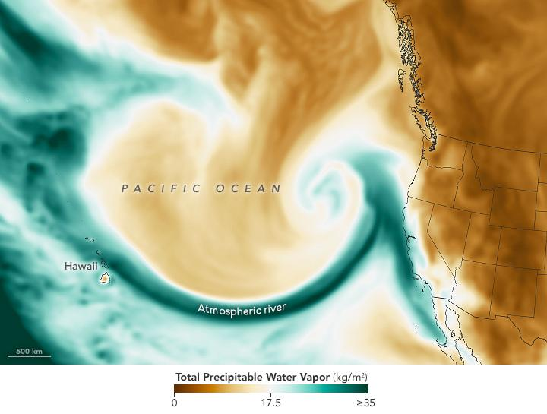
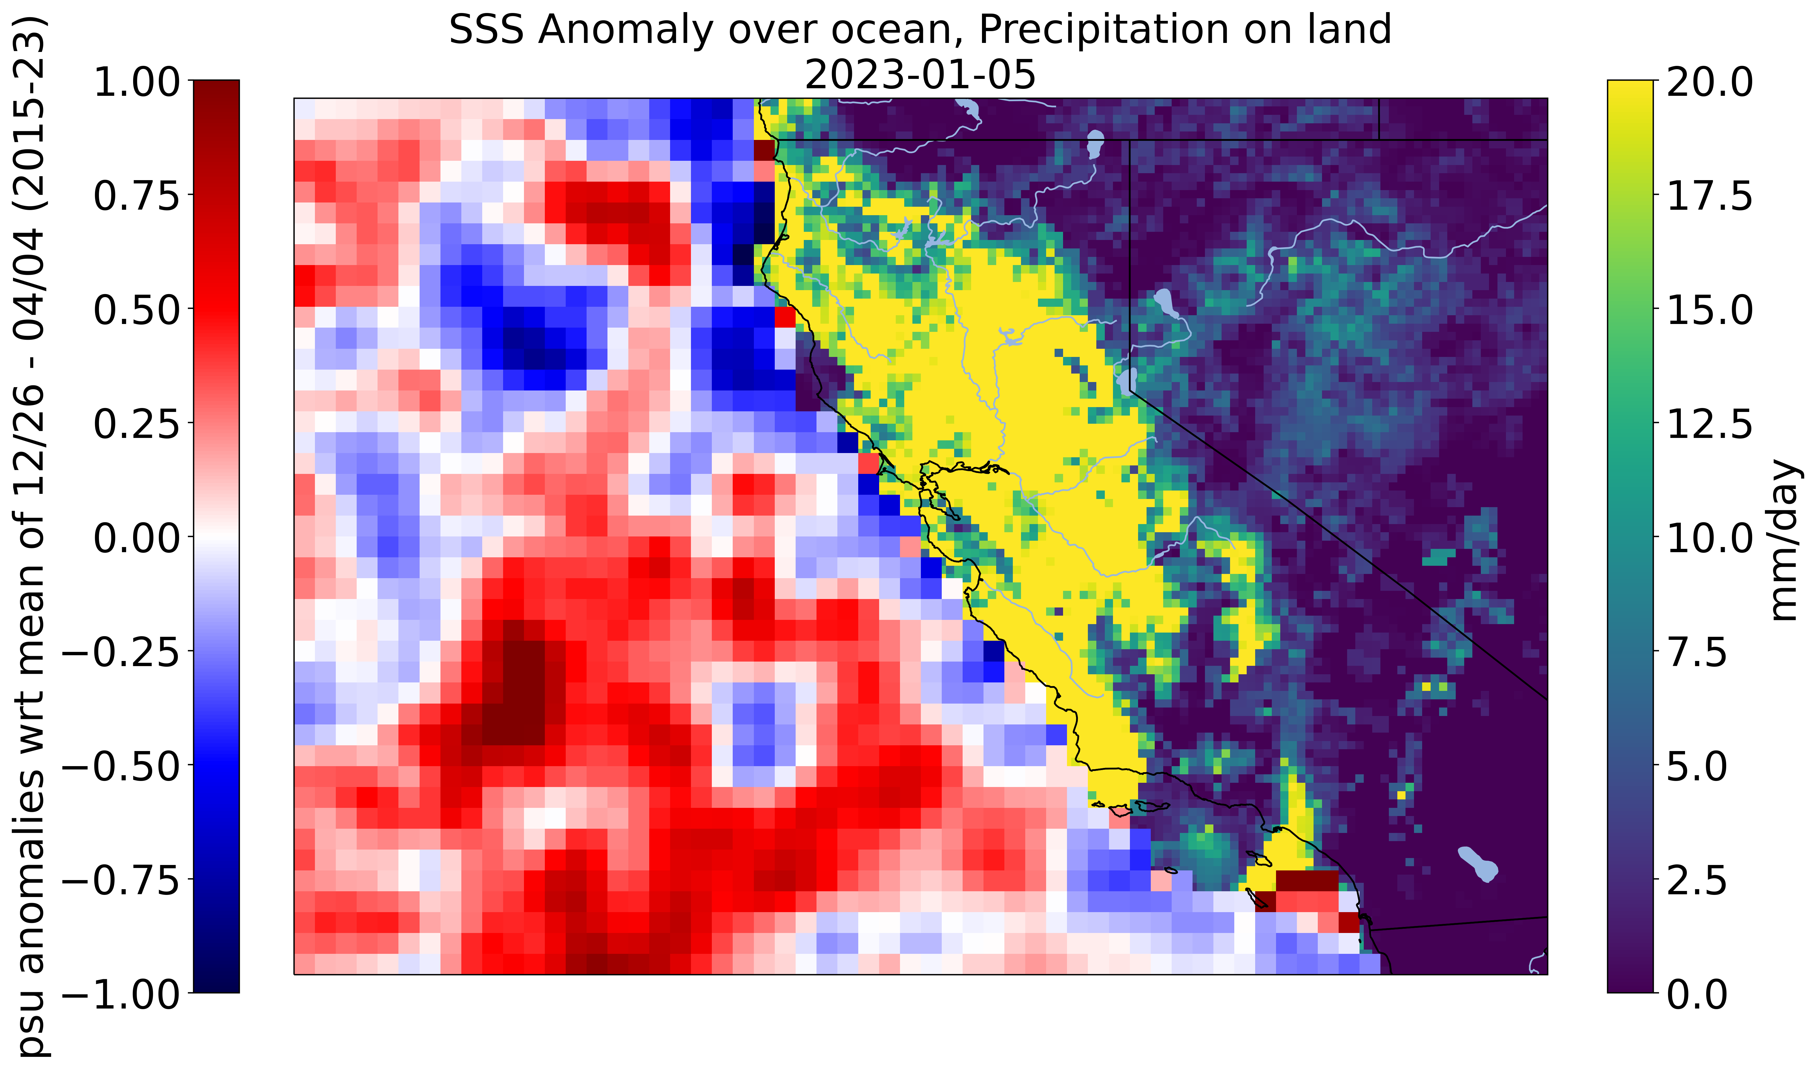
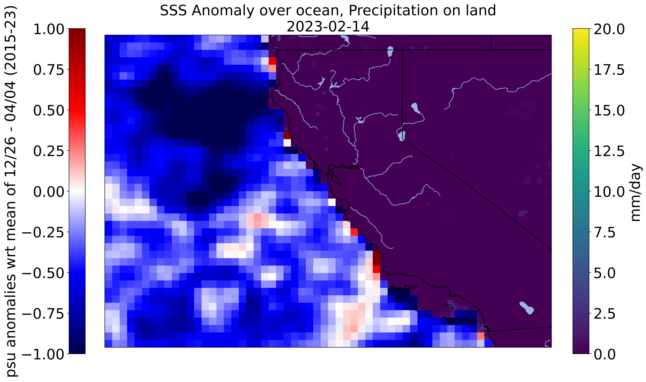
National Aeronautics and Space Administration
Postdoc Research
Revealing the Power of Atmospheric Rivers: Open Science Meets Satellite Observations
Author: Julie Sanchez, JPL Postdoctoral Fellow (329B)
Jinbo Wang (329B)
Background
In the winter of 2022 to 2023, twelve atmospheric rivers (ARs) hit the coast of California. ARs are long narrow bands of moisture in the atmosphere. These events caused major floods, loss of power, and closed many roads. The increased freshwater into the ocean from rivers, creeks, and streams can affect the ocean currents, stratification, sea level rise, and salinity. The Soil Moisture Active Passive (SMAP) satellite can be used to measure sea surface salinity and precipitation data from Integrated Multi-satellitE Retrievals (IMERG).
Source: NASA Earth Observatory
Objectives
The AR events provided the opportunity to observe the relationship between river runoff and ocean surface salinity in the coastal regions off California, all while considering how we can monitor them using satellite data. The overarching objective is to identify multi-mission synergy to study global water cycle while promoting open data and open science.
Approach and Results
The salinity anomaly is shown over the Pacific Ocean, where red is saltier than the mean and blue is fresher than the mean. Over land, precipitation is shown in millimeters per day, where yellow shows more precipitation. The result of the analysis shows a lead lag affect as the more precipitation occurs over land in a matter of days and even weeks the ocean becomes fresher. A tutorial was made to help users replicate these images which is published on the Physical Oceanography Distributed Active Archive Center (PO.DAAC) cookbook.
Significance of Results/Benefits to NASA/JPL
My research results not only highlight the significant relationship between heavy precipitation and ocean salinity but also reveal intriguing temporal trends that shed light on how this interaction may evolve in the coming decades, underscoring its relevance in the context of climate change and the potential implications for marine ecosystems.
Future Work
The effects of runoff resulting from intense land precipitation entering the ocean will be subjected to deeper investigation through the integration of river gauge data from key rivers along the California coastline and look into historical database to perform systematic analysis on regional water cycle in California region. Furthermore, in the coming years, we aim to achieve a more comprehensive understanding of the water balance by considering factors such as river discharge according to Surface Water Ocean Topography, variations in lake and river water levels in response to precipitation, and fluctuations in ocean salinity.
National Aeronautics and Space Administration
Jet Propulsion Laboratory
California Institute of Technology
Pasadena, California
www.nasa.gov
Clearance Number: CL#00-0000
Poster Number: PRD-E-034
Copyright 2023. All rights reserved.
Publications and Acknowledgements:
Data in Action: SMAP – Visualizing Ocean Salinity as Powerful Storms Wreak Havoc in California
Author Contact Information:
Julie.m.sanchez@jpl.nasa.gov

