Slide 1
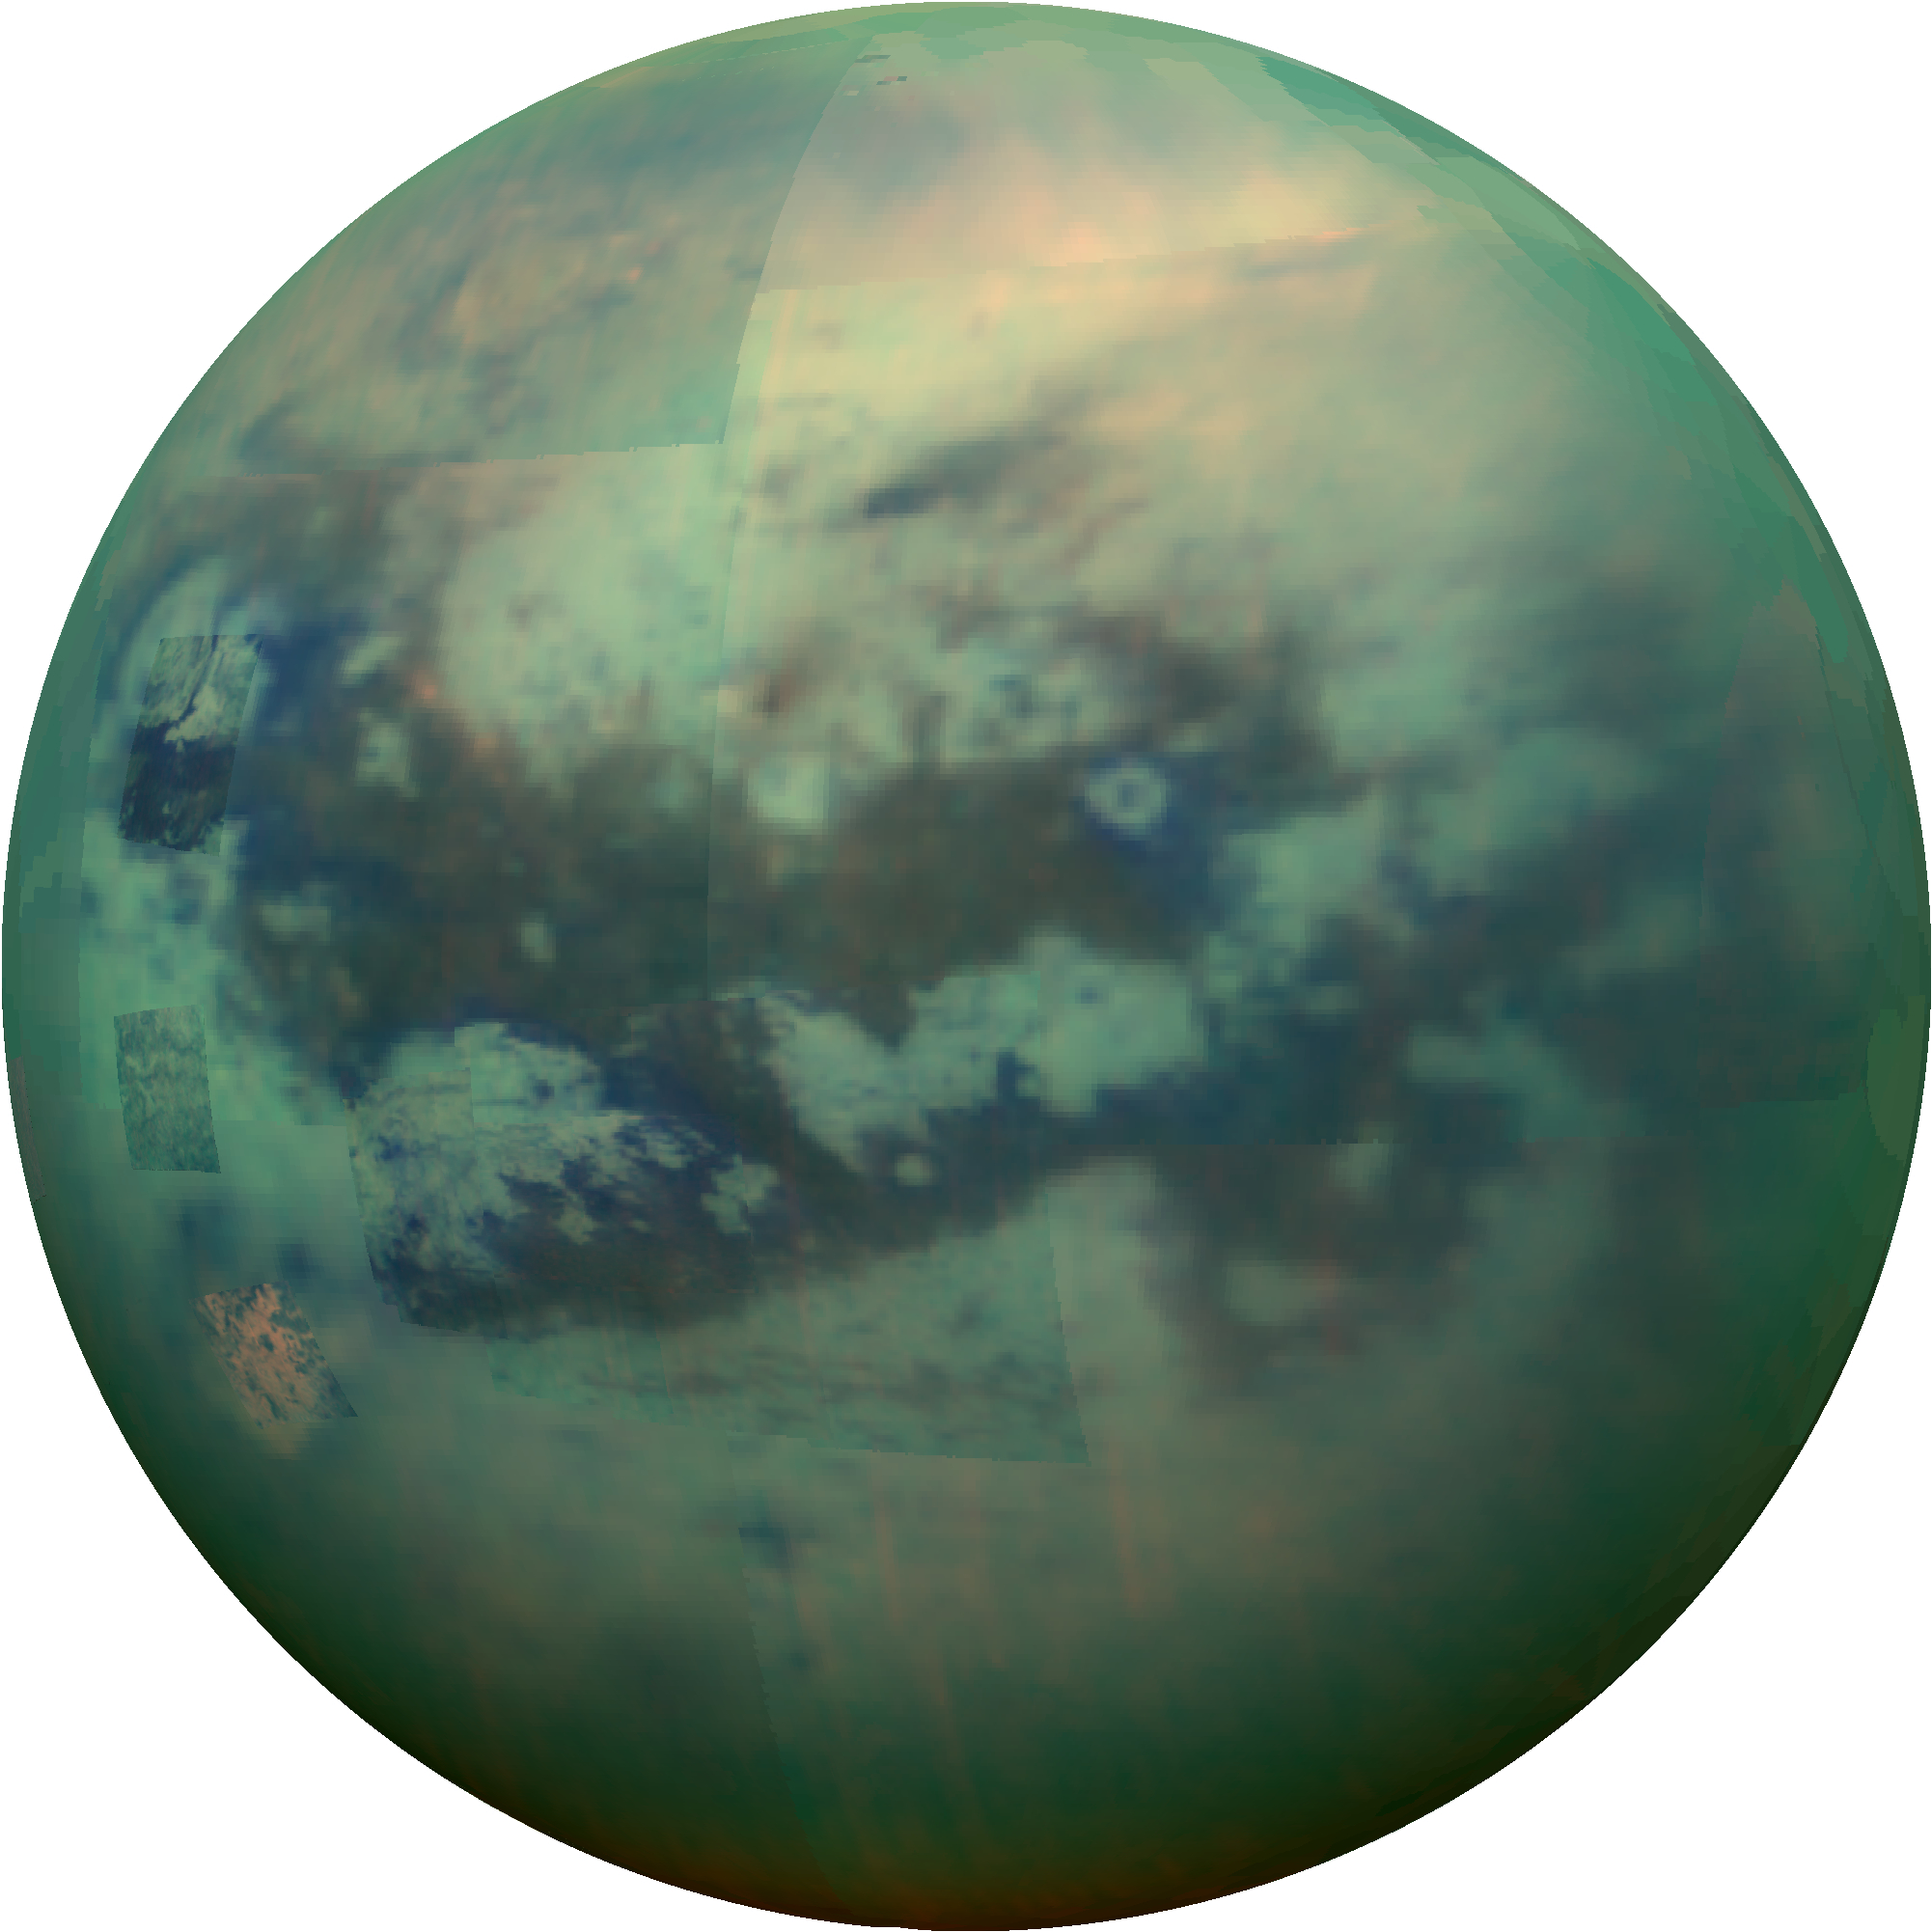
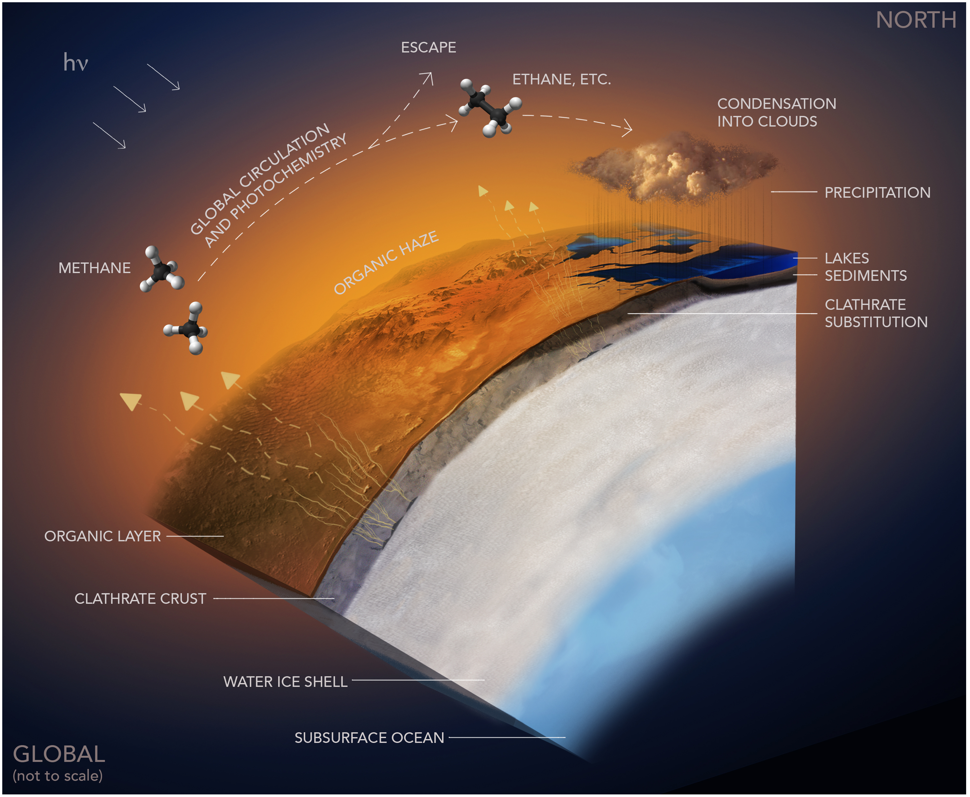
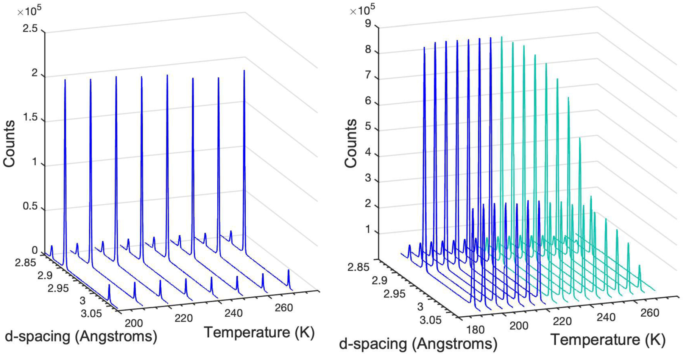
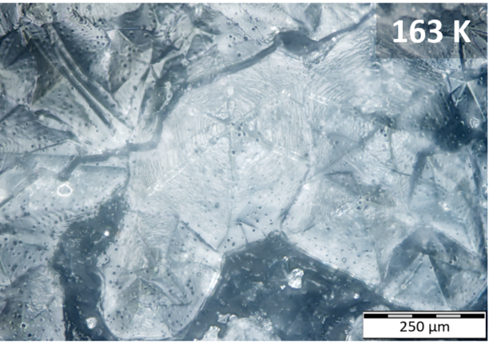
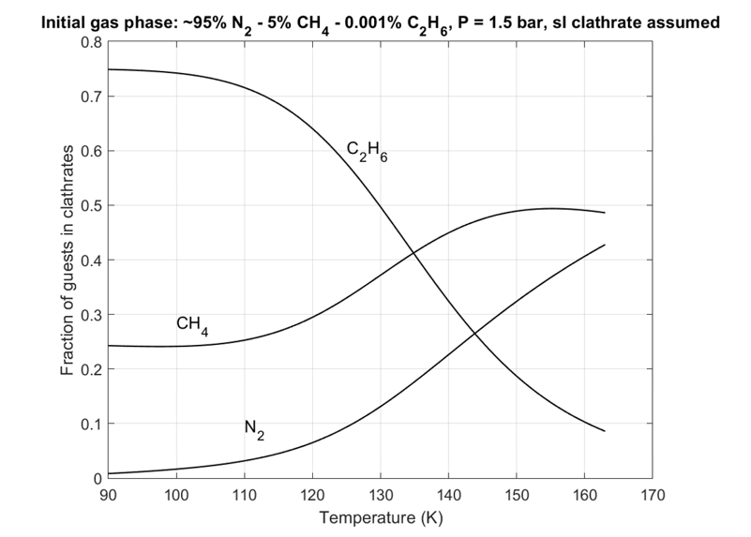
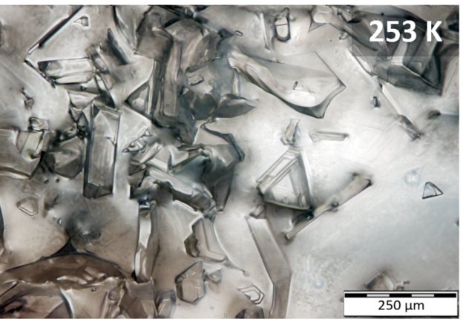
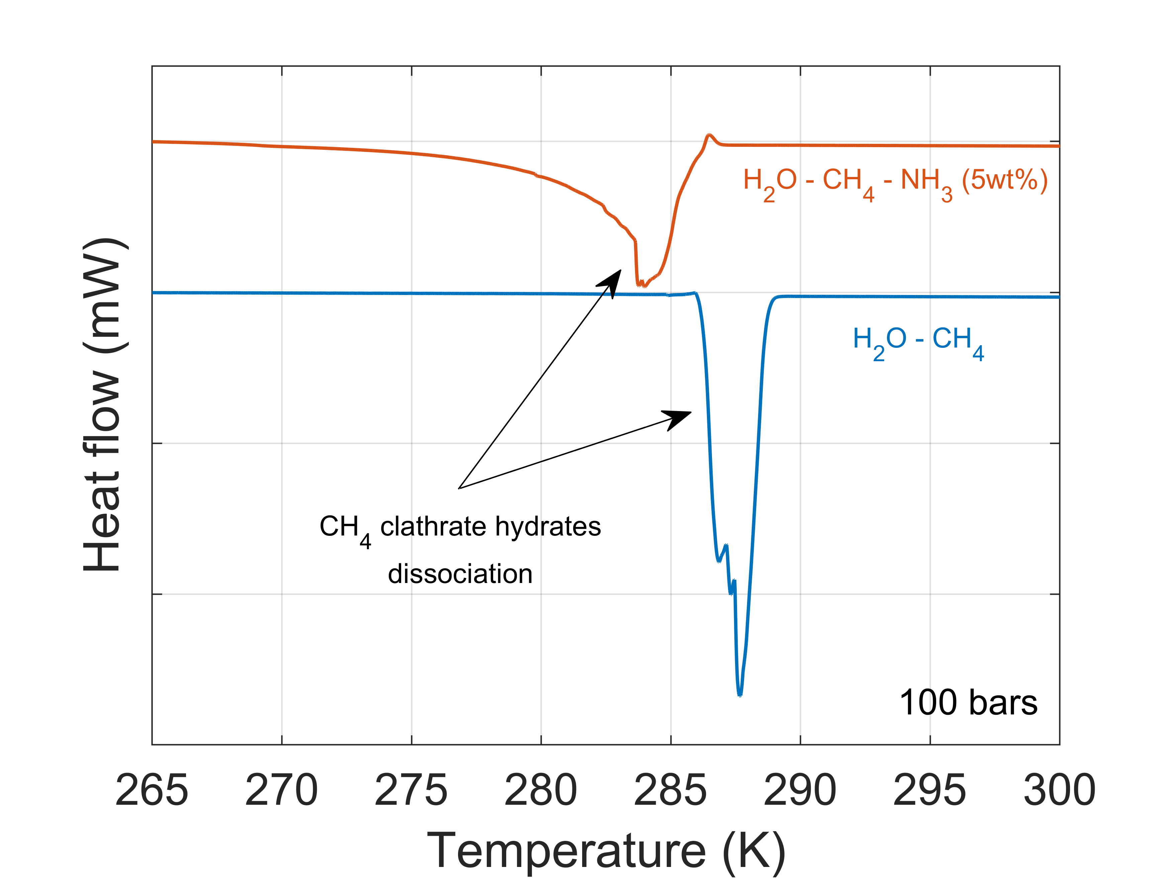
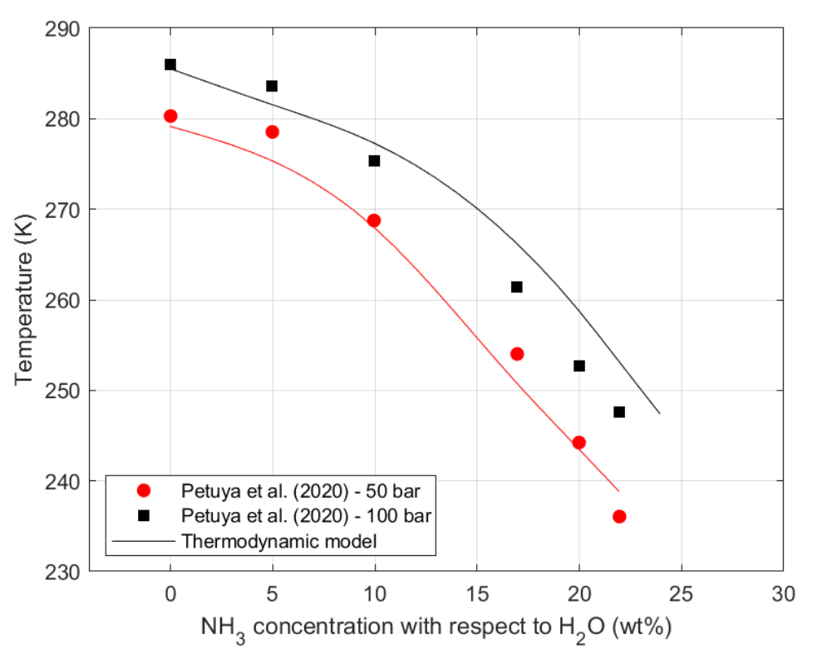
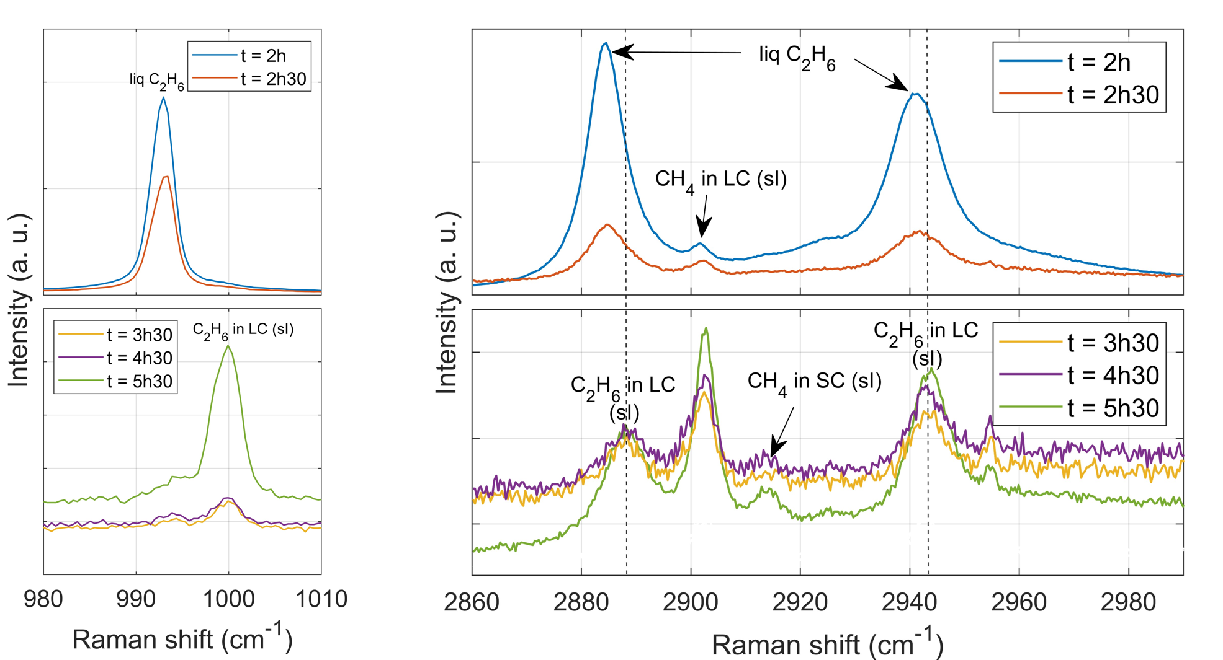
National Aeronautics and Space Administration
Postdoc Research
Methane outgassing from clathrate hydrates on Titan: Partial dissociation and substitution mechanisms
Elodie Gloesener, JPL Postdoctoral Fellow (3224)
Mathieu Choukroun (3224), Tuan H. Vu (3227), Helen E. Maynard-Casely (ANSTO), Ashley G. Davies (3223), Arnaud Desmedt (Université de Bordeaux), Christophe Sotin (Nantes Université)
Image credit: NASA/JPL/University of Arizona/University of Idaho
Background and objectives
On Titan, methane outgassing from clathrate hydrates has been proposed through:
Largescale thermal events (Tobie et al., 2006),
Slow release of methane from its clathrate cages by substitution with ethane (Choukroun & Sotin, 2012),
Potential involvement of ammonia–water cryovolcanism (Choukroun et al., 2010).
What role do clathrate hydrates play in atmospheric methane replenishment on Titan?
How interactions with ammonia affect clathrate stability?
What is the CH₄-C₂H₆ replacement kinetics in P-T conditions relevant to Titan?
Methods
Samples:
H₂O-THF-NH₃ (11 and 13 wt% NH₃).
H₂O-CH₄-NH₃ (5 wt% NH₃).
Liquid C₂H₆ deposited on top of methane clathrates.
Experimental techniques:
Raman spectroscopy.
Differential scanning calorimetry.
(Synchrotron) cryogenic X-ray diffraction (XRD).
Thermodynamic model:
Van der Waals and Platteeuw model.
Margules equation (Choukroun and Grasset, 2010) to evaluate the activity coefficient of water.
Figure 1: Titan’s hydrocarbon cycle.
Partial dissociation
Results
Methane – ethane substitution
At thermodynamic equilibrium, sI clathrates formed in Titan’s surface conditions contain ~ 75% of C₂H₆.
The experimental results show that ethane clathrate hydrates can form from the reaction of liquid ethane with methane clathrates and ice.
Figure 2: Synchrotron XRD data collected at various temperatures for the H₂O-THF (left) and H₂O-THF-NH₃ (11 wt% NH₃ - right) systems (λ = 1.0005 Å) (Gloesener et al, 2023).
Figure 5: Relative abundance of the different guests in ternary N₂-CH₄-C₂H₆ clathrates of structure I at 1.5 bar and as a function of the formation temperature.
Figure 3: Microscope images at 20x magnification for THF clathrate in a 13 wt% (with respect to water) solution of NH_{3.}
The partial dissociation of THF and CH₄ clathrates in aqueous solutions of ammonia is observed in our experiments.
Our simulated dissociation temperatures for CH₄ clathrates decrease with ammonia concentration, in agreement with experimental data.
Figure 6: Raman spectra of the mixed C₂H₆-CH₄ clathrates acquired over time after exposure of CH₄ clathrates to liquid ethane at 173 K.
Figure 4: Heating thermogram of CH₄ clathrate hydrates obtained by the multicycle method at 100 bars and 0.1 K/min (left) and dissociation temperature of methane clathrate hydrate in the presence of ammonia simulated with our model and comparison with experimental equilibrium data at 50 and 100 bar (Petuya et al., 2020) (right).
.
Conclusions and future work
The partial dissociation of methane clathrates in Titan’s upper icy shell may start at temperatures as low as 200 K.
Additional experimental data for the ternary H₂O-NH₃-CH₄ system will be acquired and Margules coefficients will be updated from THF and CH₄ data, respectively.
Liquid ethane can be trapped in Titan’s subsurface and our experimental results support the model that methane could be released as ethane replaces it in clathrate hydrates.
Reaction rate constants and activation energy will be derived and the influence of the grain size distribution on the replacement kinetics will be investigated.
National Aeronautics and Space Administration
Jet Propulsion Laboratory
California Institute of Technology
Pasadena, California
www.nasa.gov
Publication:
Gloesener, E., Choukroun, M., Vu, T. H., Maynard-Casely, H. E., Desmedt, A., Davies, A. G., and Sotin, C., 2023. Phase behavior of the ternary H₂O-THF-NH₃ system under cryogenic conditions: Implications for the destabilization of clathrate hydrates on Titan, ACS Earth Space Chem. 7(5), 1162-1171.
References: ○ Choukroun and Grasset, 2010. J. Chem. Phys. 133, 144502 ○ Choukroun et al., 2010. Icarus 205, 581-593.
○ Choukroun and Sotin, 2012. Geophys. Res. Lett. 39, L04201. ○ Tobie et al., 2006. Nature 440, 61-64. ○ Van der Waals and Platteeuw, 1959. Adv. Chem. Phys. 2, 1-57 ○ Vu et al., 2020. Geophys. Res. Lett. 47, e2019GL086265.
Author Contact Information: elodie.d.gloesener@jpl.nasa.gov
(626) 298-3037
Clearance Number: CL#00-0000
Poster Number: PRD-P-003
Copyright 2023. All rights reserved.

