Slide 1
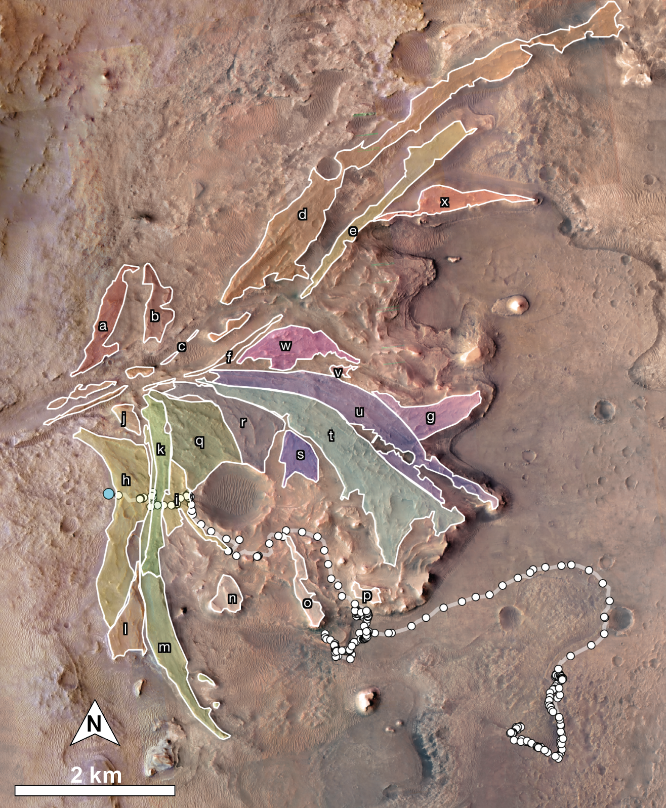
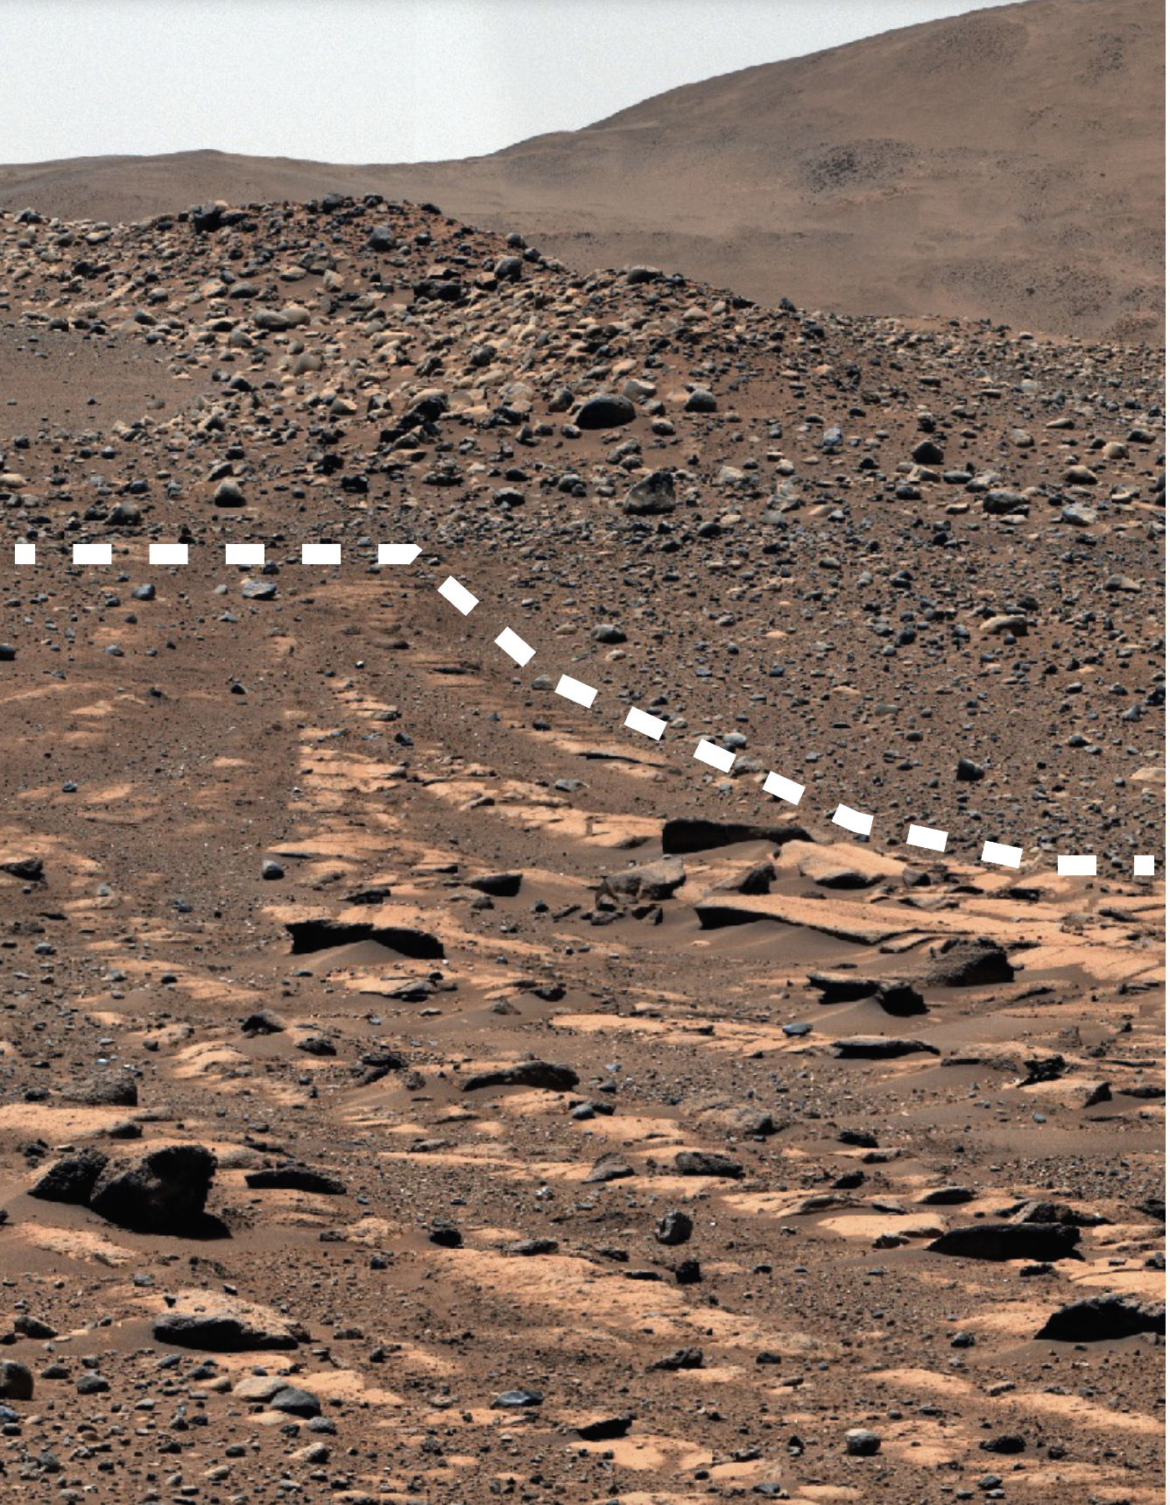
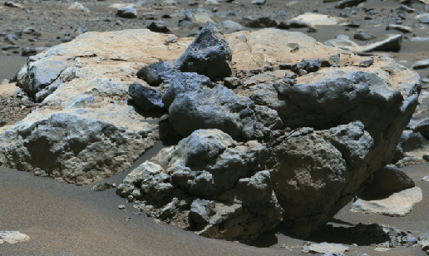
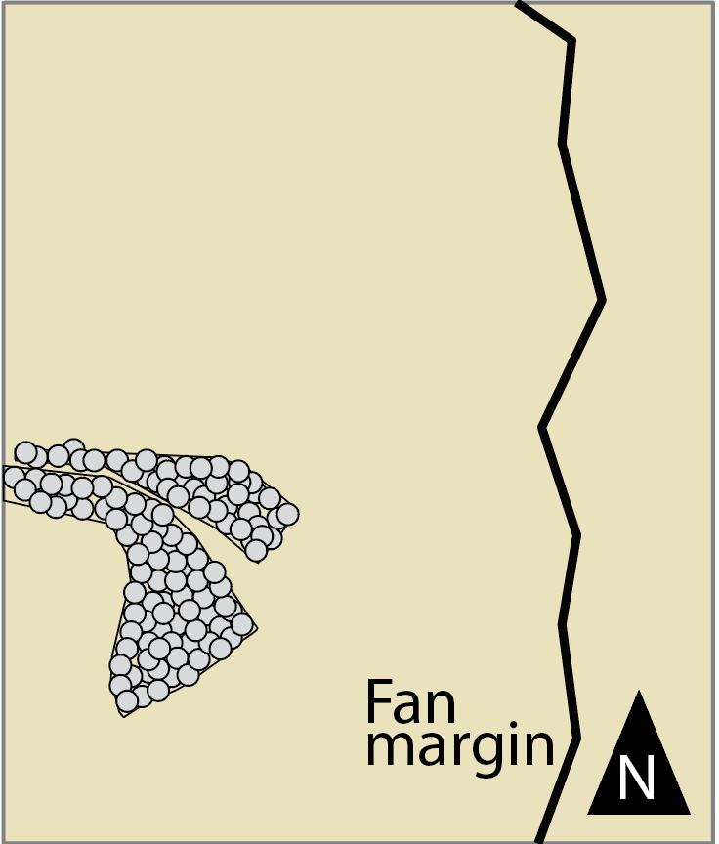
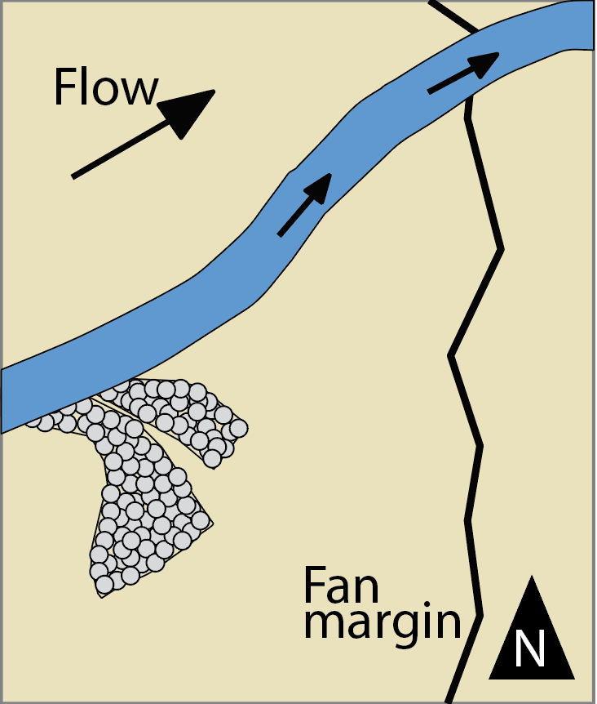
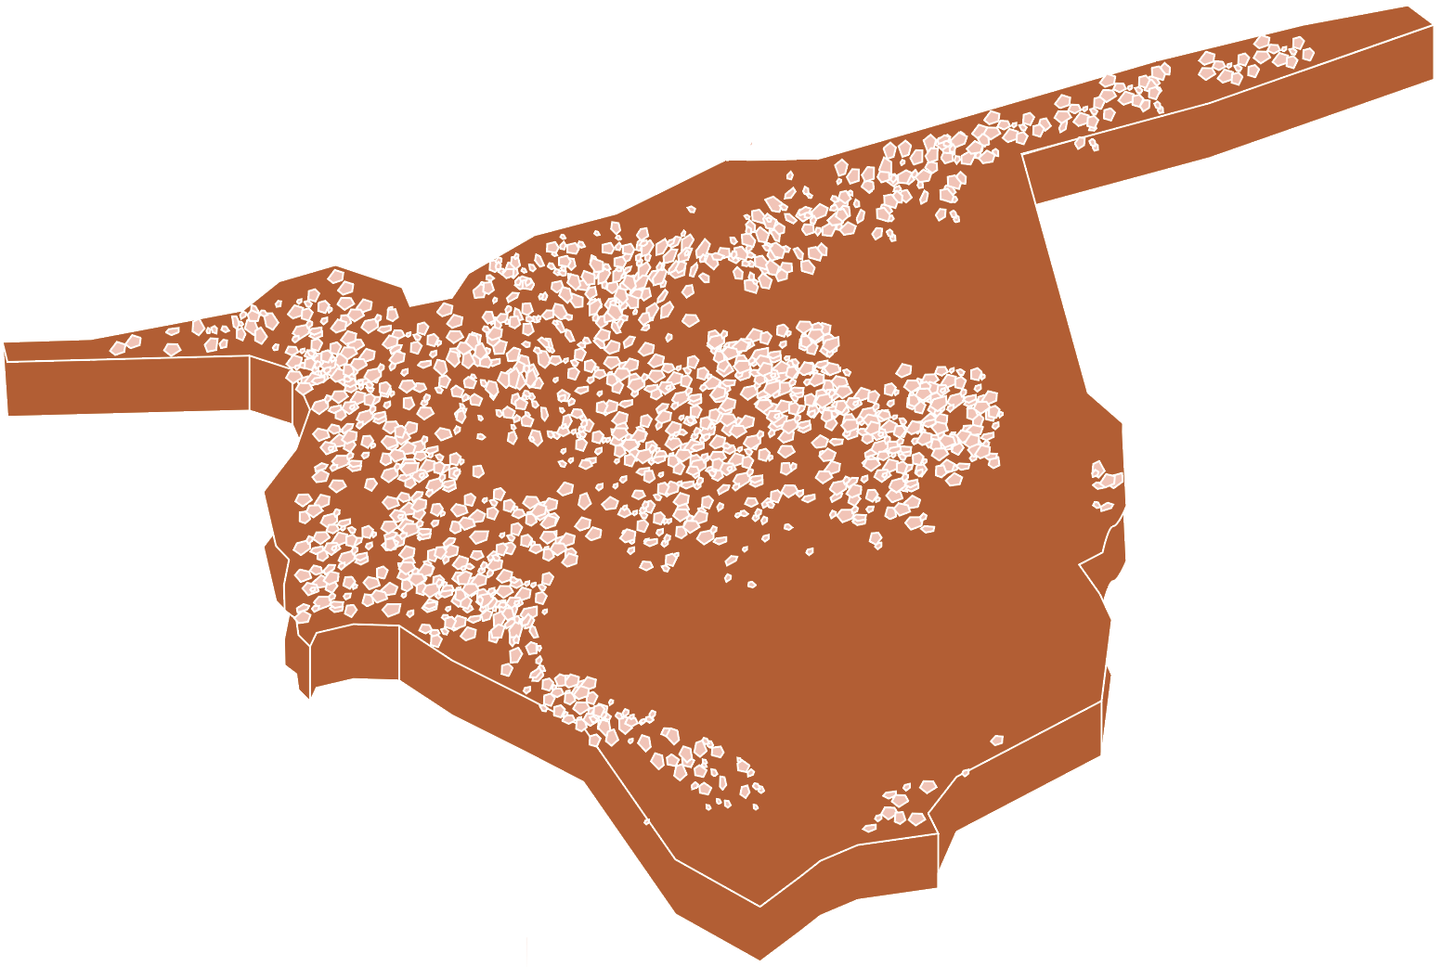
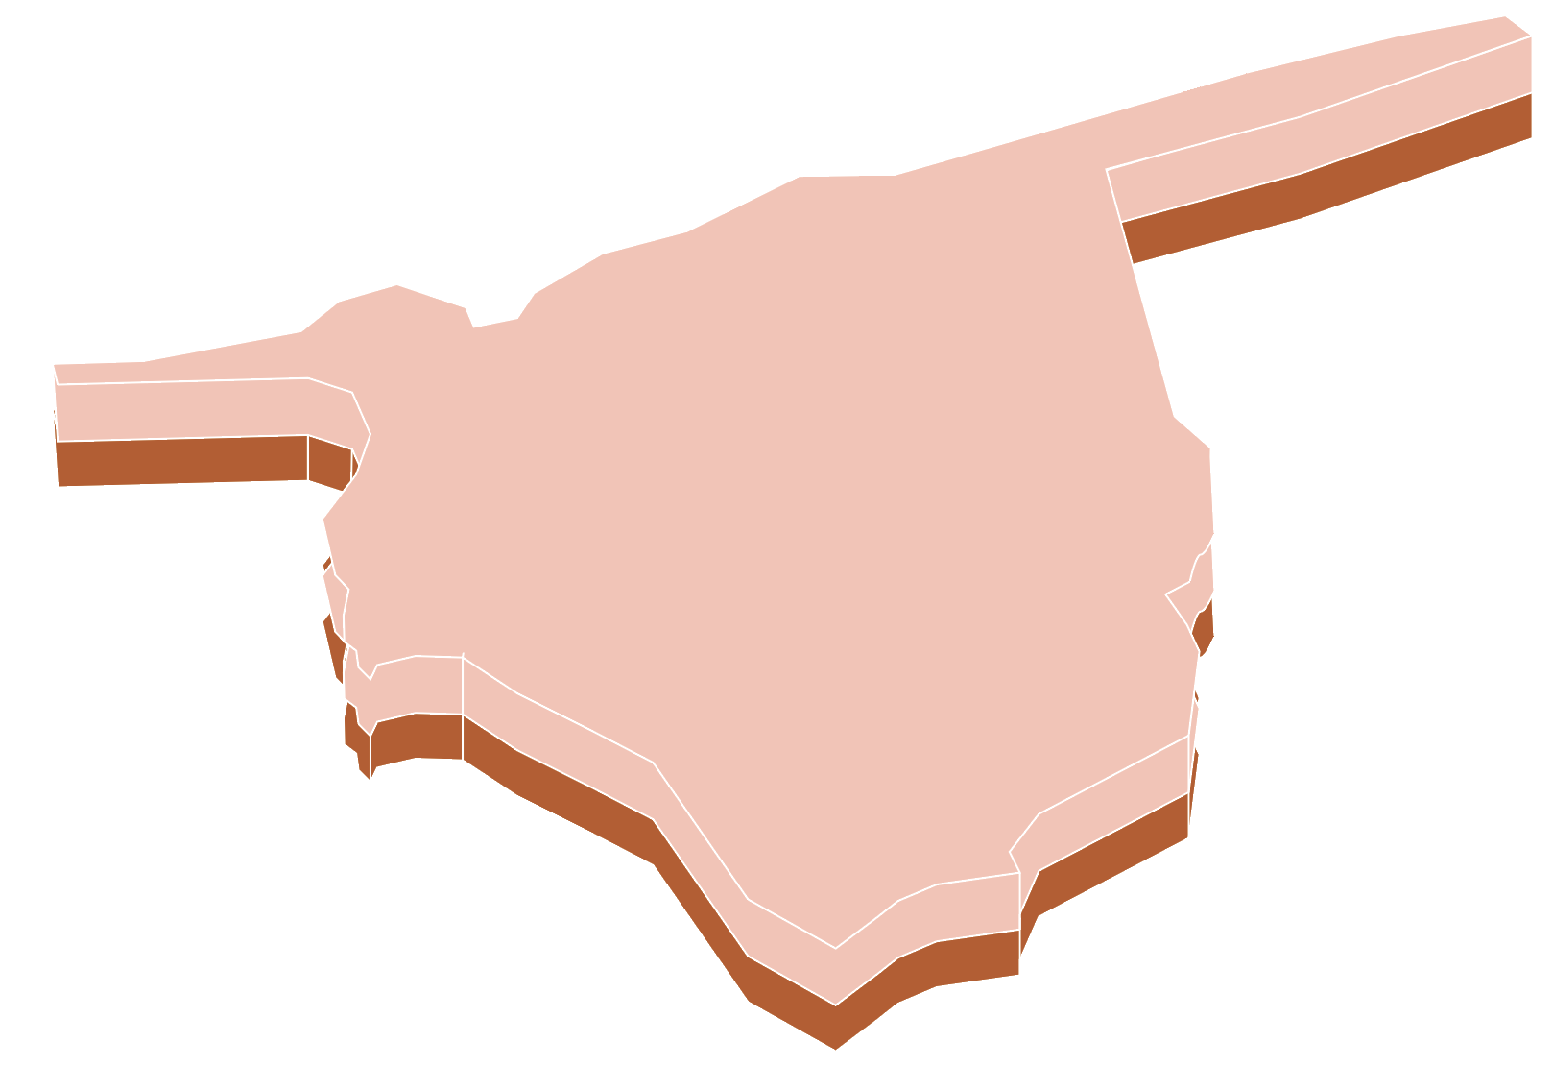
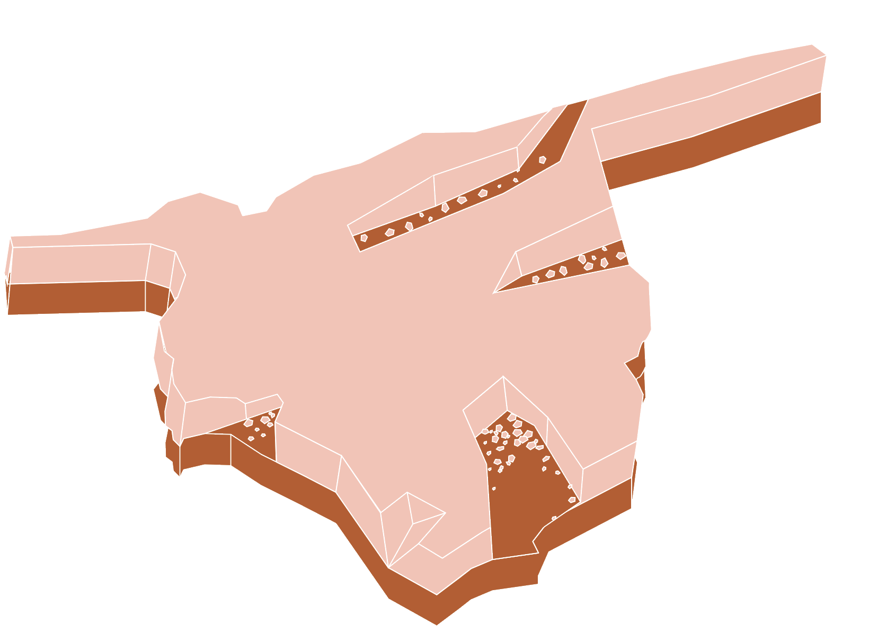
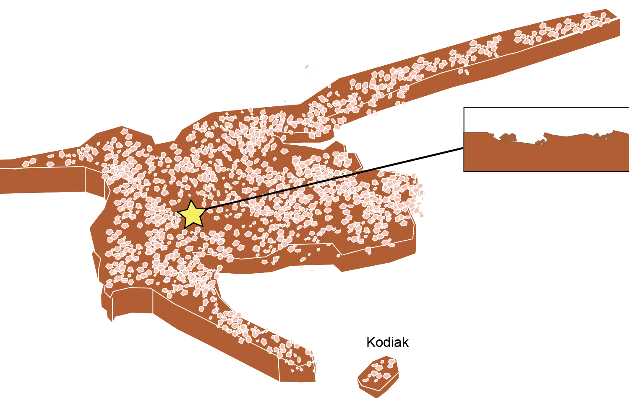
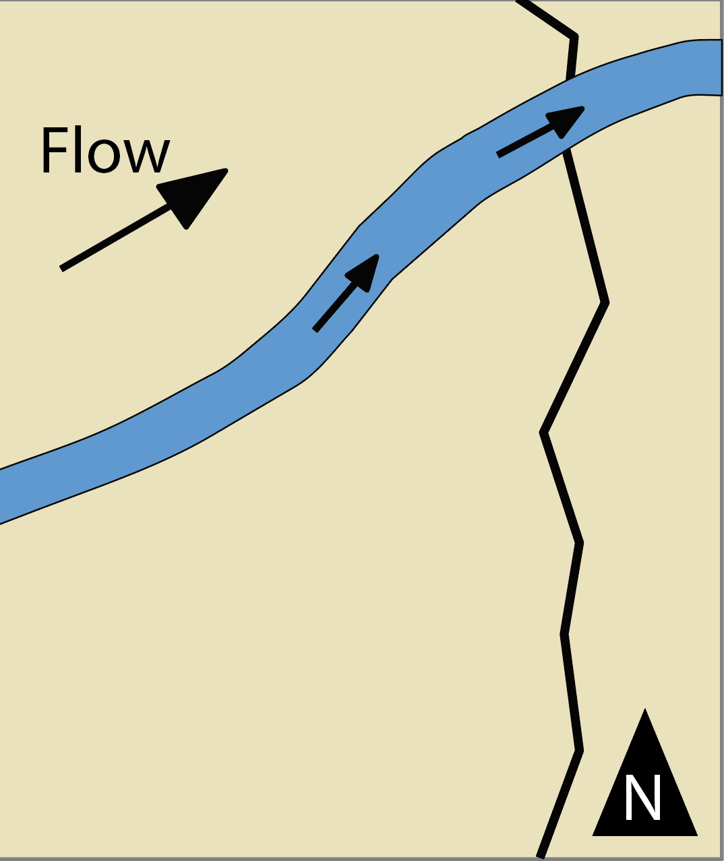
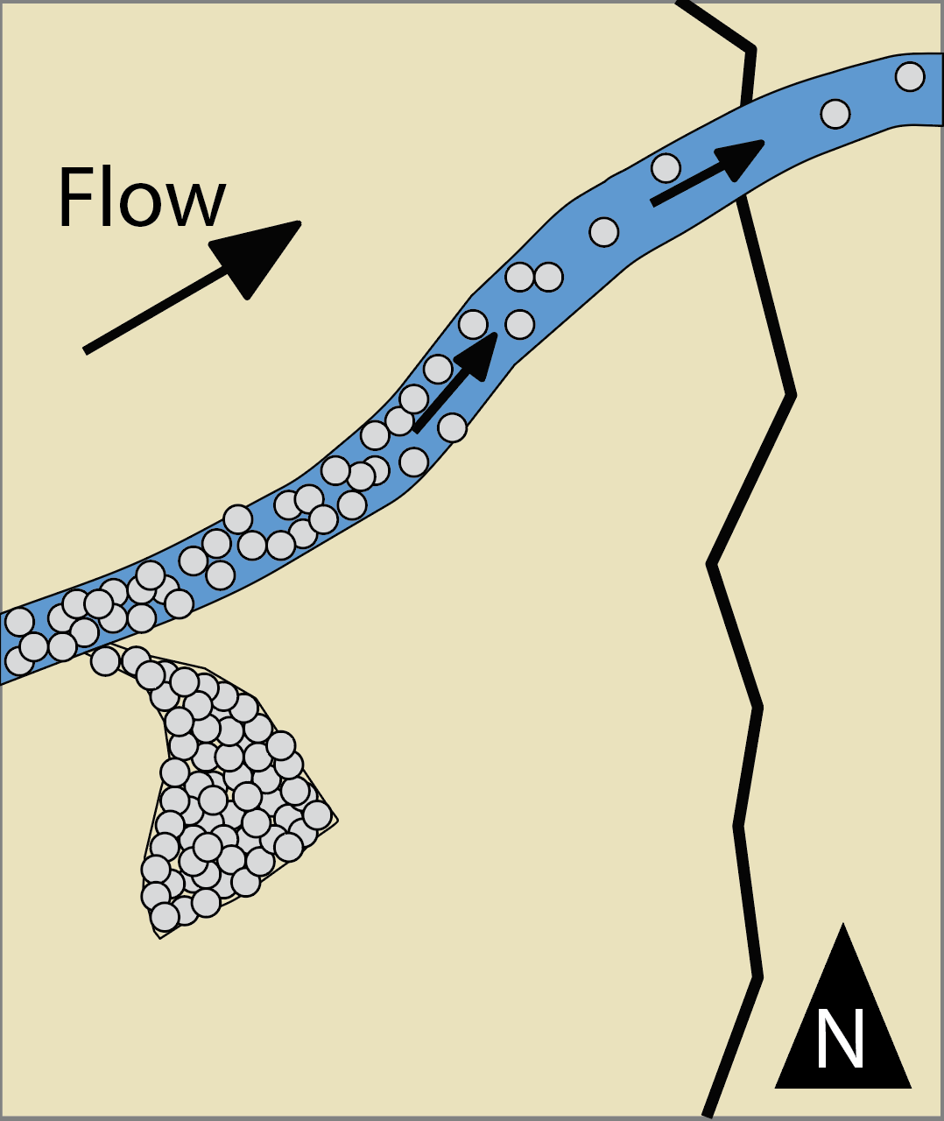
National Aeronautics and Space Administration
Postdoc Research
Depositional models for the blocky unit at Jezero crater, Mars
Author: Samantha Gwizd, JPL Postdoctoral Fellow (322)
Katie Stack Morgan (322), Nathan Williams (398), M2020 science team
Background
Jezero crater was chosen as the landing site for the Mars 2020 Perseverance rover mission to search for evidence of life and acquire a cache of samples for eventual return to Earth [1]. The “blocky” unit is the youngest orbitally defined and mapped unit of Jezero crater’s western fan. This unit, characterized by its high density of boulder-sized clasts associated with topographic ridges, can be subdivided into individual fan- and lobate-shaped deposits that are placed into a stratigraphic framework based on cross-cutting relationships [Fig. 1; 2 & 3]. The Mars 2020 Perseverance rover encountered exposures of the blocky unit beginning on Sol 755.
Neretva Vallis channel ext
Objectives
This work aims to establish the sedimentology and stratigraphy of blocky unit deposits observed along the rover traverse to determine the depositional history of the fan’s youngest unit and discuss the implications for the evolution of Jezero crater.
Present
Belva
crater
Approach
Characterize boulder sizes and morphologies using Mastcam-Z and Ingenuity-acquired images
Compare boulder characteristics between mapped deposits encountered along the Perseverance rover traverse [Fig. 1]
Use observations to model possible depositional processes.
Landing
Sedimentology and stratigraphy
Fig. 4. Secondary population of more angular pyroxene-bearing boulders.
Fig. 1. Mapped deposits of the Jezero fan
Key observations
Rover and heli views do not show a clear relationship between blocky boulders and underlying strata [Fig. 2].
We identified multiple boulder populations [Figs. 3-5], including boulder-sized clasts that appear to erode out of underlying stratigraphic units.
Boulders do not constitute the majority of ridge-forming material, but mantle the underlying lithologies.
50 cm
50 cm
5 m
20 cm
Fig. 2. Rover views show that boulders are unlithified and mantle underlying strata.
Fig. 3. The most abundant boulder population is characterized as sub- to well-rounded and olivine-bearing.
Fig. 5. Secondary population of boulder-sized clasts eroding out of underlying units.
Fig. 6
Alluvial fan
Depositional models
Erosional lag
1.
2.
Fig. 8
3.
Flow
Lobes form [Fig. 6.1] and are subsequently cross-cut by the Neretva Vallis channel extension [Fig. 6.2].
1.
Channel ext.
Neretva
Fan
Boulder strat.
Main fan margin
Lower strat.
Fig. 7
Crevasse splay
2.
4.
1.
2.
Neretva Vallis extension incises into underlying strata [Fig. 7.1]. Then, conditions become more energetic, enabling transport of boulders and formation of crevasse splays [Fig. 7.2].
Flow
Flow
Kodiak butte
Neretva channel
ext.
Additional layer(s) are deposited on underlying fan strata [Fig. 8.1]
Upper layer(s) begin to erode to boulder-sized clasts [Fig. 8.2-8.3]
Boulders act to preserve underlying strata, which also erode a population of boulder-sized clasts [Fig. 8.4].
National Aeronautics
and Space Administration
Jet Propulsion Laboratory
California Institute of Technology
Pasadena, California
www.nasa.gov
Significance: The blocky unit represents the possible youngest preserved unit on the Jezero fan, so understanding the processes responsible for boulder formation will inform the hydrologic evolution of Jezero crater.
Publications and Acknowledgements:
Mastcam-Z images: JPL/Caltech/MSSS; Ingenuity images: JPL/Caltech
Thank you to the Mars 2020 science and engineering teams for their continuous efforts.
This work will be presented at the Fall 2023 AGU meeting [Gwizd et al., 2023]
In-text citations: [1] Farley et al., 2020 [2] Stack et al., 2020 [3] Kronyak et al., 2023
Clearance Number: CL#00-0000
Poster Number: PRD-P-004
Copyright 2023. All rights reserved.
Author Contact Information:
626-630-2362 samantha.j.gwizd@jpl.nasa.gov

