Slide 1
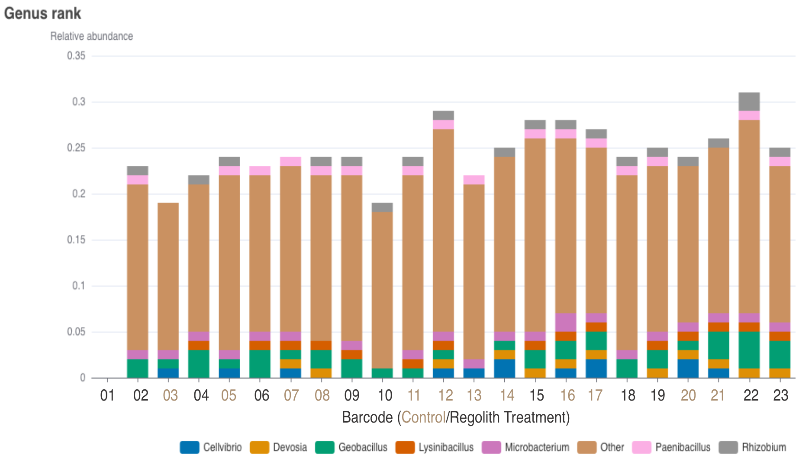
National Aeronautics and Space Administration
Postdoc Research
Microbiome development in and response to lunar regolith simulants
Author: Laura Fackrell: NASA Postdoctoral Fellow (353N)
Kasthuri J Venkateswaran (353N), Nitin K Singh (353N), Jack Dempsey (353N), and Rohil Dhaliwal (353N)
Background and Objectives
Results and Significance
Crewed missions beyond low Earth orbit present a unique and complex set of challenges for planetary protection. There has been significant effort to detect and identify microorganisms that occur on spacecraft surfaces to understand their potential to survive extraterrestrial and clean room conditions. Much of this work focuses on organisms that occur incidentally or inevitably on spacecraft surfaces [1]. Just as essential are microorganisms intentionally introduced as living components to life support systems and other bioreactor technologies. Microorganisms may play important roles in the function of life support technology and behavior of biogeochemical cycles (C, N, O, P, etc.) within these closed systems. Growing plants on the moon requires multiple resources and produces significant waste in which nutrients are lost. To help amend this gap, recycling the waste to recover nutrients turns waste into a resource [2]. In this poster, we present the initial results for project OHSNAP (Off-world Habitat Sustainable Nitrogen recovery for Agriculture Project) examining the development of microbiomes within regolith simulant / plant waste materials applicable to simulated lunar agricultural systems.
Figure 1: Taxonomic Distribution of Genus found in each sample for the vermicomposting stage.
The starting materials were autoclaved and pasteurized which resulted in very low abundance of microorganisms when decomposition began. This particular run did not include inoculants, but represented the microbiome that would naturally develop. Both decomposition stages (fermentation and vermicomposting) the biomass increased and the resulting communities were overall similar between control and treatment with regolith with the exception of the genus Cellvibrio which was only detected in control samples. The majority of identified species are related to common soil microorganisms including plant relevant species.
Approach
In OHSNAP, inedible plant waste (wheat straw) and lunar regolith simulant (Exolith LHS-1) are combined and decomposed into a growing medium [3]. Plant growth experiments using Pisum sativum var snowbird (snow peas) test the response of a legume to the growing medium. Microbial inoculants are added at various stages to help enhance decomposition or plant growth. The Microbiome was sampled at each stage. DNA was extracted using a Qiagen PowerSoil Pro kit and sequenced with Oxford Nanopore MinION Rabid Barcoding Kit.
Future Work
The next steps of this work are to test additional inoculants of microorganisms isolated from the International Space Station (ISS) relevant to decomposition or plant growth. Replications of the previous trials will also be completed to verify results.
References: ¹Smith, et al. (2017), Astrobiology (17), 253-265; ²Clauwaert, et al. (2017), Prog. Aerosp. Sci. (91), 87-98; ³Gros, et al. (2005), Adv. Sp. Res. (36), 1312-1318.
National Aeronautics and Space Administration
Jet Propulsion Laboratory
California Institute of Technology
Pasadena, California
www.nasa.gov
Publications and Acknowledgements:
Fackrell, L.E., et al, 2023, A protocol for nanopore sequencing the microbial communities of regolith simulants and simulant-based materials, ASGSR 2023 Conference Poster
Fackrell, L.E. et al, 2023, Nanopore Sequencing for Characterizing the Microbial Communities in Regolith Simulant-Based Soil-Like Substrates, LSPC 2023 Conference Poster
Fackrell, L.E. , 2024 expected, Constructing regolith-based soil-like substrates in off-world agricultural systems: in preparation for submission to Life Sciences in Space Research
Author Contact Information:
(913-307-6510 and laura.e.fackrell@jpl.nasa.gov)
Clearance Number: CL#00-0000
Poster Number: PRD-P-010
Copyright 2023. All rights reserved.

