Slide 1
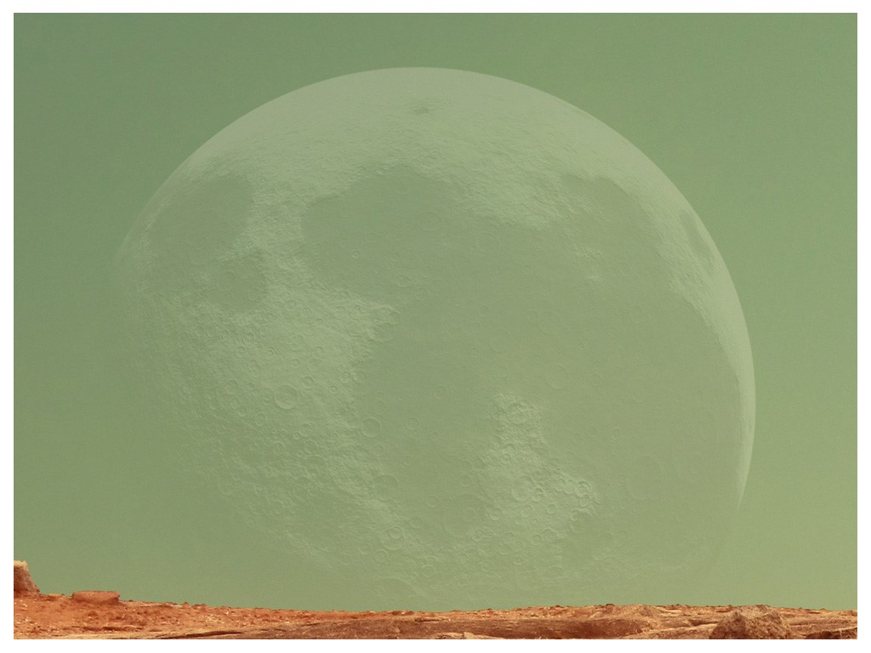
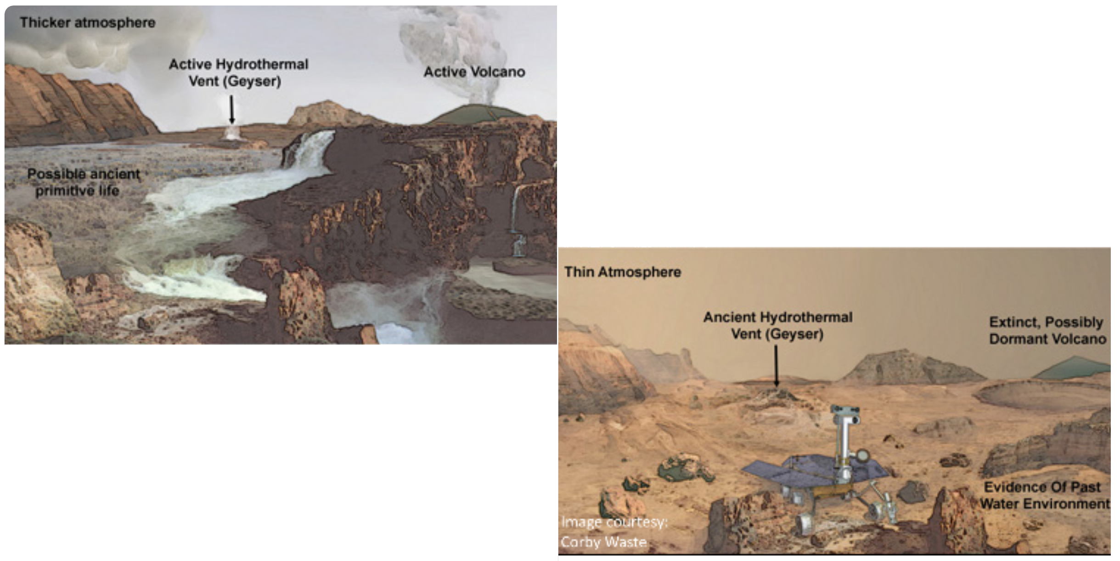
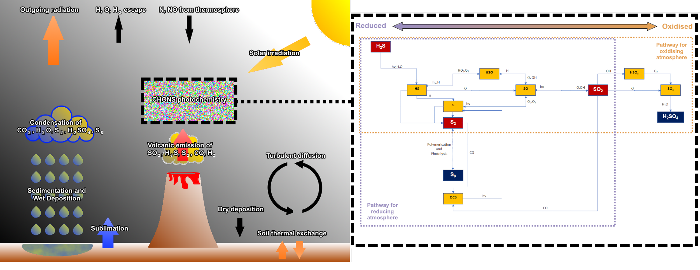
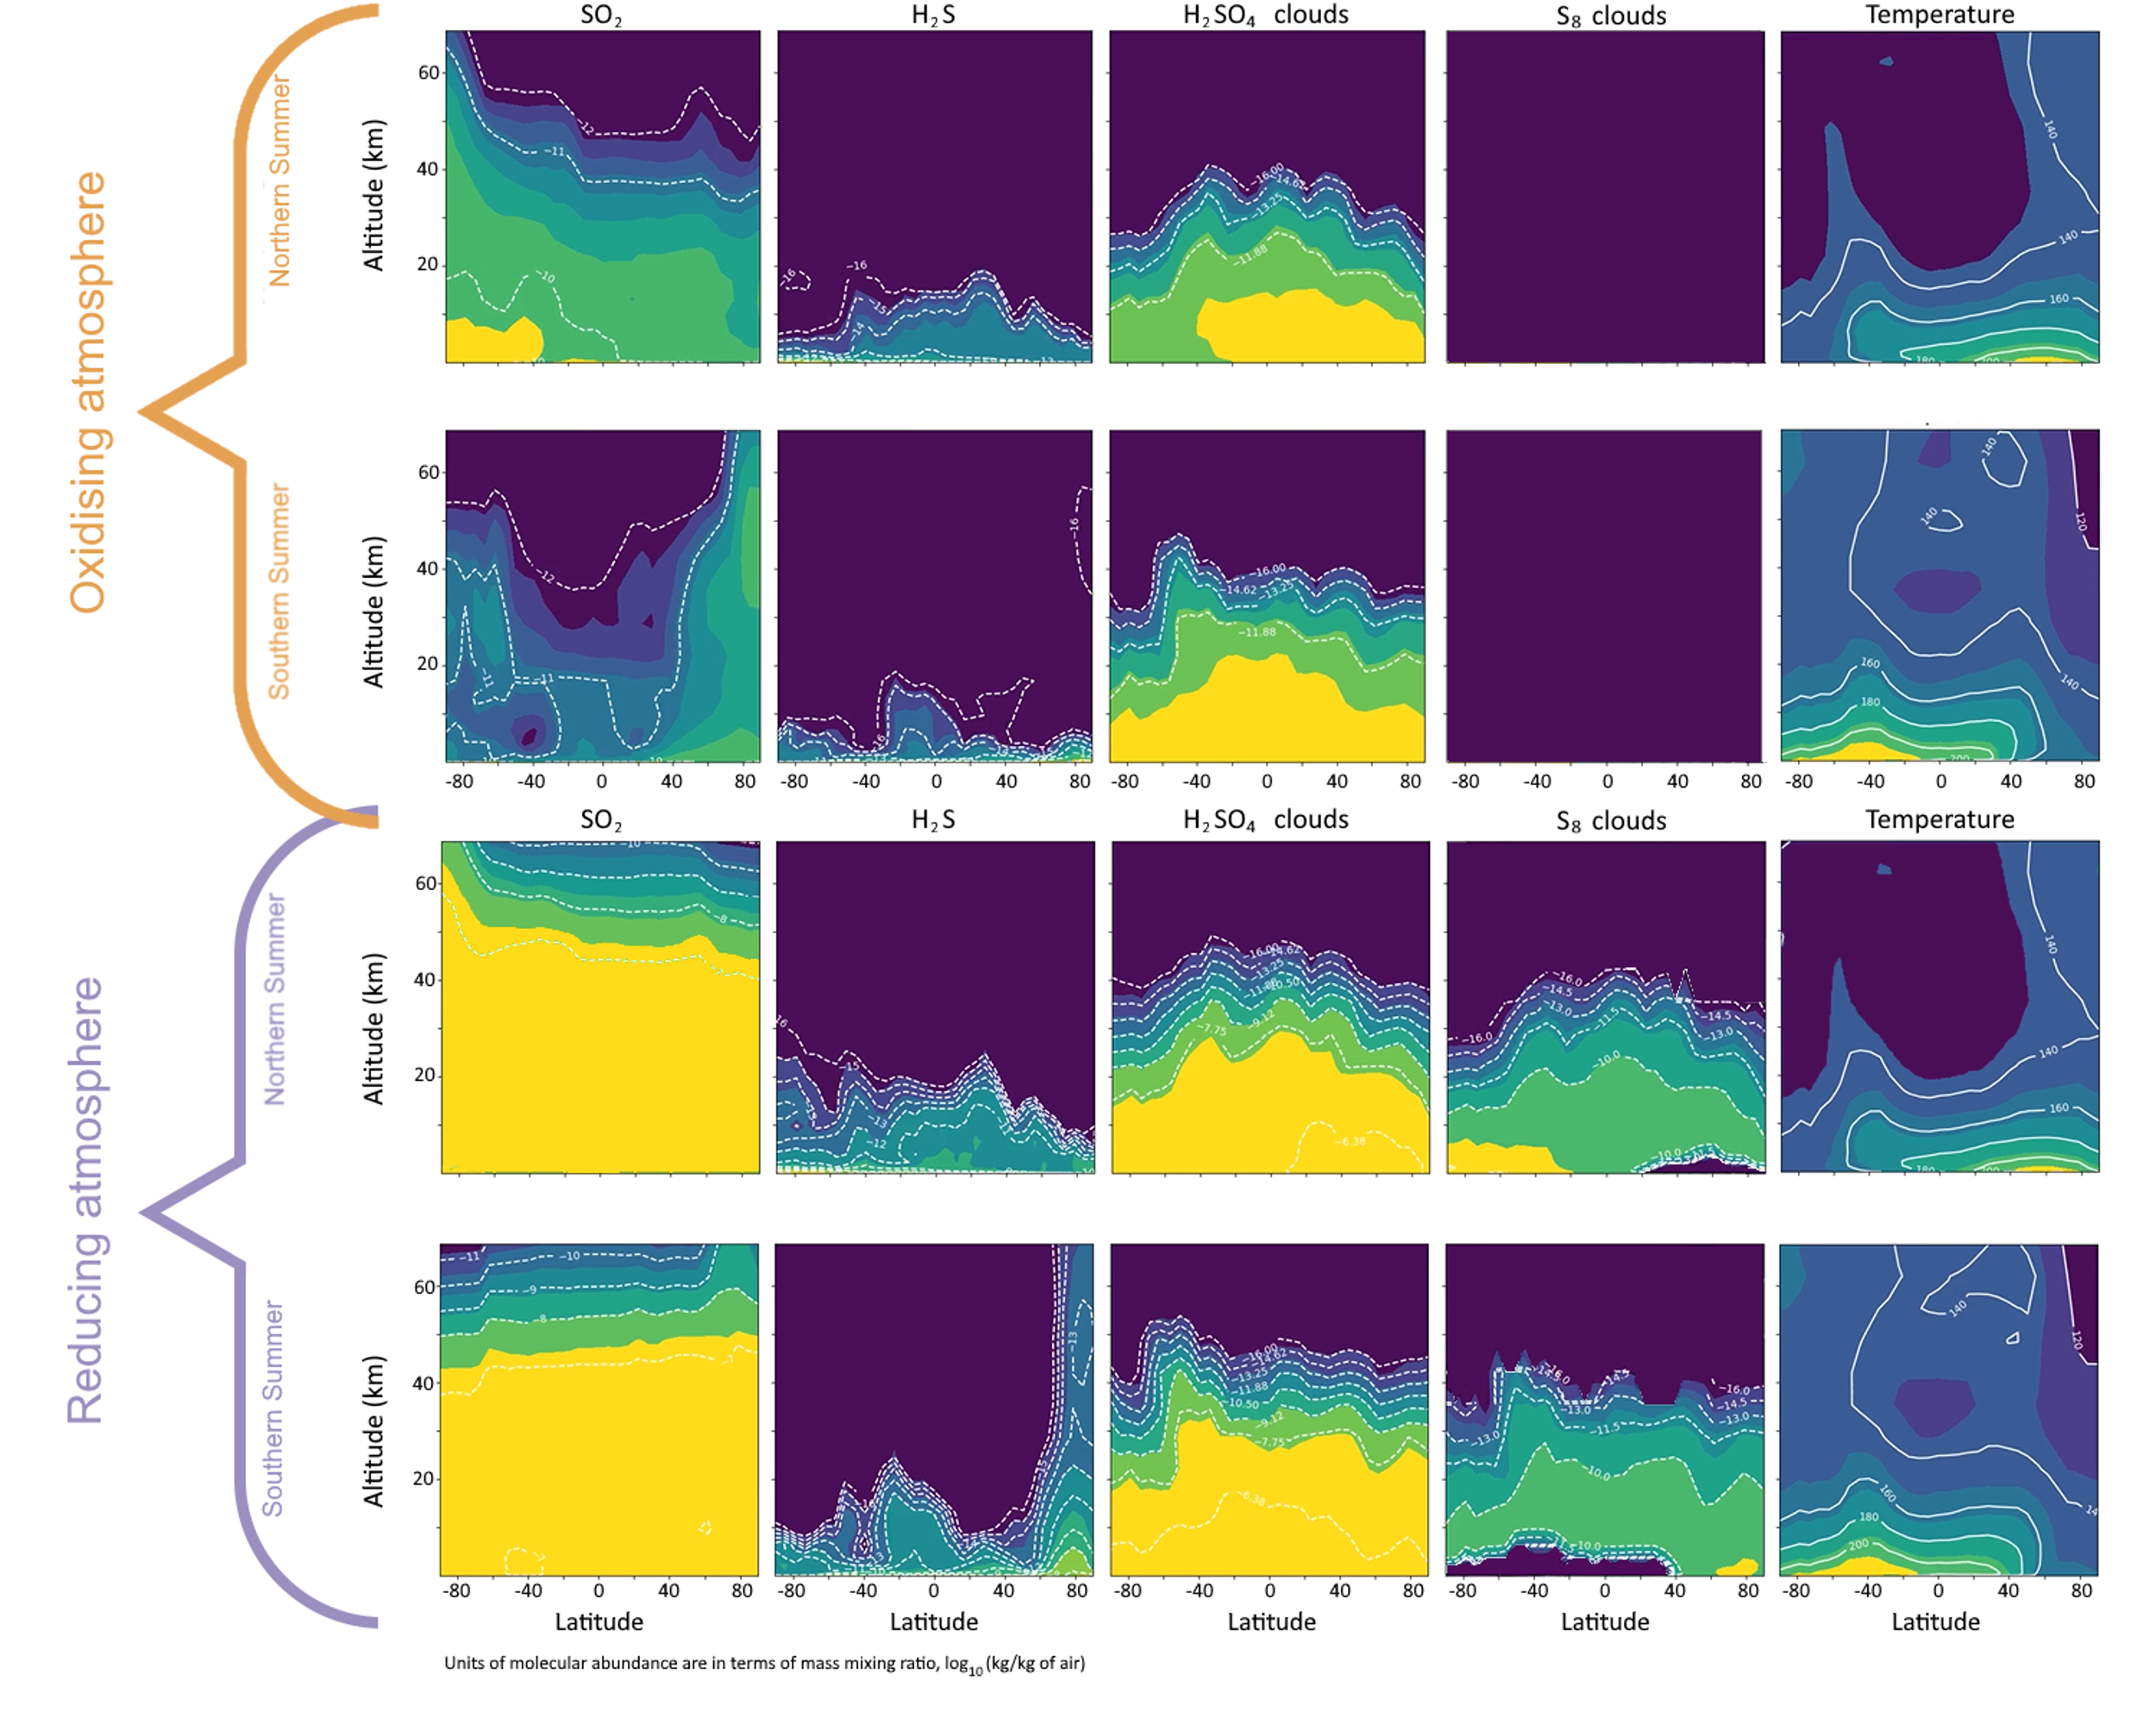
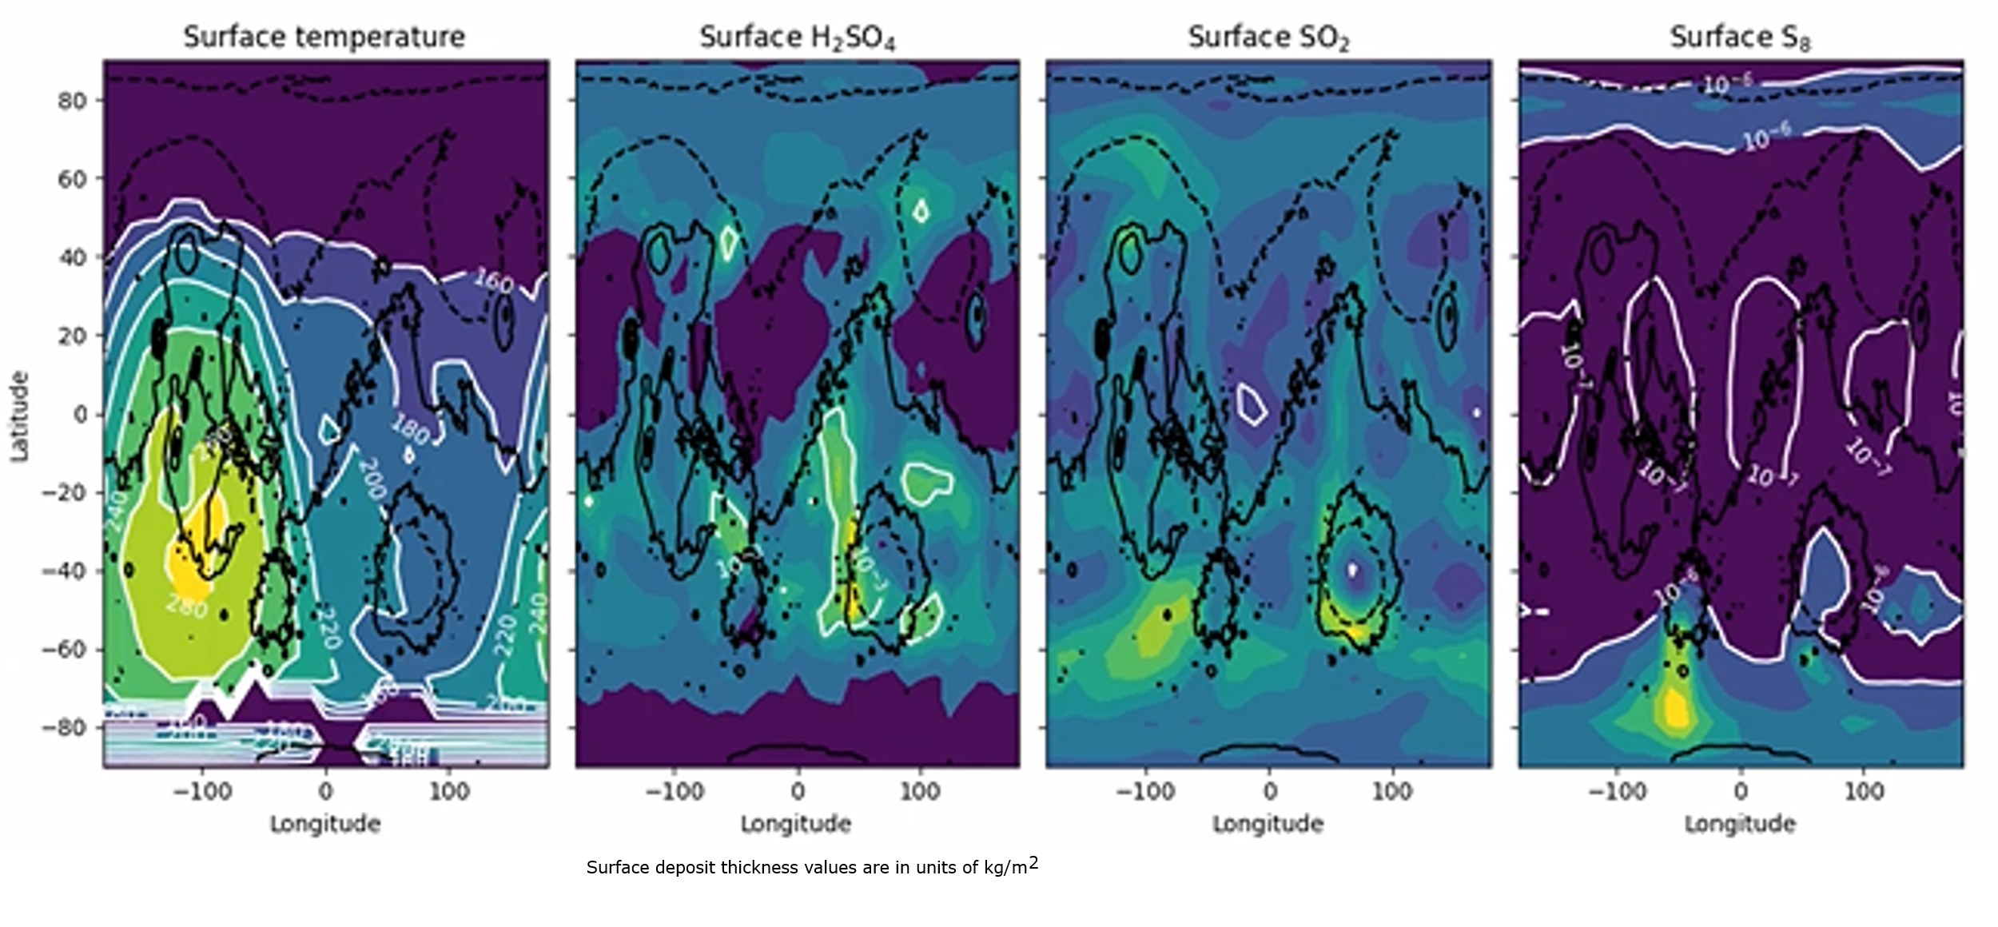
National Aeronautics and Space Administration
Postdoc Research
The effect of volcanic outgassing on the early Martian climate and geology
Author: Ashwin S. Braude, JPL Postdoctoral Fellow (3223)
Laura Kerber (3223), Franck Lefèvre (LATMOS, France), Yassin Jaziri (LATMOS, France)
Objectives: To develop a complete model of the early Martian sulphur cycle in order to understand its effect on:
1. the composition and spatial distribution of sulphur deposits on the Martian surface
2. the climate and habitability of early Mars
Background
Around the end of the Noachian era (~3.8 Gya), Mars shifted from a potentially warm and wet climate to one that was colder, drier and more acidic [1] (Fig. 1). This coincided with an increase in the sulphur content of gases emitted by Martian volcanoes, primarily as SO₂ and H₂S, which condensed into H₂SO₄ and S₈ clouds in the atmosphere that contributed to the formation of sulphur deposits covering approximately 5-10% of the Martian surface [2]. Although SO₂ is a greenhouse gas, H₂SO₄ and S₈ clouds have a net cooling effect [3,4]. Quantifying the net balance of SO₂ warming versus H₂SO₄ cooling, and the surface deposition of sulphur, is necessary to determine whether the surface could have supported liquid water and sustained a habitable environment.
Fig. 1: Predicted climate of (left) past and (right) present Mars
Approach
The Laboratoire de Meteorologie Dynamique’s (LMD) Generic Planetary Climate Model (PCM) [5] is a 3-D Global Climate Model (GCM) that is designed for palaeoclimate atmospheres. We have developed the first integrated sulphur cycle into a 3-D GCM of early Mars (Fig. 2), encompassing volcanic outgassing of SO₂ and H₂S, sulphur photochemistry involving 35 gaseous tracers and ~150 reactions [6, 7, 8], and the condensation and deposition of H₂SO₄, S₂ and S₈ [9]. We assume a background of 95% CO₂ at 10 mbar surface pressure, and simulate the effect of (a) low outgassing in an oxidising atmosphere and (b) high outgassing in a reducing atmosphere, according to predicted magma compositions in [7].
Fig. 2: Model of the sulphur cycle in the Generic PCM, taking into account (left) the main physical processes and (right) the main chemical reactions involving sulphur.
Results
Dry deposition of SO₂ is relatively uniform over the planet’s surface and is the primary surface sink of sulphur. H₂SO₄ precipitation and deposition roughly follow surface albedo and topography. S₈ formation is negligible in an oxidizing atmosphere, and is heavily suppressed by seasonal CO₂ ice sublimation, resulting in deposition confined to the poles even in a more reducing atmosphere (Figs. 3 and 4). We find that volcanic outgassing of sulphur can result in temperatures just above freezing at specific locations and times of year.
Fig 3 (left): Surface temperature in Southern Summer, and deposition thicknesses of different sulphur species for a reducing atmosphere after one full Martian year.
Fig. 4 (right): Average meridional cross-section of vertical profiles of different sulphur species, in the case of an oxidising and a reducing atmosphere.
Significance and Future Work
We plan to further study how changes in the obliquity, eccentricity and precession of Mars, as well as changes in surface pressure and geographical variations in volcanic outgassing, would have changed the distribution of sulphur deposits on the surface and affected surface temperatures. This will provide a more holistic view of how sulphur outgassing affected the long-term evolution of the Martian atmosphere, and inform sites of investigation for future Mars rovers.
National Aeronautics and Space Administration
Jet Propulsion Laboratory
California Institute of Technology
Pasadena, California
www.nasa.gov
Publications and Acknowledgements:
A. S. Braude, L. Kerber, F. Lefèvre, A. Y. Jaziri, S. S. Hamid, E. Millour, F. Forget and R. Hu. “Using a 3-D GCM to identify the effect of sulphur photochemistry on the climate of early Hesperian Mars”, in prep.
A. S. Braude, L. Kerber, F. Lefèvre, A. Y. Jaziri, S. S. Hamid, E. Millour, F. Forget and R. Hu. “Modelling the distribution of sulphur deposits on the Martian surface as a result of the Hesperian sulphur cycle”, in prep.
References
[1] Carr and Head (2010), EPSL 294, 185-203. [4] Kerber et al. (2015), Icarus 261, 133–148. [7] Sholes et al. (2017), Icarus 290, 46–62.
[2] McSween et al. (2012), J. Geophys. Res. 115, E00F12. [5] Forget et al. (1999), J. Geophys. Res. 104, 24155–24176. [8] Stolzenbach et al. (2023), Icarus 395, 115447.
[3] Tian et al. (2010), EPSL 295, 412–418. [6] Johnson et al. (2009), J. Geophys. Res. Plan. 114, E11011. [9] Hu et al. (2012), ApJ 761, 166.
Author Contact Information:
Ashwin.S.Braude@jpl.nasa.gov (183-255) tel: (626) 491-3609
Clearance Number: CL#00-0000
Poster Number: PRD-P-012
Copyright 2023. All rights reserved.

