Slide 1

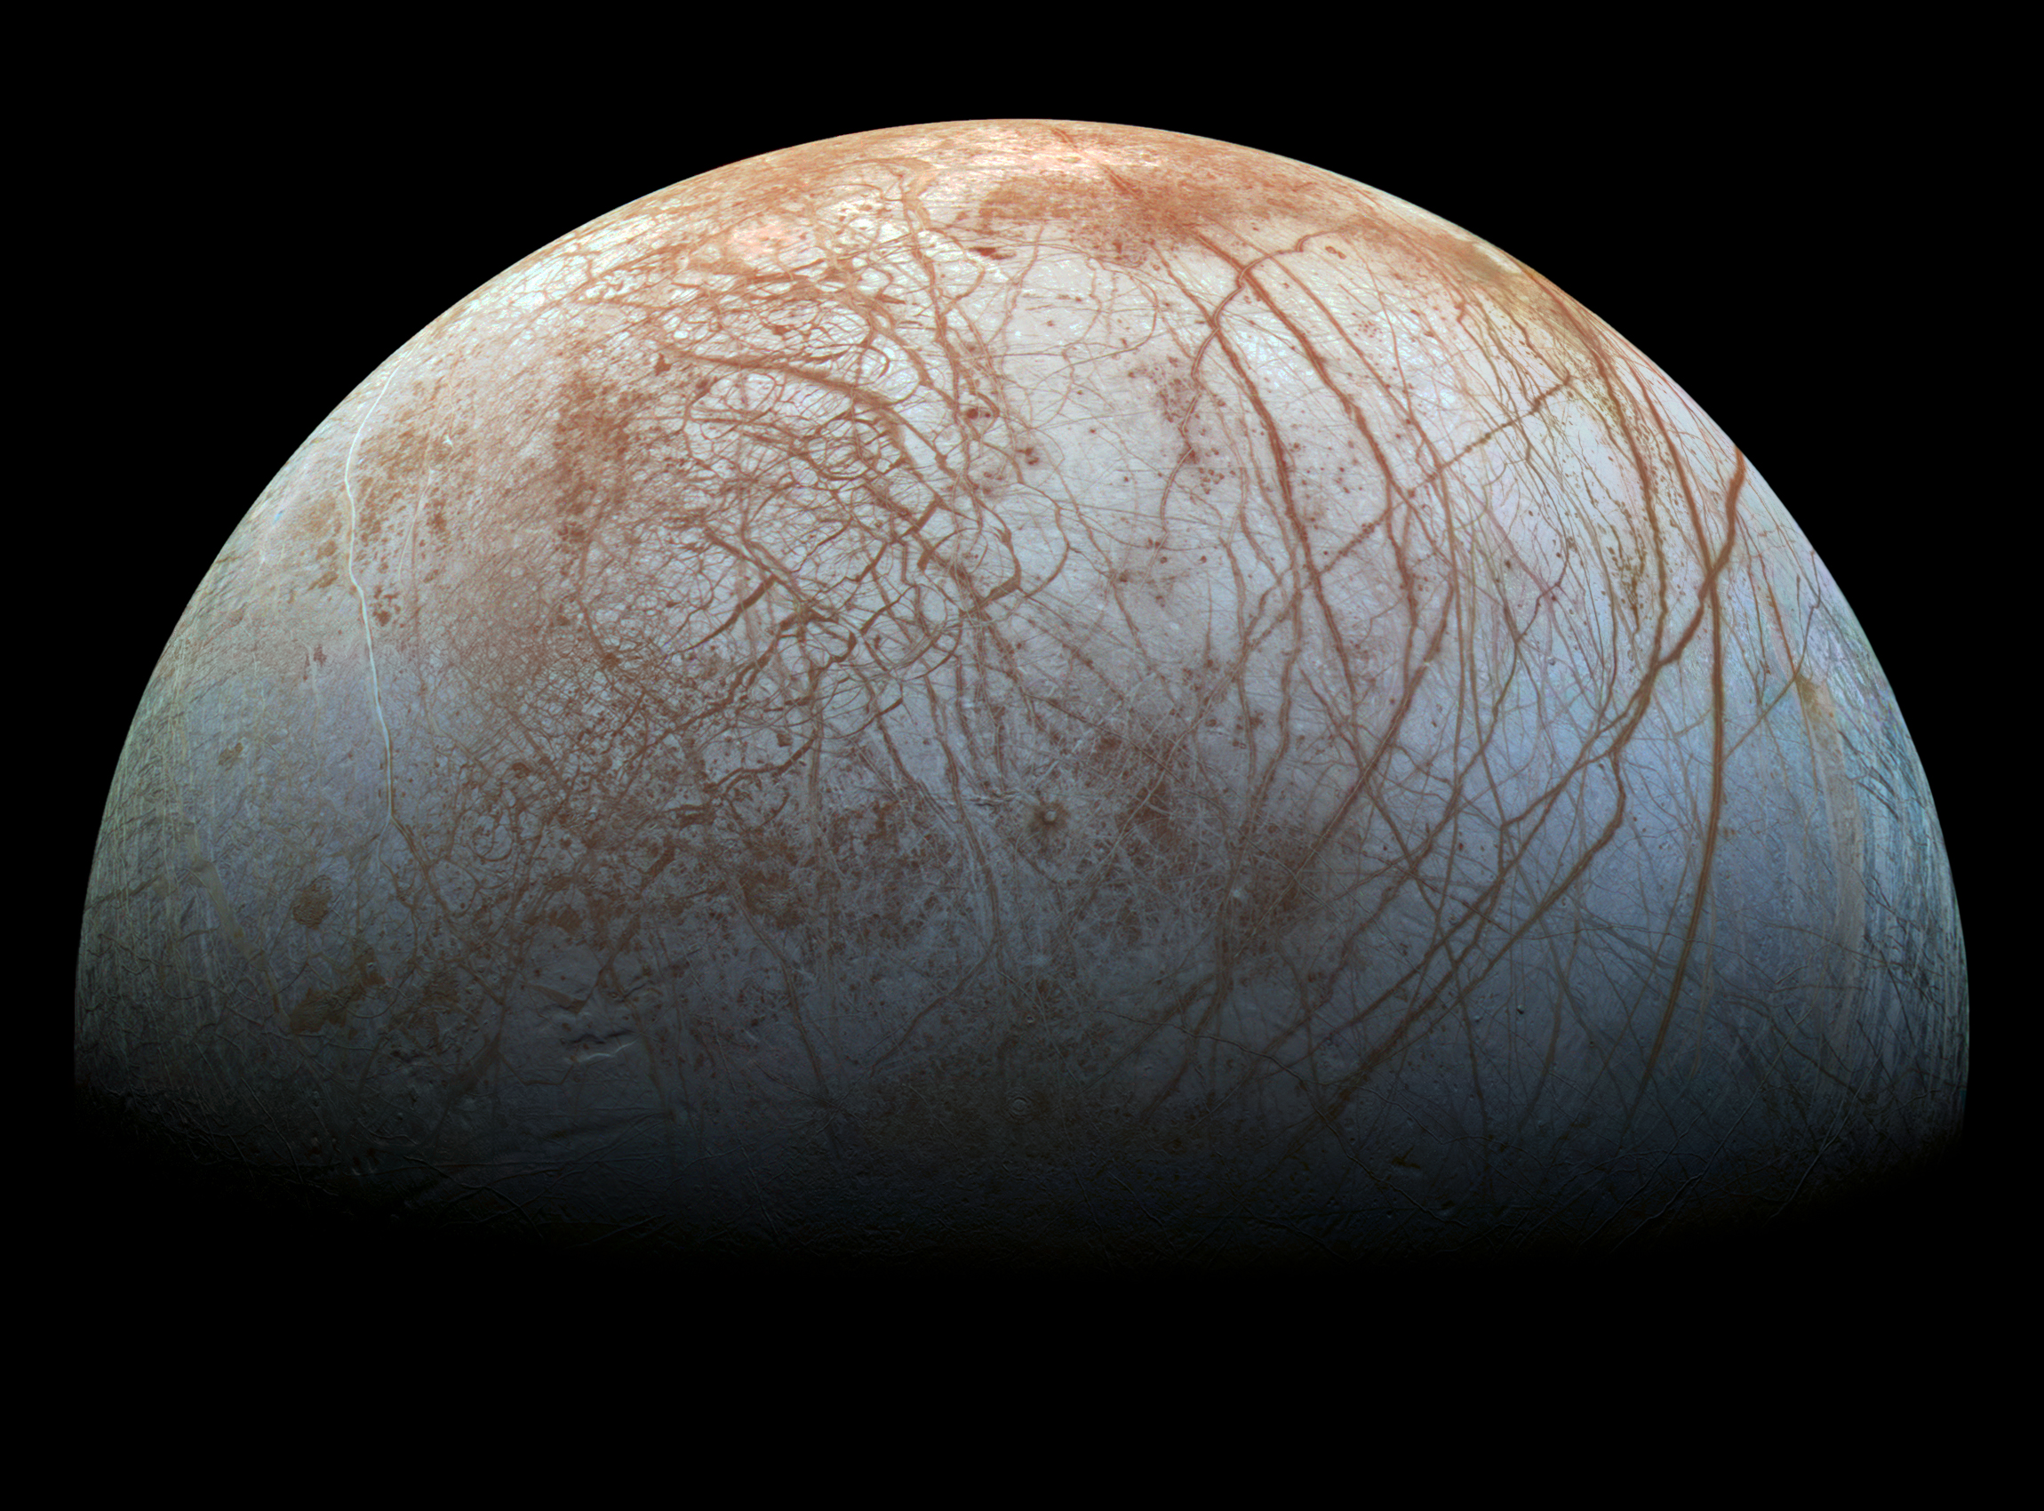
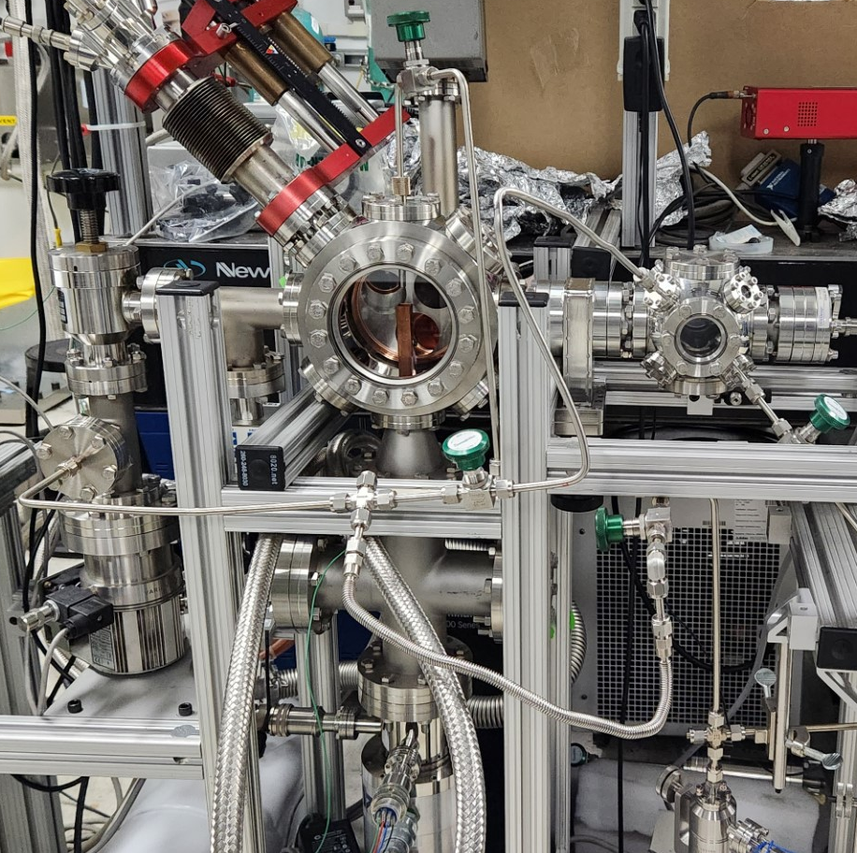
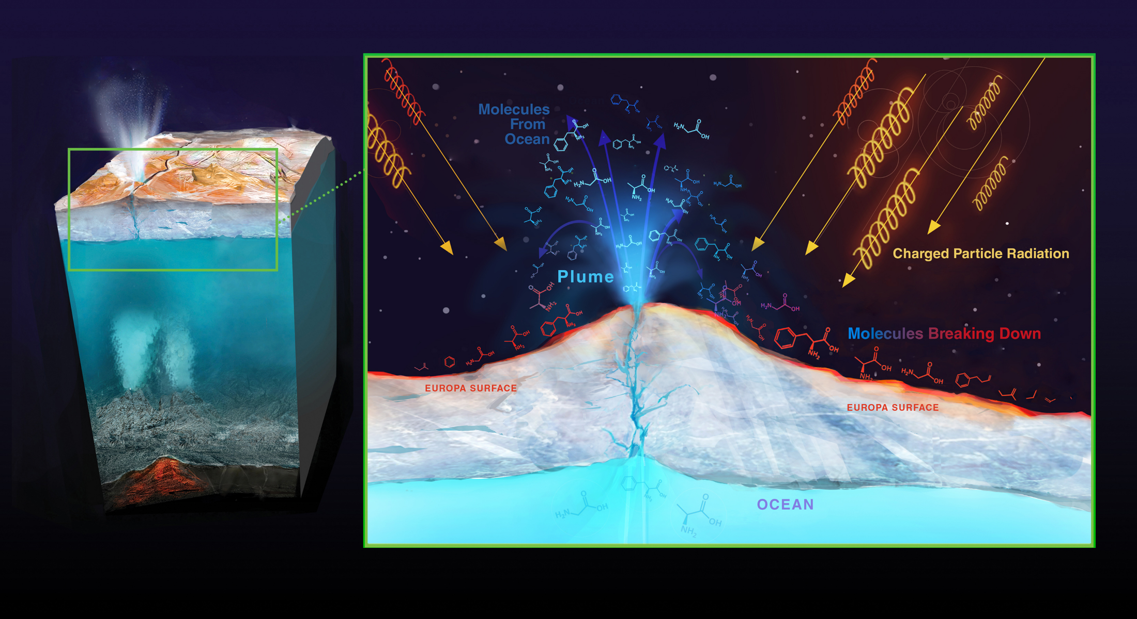
National Aeronautics and Space Administration
Postdoc Research
Radiation sputtering of organics on Europa
Author: Sankhabrata Chandra, JPL Postdoctoral Fellow (3227)
Co-Authors: Murthy S. Gudipati (3227), Bryana L. Henderson (3227)
Background
With habitability as a major focus in the NASA’s current Europa Clipper mission, we have evaluated the effects of radiation sputtering on the Europa’s icy surface and how it relates to surface temperature. Sputtering byproducts from organic species could be moved into Europa's tenuous atmosphere and potentially detected by in-situ mass spectrometers onboard the Europa Clipper spacecraft.
At the beginning of the experiment, incident radiation forms fragmented hydrocarbon chains and fragmented oxygen species. Gradually, these reactive species find each other and react in the ice matrix, causing a drop of the hydrocarbon yield at later times. We have also tracked
Results
We also track the sputtered evolution of oxygen-containing species, which shows a similar behavior except the oxygen-containing species slowly rise. With rising temperature, the differences are again more prominent at the beginning. This might be due to increased rates of reactions between oxygen species and fragmented/reactive hydrocarbon products at higher temperatures.
Objectives
In this work, our goal is to determine the sputter products which are ejected from the organic ice surface on Europa. The sputtering yields depend on different factors, but two primary factors are temperature and ice composition. Different ice compositions can yield different sputtered products. Detection of specific or localized sputtered products in Europa’s exo-atmosphere could help to understand the surface composition and vice versa. In this poster, we also show the sputtering yield of H₂O:hexane at three different Europa temperatures (corresponding to Europa midnight 80 K, morning 100 K and noon 120 K).
the sputtered evolution of oxygen-containing organic species, which shows increasing yields at later time. We also investigated how the sputtered product evolves for three different Europa temperatures (80 K, 100 K and 120 K). It is found that with rising temperature, the sputtered yield increases.
Poster summary
Daytime more sputtered composition
Significance of Results/Benefits to NASA/JPL
This study provides some insight into the variation of atmosphere compositions in the day and night time. At night, Europa will likely have less complex organic products in the atmosphere compared to the day. Therefore, daytime Europa Clipper flybys may collect more complex sputtered components.
The experiment is conducted in a stainless steel ultra-high vacuum chamber having a pressure better than 10⁻⁹ mbar. The helium cryostat can maintain the temperature down to 100 K. H₂O:hexane
Experimental methods
Nighttime less sputtered composition
Future Work
We plan to next evaluate the key sputtering products from Europa ice analogs containing nonvolatile species, such as fatty acids and sugar molecules. We currently use a sputtering energy of 2 keV, but we plan to test higher energies soon with our 10 keV to 100 keV electron gun. With this work, we link the surface materials to their sputtered byproducts, and help to understand how different materials could appear to instruments such as MASPEX and SUDA during Europa Clipper flybys.
ices are deposited through vapor deposition. A ~6 micron thick H₂O:hexane ice is deposited at a pressure of 1x10⁻⁷ mbar. A 2 keV electron irradiation is used with electron gun and sputtered species are measured with a mass spectrometer.
Picture credit: JPL/Caltech
National Aeronautics and Space Administration
Jet Propulsion Laboratory
California Institute of Technology
Pasadena, California
www.nasa.gov
Publications:
Chandra, S., Gudipati, M.S., & Henderson, B. (2023). Radiation sputtering of organics on Europa’s icy surface. Bulletin of the AAS.
Chandra, S., Gudipati, M.S., & Henderson, B. (2023). Radiation sputtering of organics on Europa’s icy surface at different Europa temperature. Manuscript in preparation
Author Contact Information:
626-630-7868 and sankhabrata.chandra@jpl.nasa.gov
Clearance Number: CL#00-0000
Poster Number: PRD-P-016
Copyright 2023. All rights reserved.

