Slide 1
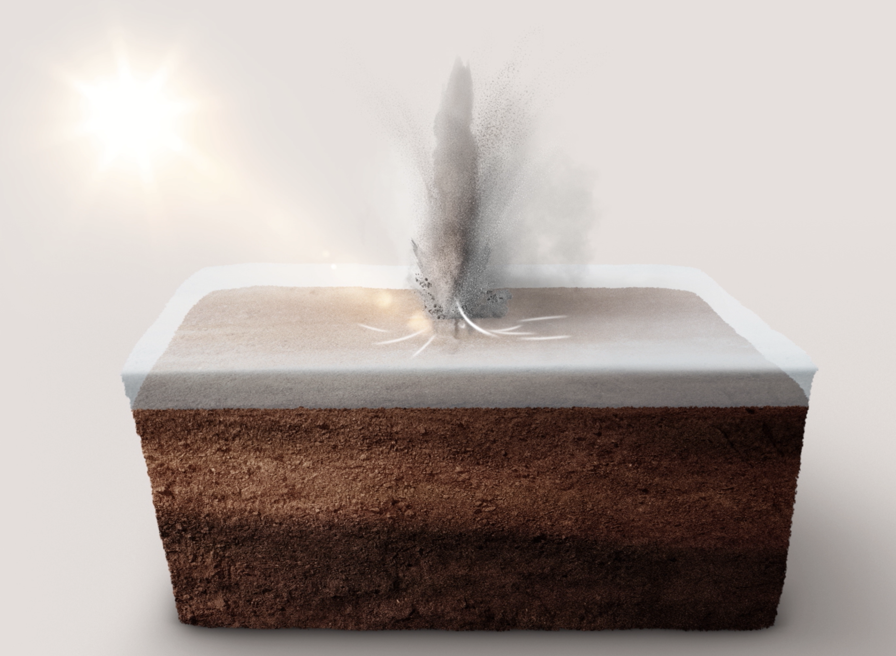
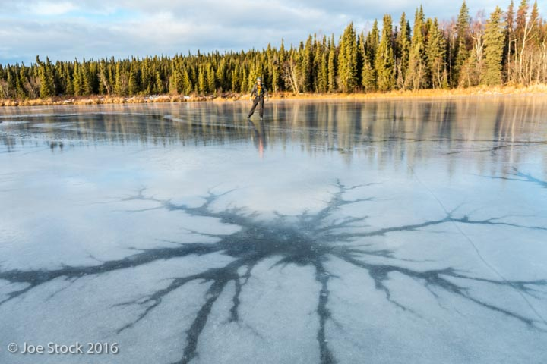
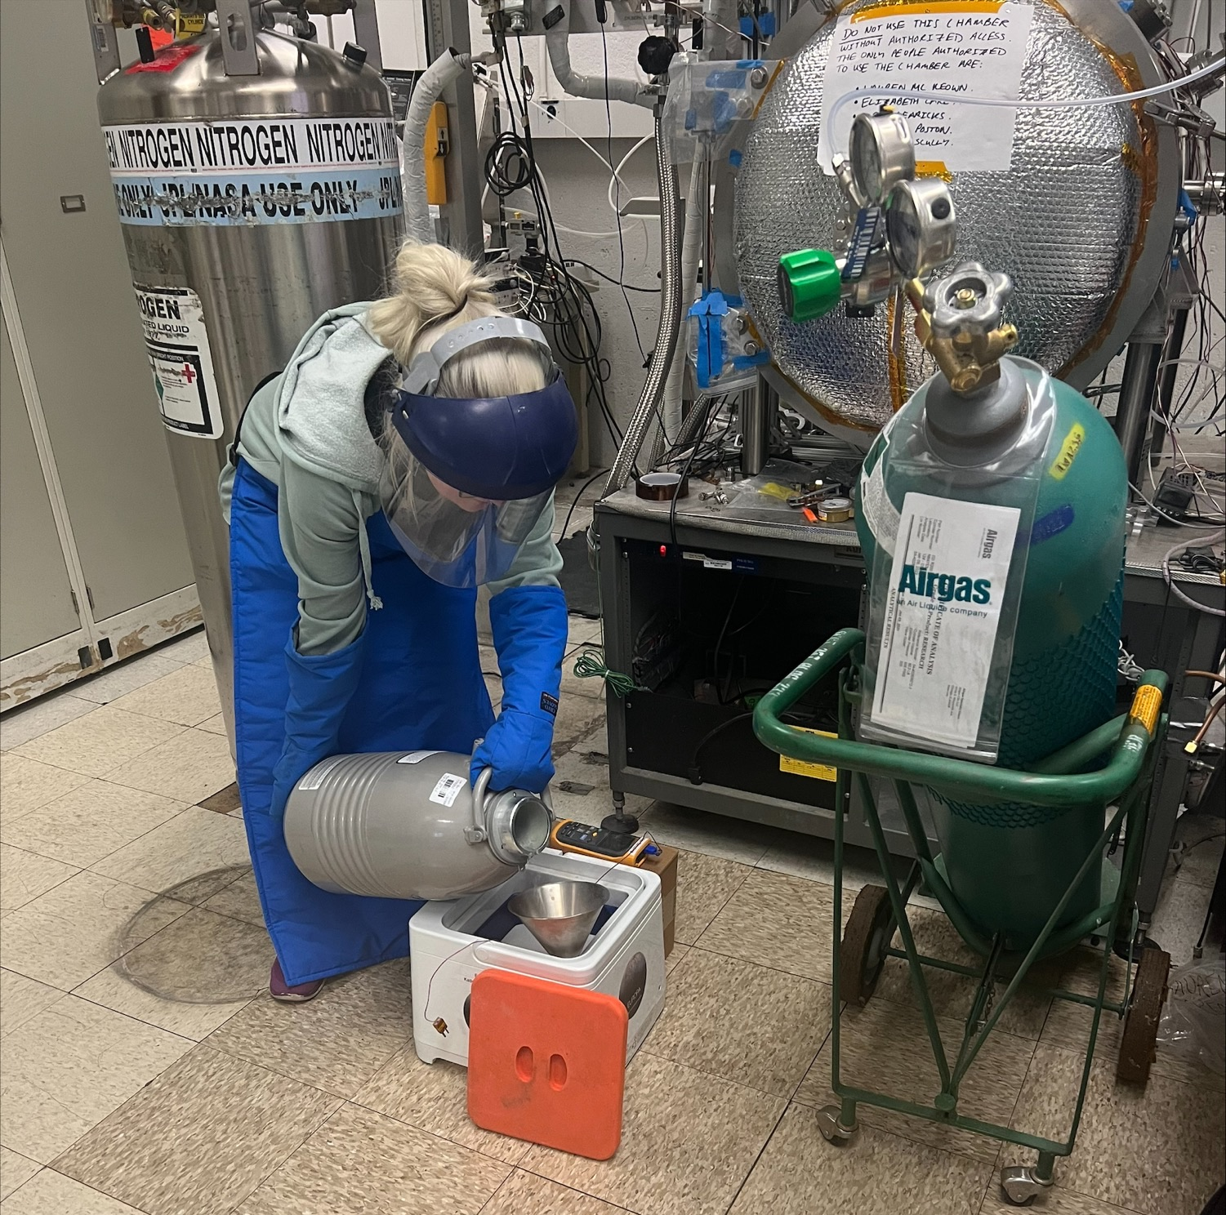
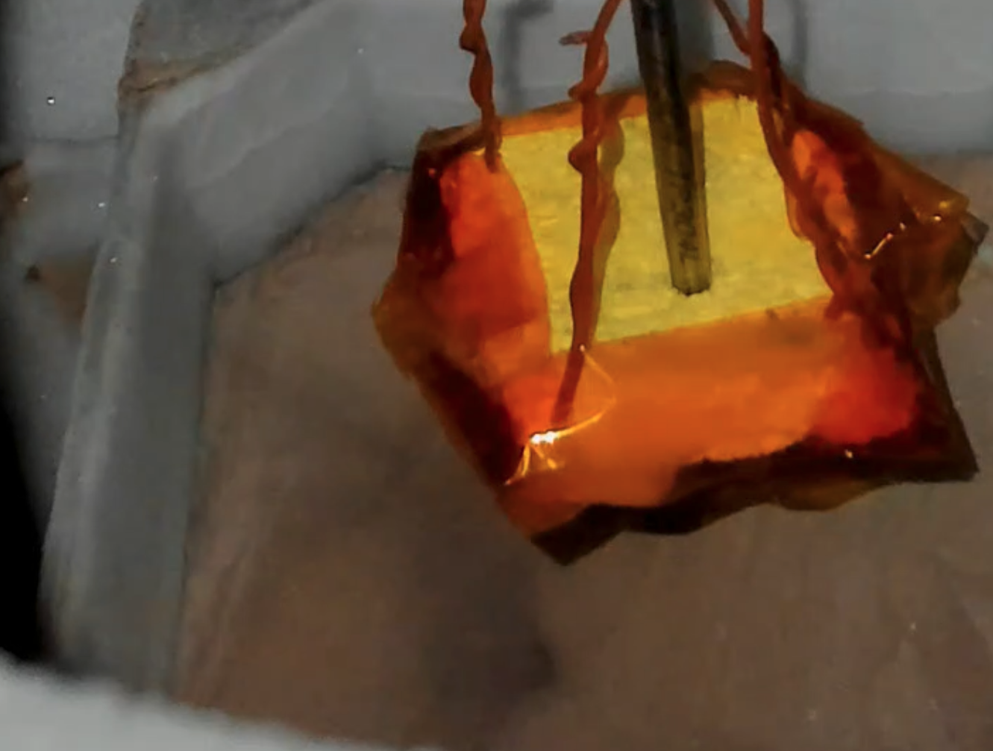
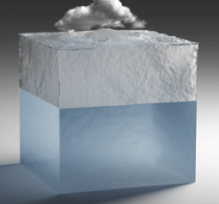
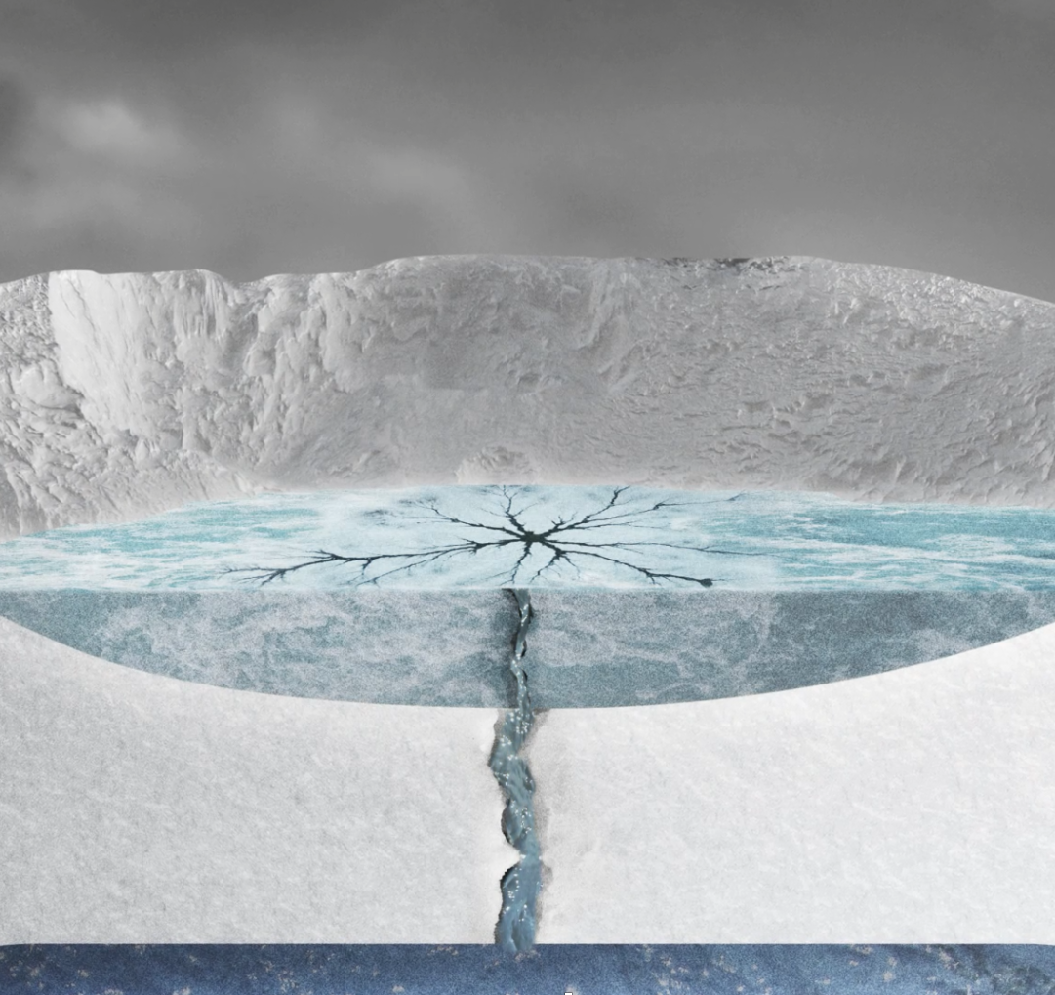
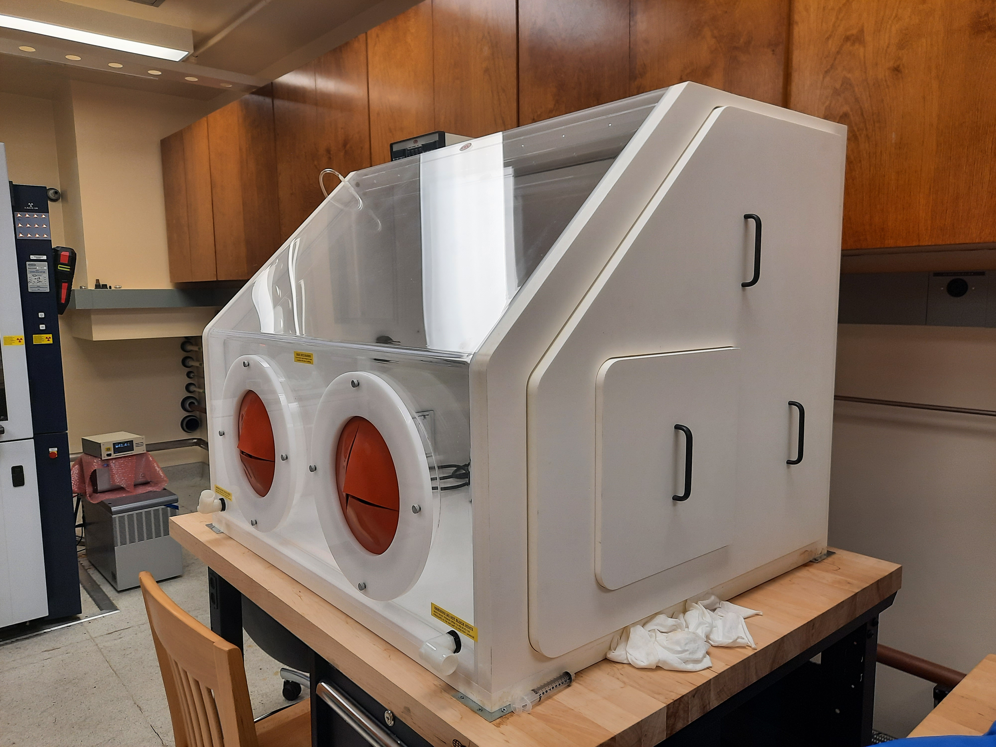
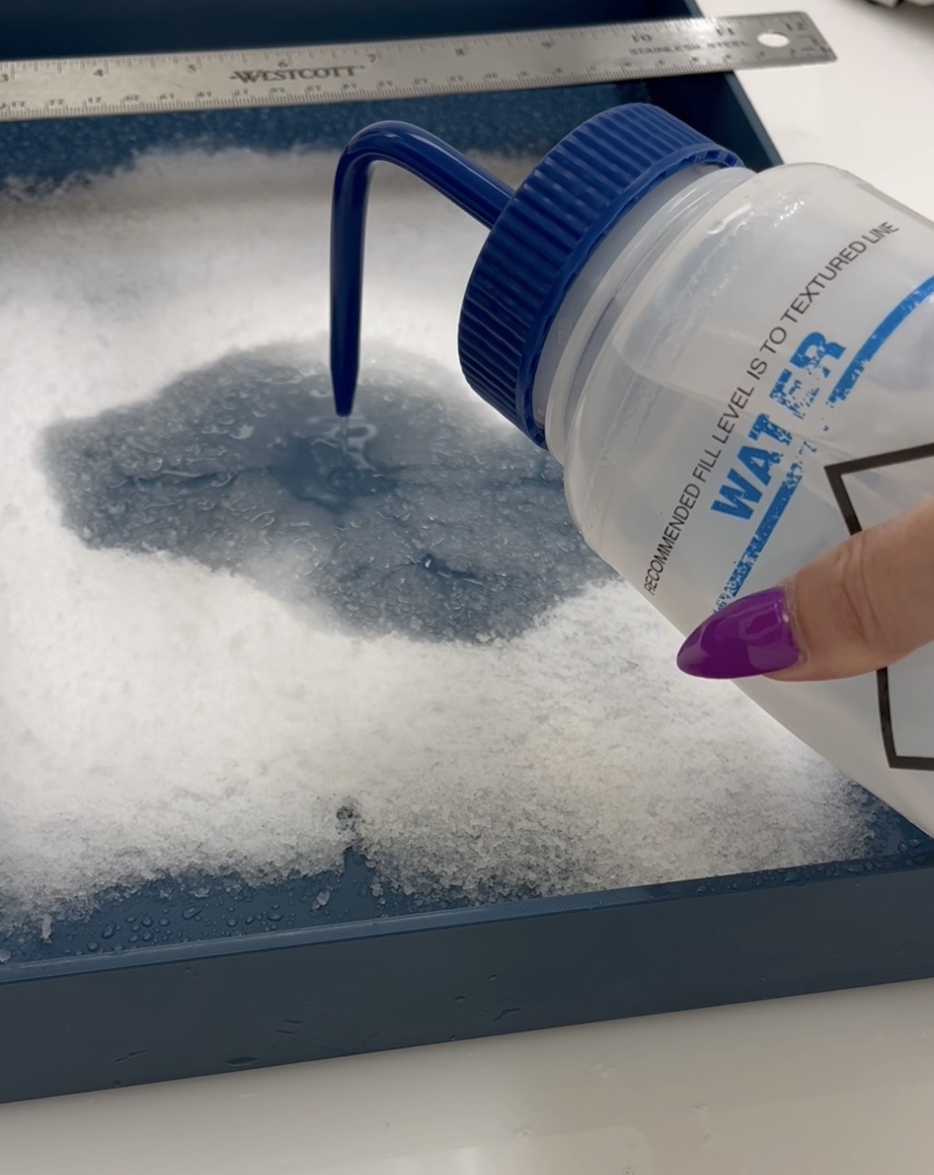
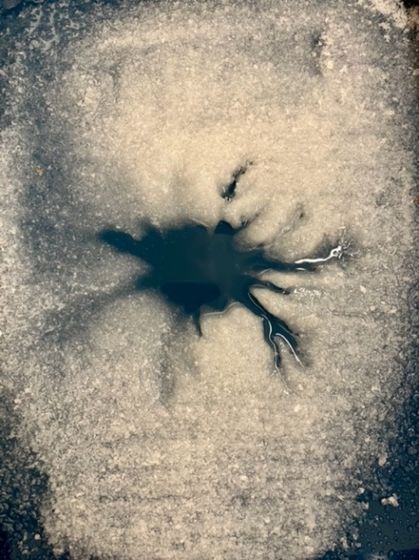
National Aeronautics and Space Administration
Postdoc Research
Spiders on Mars, Europa, and in the Laboratory
Lauren Mc Keown, JPL Postdoctoral Fellow (3223), Serina Diniega, E. Lesage, J. E. C. Scully, E. J. Leonard, R. T. Pappalardo, M. Potter, V. C. Tsai, M. Choukroun, M.J. Poston, E. Carey, C.J. Hansen, G. Portyankina, K.-M Aye, S. Piqueux
Dendritic patterns form in systems driven by physical gradients on Earth, e.g. drainage networks. Similar patterns are detected on Mars and Europa, but differ in formation mechanisms. `Spiders’ on Mars are thought to form by seasonal CO₂ ice sublimation and plume activity. We propose Earth’s `lake stars’, found on frozen lakes as an analog for Europa’s Manannán crater `spider’ feature. We present analog surface processes experiments performed at JPL to test the formation of both of these features respectively. These experiments show how, despite equifinality, we can understand extant surface processes through comparative planetology – on the large and small scale.
Spiders on Mars
Movie!
Spider on Europa
1a
1b
3
The asterisk-shaped `spider’ at the center of Manannán crater was proposed to consist of fractures originating from a brine source within Europa’s icy shell [4]. However, due to limited spatial resolution of the Galileo Solid State Imager in this area, negative topography cannot be confirmed. We present an alternative formation hypothesis based the formation of ephemeral wintertime features on Earth’s frozen ponds known as ‘lake stars’.
Lake Stars on Earth
Spiders (1a) are dendritic, negative topography features in the Martian south polar region [1]. In spring, dark fans and spots appear on the seasonal layer of CO₂ ice overlying them. The `Kieffer Model’ (1b) proposes that sunlight penetrates translucent CO₂ ice and thermal wavelengths get trapped, heating the regolith below. The ice cracks and gas rushes towards this `vent’, entraining loose material deposited as a fan or spot, and carving a `spider’. However, this model is an exotic process with no likeness on Earth and has never been observed in-action on Mars.
In the absence of Earth analogs, simulating this process at the laboratory scale can provide key insights into whether spiders reflect seasonal activity during a past climate or continue to modify the Martian surface today.
4a
4b
Lake stars (4a,b) are striking patterns that develop on the surface of ice-covered lakes on Earth in winter. When a lake surface freezes and snowfall covers the thin ice, the snow develops into slush. The ice cracks and relatively warm water wells through the snow or slush, melting it [5]. Locations with faster flow rates melt preferentially, leading to an instability that results in `fingers’ [5, 6]. Eventually the water freezes, preserving this `spider-like’ pattern encased within the ice.
Martian Spider Analog Experiments in JPL’s DUSTIE Chamber
Movie!
2a
2b
New Lake Star Formation Hypothesis for Europa’s Manannán Spider
5a
5b
5c
Movie!
Plume!
2c
2d
Following impact, a transient atmosphere and a brine pool formed (5a).
During cooling, impact slurry covered an ice layer above the brine pool (5b).
The ice cracked, and brine spread through the slurry (5c), as liquid transiently due to elevated pressure and temperature. Similarly to lake stars, water melted the slurry to form a `spider’, which was preserved as it froze. The spider had higher salt concentration, which darkened due to radiation exposure [8].
We ran experiments in JPL’s Dirty Under-vacuum Simulation Testbed for Icy Environments (DUSTIE) chamber to test if spider morphologies formed when the interface between Mars dust simulant and condensed CO₂ ice was heated.
A layer of dust with a heater ~ 5 mm below the surface was cooled to ~ 90 K in a LN₂ bath then placed into DUSTIE which is cooled with a LN₂ plate and shroud (2a). A vacuum pump pulled to Mars polar winter pressures between 4 and 10 mbar. We flowed in CO₂ gas which condensed as ice. We then activated the heater. In each case, a plume developed and `cracked’ spider morphologies formed. However, CO₂ diffused < 5mm into the dust and so the ice sublimated from within the simulant causing thermal stress cracks. Future experiments will investigate whether this alternate mechanism is dependent on grain size and ice deposition modes. When reconciled with mapping work with Mars Reconnaissance Orbiter high resolution imagery, these experiments may help to relate morphology and activity to local conditions, revealing insights to seasonal activity on Mars, past and present.
Europa Lake Star Experiments in LN₂-Cooled Glovebox
6a
6b
In a LN₂ glovebox at post-impact temperatures (~0 °C) we flowed liquid water onto Europa granular ice simulant (av. diameter 317 μm), varied concentrations of MgSO₄).
‘Lake star’ patterns formed in all cases. These were more distinct for higher ΔT between water/simulant and lower salt content. Future experiments will invoke post-impact pressures. This work can help us to understand cryovolcanic processes and post-impact transient conditions on Europa.
6c
6d
National Aeronautics and Space Administration
Jet Propulsion Laboratory
California Institute of Technology
Pasadena, California
www.nasa.gov
Clearance Number: CL#00-0000
Poster Number: PRD-
Copyright 2023. All rights reserved.
5 cm
Publications on this work:
Mc Keown et al., A Lab-Scale Investigation of the Mars Kieffer Model, In Prep
Mc Keown et al., Lake Stars as an Earth Analog for Europa’s Manannán Crater Spider Feature, Submitted, Nature Geoscience.
Author Contact Information: lauren.mckeown@jpl.nasa.gov
References: [1] Piqueux et al., (2003) JGR: Planets. [2] Kieffer et al., (2006) Nature. [3] Mc Keown et al., (2021) Scientific Reports. [4] Steinbrügge et al. (2020) Geophysical Research Letters [5] Tsai & Wettlaufer, (2007) Physical Review E. [6] Bowling et al., (2019) Icarus. [7] Lesage et al., (2022) The Planetary Science Journal.
[8] Hand & Carlson, (2015) Geophysical Research Letters

