Slide 1
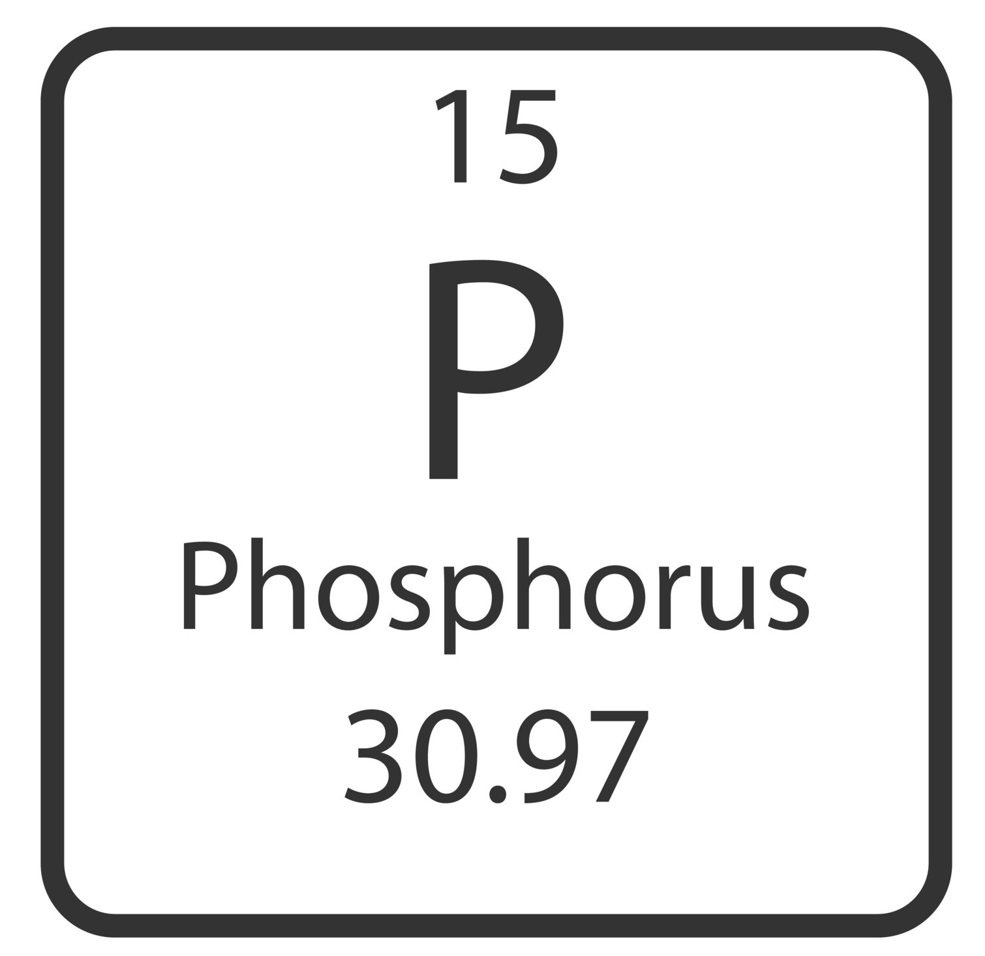
National Aeronautics and Space Administration
Postdoc Research
Phosphorus and Mineral Interactions on Enceladus
Author: Katherine A. Dzurilla, JPL Postdoctoral Fellow (3227)
Bronwyn L. Teece (3227), Laura M. Barge (3227)
Background: Enceladus may be hydrothermally active (Waite et al. 2017) and contain a subsurface ocean containing primarily salts and carbonates. Phosphorus (P), an element necessary for life on Earth was recently discovered on Enceladus (as phosphate) (Postberg et al. 2023). P cycling and its interactions with minerals in hydrothermal vent systems might sequester available P through precipitation and/or surface adsorption. It is thought that carbonates present in Enceladus might compete with metal cations for binding to the phosphates, similar to soda lake environments on Earth (Toner and Catling 2020). If metal cations bind to P species, P will be sequestered into the mineral and unavailable to participate in prebiotic / organic chemistry in the aqueous phase. However, if the cations preferentially bind to carbonate, P will be liberated into solution and free to react. Thus, it is important to investigate the behavior of P with metals / minerals and carbonate under Enceladus conditions, to understand how much P could be present in Enceladus’ ocean for future missions to detect.
Objectives
We are conducting laboratory experiments to observe the interactions of reduced forms of P (phosphite) with minerals relevant to hydrothermal systems similar to those thought to be present on Enceladus. Results from this study can provide insight in to availability of P to participate in potential prebiotic reactions at the Enceladus seafloor, and can help constrain the potential habitability of the Enceladean ocean.
Approach and Results
Solutions with .3M NaCl and Na₂CO₃ were prepared under anoxic concentrations similar to interpretations of Cassini observations (Fifer et al. 2022). Carbonate concentration was increased to 6M in order to better observe cation binding preferences to carbonates as opposed to phosphite. Phosphite was added as Na₂HPO₃ to samples in 25mM. Fe minerals are prevalent in many hydrothermal vent locations on Earth, and Fe was therefore selected as the cation for investigating the potential mineral composition in an Encleadean hydrothermal environment. FeCl₃ hexahydrate was added to samples in concentrations of .03M, .15M, and .3M . of Fe. Samples were reacted for 15 days, with 2ml aliquots sampled every 3 days and analyzed with ³¹P NMR (Figure 2). Phosphite oxidation to phosphate was observed in .03M and .15M FeCl₃ hexahydrate until 19 days. No phosphate was produced in highest FeCl3 concentration (.3M) at any time point. We interpret these results to indicate that phosphate is being produced from oxidation of phosphite. However, phosphate is adsorbing to the Fe minerals and remaining trapped on the surfaces.
Figure 1: Samples containing .3M NaCl, 6M Na₂CO3, and .25M phosphite before (left) and after (right) the addition of .15M FeCl3
t=0
t=0
t=3 days
t=3 days
t=6 days
t=6 days
t=19 days
t=19 days
Figure 2: High carbonate/salt samples with .25M phosphite and .03M FeCl3 (left) / .3M FeCl3 (right) after being reacted for 19 days. Phosphate peaks are observed in .03M and .15M (not shown) FeCl₃ samples until t=19 days. No phosphate was observed in samples containing .3M FeCl₃.
Significance of Results/Benefits to NASA/JPL
With P playing a vital role in biology it is important to investigate P availability within the Enceladus environment. Understanding of the solubility of P in terms of mineral precipitation and surface adsorption in this environment can help constrain predicted biosignature compounds for future NASA missions as well as help inform our understanding of Enceladus habitability and prebiotic potential.
Future Work
Future mineral analysis will be conducted to determine if P can be detected in the solid phase. Additionally, these Fe and P concentration ratios will be repeated under more realistic Enceladus conditions of .15M NaCl/.075M Na₂CO₃ to observe any potential changes within reactions or phosphate sequestering.
National Aeronautics and Space Administration
Jet Propulsion Laboratory
California Institute of Technology
Pasadena, California
www.nasa.gov
Publications and Acknowledgements:
NASA Habitable Worlds, “Phosphorus Chemistry on Rocky and Icy Planets” (PI: Laurie Barge; Co-I: Matt Pasek, USF)
Author Contact Information:
(626) 487-5806 Katherine.a.Dzurilla@jpl.nasa.gov
Clearance Number: CL#00-0000
Poster Number: PRD-P-020
Copyright 2023. All rights reserved.

