Slide 1
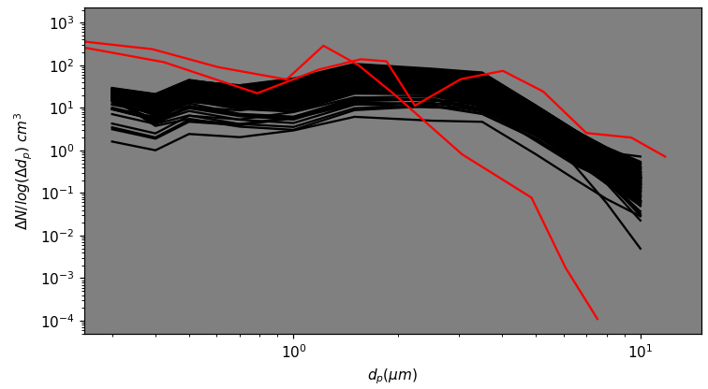
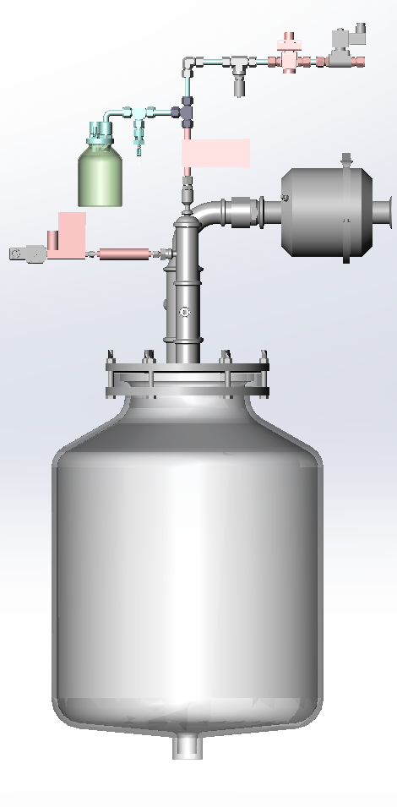
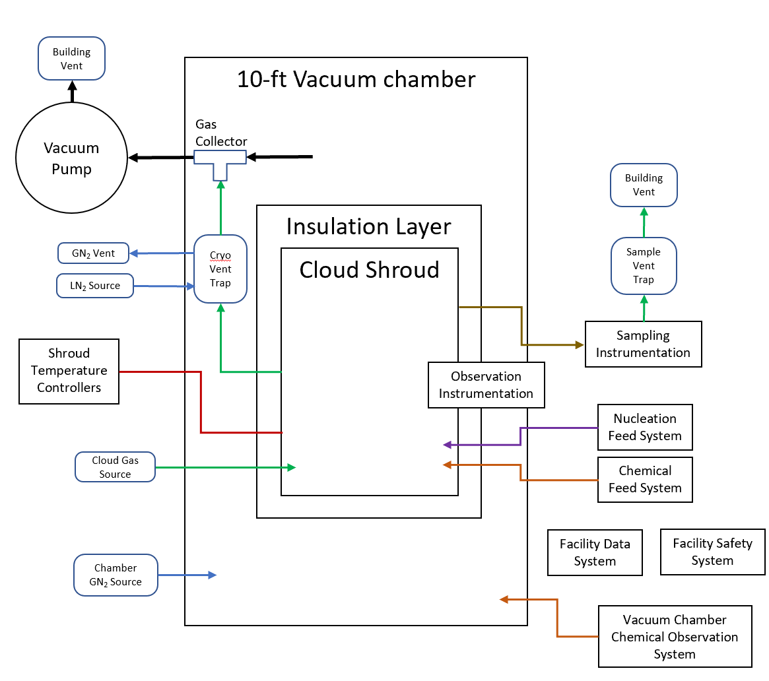
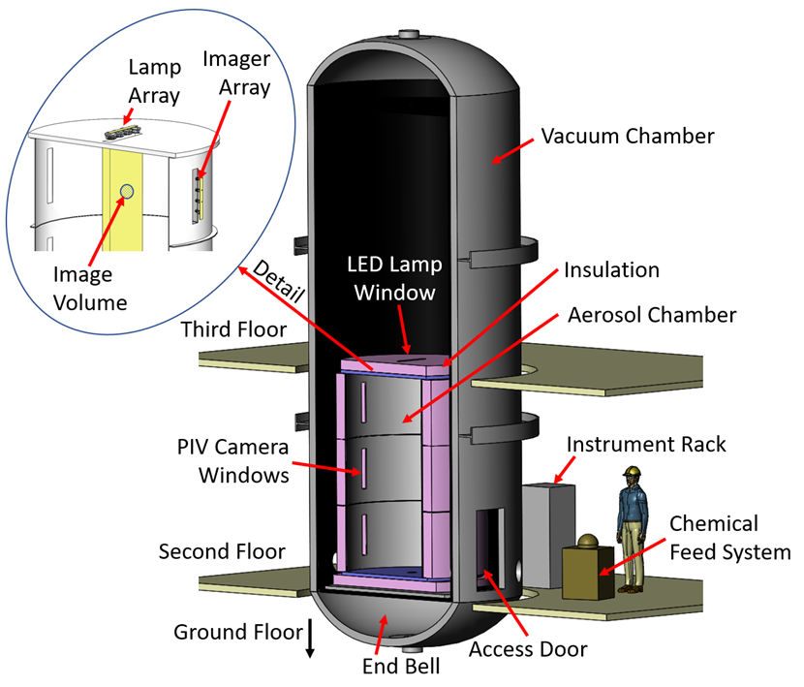
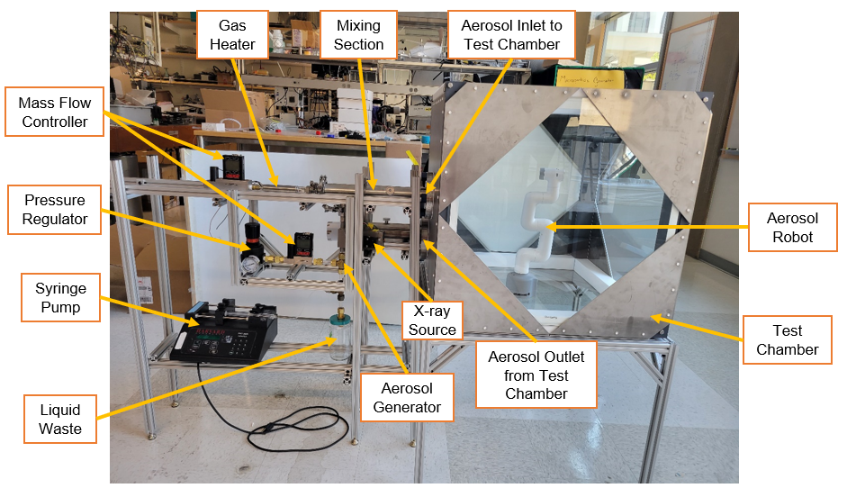
National Aeronautics and Space Administration
Postdoc Research
Facilities to Enable Study of Planetary Aerosol Formation and Cloud Microphysics
Author: Joseph Salazar, Postdoc (353)
Co-Investigators: Michael Pauken (353), Rick Flagan (Caltech), Will Cantrell (MTU), Kevin McGouldrick (LASP), Noah Brown (357), Matt Devost (353), Hong Tang (383), Kevin Bains (322), Bryana Henderson (322), Jeehyun Yang (322), Luca Valdarno (353), Murthy Gudipati (322), Stephen Akwaboa (SUS), Ivana Barley (SUS), Patrick Mensah (SUS), Charles Dandino (351), Theodore Sharp (357)
Background
Here, we describe two facilities that explore formation and transformation of planetary atmospheric aerosols. These facilities aim to deepen our understanding of the microphysics, chemistry, and thermodynamics underlying aerosol dynamics, encompassing a diverse spectrum of aerosol species identified in planetary atmospheres. Key examples include H₂SO₄ (found on Venus), CO₂ and H₂O (relevant to Mars), NH₃ (pertinent to Jupiter and Saturn), and CH₄ (associated with celestial bodies like Titan and the Ice Giants). To facilitate these investigations, we are in the process of developing two chambers: Planetary Cloud Aerosols Research Facility (PCARF) and Venus Cloud Simulator (VCS). PCARF will enable controlled experimentation and replication of planetary atmospheres, allowing us to explore how aerosols are formed and evolve in a variety of planetary conditions. The VCS is designed specifically to emulate the extreme conditions of Venus' atmosphere, where sulfuric acid aerosols play a crucial role and involves rigorous testing of equipment to assess its durability and resilience on Venus. This interdisciplinary research effort finds alignment with the strategic scientific directions articulated in the National Academies of Science (NAS) publication, "Origins, Worlds, and Life: A Decadal Strategy for Planetary Science and Astrobiology 2023-2032" (NAS, 2022), specifically focusing on the role of physics and chemistry in shaping planetary atmospheres. Additionally, it synergizes with the objectives of the JPL Venus Aero Bot Mission, Phantom, reflecting our commitment to advancing our understanding of planetary atmospheres and supporting the mission's scientific goals.
Objectives
Venus Cloud Chamber
Research Goals
- To establish a dedicated facility capable of emulating the Venusian atmospheric conditions for the purpose of testing and experimentation.
Specific Objectives
- Generate sulfuric acid aerosols that reproduce the particle size, mass distribution, acid concentration, bulk gas composition, and temperature of Venus' atmosphere.
- Design and construction of a facility that serves as a reliable testing source for the Gas and Aerosol Mass Spectrometer.
Planetary Cloud Aerosols Research Facility
A. Research Goals
- Engineer a cutting-edge facility with the capacity to both produce and analyze aerosols.
B. Specific Objectives
- Establish the capability for precise aerosol measurement within the chamber.
- Grow aerosols within a controlled, turbulent mixing environment.
- Operate at pressures ranging from 1 μbar to 1 bar, and temperatures ranging from -180° to +125°C (93 to 398K).
Approach and Results
Venus Aerosol distribution
Aerosol Introduction System
at 54km*
at 58km*
Exhaust
System
Glass Vessel
Significance of Results/Benefits to NASA/JPL
The VCS serves as a accurate simulation of the Venusian cloud aerosol environment. This innovative facility empowers NASA to rigorously assess Venus-specific components and instrumentation within an Venus-like environment, positioning JPL as a pioneer in corrosion testing under Venusian conditions.
PCARF offers invaluable opportunities for researchers for investigations in Planetary Science, Habitable Worlds, and Exoplanet Research to engage in laboratory investigations of aerosols. The outcomes of research conducted within the PCARF hold immense promise for in situ missions and remote observations. By serving as a versatile testbed, the PCARF facilitates the validation and calibration of data related to clouds and aerosols, further enhancing our scientific understanding of these planetary atmospheres. This research not only signifies a critical step toward achieving our objectives but also promises to significantly impact JPL missions and programs, while also offering lasting benefits to NASA's broader scientific endeavors.
Future Work
Our focus will be on advancing both the Venus Cloud Chamber (VCS) and the Planetary Cloud Aerosols Research Facility (PCARF). We intend to refine and expand their capabilities, with a key objective being the publication of their designs to benefit the broader scientific community.
National Aeronautics and Space Administration
Jet Propulsion Laboratory
California Institute of Technology
Pasadena, California
www.nasa.gov
Publications and Acknowledgements:
Pauken, M., Salazar, J., Baines, K., Flagan, R., Gao, P., McGouldrick, K., Cantrell, W., Byrne, P., Akwaboa, S., The Planetary Cloud Aerosol Research Facility, 19th International Planetary Probe Workshop, Santa Clara, CA, 2022.
Author Contact Information:
Email: Joseph.Salazar@JPL.NASA.GOV
Clearance Number: CL#00-0000
Poster Number: PRD-P-021
Copyright 2023. All rights reserved.

