Slide 1
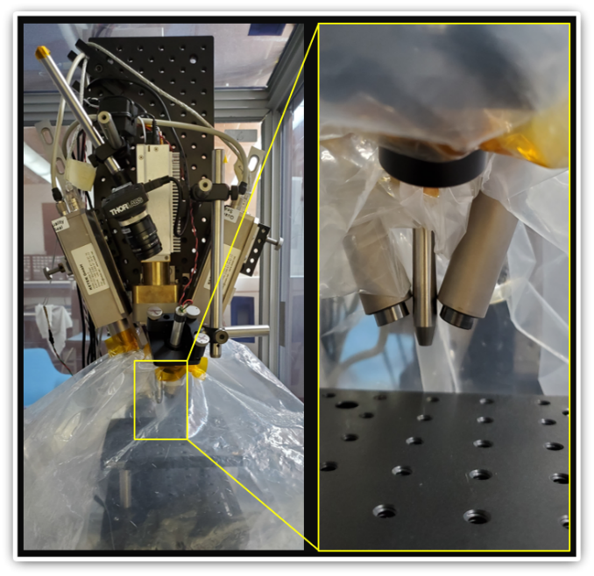
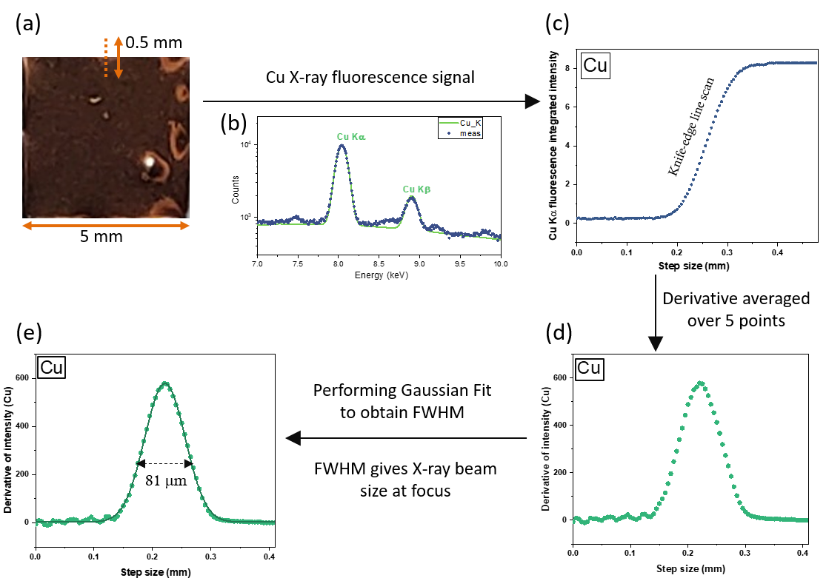
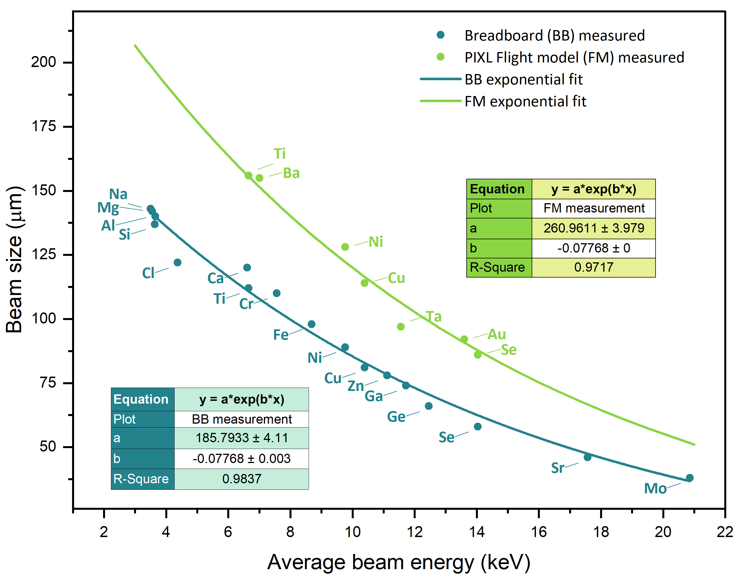
National Aeronautics and Space Administration
Postdoc Research
Energy Dependence of X-ray Beam Size Produced by Polycapillary X-ray Optics
Author: Anusheela Das, JPL Postdoctoral Fellow (3227)
Co-Authors : Chris M Heirwegh (3227), Ning Gao, Benton C Clark III, William T Elam, Lawrence A Wade (328A)
Background
Micro-region elemental analyses important in the fields of geology, geochemistry, planetary sciences
X-ray fluorescence spectroscopy (XRF) enables non-destructive micro-region analysis at ambient pressure conditions
Polycapillary X-ray focusing optics coupled to a compact X-ray tube achieves high intensity, small X-ray beam
Beam spot size affects micro-region interrogation volume → hence affects quantified elemental maps
These discrepancies can be identified and accounted for with knowledge of exact beam size at any energy
Objectives
Studied two systems associated with the Planetary Instrument for X-ray Lithochemistry (PIXL),
PIXL: In-situ exploratory instrument on the Mars Perseverance Rover
Portable X-ray fluorescence spectrometer consists of rhodium X-ray tube (Moxtek®, Orem, Utah) coupled to a polycapillary focusing optic (XOS®, East Greenbush, NY)
This work establishes beam diameter relationships as a function of energy
For both the PIXL flight unit and a lab-based breadboard micro-XRF system that emulates PIXL’s functionality
Each instrument possesses X-ray tubes and optics produced by the same manufacturers, however, model types and geometries differ
Hence beam diameter relations are also expected to differ.
Approach and Results
Breadboard (BB) X-ray tube set at 28 kV and 230 μA → Generates X-ray beam with similar intensity as the PIXL flight hardware (FM)
BB beam size was measured using a “knife-edge” beam raster scan method and subsequent processing shown below, for a Cu foil
FWHMs of the final derivative curves are the values of the beam diameters reported at each respective average X-ray beam energy
Twelve different knife-edge samples of various pure elements, their oxides or alloys were measured
Yielded fluorescence signals from 17 elements: Na, Mg, Al, Si, Cl, Ca, Ti, Cr, Mn, Fe, Ni, Cu, Zn, Ga, Ge, Se, Sr.
FM Beam size evaluated by measuring six circular spots of a multi-alloy (Ni, Cu, Se, Ta, Au) metal plated on a Ti-Ba substrate
Yielded fluorescence signal from these seven elements
BB measured beam size shows inverse exponential relation to beam energy : y = 185.8 exp(-0.078x),
where, y → beam size (in μm), x → X-ray beam energy (in keV). Beam energy refers to average photon excitation energy
This function then used to fit the FM data , keeping the same exponential coefficient as BB and allowing the amplitude to vary
Gives us the FM beam sizes at a broad range of beam energies even though there is a limited set of measured data.
The relation for the FM is y = 260.9 exp(-0.078x)
Discussion and Significance of Results
PIXL BB has a 20 mm whereas PIXL FM has a 30 mm focal length optic
Smaller focal length results in smaller diameter in-focus beam size
At lower energy, critical angle for total external reflection of X-rays are higher → More photons satisfy the condition of their incident angle being smaller than the critical angle → more photons propagate through the optic thus leading to a larger beam size
If beam size smaller than grain size → missing information from regions around the grains
If beam size larger than grain size → overlapping information from multiple grains
This work helps in accounting for these discrepancies and thus improving elemental quantification. Highly beneficial for PIXL and other micro-XRF instruments
Future Work
Exact beam diameter values at specific beam energies will be incorporated into PIXLISE which is our in-house developed software for XRF data analysis
This work could help in obtaining more accurate elemental quantification of Mars soil as well as any future planetary missions
National Aeronautics and Space Administration
Jet Propulsion Laboratory
California Institute of Technology
Pasadena, California
www.nasa.gov
Publications and Acknowledgements :
Manuscript in preparation to be submitted to journal article.
This work was presented at the Denver X-ray Conference, 2022
Research was carried out at the Jet Propulsion Laboratory, California Institute of Technology, under a contract with the National Aeronautics and Space Administration (80NM0018D0004).
Author Contact Information:
Phone: (626)319-3494
Email: anusheela.das@jpl.nasa.gov
Clearance Number:
Poster Number: PRD-P-022
Copyright 2023. All rights reserved.

