Slide 1
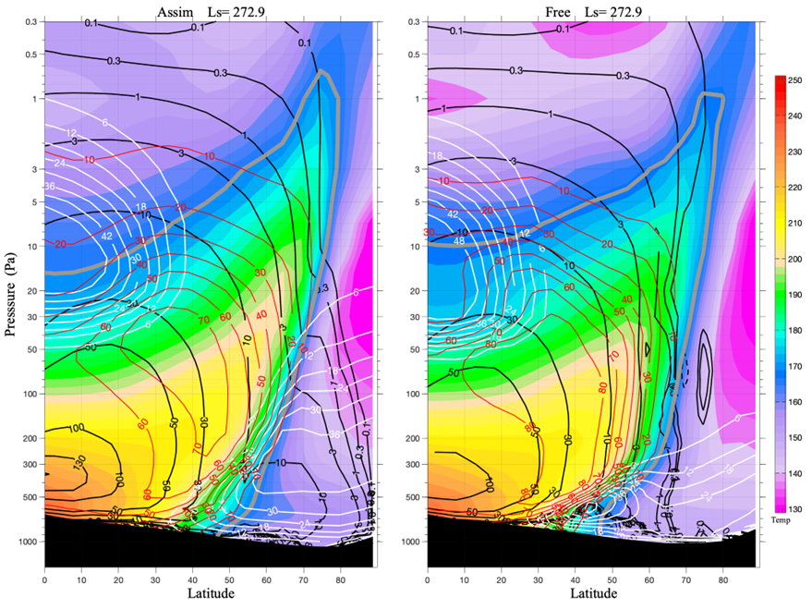
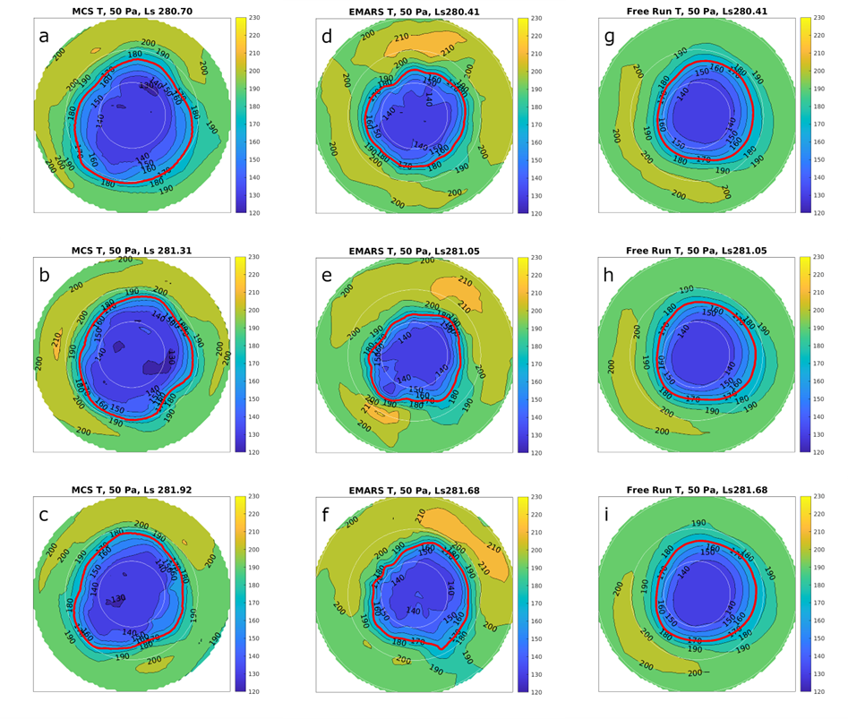
National Aeronautics and Space Administration
Postdoc Research
Water Transport in the Mars Northern Winter Polar Atmosphere: Observations and Simulations
Presenter: Hartzel Gillespie, JPL Postdoctoral Fellow (Section 322)
Advisor: Armin Kleinböhl (JPL/Caltech, Section 322)
Collaborators: Dan McCleese (Synoptic Science), David Kass (JPL/Caltech, Section 322), Steven Greybush (Penn State), R. John Wilson (NASA Ames)
Objective
The objective of this work is to determine how much water (vapor and ice) is passing through the boundary of the Martian north polar vortex during the winter, as well as where the water is entering the vortex and why.
Figure 2, reproduced from Fig. 10 in Gillespie et al. (in revision). Zonal mean stream-function, and other quantities, in EMARS (left) and the free run (right) averaged over 5 sols after
Background
Dynamically, the atmosphere of Mars is more similar to Earth than all other known planetary atmospheres. Mars has a tenuous and cold atmosphere, with an average surface pressure of 6 mb (600 Pa), less than a hundredth the pressure of Earth’s atmosphere. The scale height for Mars (that is, the vertical distance over which pressure drops or rises by a factor of e) is about 10 km, slightly larger than Earth’s scale height.
Aside from the objective, several unanswered questions about the Martian atmosphere motivate this study and are addressed tangentially:
How do the winds on Mars vary over space and time?
Is the north pole gaining or losing water over time?
Why is Mars’s polar vortex more permeable than Earth’s?
Figure 1 (reproduced from Fig. 7 in Gillespie et al., in revision). Three consecutive daily north polar temperature maps, sampled at ~3 pm local time, at ~50 Pa (or ~25 km) from MCS (panels a, b, c), EMARS reanalysis (d, e, f) and the free run (panels g, h, i). The three rows in the figure are consecutive days centered on the listed Ls in Mars Year 30. The maps extend to 45°N.
winter solstice as a function of latitude and pressure (Pa). Streamfunction (10^8 kg/s) is in black, water vapor mass mixing ratio (10^-6 kg/kg, or ppm by mass) is in red, water ice mass mixing ratio (also 10^-6 kg/kg, or ppm by mass) is in white, and temperature (K) is in color. The 170 K contour is marked in bold gray. In EMARS, the streamfunction reaches further into the vortex, and ice amounts are much higher and more vertically extended than in the free run.
The figure above shows the observed transport. To an approximation, air follows the black streamfunction contours clockwise, and the 170 K isotherm, which is the polar vortex boundary in regions where colder air lies under the isotherm, is in gray. Air enters the polar vortex at higher altitudes in EMARS (left) than in the free run (right). Also, air crossing the polar vortex boundary in EMARS contains more water (red) and ice (white) than in the free run.
We calculate that in EMARS, there is a net transport of 5.9 Tg/day water into the polar vortex near the winter solstice, while in the free run, there is 3.6 Tg/sol. Additionally, water transport into the vortex is substantially more variable in space and time in EMARS than in the free run.
The red contour is 170 K and defines the vortex boundary. The vortex shape is more similar to the MCS measurement in EMARS than in the free run.
Significance of Results/Benefits to NASA/JPL
Reanalyses provide a unique perspective because they assimilate MCS retrieved temperatures and provide a corresponding observationally constrained wind field to enable studies of transport. When considering the time variability of the polar vortex, EMARS is much more realistic than the MGCM free run when compared to MCS data; EMARS and MCS demonstrate a dynamically changing vortex edge and the more robust presence of transient eddies aloft that rotate around the pole. The boundary of the polar vortex has substantial variability in time and space, even on timescales of a few sols, and that variability presents a challenge for understanding transport into the polar vortex using zonal mean quantities.
Both Earth and Mars have polar vortices (the polar vortex of Mars is shown above, encircled in red), which are large, dynamic pools of cold air over the winter pole, near the winter solstice. The vortex boundary is characterized by large gradients in a variety of fluid dynamical fields, including temperature. On Earth, the polar vortex is quite dry, and it is difficult for air to enter and exit the vortex. On Mars, however, we show that the vortex is quite permeable, and we illustrate how water can enter the vortex.
Approach and Results
To determine the amount of water entering the northern polar vortex of Mars, we combine observational information with computer simulations (models) using a statistical process called data assimilation. Observations of temperature from the Mars Climate Sounder (MCS) (McCleese et al., 2007) are assimilated, and dust observations are taken into account as well, to anchor the simulation to real Martian conditions; MCS also observes water ice. A Mars global climate model (MGCM), referred to as a free run, is required as a base because observations of wind are not available for Mars globally. Wind is determined based on a combination of simulated and observed temperature in accordance with the primitive equations of meteorology, which are themselves conservation laws. The combination of the observations and model is called the Ensemble Mars Atmosphere Reanalysis System (EMARS) (Greybush et al., 2019).
Future Work
This work has been and will be shared at a variety of conferences significant to the Mars atmosphere community, such as the American Geophysical Union (AGU) fall meetings, the International Conferences on Mars, and the Mars Atmosphere Modeling and Observations workshops. The next step to take is: What does the Southern Hemisphere look like? Is it similar, or very different?
Funding: This research was carried out at the Jet Propulsion Laboratory, California Institute of Technology, under a contract with the National Aeronautics and Space Administration. H.E.G. and A.K. acknowledge support by the Solar System Workings program (80NM0018F0612).
National Aeronautics and Space Administration
Jet Propulsion Laboratory
California Institute of Technology
Pasadena, California
www.nasa.gov
Publications and Acknowledgements:
Gillespie, H. E., D. J. McCleese, A. Kleinböhl, D. M. Kass, S. J. Greybush, and R. J. Wilson (in revision). Water transport in the Mars northern winter polar atmosphere: observations and simulations, J. Geophys. Res. Planets
Author Contact Information:
hartzel.e.gillespie@jpl.nasa.gov, (818) 354-2970
Clearance Number: CL#00-0000
Poster Number: PRD-P-023
Copyright 2023. All rights reserved.

