Slide 1
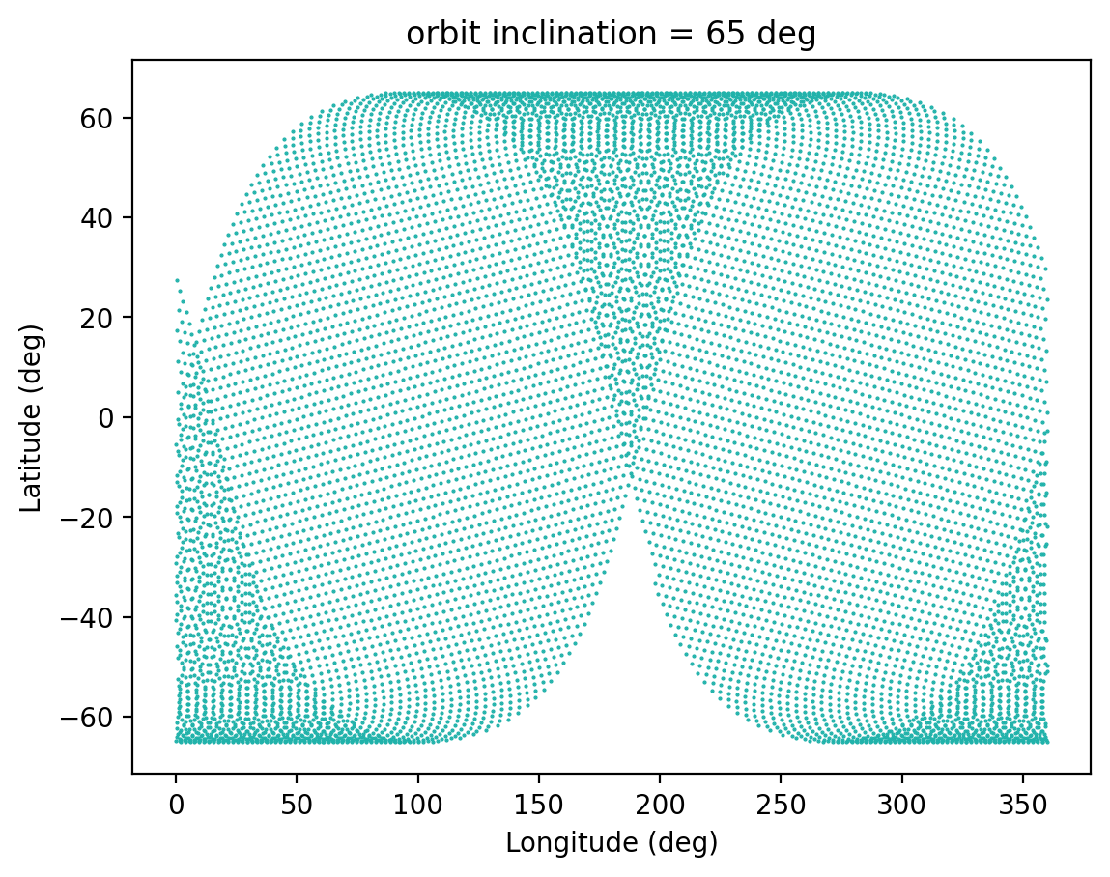
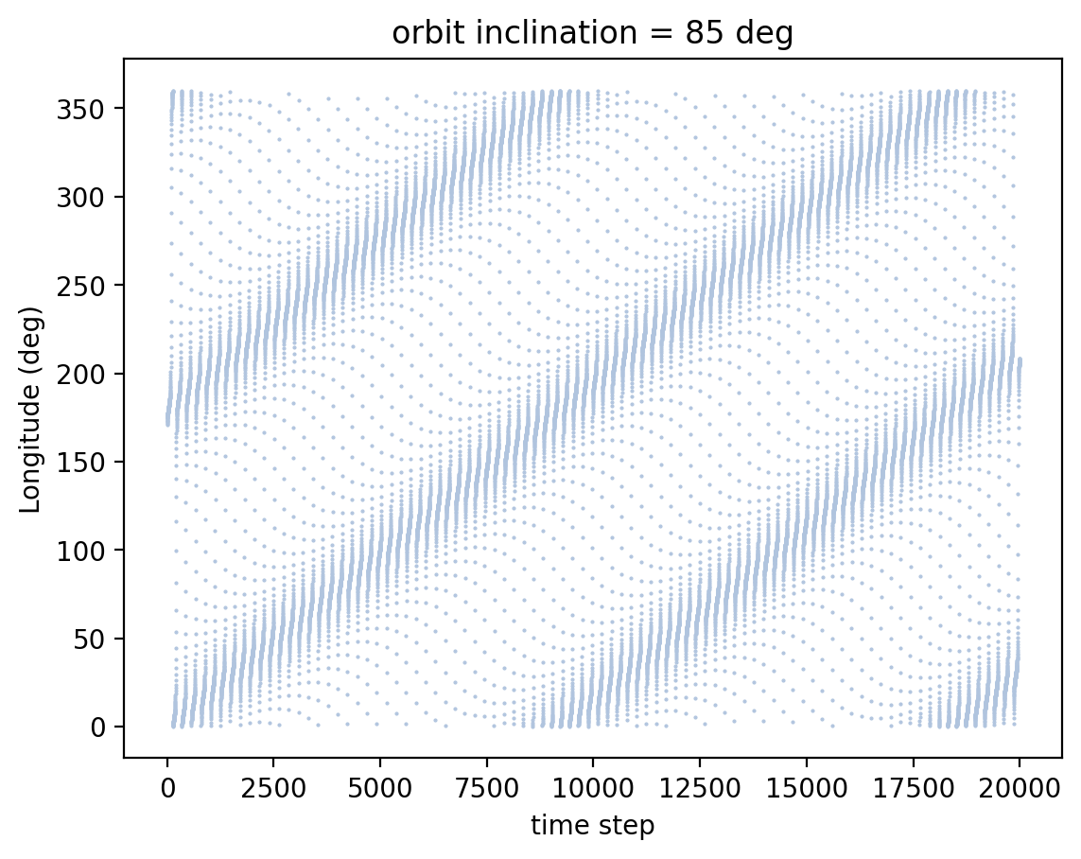
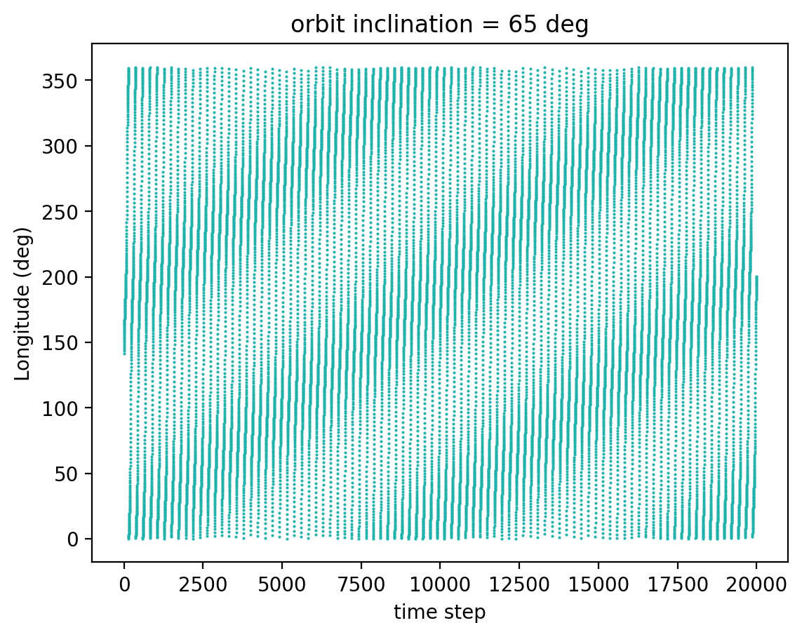
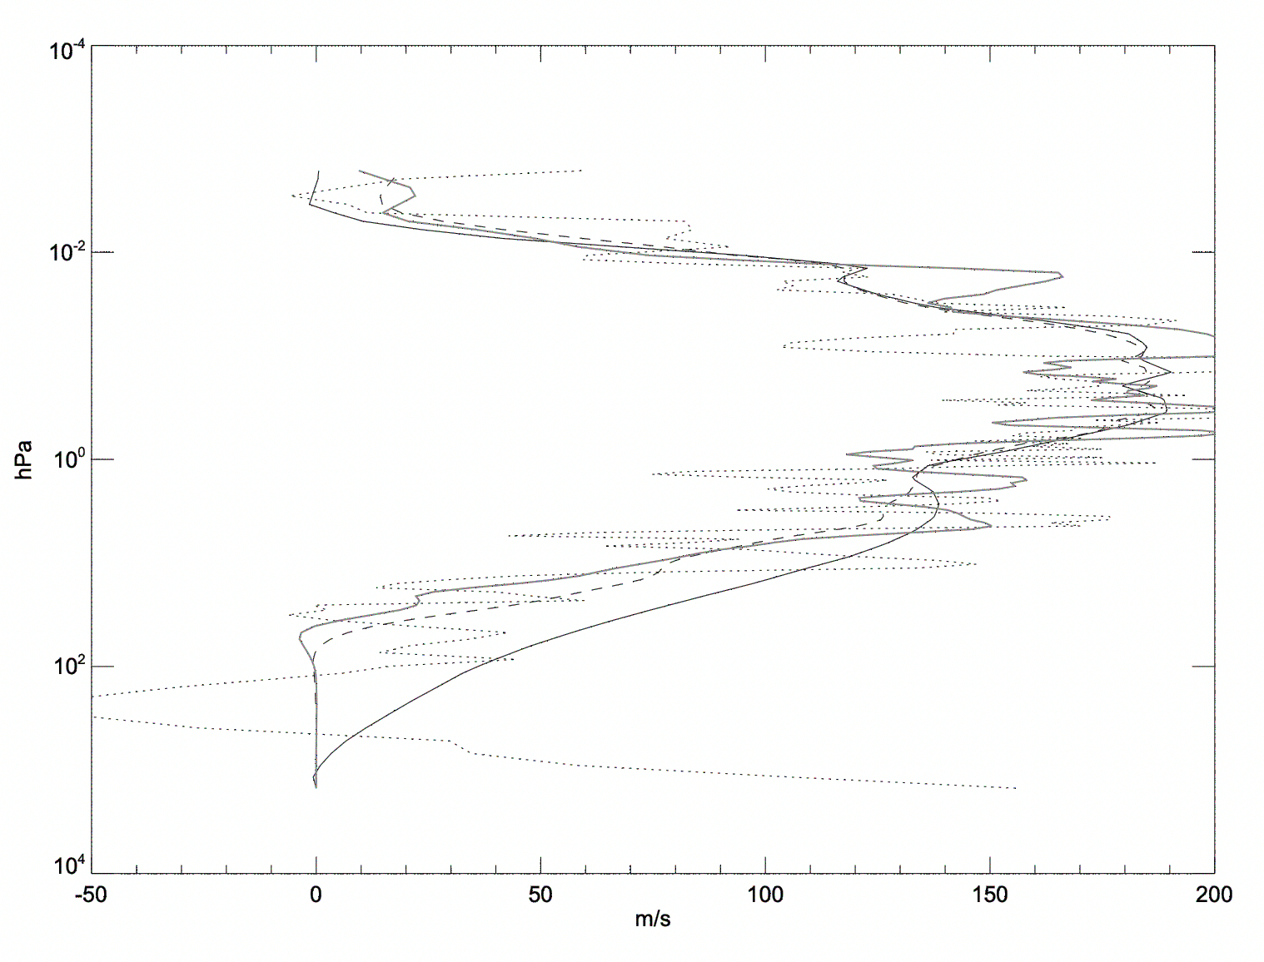
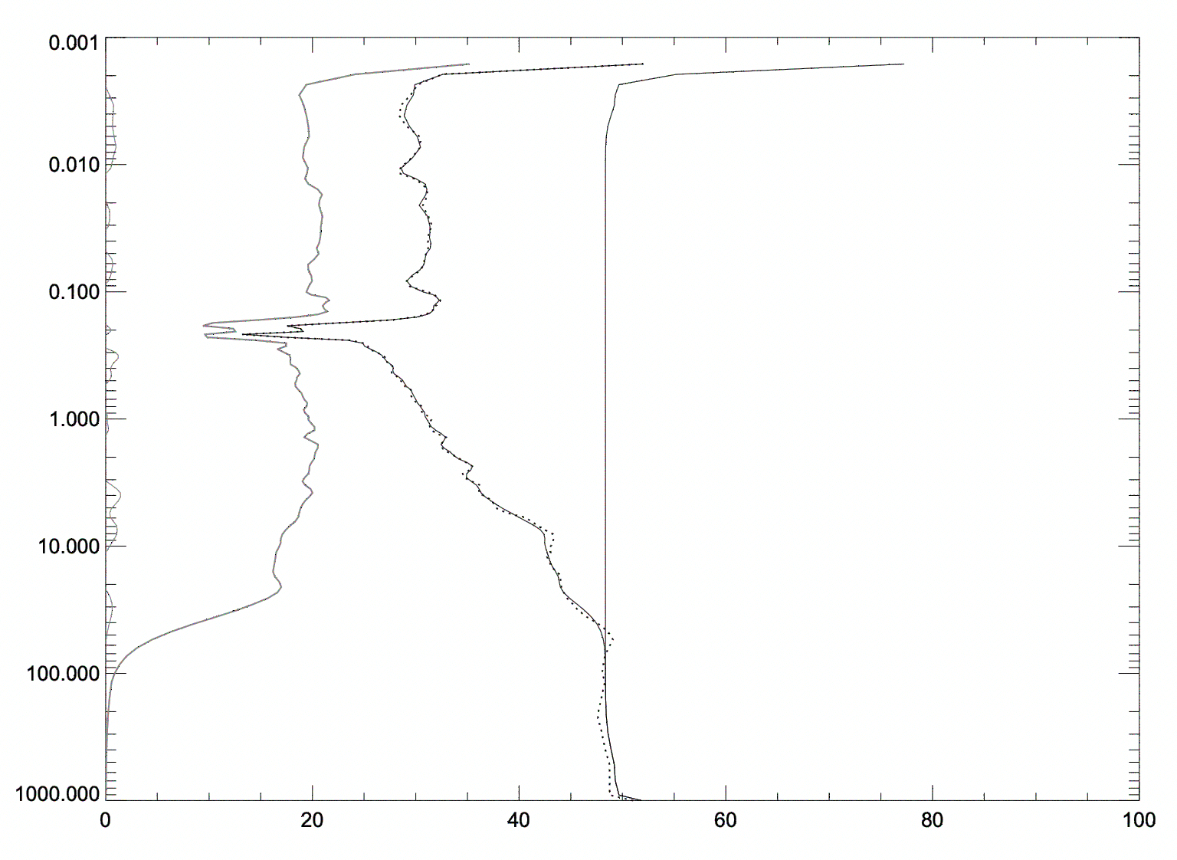
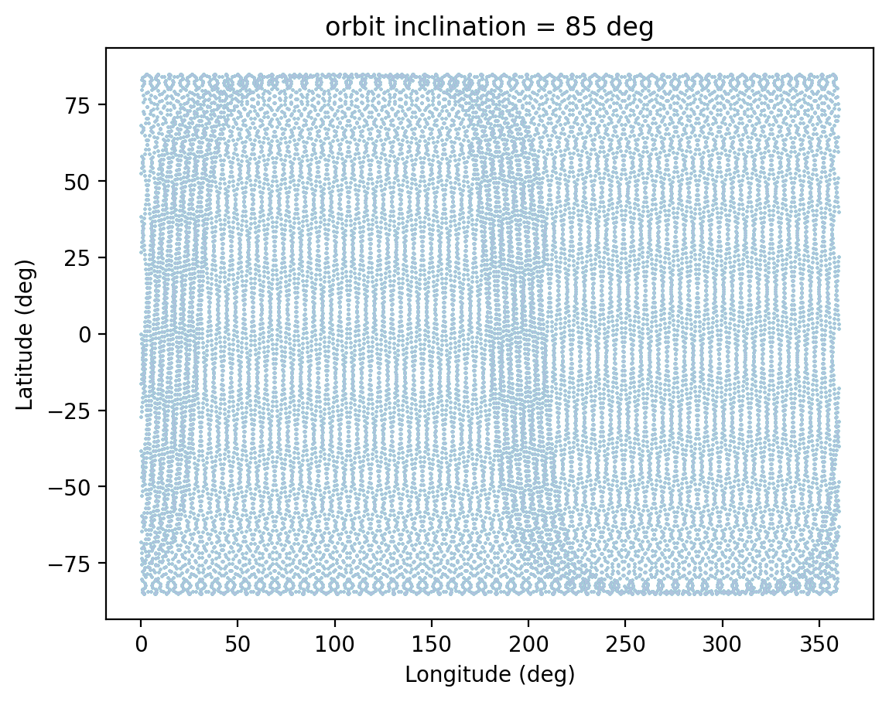
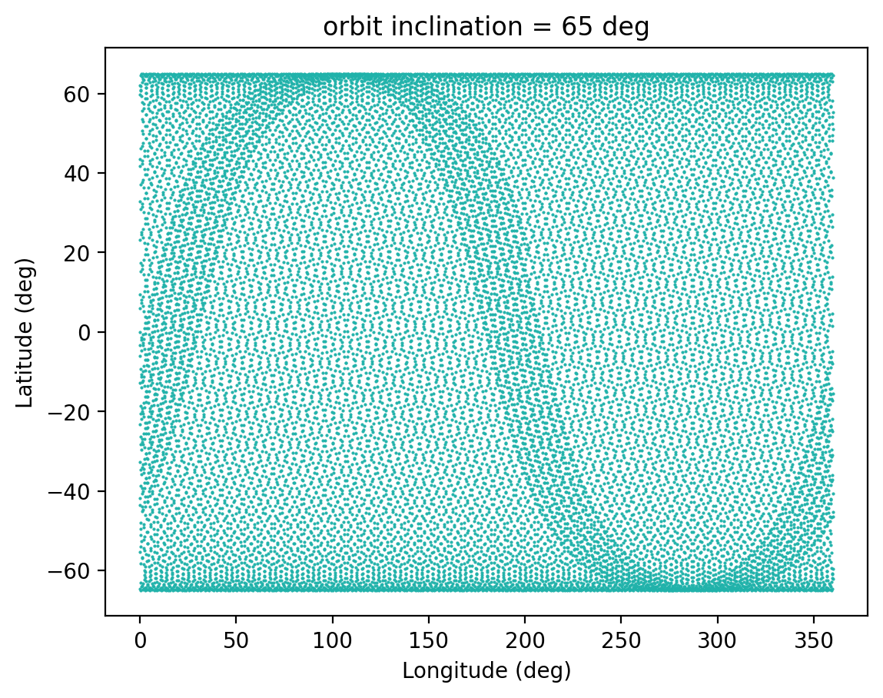
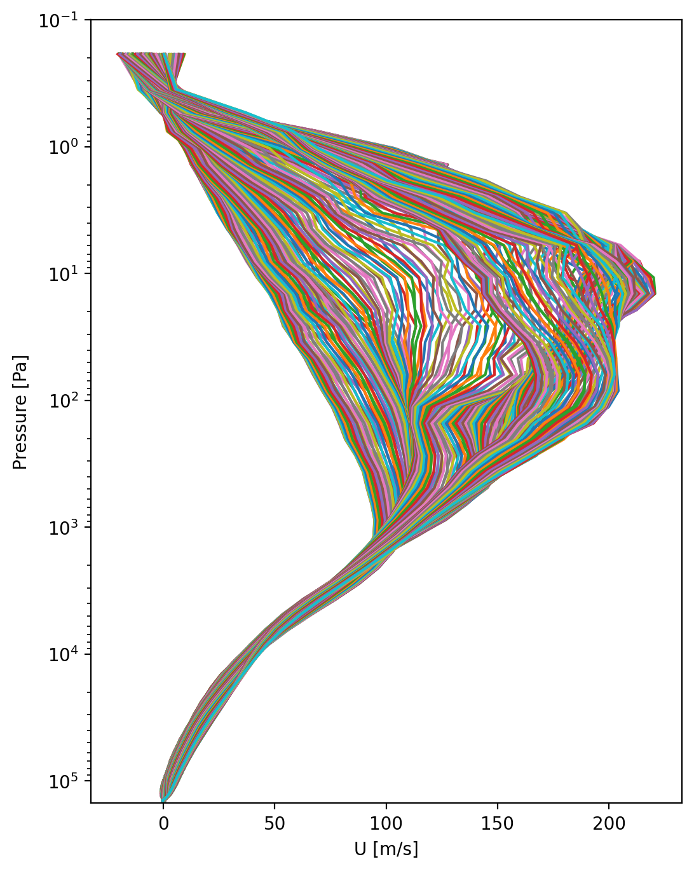
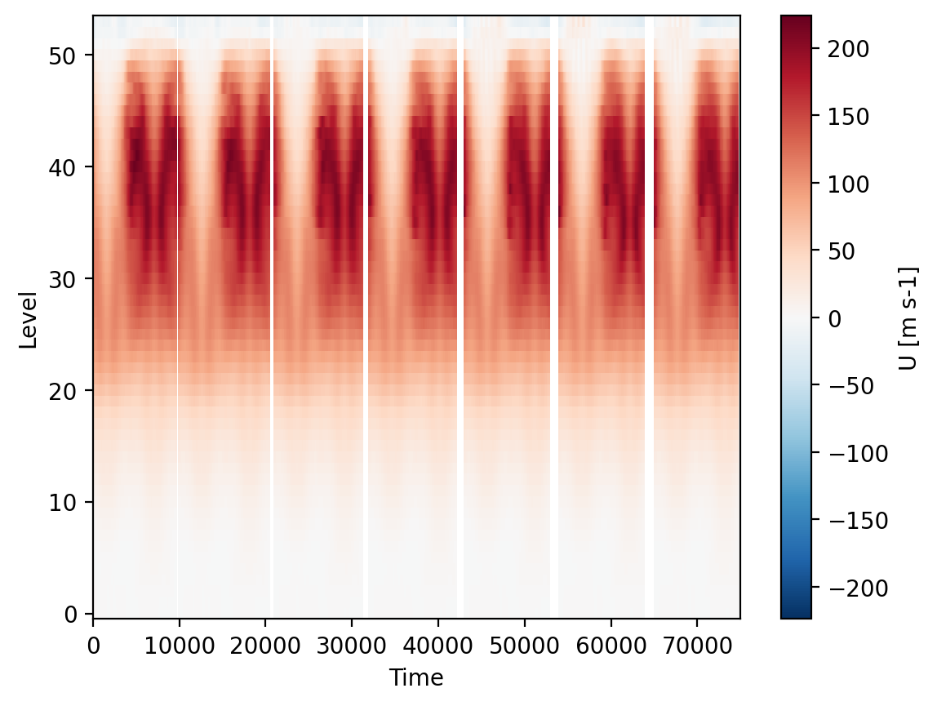
National Aeronautics and Space Administration
Postdoc Research
OSSE for Titan Sub-mm Instrument Development
Authors: Cecilia Leung (322), JPL Postdoctoral Fellow
Leslie Tamppari (3222), William Read (329), Nathaniel Livesey (329), Goutam Chattopadhyay (386), Yuan Lian (Aeolis Research), Claire Newman (Aeolis Research)
Objectives (1) Develop the first Observation System Simulation Experiment (OSSE) to evaluate the efficacy of a sub-millimeter spectrometer in orbit around Titan.
(2) Evaluate suitable orbit configurations for our sub-mm point design to optimize the retrieval of vertical winds, temperature, and composition.
(3) Create a synthetic data set of measurements, and compare its fidelity with GCM output for wave detection in Titan’s atmosphere.
Background
Titan’s dynamic atmosphere is laden with organic molecules of astrobiological significance, while its atmospheric circulation including its strong superrotation contributes to how complex hydrocarbons produced in the upper atmosphere are distributed within the middle and lower atmosphere. A sub-millimeter sounder instrument designed to directly observe vertical profiles of temperature, winds, and composition could characterize trace gas transport processes and wave dynamics on Titan.
Approach and Results
Creating the synthetic data:
Fig. 1
Fig. 2
First, we created a point design for a limb-sounding sub-mm spectrometer using measurements of ¹³CO, C¹⁸O, H¹³CN, & HC¹⁵N spectral lines. Then, using TitanWRF GCM output as our “nature run” to represent the “true” state of Titan’s atmosphere, we generated a “synthetic L2 dataset” of pressure, temperature, & winds along the measurement track of a sub-mm instrument using our simulated orbit and orbital-sampling.
Orbit Evaluation & Selection:
We evaluated various orbit configurations for a spacecraft around Titan, and a near-circular polar orbit at an altitude of 1500 km with an inclination of 65 deg was selected. This choice sacrifices some polar coverage (above 65deg N & S), but provides relatively dense coverage at all other latitudes and longitudes. This coverage is suitable since our momentum transfer events are primarily equatorial to mid-latitude, the loss of polar coverage is acceptable. The orbital period is ~4.8 hours. Figure 1 maps latitude-longitude of the observations at a 75-sec sampling cadence.
Fig. 3
Figure 2 shows the effect of smoothing by the retrieval process as well as the addition of a representative amount of measurement noise consistent with the levels predicted by the retrievals to the initial model profiles to simulate the performance of the instrument. The estimated uncertainty computed are shown on the right.
A sample set of resulting wind profiles representing the synthetic L2 measurement data are shown in Figure 3.
Comparison of truth-to-synthetic data
We compare the “synthetic” data to the TitanWRF GCM modeled output of zonal-mean zonal winds and temperatures to determine the global and meridional atmospheric flow at Ls=191 on Titan during a season where large angular momentum transfer activity takes place. Identifying regions of discrepancy helps to quantify the simulated instrument’s ability to capture the atmospheric dynamical processes of interest for wave analysis.
Fig. 4
Significance / Benefits to JPL and NASA
Direct observations of Titan’s atmospheric circulation, as well as instrument development for the next generation of measurements winds, temperatures, and composition on Titan are of high strategic priority for JPL, NASA, and its ‘Roadmap to Ocean Worlds’. The completion of our Titan sub-mm point design and plans to test it with an OSSE significantly benefit JPL by extending the range of application of a JPL sub-mm sounder.
Future Work
Utilizing our synthetic dataset, future work would include performing cospectral and spherical harmonic wave analysis to identify the dominant atmospheric waves and comparing their characteristics with waves driving and maintaining superrotation on Titan directly using the TitanWRF GCM model output, thus allowing us to further evaluate our sub-mm instrument’s performance.
References [1] Claire Newman et al., “Stratospheric Superrotation in the TitanWRF Model,” Icarus, 213(2), 2011, pp. 636–654.[2] William Read et al., “Retrieval of wind, temperature, water vapor and other trace consituents in the Martian Atmosphere,” Planet. Space Sci., 161, 2018, pp. 26–40 [3] Tamppari et al., “Testing the efficacy of a sub-mm sounder for Mars atmospheric measurements,” Planet. Space Sci., in review.
National Aeronautics and Space Administration
Jet Propulsion Laboratory
California Institute of Technology
Pasadena, California
www.nasa.gov
Publications and Acknowledgements:
[A] Yuan Lian et al. “The Role of Planetary-Scale Waves on the Stratospheric Superrotation in Titan’s Atmosphere”. Manuscript to be submitted to Icarus or JGR Planet (2023).
[B] Cecilia Leung, Leslie Tamppari, Claire Newman, and Yuan Lian. “Angular Momentum Transfer in Titan’s Stratosphere,”,Europlanet Science Congress 2022, Granada, Spain, 18–23 Sep 2022, EPSC2022-716, 2022.
[C] Cecilia W. S. Leung, Yuan Lian, Leslie K Tamppari, Claire E Newman, William G Read, Nathaniel J Livesey, Goutam Chattopadhyay, Sven van Berkel and Subash Khanal, (2022) “Angular Momentum Transfer Events in Titan’s Stratosphere,” Abstract ID# 1097675 presented at 2022 AGU Fall Meeting, Chicago, USA. 12-16 Dec 2022.
Author Contact Information:
Email: cecilia.leung@jpl.nasa.gov
Clearance Number: CL#00-0000
Poster Number: PRD-P-028
Copyright 2023. All rights reserved.

