Slide 1
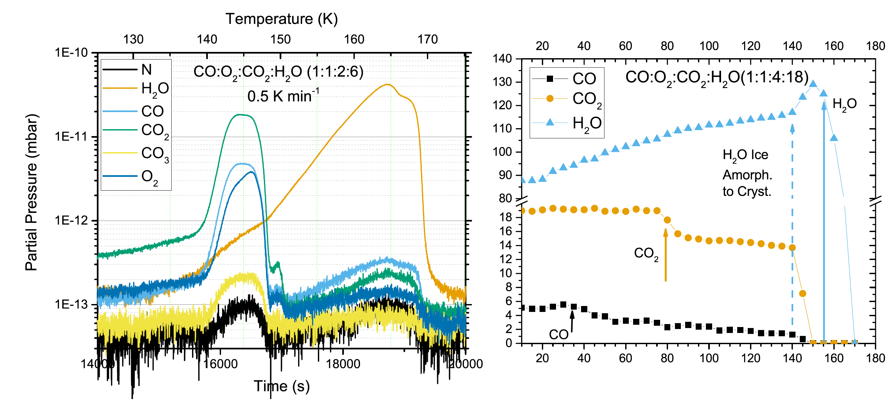
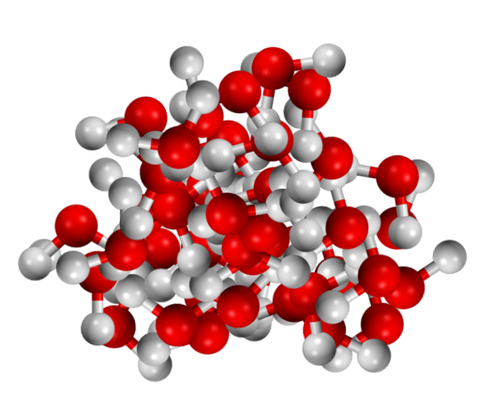
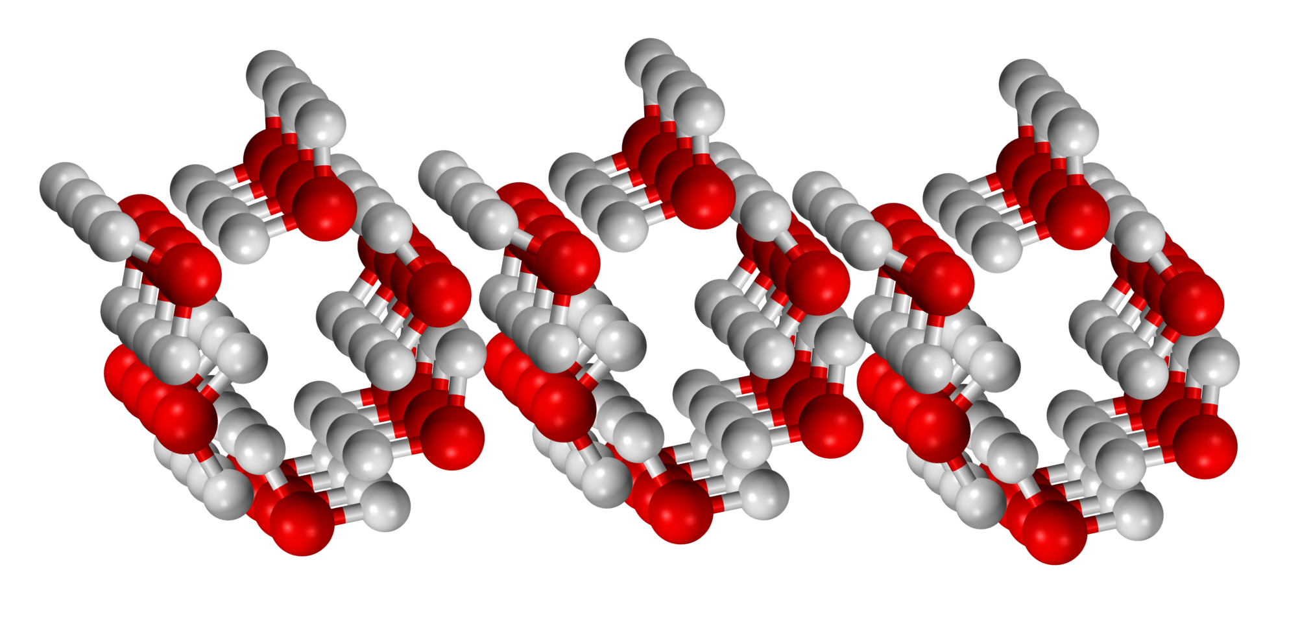
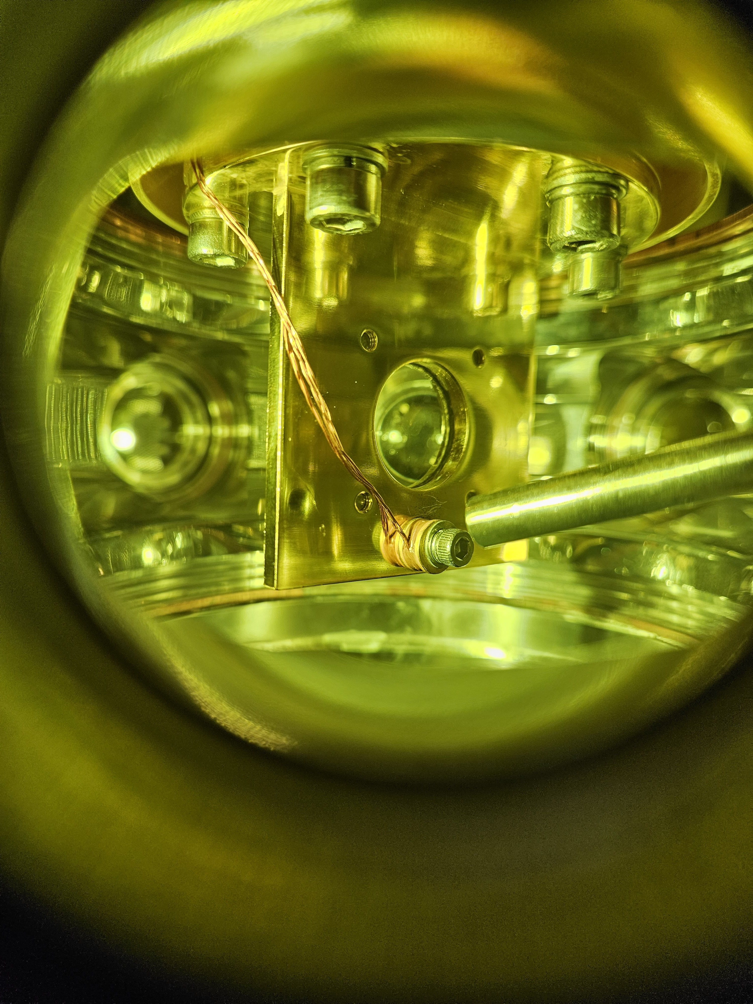
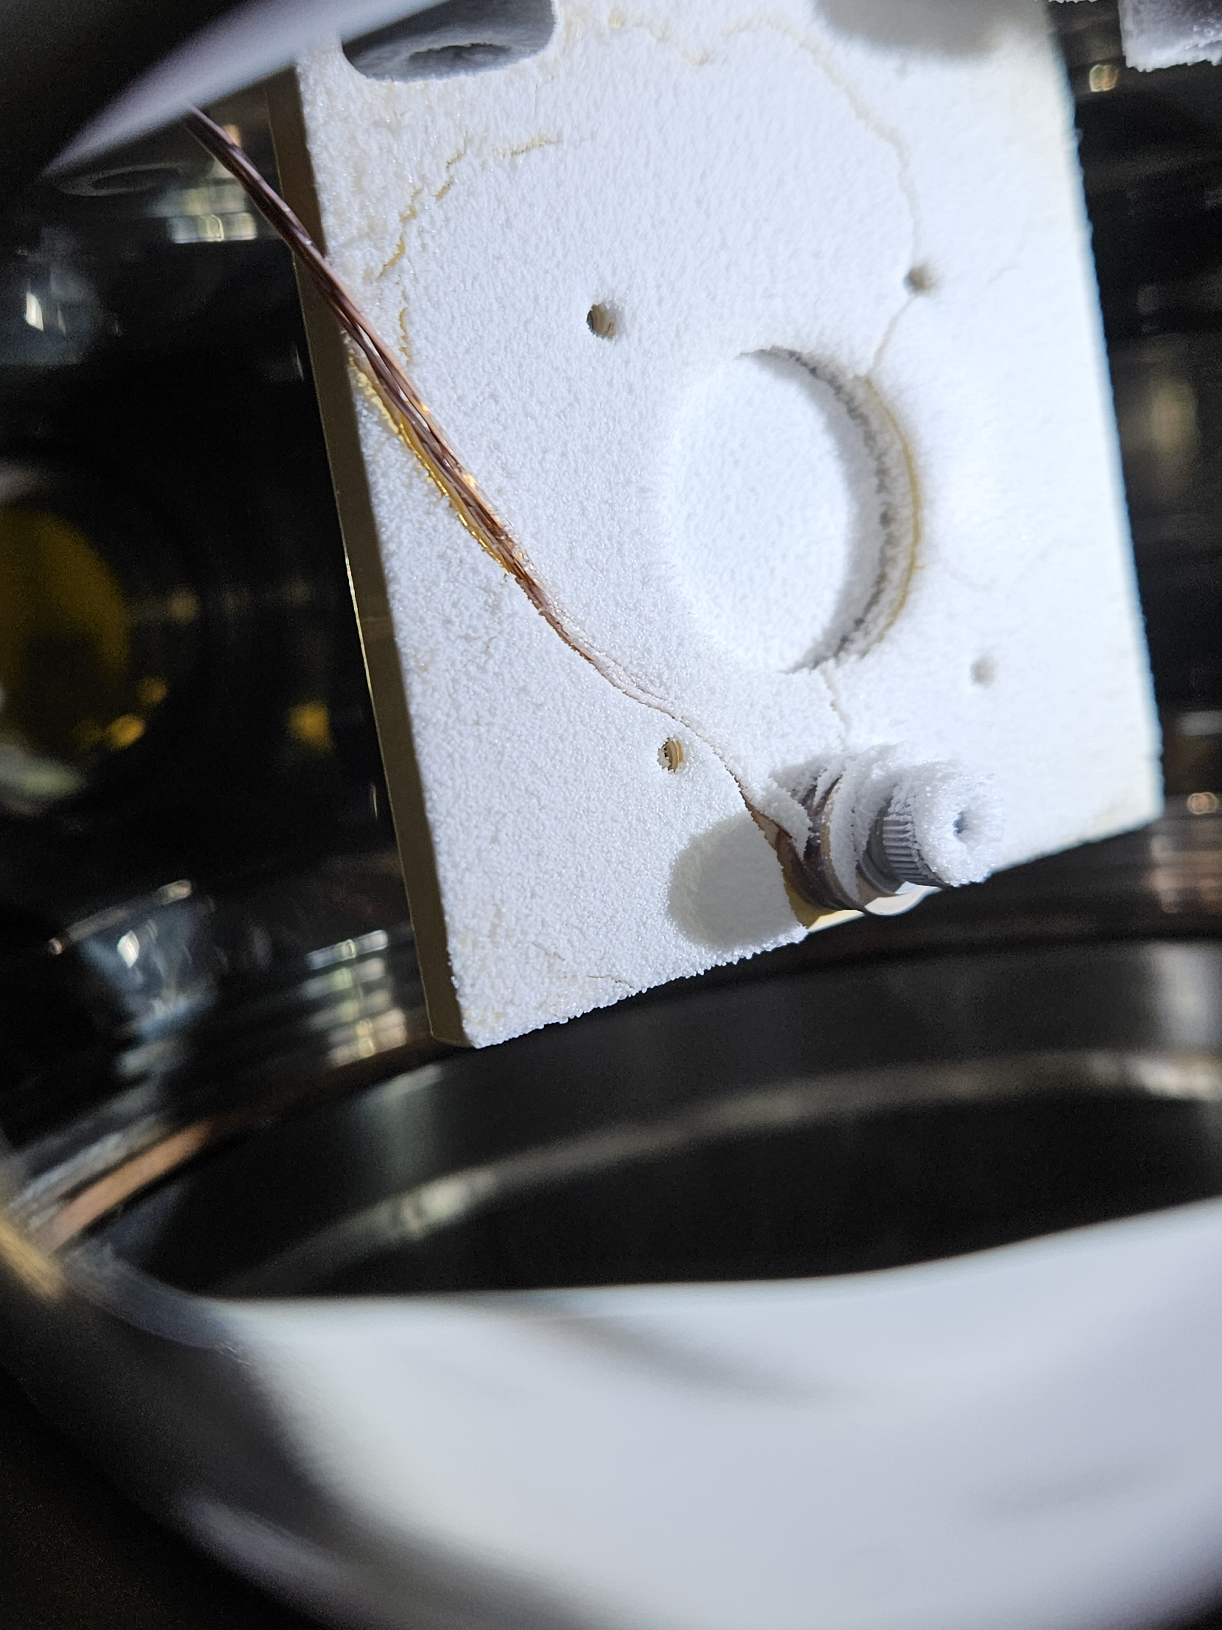
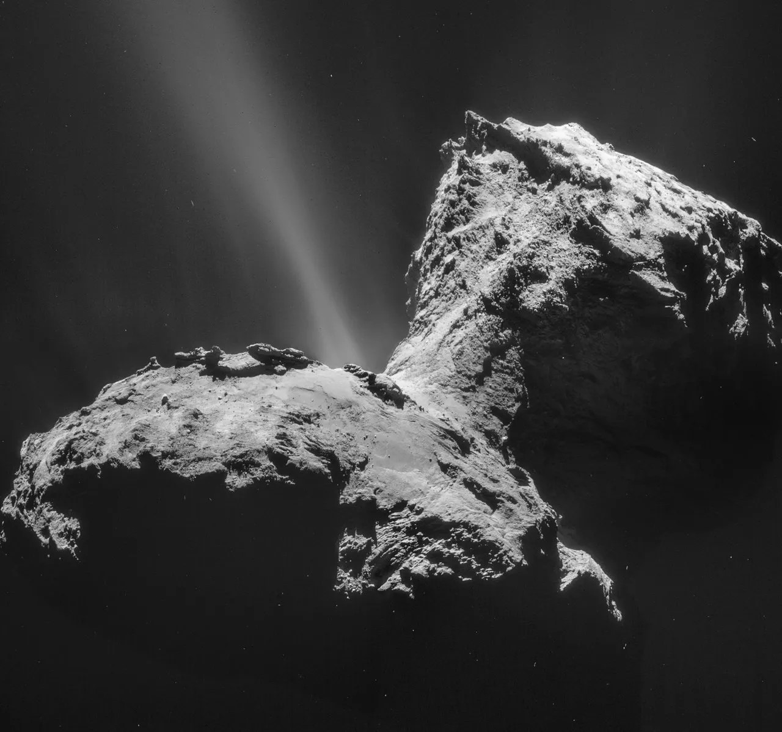
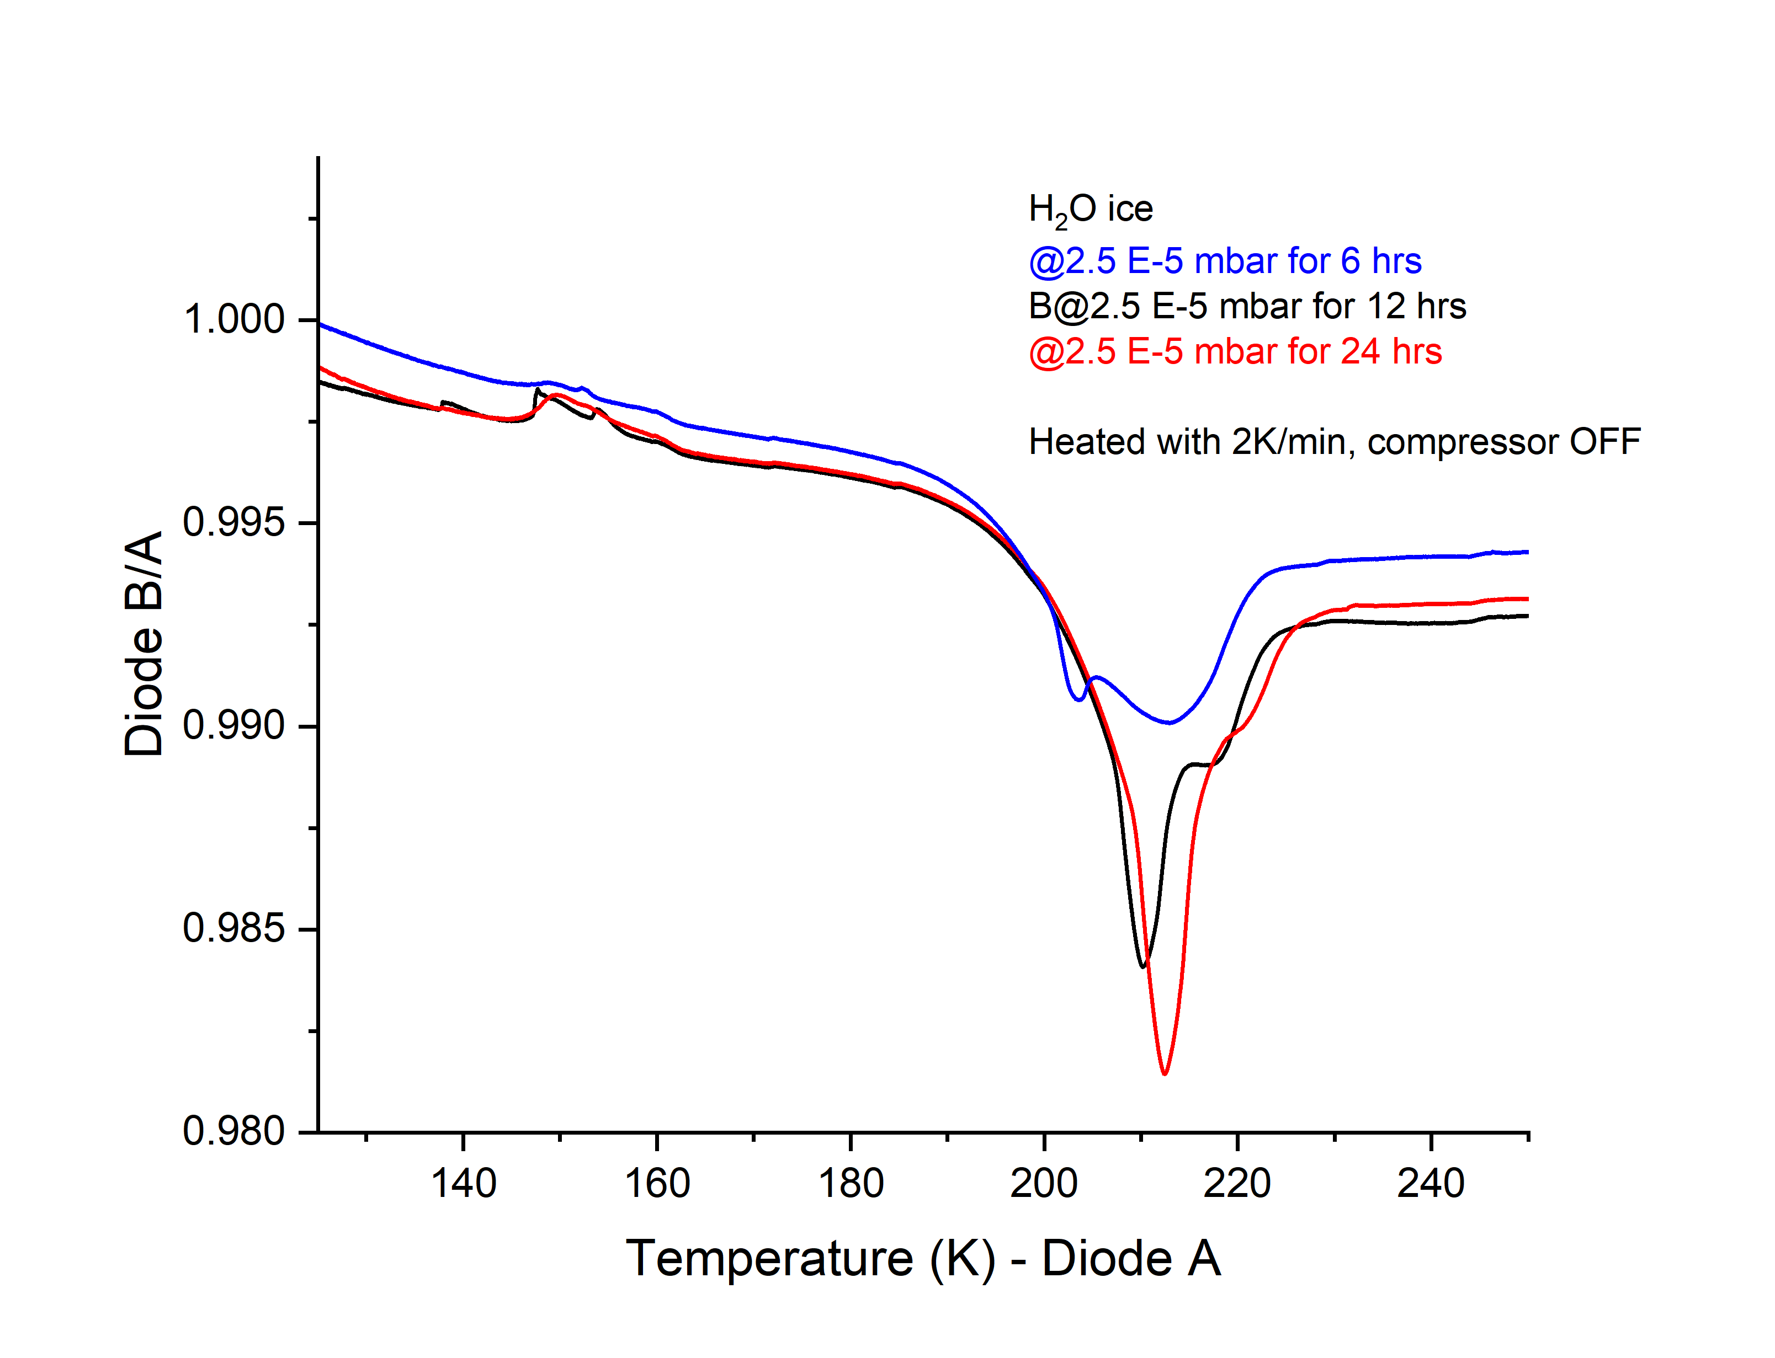
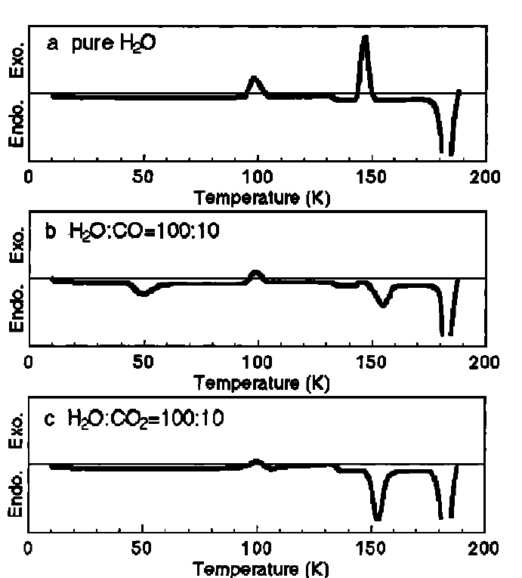
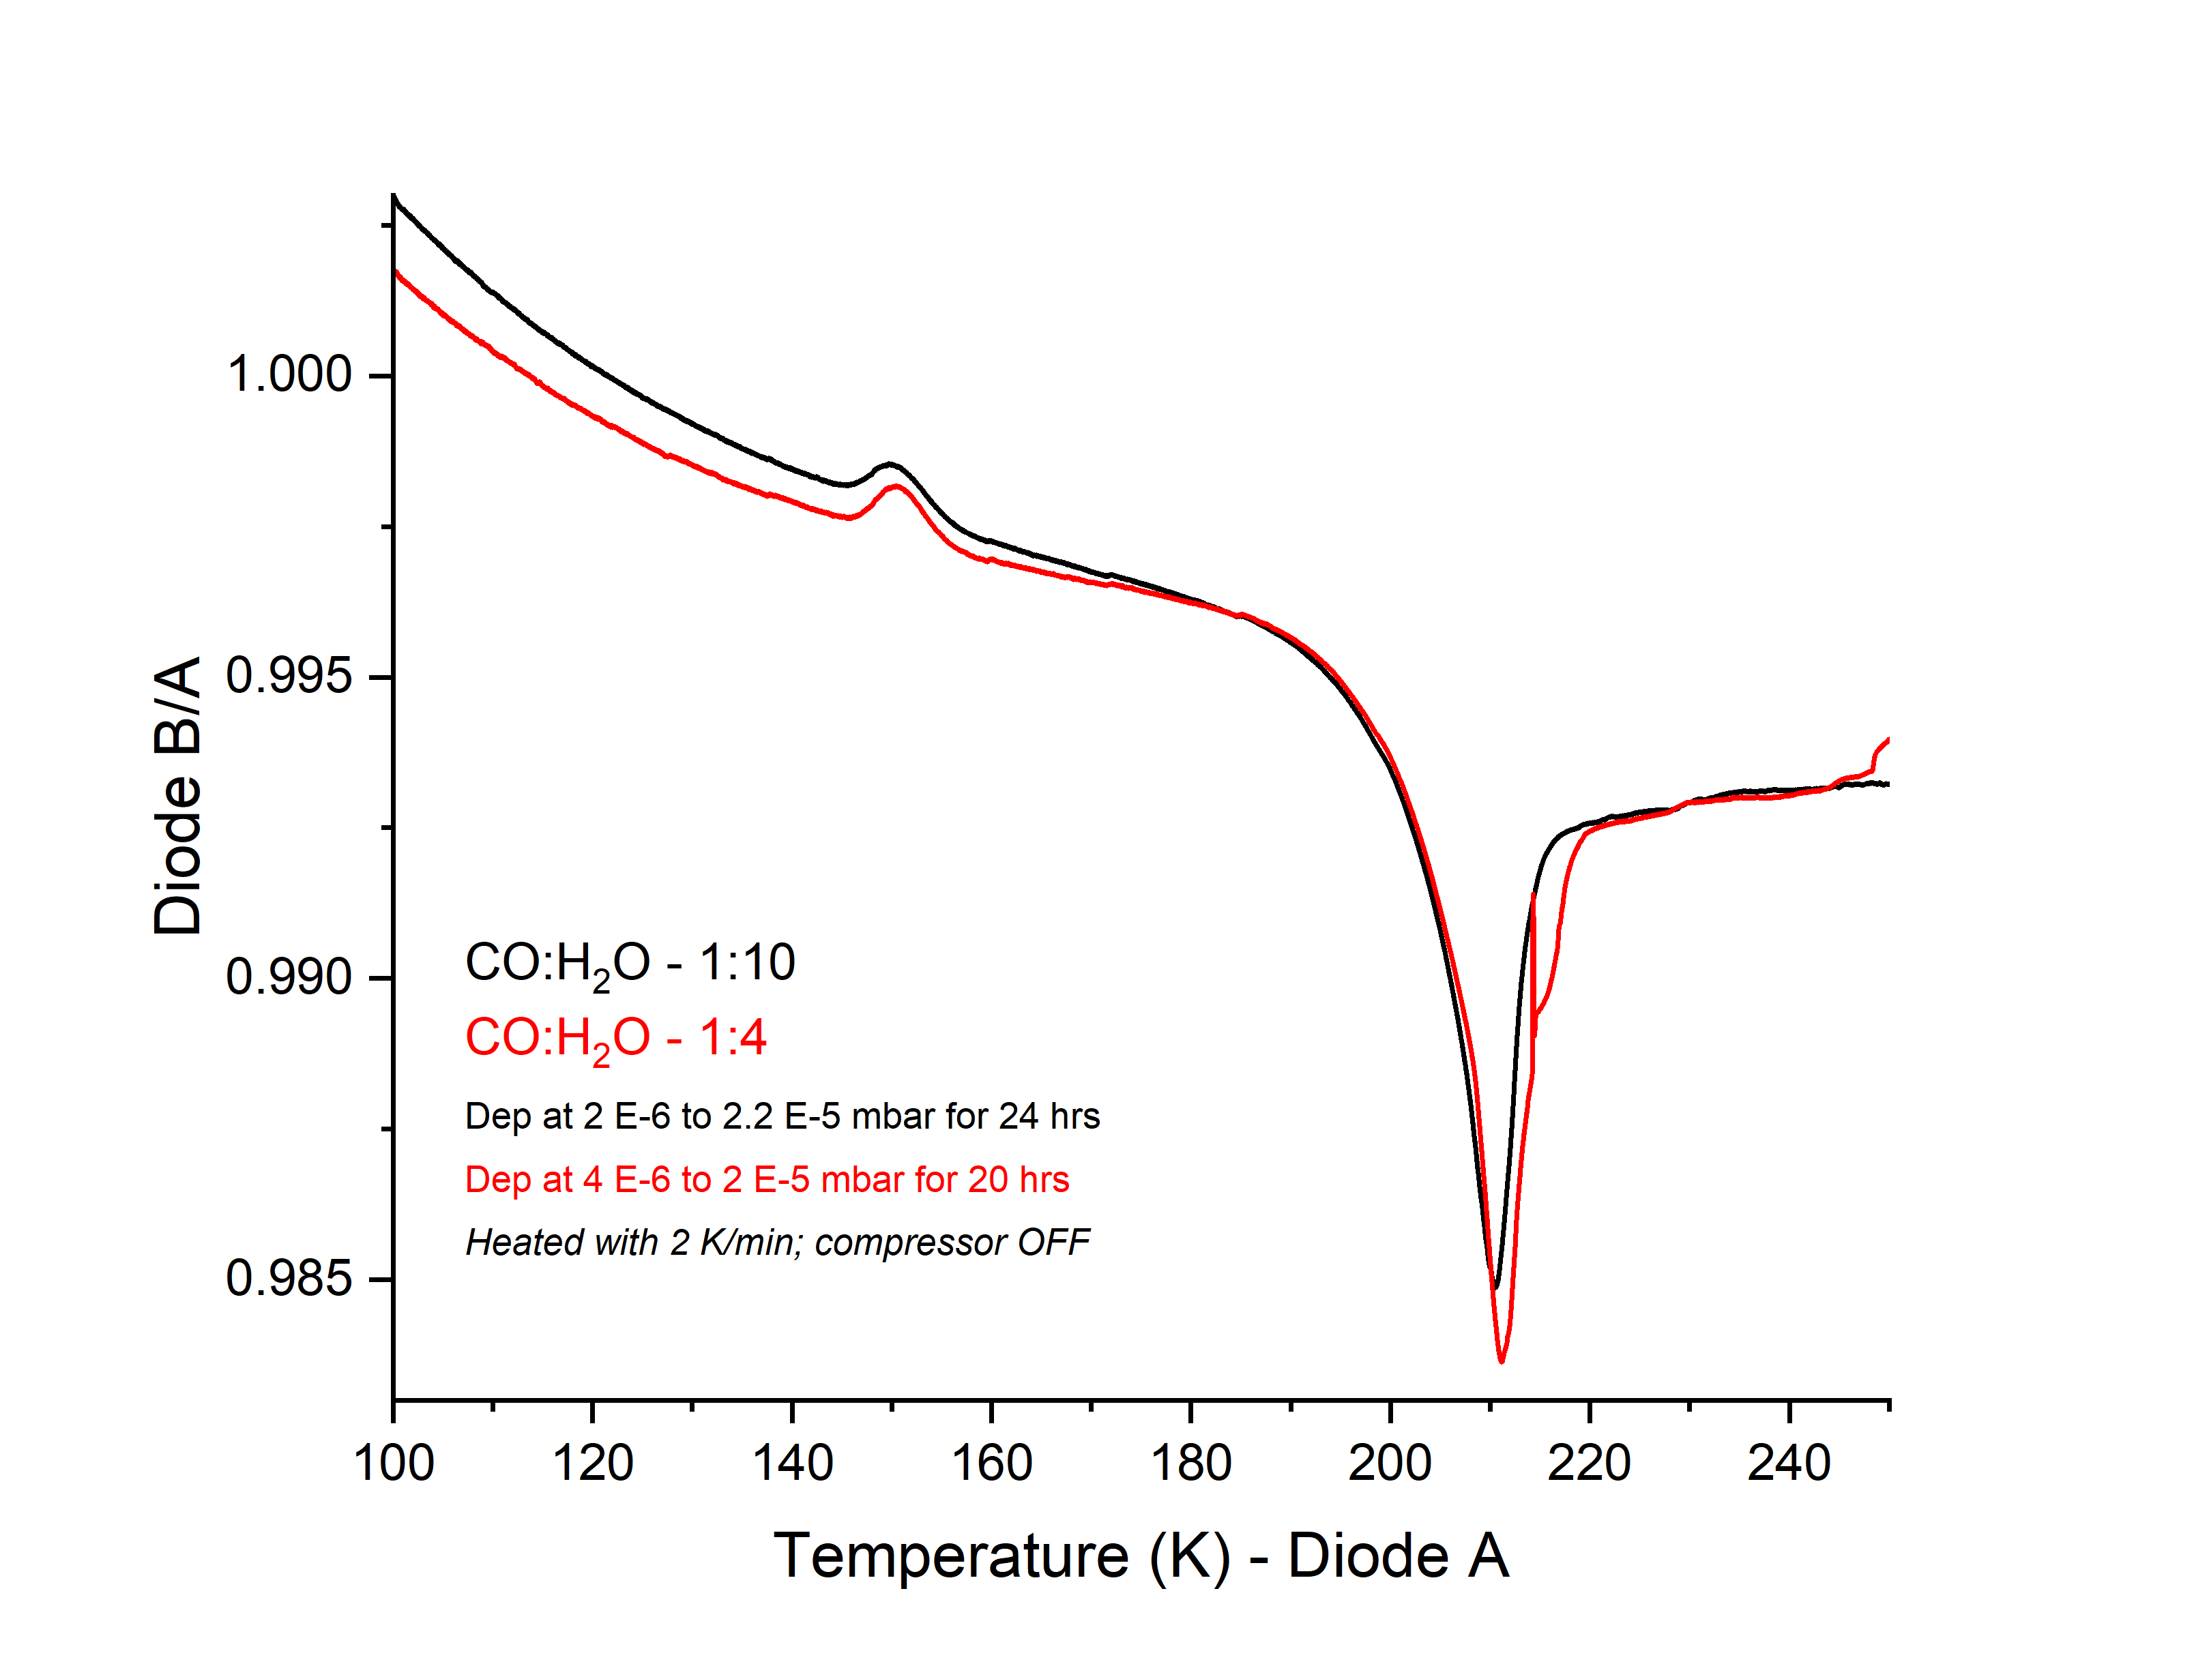
National Aeronautics and Space Administration
Postdoc Research
Calorimetry studies of cometary ice analogs
Rahul Kushwaha, JPL Postdoctoral Fellow (3227)
Murthy Gudipati (3227), Bryana Henderson (3227)
Background
Amorphous water (H₂O) ice plays a crucial role in the outgassing and chemical evolution of comets due to its porous nature and low thermal conductivity.
The crystallization of H₂O ice is an exothermic process (Fig. 1) and releases most of the trapped volatile molecules (Fig. 2) (Gudipati et al. 2023).
Recent exploration of Comet 67P shows the dichotomy of volatiles outgassing with H₂O and CO₂ (Gasc et al. 2017).
Objective
We use calorimetry to measure the energy released during phase changes in cometary ice analogs, i.e. H₂O mixed with volatiles (CO and CO₂) to understand how phase changes may affect outgassing of the comets.
Amorphous ice
Crystalline ice
4 K - 135 K
>135 K
Fig 2: Temperature-programmed desorption of cometary ices, tracking (a) mass spectra and (b) infrared spectra to follow outgassing and changes in ice concentration (Gudipati et al. 2023)
Fig 1: Graphical representation of energy being released during the phase transition of amorphous → crystalline H₂O ice
Fig 4: Photograph of substrate/ice sample holder - bare substrate (left), CO:H₂O ice on the sample holder (right)
Fig 3: Images of Comet 67P and Comet 1P/Halley (Image courtesy: ESA/NASA)
Exothermic
Results
The calorimetry experiments were conducted at the “Himalaya” set up in the Ice Spectroscopy Lab at JPL (Fig. 4).
The calorimetry data of H₂O ice shows that the heat of crystallization is approximately 110 kJ/kg (Fig 5), which is in agreement with findings of Gudipati et al. (2023) and others.
The CO (>10%) mixed H₂O ice also have exotherm peak during phase change of H₂O ice, which was not observed by Kouchi and Sirono (2002), they reported volatiles/impurity reduces the heat of crystallization of H₂O ice (Fig 6).
We are currently conducting infrared spectroscopy of these ice analogs for complementary analysis.
Endothermic
Fig 5: Calorimetry data of H₂O ice of different thickness (left) and amount of energy released during crystallization (right)
Exothermic
Endothermic
Significance of Results
This work is of primary relevance to comet exploration, such as the Rosetta Mission. The energy released during crystallization will aid in our understanding of how the presence of volatiles in cometary ice analogs affects comet outgassing.
Fig 6: Calorimetry data of CO and CO₂ mixed H₂O ice from Kouchi and Sirono 2002 (left) and calorimetry data of CO mixed H₂O ice; our work (right)
References
(1) Gudipati et al. (2023) Faraday Discussions, 245, 467 (2) Gasc, S. et al. (2017) MNRAS, 469, S108. (3) Kouchi and Sirono (2002) GRL, 28, 827
National Aeronautics and Space Administration Jet Propulsion Laboratory
California Institute of Technology
Pasadena, California
www.nasa.gov
Clearance Number: CL#00-0000
Poster Number: PRD- P- 31
Copyright 2023. All rights reserved.
Acknowledgements:
Author Contact Information:
Rahul.kumar.Kushwaha@jpl.nasa.gov

