Slide 1

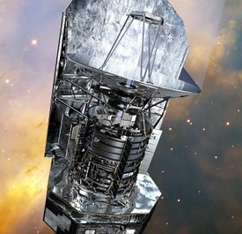




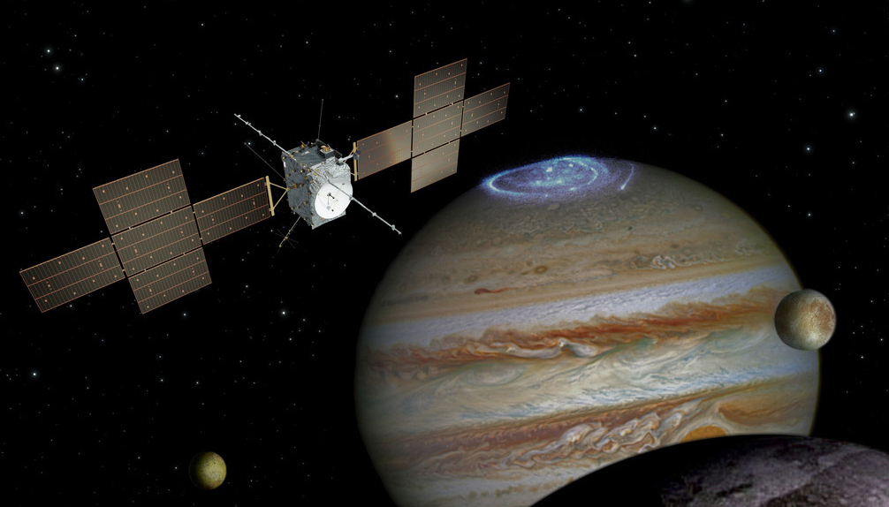


National Aeronautics and Space Administration
Postdoc Research
Novel Heterodyne Detectors for
THz High-resolution Spectroscopy
Author: Changyun (Chang) Yoo, NASA Postdoctoral Fellow (386H)
Supervisor: Boris Karasik (386H)
Collaborators: Jonathan Kawamura (386H), Chris Curwen (386H),
Changsub Kim (389I), Daniel Cunnane (389I), Mark Sherwin (UCSB)
Science Objectives
THz Heterodyne Spectrometer
Past & Future THz Heterodyne Instruments
High-resolution (f/Δf > 10⁷) spectroscopy at THz frequencies (1-5 THz)
High-resolution spectroscopy at THz frequencies is enabled by heterodyne detection.
Herschel Space
Observatory
STO-2 and ASTHROS
AURA
THz Signal
Low
Room-T Amplifiers
Back-end
Spectrometer
Heterodyne
Detector
(Mixer)
Low-noise
Amplifier
HIFI: 0.48 - 1.25 THz
1.41 - 1.91 THz
1.4 - 1.5 THz; 2.4 - 2.7 THz
MLS: 118, 190, 240, 640, 2500 GHz
THz Local-Oscillator (LO)
Cooled to cryogenic temperature
SOPHIA
Rosetta Orbiter
JUICE
Detection of key molecules and atoms in the interstellar space and in the atmospheres of planets and comets
Study of kinematics of THz emitting bodies and wind velocities
Motivation
GREAT: 1.4 - 1.9 THz,
2.4 - 2.7 THz, and 4.7 THz
MIRO: 190, 562 GHz
SWI: 530 - 625 GHz;
1080 - 1275 GHz
The motivation for this work comes from the continuous and ongoing need for sensitive THz mixers at 1 - 5 THz that operate at a high operating temperature (> 20K) with a wide intermediate-frequency (IF) bandwidth (>10 GHz) and a small required local-oscillator (LO) power (< 1 µW).
Hot-Electron Bolometer (HEB) Mixer
Based on High-T_{c} Superconductor
Tunable Antenna-Coupled Intersubband
Terahertz (TACIT) Mixer
MgB₂ mixers are based on thin (< 20 nm) MgB₂ superconducting films that have high T_{c} (~ 40 K for bulk).
In MgB₂ HEB mixers, THz absorption occurs via Joule heating, and the IF response comes from the bolometric response due to the electron heating.
Fast energy relaxation in MgB₂ thin films offers wide (~ 10 GHz) IF bandwidth.
TACIT mixer is based on a single, 40-nm wide GaAs/AlGaAs square quantum-well (QW) heterostructures.
THz absorption occurs via tunable quantum transitions (intersubband transitions), and the IF signal is read out by the hot-electron bolometric response of the 2-dimensional electron gas (2DEG).
The detection frequency can be tuned in a wide range (2 -5 THz) with electrostatic biases, and a wide IF bandwidth (~ 10 GHz) is possible thanks to the fast energy relaxation (τ ~ 10 ps) in the 2DEG.
Source
Top Gate
Drain
THz RF, LO
Bottom Gate
GHz IF
Path Forward
Mixer Technology | DSB Noise Temperature | Operating Temperature | Required Pump (LO) Power | IF Bandwidth
Superconducting HEB (MgB₂) | < 2,000 K | > 20 K | ~ 1 µW | ~ 10 GHz
TACIT | < 2,000 K | 20 – 60 K | ~ 1 µW | ~ 10 GHz
Our mixer technology based on MgB₂ HEBs and TACIT mixers will enable sensitive, multi-pixel THz heterodyne receivers with relaxed requirements on cryogenic cooling and THz LO power.
National Aeronautics and Space Administration
Jet Propulsion Laboratory
California Institute of Technology
Pasadena, California
www.nasa.gov
Publications:
D. Cunnane et al., "Optimization of Parameters of MgB2 Hot-Electron Bolometers," IEEE Transactions on Applied Superconductivity, vol. 27, no. 4, pp. 1-5, 2017
C. Yoo et al., "Demonstration of a tunable antenna-coupled intersubband terahertz (TACIT) mixer," Applied Physics Letters, vol. 116, no. 1, 2020
Author Contact Information:
chang.yoo@jpl.nasa.gov
Clearance Number: CL#00-0000
Poster Number: PRD-T-001
Copyright 2023. All rights reserved.

