Slide 1
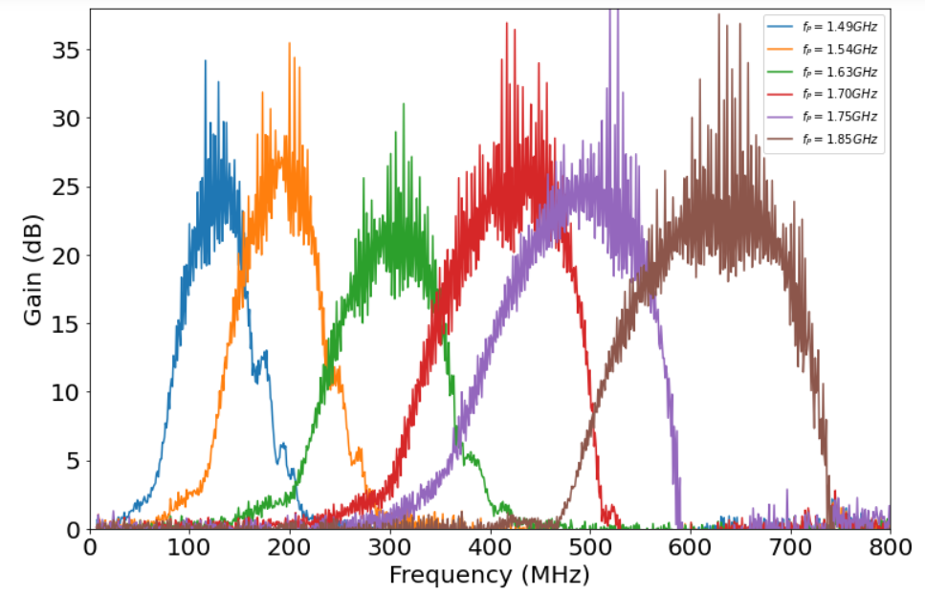
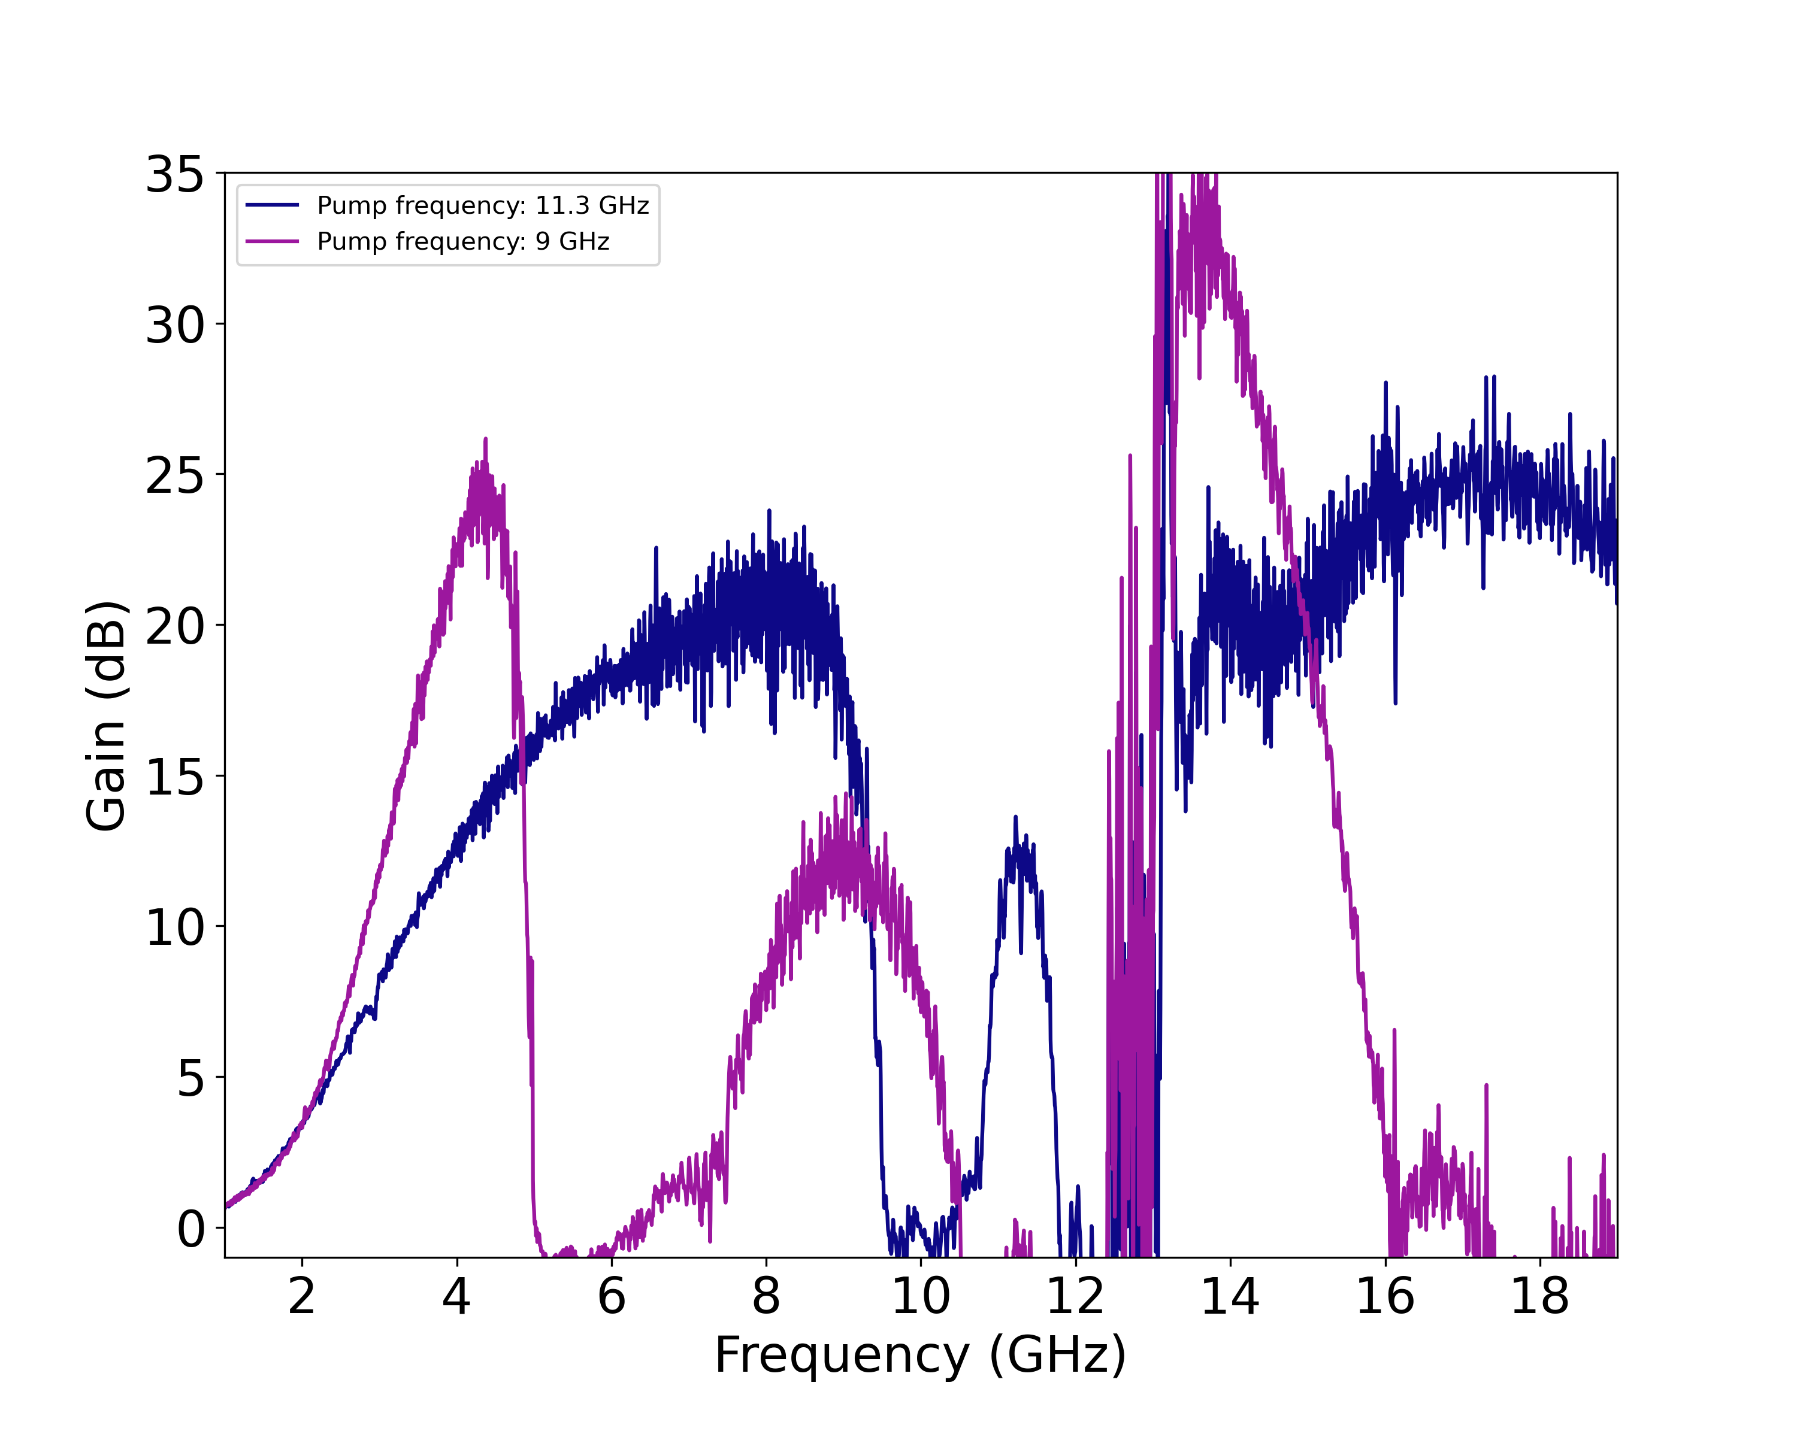
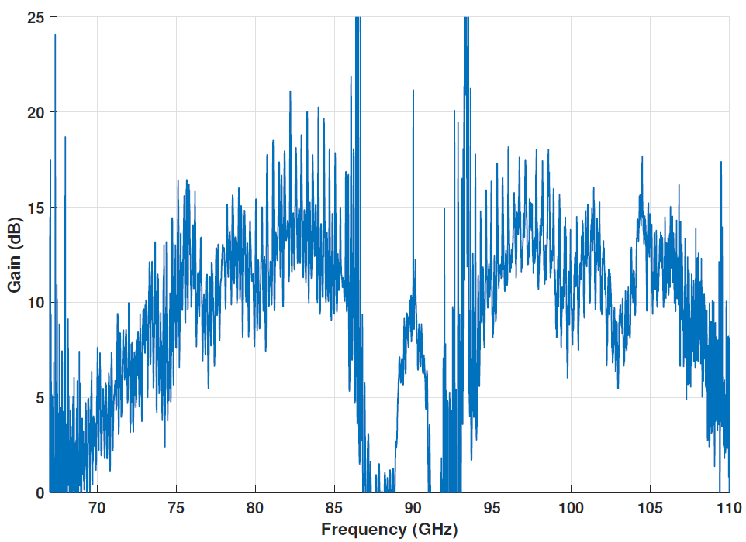
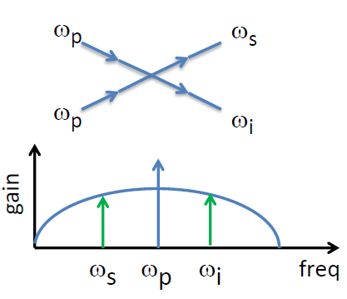
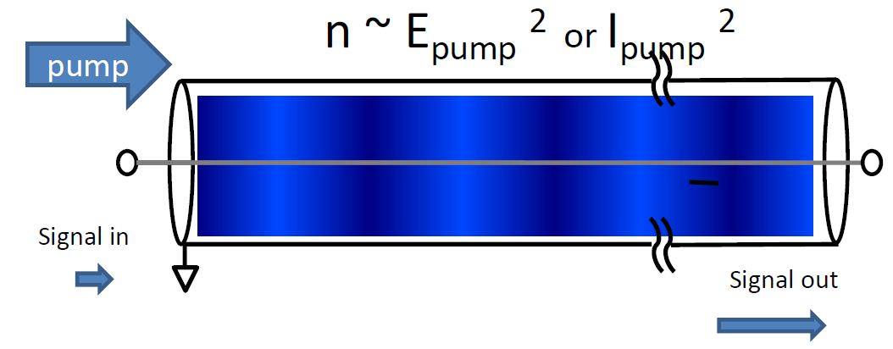
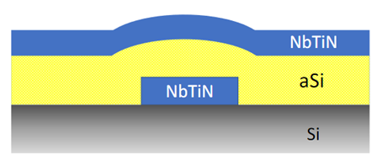
National Aeronautics and Space Administration
Postdoc Research
Kinetic Inductance Traveling Wave Parametric Amplifiers for Applications in Astrophysics
Author: Farzad Faramarzi, NASA Postdoctoral Fellow (389I)
Ryan Stephenson, Sasha Sypkens, Henry Leduc, Peter Day (389I)
Background
Direct detectors and heterodyne receivers can benefit from amplifiers with wide instantaneous bandwidth and quantum-limited noise performance. Transistor-based amplifiers are a common choice for frequencies below 100 GHz, but their noise temperature is in the tens of kelvin. Superconducting-insulating-superconducting (SIS) mixers are commonly used at higher frequencies but operate at noise temperatures a few times the quantum-noise limit. A new promising superconducting amplifier technology is the Kinetic Inductance Traveling-Wave Parametric Amplifier (KI-TWPA), which satisfies the abovementioned criteria. Coherent receivers are an irreplaceable tool for measuring the narrow atomic and molecular lines that trace the cool interstellar medium, providing the primary motivation for the HERO instrument on the Origins Space Telescope and the HIFI instrument on the last major far-IR mission, Herschel. This project focuses on characterizing microwave KI-TWPAs for cryogenic detector readout and fabricating and characterizing mm-wave versions for future applications in heterodyne receivers and detector readout.
Measurements:
Wideband and tunable gain
Y-factor technique
Near quantum limited performance
Summary:
Achieved wideband gain from few MHz to few GHz
Demonstrated QM-noise-limited performance in the µ-wave region
Fabricated mm-wave KI-TWPA
Fig.5. Gain plots of a sub-GHz TWPA .
Objectives
This project aims to demonstrate the near quantum-limited noise performance of the microwave KI-TWPA with wideband gain for read-out of cryogenic sensors such as MKIDS and TESs. It is also maturing the millimeter wave KI-TWPA technology by characterizing and optimizing the current prototype and developing a sub-millimeter version with wide bandwidth and quantum noise-limited performance. This would align with the continuation of NASA's decades of developing submillimeter-wave detectors.
Fig.6. Left,Gain plot of a µ-wave TWPA with different pump conditions. Right, measure noise of the TWPA and the system in units of quanta.
Fig.7. Left, fabricated W-band TWPA. Right, gain measurement of a W-band device.
Approach and Results
Theory of Operation:
Key circuit parameter is the non-linear inductive response
I²dI/dt Non-linearity transfers power from pump to signal and idler tones
Purely reactive nonlinearity
Dispersion Engineering is used for phase matching
Device Design and Fabrication:
3 fab layers
Inverted microstrip geometry
0.25-micron linewidth.
Significance of Results/Benefits to NASA/JPL
The Low-Temperature Detector technologies (e.g., MKIDs) that can benefit from parametric amplifiers are the primary candidate sensors for imaging, polarimetry, and spectroscopy for a broad range of astrophysics missions operating in the mm/sub-mm/FIR bands and also in the X-ray region.
The mm-wave and sub-mm-wave amplifiers will extend the existing state-of-the-art by providing quantum-noise-limited gain blocks. Improving receiver sensitivity would be a basic and relatively low-cost way to enhance the scientific value of any instrument employing heterodyne receivers for future NASA missions.
Fig.2. Transmission line Nonlinearity.
Fig.1. Four-Wave Mixing Process
Future Work
Noise characterization of mm-wave TWPA
Increase instantaneous bandwidth to cover W-band
Increase frequency mode of operation towards 1 THz
The future results will be published in accreted journals and reported in conferences and invited talks.
Fig.3. Fabrication Stack
Fig.4. Optical Image of the transmission line.
National Aeronautics and Space Administration
Jet Propulsion Laboratory
California Institute of Technology
Pasadena, California
www.nasa.gov
Publications and Acknowledgements:
F.Faramarzi et al., A 4-8 GHz Kinetic Inductance Traveling Wave Parametric Amplifier Using Four-Wave Mixing with a Near Quantum Noise Limited Performance.
Dr. Faramarzi’s research was supported by appointment to the NASA Postdoctoral Program at the Jet Propulsion Laboratory, administered by Oak Ridge Associated Universities under contract with NASA.
Author Contact Information:
(415)323-9582, faramarzi@jpl.nasa.gov
Clearance Number: CL#00-0000
Poster Number: PRD-T-010
Copyright 2023. All rights reserved.

