Slide 1

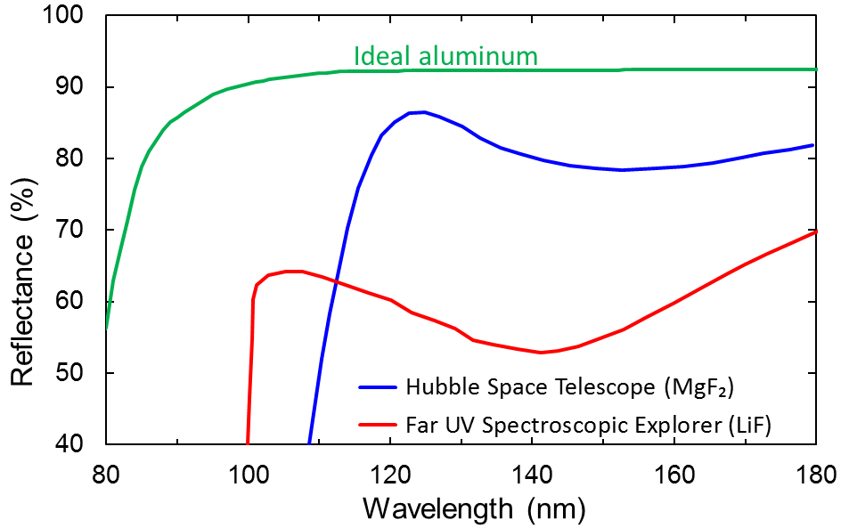
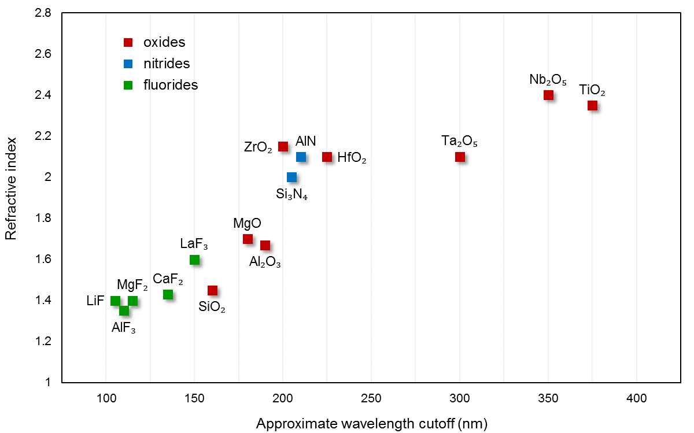
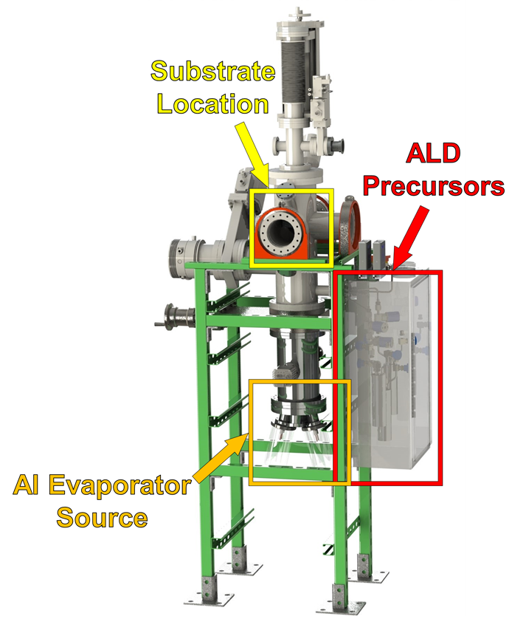
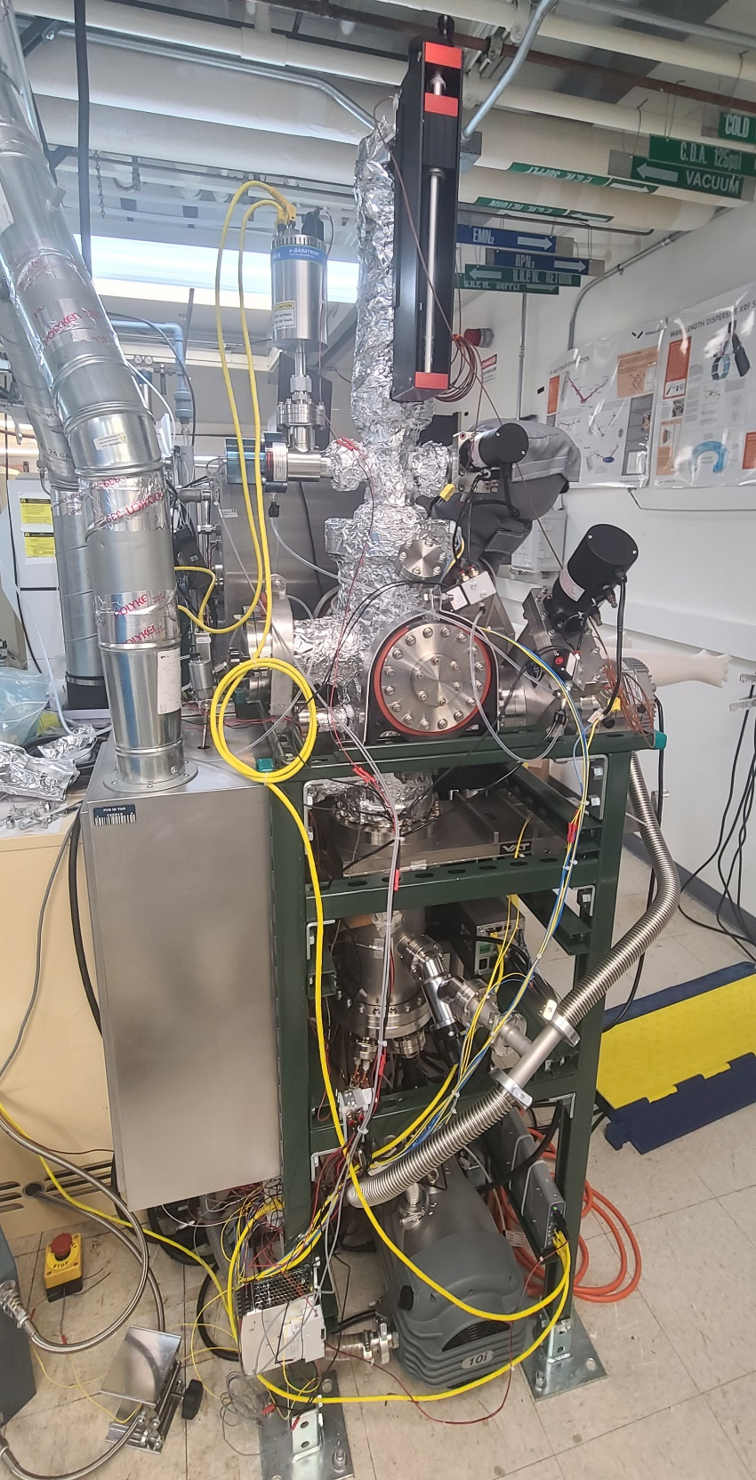
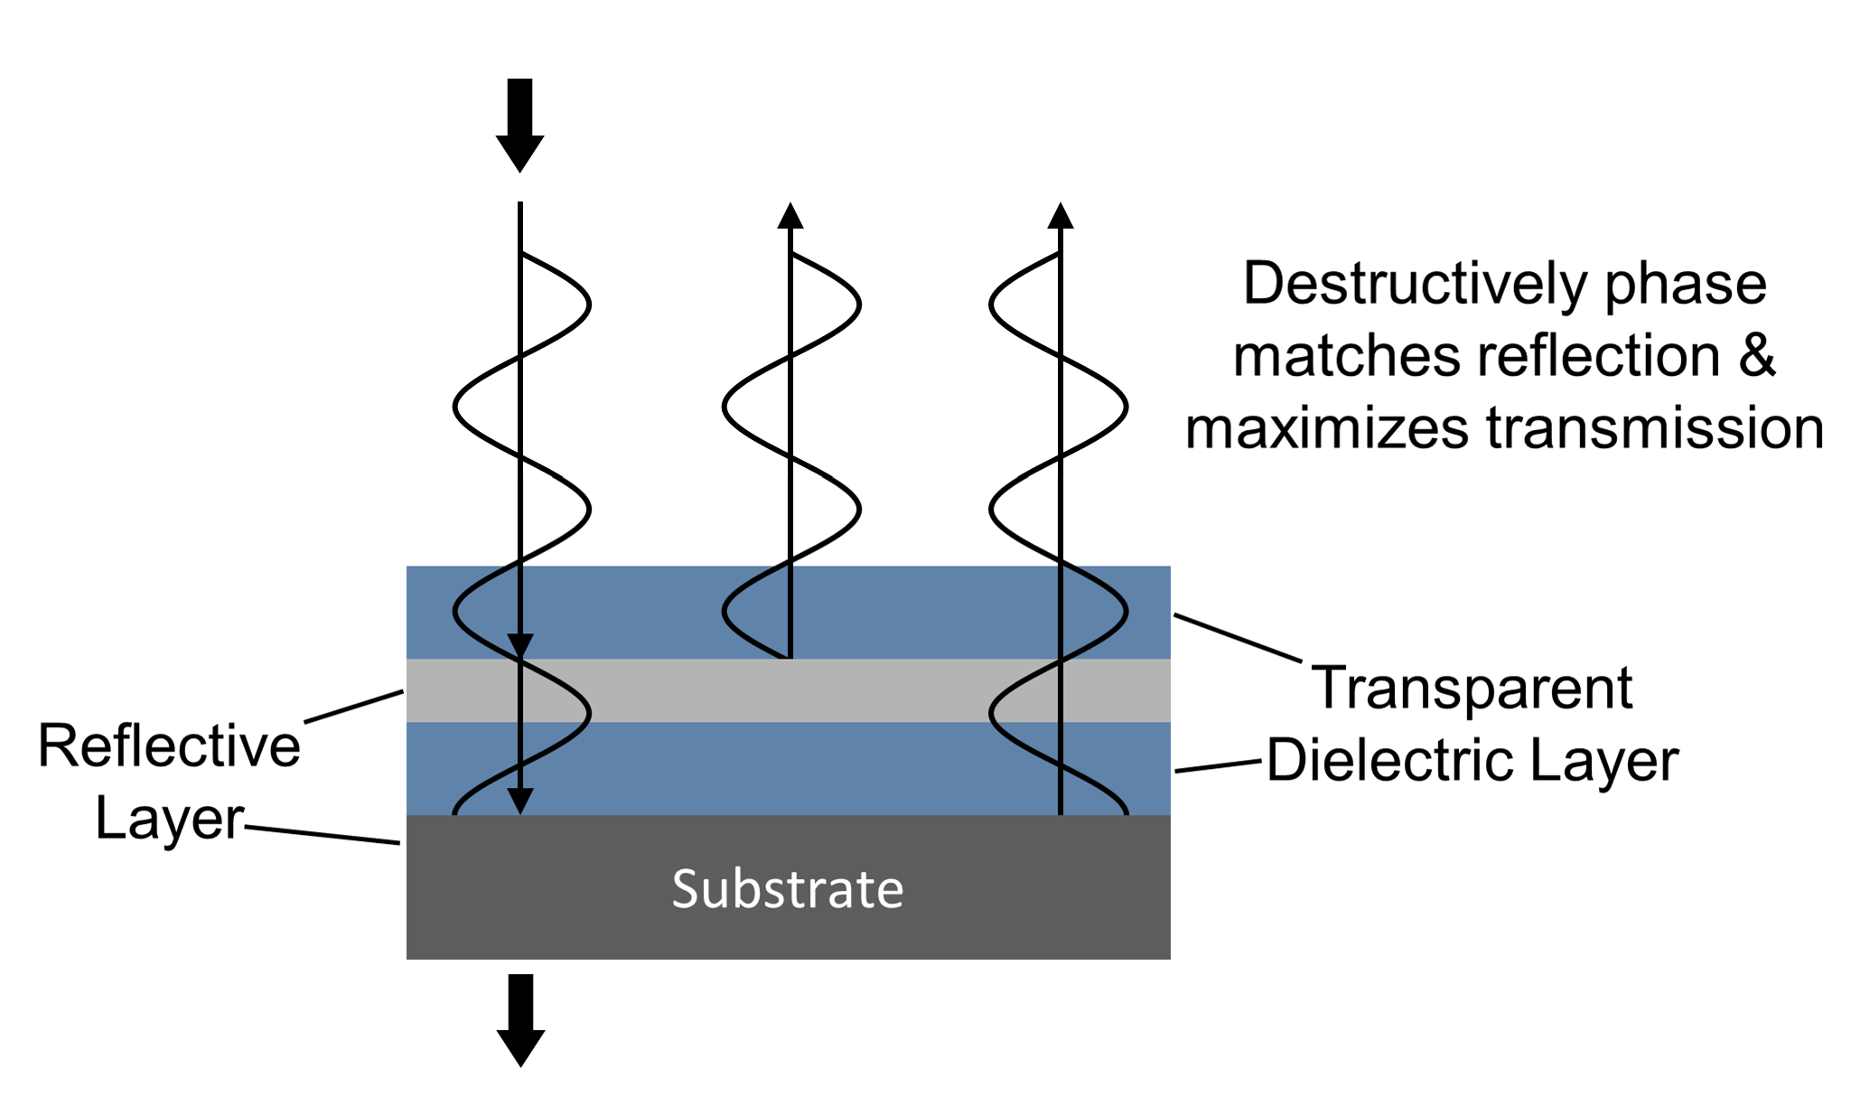
National Aeronautics and Space Administration
Postdoc Research
Thermal Evaporation and Atomic Layer Deposition for
Far Ultraviolet Mirror Coatings and Bandpass Filters
Author: Robin E. Rodríguez, JPL Postdoctoral Fellow (389E)
John Hennessy (389E), April Jewell (389E), Shouleh Nikzad (3200), Michael Hoenk (389E)
Background
  Astro2020 has recommended one of NASA’s future flagships, the Habitable Worlds Observatory (HWO), to be a 6 meter aperture infrared/optical/ultraviolet (IR/O/UV) observatory optimized for exoplanets and general astrophysics
  Ultraviolet (UV) instruments have always played an important role for planetary missions
  Mirrors highly reflective in the UV will play a major role
Challenges and Objectives
  Al mirror coatings offer a broad ultraviolet/visible/near-infrared spectral response
  However, Al is very susceptible to oxidation; this oxide layer absorbs ultraviolet (UV) light, which results in poor UV reflectance
  Protecting Al surface from oxidation is key to achieving high reflectance in the far UV (FUV, 90-200 nm)
  To protect the Al surface from oxidation, a thin, dense dielectric fluoride coating can be applied
  Fluoride coatings are transparent in the UV and can offer protection against surface oxidation of the Al
In this work, thermal evaporation and atomic layer deposition (ALD) processes were used to produce protected UV mirror coatings and far-UV (FUV) bandpass filters on charge-coupled detectors (CCDs)
Adapted from Keski-Kuha, R.A.M., Larruquert, J.I., Gum, J.S. and Fleetwood, C.M., 1999. Optical coatings and materials for ultraviolet space applications. In Ultraviolet-Optical Space Astronomy Beyond HST (Vol. 164, p. 406).
Adapted from Pfeiffer, K., Schulz, U., Tünnermann, A. and Szeghalmi, A., 2017. Coatings, 7(8), 118. https://doi.org/10.3390/coatings7080118
Approach and Results
Coatings deposited by atomic layer deposition (ALD) have unparalleled conformality, uniformity, and sub-nanometer thickness control
A custom, JPL-built vacuum system was designed to do thermal evaporation of Al and ALD of fluoride coatings within the same vacuum chamber
AlF₃-protected UV mirror coatings
TECHNOLOGICAL INNOVATION:
Reflective Al and fluoride coatings deposited in the same vacuum system without breaking vacuum, has the potential to extend the performance of UV mirror coatings and FUV filters
Model transmission of 3-layer MDFs with varying dielectric layer (AlF₃) thickness
Transmittance and QE of CCD with FUV Bandpass Filter
Metal-Dielectric Filter (MDF)
Jewell et al, Proc. SPIE 12181
Significance of Results/Benefits to NASA/JPL
ALD is a promising approach to deposit ultra-thin metal fluoride coatings for UV-reflective Al mirrors and metal-dielectric filters (MDFs)
Thermal evaporation enhanced atomic layer deposition (TE-ALD) provides a powerful platform to extend the performance of UV systems and devices by allowing thermal evaporation of Al and ALD of fluorides to occur within the same reactor, minimizing oxidation of the Al
MDF fabrication work presented was used for the Star-Planet Activity Research CubeSat (SPARCS)
Similar filters are baselined for the Ultraviolet Explorer (UVEX) MIDEX mission currently conducting a Phase A concept study
National Aeronautics and Space Administration
Jet Propulsion Laboratory
California Institute of Technology
Pasadena, California
www.nasa.gov
Future Work
Optimization of UV mirror coating processes are to be continued
Other ALD materials and their performance for UV mirror coatings will be studied (e.g. MgF₂, LiF, CaF₂)
Accelerated aging tests are to be conducted to evaluate the long-term stability of the various fluoride-protected UV mirror coatings
Clearance Number: CL#00-0000
Poster Number: PRD-T-014
Copyright 2023. All rights reserved.
Author Contact Information:
E-mail: robin.e.rodriguez@jpl.nasa.gov
Mobile: (787) 519-2210

