Slide 1

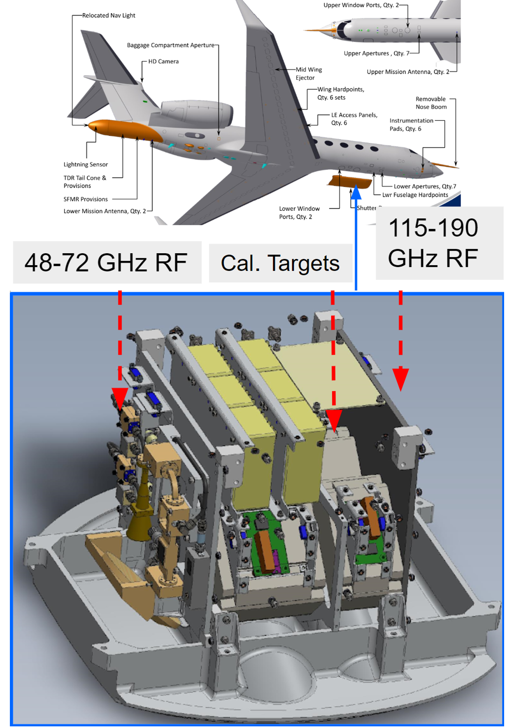
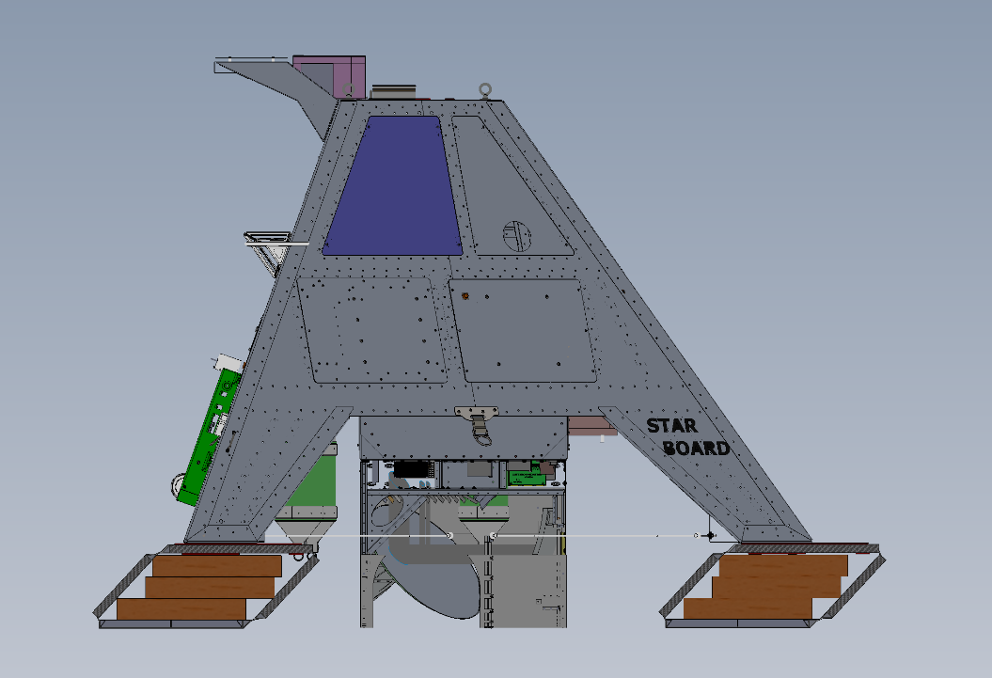
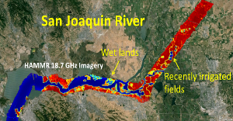
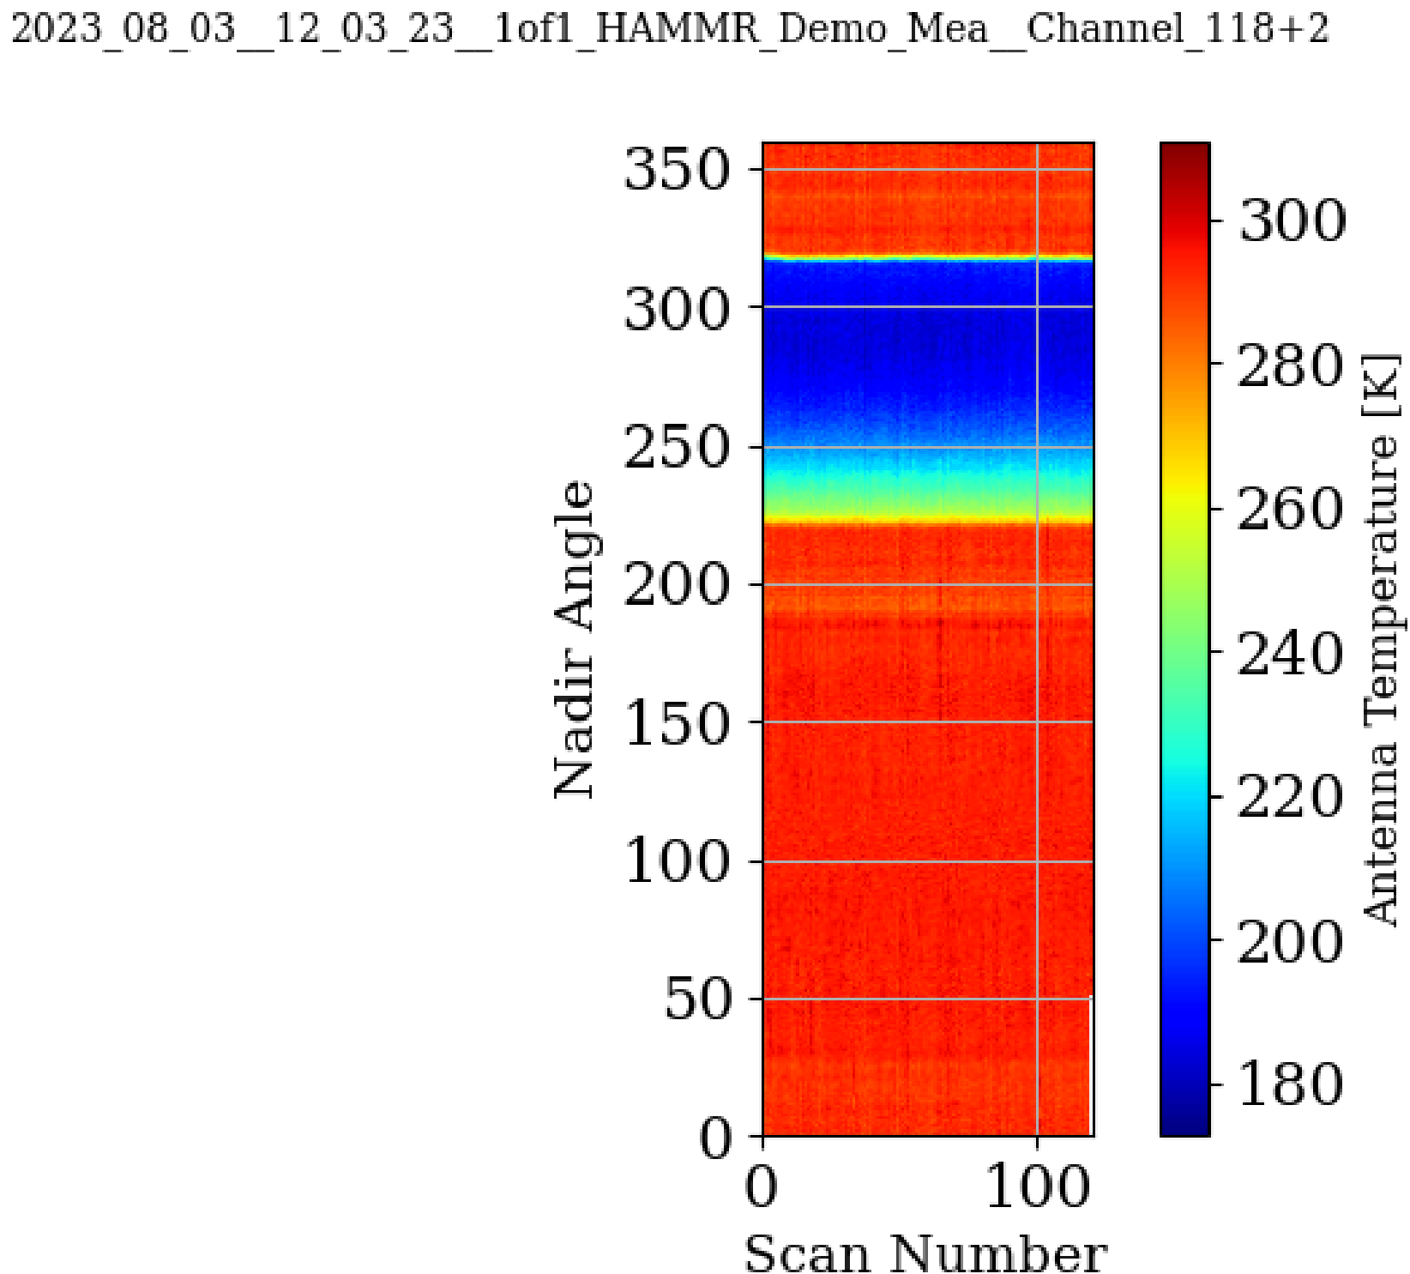
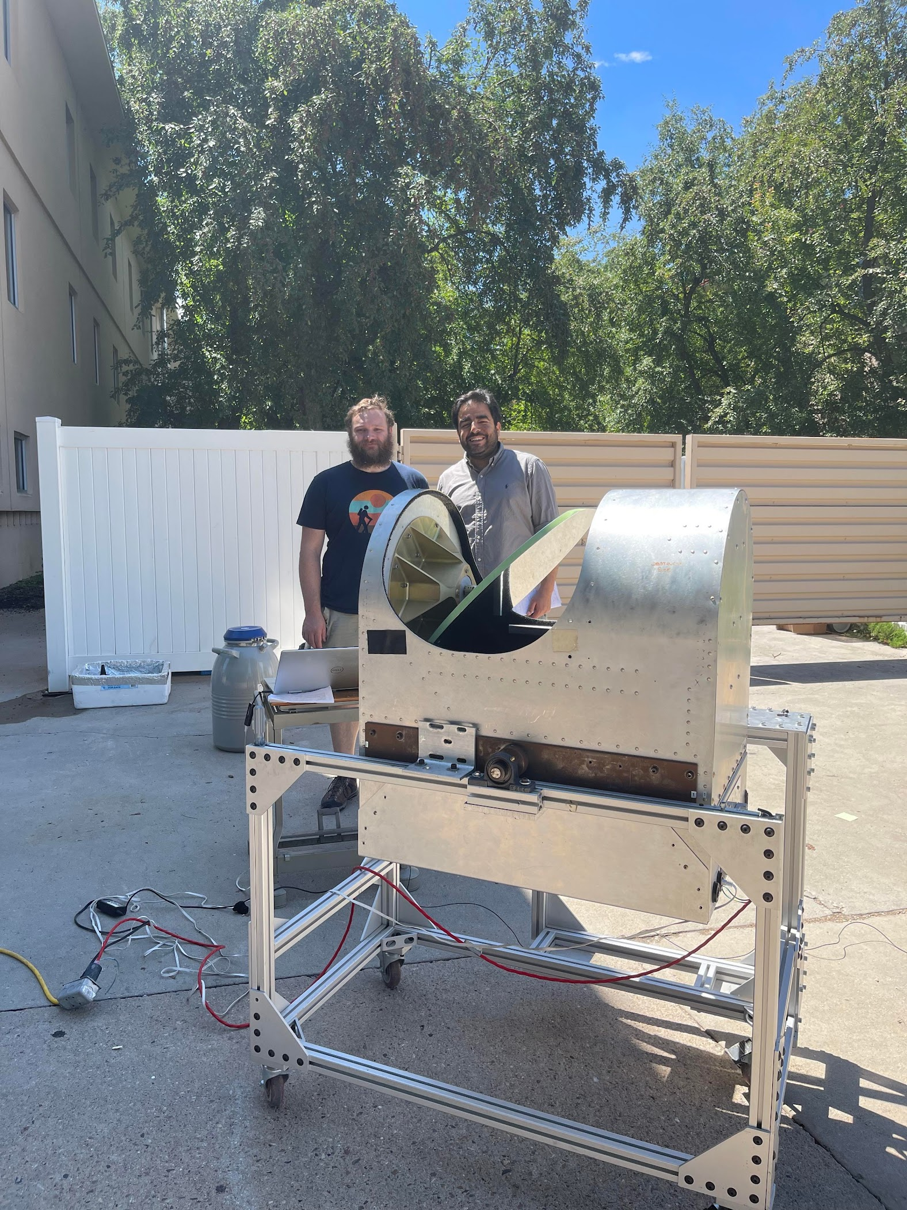
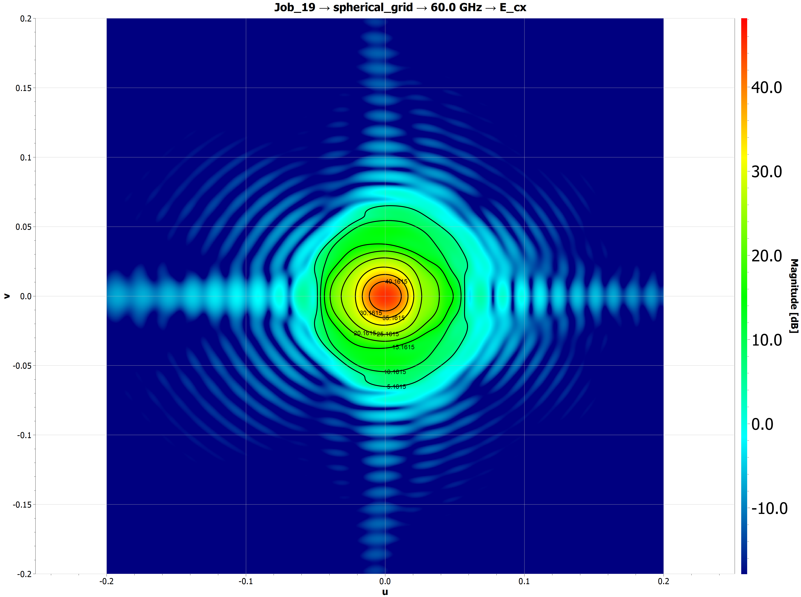
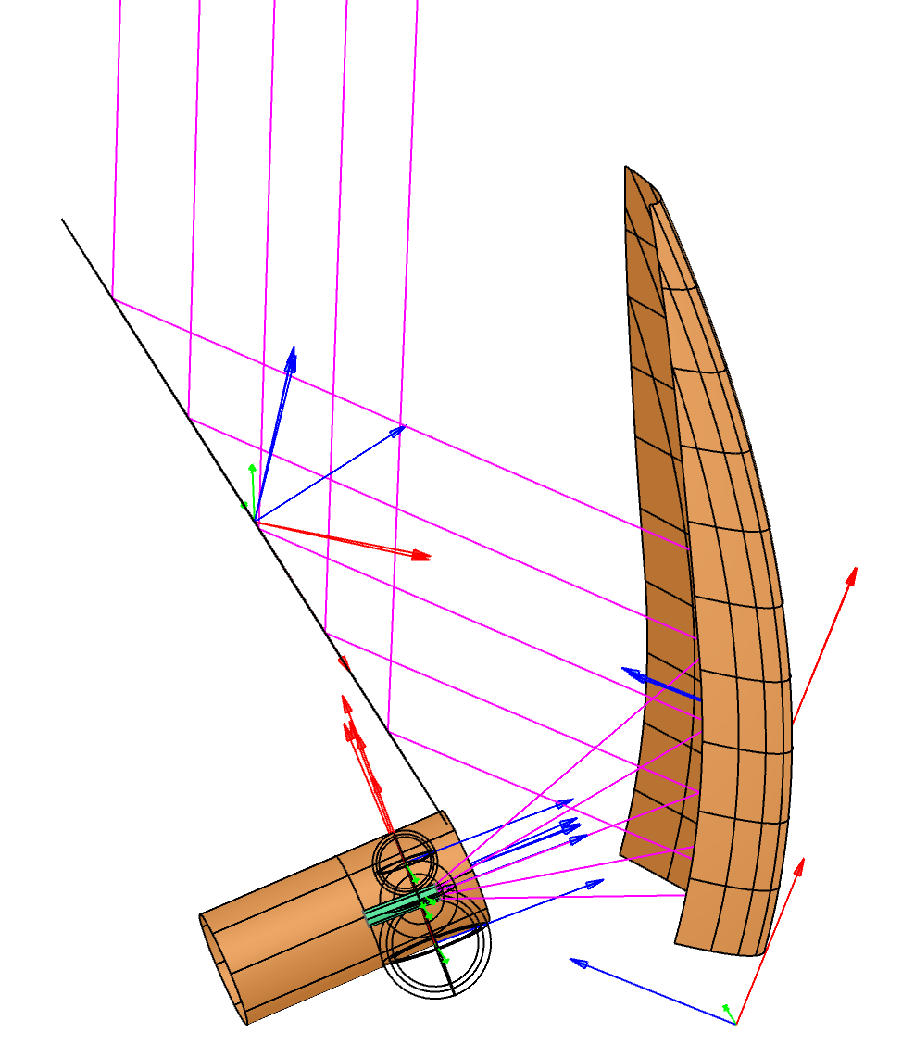
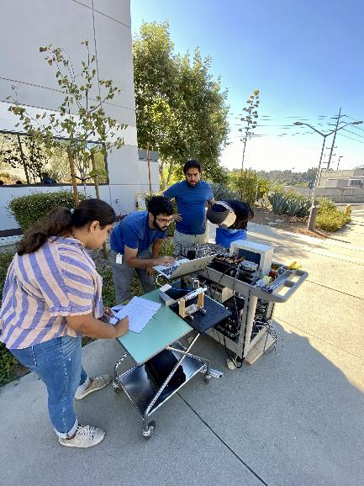
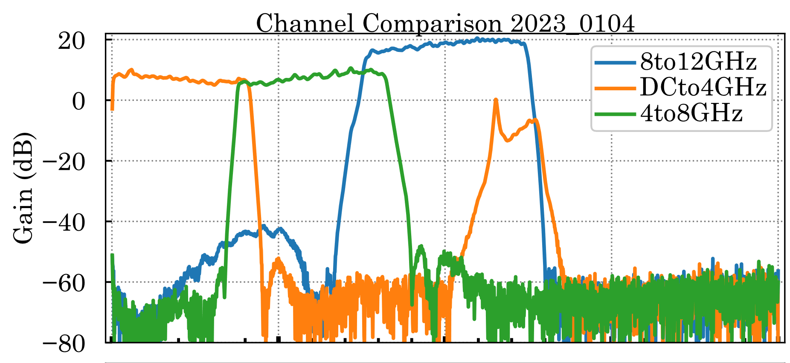
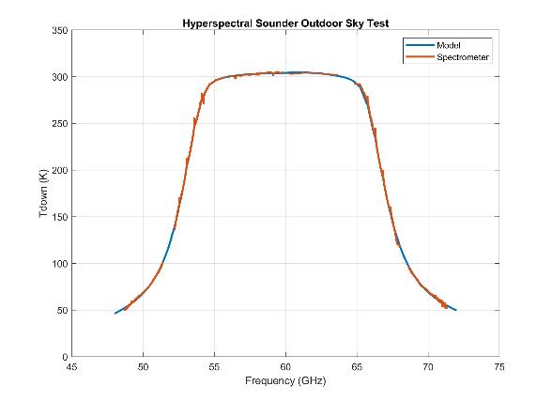
National Aeronautics and Space Administration
Postdoc Research
The Next Generation Hyperspectral Microwave Radiometers for Atmospheric Remote Sensing
Author: Ahmed Mohamed , JPL Postdoctoral Fellow (386G)
Shannon T Brown (386G), Omakr Pradhan (386F), Akim Babenko (386F), Alan Tanner (386G), Niyati Shah (386E), and Pekka Kangaslahti (386F)
Background
The 2017-2027 Decadal Survey for Earth Science and Applications from Space (ESAS 2017) has recommended the development of new technologies, retrieval approaches and observational techniques for remotely sensing the Planetary Boundary Layer (PBL) with an unprecedented sensitivity. The panel has identified the accurate observation of PBL as one of the top ranked Earth science questions to better advance our understanding to the topography of the earth’s surface.
Objectives
We aim to better observe the PBL and extract the hidden information at the microwave frequencies [1]. The current passive microwave sensors and those planned to be launched in the next decade do not demonstrate the required spectral resolution and bandwidths. Our key innovations from existing microwave sounders are (i) increasing the number of channels around the oxygen and water-vapor absorption lines with high-resolution spectral sampling, thereby reducing reduced profile retrieval errors and (ii) over a wide-coverage. The hyperspectral microwave concept leads to a multiplexed system with high number of Intermediate Frequency (IF) window channels.
Approach and Results
We describe two radiometer technology developments for high-resolution PBL observations. The first is a wide bandwidth three channel airborne atmospheric microwave sounder (AMS) to be installed onto the NOAA G550 aircraft [Fig.1]. The second is the development of a high-altitude balloon (~20 km) instrument based on the existing high-frequency airborne microwave and millimeter-wave radiometer [2] (HAMMR-HD) [Fig.2]. Both instruments will enable processed sounding spectra with unprecedented 5MHz resolution that can span up to 40 GHz instantaneously. The first outdoor test at JPL with a complete 48-72 GHz radiometer system demonstrated our technology and showed an excellent spectral agreement with atmospheric model (Fig. 3).
Fig.1: AMS mounts under the cabin of G550
Fig.2: HAMMR-HD on the balloon
Significance of Results/Benefits to NASA/JPL
The two experiments will provide a rich science data set sampling the full microwave spectrum from 18-200 GHz over a variety of atmospheric scenes. The resulting data will be valuable for testing our ability to extract PBL structure from observed microwave spectra and support mission/instrument concept development for future PBL focused missions at NASA. We will also provide recommendations for spaceborne sounders for 2030
Far-field optical beam at 60 GHz
Future Work
We continue the development, integrating and testing of hyperspectral instrument. AMS and HAMMR-HD instruments will be integrated with Aircraft and high-altitude balloon, respectively, to obtain long duration data over a variety of weather conditions over land/ocean in 2024-2025.
References:
[1] J.-F. Mahfouf, et. Al., "Information content on temperature and water vapor from a hyper-spectral microwave sensor," Quarterly Journal of the Royal Meteorological Society, vol. 141, no. 693, pp. 3268-3284, 2015
[2] X. Bosch-Lluis et al., "Instrument design and performance of the high-frequency airborne microwave and millimeter-wave radiometer", IEEE J. Sel. Topics Appl. Earth Observ. Remote Sens., vol. 12, pp. 4563-4577, Nov. 2019.
National Aeronautics and Space Administration
Jet Propulsion Laboratory
California Institute of Technology
Pasadena, California
www.nasa.gov
Fig. 3: Complete 48-72 GHz radiometer system outdoor measurements at JPL.
Publications (in preparation for a journal paper):
Ahmed Mohamed, et al., “ The development of next generation hyperspectral radiometers for the planetary boundary layer observation “ The 104th Annual American Metrological Society Meeting, Maryland, USA, January, 2024.
Author Contact Information:
6263458559, Ahmed.M.Mohamed@jpl.nasa.gov
Clearance Number: CL#00-0000
Poster Number: PRD-T-016
Copyright 2023. All rights reserved.

