Slide 1
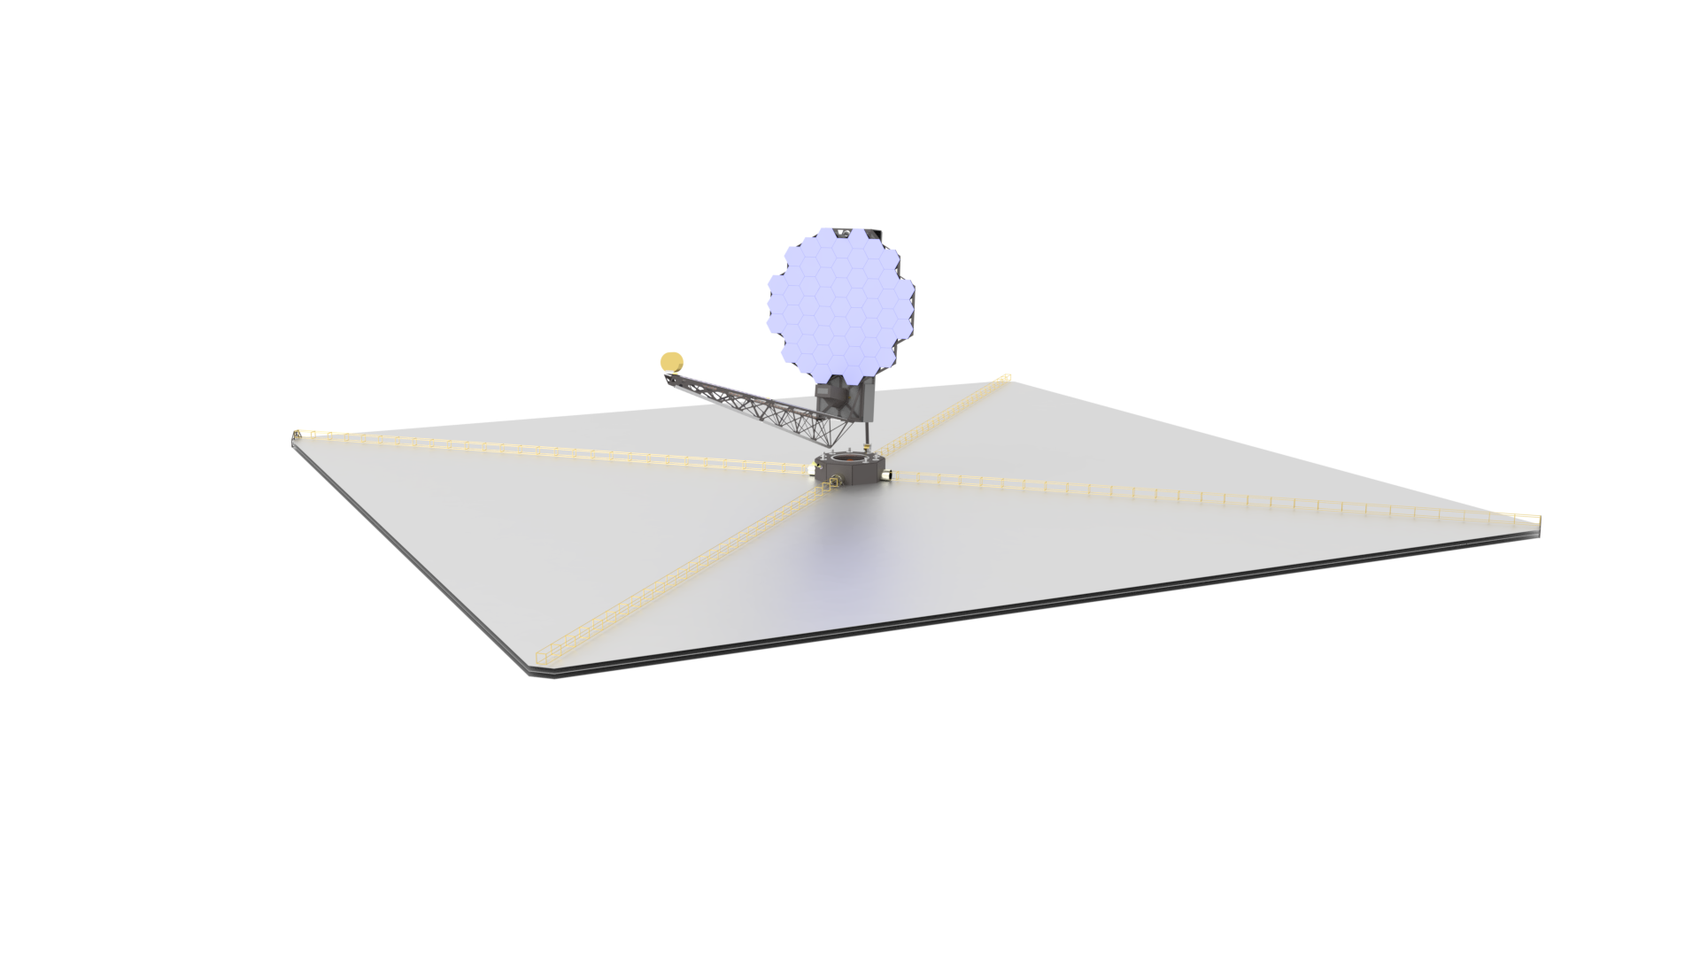
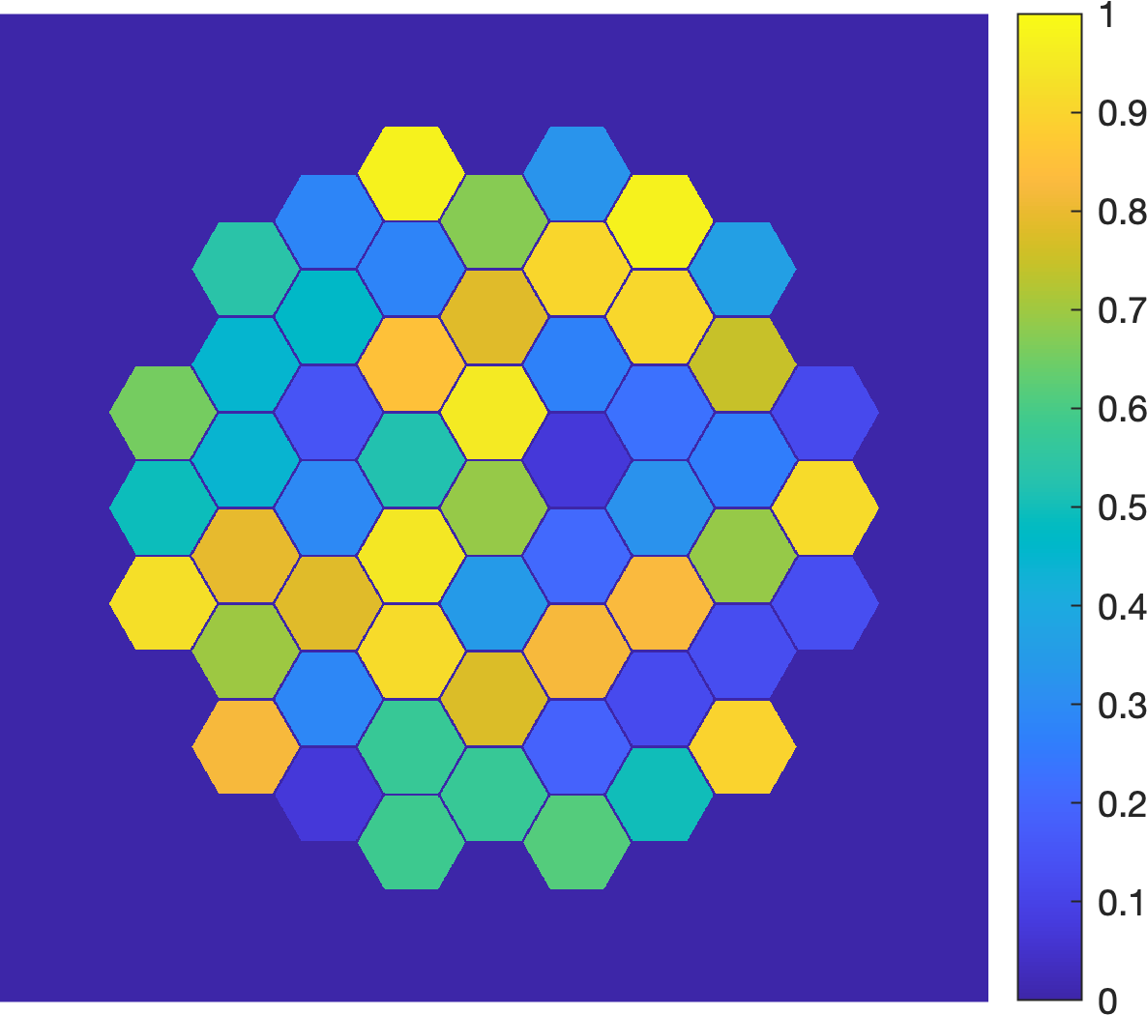
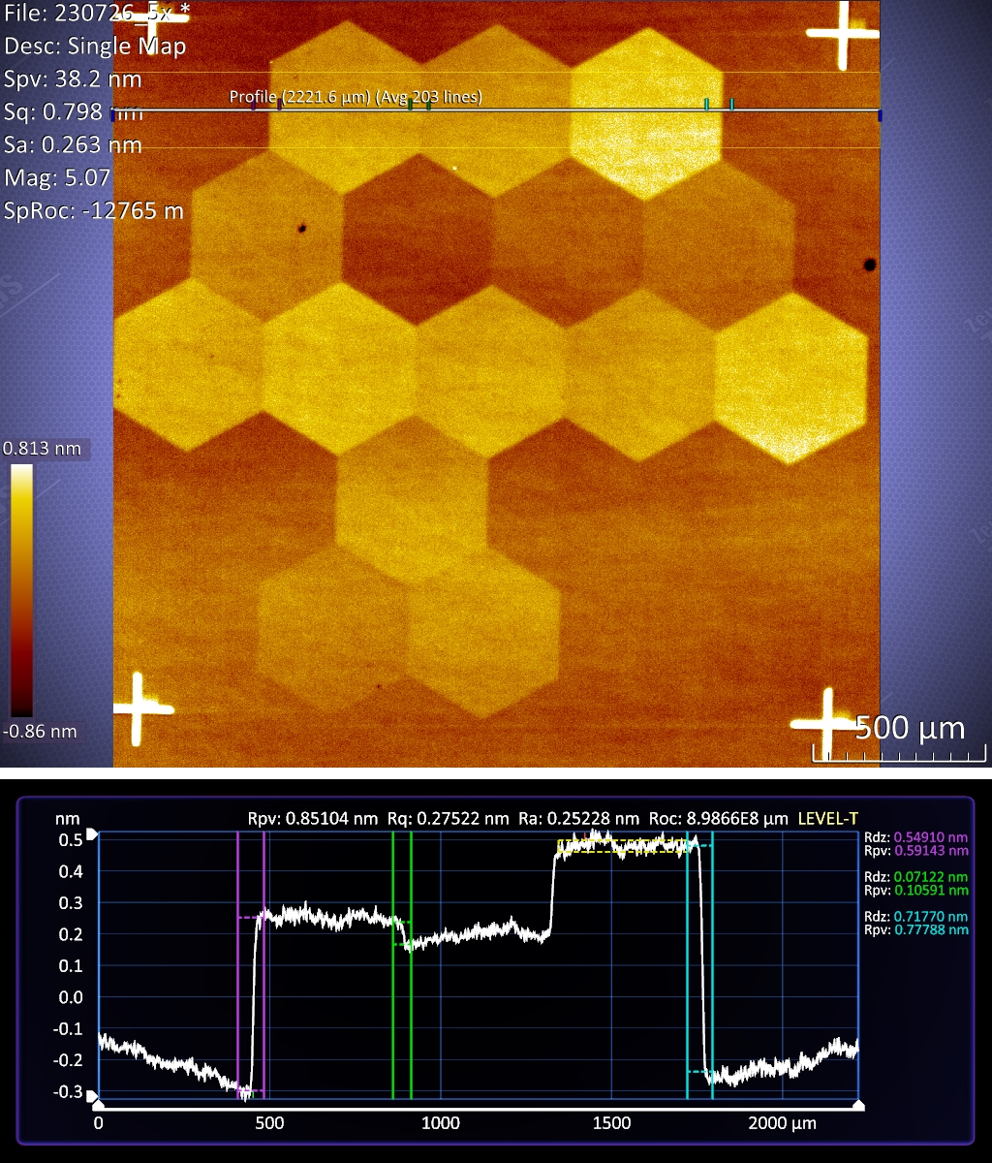
National Aeronautics and Space Administration
Postdoc Research
Sub-nm segmented mirror for the Habitable Worlds Observatory
Author: Daniel Shanks (389W), JPL Postdoctoral Fellow
Collaborators: Garreth Ruane (383A), Daniel Wilson (3890)
Background
The Habitable Worlds Observatory (HWO) is a future space telescope concept that aims to detect and characterize Earth-like exoplanets via direct imaging with a coronagraph instrument. The coronagraph uses optical masks and deformable mirror (DM) technologies to suppress starlight to reveal exoplanets that are ~1e-10 times fainter than their host stars. One obstacle in this instrument will be the wavefront error caused by segmentation of the primary mirror. Unlike mirror deformations within individual segments, which will cause continuous spatial wavefront error, height differences between mirror segments will cause discrete jumps in the wavefront phase. This will pose a unique challenge for the wavefront control system, which will likely use continuous DM surfaces to correct for segment phasing errors that appear as abrupt jumps in the wavefront.
LUVOIR B concept
Objectives
We need to inject a wavefront representative of a segmented telescope to test how well the coronagraph will be able to achieve the contrast requirements and correct the wavefront changes due to segmented phasing errors. The objective of this work is to fabricate a reflective optic that will introduce this stepped wavefront with optical path differences (OPDs) as small as 0.1 nm, similar to those that would be introduced by changes in height differences between primary mirror segments.
Example OPD injection (nm)
Approach and Results
We fabricated a static segmented mirror on a 1” ultra flat silicon substrate, using multiple overlapping rounds of maskless photolithography and electron-beam metal evaporation to deposit thin films of titanium. The initial titanium thickness is ~0.1 nm, which oxidizes to form a film of TiO_{x} that is ~1 nm thick. The thin film interference between the reflection off the air/TiO_{x} and TiO_{x}/Si interfaces creates OPDs on the order of 0.1 nm, which are measured by a Zemapper optical profiler.
Significance of Results/Benefits to NASA/JPL
This characterization will test how well the HWO wavefront control system can correct for these stepped wavefront aberrations. These optics will be a crucial part of the testbed demonstrations for static coronagraph performance on segmented telescopes and for constraining the error budget terms related to tolerances between segmented mirror heights and stability for the Habitable Worlds Observatory.
OPD measurement
Future Work
The future fabrication work on this will include the creation of larger area segmented mirror on a 4” substrate, and the installation of this optic into the Decadal Survey Testbed for characterization and use in TRL 5 level coronagraph demonstrations.
0.07 nm step
National Aeronautics and Space Administration
Jet Propulsion Laboratory
California Institute of Technology
Pasadena, California
www.nasa.gov
Publications and Acknowledgements:
Publication in preparation
Author Contact Information:
(626) 630-1251. dshanks@jpl.nasa.gov.
Clearance Number: CL#00-0000
Poster Number: PRD-T-018
Copyright 2023. All rights reserved.

