Slide 1
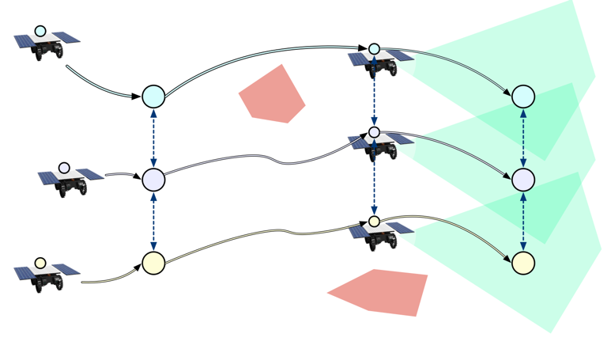
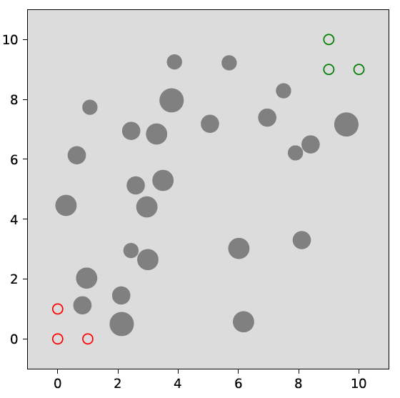
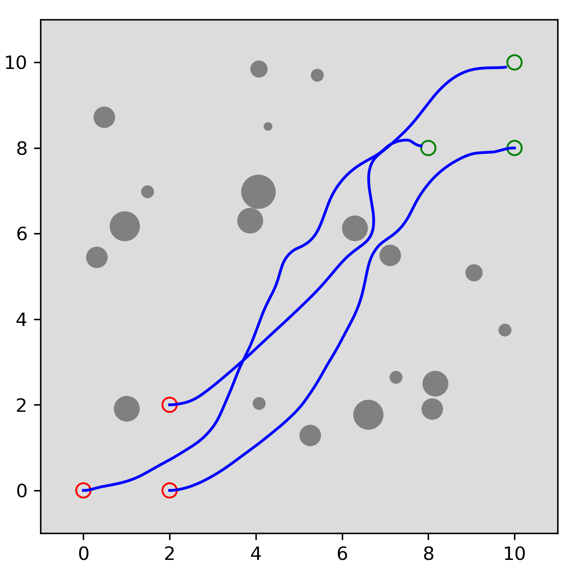
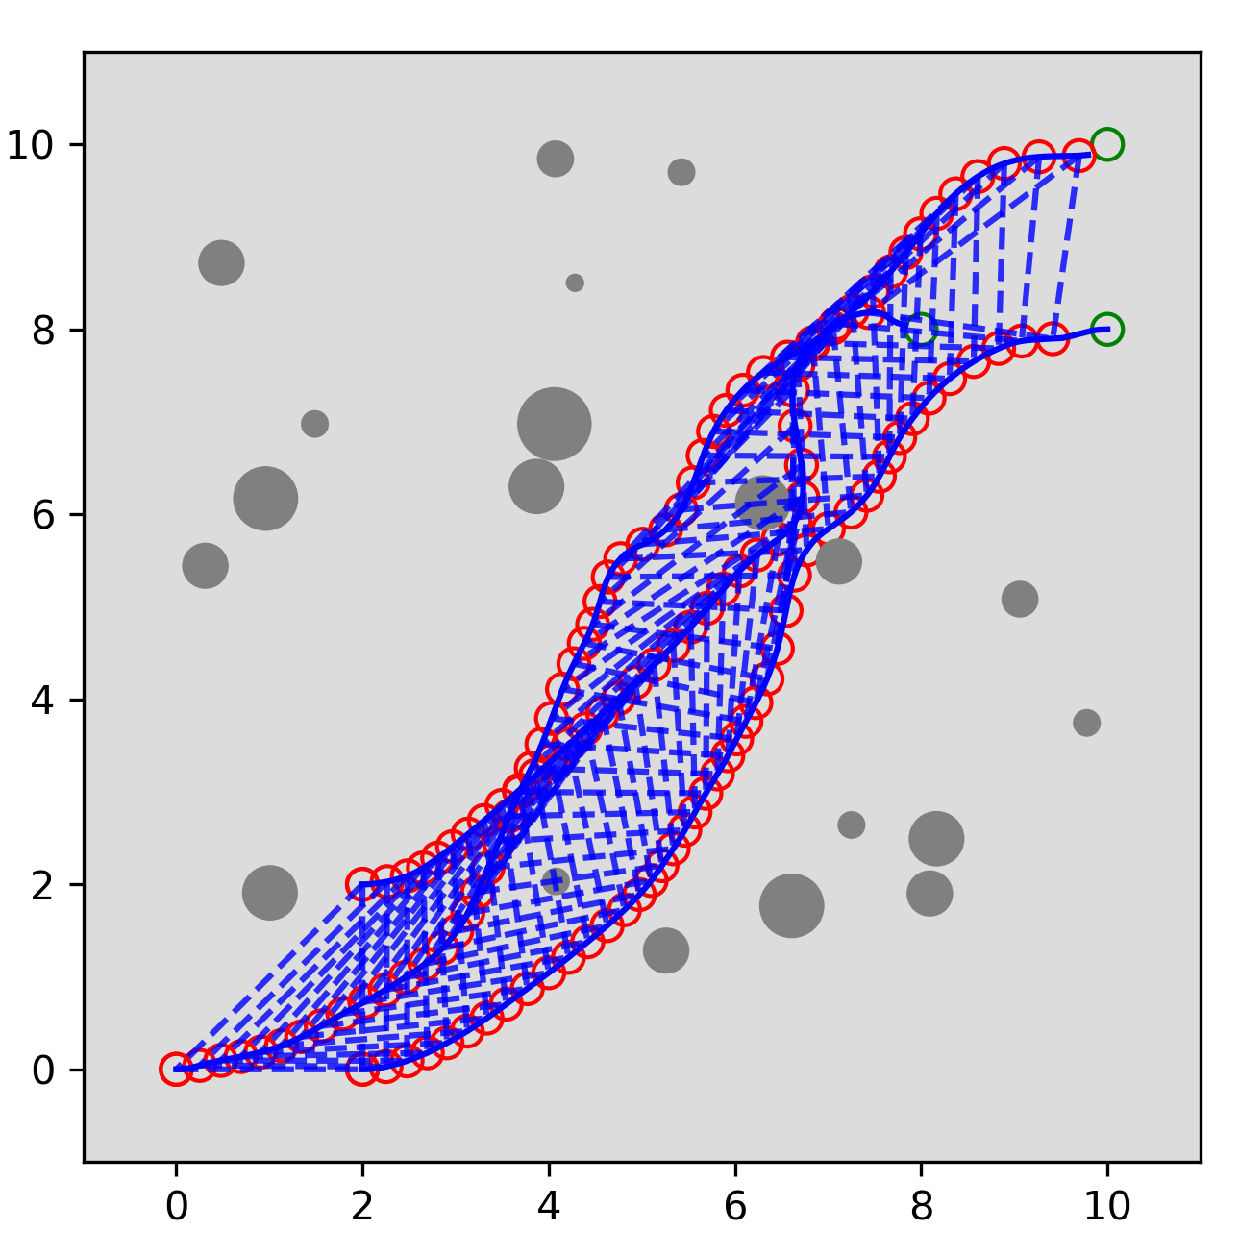
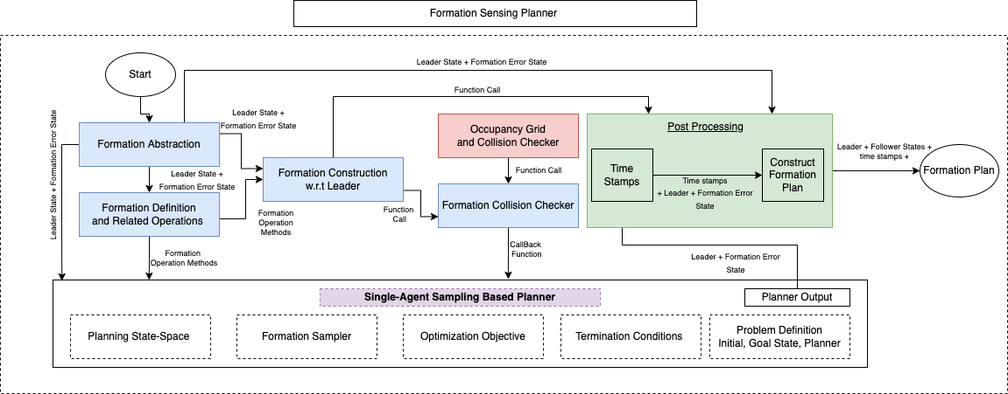
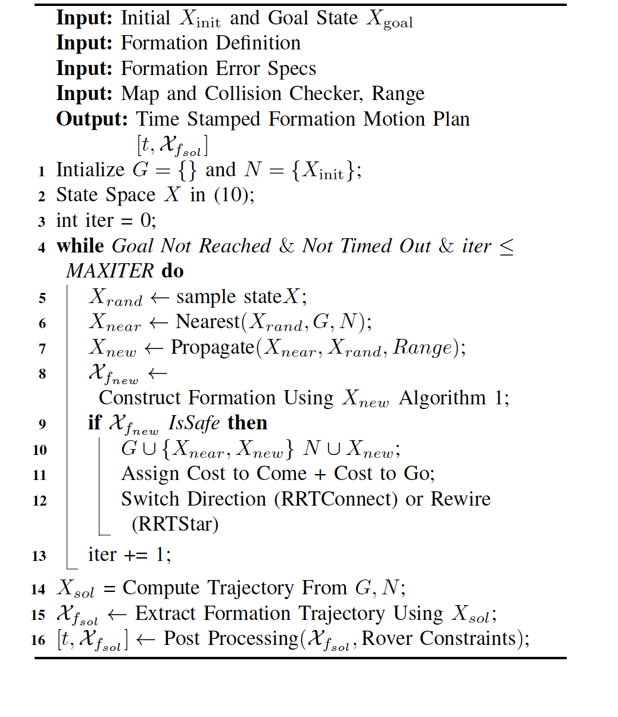
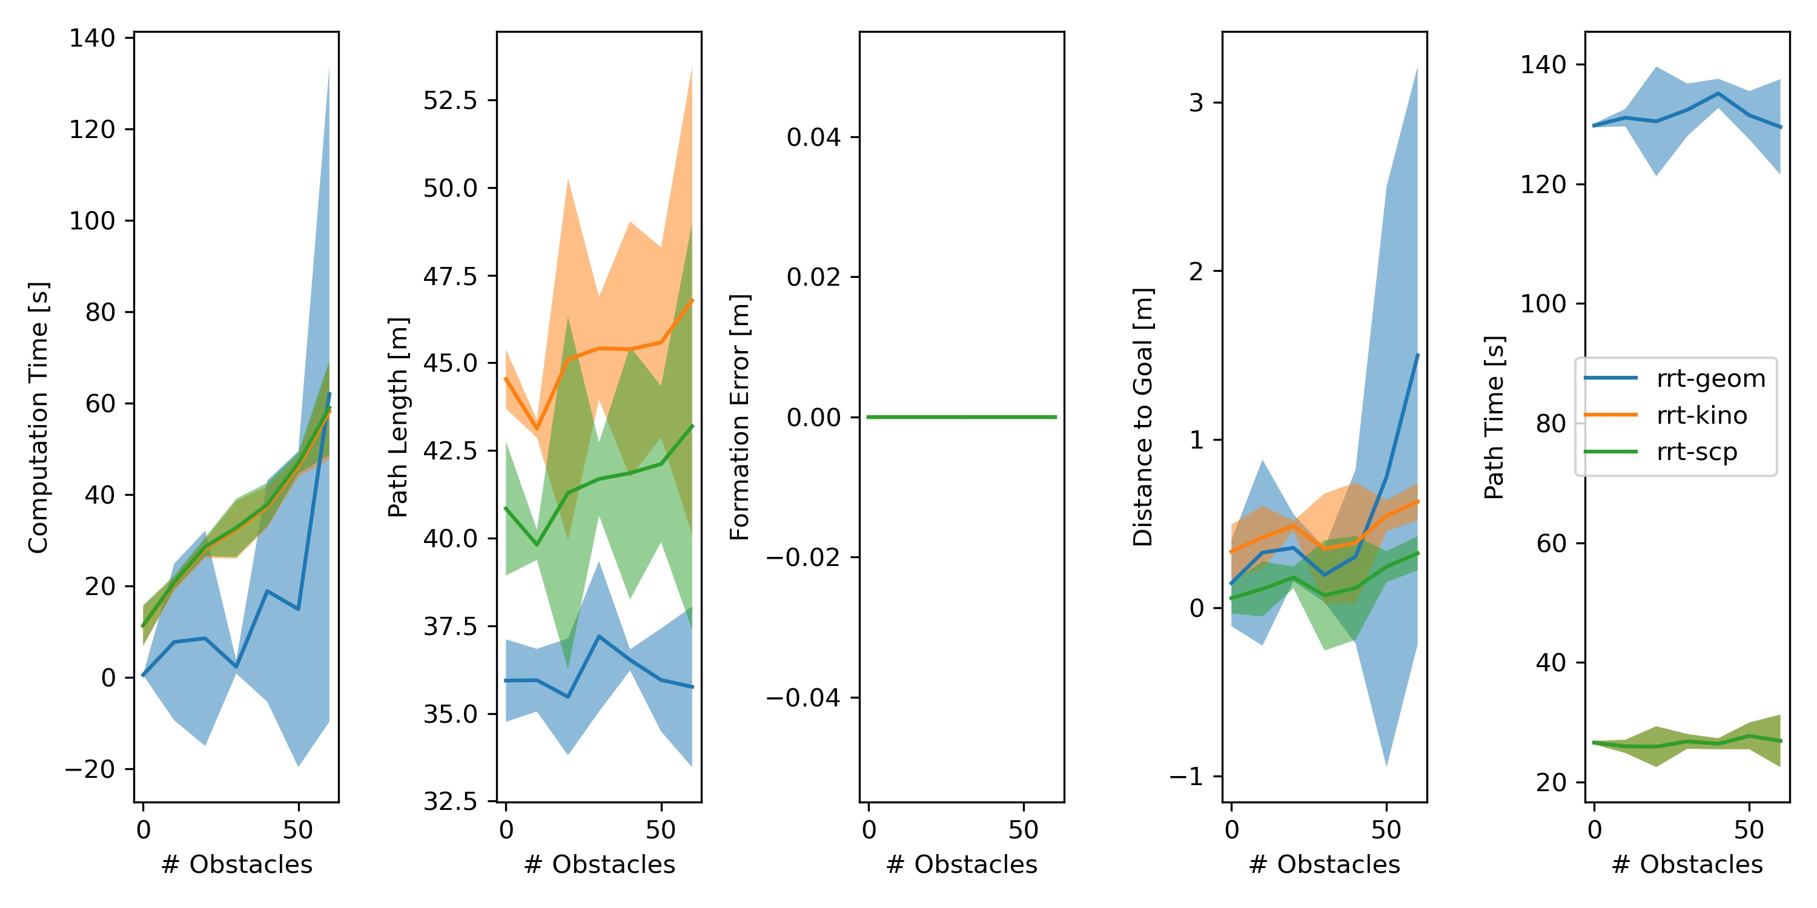
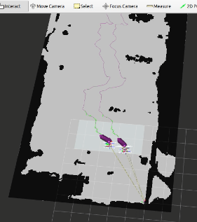
National Aeronautics and Space Administration
Formation Sensing Cooperative Autonomous Distributed Robotic Explorers (CADRE)
Author: Yashwanth Kumar Nakka, JPL Postdoctoral Fellow (347N)
Federico Rossi, Jean-Pierre de la Croix, Amir Rahmani (347N)
Introduction
Multi-Agent Formation Sensing Planner
What we want from Formation Sensing?
Generate Feasible Path
Ensure Formation
Ensure Formation
Collect measurements (e.g., camera images) at synchronized times (with some tolerance) at prescribed distance OR time intervals (with some tolerance) safely
While (at the time of the measurement) we are in a formation of a given constant shape to within some relative tolerance
Distributed Measurements
Formation Trajectory:
Algorithm
Formation
$$\vec{l12}$$
$$+w_{12}\vec{ν_{12} }$$
$$\vec{l14}$$
$$+w_{14}\vec{ν_{14}}$$
$$\vec{l13}$$
$$+w \vec{ν_{13}}$$
Search-Based Vs. Sampling-Based Vs. Optimization-Based Planning
 | Search-Based | Sampling-Based
Map | Grid | Grid (or) Oracle
Formation Constraints (Hard) | No | Yes
Formation State Space | Large | Dimension-reduction possible
Curse of Dimensionality | Need Heuristics | Is handled implicitly due to sampling
Other | Grid resolution depends on formation constraints
ROS-Based Intergated Testing With GNC
Formation Sensing Team Planner
Tracking using a Timed Elastic.Band Planner
Agent Level Global Planner
Agent Level Local Planner
National Aeronautics and Space Administration
Jet Propulsion Laboratory
California Institute of Technology
Pasadena, California
www.nasa.gov
Publications:
Yashwanth Nakka, Federico Rossi, Jean-Pierre de la Croix Coordinate Roving on the Moon For Collaborative Sensing: Multi-Agent Formation Planning under Science Constraints. [Under Preparation]
Author Contact Information:
Email: yashwanth.kumar.nakka@jpl.nasa.gov
Poster Number: PRD-T#010
Copyright 2022. All rights reserved.

