Slide 1

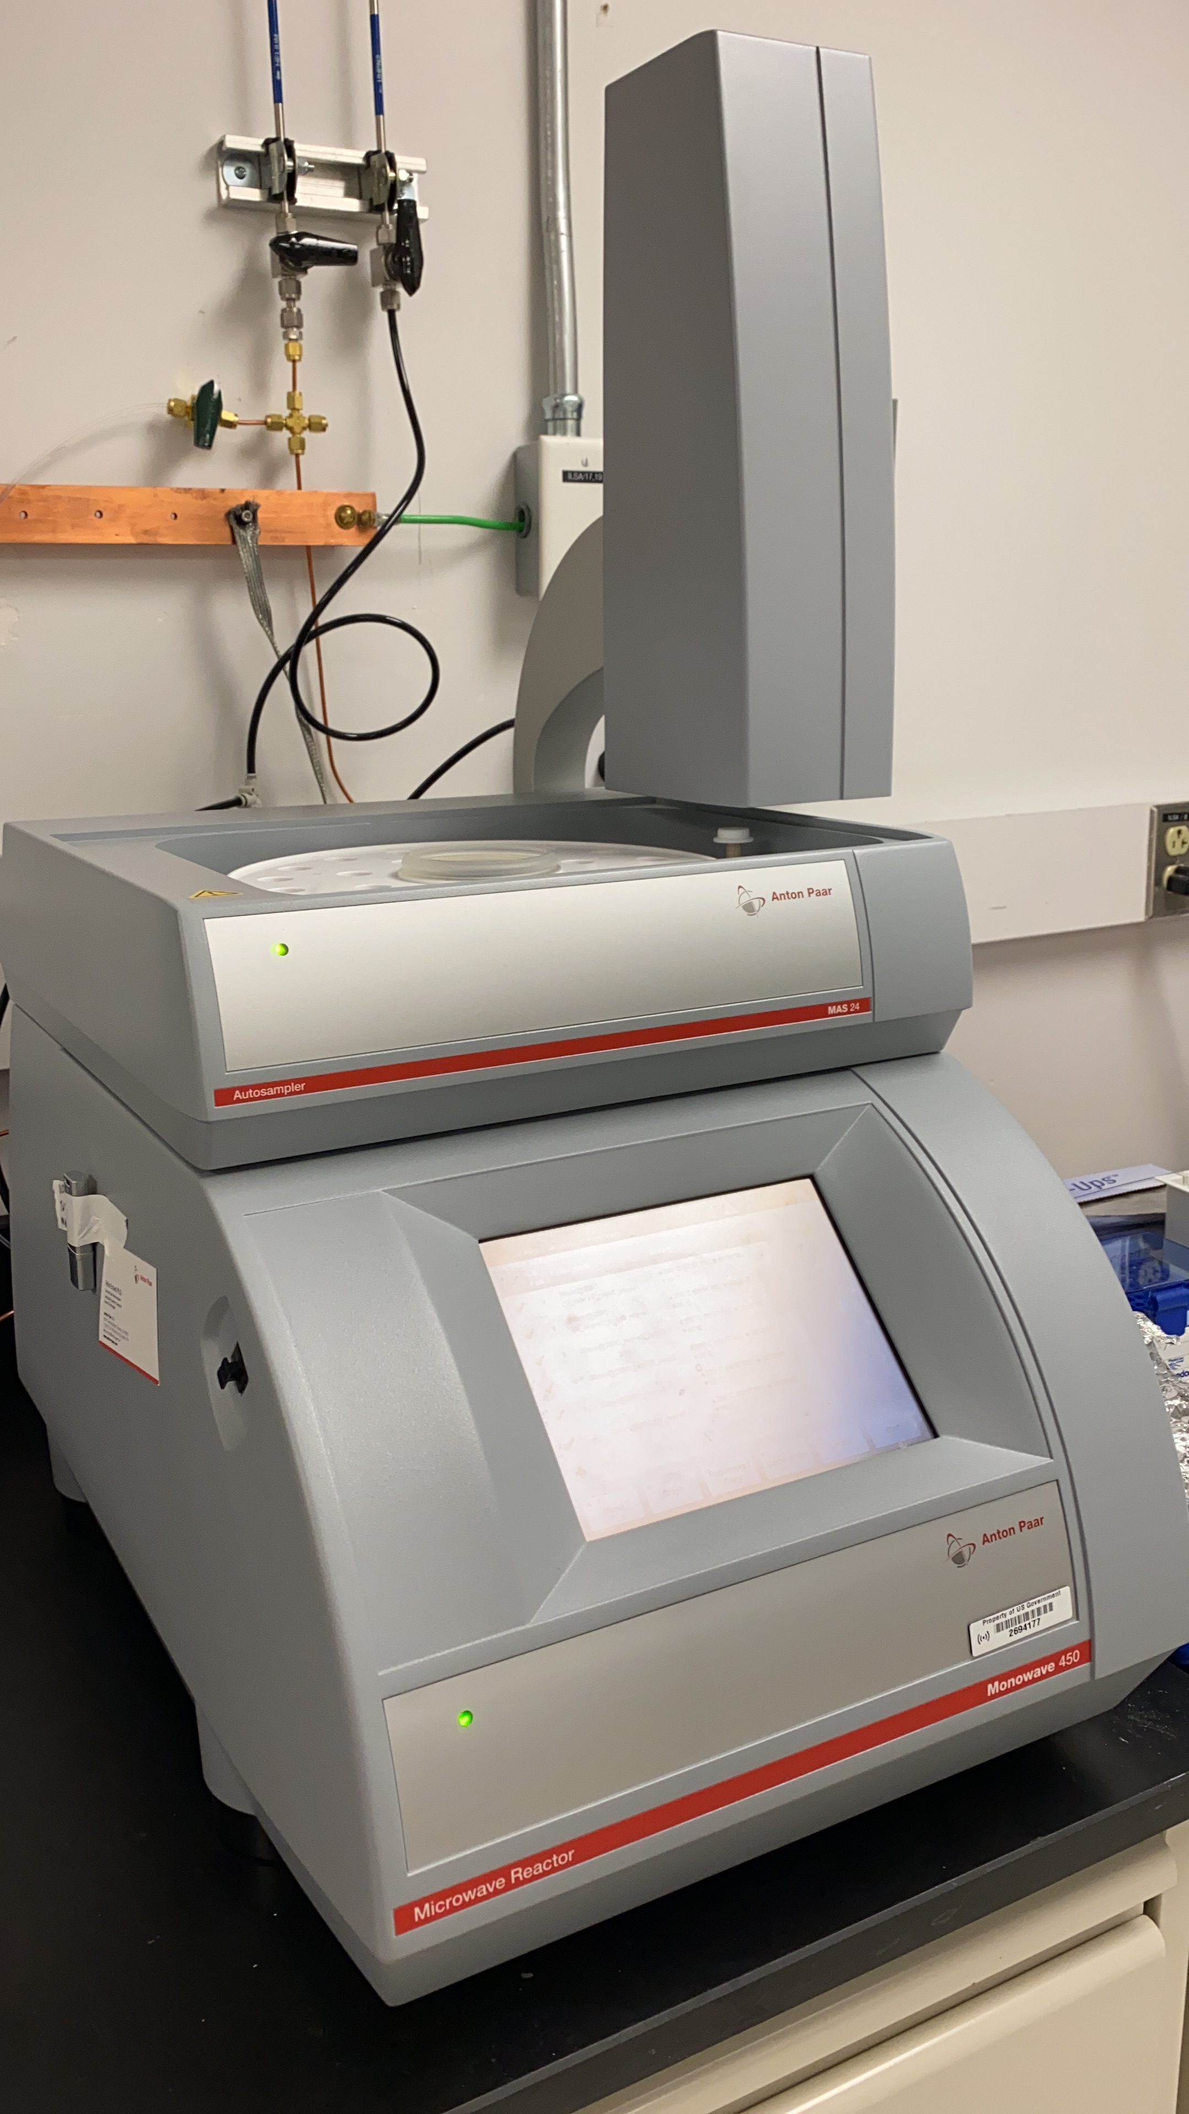
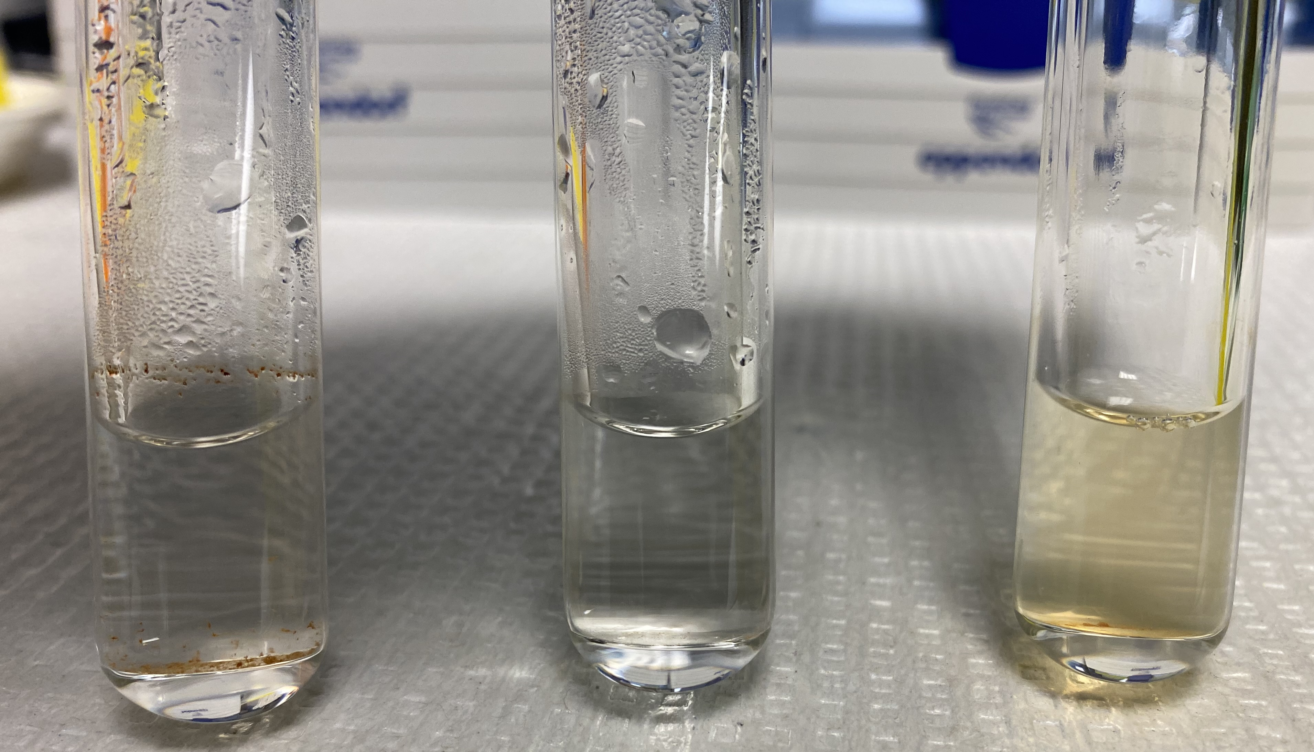

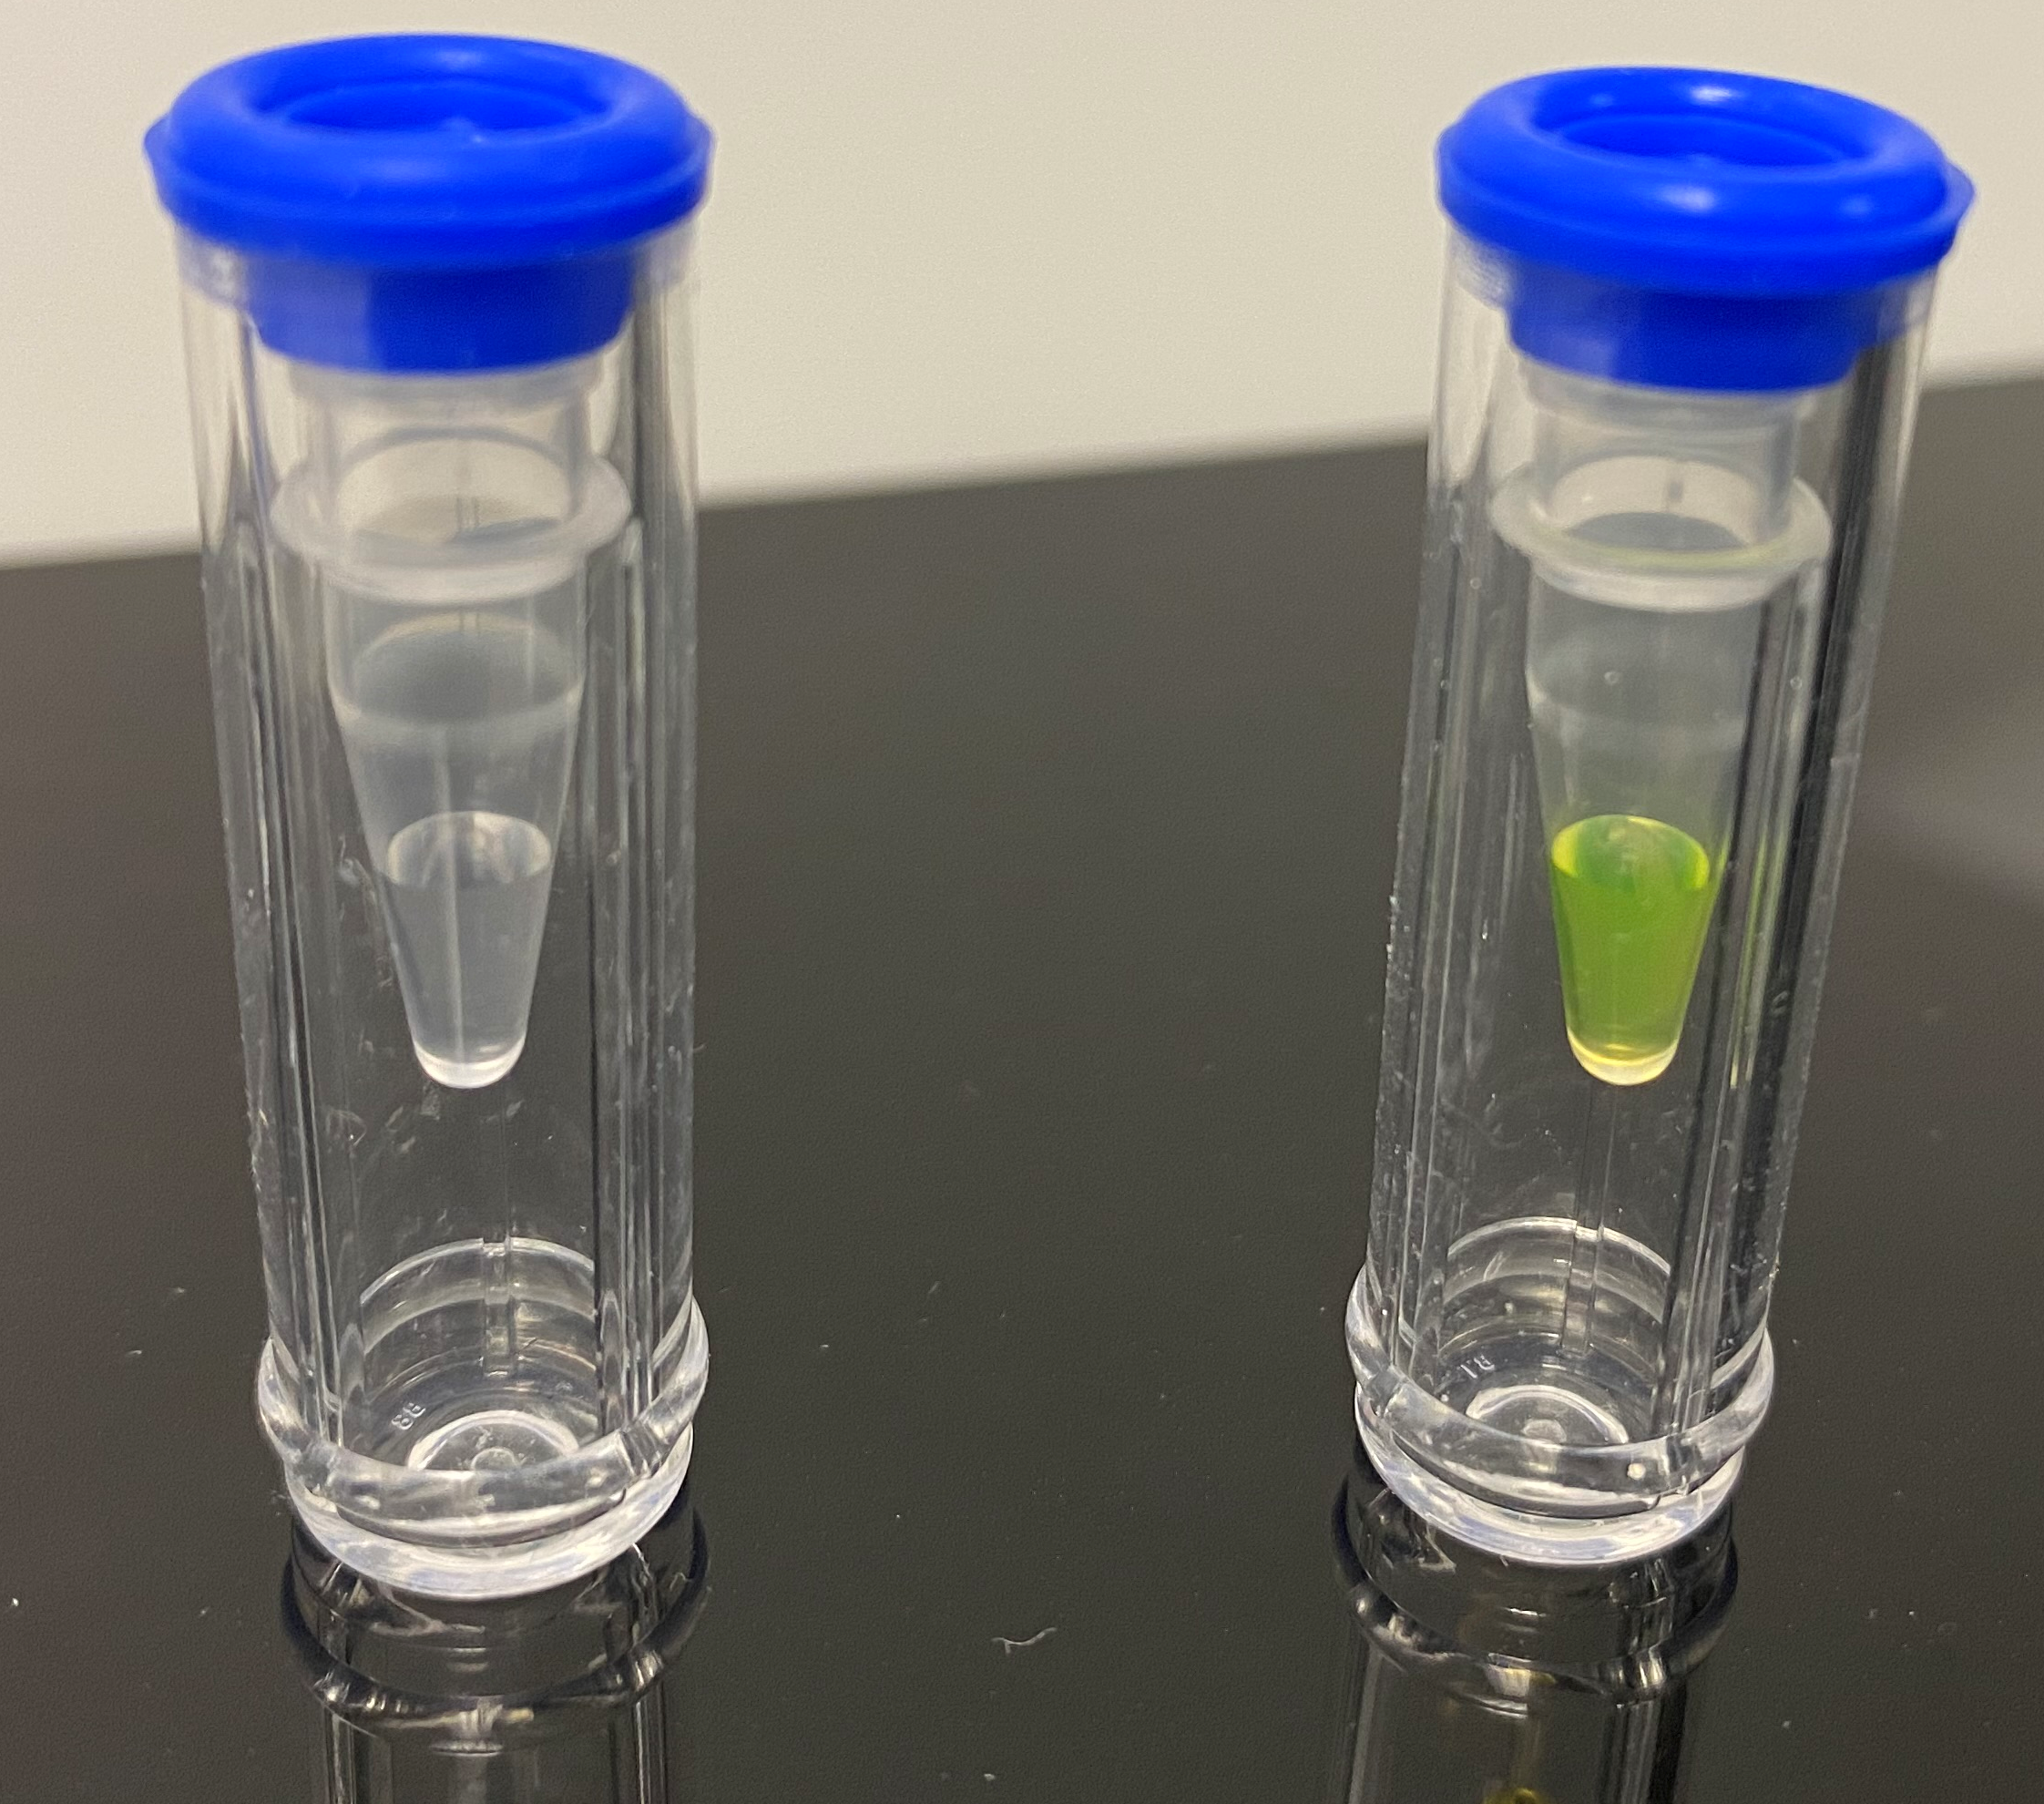
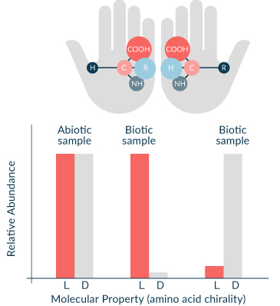
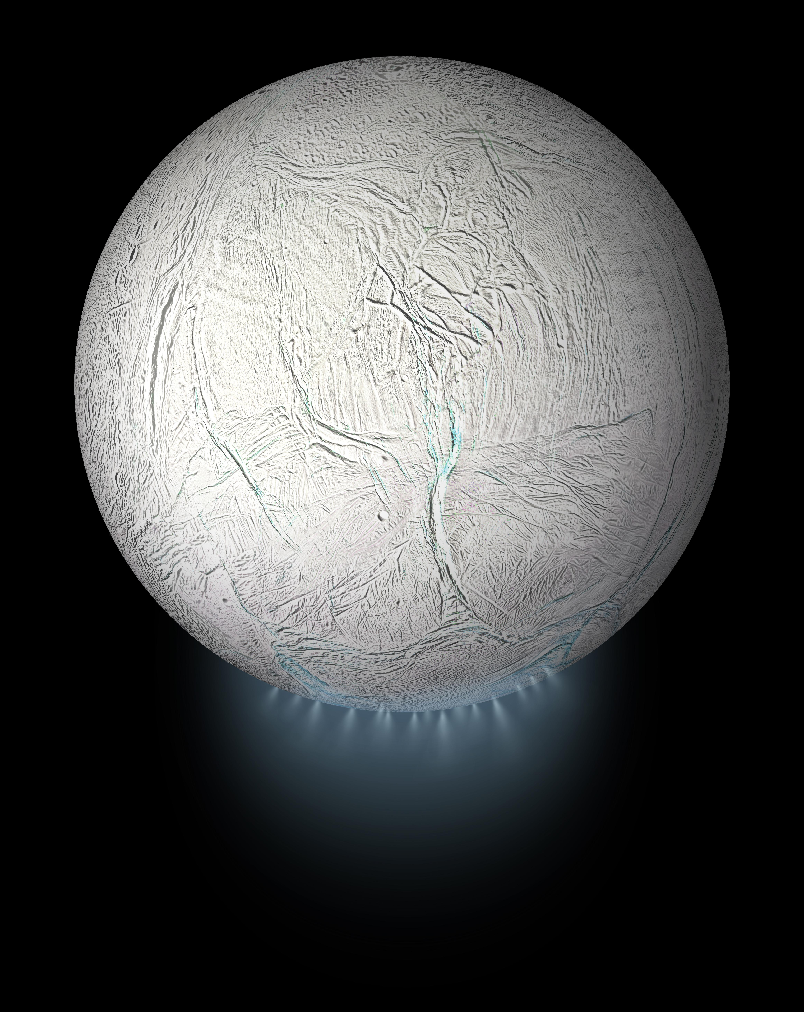
National Aeronautics and Space Administration
Subcritical water extraction for releasing biosignatures from microorganisms
Author: Zuzana Cieslarova, JPL Postdoctoral Fellow (398U),
Maria F. Mora (398U), Aaron C. Noell (398U), Ceth W. Parker (353U), Peter A. Willis (398U)
Introduction
pH scale
2
Previous studies showed successful amino acids release from whole cells and spores via SCWE
6
Although both water and 10 mM HCl as extraction solvent enable release of amino acids, acidic conditions lead to higher extraction yields
12
Could we also obtain high extraction yields without compromising biosignature’s distributions in high pH (pH ~11-12 is expected to be found on Enceladus’s ocean)?
Release and analysis of amino acids from microorganisms
Extraction
Labeling
CE Separation
LIF Detection
Water
SCWE extract
Labeled SCWE extract
Gly-
200°C
30 min
10 mM HCl
D-His-
L-His-
D-Ala-
L-Ala-
10 mM NaOH
Effect of pH on extraction of amino acid biosignatures
pH | dilution
12 | 600x
6 | 240x
2 | 400x
blank
"Courtesy NASA/JPL-Caltech."
Fig 3: Cosine similarities versus biotic and abiotic references calculated for relative abundances to total amino acid content excluding glycine ([AA]/[Total AA−Gly]). Dashed lines represent the cosine similarity between the biotic and abiotic references and the value for identical vectors (=1).
Fig 1: Electropherograms of blank and SCWE of P. haloplanktis in different pH
Amino acids were released from
P. haloplanktis via SCWE regardless the pH of extraction solvent (Fig. 1).
The distribution of released amino acids changes with pH.
Fig 2: D- and L-amino acid abundances in SCWE extracts
Released amino acids show relative distributions similar to amino acid distributions found in samples of biotic origins (Fig. 3).
Higher extraction yields and amino acid racemization were observed when using higher pH (Fig. 2)
Conclusion
High temperature, pressure and acidic/alkaline conditions lead to higher extraction yields, but also degradation, however, amino acid distributions associated with biotic origin remains distinguishable from abiotic, regardless the pH of sample during SCWE.
National Aeronautics and Space Administration
Jet Propulsion Laboratory
California Institute of Technology
Pasadena, California
www.nasa.gov
Publications:
Cieslarova, Z., Noell, A. C., Willis, P. A., & Mora, M. F. (2022). GRL, 49, e2022GL098082. https://doi.org/10.1029/2022GL098082
Author Contact Information:
zuzana.cieslarova@jpl.nasa.gov
 +1 (626) 639-5305
Poster Number: PRD-P#008
Copyright 2022. All rights reserved.

