Slide 1
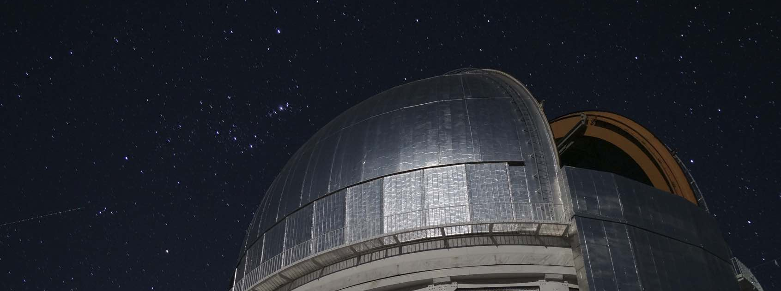

Testing the Laws of Gravity with Galaxy Surveys
Agnès Ferté
Organization: 3268
Advisors: Eric Huff (3268), Jason Rhodes (3200)
Postdoc Program: JPL

Slide 2
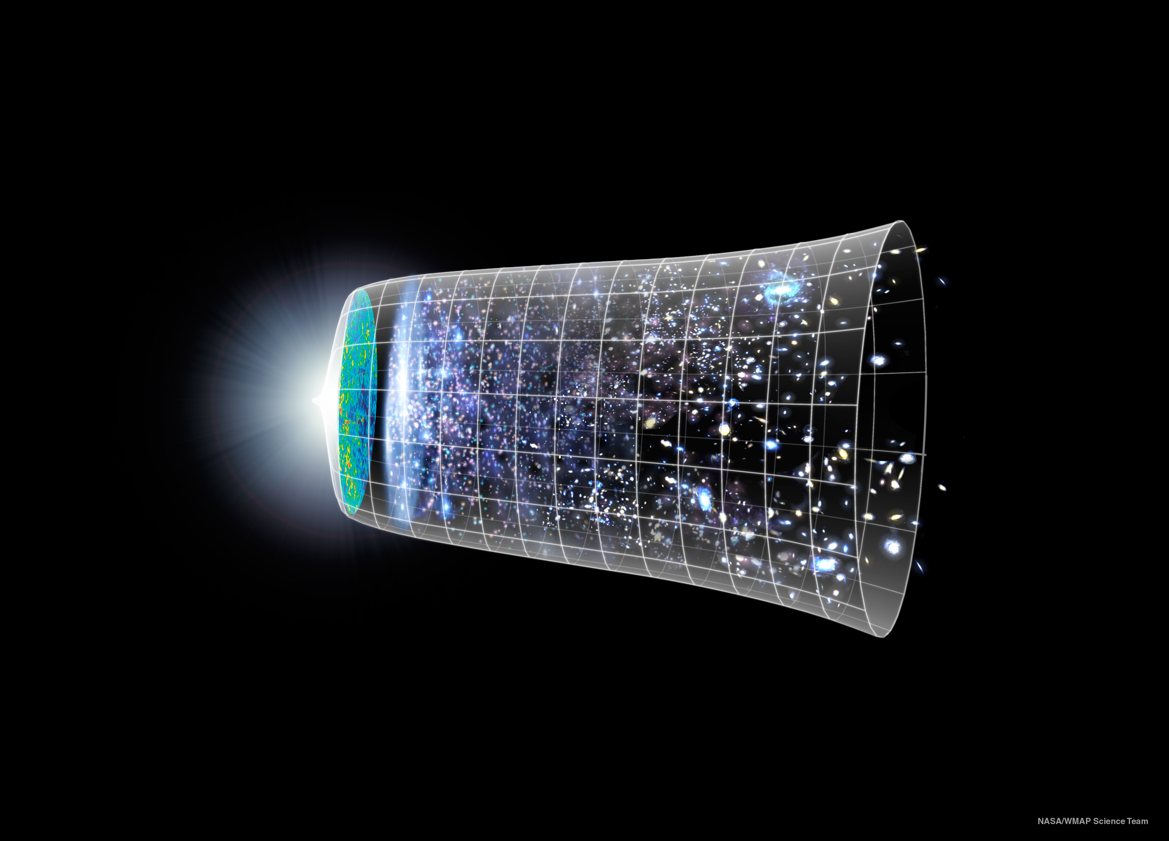
Why is the universe’s expansion accelerating?
Dark energy or Modified gravity?
NASA/WMAP science team

Slide 3
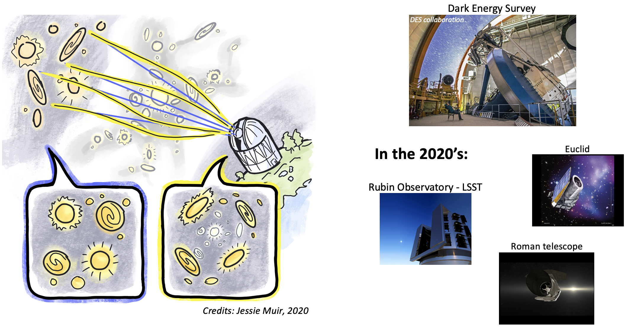
Weak gravitational lensing probes modified gravity

Slide 4
So many alternative theories to General Relativity!

Slide 5
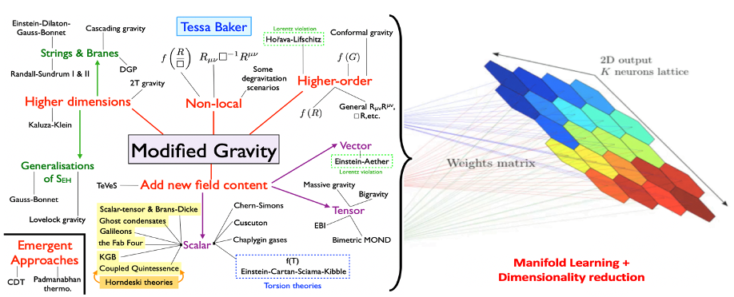
A new approach to simplify the space of Modified Gravity theories

Slide 6
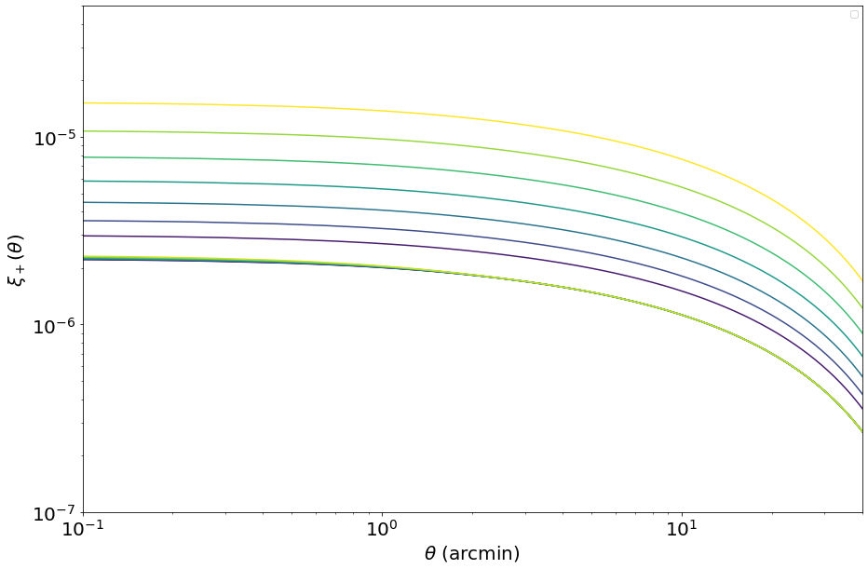
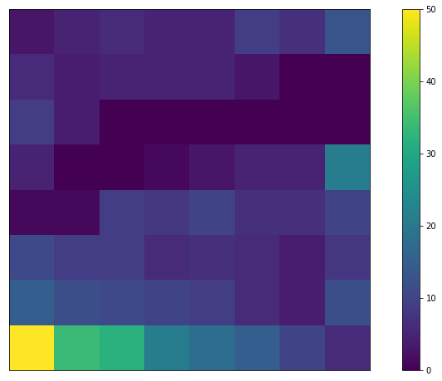
Results
Step 1
Create training data = theoretical predictions of the weak lensing signal for a set of different modified gravity theories
Step 2
Produce the Self-Organizing Map using the training data
Number of theories

Slide 7
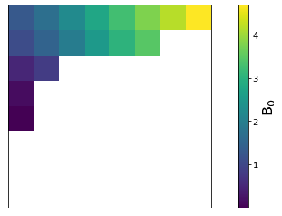
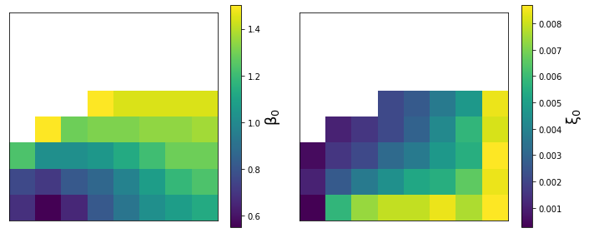
Some theories are distinguishable using weak gravitational lensing!
These two theories of modified gravity (f(R) and dilaton) are in different places of the Self-Organizing Map:
they can be distinguished!
f(R) are on the top left
Dilaton are on the bottom right

Slide 8
Outlooks
Self-Organizing Map can be used to simplify the space of modified gravity
Our next step is to project the effect of future measurements on the Self-Organizing Map of modified gravity.
➔ We will be able to indicate which theories to test with future galaxy surveys
Publication:
Agnès Ferté, Shoubaneh Hemmati, Daniel Masters, Brigitte Montminy, Jason Rhodes, Self-Organizing Map of modified gravity theories constrained by cosmic shear, in prep.

