Slide 1
A Planetary Broadband Seismometer (PBBS)
2020 Postdoc Research Day Presentation Conference
Andrew Erwin
Organization: 382J
Advisor: Talso Chui (382J)
Postdoc Program: JPL

Slide 2
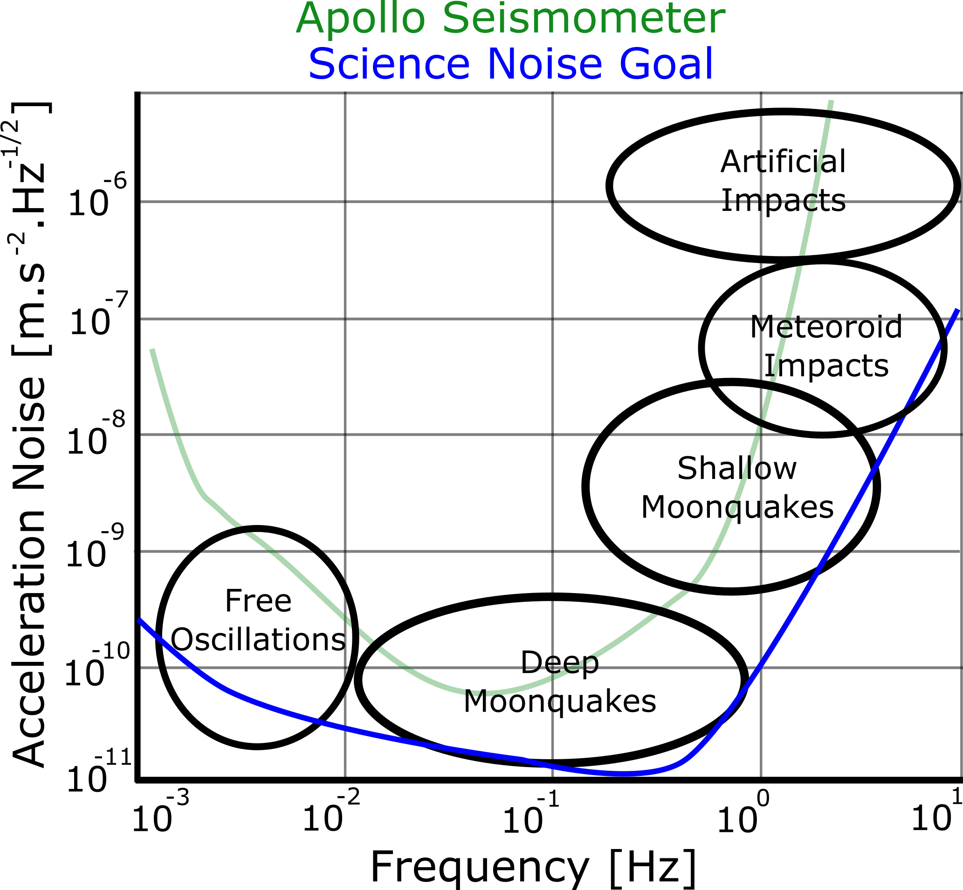
Motivation: Understanding the Lunar Interior
The Lunar Geophysical Network, a New Frontiers mission concept, calls for a seismometer more sensitive than the state of the art
The science goals of the Lunar Geophysical Network drive seismometer performance requirements

Slide 3
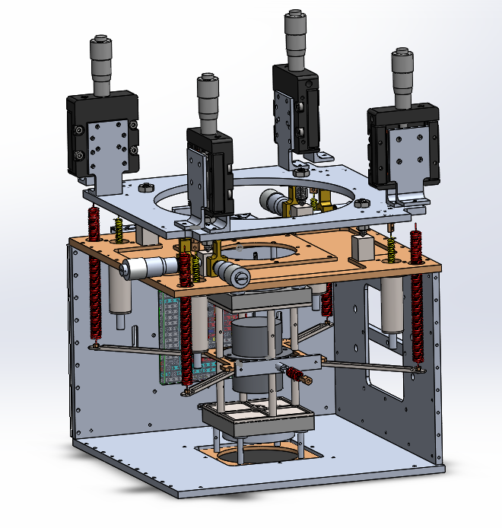
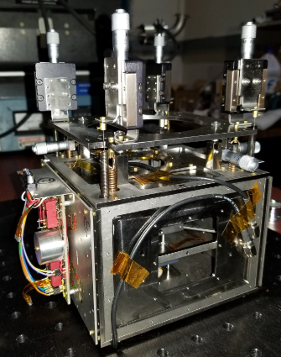
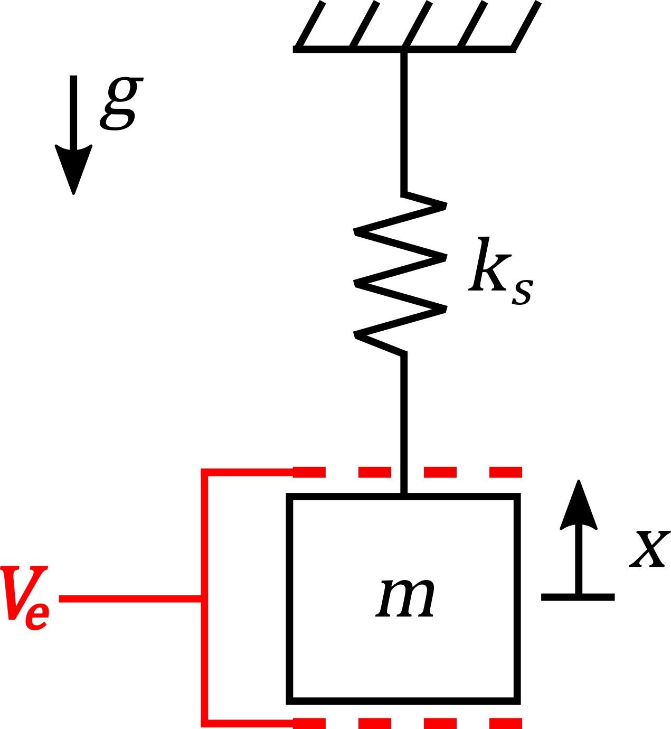
A Planetary Broadband Seismometer (PBBS)
Spring
Mass
Capacitor
At low frequency
$$f_{o}=3.1 Hz$$
$$Δ=\frac{\ddot{Z}}{ω_{o}^{2}}$$
(Ground Acceleration)
(Measurement)
(Resonance Frequency)

Slide 4
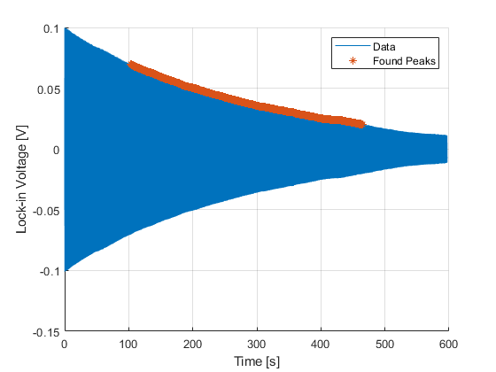
Understanding our Seismometer: Measuring $Q$
When the test mass is released, it will oscillate with a decaying amplitude
Ring down given an exponential decay
Estimate $Q$ from time constant ($τ$) of exponential fit
$$Q=\frac{τω_{o}}{2}$$
$$x\left(t\right)=x_{o}e^{−t/τ}sin⁡(ω_{o}t)$$

Slide 5
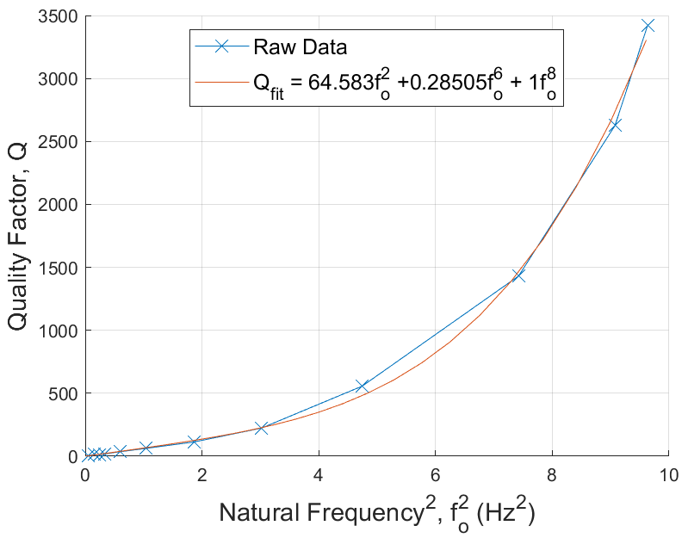
PT-1 Quality Factor: $Q≠af_{o}$
Expected: $Q∝f_{o}$
Measured:${ Q∝f}_{o}^{6}$

Slide 6
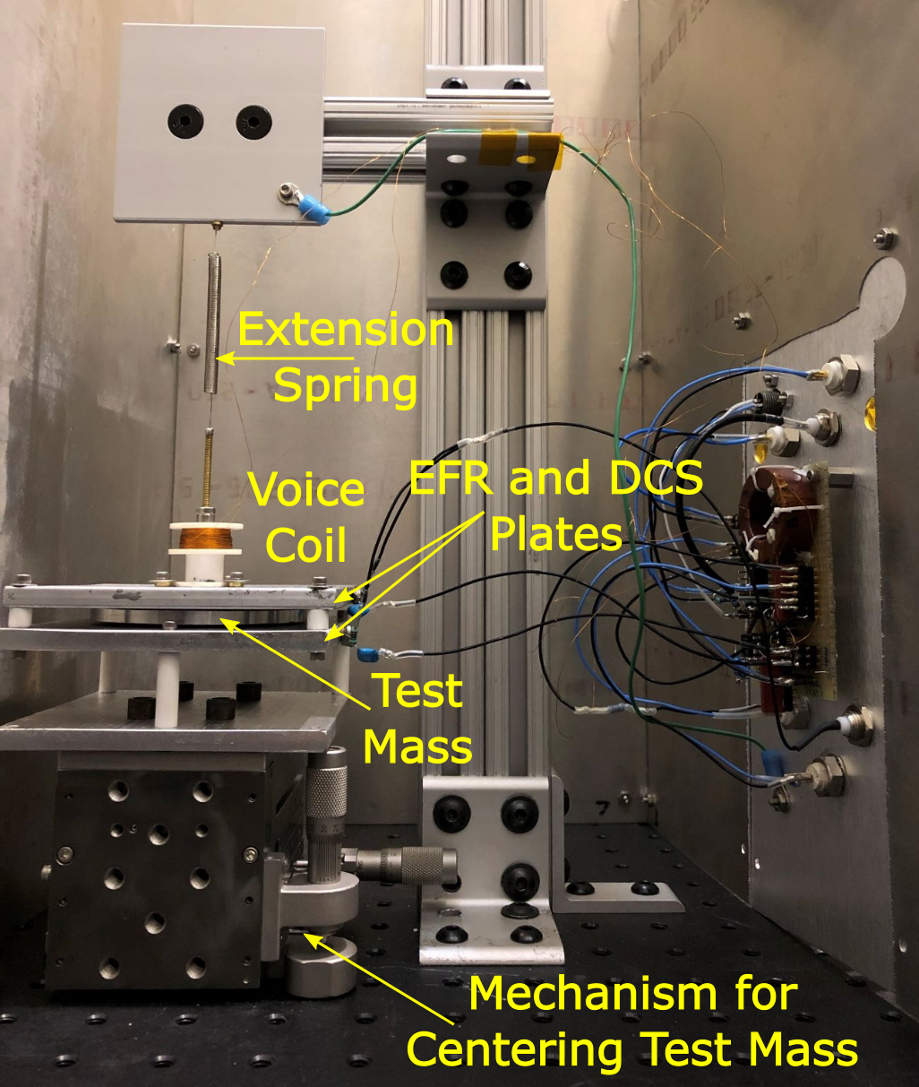
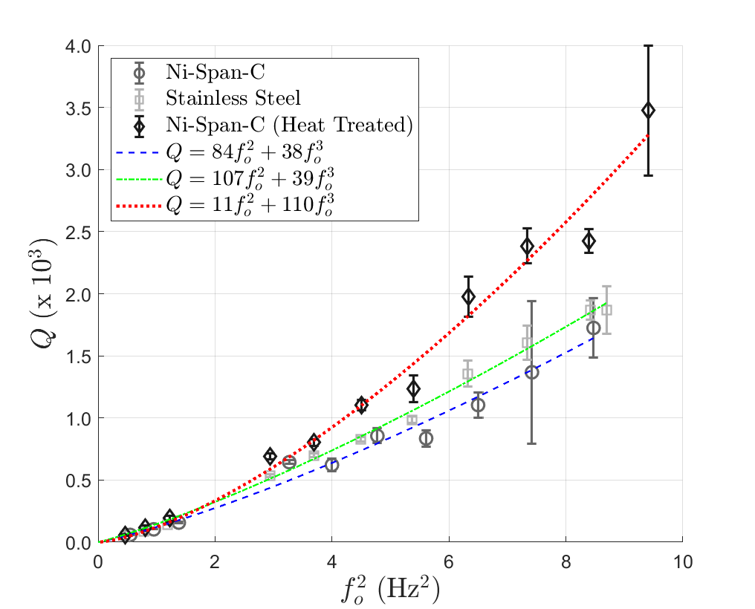
Internal Friction: $Q∝f_{o}^{2}$

Slide 7
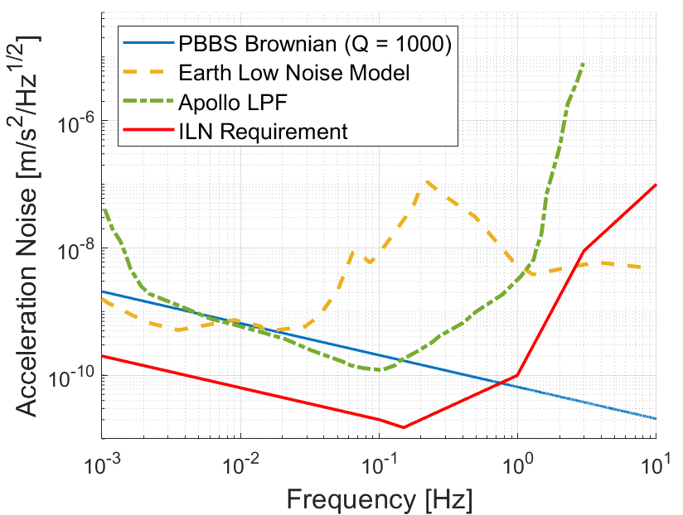
Implications for the PBBS Project
Brownian Noise
Air Damping:
$$\sqrt{S_{a}}=\sqrt{\frac{8πk_{B}Tf_{o}}{mQ}}$$
Internal friction:
$\sqrt{S_{a}}=\frac{1}{m}\sqrt{\frac{4k_{B}Tk_{s}}{ωQ(0) }}$
$$1/f$$
noise

Slide 8
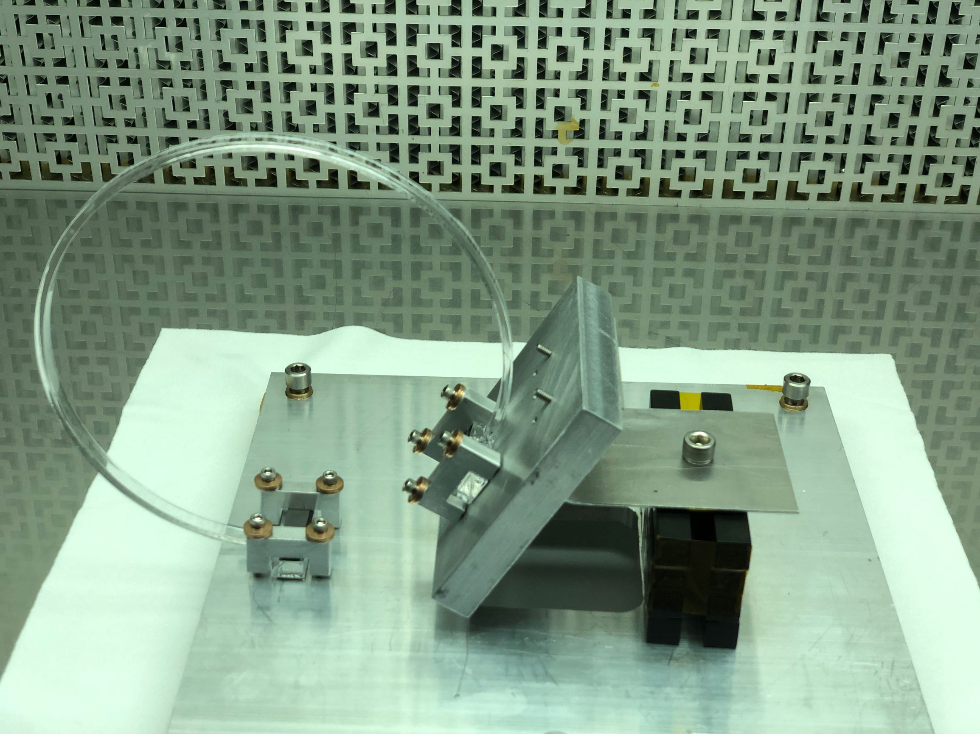
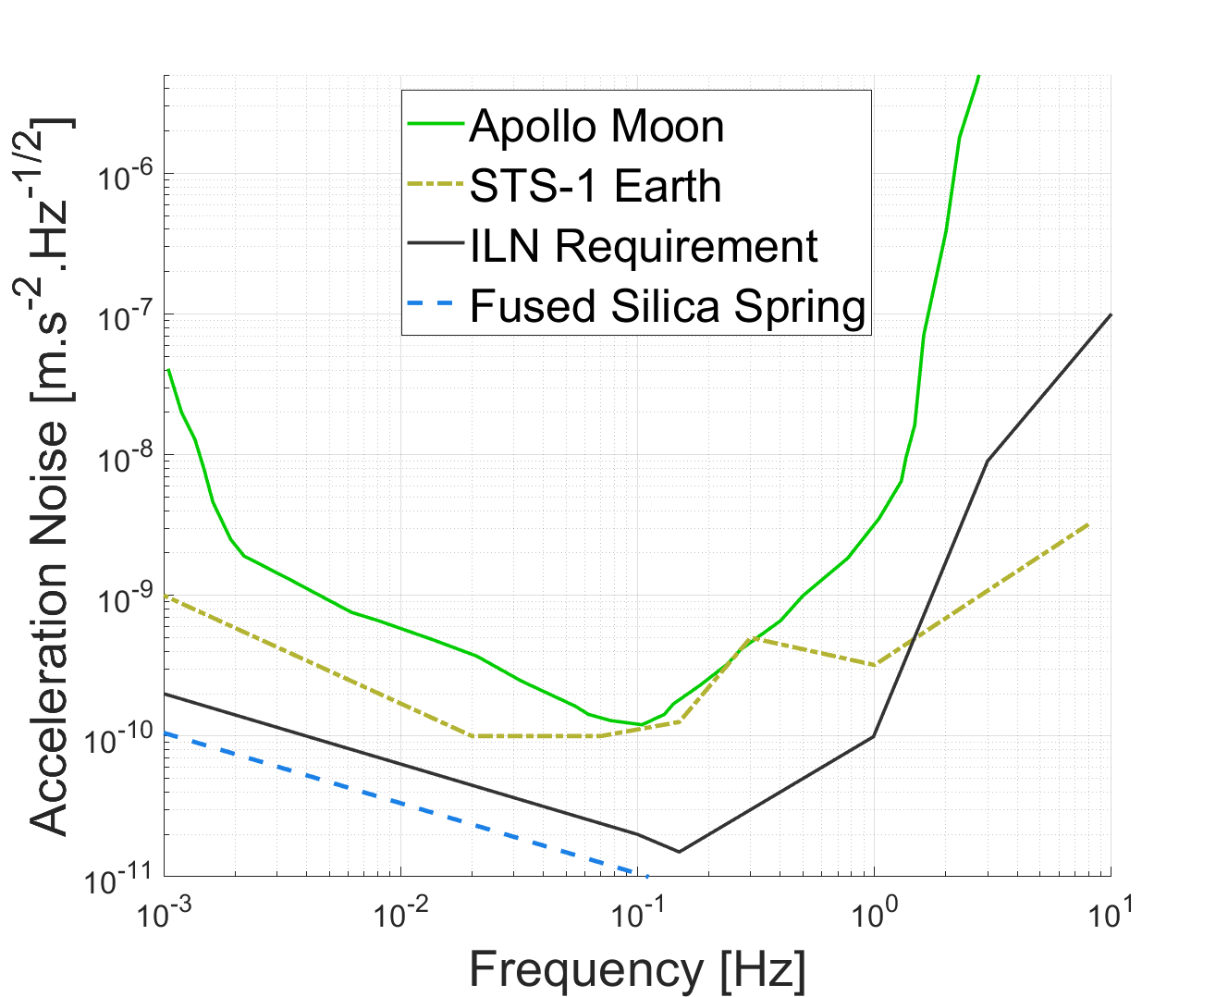
A Possible Solution: Fused Silica Spring
Fused silica suspension element: 0.135 m diameter and a 69º cutout

Slide 9
Publications and Acknowledgements
A. Erwin, K. J. Stone, D. Shelton, I. Hahn, W. Huie, L. A. N. de Paula, N. C. Schmerr, H. J. Paik, and T. C. P. Chui, “Electrostatic Frequency Reduction: A Negative Stiffness Mechanism for Measuring Dissipation in a Mechanical Oscillator at Low Frequency,” Review of Scientific Instruments (In Review).
A. Erwin and T. C. P. Chui, “Design considerations for long-period seismometers: Brownian, thermal, and DCS noise,” Review of Scientific Instruments (In Preparation).
A. Erwin, K. J. Stone, D. Shelton, R. Calvet, I. Hahn, S. Kedar, N. C. Schmerr, H. J. Paik, and T. C. P. Chui, “Development of a seismometer for the Moon: Overcoming Brownian motion,” Lunar and Planetary Science Conference (LPSC), 2020.
A. Erwin, K. J. Stone, S. Kedar, D. Shelton, H. J. Paik, P. R. Williamson, and T. C. P. Chui, “A planetary broadband seismometer (PBBS) for the Lunar Geophysical Network and Ocean Worlds: Experiment and theory on the thermal drift due to EFR,” Lunar and Planetary Science Conference (LPSC), 2019.
A. Erwin, K. J. Stone, S. Kedar, D. Shelton, H. J. Paik, P. R. Williamson, and T. C. P. Chui, “A planetary broadband seismometer (PBBS) for the Lunar Geophysical Network,” Los Angeles Postdoctoral Research Symposium, Los Angeles, CA, 2019. 2nd Place Poster Presentation.
This work was carried out by the Jet Propulsion Laboratory, California Institute of Technology, under a contract with NASA. This work was supported in part by the NASA MatISSE program. Dr. Andrew Erwin was supported by an appointment to the NASA Postdoctoral Program at the Jet Propulsion Laboratory, administered by USRA under contract with NASA, between 2018-2020. Andrew is currently supported by the JPL Postdoctoral program.

Slide 10
PBBS Contributors
PI: Talso Chui
JPL Co-I: Inseob Hahn, Sharon Kedar
U. Maryland Co-I: Ho Jung Paik, Nicholas Schmerr
Austin Sensor Co-I: Roger Williamson
Staff Technologist: Kristjan Stone
JPL Postdoctoral Fellow: Andrew Erwin
U. Maryland Postdocs: Leandro de Paula, Christopher Collins
Summer Intern Students: Will Huie, Owen Winship
JPL Advisors: Rob Calvet, Mark Balzer, Kenneth Hurst,
Jason Feldman, Jeffrey Umland, Kerry Klein
Collaborators: Bruce Banerdt (JPL), Steve Vance (JPL),
Clive Neal (U. Notre Dame)

