Slide 1
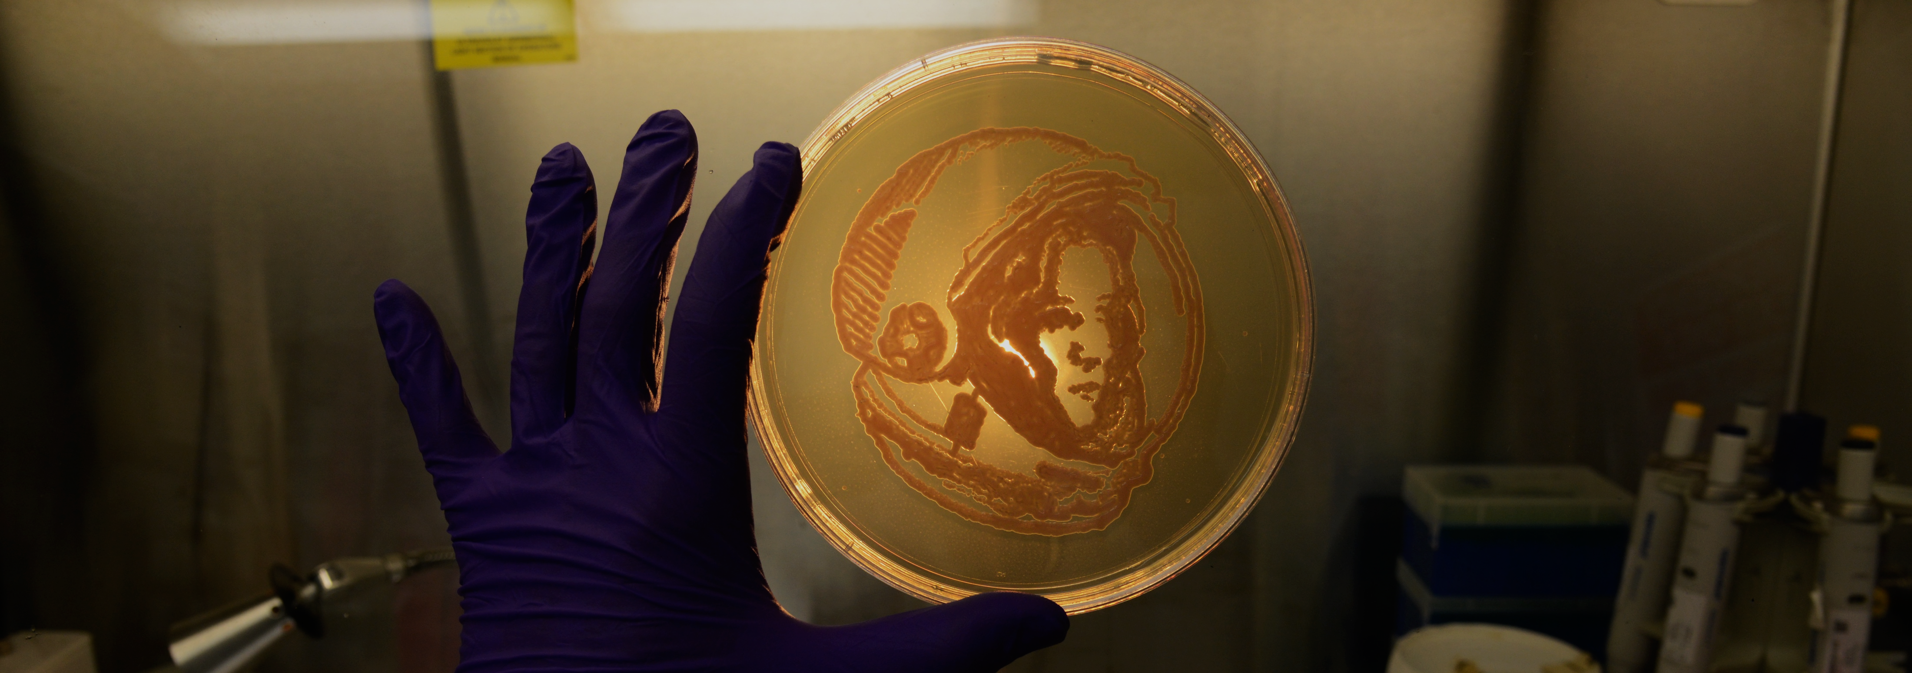


I used a Rhodotorula mucilaginosa strain
isolated from the International Space Station
to ‘paint’ American astronaut Anna Fisher
Instrument Development to test Microgravity Biofilm Formation Aboard the International Space Station
Ceth Parker
Organization: Biotechnology and Planetary Protection (352N)
Advisor: Kasthuri Venkateswaran
Postdoc Program: JPL

Slide 2
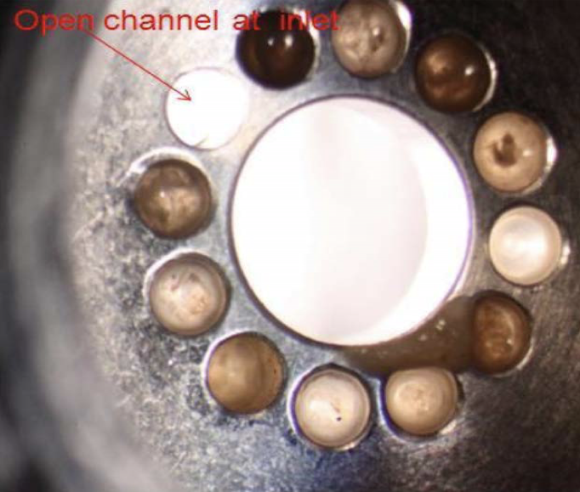
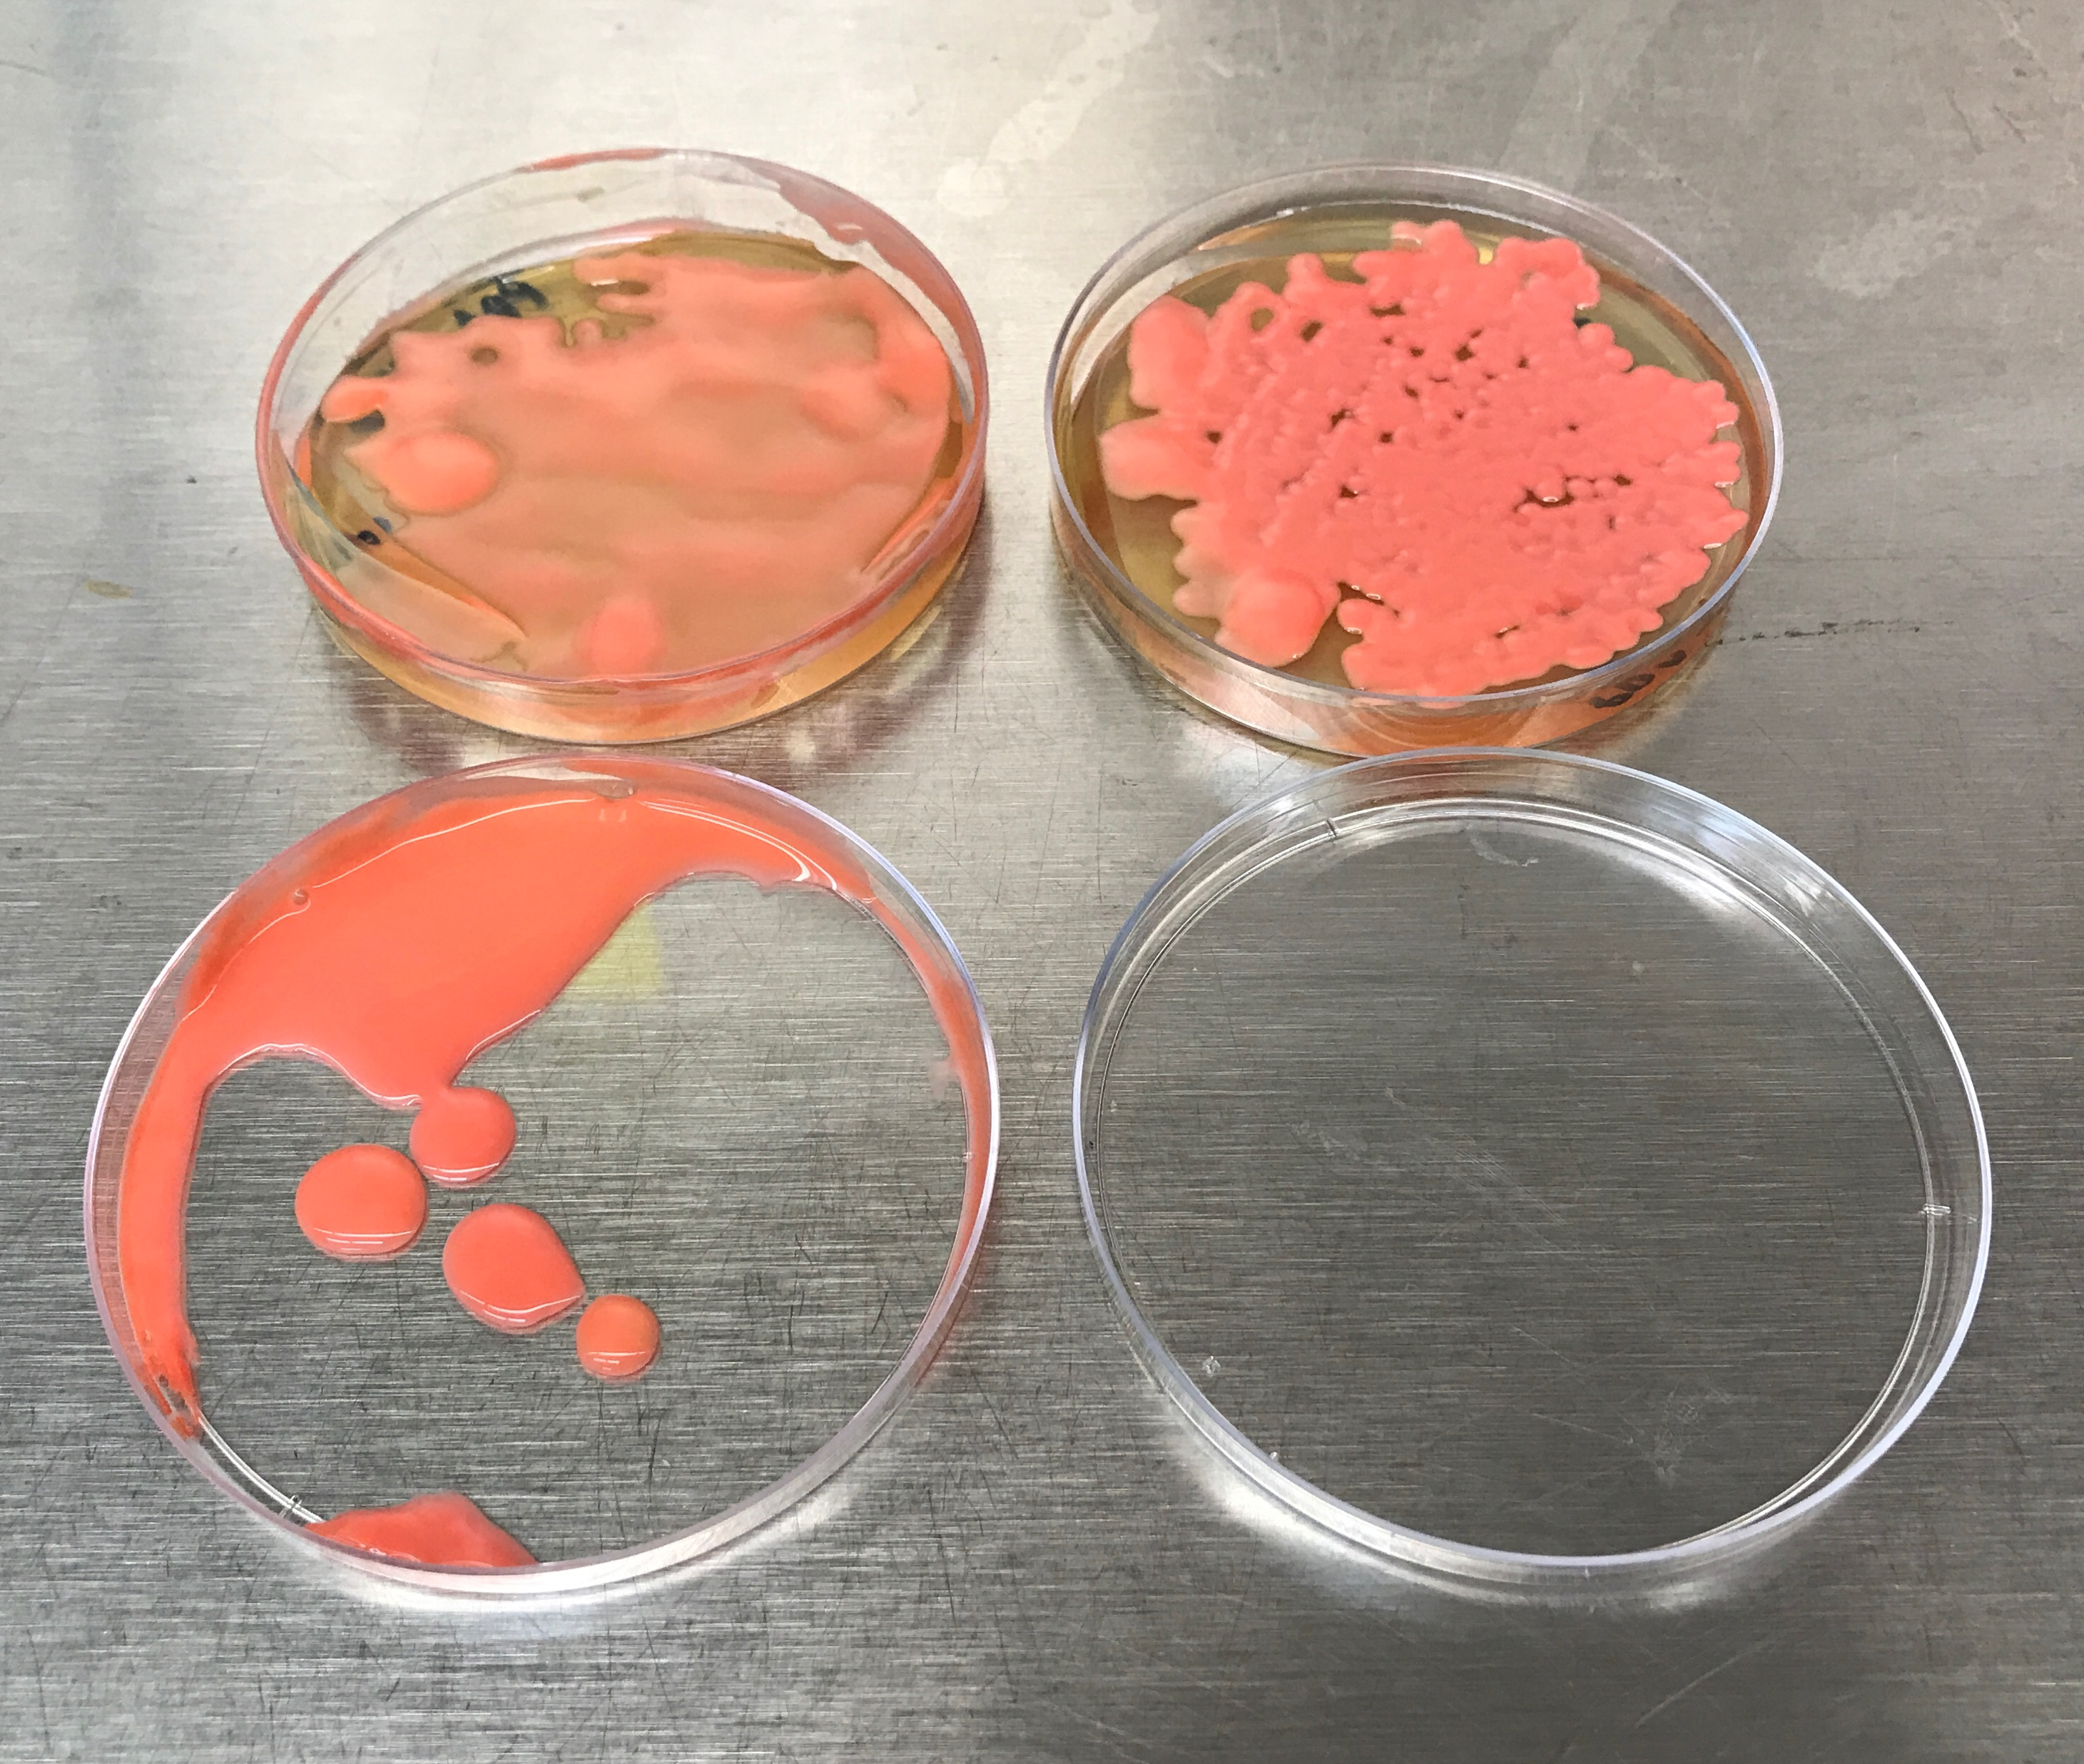
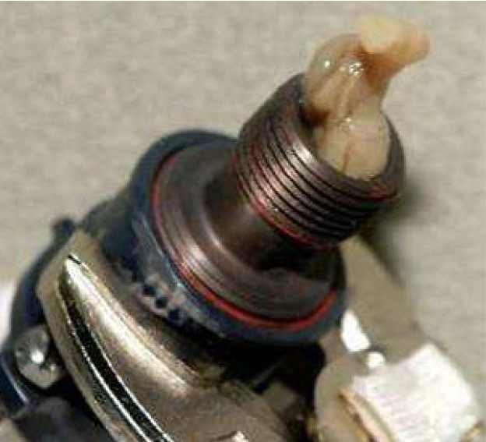
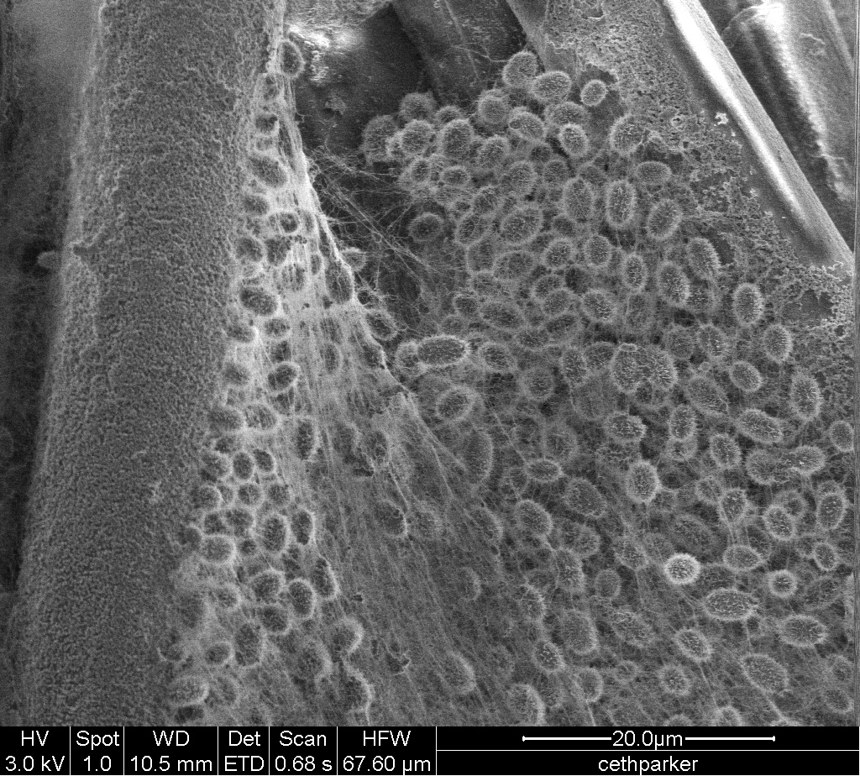
Biofilms on the ISS
Cultivated at JPL
Introduction
Biofilms pose threats to the crew and life support systems aboard the International space Station (ISS)
Biofilm mitigation is essential for Moon and Mars missions
Cultivating ISS Microbes on Earth
Discovered dual biofilm morphologies in ISS yeast Rhodotorula mucilaginosa
Need to to study under ‘ISS’ relevant conditions
A
C
B
D
Photos from Mr. Donald Layne Carter,
NASAMarshall Space Flight Center
Images from Dr. Ceth Parker,
NASA Jet Propulsion Laboratory
2

Slide 3
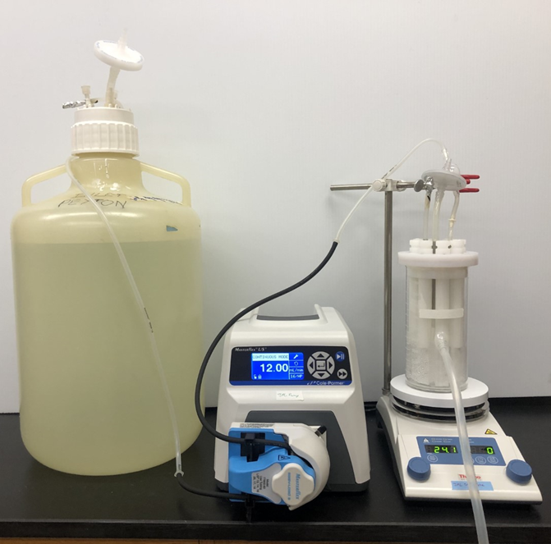
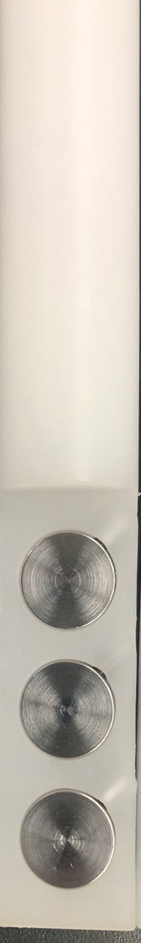
Current State of the Art
Reactor
Rods
Peristaltic
Pump
CDC
Reactor
Centers for Disease Control
(CDC) bioreactors
  State of the art
  Industry standard
  Bench top method provides flow regimes
  However; many draw backs
Coupons
Feed Reservoir
3

Slide 4
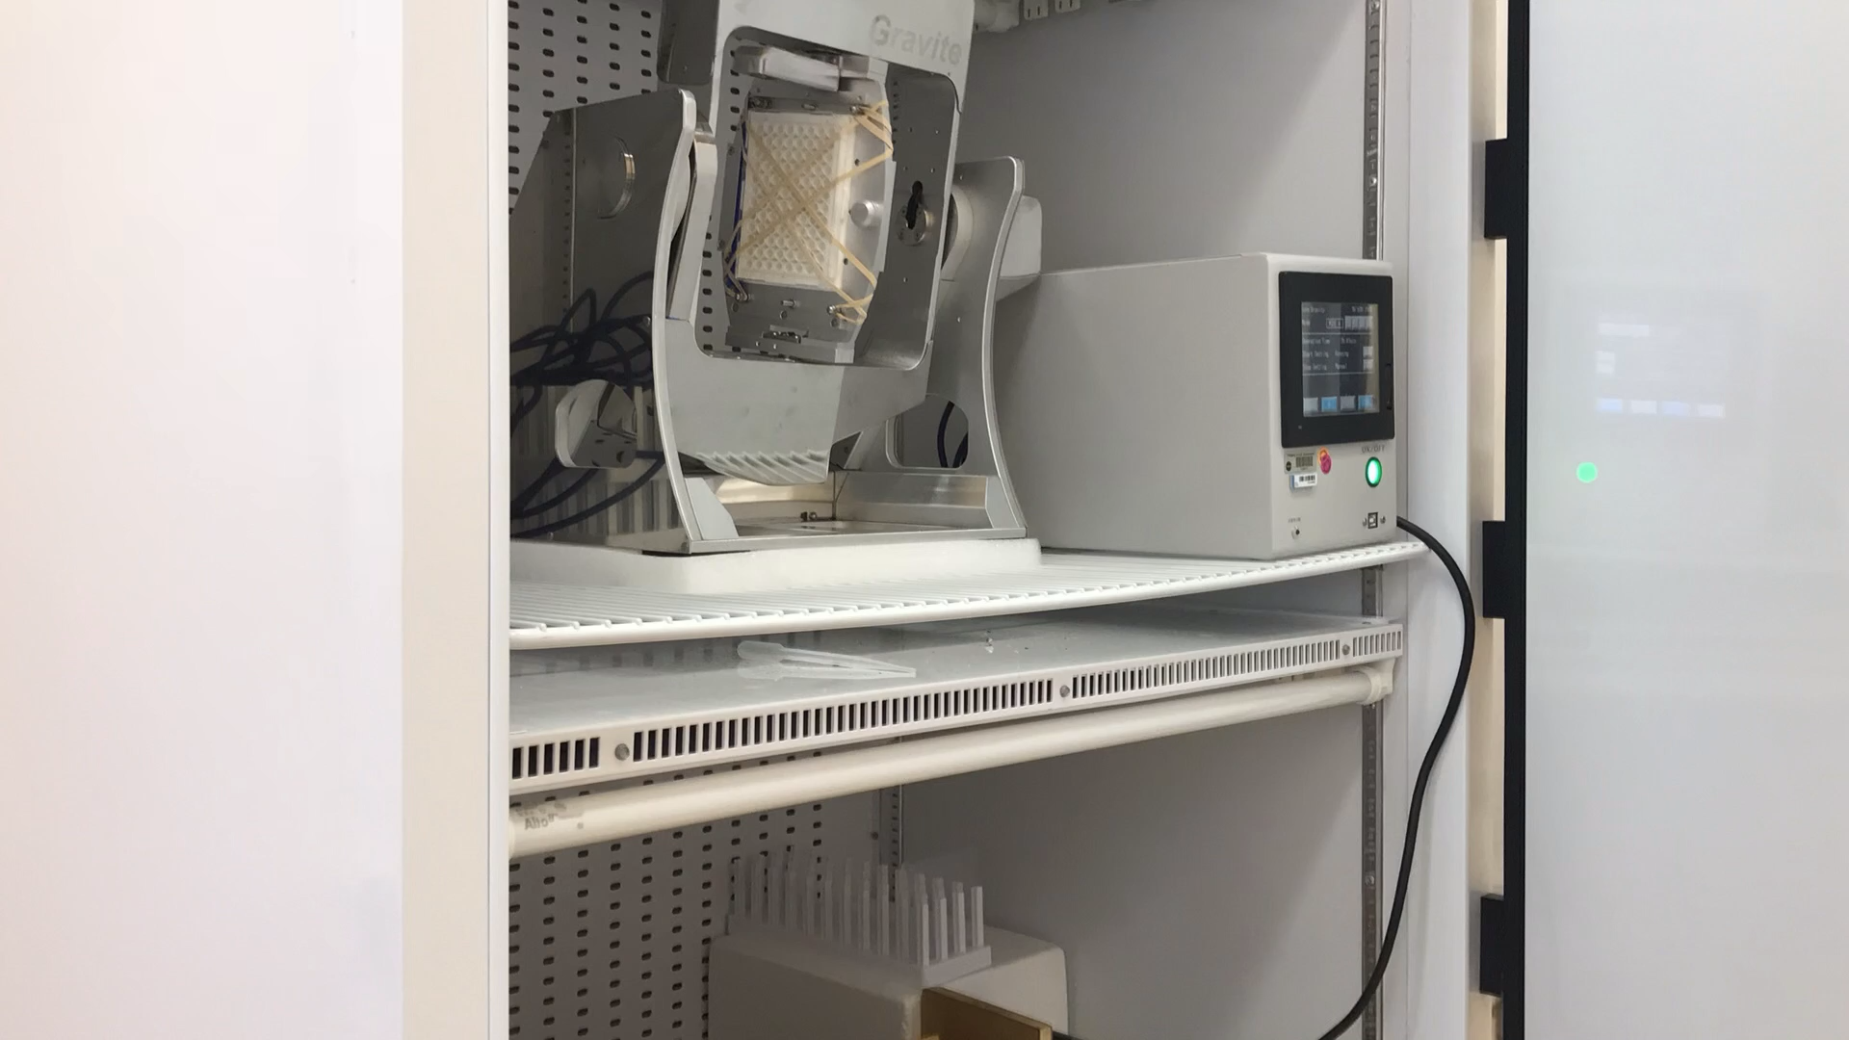
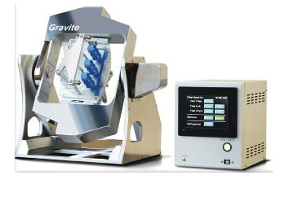
Role of Microgravity (µG) in Biofilm Formation
Simulated µG Devices (3D Clinostats) allow testing on Earth
  Samples are inverted while being turned in all directions
Need to test µG AND flow regimes
NO current Technology can meet these requirements
4

Slide 5
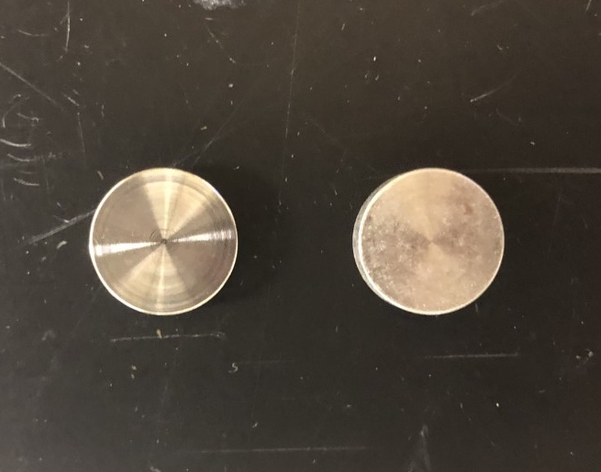
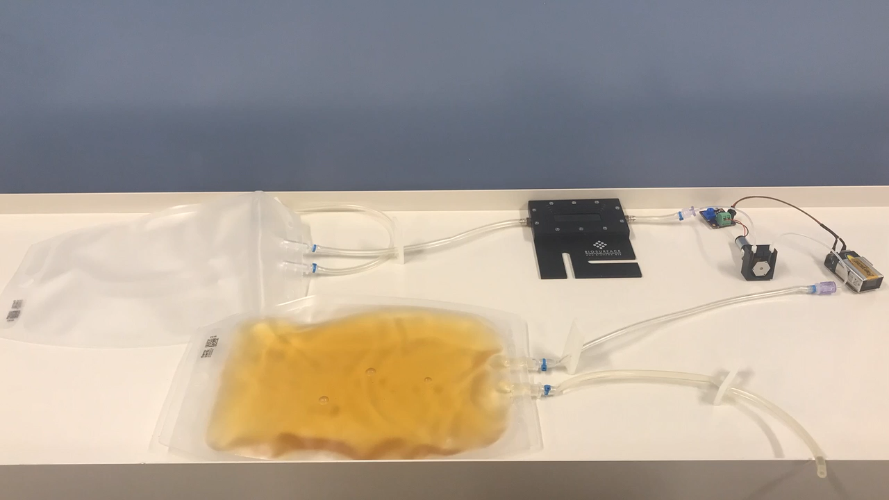
Microgravity Compatible Continuous System
Flow Cell (µCFC) for Microbial Growth and Biofilm Analysis
Micro-Peristaltic Pump
Coupon Holder -
Flow Cell
Controller
9 Volt
Battery
Waste Reservoir
Feed Reservoir
5
Problem discovery, concept, design, system building, and testing performed by Dr. Ceth Parker; Controller was designed and built by Dr. George Richdale

Slide 6
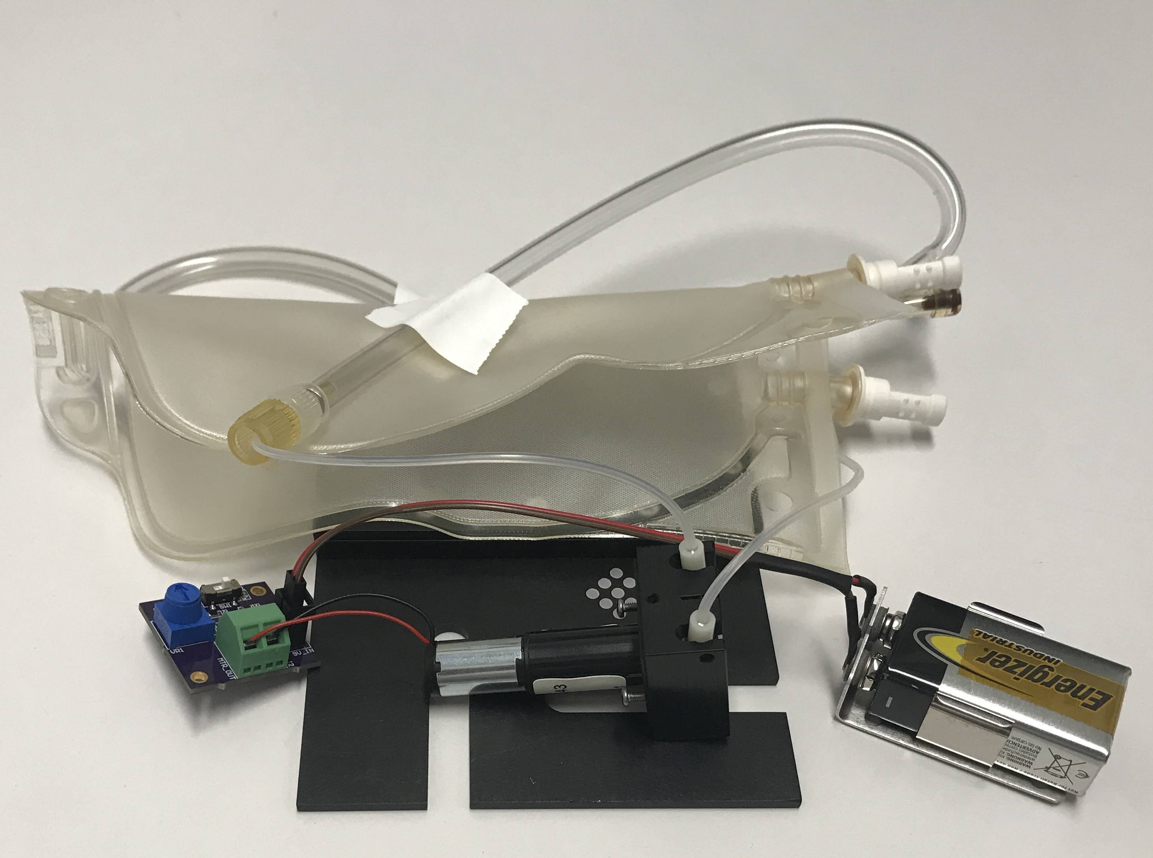

Accomplishments
Folded up µCFC
Succeeded
  Complete Miniaturization
  Filling the technology gap
    Can operate on simulated-µG devices
1 New Technology Report
1 Provisional Patent
6

Slide 7
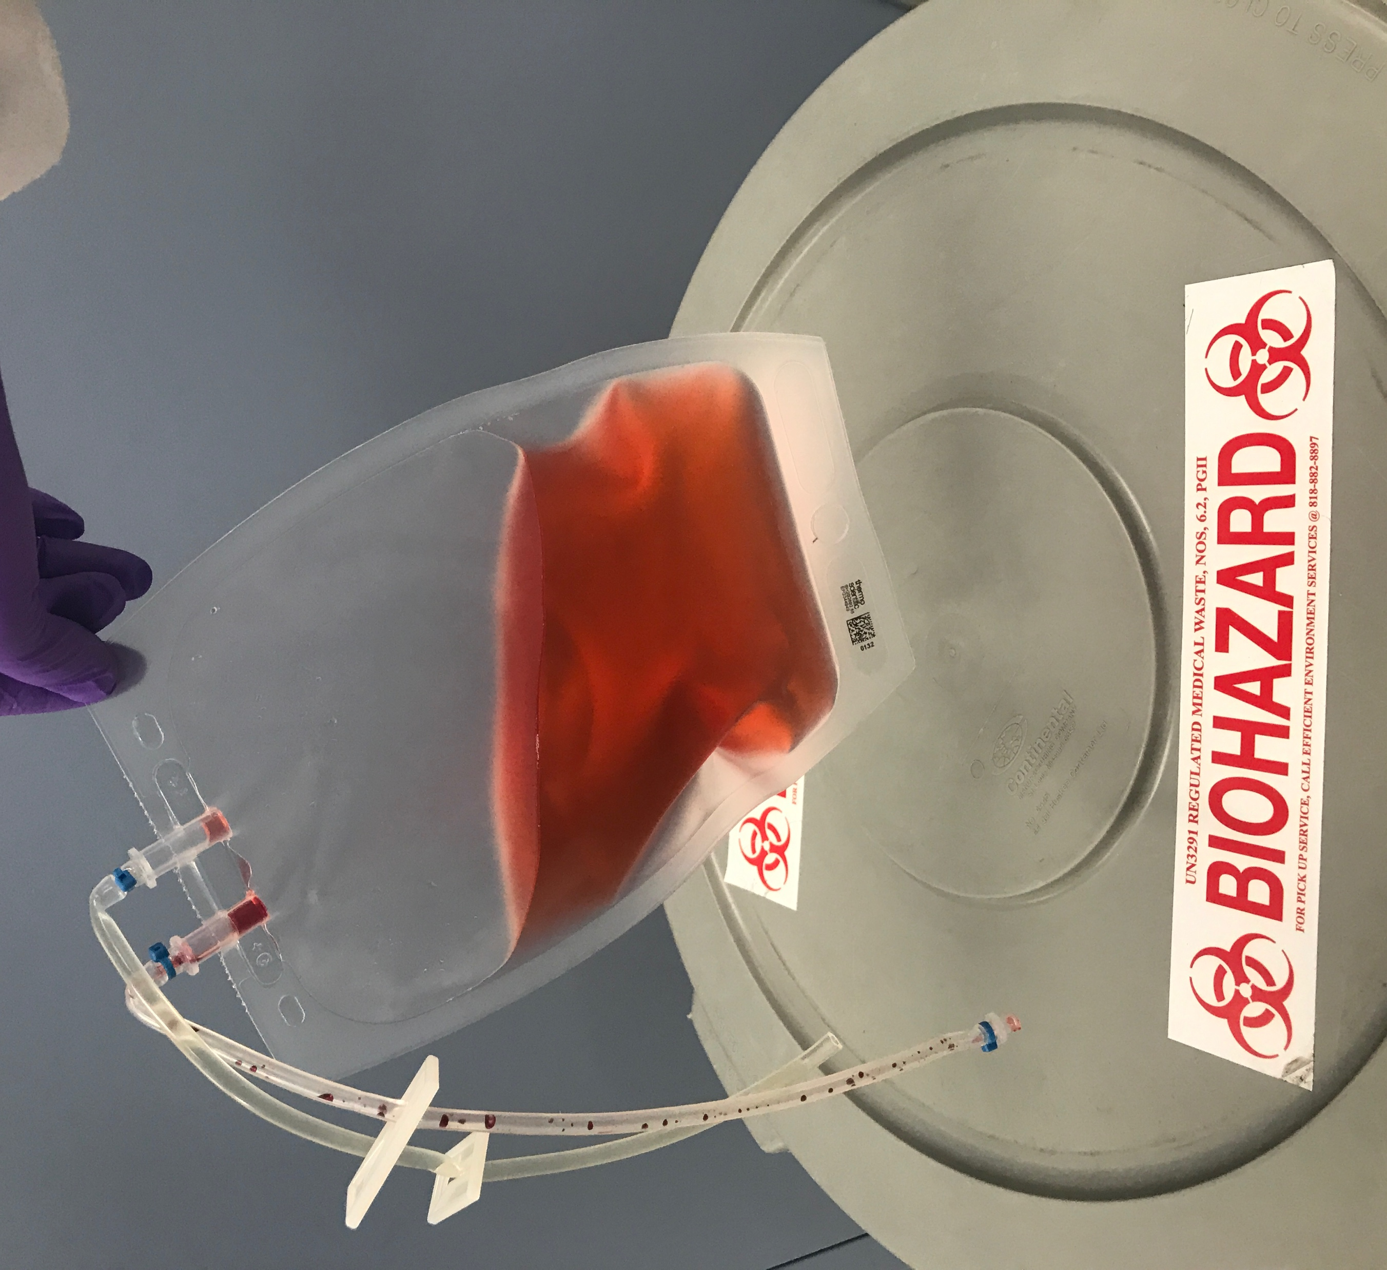
Varied Applications
Microgravity Associated Research
  Simulated-µG studies
  International Space Station studies
  Cube Sat Studies
  Antarctic Balloon Studies
Medical Research
  Infectious Microorganisms
    Full sample and waste containment
  Biofilm growth on Medical Devices
General Biofilm Studies
7

Slide 8
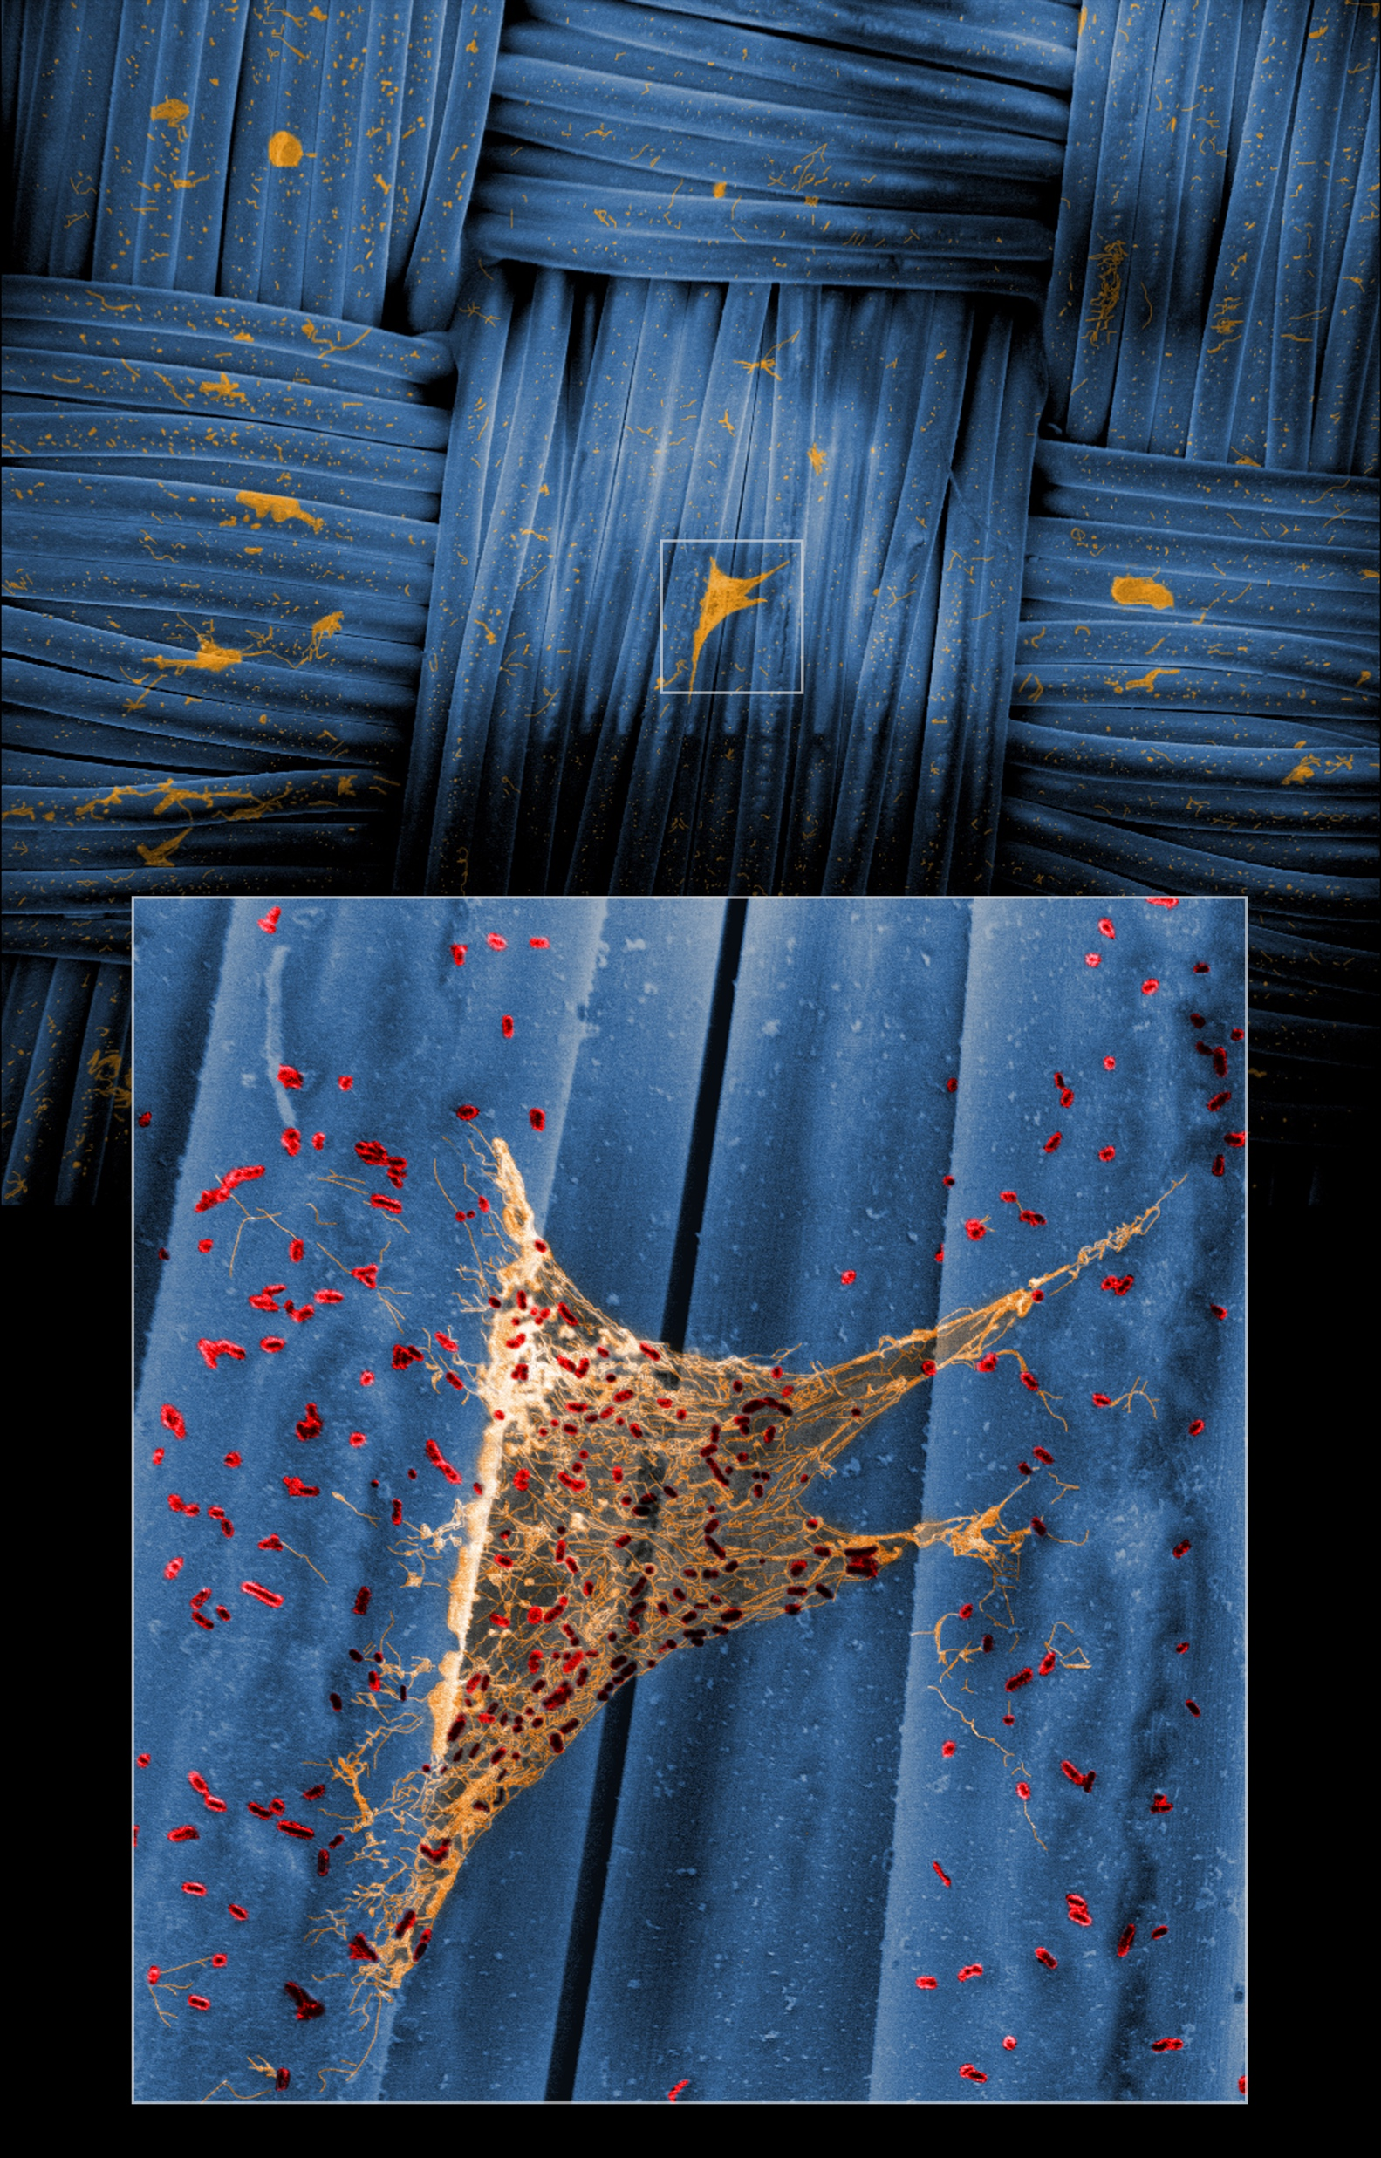
Accomplishments and Publications
Awards
  2019 American Society for Gravitational and Space Research conference in Denver, CO., 1st place in Technical Merit for my submitted SEM (Below) .
  Two JPL Team awards
    “COVID Surface Testing Team Award”
    “Outstanding execution of the move and set up of the new B245 Planetary Protection Lab”
Provisional Patents
  Microgravity Compatible Continuous Flow Cell (µCFC) System for Microbial Growth and Biofilm Analysis
    Ceth Parker, George Richdale, Kasthuri Venkateswaran CIT-8517-P
New Technology Reports
  Microgravity Compatible Continuous Flow Cell (µCFC) System for Microbial Growth and Biofilm Analysis
    Ceth Parker, George Richdale, Kasthuri Venkateswaran JPL NTR ID # 51649
  Enclosed Miniature-CDC Rods (EMCR) system for Biofilm Analysis in Microgravity Simulators
    Ceth Parker, Kasthuri Venkateswaran JPL NTR ID # 51725
  Culture Tube Holder for both the Gravite and RPM Microgravity Simulators
    Jonathan Gleeson, Jeffrey Richards, Ceth Parker, Kasthuri Venkateswaran, Ye Zhang: NASA NTR ID # 1596561636
Select Accepted Publications
  Parker CW*, Singh N*, Tighe S*, Blachowicz A, Wood JM, Seuylemezian A, Vaishampayan P, Urbaniak C, Hendrickson
  R, Laaguiby P, Clark K, Clement BG, O’Hara NB, Couto-Rodriguez M, Bezdan D, Mason M, and Venkateswaran K*.
  End-to-End Protocol for the Detection of SARS-CoV-2 from Built Environments. mSystems. Accepted. (*Co-First Authorship)
  Mohan GB*, Parker CW*, Urbaniak C*, Singh N, Hood A, Minich J, Knight R, Rucker MA, Venkateswaran K. Microbiome and
  Metagenome Analyses of a Closed Habitat During Human Occupation. mSystems. 2020;5:1. (*Co-First Authorship)
  Mhatre SS, Singh NK, Wood JM, Parker CW, Venkateswaran K. Description of chloramphenicol resistant
  Kineococcus rubinsiae sp. nov. isolated from a spacecraft assembly facility. Frontiers in Microbiology. 2020;11:1957.
  Urbaniak C, Wong S, Tighe S, Arumugam A, Liu B, Parker CW, Wood JM, Singh NK, Skorupa D, Peyton B, Jenson R. Validating an
  automated nucleic acid extraction device for omics in space using whole cell microbial reference standards. Frontiers in Microbiology. 2020;11:1909.
“One Small EPS for Bacteria,
One Giant Biofilm for Bacterial-Kind”
8

Slide 9
Acknowledgements and Funding
Funding Sources
  JPL Directors Innovation Fund
  ISS Advanced Exploration Life Support System program (LSS)-Nanoengineered Materials That Resist Organisms (NEMO)
Advisor
  Kasthuri Venkateswaran
Group Supervisor
  Brian Clement
Lab Members
  Nitin Singh, Adriana Blachowicz, Jason M. Wood, Camilla Urbaniak, Ganesh Babu Malli Mohan
Other JPLers
  George (Coleman) Richdale, Matthew Gentile, Josh Krohn, Josh Ravich
Visiting Students
  Madelyn Mettler, Robert Daudu, John Bateh, Adriana Gonzalez
Collaborators
  Brent M. Peyton (MSU), Dana Skorupa (MSU), Niamh O’hara (Biotia), Mara Couto-Rodriguez (Biotia), Ryan Jensen (IRPI), Ye Zhang (KSC), Jeff Richards (KSC), Season Wong (AI Bioscience), Arun Kumar (AI Bioscience), Daniela Bezdan (Weill Cornell Medicine), Chris Mason (Weill Cornell Medicine), Scott Tighe (VIGR), Julie Dragon (VIGR), Pheobe Laaguiby (VIGR), Fathi Karouia (AMES), Donald Layne Carter (Marshal)
9

