Slide 1
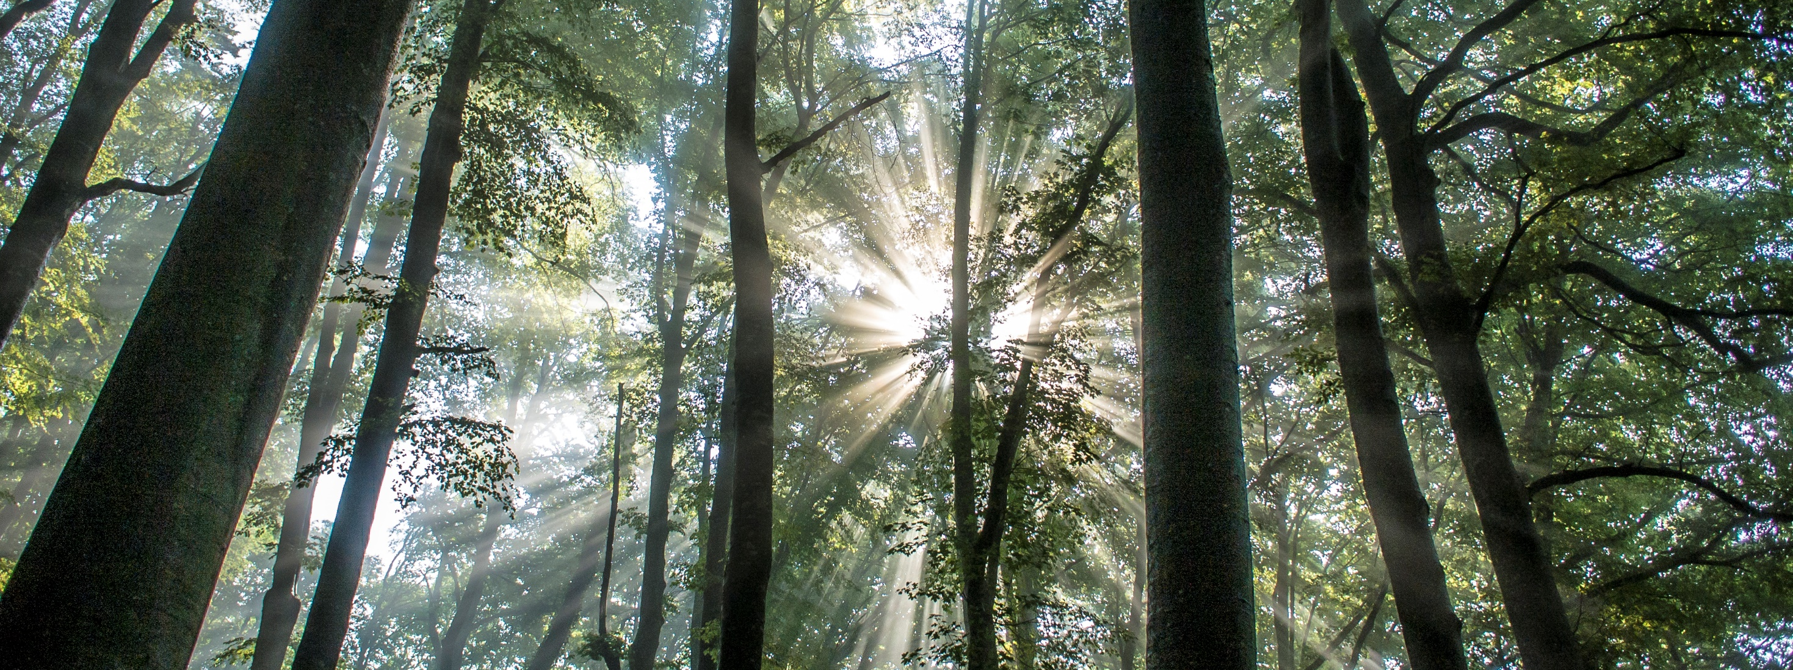

2020 Postdoc Research Day Presentation
Fabian D Schneider
Organization: 329G
Advisor: David Schimel (329G)
Postdoc Program: JPL (California Institute of Technology)

Slide 2
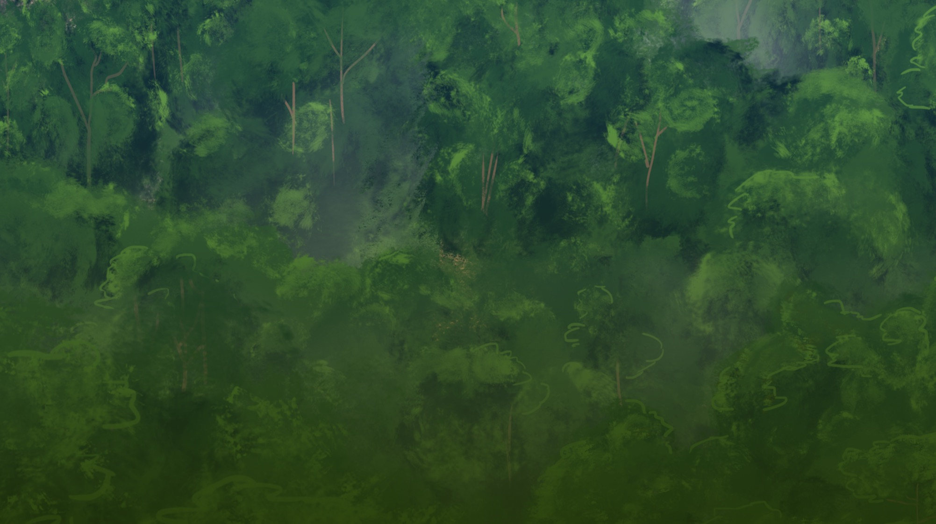
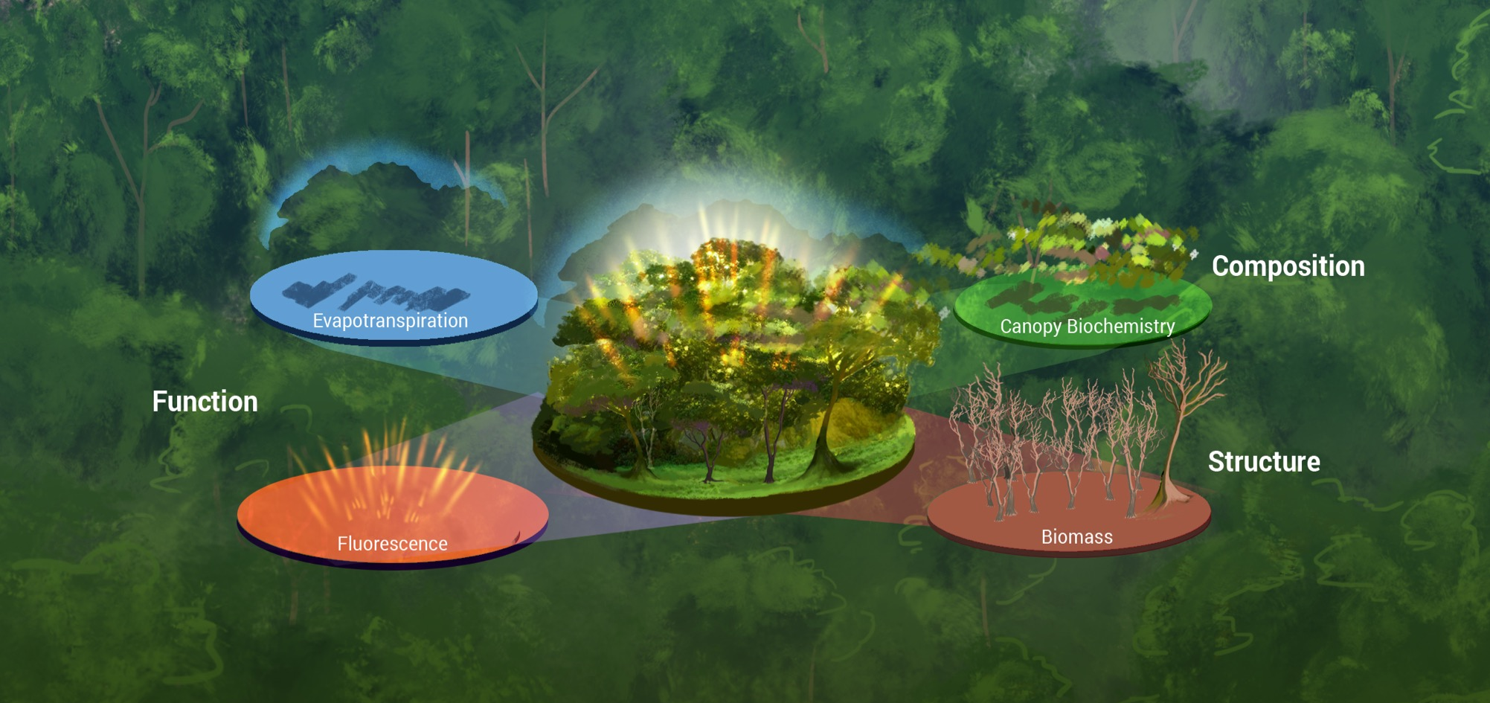

Remote Sensing of Biological Diversity & Function
Physiological
Diversity
Morphological
Diversity
Image Credit: ELEVATE team, Josh Fisher

Slide 3
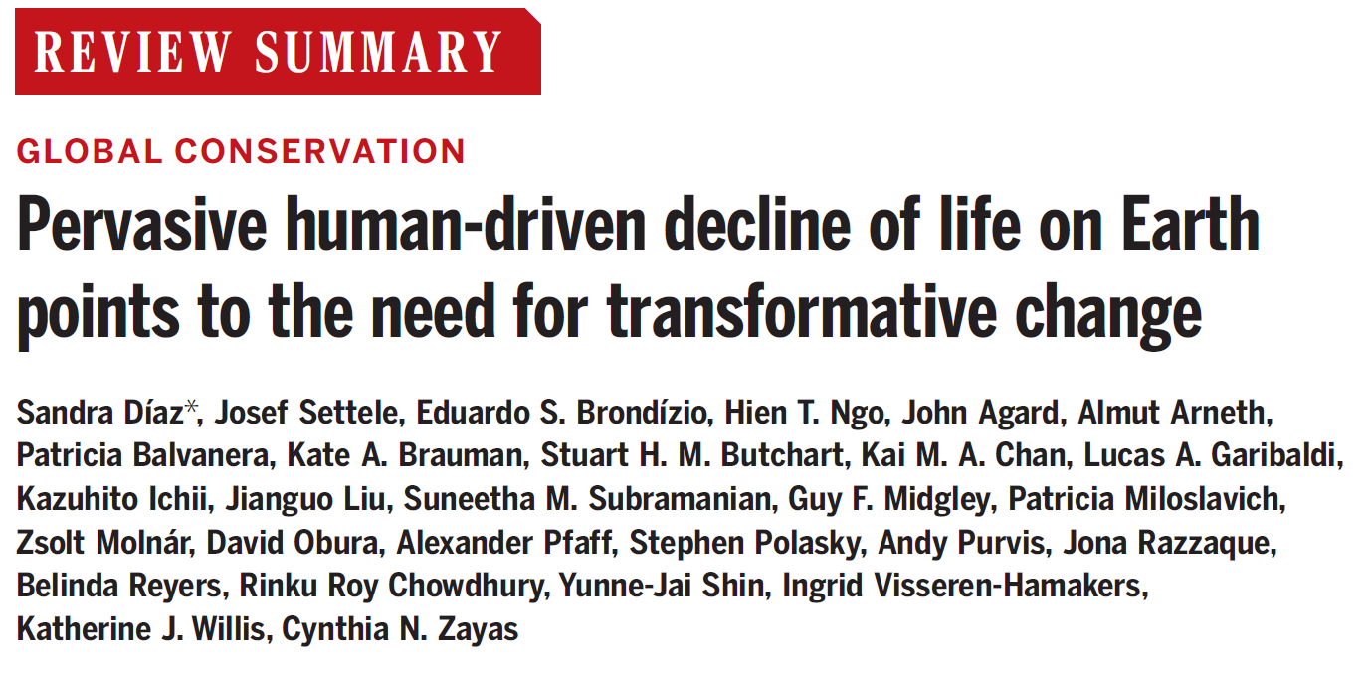
Biodiversity Crisis & Solutions
Perceived Risks over the next Decade
Garschagen et al. (2020) Earth’s Future
Diaz et al. (2019) Science

Slide 4
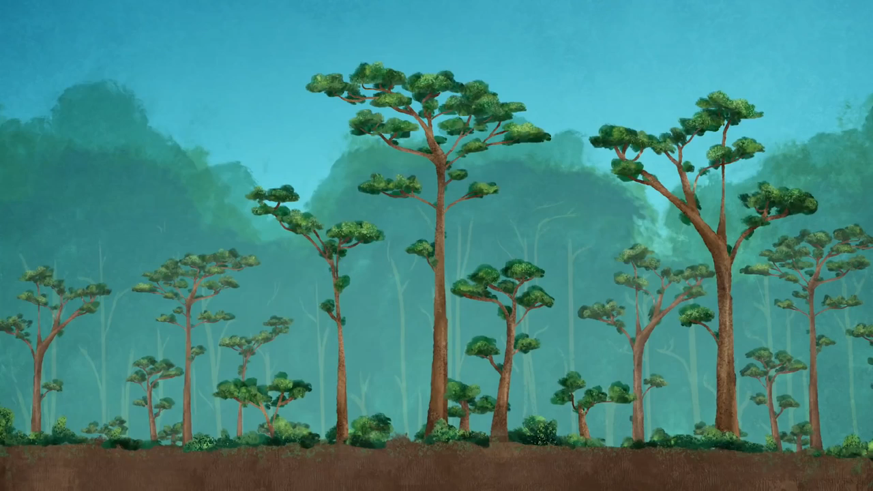
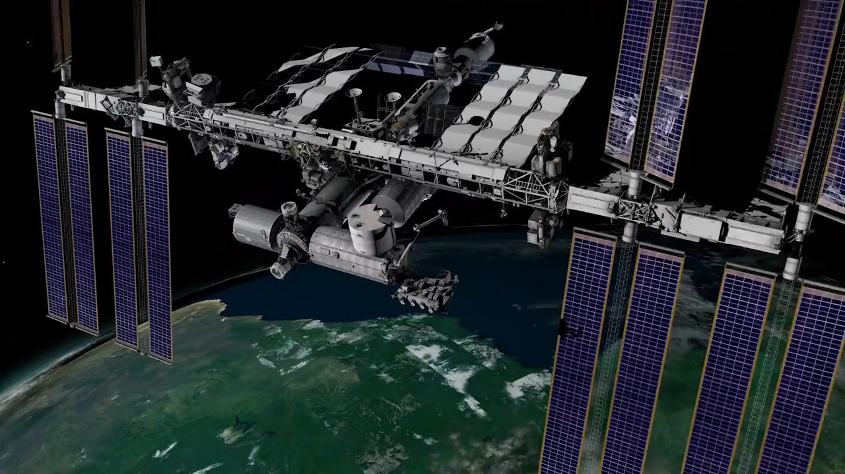

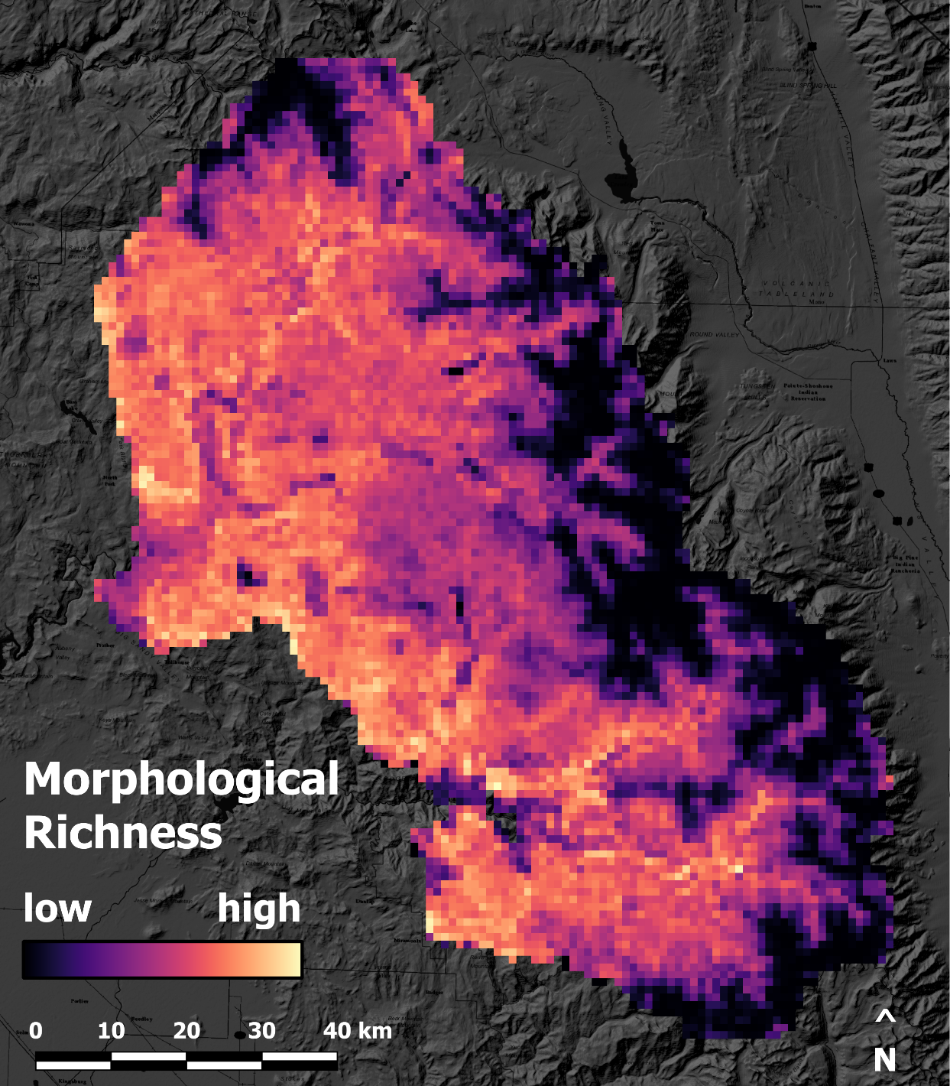
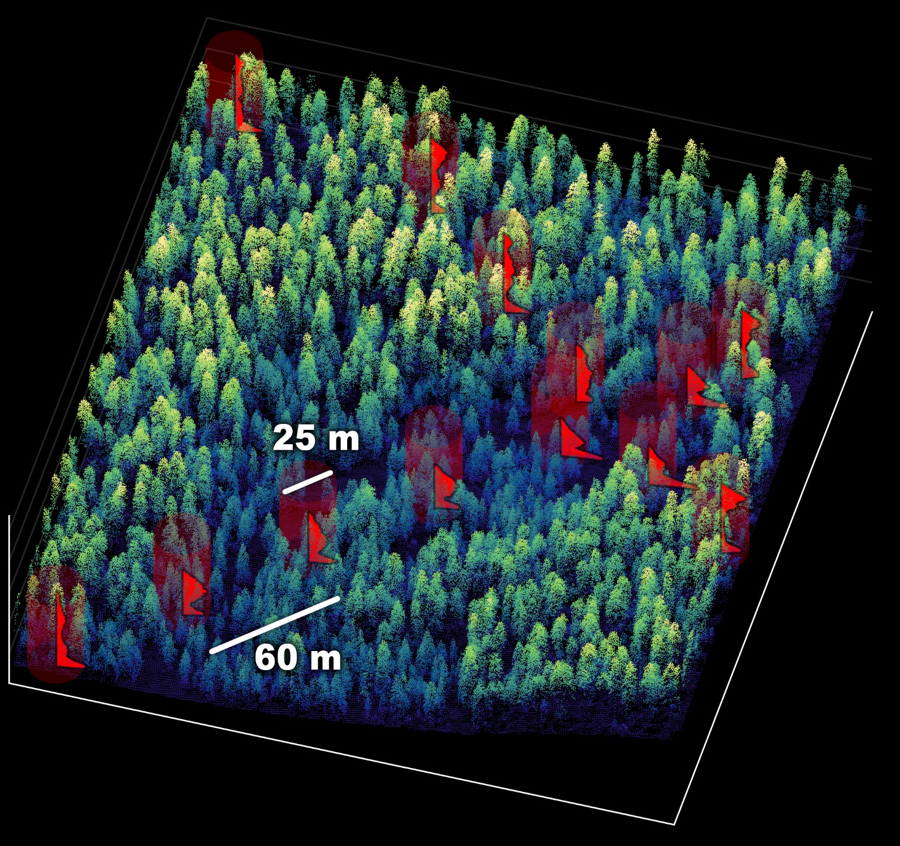
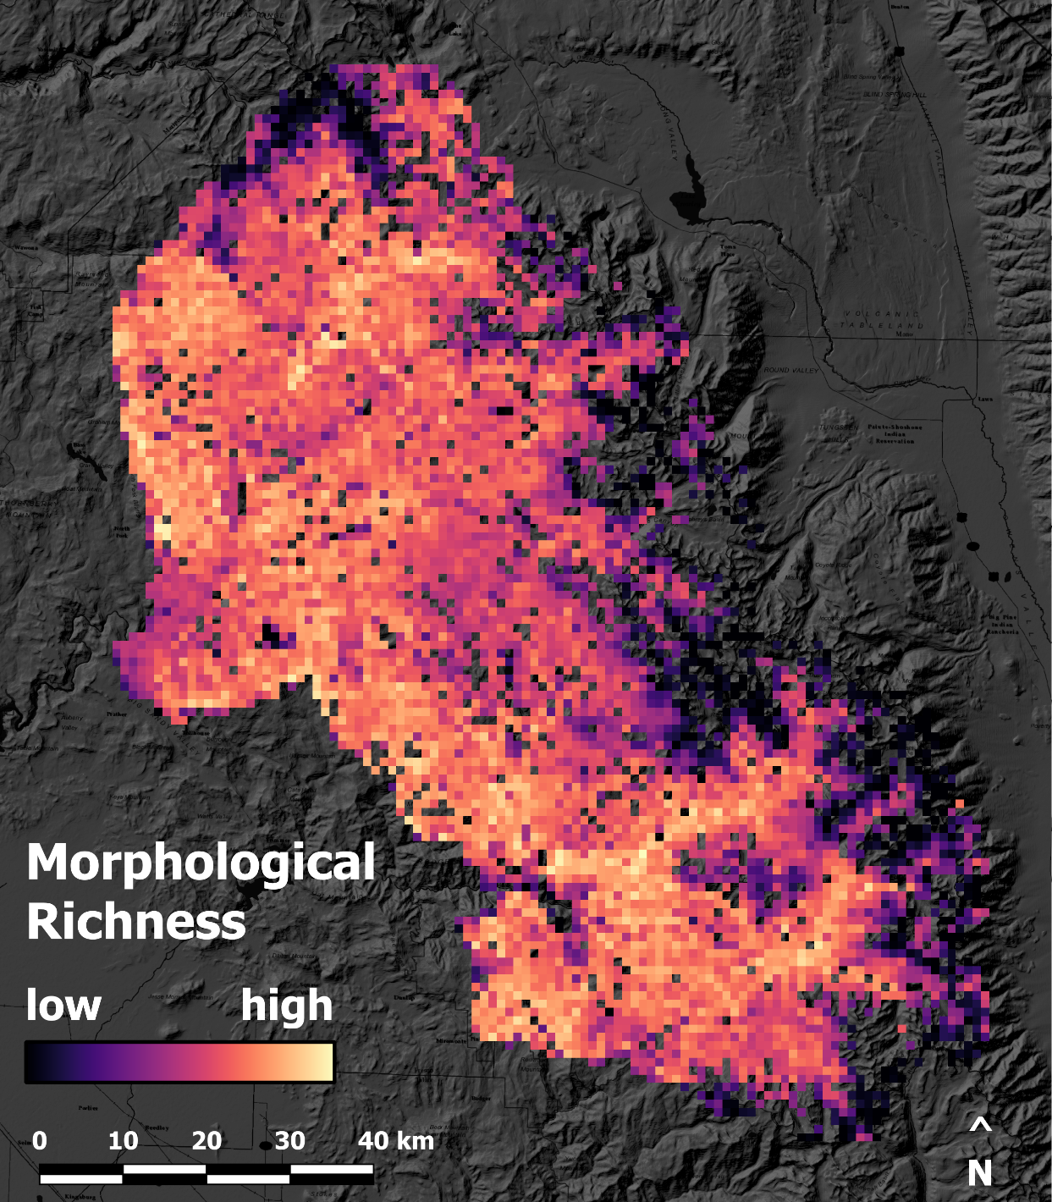


Morphological Diversity
GEDI Waveforms
Methodology
r² = 0.75
Formulation, theory or experiment description
Innovation, advancement
Airborne
Point
Cloud
Schneider, et al. (2020) ERL
Credit: NASA's Goddard Space Flight Center

Slide 5
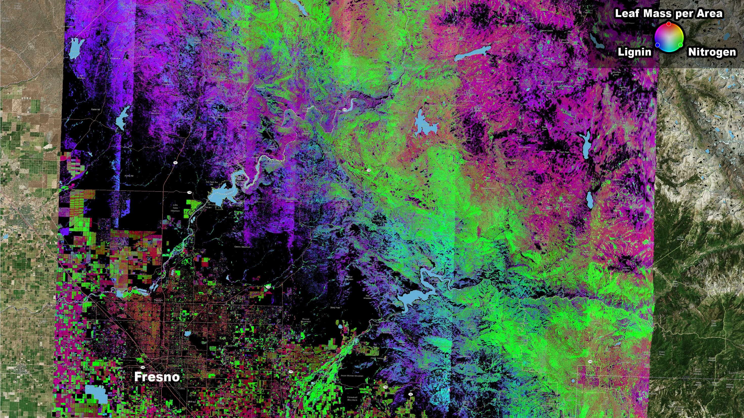
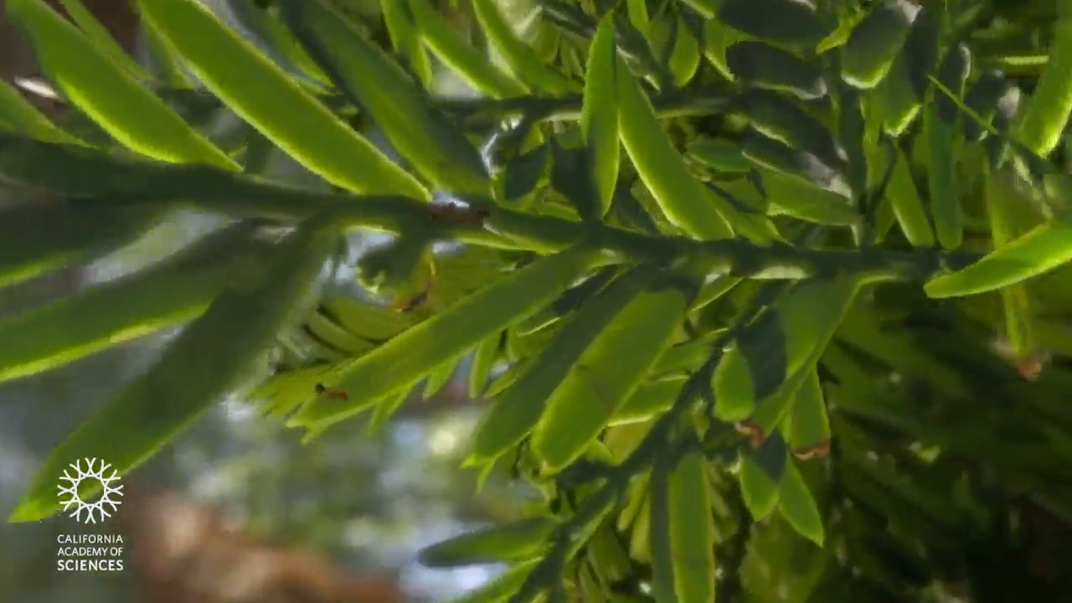
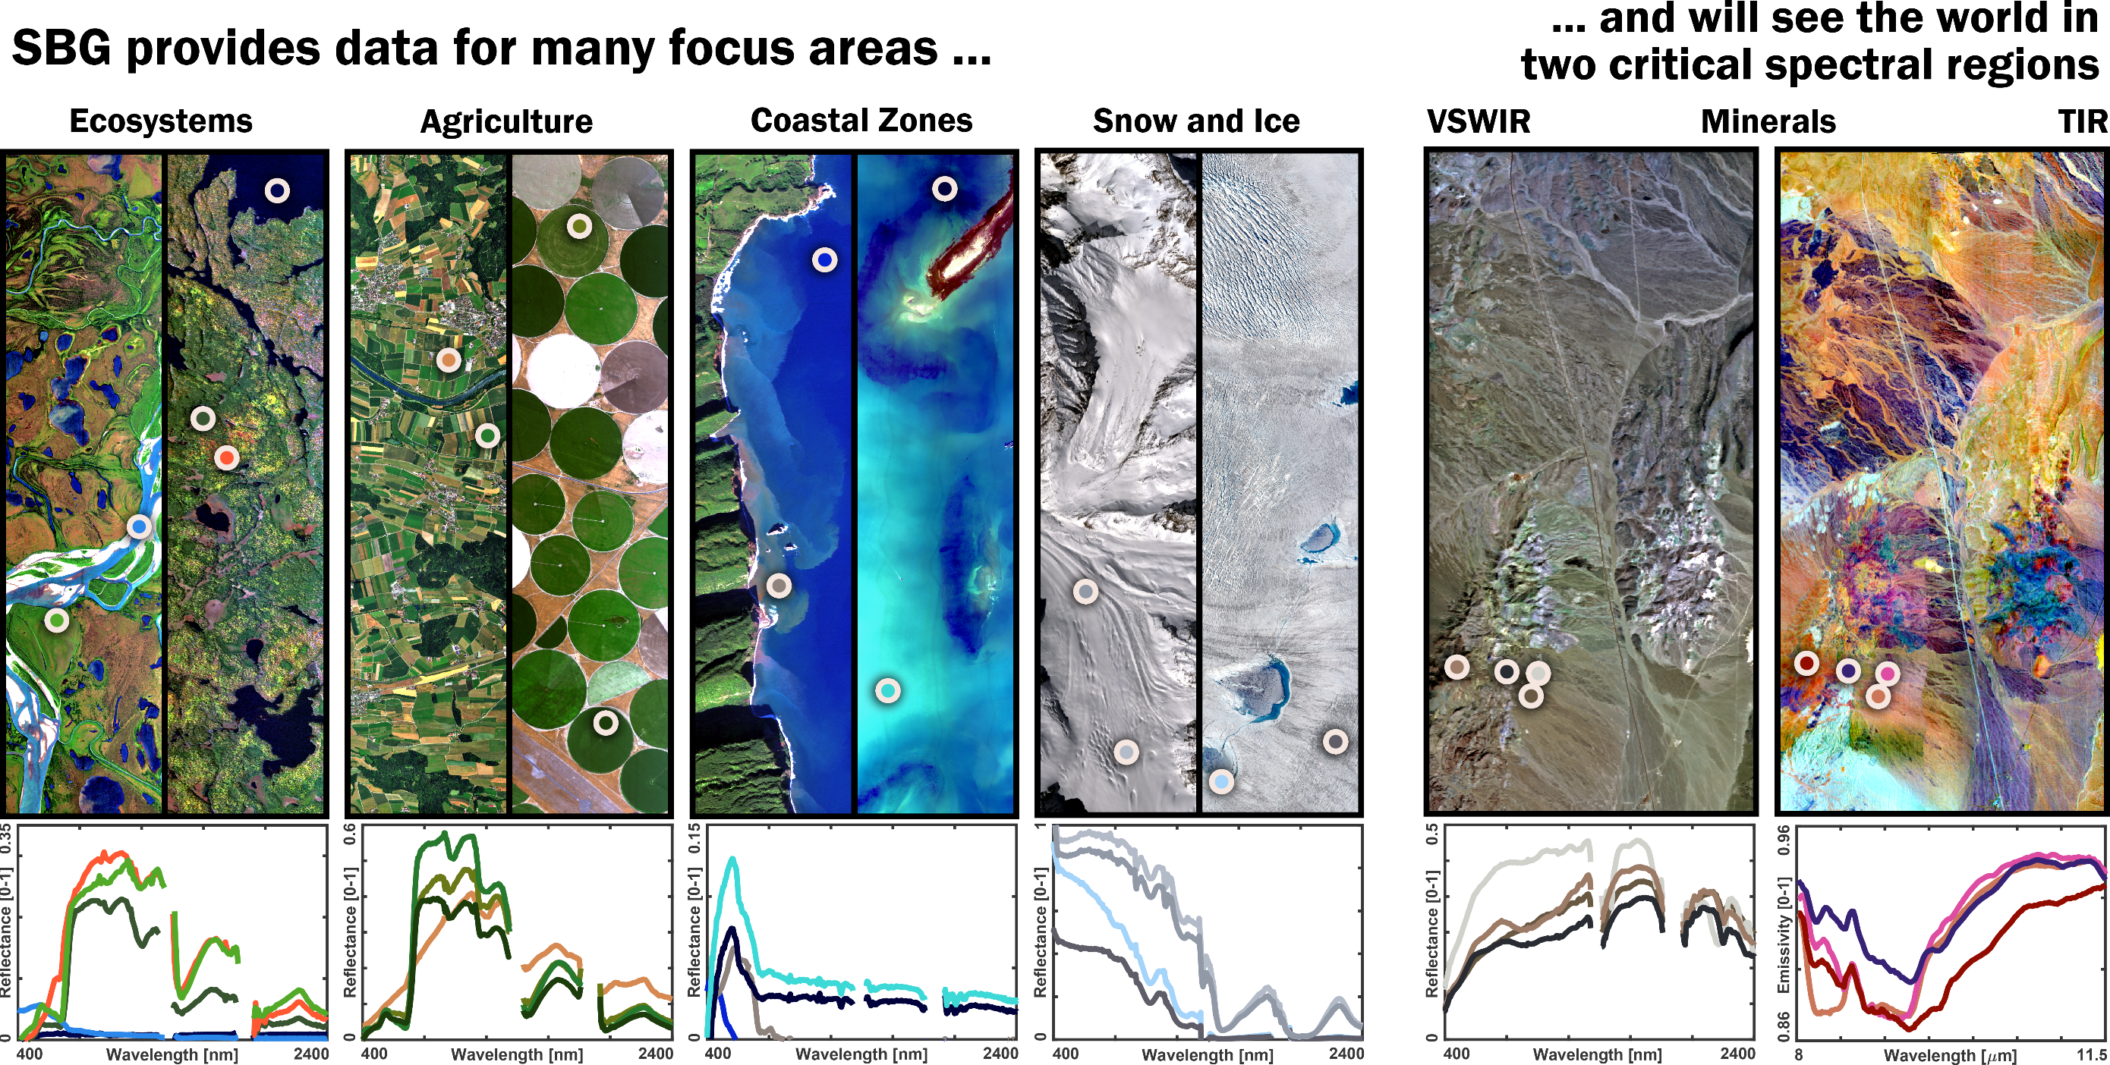

Imaging Spectroscopy – Reflectance of the Earth Surface
Credit: California Academy of Sciences
Credit: Schneider, JPL-Caltech, Townsend Lab
Schneider et al. (2019) EOS - NASA’s planned Surface Biology and Geology (SBG) observing system

Slide 6
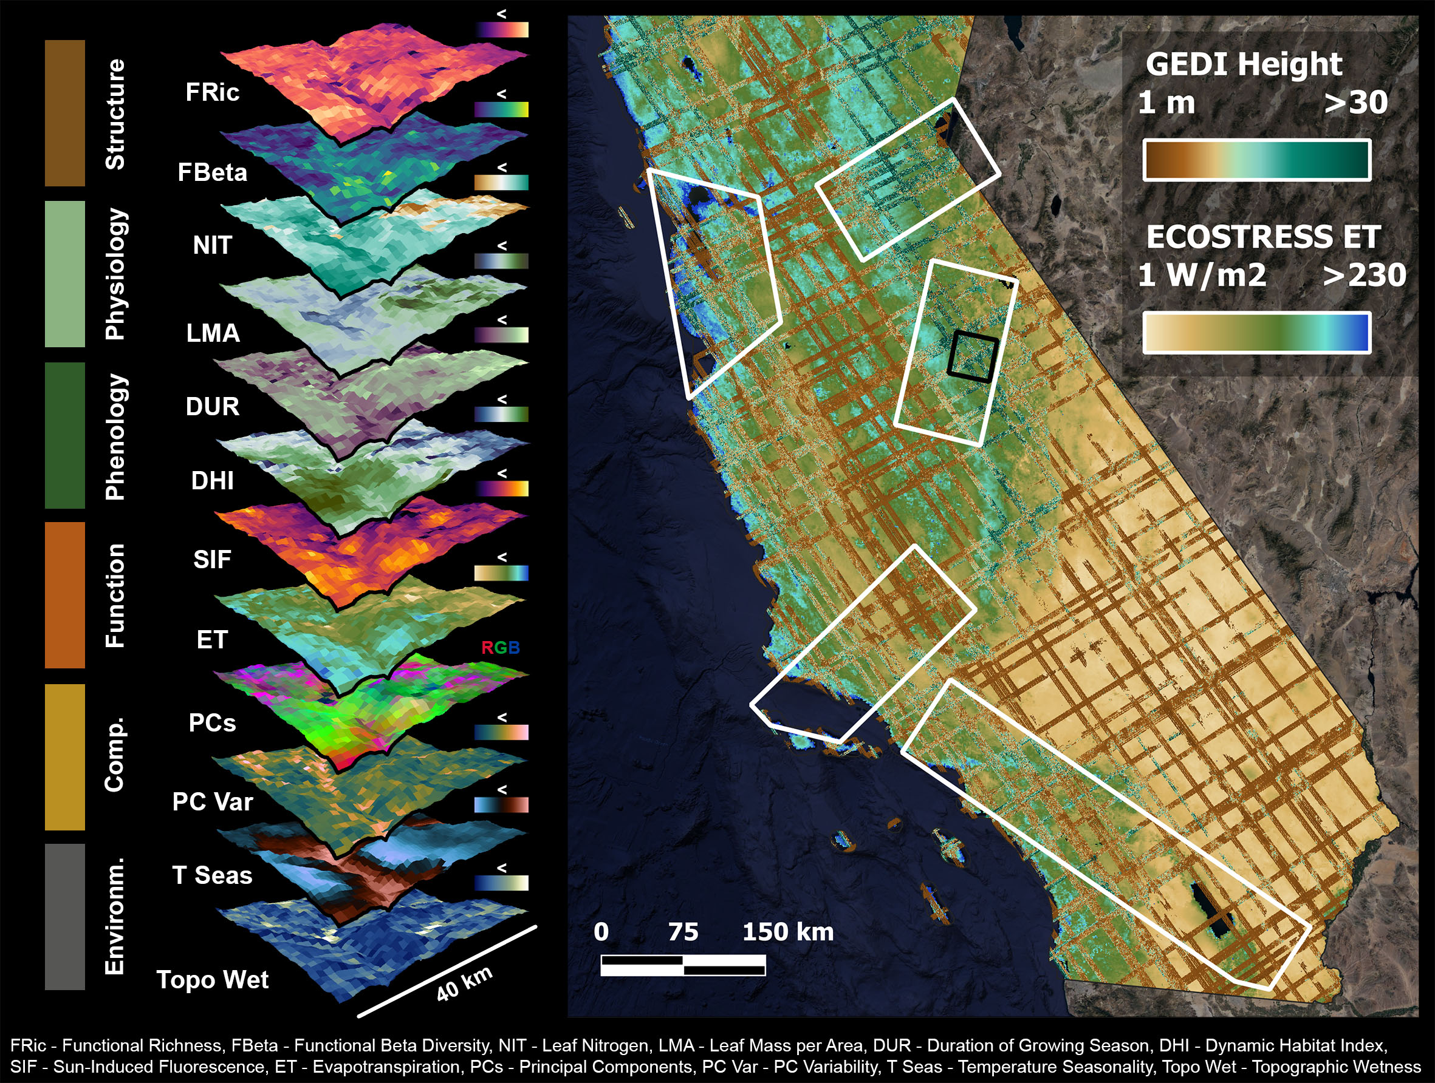
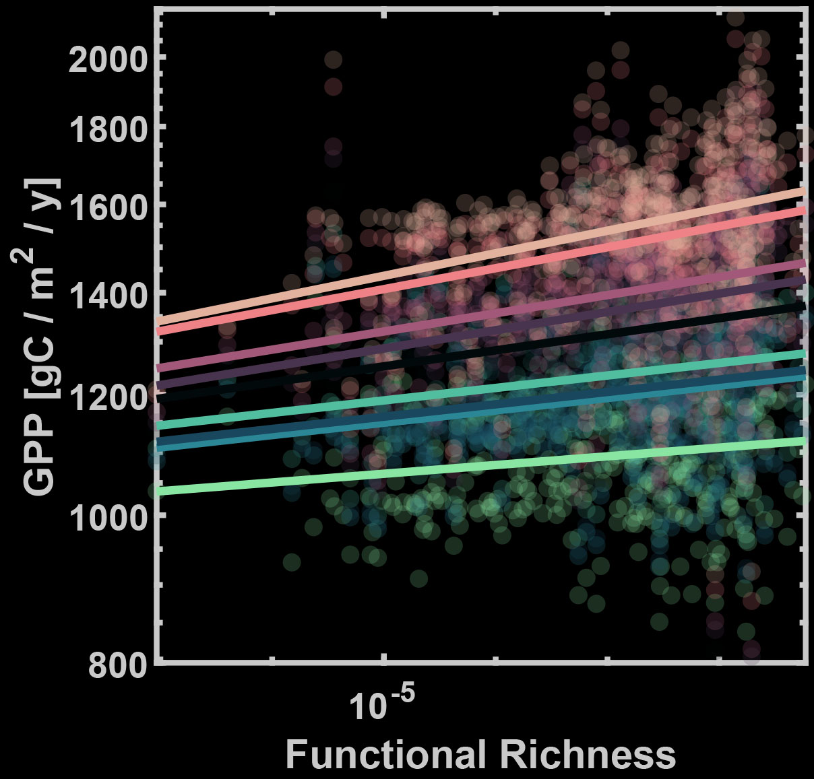
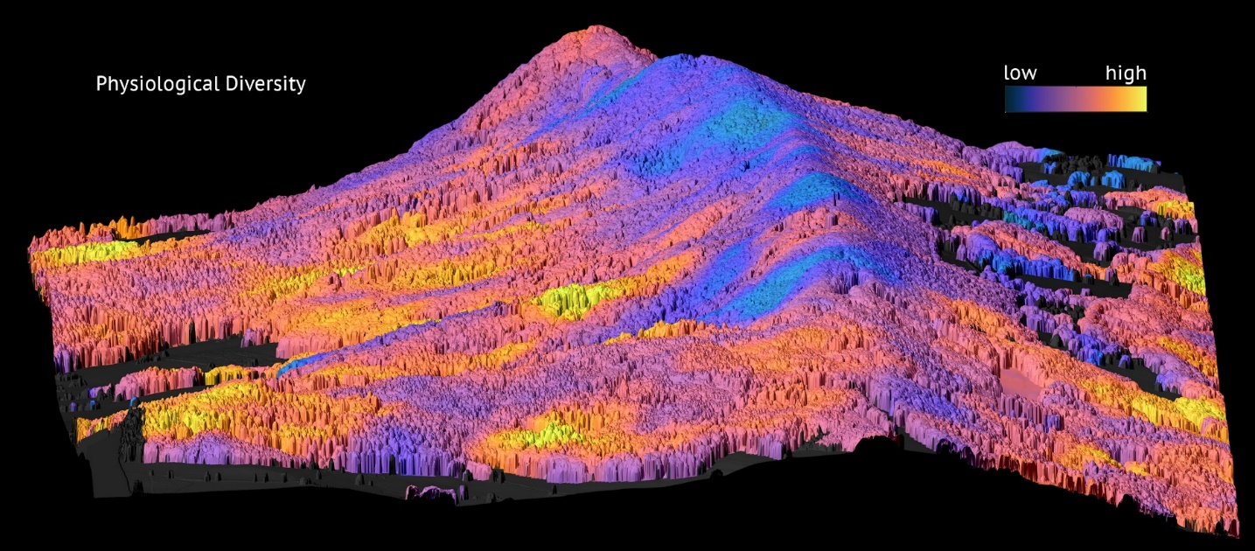
Biodiversity Data Cube
Function – Biodiversity – Environment
Physiological Diversity
Functional Richness
Schneider et al. (2017) Nature Communications
Schneider et al. (in preparation)

Slide 7
Publications (1/2)
Published
Schneider, F.D., Ferraz, A., Hancock, S., Duncanson, L.I., Dubayah, R.P., Pavlick, R.P., & Schimel, D.S. (2020). Towards mapping the diversity of canopy structure from space with GEDI. Environmental Research Letters. https://doi.org/10.1088/1748-9326/ab9e99
Morsdorf, F., Schneider, F.D., Guillén-Escribà, C., Kükenbrink, D., Leiterer, R., & Schaepman, M.E. (2020). The Laegeren Site: An Augmented Forest Laboratory. In J. Cavender-Bares, J.A. Gamon & P.A. Townsend (Eds.). Remote Sensing of Plant Biodiversity (pp. 83-104). https://doi.org/10.1007/978-3-030-33157-3_4
Czyż, E.A., Guillen Escriba, C., Wulf, H., Tedder, A., Schuman, M.C., Schneider, F.D., & Schaepman, M.E. (2020). Intraspecific genetic variation of a Fagus sylvatica population in a temperate forest derived from airborne imaging spectroscopy time series. Ecology and Evolution, 10 (14), 7419-7430. https://doi.org/10.1002/ece3.6469
Paul-Limoges, E., Wolf, S., Schneider, F. D., Longo, M., Moorcroft, P., Gharun, M., & Damm, A. (2020). Partitioning evapotranspiration with concurrent eddy covariance measurements in a mixed forest. Agricultural and Forest Meteorology, 280, 107786. https://doi.org/10.1016/j.agrformet.2019.107786
Thonicke, K., Billing, M., Bloh, W., Sakschewski, B., Niinemets, Ü., Peñuelas, J., Cornelissen, J.H.C., Onoda, Y., van Bodegom, P., Schaepman, M.E., Schneider, F.D., & Walz, A. (2020). Simulating functional diversity of European natural forests along climatic gradients. Journal of Biogeography, 47 (5), 1069-1085. https://doi.org/10.1111/jbi.13809
Schneider, F. D., A. Ferraz, & Schimel, D. (2019). Watching Earth’s interconnected systems at work, EOS, 100. https://doi.org/10.1029/2019EO136205
Schneider, F. D., Kükenbrink, D., Schaepman, M. E., Schimel, D. S., & Morsdorf, F. (2019). Quantifying 3D structure and occlusion in dense tropical and temperate forests using close-range LiDAR. Agricultural and Forest Meteorology, 268, 249–257. https://doi.org/10.1016/j.agrformet.2019.01.033
Schimel, D., Schneider, F. D., & JPL Carbon and Ecosystem Participants (2019). Flux towers in the sky: global ecology from space. New Phytologist, 224 (2), 570–584. https://doi.org/10.1111/nph.15934

Slide 8
Publications (2/2)
In Review
Lin, M., Simons, A.L., Curd, E.E., Harrigan, R.J., Schneider, F.D., Ruiz-Ramos, D. V., Gold, Z., … & Meyer, R.S. (in review). A Biodiversity Map of California Derived from Environmental DNA Metabarcoding and Earth Observation. Ecological Applications, Available as Preprint: https://doi.org/10.1101/2020.06.19.160374
Zheng, Z., Zeng, Y., Schneider, F.D., Zhao, Y., Zhao, D., Schmid, B., Schaepman, M.E., & Morsdorf, F. (in review). Mapping functional diversity using individual tree-based morphological and physiological traits in a subtropical forest. Remote Sensing of Environment.
Guillén Escribà, C., Schneider, F.D., Tedder, A., Schmid, B., Furrer, R., Niklaus, P.A., Hueni, A., & Schaepman, M.E. (in review). Remotely sensed within-species functional trait variation of a temperate forest. Ecology and Evolution.
Kükenbrink, D., Schneider, F.D., Schmid, B., Gastellu-Etchegorry, J.P., Schaepman, M.E., & Morsdorf, F. (in review). Modelling of three-dimensional, diurnal light extinction in two contrasting forests. Agricultural and Forest Meteorology.
Cawse-Nicholson, K., Townsend, P.A., Schimel, D.S., Assiri, A.M., … Schneider, F.D., … & Zhang, Q. (in review). The world of surface imaging algorithms: NASA’s Surface Biology and Geology Designated Observable. Remote Sensing of Environment.
In Preparation
Schneider, F.D., Longo, M., Schaepman, M.E., Schmid, B., Paul-Limoges, E., Morsdorf, F., Scholl, V., Pavlick, R.P., Schimel, D.S., & Moorcroft, P.R. (in preparation). Remote sensing-based forest modeling reveals positive effects of functional diversity on productivity regulated by soil characteristics.
Ilangakoon, N., Glenn, N.F., Schneider, F.D., Dashti, H., Hancock, S., Spaete, L., & Goulden, T. Spaceborne LiDAR reveals trends and patterns of functional diversity in a semi-arid ecosystem.
Rocchini, D., Iannacito, M., Thouverai, E., Marcantonio, M., Da Re, D., Bacaro, G., Bazzichetto, M., Bernardi, A., Foody, G.M., …, Schneider, F.D., …, & Wegman, M. (in preparation). Rasterdiv – an Information Theory tailored R package for measuring diversity from space: to the origin and back.

Slide 9
Acknowledgements
I would like to thank the Remote Sensing Laboratories at the University of Zurich, the Townsend Lab at the University of Wisconsin-Madison, the Moorcroft Lab at Harvard University, the GEDI Science Team members from Goddard / University of Maryland, and my current lab Carbon Cycle & Ecosystems at JPL for the excellent collaborations and scientific discussions.
The research carried out at the Jet Propulsion Laboratory, California Institute of Technology, was under a contract with the National Aeronautics and Space Administration (80NM0018D0004). Government sponsorship is acknowledged.

