Slide 1
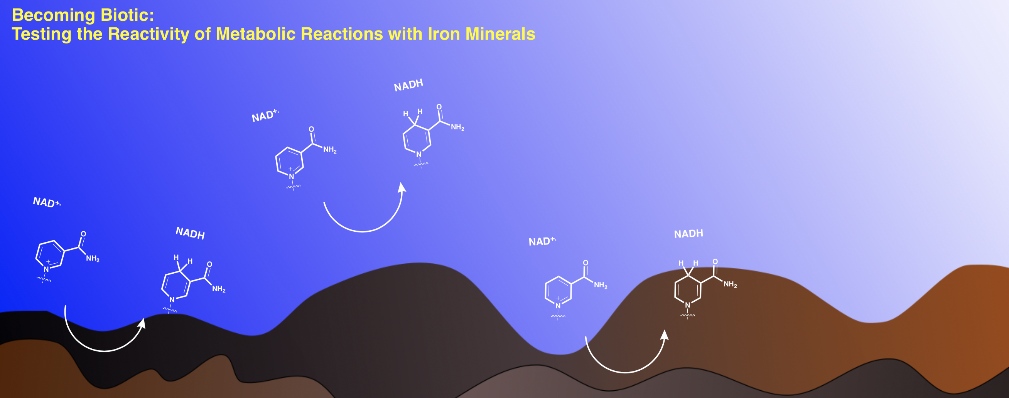

2020 Postdoc Research Day Presentation Conference
Jessica Weber
Organization: 3227
Advisor: Laurie Barge (3227)
Postdoc Program: JPL
© 2019 California Institute of Technology. Government sponsorship acknowledged.

Slide 2
Introduction
Abstract
The origin of metabolism on Earth is not presently known. Additionally, while we know life emerged within the geological context of early Earth, we do not know the roles minerals played in this evolution. Knowledge as to whether or not minerals can catalyze these reactions could be important for both how life originated on Earth and where we search for life on other worlds. We investigated if the biochemically important redox reaction of nicotinamide adenine dinucleotide (NAD) to NADH could be successfully catalyzed by iron minerals as opposed to complex enzymes. We were able to successfully show that NAD could be reduced to NADH by using FeS to mediate that electron transfer.

Slide 3
Problem Description
Context: The origin of metabolism is unknown and how specific metabolic reactions on Earth evolved is not well understood. Understanding how this process could have evolved on Earth will help researchers better understand how life could have evolved on other worlds, especially if these reactions can be performed by simple and readily available iron minerals.
Why does it interest you? What are your own contributions as distinct from those of your advisor or research group? This is a very interesting chemical problem. My PhD was in organic chemistry with a focus on catalysis and this project involves experimentally finding a successful catalyst for a reaction. I bring experimental techniques from chemistry that I can apply to astrobiologial or planetary science problems. I designed the experiments and analysis for this project.

Slide 4
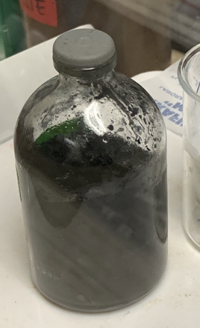
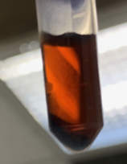
Methodology
Formulation, theory or experiment description: These reactions were tested experimentally within a nitrogen filled glovebox to simulate an early Earth environment. NAD was used as a starting material and we explored different Fe sources (dissolved Fe²⁺, FeS), concentrations, and mixing. These reactions were run for 1 week with multiple time points being taken. These time points were analyzed by UVVis and nuclear magnetic resonance (NMR). The FeS mineral was characterized with XRD and Raman.
Innovation, advancement:
    This is one of the first examples exploring the redox transformation of NAD to NADH via a simple mineral catalyst
    We developed a novel characterization set for this reaction. We were able to determine yields for this reaction, which has been challenging in previous reports due to the instability of NADH
    We determined that a red colored organometallic intermediate was being formed during the reaction and characterized that structure with Raman spectroscopy
Reaction after 72 h

Slide 5
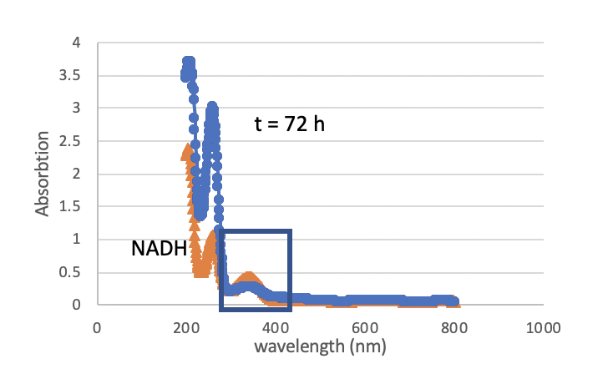
Results
We observed the transformation of NAD to NADH in the presence of FeS via UVVis at t = 72 h.
No NADH was observed without mineral present or when dissolved Fe²⁺ was used in the reaction indicating the reaction requires the mineral to proceed

Slide 6
Results
Accomplishments versus goals: I completed my experimental goals and successfully tested if NAD could be transformed to NADH in the presence of iron mineral. We determined that this transformation was possible at 500 mM NAD with FeS performing the electron transfer.
Significance: For the first time, this reaction was shown to be catalyzed by minerals without any chemical mediators or enzymes. As minerals are capable of mediating these transformations, the origin of metabolism on Earth could have been mineral catalyzed.
Next steps:
  I want to test if other important biochemical redox reactions (including quinone/hydroquinone) can be mineral catalyzed
  Once these reactions are understood individually, I want to link them in a proto-metabolic sequence
  In linking these reactions in a sequence, I am interested in developing a continuous-flow reactor to directly telescope the reactions into each other

Slide 7
Publications and Acknowledgements
Thank you to my collaborators on this work: Bryana Henderson, Doug LaRowe (USC), Aaron Goldman (Oberlin), Scott Perl, Keith Billings, and Laurie Barge. This project is funded by the NASA/NSF Ideas Lab for the Origins of Life: “Becoming Biotic” Award.
Publications, abstracts, and presentations are listed below:
Weber, J.M., Henderson, B., LaRowe, D.E., Goldman, A.D., Perl, S., Billings, K., Barge, L.M., 2020. Iron-sulfur minerals drive NAD⁺ reduction under prebiotic Earth conditions. Nature Ecology and Evolution. In preparation.
Weber, J.M., Crucilla, S., LaRowe, D., Goldman, A.D., Barge, L.M., 2019. Becoming Biotic: Exploring the Origin of Metabolic Pathways. 2020 Origins of Life Gordon Research Conference
“Synthesis and Use of Metal Complexes for Catalysis.” Invited Presentation at Earth Life Science Institute (Tokyo Tech) Seminar. October 16, 2019.
Notes:
Include all conference papers, journal articles in prep/submitted/accepted, book chapters as a result of your work

