Slide 1


The search for sodium chloride on Europa
Image credits: JPL-Caltech/NASA
2020 Postdoc Research Day Presentation Conference
Dr. Bernhard Jost
Organization: (3227) Jet Propulsion Laboratory, California Institute of Technology
Advisor: Dr. Paul V. Johnson (3220)
Postdoc Program: NPP

Slide 2
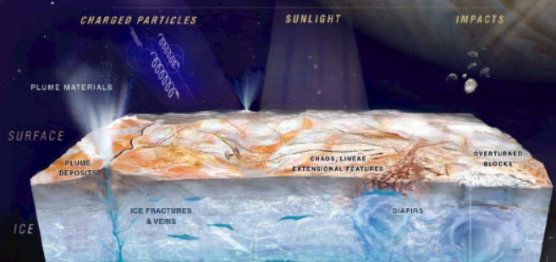
Abstract
Image credits: JPL-Caltech/NASA
My research provides laboratory spectral data to support the interpretation of remote sensing data from the upcoming Europa Clipper mission.
The study of Europa’s surface materials is a possibility to disentangle the composition of its global subsurface ocean. The main focus lies on salt species and their concentration which is indicative for geological processes on the seafloor and determines potential habitability of the ocean.
My work focusses on the lifetime of hydrated salt minerals under Europa’s surface conditions to provide means of resurfacing processes like cryovolcanism and surface ages.

Slide 3
Problem Description
The main problem when trying to detect salts from remote sensing is the total absence of any spectral features in the visible- and infrared wavelength range, i.e. salts are spectrally neutral in their pure form and very easy to overlook.
However, most salts show spectral features when they are hydrated. In case of Sodium Chloride (NaCl) the only hydrated state relevant for Europa’s surface is a dihydrate called Hydrohalite (NaCl·2H₂O) which forms in brines below -23°C.
Hydrated salt minerals have never been unambiguously detected by previous spacecraft and ground based observations, but are known to dehydrate under vacuum conditions and irradiation.
My goal is to quantify dehydration rates under different temperatures, NaCl concentrations and morphological states and provide a maximum lifetime on Europa’s surface as soon as the material is exposed.

Slide 4
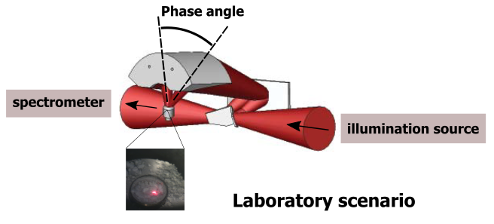
Methodology
We use near-infrared reflectance spectroscopy in the 1.4-7.0µm wavelength range, this covers the main vibration modes and overtones of water ice.
This configuration is comparable to spacecraft remote sensing with imaging spectrometers in terms of observation geometry and spectral resolution but differs in spatial resolution and signal-to-noise-ratio.
Laboratory measurements of mm-sized samples are performed at pressures of a few millitorr and temperatures in the 100-235K range. Spectra are acquired every few minutes to monitor sample evolution over multiple hours/days.

Slide 5
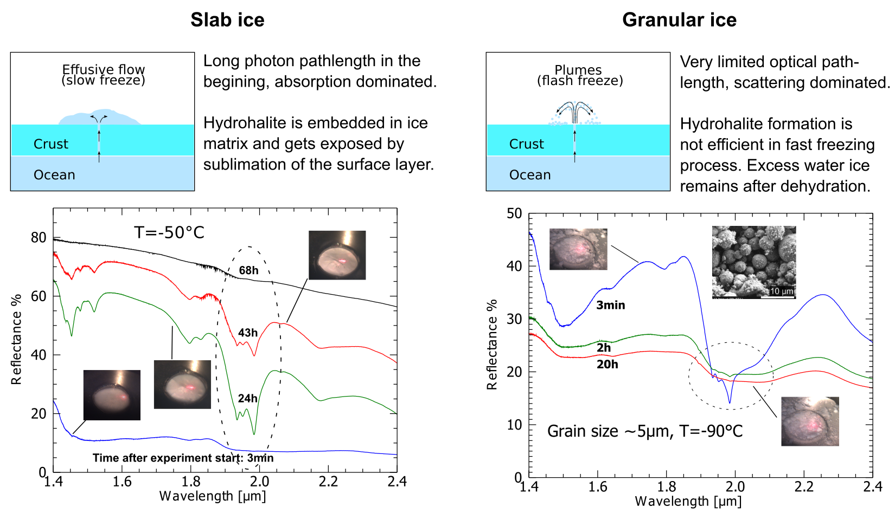
Results
Jost et al., in prep

Slide 6
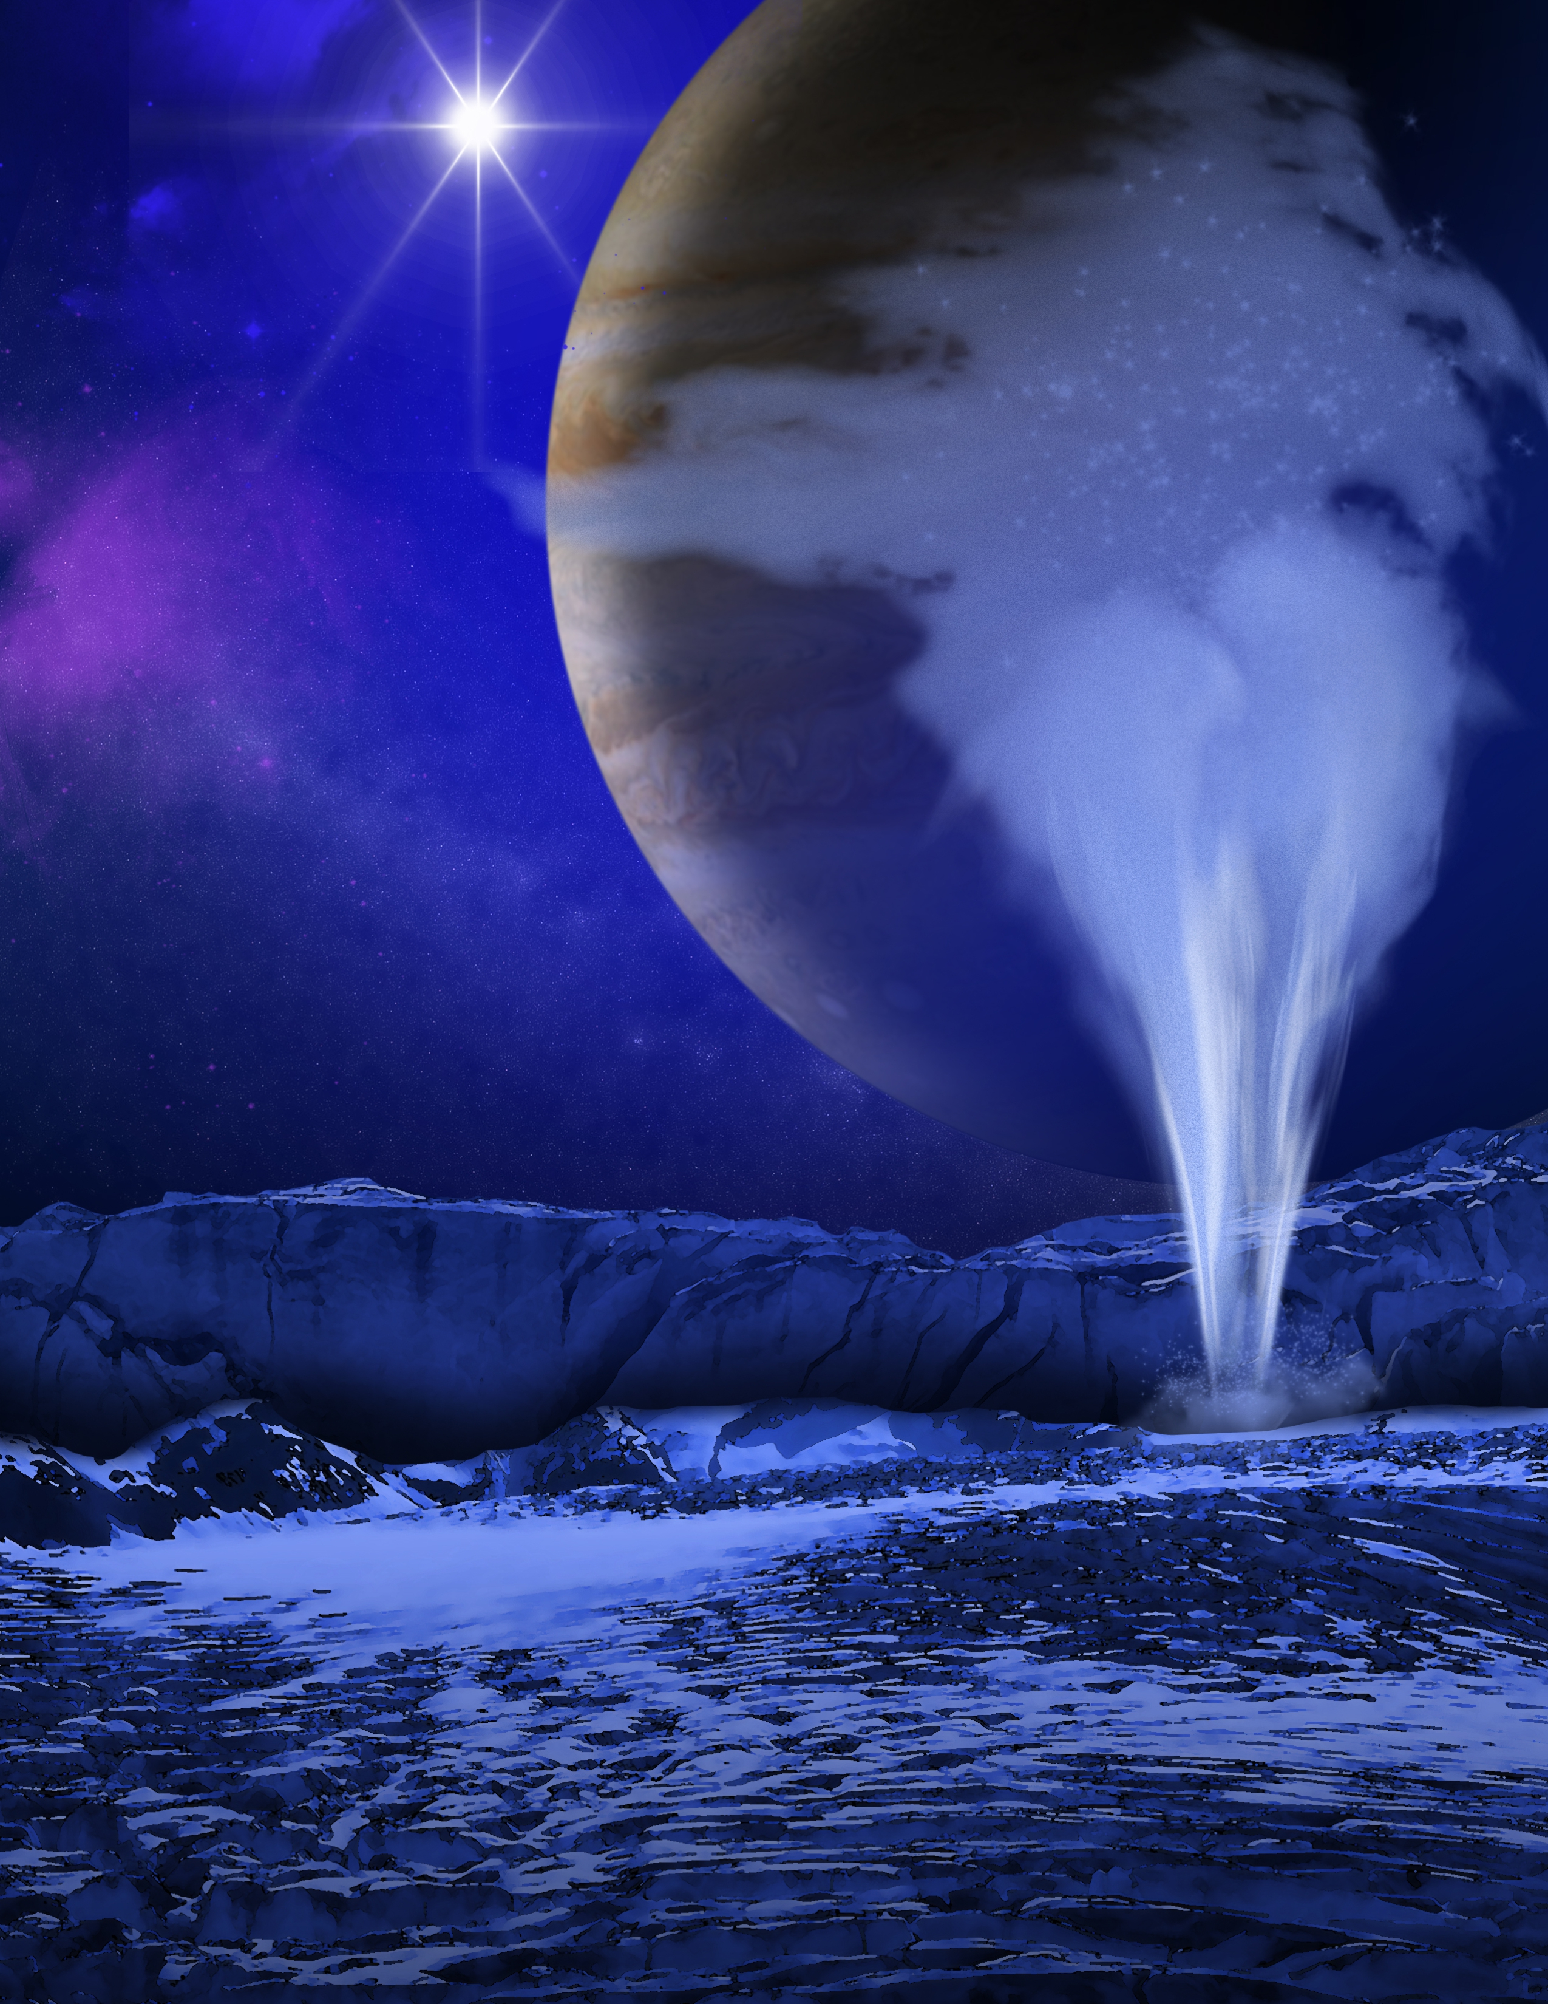
Key messages
Sodium chloride is not detectable by spectroscopy in its anhydrous and un-irradiated state; a false-negative detection is very likely.
Hydrohalite can't survive on Europa's surface over long timescales, regardless of irradiation dose. If hydrated salts were found in the future they must be associated with recent or ongoing cryovolcanic re-surfacing processes.
The physical structure of frozen brines plays a crucial role for the dehydration timescales of hydrated salt minerals. Plume depositions are less likely to contain hydrated salts since the dehydration is faster and the formation of hydrates is less efficient in flash-freezing processes.
Image credits: NASA/ESA/K. Retherford/SWRI

