Slide 1

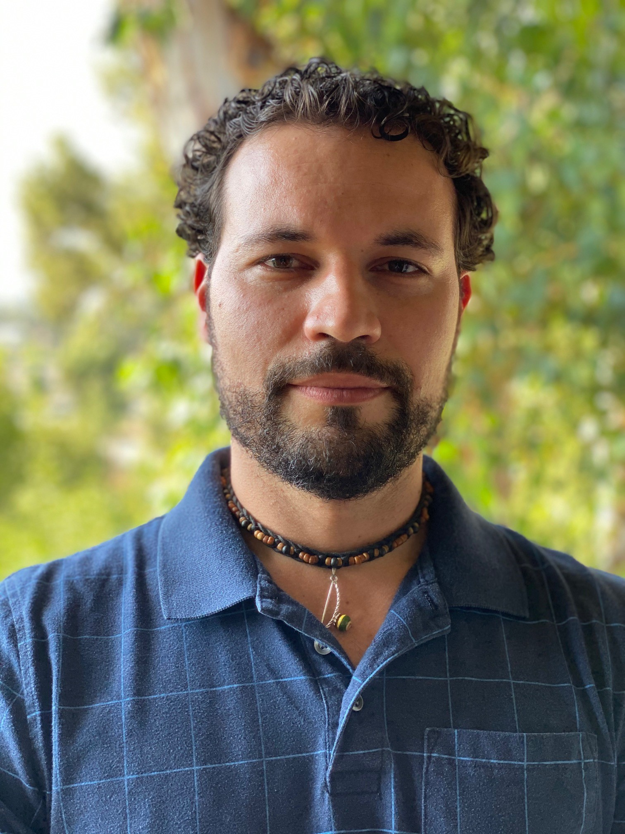
Onboard Monitoring of Silver Biocide during Future Human Space Exploration Missions
Mauro S. Ferreira Santos
Organization: 389U
Advisor: Maria Fernanda Mora (389U)
Postdoc Program: JPL

Slide 2

Introduction
To extend human presence deeper into space is one of NASA's goals;
Water is a key resource to enable long duration human space travel;
On the International Space Station (ISS), the water on board has to be recycled to reduce the need for resupply from Earth;
Chemical and/or biological contamination can occur during the water recovery/treatment process, therefore the quality of the water needs to be periodically monitored to ensure crew safety;
Only basic measurements can be performed onboard the ISS, and full chemical characterization is usually carried out in sample returned to Earth;
Iodine (I₂) is currently added to the water system as a biocide in the U.S. segment of the ISS.
Credit: NASA

Slide 3
Problem Description
A biocide needs to be added to the potable water onboard the ISS to prevent bacterial growth and make it safe for astronaut’s consumption;
Iodine has been successfully used for water disinfection on Earth and it is the biocide currently in use onboard the ISS;
Although iodine is essential in the human diet it can have adverse effects on the thyroid at elevated levels;
Iodine has to be removed prior to water consumption by the astronauts, adding complexity to the water processing system;
Ionic silver (Ag⁺) has been proposed as a new biocide to treat the water in the ISS and also future human space exploration vehicles/habitats. Ag⁺ is effective as biocide in levels (200 to 500 ppb) safe for human consumption.
Goal: To develop a method/technique for monitoring Ag⁺ levels in water ranging from 50 to 1000 ppb.

Slide 4
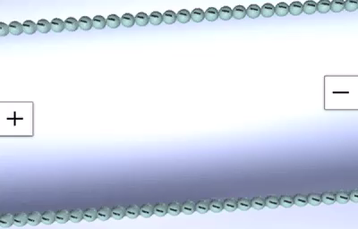
Methodology
A capillary electrophoresis instrument with a contactless conductivity detector (CE-C⁴D) was used.
CE-C⁴D is an ideal method for measuring inorganic ions. It provides short analysis time, low sample and reagents consumption, and it can be automated and miniaturized.
Two methods were developed for monitoring Ag⁺ in water.
The methods were evaluated by analyzing a simulant of ISS water containing inorganic ions commonly present in the water: K⁺, Ca²⁺, Na⁺, Mg²⁺, Ni²⁺, and Zn²⁺.

Slide 5
Results
Method 1
Medium: 5 M acetic acid
Limit of detection for Ag⁺: 100 ppb
Analysis time: 4.5 min
Allows simultaneous measurements of other cations commonly found in the ISS potable water.
Method 2
Medium: 0.5 M acetic acid
Limit of detection for Ag⁺: 25 ppb
Analysis time: 2.5 min
Allows detection of lower levels of silver in water but the other ions cannot be separated and quantified.

Slide 6
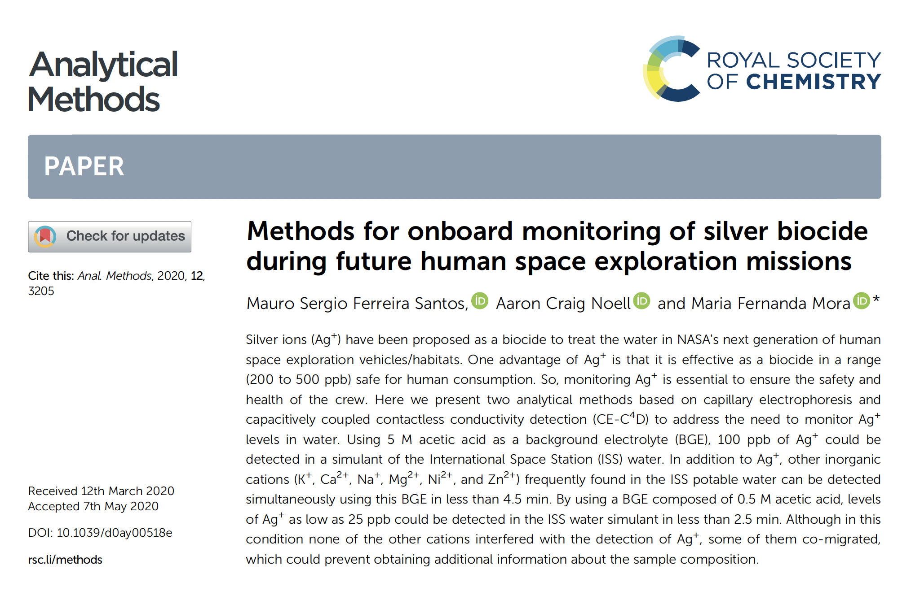
Publications and Acknowledgements
This research was carried out at the Jet Propulsion Laboratory, California Institute of Technology, under a contract with the National Aeronautics and Space Administration.
Financial support for this project was provided by The Planetary Instrument Concepts for the Advancement of Solar System Observations Program.

