Slide 1
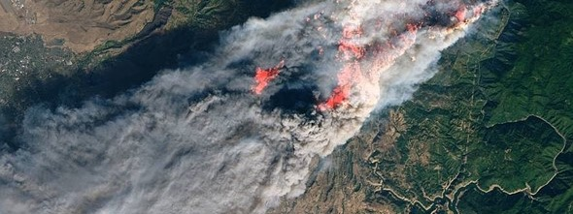

2020 Postdoc Research Day Presentation Conference
Fire-induced Damage Detection using
Sentinel-1and Sentinel-2 Data based on
Bayesian Network Fusion
Jungkyo Jung, Sang-Ho Yun, Jeri Xu, Boyi Xie
Organization: Org# 334
Advisor: Sang-Ho Yun (Org # 334)
Postdoc Program: JPL

Slide 2
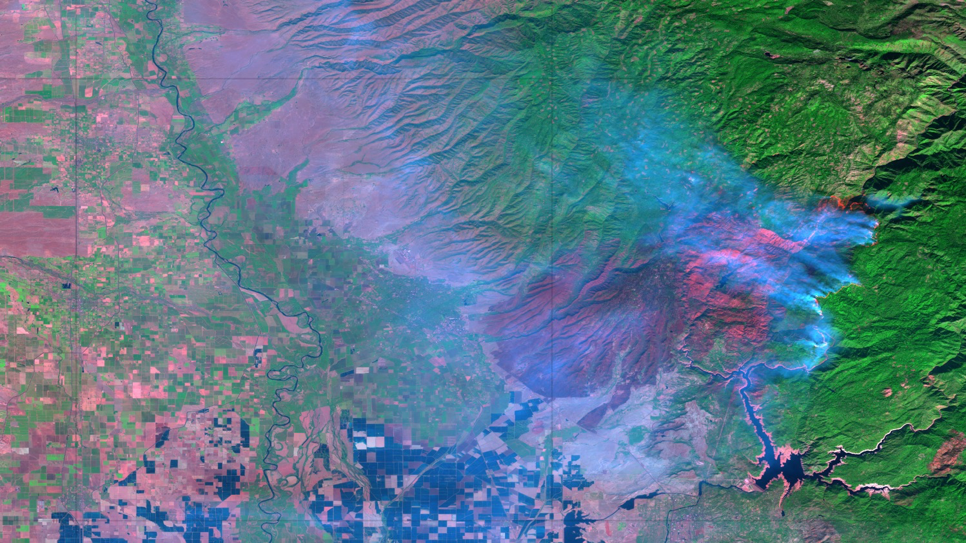
Introduction
Camp Fire
Camp Fire was one of the most destructive wildfires in California history. It started on November 8, 2018 in Northern California’s Butte County. The east wind drove the fire through the foothill town of Paradise. The fire was contained after seventeen days on November 25, 2018 with the arrival of first winter rainstorm of the season.
The fire induced 85 fatalities and 18,000+ structures destroyed. The estimates of burnt area reach 153,000+ acres. The towns of Paradise and Concow were almost destroyed, losing 95% of structures.
Back ground image :
Sentinel-2 acquired at Nov 16, 2018
R : B 12 G; B 8 B : B 2

Slide 4
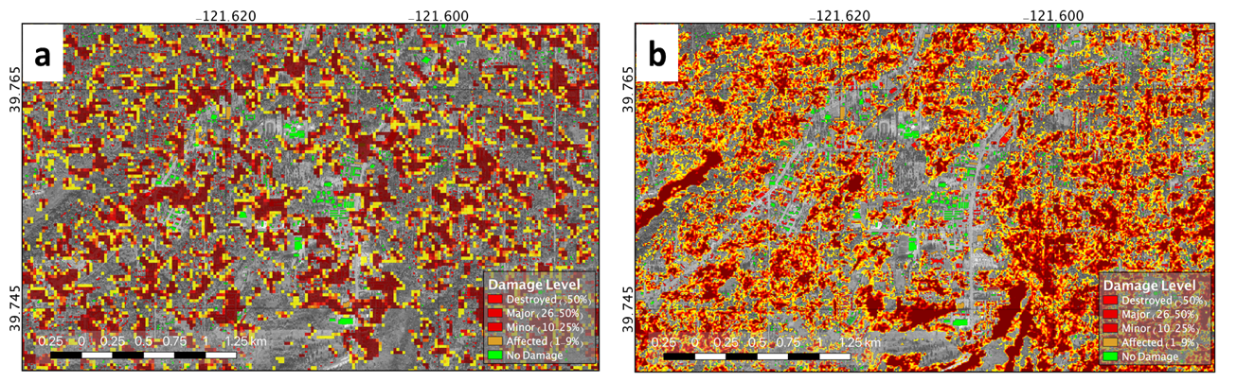
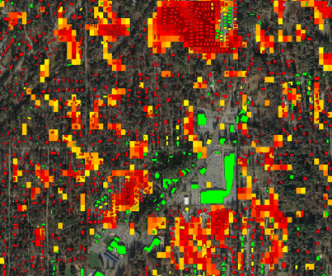
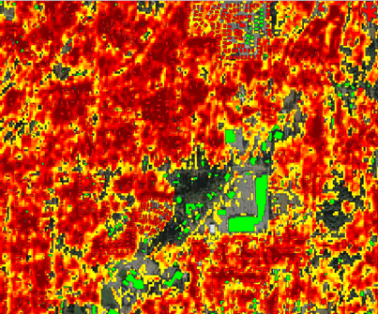
Problem Description
Sentinel-1 (SAR)
Coherence
Sentinel-1 (multi-spectral)
dNBR
Sentinel-1
Coherence
In urban area,
Coherence (SAR) shows better performance than dNBR.
In forest area,
dNBR shows better performance than coherence.
Sentinel-2
dNBR

Slide 5
Methodology
Bayesian Network combining Coherence (Sentinel-1) and dNBR (Sentinel-1)
Multi-temporal Coherence (Sentinel-1) :
Damage detection performance is dependent of the coherence level of the reference images. Generally, vegetated area has lower coherence than urban area.
dNBR (Sentinel-2)
NBR is reflectance-based index to detect the levels of the severity of fires using Band 8 (near-infrared) and B12 (short-wave infrared).
Bayesian Network Fusion
Focused on the coherent change detection mechanisms
The temporal decorrelation can be factorized by two terms depending on their behaviors: time-characteristic behavior and temporally uncorrelated behavior
This approach enables us to exploit the multi-temporal coherences independent of temporal baseline
Sentinel-1 (SAR)
Provides the multi-spectral data with 13 bands
Normalized Burn Ratio (NBR) to emphasize the burnt area using near-infrared and short-wave infrared.
The difference between NBRs is calculated for pre- and post-event to highlight the damages by reducing the unchanged area.
Sentinel-2 (Multi-Spectral)

Slide 6
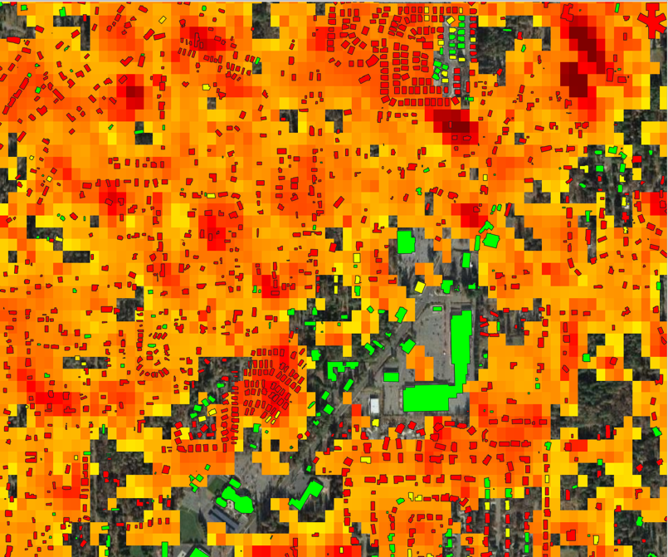
Preliminary Result
Sentinel-1
Coherence
Damage Probability
Combining Coherence
And dNBR
Sentinel-2
dNBR

Slide 7
Publications and Acknowledgements
Conference paper
Jung, Jungkyo, Sang-Ho Yun, Jeri Xu, Boyi Xie, “Evaluation of burnt building damage using sentinel-1 and sentinel-2 data.” IGARSS2020 (2020)
Jung, Jungkyo, and Sang-Ho Yun. "Damage Mapping Techniques using Synthetic Aperture Radar for Rapid Response: A Case Study for Hokkaido Landslide." AGUFM 2019 (2019): NH12A-08.
Journal Article
Jung, Jungkyo, and Sang-Ho Yun. "Evaluation of Coherent and Incoherent Landslide Detection Methods Based on Synthetic Aperture Radar for Rapid Response: A Case Study for the 2018 Hokkaido Landslides." Remote Sensing 12.2 (2020): 265.
Jung, Jungkyo, Sang-Ho Yun, Jeri Xu, Boyi Xie , “Evaluation of Burnt Building Damage using Sentinel-1 and Sentinel-2 Data based on Bayesian Network Fusion.” , (prep).

