Slide 1
Vertical Distribution of Water Vapor on Mars
from Orbiter-Lander Coordinated Observations
Image: NASA
2020 Postdoc Research Day Presentation Conference
Cecilia W.S. Leung
Organization: Org#3222
Advisor: Dr. Leslie Tamppari (Org #3222)
Postdoc Program: NPP (1st year)

Slide 2
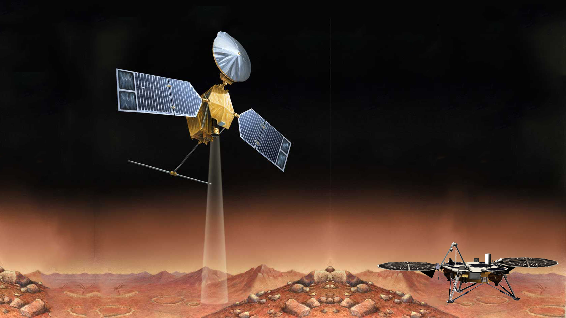
Introduction
Abstract
Orbital observations provide a climatology of the water vapor column abundances in the Martian atmosphere, but how this water varies with height is still largely unconstrained.
The vertical distribution of water reflects the complex interactions involving temperature variability, convective & turbulent mixing, winds, cloud microphysics, as well as regolith-atmosphere exchange (Montmessin et al., 2017).
Coordinated observations from the Mars Reconnaissance Orbiter paired with surface measurements from the Phoenix Lander provide a unique opportunity to study the vertical distribution of water abundances from the surface up to ~80 km, connecting processes occurring near the surface to those active aloft.
Results of this study help constrain the extent to which subsurface-atmospheric exchange modify the water budget in the planetary boundary layer.

Slide 3
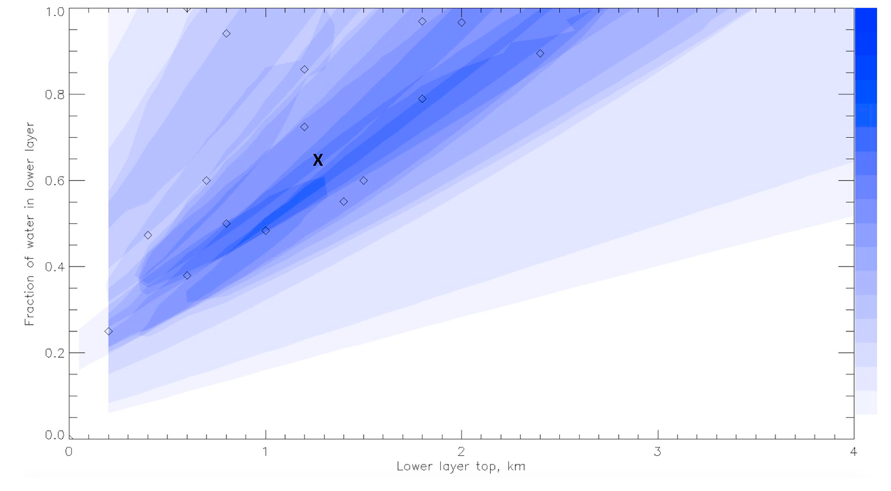
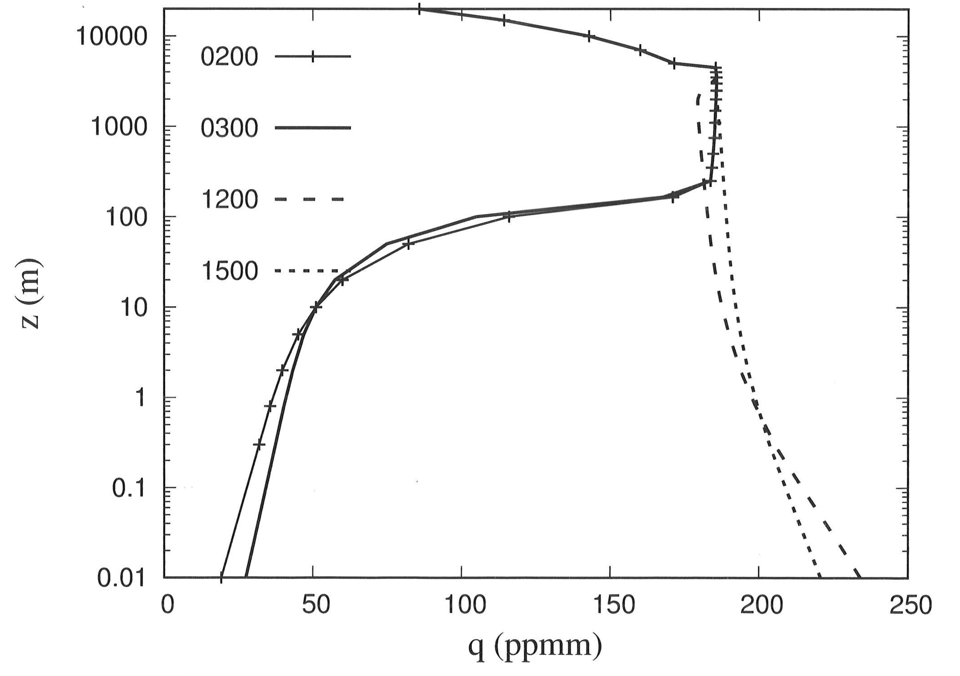
Problem Statement
Testing Three Proposed H₂O Vertical Distributions
1. Uniformly Well Mixed
(to Cloud Condensation Level)
2. Two Layer Model
3. Non-uniform
Altitude (m)
Water mass. Mixing ratio (ppmm)
Tamppari & Lemmon (2020)
Pankine & Tamppari (2015)
Savijarvi et al. (2020)

Slide 4
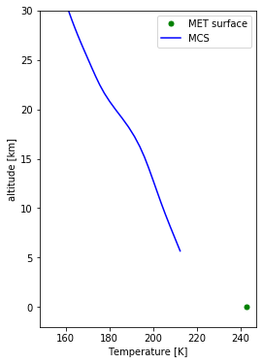
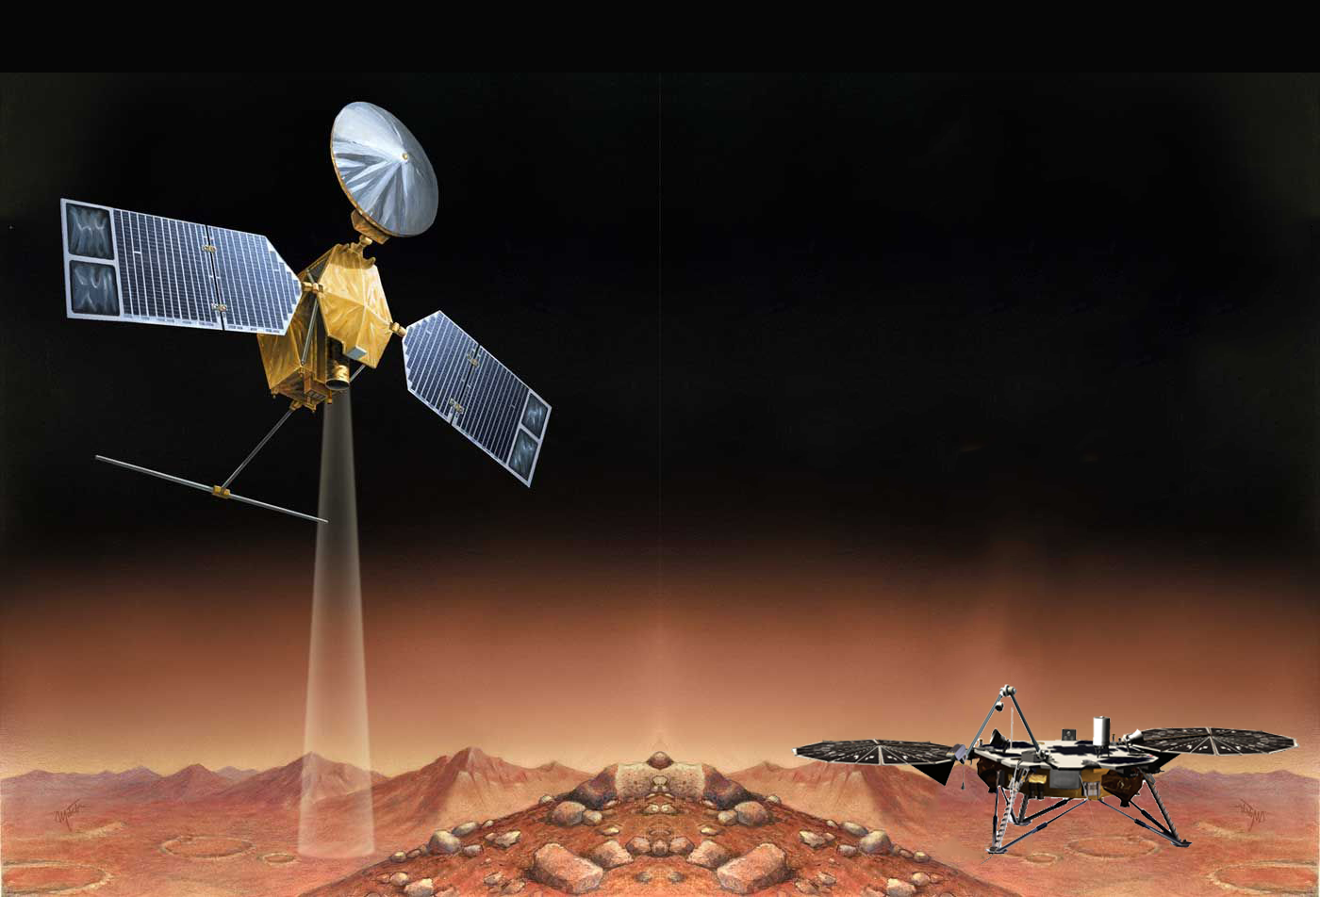
Coordinated Measurements
Methodology
Mars Reconnaissance Orbiter
CRISM – H2Ov column abundance
MCS– temperature profiles, H2O ice profiles
Lidar – Profiles Ice water content
TECP – Surface Relative Humidity
MET – Surface pressure, temperature
Phoenix Lander
Image: NASA

Slide 5
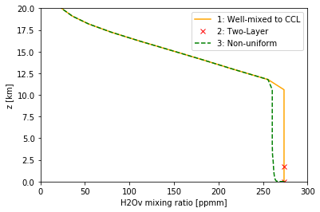
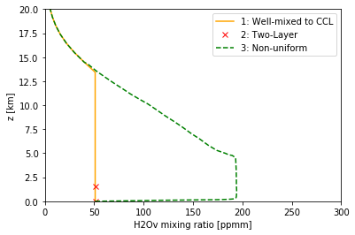
Results
15:00 (mid-afternoon)
03:50 (overnight)
Sol 43/44 | Ls = 95.8/96.5 | LT = 15.0 |  | LT = 3.83
CRISM | Total column H2Ov | 39.655 pr-um |  | 26.597 pr-um
1. Well-Mixed (to cloud condensation level) | Total column H2Ov | 47.4 pr-um |  | 9.074 pr-um
2. Two layer model | Vapor content < z = 1.5km | 8.389 pr-um (21.15% of CRISM column) |  | 1.359 pr-um (5.11%of CRISM column)
3. Non Well-mixed | Total column H2Ov | 44.987 pr-um |  | 35.089 pr-um

Slide 6
Results
Scenario 1: Uniformly well-mixed distribution generates water vapor column that’s too high at LT= 1500, and too low at LT = 0300 when compared to CRISM observations.
Scenario 2: Using TECP water mixing ratios observed at the surface, quantity of near-surface water confined up to height of 1.5km is 21% of the observed CRISM column, < previously hypothesized estimate of 60% of the column.
Scenario 3: Non-uniform H2Ov mixing ratios results in lower total water column abundance compared to the well-mixed case. However, the quantity of water in the column is still greater than observed CRISM values.
Significance
Neither the uniformly well-mixed distribution nor a two layer model is sufficient to account for the day-night variability in observed CRISM vapor column abundances
Higher concentration of surface water vapor mixing ratio during the day vs at night as observed by the TECP instrument requires active exchange of water between the atmosphere and the regolith.

Slide 7
Next Steps
While only one day-night pair of measurements (Sol 43-44) was shown in this presentation, this technique is being applied to all remaining available data from the 150 Sol Phoenix Mission (Ls= 76.5° to 148°) in order to explore seasonal trend in the vertical distribution of water vapor.
In Year 2 of my postdoc, coordinated measurement between MRO & the Curiosity Rover can be used to conduct similar study for the water cycle near Gale Crater.
Publications and Acknowledgements
The results from this study will be presented at the AGU 2020 Fall Meeting:
Abstract ID: 675368 Abstract Title: Vertical Distribution of Water Vapor Using the Recalibrated TECP Relative Humidity Measurements and Coordinated MRO Observations at the Mars Phoenix Lander Site Final Paper Number: P039-06 Presentation Type: Oral Session
I would like to thank the NPP program and the generous support of JPL for funding this research.

