Slide 1
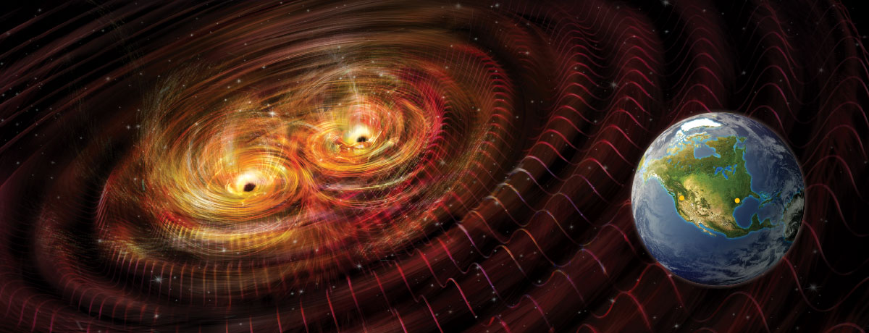
Detecting Gravitational Waves with the Roman Space Telescope
Kris Pardo
Organization: 3268
Advisor: Olivier Doré (3268)
Postdoc Program: JPL
This work in collaboration with: Yijun Wang (Caltech), Tzu-Ching Chang (JPL 3266), & Olivier Doré (JPL 3268)

Slide 2
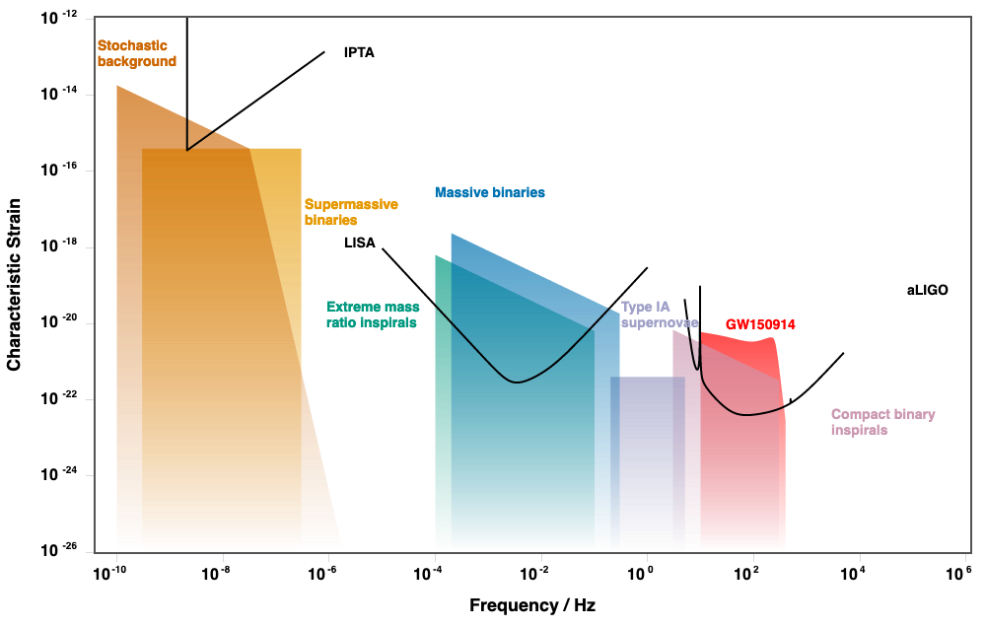
Gravitational Waves are an under-explored tool for observing the Universe!
Areas with no planned GW observatories
Gravitational Waves (GWs) are produced by the inspirals and mergers of black holes at all mass ranges – this produces waves at a large range of frequencies.
GWs allow us to test GR and tell us about black hole populations and evolution. In addition, they can tell us more about the evolution of the universe (e.g., measuring the Hubble constant).
So far, GWs have only been observed by LIGO/VIRGO, which observe at the 10-100 Hz range.
Current and planned experiments (like pulsar timing arrays and LISA) will cover a large range of other frequencies.
However there are still gaps in the frequency spectrum! These are in important places that can tell us how sources evolve as the binaries spiral to coalescence.
Moore+ (2014)

Slide 3
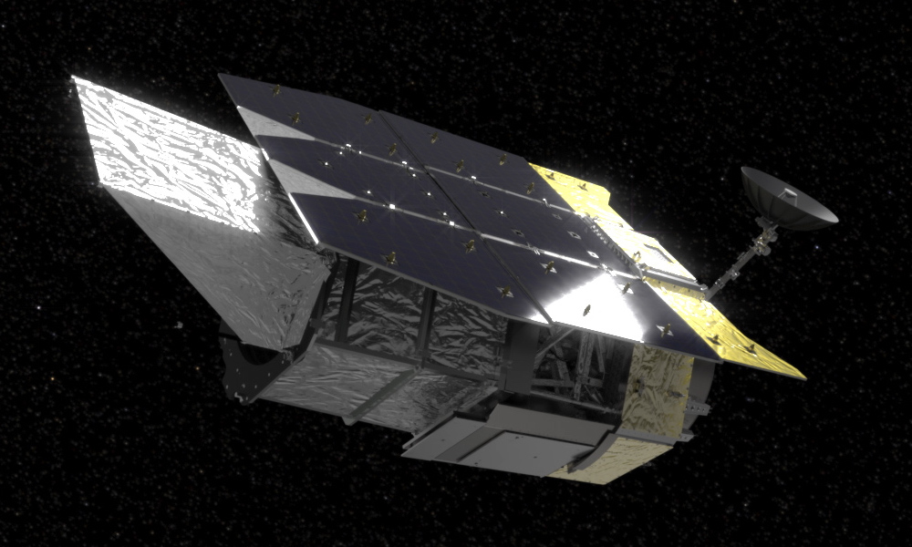
Roman Space Telescope - planned for launch mid-2020s
The Roman Space Telescope will probe the properties of dark energy, investigate supernovae and galactic properties, and discover exoplanets through its many surveys of the sky.
One of its surveys, the Exoplanet Microlensing Survey (EML), will discover ~1000 planets by closely monitoring the galactic center (pictured right).
Over six, 72-day epochs, it will take 50s exposures of the same regions every 15 minutes.
However, this survey strategy is also ideal for detecting GWs in the GW frequency gaps!
Roman will observe stars in this region
almost 41,000 times over 5 years!
NASA and WFIRST team
See Spergel + (2013) and Penny + (2017) for more information on Roman and the EML survey.

Slide 4
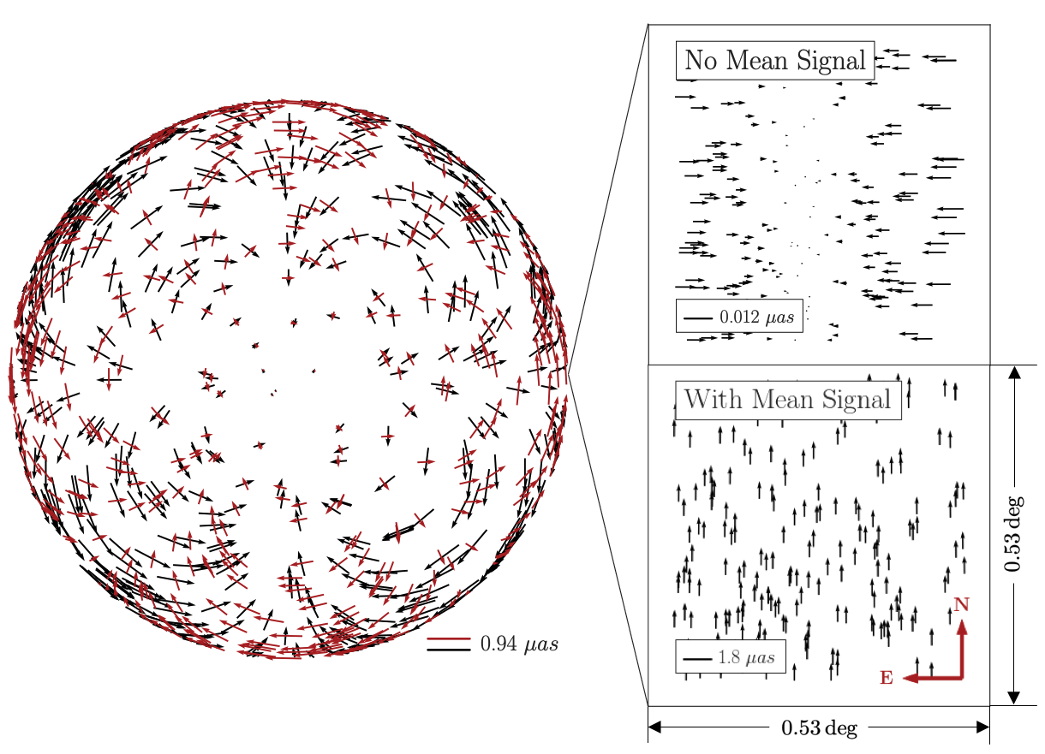
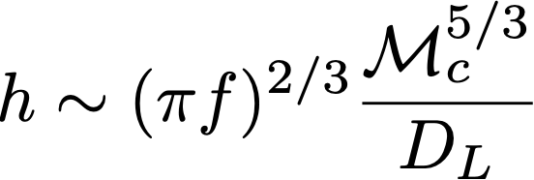
GWs can produce shifts in apparent star positions
The amplitude of a GW is measured by its strain:
By distorting the spacetime at the Earth, a GW can produce apparent shifts in star positions (see right). This shift is about:
The sensitivity of a photometric survey to a GW is approximately:
Chirp mass of the binary (like a reduced mass)
Distance to the source
On-sky angle between the star and the source
Astrometric sensitivity
Will the Roman Space Telescope be sensitive to nearby supermassive black hole mergers?
See Pyne + (1996) and Book & Flanagan (2011) for the original derivations of the astrometric detection of GWs.

Slide 5
Methodology
Simulate images of stellar positions, assuming the expected Roman Space Telescope
Simulate the expected change in stellar positions if a GW event produced by a black hole binary occurs.
Use Markov Chain Monte Carlo sampling to find the sensitivity of the Roman Space Telescope to black hole binaries at different masses and distances.
This is degenerate with pointing error!

Slide 6
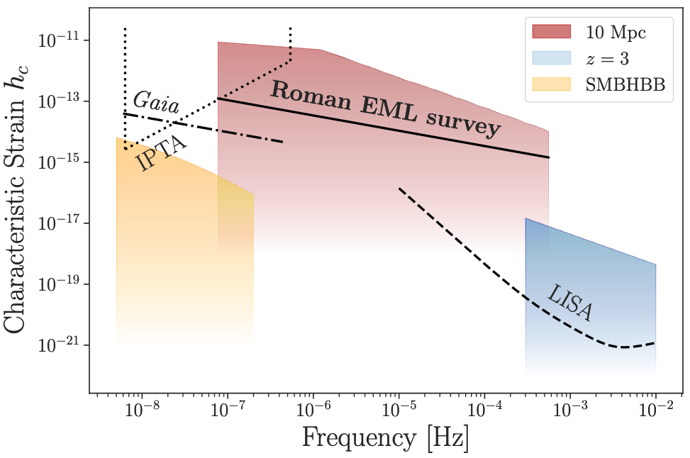
Results
Expected signals from different source populations
Roman will cover the frequency gap between LISA and pulsar timing arrays

Slide 7
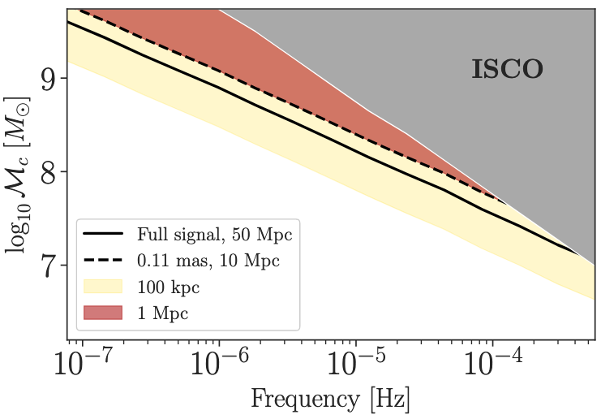
Sensitivity to nearby binaries
Because of the current survey design, we expect that Roman will only be able to detect binaries out to about 1 Mpc.
Improvement of the sensitivity or a method that would allow us to retain the full signal would allow us to increase the discovery distance by at least 10x.
We also looked into the other upcoming photometric surveys and what they could do to be competitive GW detectors. This work was the first time that surveys outside of dedicated astrometric or radio surveys have been considered as GW observatories.
We are now working to quantify Roman’s sensitivity to a population of supermassive black hole binaries.

Slide 8
Publications
Wang, Y., Pardo, K., Chang, T. C., & Doré, O., 2020, submitted to Phys. Rev. D., (arXiv:2010.02218)
Acknowledgments
First and foremost, I would like to thank my collaborators: Yijun Wang (Caltech), Tzu-Ching Chang (JPL 3266), & Olivier Doré (3268).
We are all deeply grateful for discussions with Jeff Kruk, Scott Gaudi, and Davy Kirkpatric on the Roman Space Telescope, as well as Robert Lupton on the Rubin Observatory and Joseph Lazio and Steven Myers on the ngVLA. We thank Todd Gaier for a discussion that inspired this work.
Part of this work was done at Jet Propulsion Laboratory, California Institute of Technology, under a contract with the National Aeronautics and Space Administration. This work was supported by NASA grant 15-WFIRST15-0008 Cosmology with the High Latitude Survey, Roman Science Investigation Team (SIT).

