Slide 1
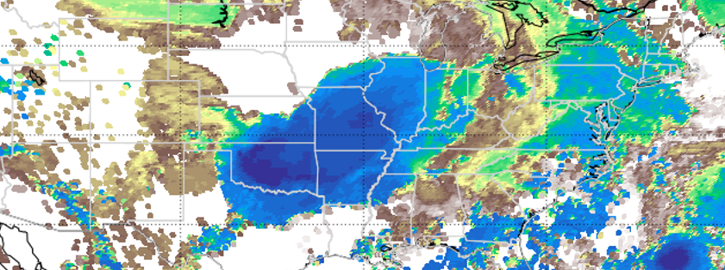

Extreme outliers in lower stratospheric water vapor over North America observed by Aura MLS
2020 Postdoc Research Day Presentation Conference
Frank Werner
Organization: 329D
Advisor: Nathaniel J. Livesey (3290)
Postdoc Program: JPL

Slide 2
Introduction
Stratospheric water vapor impacts the atmospheric radiation budget and stratospheric ozone
An increase of water vapor around the tropopause can lead to substantial surface warming
Strong convective events that overshoot into the lowermost stratosphere contribute to regional water vapor maxima over the boreal summer monsoon regions
These plumes can yield elevated water vapor mixing ratios of 10-20 ppmv, while typical background values are 4-6 ppmv
Strengthening convection in a warmer climate can potentially result in a positive climate feedback
Determining the importance of convection on global stratospheric humidity is the subject of ongoing research:
  DCOTSS field campaign in summer 2021
  SWITCH Earth Venture Instruments-6 concept
a)
Werner et al. (2020a)
$→$ One of my tasks is to better understand the connection between overshooting convection and outliers in stratospheric humidity
Notes:
Abstract
(Plain language description designed for the non expert in the field. The introduction should be concise and should provide a broad context of your work.)

Slide 3
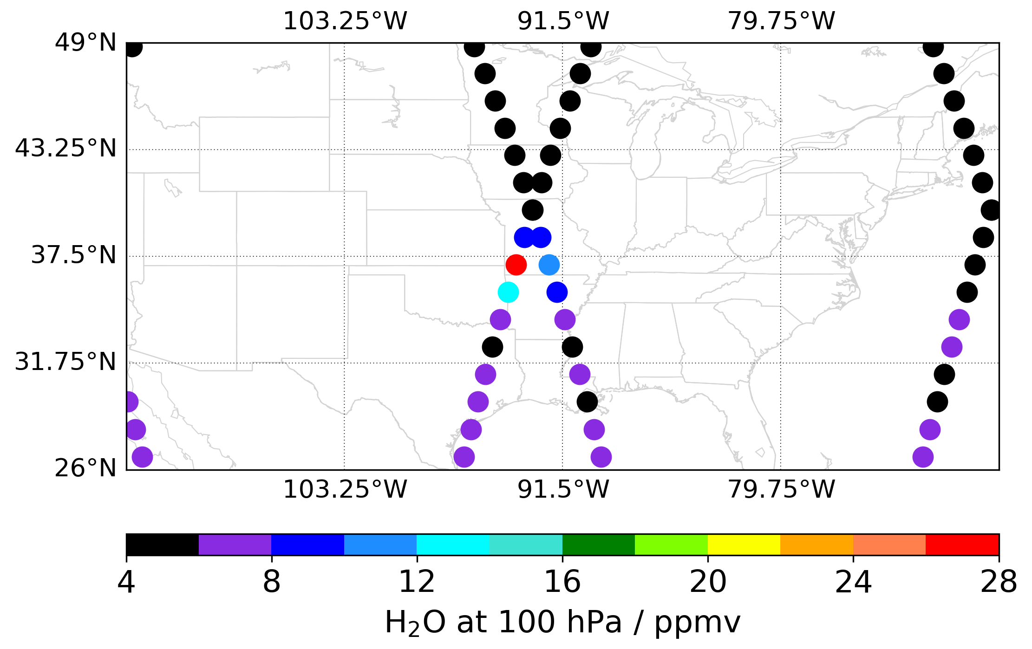
Problem Description
JPL’s Microwave Limb Sounder (MLS) provides ~3500 daily profiles of atmospheric constituents, including water vapor
The MLS field of view is rather narrow and clouds are effectively transparent to most of its channels.
Connect MLS-observed outliers in lower-stratospheric water vapor with properties of cloud seen in convective events
Augment the excellent MLS water vapor retrievals with cloud observations from other instruments
Identify the relevant characteristics of overshooting convection that yield local humidity maxima in the stratosphere
Notes:
a) Context (Problem statement and relevance to the field)
b) Why does it interest you? What are your own contributions as distinct from those of your advisor or research group?

Slide 4
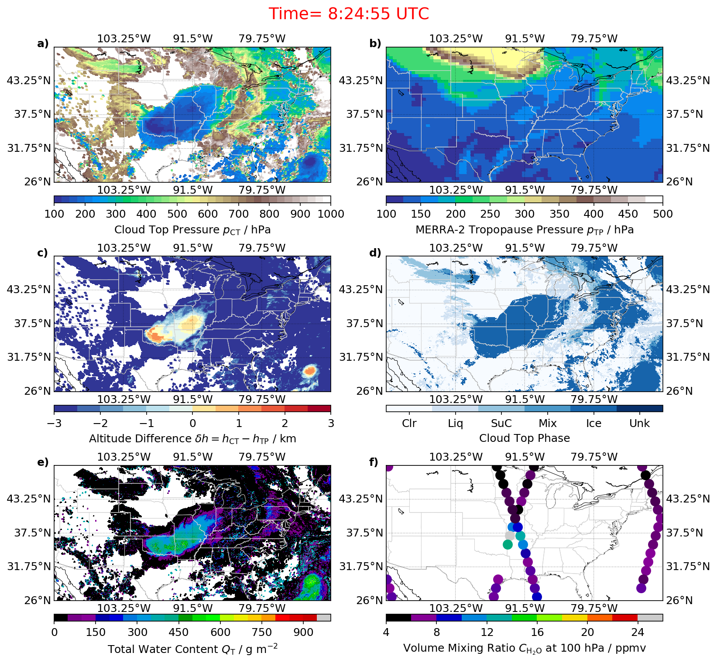
Methodology
a)
For all profiles over North America in the MLS data record:
  Colocate with cloud variables from the Moderate Resolution Imaging Spectroradiometer (MODIS, see example in panel a)
  Colocate with tropopause altitude from the Modern-Era Retrospective analysis for Research and Applications, Version 2 (MERRA-2) reanalysis data to derive a tropopause-relative altitude difference (panel b)
$→$ Addresses research item 1
b)
Determine possible correlations between certain properties of overshooting convection and MLS-observed humidity outliers
One particular profile from August 2019 stood out in 16-year MLS data record. Determine which properties conspired to make it the largest retrieved water vapor mixing ratio in the MLS record
$→$ Addresses research item 2
Notes:
Formulation, theory or experiment description
Innovation, advancement

Slide 5

Results
Cumulative distributions of proximity to overshooting convection (panel a) and covered area of the overshooting convection within a 500-km perimeter (panel c)
Largest humidity outlier indicated by orange line
The median and interquartile range of proximity (panel d) and area (panel f) as a function of water vapor mixing ratio
$→$ Only 2.3% of profiles are as close to overshooting convection
$→$ Only 0.024% of profiles are associated with larger overshooting convection
$→$ Larger humidity outliers are closer to large overshooting convection
$→$ Overshooting height and ice water content show no correlation with humidity outliers
We successfully trained a neural network to predict MODIS cloud top pressure from MLS observations (not shown)
Werner et al. (2020a)
Notes:
Accomplishments versus goals
Significance
Next steps

Slide 6
Publications
Journal article on colocated MLS-MODIS analysis, currently in review at Geophysical Research Letters
Journal article on MLS cloud detection via neural networks, in preparation for Atmospheric Measurement Techniques
Journal article on extreme pyrocumulonimbus events resulting from the historic 2020 Australian fires, currently in review at Geophysical Research Letters
Werner, F., Schwartz, M. J., Livesey, N. J., Read, W. J., and Santee, M. L. (2020), Extreme outliers in lower stratospheric water vapor over North America observed by MLS: Relation to overshooting convection diagnosed from colocated Aqua-MODIS data, Geophys. Res. Lett., in review
Werner, F., Schwartz, M. J., Livesey, N. J., Read, W. J., and Santee, M. L. (2020), Improved cloud detection for MLS: Training an artificial neural network on colocated MLS and Aqua MODIS data, Atmos. Meas. Tech., in preparation
Schwartz, M. J., Santee, M. L., Pumphrey, H. C., Manney, G. L., Lambert, A., Livesey, N. J., Read, Millán, L., Neu, J. L., Read, W. J., Werner, F. (2020), Australian New Year’s PyroCb impact on Stratospheric Composition, Geophys. Res. Lett., in review
Notes:
Include all conference papers, journal articles in prep/submitted/accepted, book chapters as a result of your work

