Slide 1
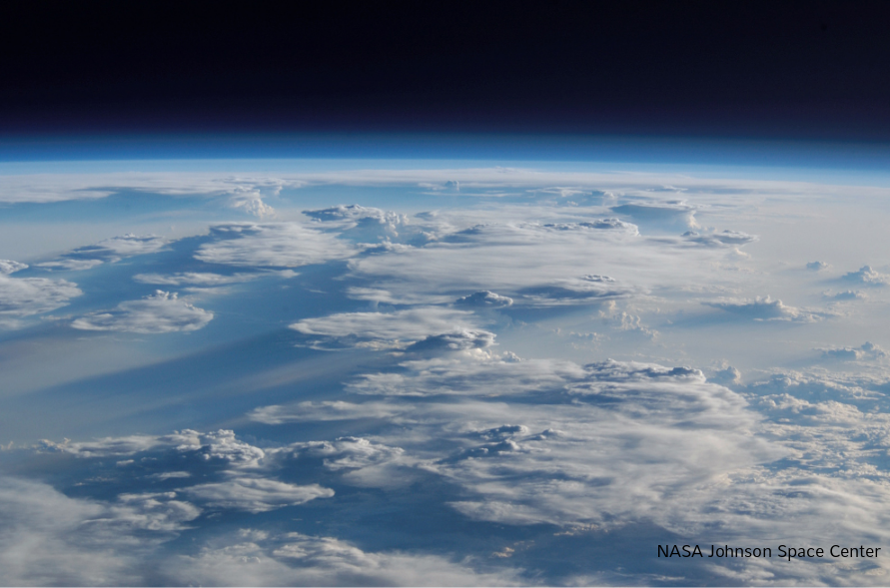

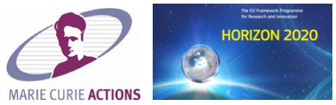

2020 Postdoc Research Day Presentation Conference
New Insights into Cloud Properties:
3D Cloud Tomography from Space
Linda Forster, Anthony B. Davis, David J. Diner, Bernhard Mayer
Organization: 329 J
Advisor: Anthony B. Davis (329 J)
Postdoc Program: JPL

Slide 2
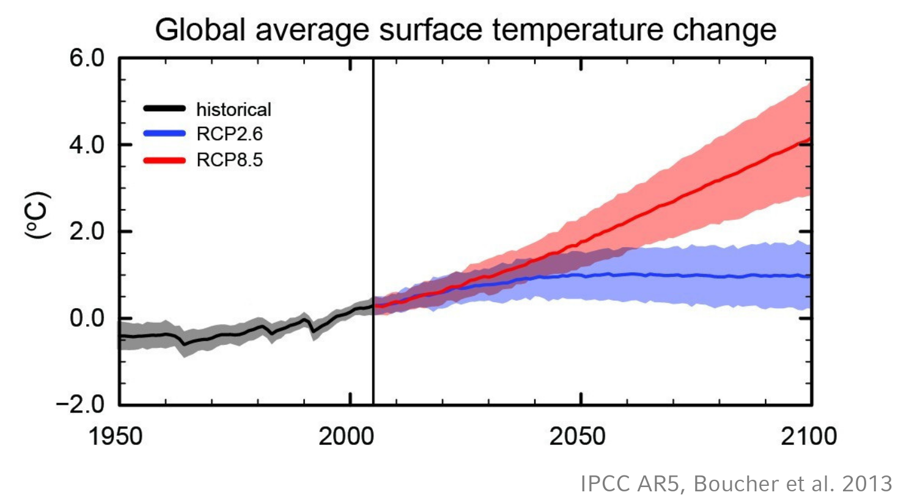
Motivation
IPCC AR5:
“Clouds and aerosols continue to contribute the largest uncertainty to estimates and interpretations of the Earth’s changing energy budget.”
Notes:
(Plain language description designed for the non expert in the field. The introduction should be concise and should provide a broad context of your work.)

Slide 3
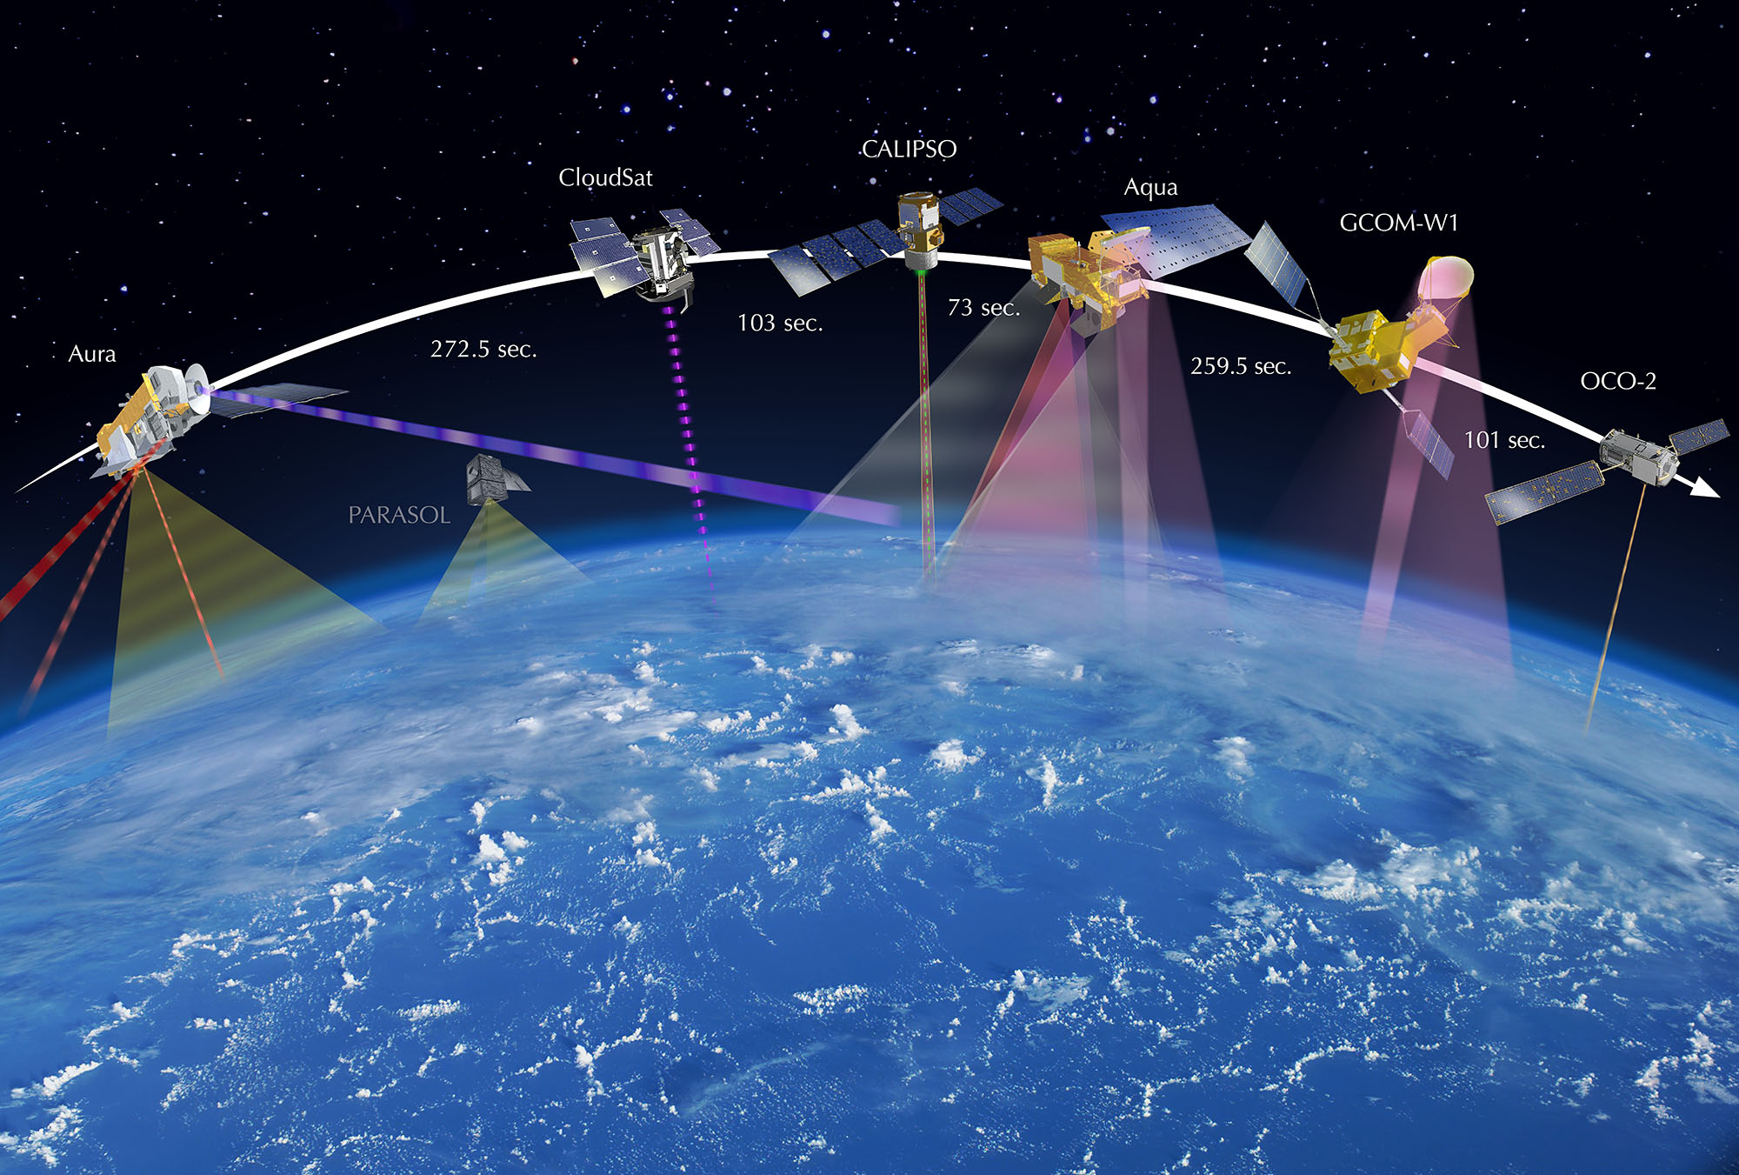
Satellite remote sensing of cloud properties
→ Global coverage
Image source: https://en.wikipedia.org/wiki/A-train_(satellite_constellation)
Notes:
(Plain language description designed for the non expert in the field. The introduction should be concise and should provide a broad context of your work.)

Slide 4
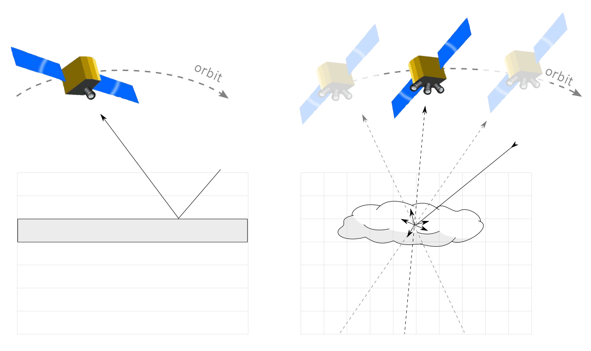
Satellite remote sensing of cloud properties
Traditional 1D retrieval
…
…
[Nakajima and King 1990]
Notes:
(Plain language description designed for the non expert in the field. The introduction should be concise and should provide a broad context of your work.)

Slide 5
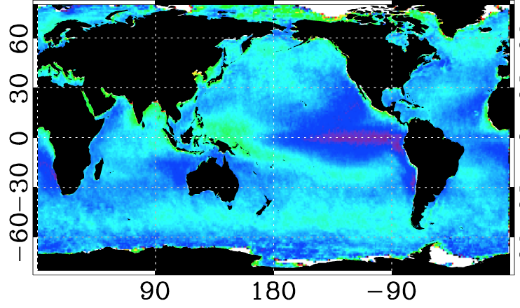
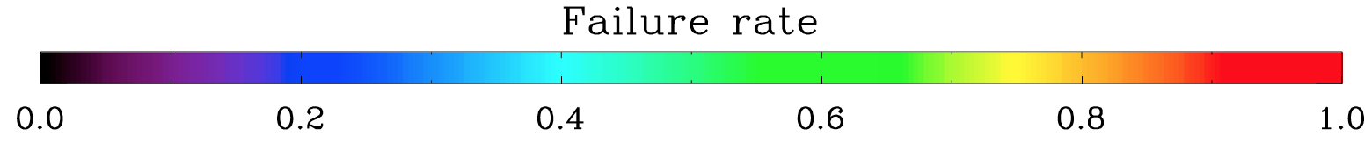
Satellite remote sensing of cloud properties
Traditional 1D retrieval
→ Gap in global monitoring of cloud properties
…
…
[Nakajima and King 1990]
[Cho et al. 2015]
Notes:
(Plain language description designed for the non expert in the field. The introduction should be concise and should provide a broad context of your work.)

Slide 6
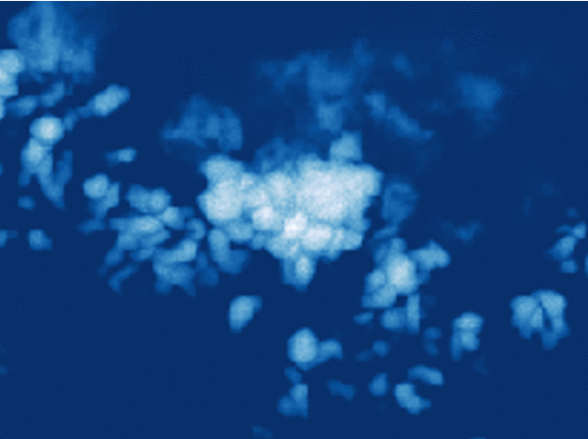
Satellite remote sensing of cloud properties
Traditional 1D retrieval
New 3D tomographic approach
…
…
[Nakajima and King 1990]
Notes:
(Plain language description designed for the non expert in the field. The introduction should be concise and should provide a broad context of your work.)

Slide 7
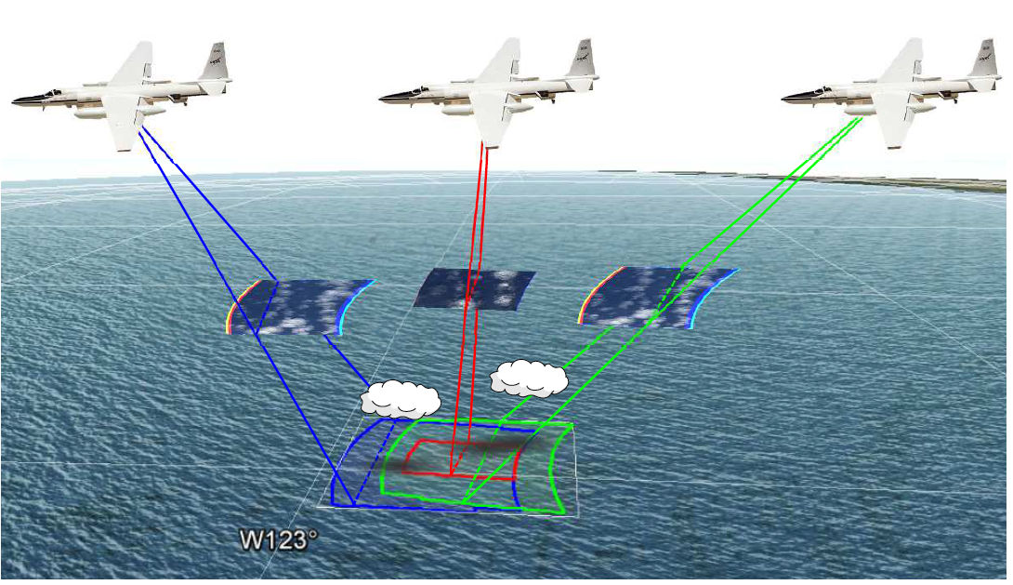
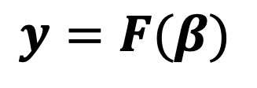
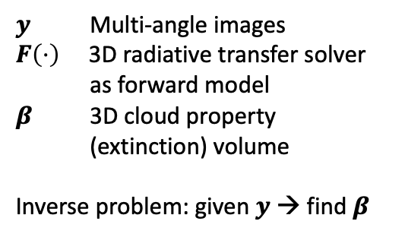
Cloud tomography
Levis et al. (2015, 2017, 2020): Cloud tomography as large inverse problem
$$y=F(β)$$
$y$ Multi-angle images
$F\left(⋅\right)$ 3D radiative transfer solver as forward model
$β$ 3D cloud property (extinction) volume
Inverse problem: given $y$ → find $β$

Slide 8

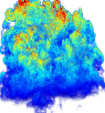

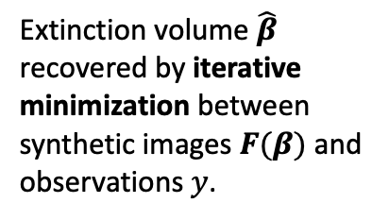
Cloud tomography
Levis et al. (2015, 2017, 2020): Cloud tomography as large inverse problem
Multi-angle Observations
$$y$$
$$y=F(β)$$
Extinction volume $\hat{β}$ recovered by iterative minimization between synthetic images $F(β)$ and observations $y$.
Cost function
Recovered extinction volume

Slide 9
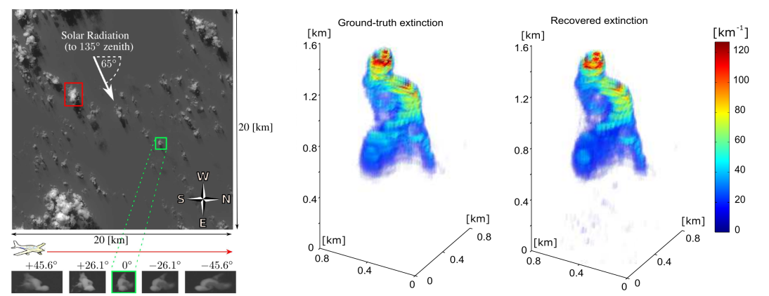

Cloud tomography
Levis et al. (2015, 2017, 2020): Cloud tomography using multi-angle airborne images
Correlation
coefficient: $ρ=0.94$
Large-Eddy Simulation
(LES) cloud field
Ground truth
Reconstruction

Slide 10
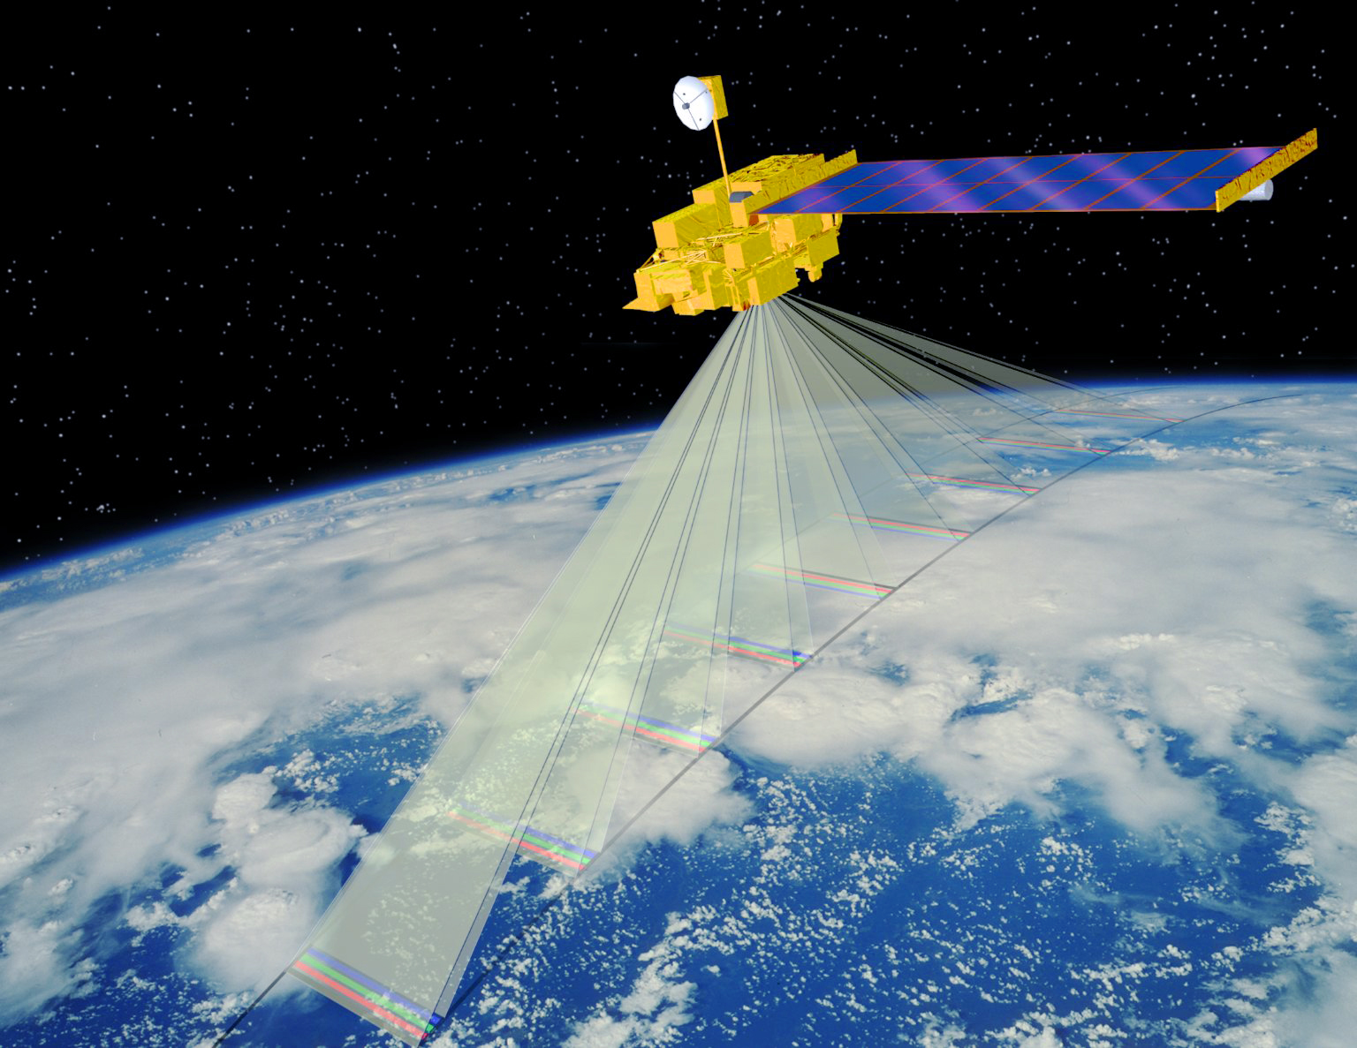
Advance cloud tomography to satellite observations
AirMSPI on ER2
[Diner et al. 2013]
MISR on Terra
[Diner et al. 1998]
Pixel size ≈ 20 m
Increase by
> factor 10!
Pixel size ≈ 275 m
→ Observation of larger, optically thick cloud volumes

Slide 11
Cloud tomography from space
Increased pixel size from 20 m (AirMSPI) to 275 m (MISR) leads to
observations of larger, optically thick cloud volumes. This causes the following
Challenges:
Computational run time and memory issues for the
radiative transfer solver
Loss of information due to multiple scattering contributes to
ill-posedness of inverse problem

Slide 12
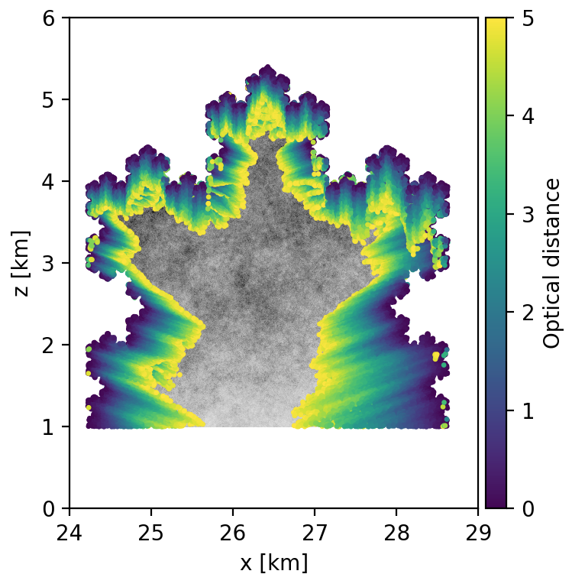

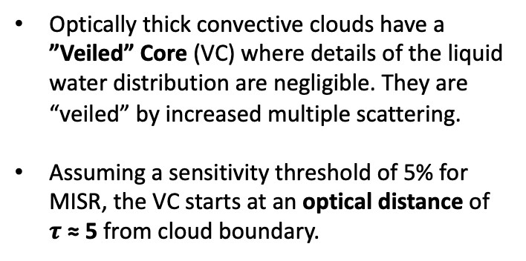
Solution of challenge #1:
Increase efficiency of radiative transfer solver
Optically thick convective clouds have a ”Veiled” Core (VC) where details of the liquid water distribution are negligible. They are “veiled” by increased multiple scattering.
Assuming a sensitivity threshold of 5% for MISR, the VC starts at an optical distance of $τ \text{≈}$5 from cloud boundary.
Veiled
Core
$$τ \text{≈} 5$$
Forster, L., A. B. Davis, D. J. Diner, and B. Mayer, 2020: Toward Cloud Tomography from Space using MISR and MODIS: Locating the ”Veiled Core” in Opaque Convective Clouds. J. Atmos. Sci., in press.

Slide 13
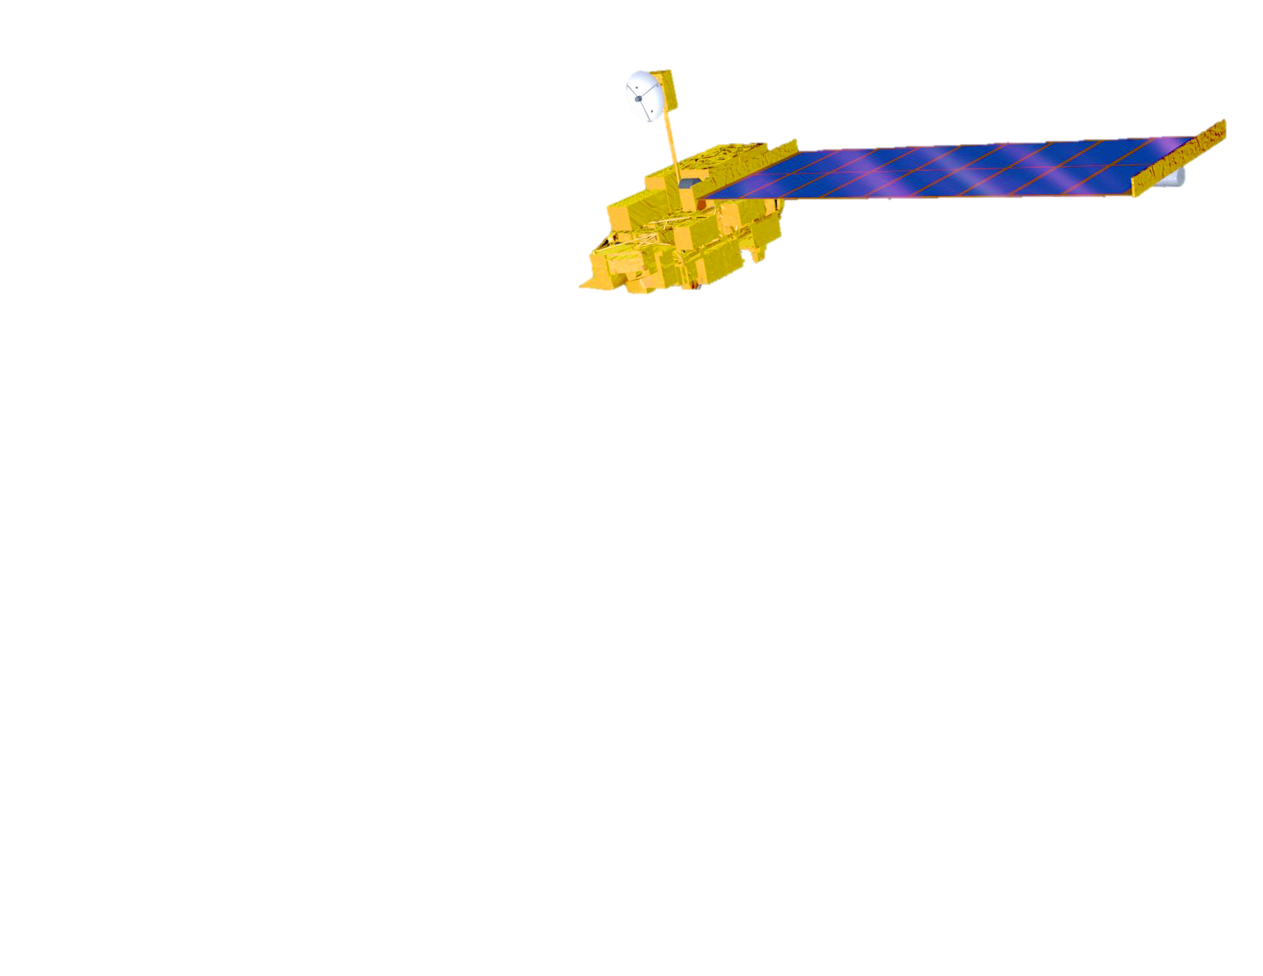


Solution of challenge #1:
Increase efficiency of radiative transfer solver
Make use of the VC to develop a fast and efficient hybrid radiative transfer (RT) solver:
Detailed 3D solver in the cloud shell and a fast method in the core (e.g. Photon Diffusion Theory).
The bias introduced by applying Photon Diffusion Theory decreases below MISR’s sensitivity
threshold of 5% inside the VC.
Hybrid
solver
Shell
Detailed
radiative transfer
Veiled
Core
Diffusion
Forster, L., A. B. Davis, D. J. Diner, and B. Mayer, 2020: Toward Cloud Tomography from Space using MISR and MODIS: Locating the ”Veiled Core” in Opaque Convective Clouds. J. Atmos. Sci., in press.

Slide 14
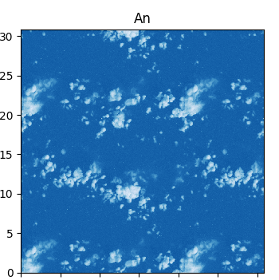
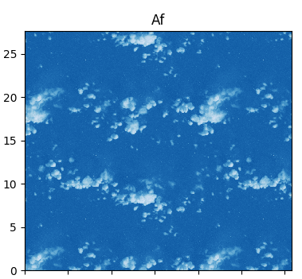
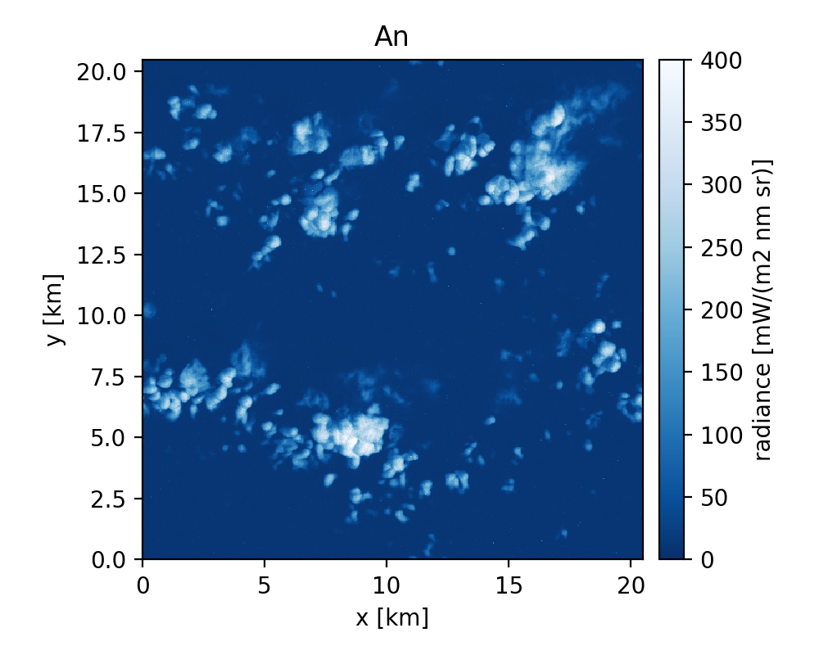
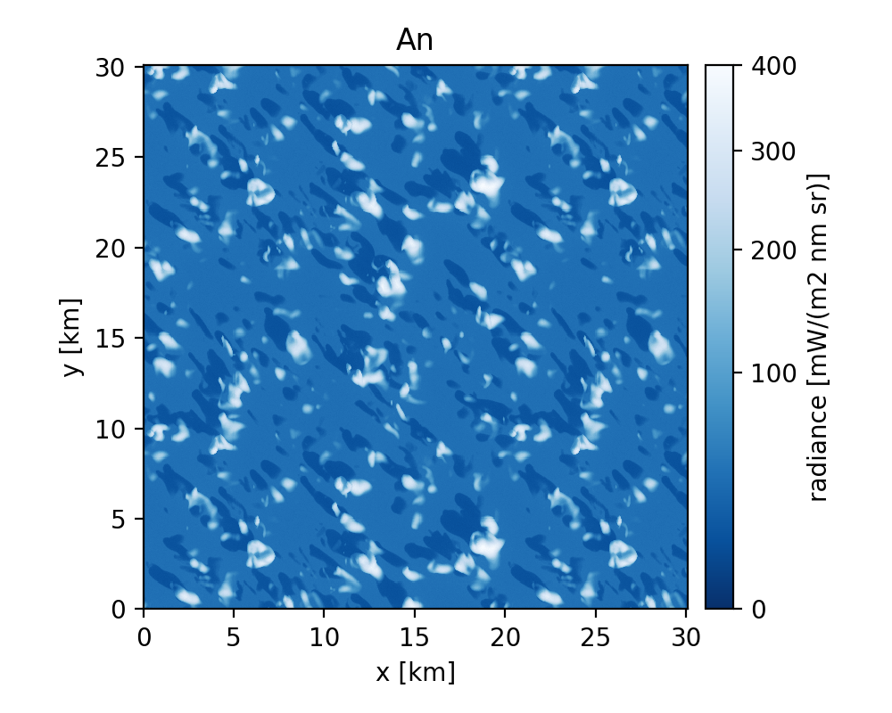
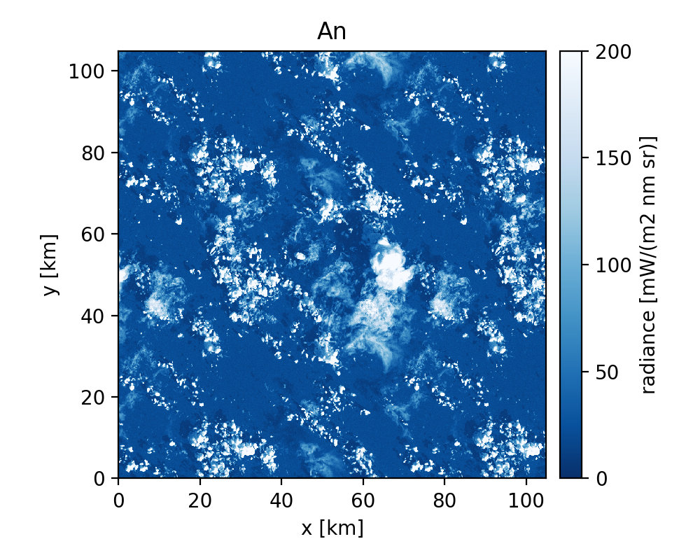
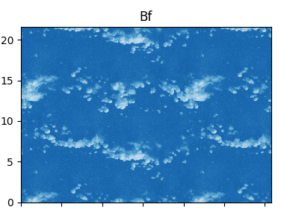
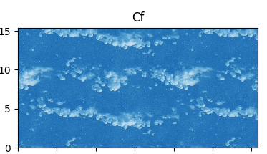
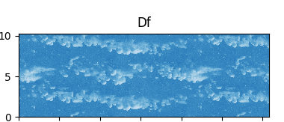
Solution of challenge #2:
Regularization and improved initial guess
Viewing
angle
0°
Database of synthetic multi-angle observations using 3D radiative transfer model MYSTIC [Mayer 2009] and synthetic cloud fields [provided by Marcin Kurowski, JPL]
RICO
ARM
LBA
26°
45°
60°
Testbed for developing regularization methods
Training data for deep learning approach to obtain an improved estimate for the initial guess of the reconstruction
75°

Slide 15
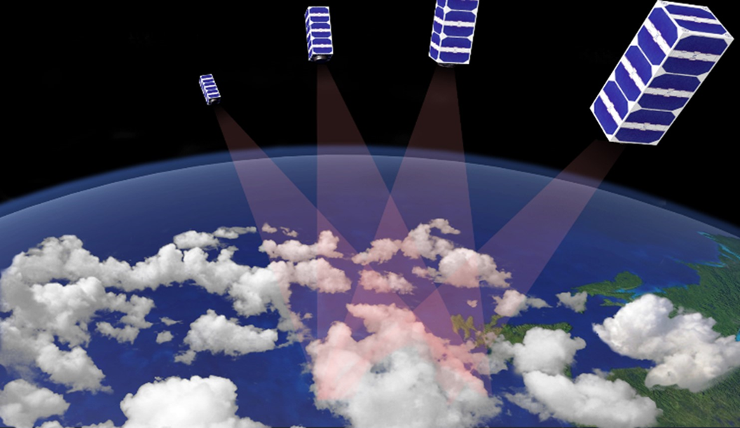
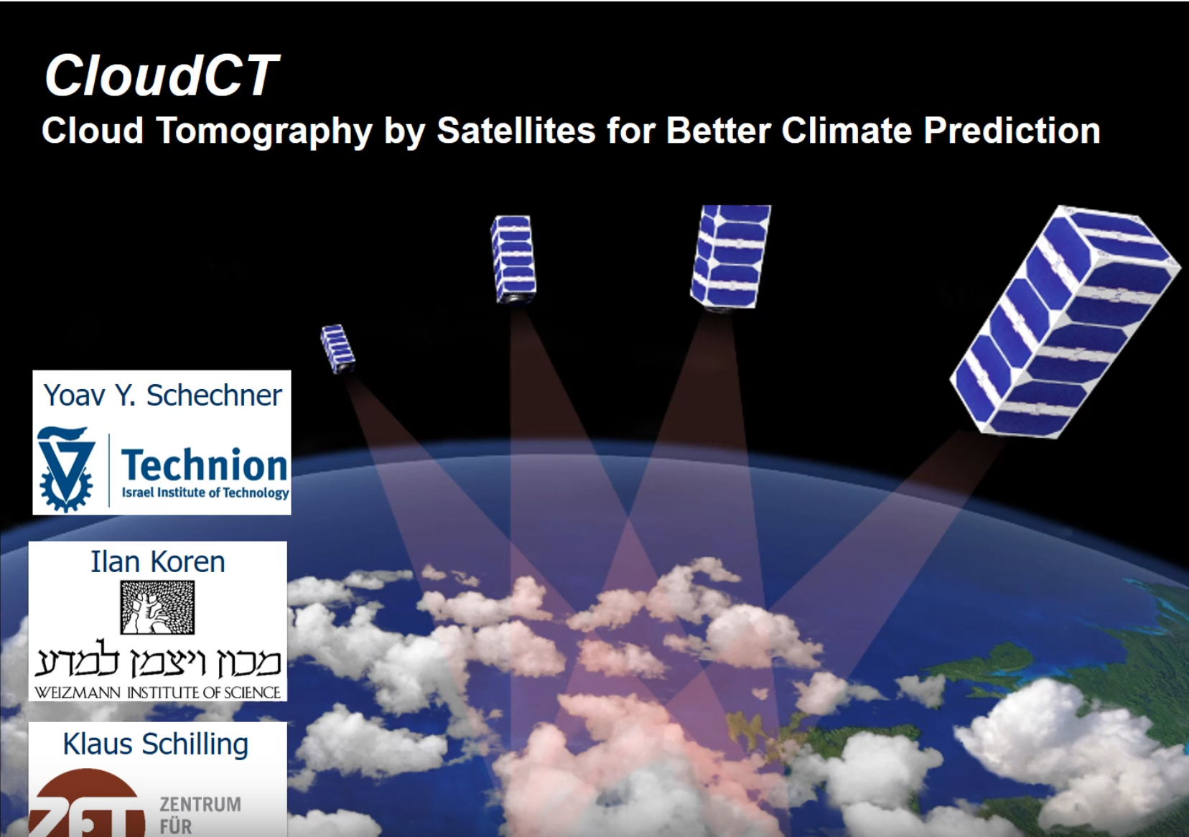

The future of cloud tomography: CloudCT
ERC funded Israeli-German mission (14 million Euro) for cloud tomography using a
constellation of nanosats [Schilling et al. 2019]
Further information:
https://www.youtube.com/watch?v=_DF-SCbpQi8&feature=youtu.be
https://vee.technion.ac.il/clouds-what-do-we-know-about-them/

Slide 16
Cloud tomography from space
Benefits:
Close the gap in global monitoring of cloud properties by accounting for the 3D morphology of clouds
Reveal unprecedented 3D microphysical properties of convective clouds
→ new constraints to advance understanding of the cloud-climate feedback
Tomographic reconstruction method applicable to aerosol plumes as well
(e.g. wild fires, dust and volcanic plumes)

Slide 17
Publications and Acknowledgements
Funding: This project was funded by the European Union’s Framework Programme for Research and Innovation Horizon 2020 (2014-2020) under the Marie Skłodowska-Curie Grant Agreement No. 754388 (LMUResearchFellows) and from LMUexcellent, funded by the Federal Ministry of Education and Research (BMBF) and the Free State of Bavaria under the Excellence Strategy of the German Federal Government and the Länder.
Publications:
Forster, L., A. B. Davis, D. J. Diner, and B. Mayer, 2020: Toward Cloud Tomography from Space using MISR and MODIS: Locating the ”Veiled Core” in Opaque Convective Clouds. J. Atmos. Sci., in press. ArXiv preprint available: https://arxiv.org/abs/1910.00077
Davis, A. B., L. Forster, D. J. Diner, and B. Mayer, 2020: Toward cloud tomography from space using MISR and MODIS: The physics of opaque 3D cloud image formation. J. Atmos. Sci., in preparation.
Conference talks/presentations:
Forster, L., A. B. Davis, D. J. Diner, B. Mayer, 2019: 3D Cloud Tomography using Satellite Observations: Defining the “Veiled” Core. A23T-2980. AGU (American Geophysical Union) Fall Meeting. December 9 – 13, San Francisco, CA, US.
Forster, L., A. B. Davis, D. J. Diner, B. Mayer, M. Kurowski, and J. Teixeira, 2019: Synthetic MODIS and MISR Images of Planetary Boundary Layer Cloud Scenes: Application to 3D Cloud Tomography Development. MISR/VIIRS Science Team Meeting. November 18 – 22, College Park, Maryland, US.
Forster, L., A. B. Davis, D. J. Diner, and B. Mayer, 2019: 3D cloud tomography using satellite observations: defining the
“veiled core”. Gordon Research Conference on Radiation and Climate. July 21 - 26, 2019, Lewiston, MA, US.
Forster, L., A. B. Davis, and B. Mayer, 2019: Progress in 3D Tomographic Cloud Reconstruction: MISR’s perspective on the
“hidden zone” inside opaque convective clouds. MISR Science Team Meeting. February 12 – 13, Pasadena, CA, US.
Notes:
Include all conference papers, journal articles in prep/submitted/accepted, book chapters as a result of your work

Slide 18
References
Boucher, O., and Coauthors, 2013: Clouds and aerosols. Climate Change 2013: The Physical Science Basis. Contribution of Working Group I to the Fifth Assessment Report of the Intergovernmental Panel on Climate Change, Cambridge University Press, Cambridge (UK), 571–657.
Cho, H.-M., and Coauthors, 2015: Frequency and causes of failed MODIS cloud property retrievals for liquid phase clouds over global oceans. Journal of Geophysical Research: Atmospheres, 120 (9), 4132–4154, doi:10.1002/2015JD023161.
Diner, D. J., and Coauthors, 1998: Multi-angle Imaging SpectroRadiometer (MISR) instrument description and experiment overview. IEEE Transactions on Geoscience and Remote Sensing, 36, 1072– 1087, doi:10.1109/36.700992.
Diner, D. J., and Coauthors, 2013: The Airborne Multiangle Spectro-Polarimetric Imager (AirMSPI): a new tool for aerosol and cloud remote sensing. Atmos. Meas. Tech., 6 (8), 2007–2025, doi:10.5194/ amt- 6- 2007- 2013.
Levis, A., Y. Y. Schechner, A. Aides, and A. B. Davis, 2015: Airborne three-dimensional cloud tomography. 2015 IEEE International Conference on Computer Vision (ICCV), 3379–3387, doi: 10.1109/ICCV.2015.386.
Levis, A., Y. Y. Schechner, and A. B. Davis, 2017: Multiple-scattering microphysics tomography. 2017 IEEE Conference on Computer Vision and Pattern Recognition (CVPR), 5797–5806, doi:10.1109/ CVPR.2017.614.
Levis, A.; Y. Y. Schechner, A. B. Davis, and J. Loveridge, 2020: Multi-View Polarimetric Scattering Cloud Tomography and Retrieval of Droplet Size. Remote Sens., 12, 2831.
Mayer, B., 2009: Radiative transfer in the cloudy atmosphere. European Physical Journal Conferences, 1, 75–99, doi:10.1140/epjconf/ e2009- 00912- 1.
Nakajima, T., and M. King, 1990: Determination of the optical thickness and effective particle radius of clouds from reflected solar radiation measurements. Part I: Theory. J. Atmos. Sci., 47, 1878–1893, doi:10.1175/1520- 0469(1990)047⟨1878:DOTOTA⟩2.0.CO;2.
Schilling, K., Y. Y. Schechner, and I. Koren, 2019: CloudCT - computed tomography of clouds by a small satellite formation. IAA symposium on Small Satellites for Earth Observation, IAC–19–D1.6.3.

