Slide 1
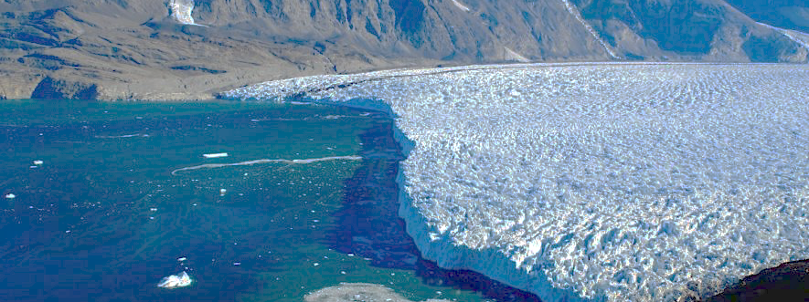

Impact of basal friction law on dynamics of Greenland outlet glaciers
2020 Postdoc Research Day Presentation Conference
Youngmin Choi
Organization: 329c
Advisor: Helene Seroussi (329c)
Postdoc Program: JPL

Slide 2
Introduction
Abstract
This project is part of the Earth 2050 initiative, a JPL/campus effort to improve our understanding of fundamental climate science questions. It specifically addresses the stability of the Greenland Ice Sheet and its contribution to sea level rise in a warming climate over the next 30 years. To understand the current state of the Greenland Ice Sheet, we need to understand key mechanisms that affect dynamics of glaciers (Fig. 1).
Here we focus on basal friction under the ice sheet, that controls sliding of glaciers, but cannot be directly measured through remote sensing. We use the JPL Ice Sheet System Model (ISSM) to invert basal friction parameters. We investigate the response of glaciers when various friction laws are applied, to determine which friction law best reproduces the observed pattern of acceleration and thinning.
Figure 1: Schematic of a Greenland tidewater glacier including key mechanisms (Straneo et al., 2013)

Slide 3
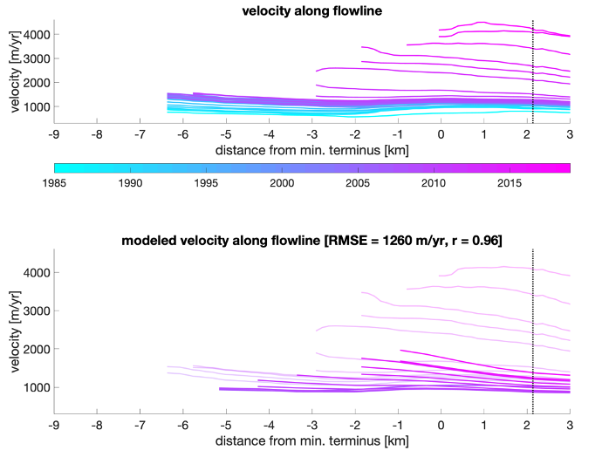
Problem Description
a) Greenland-wide model with commonly used velocity & basal friction relations
Overall agreement of mass changes of Greenland
Comparing with extensive dataset of glacier state, including surface velocity, ice flux at the glacier terminus, evolution of the terminus position for the largest 182 glaciers around Greenland
For some glaciers, discrepancy between observed and modeled acceleration even when the ice front evolution is in good agreement with observations (Fig. 2)
Ice sheet models use different friction laws assuming different state of basal conditions that range from “linear viscous” to “Coulomb-plastic”
Narrowing this range is critical to reducing uncertainty in sea‐level projections
Recently suggested more plastic basal conditions under Antarctic Ice Sheet (Brondex et al., 2019, Joughin et al., 2019), but little work on Greenland
Figure 2: Surface velocity of Kjer Glacier for the 1985-2018 period: a) Observed surface velocity for 1985-2018, b) comparison of observed (shaded) and modeled velocity for 2007-2018

Slide 4
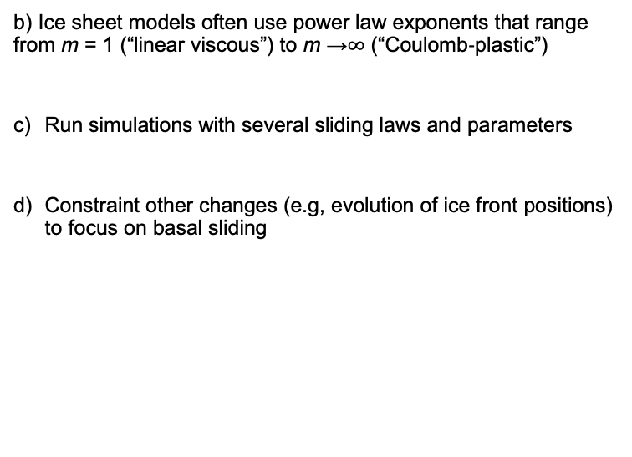
Methodology
Reproduce initial state of glacier in 2007
Invert for basal friction using observations, including velocity, geometry and ice front positions in 2007
b) Various friction laws
Weertman law (Weertman, 1957)
(Eq. 1)
Budd law (Budd, 1979)
(Eq. 2)
Schoof law (Schoof, 2005)
(Eq. 3)
Velocity trend..
Run simulations with force ice front retreat and several sliding laws and parameters
b) Ice sheet models often use power law exponents that range from m = 1 (“linear viscous”) to m →$∞$ (“Coulomb‐plastic”)
Run simulations with several sliding laws and parameters
Constraint other changes (e.g, evolution of ice front positions) to focus on basal sliding

Slide 5
Results
Observed acceleration is better reproduced when Budd friction law is used and basal condition is more plastic (m>10) than the most commonly assumed relations (m=1 or 3) in ice sheet models (Fig. 3).
The results show that some Greenland glaciers could be more sensitive to dynamical perturbations than predicted with lower exponent values.
The simulations will be extended to larger regions and longer time periods.
(d)
Figure 3: (a-c) Observed velocity (dashed lines) for Kjer glacier in Central West Greenland, from 2007 to 2018 and modeled velocity (solid lines) using a Budd friction law (Eq. 2). Exponents used in the Budd friction law are a) m=1, b) m=5, and c) m=12 (d) Root Mean Square Error between modeled and observed ice velocity in 2018 for various sliding laws as a function of the sliding exponent in the friction law.

Slide 6
References
Straneo, F., Heimbach, P., Sergienko, O., Hamilton, G., Catania, G., Griffies, S., Hallberg, R., et al. (2013). Challenges to Understanding the Dynamic Response of Greenland’s Marine Terminating Glaciers to Oceanic and Atmospheric Forcing. Bull. Amer. Meteor., 94 (8), 1131-1144, doi:10.1175/BAMS-D-12-00100.1
Brondex, J., Gillet‐Chaulet, F., & Gagliardini, O. (2019). Sensitivity of centennial mass loss projections of the Amundsen basin to the friction law. The Cryosphere, 13(1), 177–195. https://doi.org/10.5194/tc‐13‐177‐2019
Joughin, I., Smith, B. E., & Schoof, C. G. (2019). Regularized Coulomb friction laws for ice sheet sliding: Application to Pine Island Glacier, Antarctica. Geophysical Research Letters, 46. https://doi.org/10.1029/2019GL082526
Weertman, J. (1957). On the sliding of glaciers. Journal of Glaciology, 3(21), 33–38. https://doi.org/10.3189/S0022143000024709
Schoof, C. (2005). The effect of cavitation on glacier sliding. Proceedings of the Royal Society A: Mathematical, Physical and Engineering Sciences, 461(2055), 609–627. https://doi.org/10.1098/rspa.2004.1350
© Copyright 2020. All rights reserved

