Slide 1
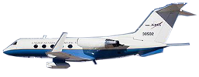
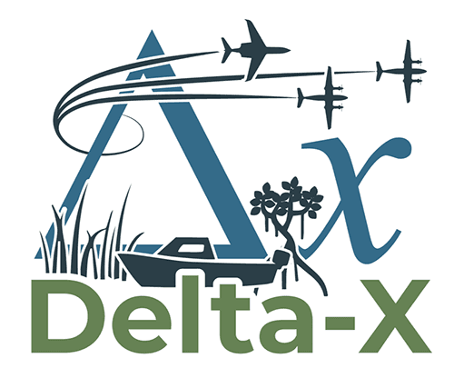
InSAR Phase Unwrapping Error Correction for Rapid Repeat Wetland Water-Level Change Measurements
Talib Oliver-Cabrera
Organization: 334G
Advisor: Dr. Cathleen Jones (334G)
Co-Authors: Dr. Marc Simard (334G), Dr. Yunjun Zhang (Caltech)
Postdoc Program: JPL

Slide 2
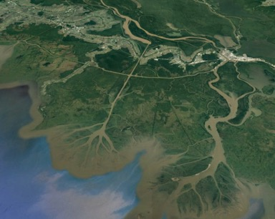
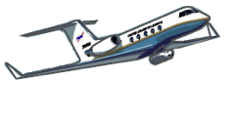
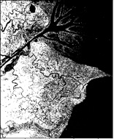
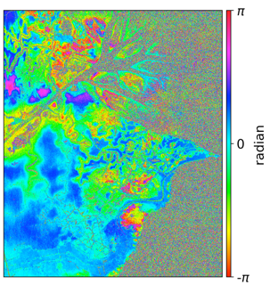
Introduction
Abstract
As part of NASA’s Delta-X project to study the processes controlling soil accretion and retention in deltas, the Uninhabited Aerial Vehicle Synthetic Aperture Radar (UAVSAR) is scheduled to perform L-band radar surveys over Louisiana’s coastal wetlands.
We take advantage of the rapid-repeat airborne Synthetic Aperture Radar (SAR) acquisitions to generate interferometric (InSAR) time-series. InSAR products from UAVSAR provide spatially extensive water level change measurements within areas with emergent vegetation. These measurements will be used to better constrain the hydrology and sediment transport models, including areas difficult to reach or to install tide-stations.
UAVSAR acquisitions
Interferogram
every ~30 mins
Each interferogram is formed by a pair of SAR acquisitions
T1
Time
Tn
In this study, we present an enhanced algorithm to correct phase unwrapping errors in InSAR for water-level measurements incorporating spatial bridging between islands and phase closure between interferograms.

Slide 3
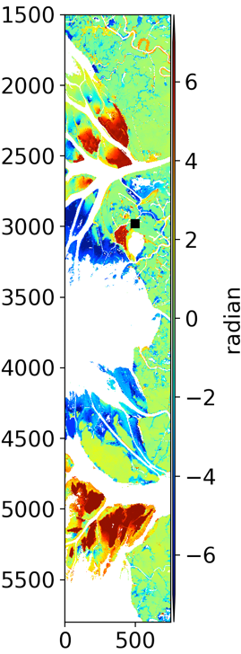
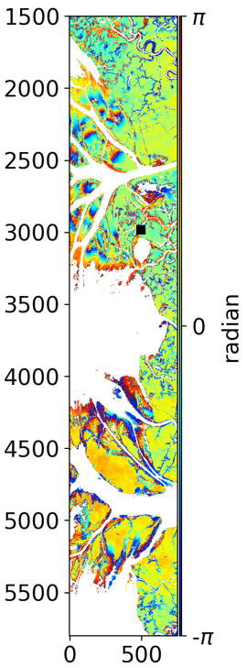
Unwrapped
Wrapped
Problem Description
8π
Phase Unwrapping:
InSAR measurements quantify surface changes in cycles of 2π. To be able to know the rate of change in metric units, we most quantify the number of cycles within an area on a interferogram. This process is know as phase-unwrapping.
6π
Unwrapped
Phase
4π
Wrapped
2π
0
Pixels
Phase jumps due to unwrapping errors
InSAR phase-unwrapping in coastal wetlands can be challenging:
Landscape is naturally separated into islands.
Tidal dynamics often drive large and rapid changes in water level.
Riverine flooding can overtop vegetation.
These phenomena cause fast temporal decorrelation and high phase gradients, resulting in incorrect numbers of phase cycles (2π) during phase unwrapping.

Slide 4
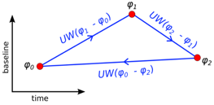
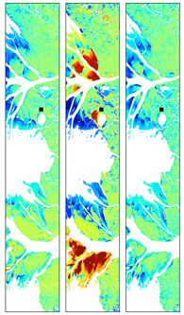
Methodology
Our correction algorithm consist of an iterative process of bridging between islands (spatial domain) and phase closure between interferograms (time domain). Bridging algorithm uses the spatial relationship of phase within pixels to correct for unwrapping errors. Phase closure looks into the phase relationship in time within the same pixel to find the correct phase cycle.
First we apply bridging corrections to the interferograms with shortest temporal baseline, which are expected to have the least amount of unwrapping errors.
We increment the interferometric network one degree (2 connections between interferograms) and apply guided phase closure correction to the newly added interferograms. We guide the correction using a mask from the triplet closure.
Guided bridging corrections are applied to the same interferograms to correct for possible error islands left. The integer triplet closure mask is again used as guide.
Repeat steps 2 and 3 for subsequent interferometric network increments.
(Hussain et al., 2016)
Triplet closure phase (CP) is expected to be:
CP= ﻿UW(φ1 − φ 0) + UW(φ 2 − φ 1) + UW(φ 0 − φ2) = 0
Interferogram to be corrected
A random phase sampling within each component is performed to estimate the phase offsets.
3 bridges are formed with the nearest components. The bridge with lower coherence STD is used as reliable.
Interferogram triplet
Triplet integer ambiguity
Phase-closure correction result
Triplet integer ambiguity
Bridge connections with nearby components
Original unwrapped phase
Corrected unwrapped phase

Slide 5
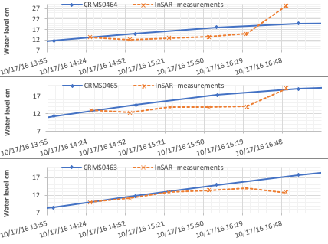
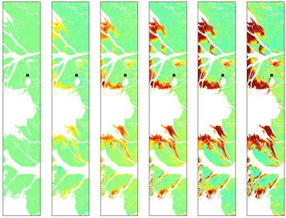
Results
Time-series analysis of the corrected interferometric stack is performed to retrieve the dynamics of water-level change throughout the wetlands.
Results show relative water-level increase higher than 25cm during high tide. The largest rate of change can be observed in red/orange colors in the edges of the deltas (figure to the right).
Time
Pixel values with temporal coherence close to 1 are unwrapped correctly whereas values near zero correspond to poorly unwrapped data.
We use Temporal Coherence (Pepe and Lanari, 2006) of the time series to evaluate the performance of the correction algorithm.
Comparison with some tide-gauge stations in the area show good agreement between InSAR and tide-gage measurements.
Before
After
Future work will include further and more robust comparison with tide-gauge stations as well as adjustments to improve corrections for very small narrow areas with unwrapping error.
Unwrapping Corrections

Slide 6
Publications and Acknowledgements
This project is funded by JPL under contract with NASA.
The NASA Delta-X project is funded by the Science Mission Directorate’s Earth Science Division through the Earth Venture Suborbital-3 Program NNH17ZDA001N-EVS3.
Manuscript in process.

