Slide 1
Impact of acquisition conditions on SAR backscatter-modeled forest biomass estimation
2020 Postdoc Research Day Presentation Conference
Unmesh Khati
Organization: 334H
Advisor: Marco Lavalle (334H)
Postdoc Program: JPL

Slide 2
Introduction
Accurate estimation of forest above-ground biomass (AGB) is essential for modeling global carbon cycle
Synthetic Aperture Radar (SAR) data has been extensively used for forest AGB estimation
However, single-epoch estimates of forest parameters are susceptible to uncertainties due to variations in imaging and environmental conditions
Research in SAR remote sensing is progressing towards modeling and time-series for algorithm development
Forthcoming NASA-ISRO SAR (NISAR) mission is focused on generating time-series data-sets
3-year mission, L-band radar
Global mapping every 12 days with dual-polarimetric mode
Time-series data-sets help:
Detect surface changes (e.g. forest disturbances)
Estimate model parameters more robustly (e.g. above-ground biomass)
Correct for single-image artifacts and distortions (e.g. atmospheric effects)

Slide 3
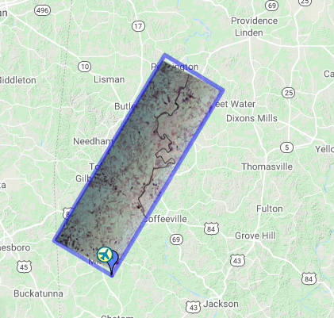
Problem Description
SAR backscatter-AGB relation is affected by changes in environmental conditions (soil moisture and precipitation)
It is essential to understand the impact of these changes on AGB estimation
The 2019 AM-PM UAVSAR airborne campaign collected multi-temporal SAR acquisitions in support of the upcoming NISAR mission
This study utilizes this multi-temporal data along with intensive field measurements to:
Assess the impact of variations in soil moisture and precipitation conditions on forest AGB estimation.
Advantage of multi-temporal acquisitions to improve AGB estimates
Lenoir Landing, AL

Slide 4
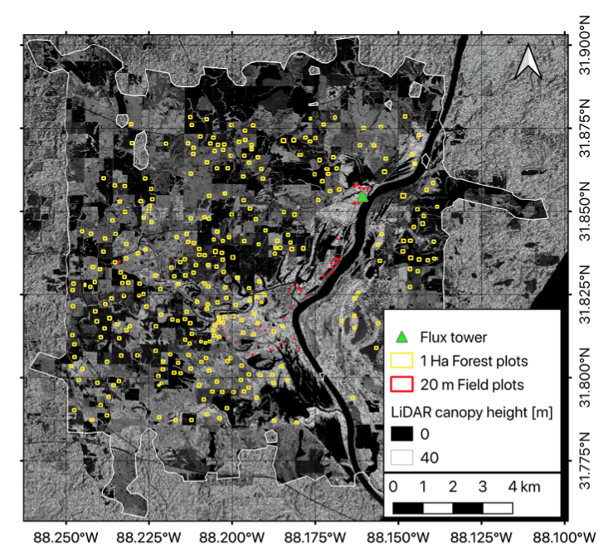
Study site – Lenoir Landing, AL
Temperate deciduous forest
AGB between 0.05 Mg/ha to 373 Mg/ha
20m mean elevation
NEON site
41 plots 20mx20m (2015-2018)
10 plots 40mx40m (end 2019)
Permanent flux tower with soil moisture sensors
1m lidar-derived AGB map
311 random square polygons manually selected of 1 ha
0 Mg/ha to 335 Mg/ha with a mean of 125 Mg/ha
Unmesh Khati, Marco Lavalle, Gustavo H.X. Shiroma, Victoria Meyer, and Bruce Chapman, “Assessment of forest biomass estimation from dry and wet SAR acquisitions collected during the 2019 UAVSAR AM-PM campaign in Southeastern United States”, in review.

Slide 5
SAR Dataset and workflow – Lenoir Landing
Download 7 full-resolution single-look-complex (SLC) products
Coregister SLC images in a stack with same geometry using isce3
Average Radiometric Terrain Corrected backscatter within each 1-ha polygon using isce3 *
Fit WCM model and analyze multi-temporal data versus moisture and precipitation
*G. H. X. Shiroma, P. Agram, H. Fattahi, R. Burns, M. Lavalle, and S. Buckley, “An efficient area-based algorithm for SAR radiometric terrain correction and MAP projection,” in Geoscience and Remote Sensing Symposium(IGARSS), 2020 IEEE International. IEEE, July 2020.

Slide 6
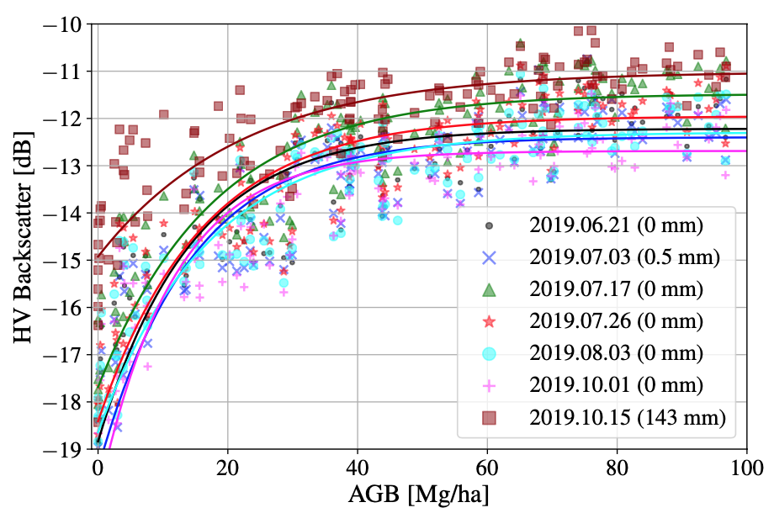
Fitting the backscatter-biomass model
Radiometric Terrain Corrected backscatter versus biomass model with 3 parameters to be estimated
Chi-squared minimization using 137 1-ha plots with AGB up to 100 Mg/ha.
Precipitation reduces the dynamic range
backscatter
biomass
model coefficients

Slide 7
Effects of moisture and precipitation on WCM model parameters
backscatter
biomass
Parameters ‘a’ and ‘b’ are positively correlated while ‘c’ is negatively correlated
Ground component of backscatter (‘a’) shows 5 dB change between wet and dry conditions
model coefficients

Slide 8
AGB estimation performance
30 iterations on random training (60%) and validation (40%) sets. Does not include field biomass uncertainty
Individual acquisitions show variation in AGB estimation performance (dotted line, fig A)
AGB estimation improves by up to 20% using multi-temporal weighted average (WA)
Weighted by soil moisture measured at each acquisition (WA-SM)
Weighted by dynamic range of backscatter for each acquisition (WA-DR)

Slide 9
Multi-temporal analysis
Model calibrated on a dataset and validated on all other datasets
MT = Multi-temporal averaging of backscatter
MT-24 (no precipitation 24h before the acquisition) has the optimal trade-off between AGB estimation accuracy (RMSE = 17.8 Mg/ha) and plots with valid AGB solutions (72%).

Slide 10
Summary and Future work
Precipitation affects AGB retrieval accuracy with up to 20% increase in AGB estimation error
WCM model parameters absorb moisture variations and are correlated with in-situ measured soil moisture
Models calibrated and validated using acquisitions with significantly different meteorological conditions provide erroneous AGB estimates
Averaging backscatter over the time-series is beneficial for absorbing moisture fluctuations. Better time-series strategies can be devised
Scope for improvement:
The analysis did not consider all sources of error in AGB estimation and its propagation
The environmental conditions (soil moisture, precipitation) are from point measurements – can deviate locally
SAR time-series acquired does not cover a seasonal changes (leaf on/off)
Inherent difference in viewing geometry of lidar and SAR will impact accuracy of lidar AGB-SAR backscatter relation

Slide 11
Publications and Acknowledgements
Conference proceeding:
Marco Lavalle, Unmesh Khati, Gustavo H.X. Shiroma, Bruce Chapman, “Assessment of PolSAR and InSAR time-series for above-ground biomass estimation” in 2020 IEEE International Geoscience and Remote Sensing Symposium (IGARSS 2020), 28 September - 02 October 2020 (Virtual)
Journal article:
Unmesh Khati, Marco Lavalle, Gustavo H.X. Shiroma, Victoria Meyer, and Bruce Chapman, “Assessment of Forest Biomass Estimation from Dry and Wet SAR Acquisitions Collected during the 2019 UAVSAR AM-PM Campaign in Southeastern United States”, Remote Sens. 2020, 12(20), 3397; https://doi.org/10.3390/rs12203397
Acknowledgments: I would like to thank the UAVSAR and NISAR teams for designing the AM-PM Campaign and making the single-look complex SAR data available. The author thanks the NISAR Project and Algorithm Definition Team (ADT) for providing the InSAR Scientific Computing Environment (ISCE3) software that was used for co-registering and radiometric-terrain correcting the UAVSAR SLC stack. A prototype of this work was developed and tested on the pilot version of the joint NASA-ESA Multi-Mission Algorithm and Analysis Platform (MAAP). The author thanks the National Ecological Observatory Network (NEON) Program for the field, lidar and meteorological data acquired over the study site.

Slide 12
This presentation discusses our work on exploring the use of the upcoming NISAR mission for ecosystem mapping and monitoring. Especially of importance is to estimate the global forest above-ground biomass (AGB) using synthetic aperture radar (SAR) data that would be available globally every 12 days. Efforts are made to understand the impact of changes in acquisition conditions (precipitation and soil moisture changes) that would impact the forest AGB estimated using models applied to SAR backscatter. The presentation is the same that was cleared by JPL URS.

