Slide 1
Monitoring Vegetation Dynamics of Coastal Deltas
Alexandra Christensen
Organization: 334F Suborbital Radar Science and Engineering
Advisor: Marc Simard
Postdoc Program: NPP – year 1
2020 Postdoc Research Day Presentation Conference

Slide 2
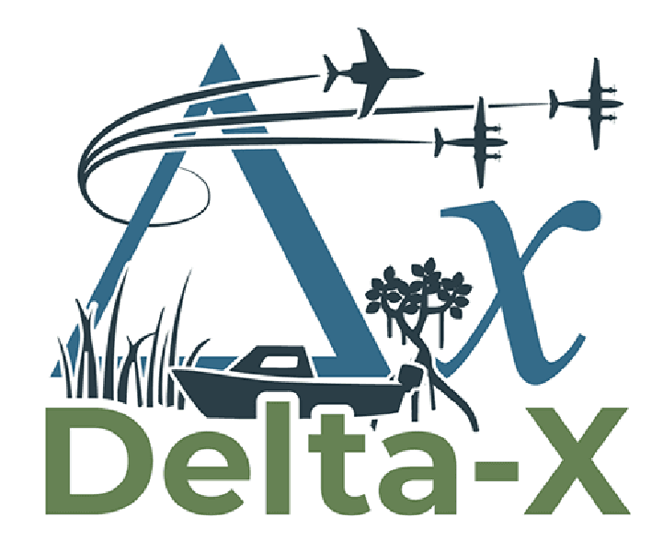
Introduction
Delta-X Mission:
Assess impacts of climate change on delta land building and land loss to better understand resilience of coastal ecosystems
Airborne remote sensing and field measurements of surface water, vegetation, and soil processes in the Mississippi River Delta
The NASA Delta-X project is funded by the Science Mission Directorate’s Earth Science Division through the Earth Venture Suborbital-3 Program NNH17ZDA001N-EVS3
Presentation Objectives:
Wetland land cover classification using plant phenology
Monitor seasonal and interannual changes in vegetation and plant recovery from disturbances
https://deltax.jpl.nasa.gov/
Wax Lake Delta

Slide 3
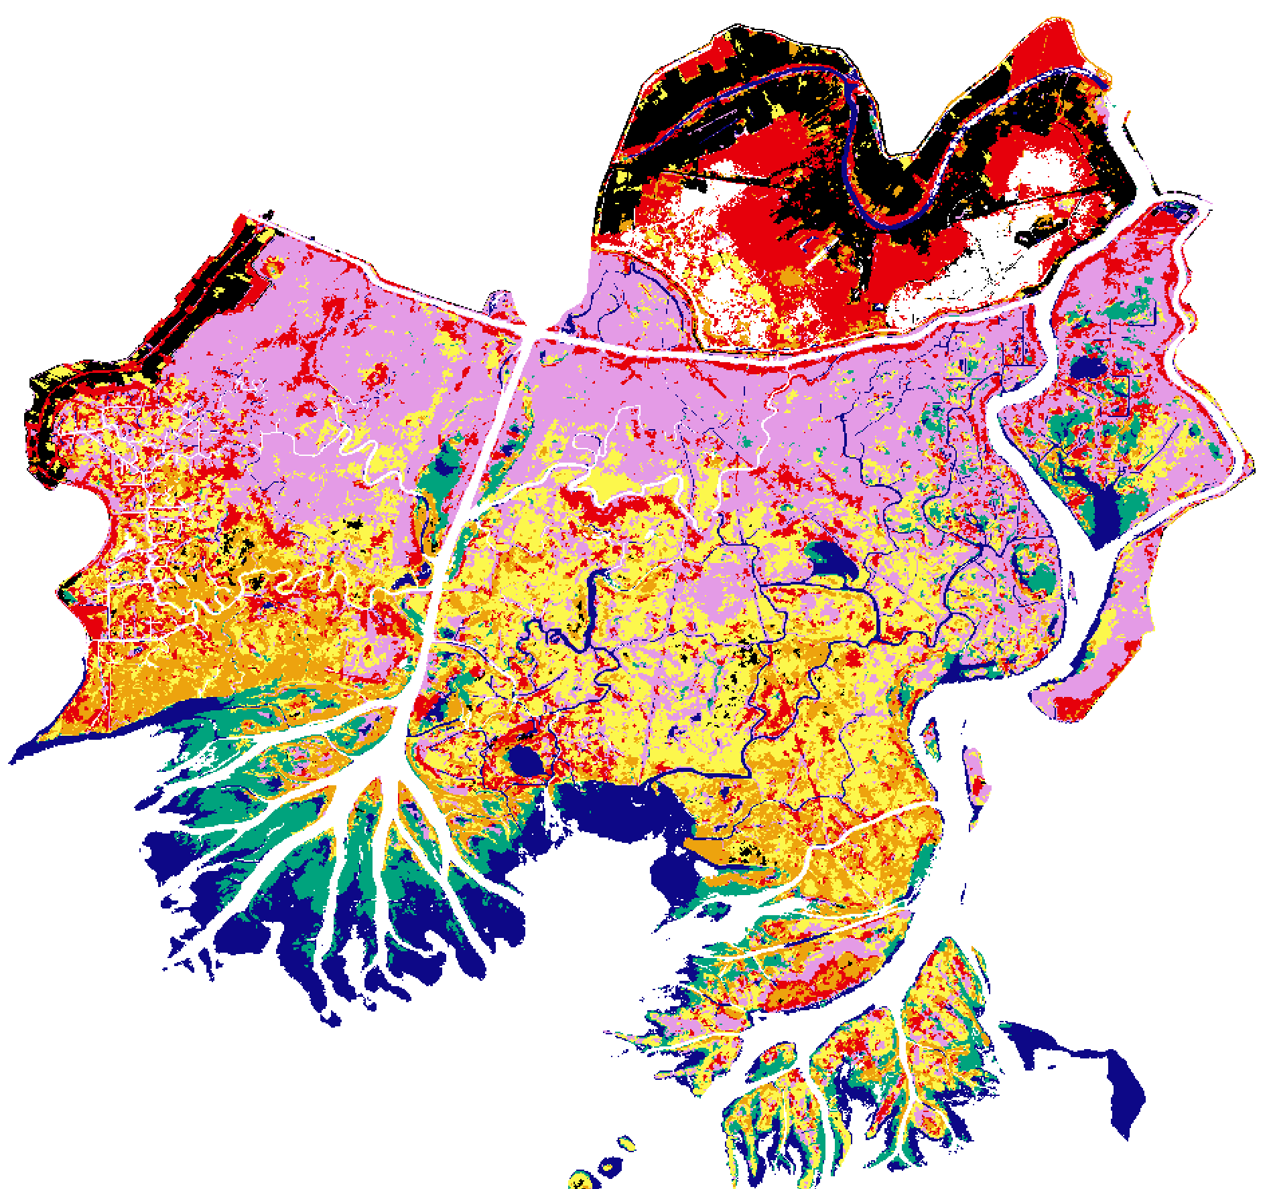
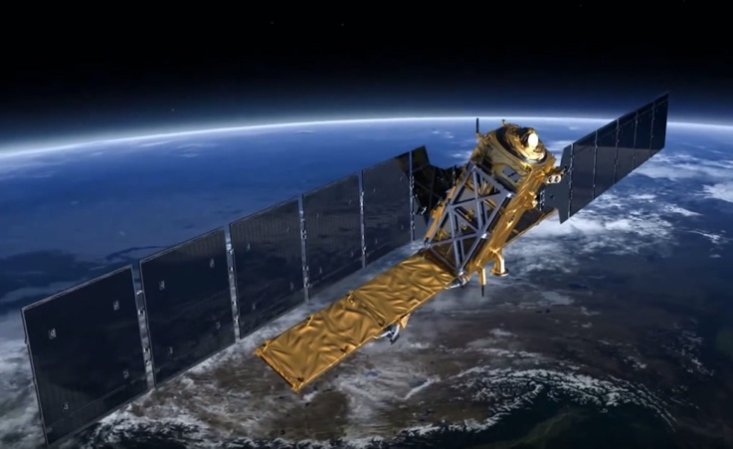
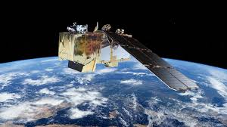
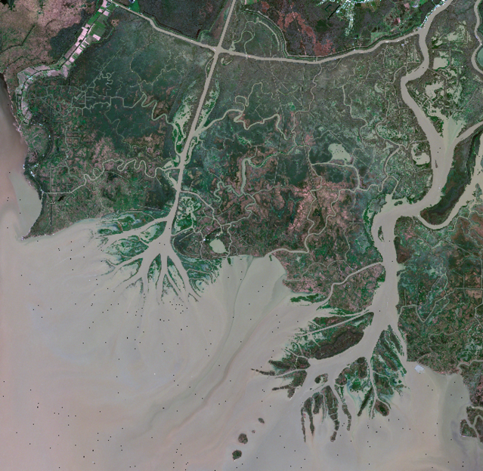
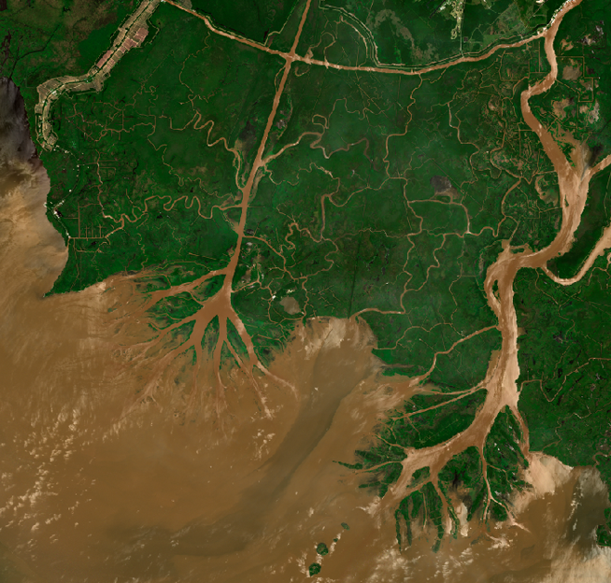
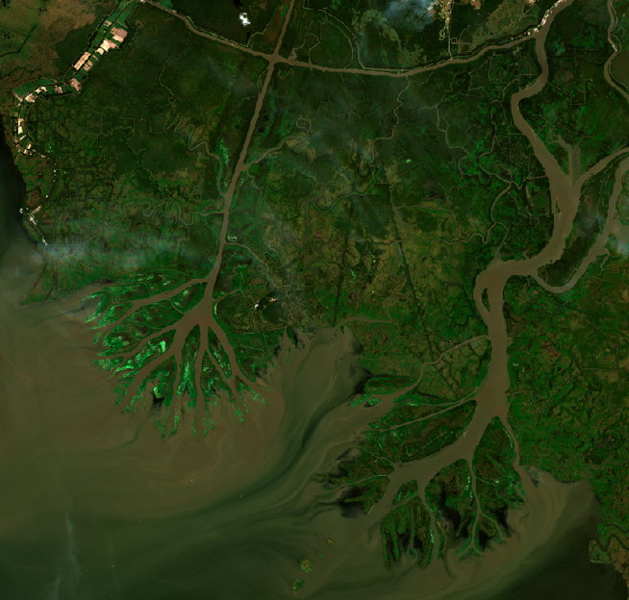
Methods: Vegetation Classification
Sentinel-1 and Sentinel-2
Unsupervised classification using plant phenology (January, May, October 2016)
Spatial distribution of vegetation classes controlled by inundation frequency and duration
01/04/16 05/09/16 10/14/16
Forest (Salix, Myrica)
Forest (Salix, Myrica)
Broad leaf, mixed herbaceous marsh (Colocasia, Polygonum)
Grass, herbaceous marsh (Leersia, Panicum, etc)
Floating leaf, Submerged aquatic vegetation (Nelumbo, Potamogeton)
Water, mudflat, some submerged aquatic vegetation
Urban

Slide 4
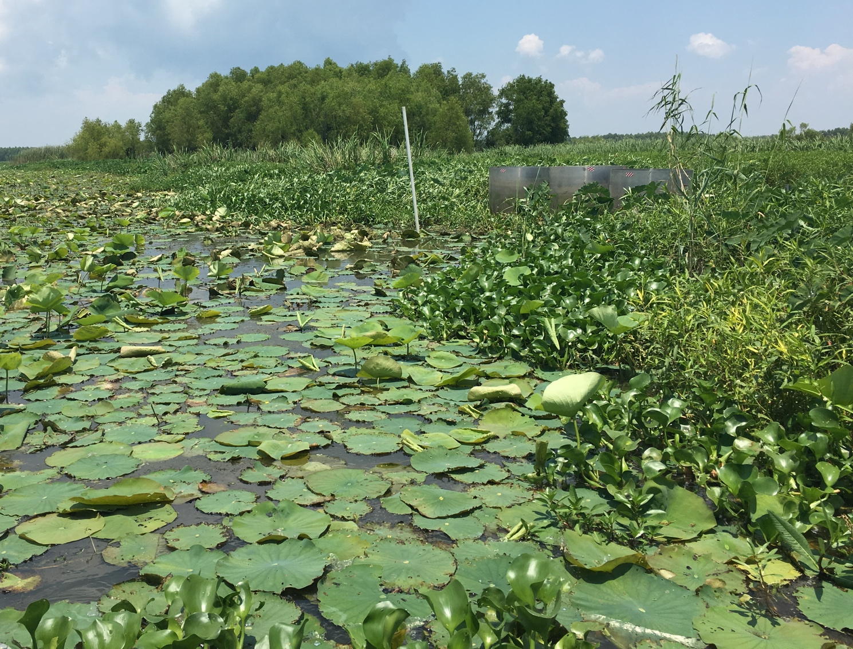
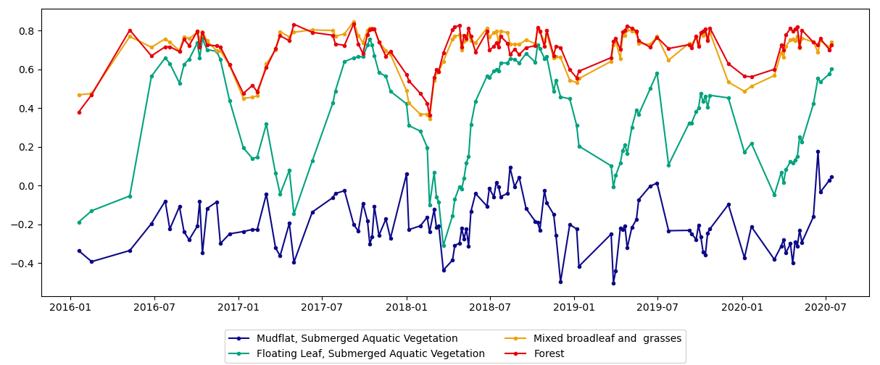
Results: Seasonal Trends
Forest
Normalized Difference Vegetation Index (NDVI)
Emergence of lower elevation species is dependent on timing of river flood pulse and warming spring temperatures
Impact of Hurricane Barry in July 2019
Mixed broadleaf and grass
Floating Leaf, Submerged Aquatic Vegetation

Slide 5
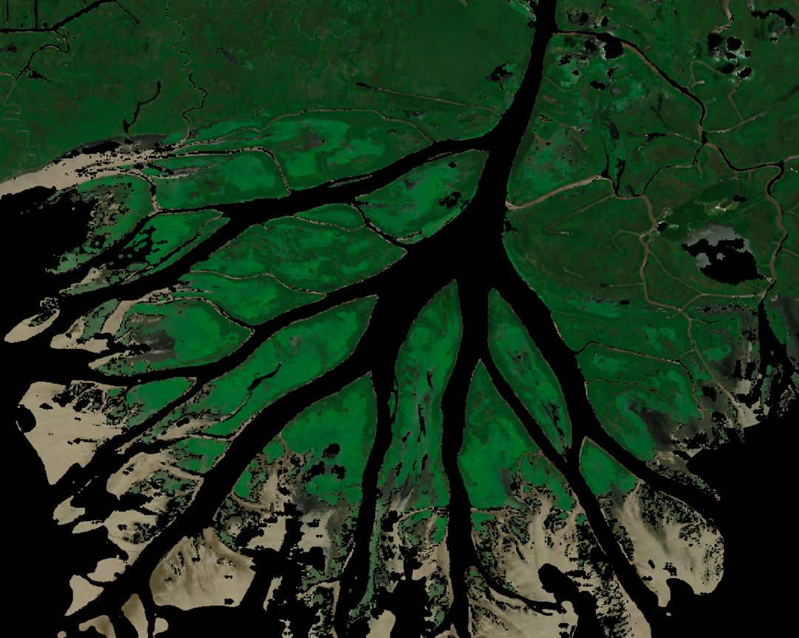
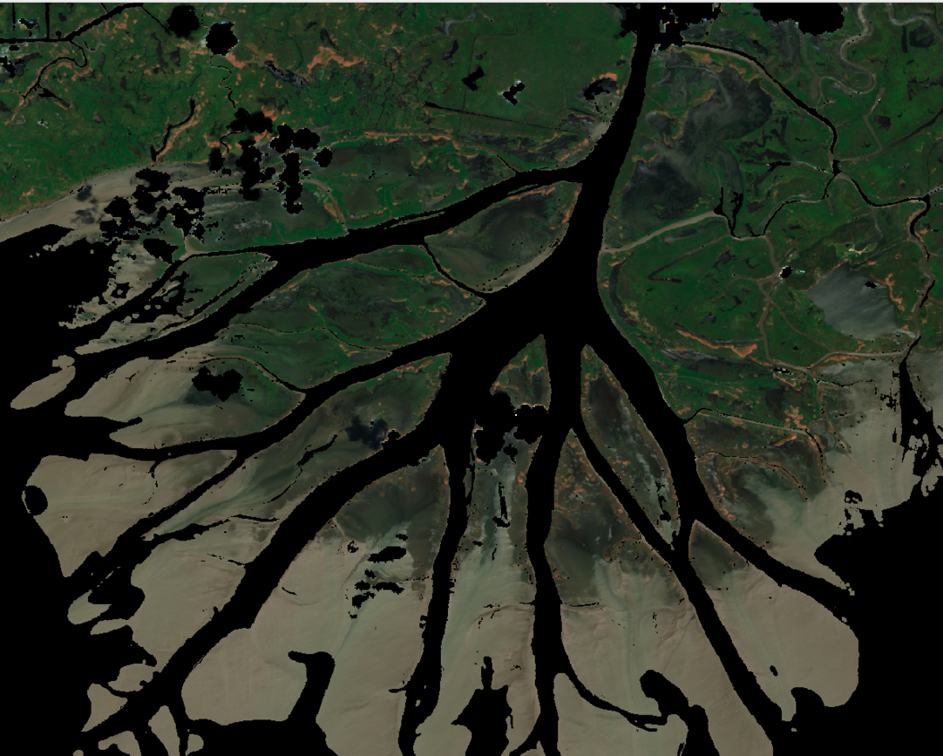
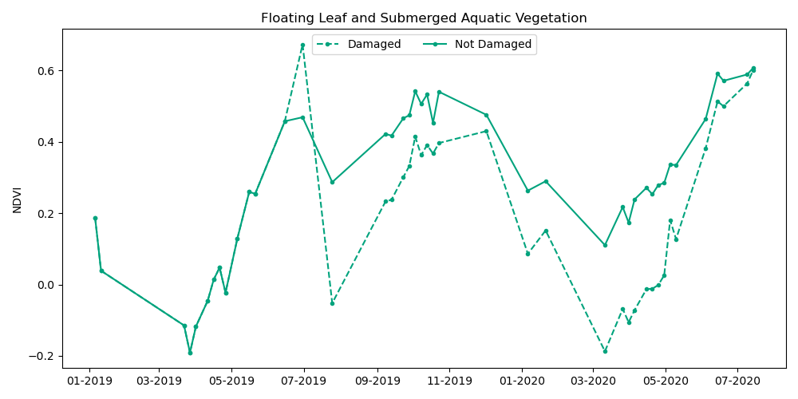
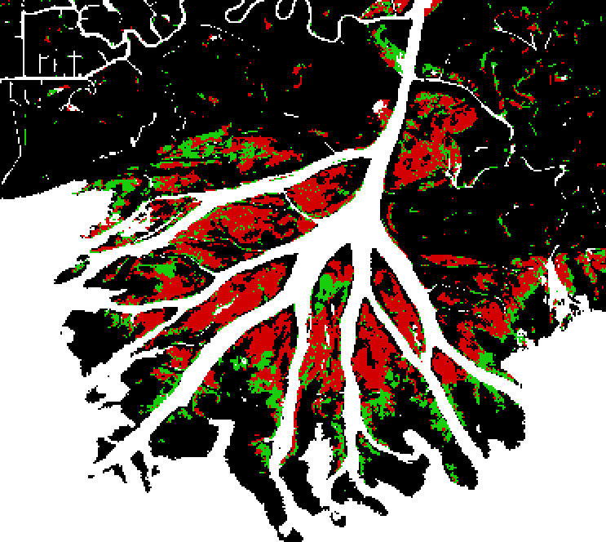
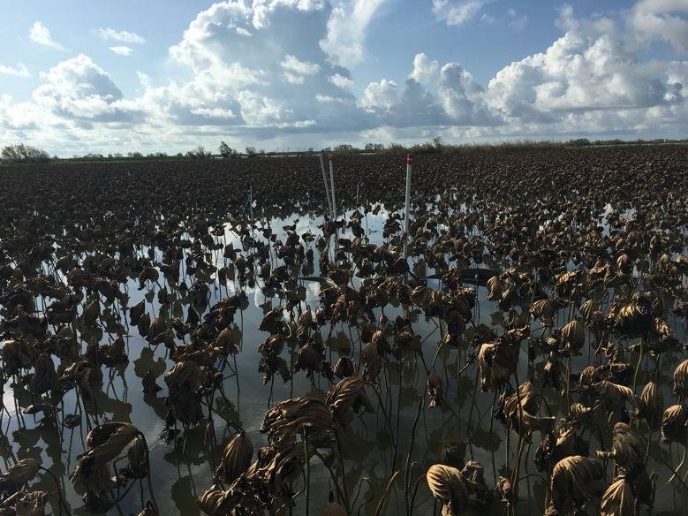
Results: Vegetation Recovery
Pre
Post
Hurricane Barry: July 15, 2019
Significant damage to lower elevation zones
Floating Leaf and Submerged Aquatic Vegetation
Damaged in Hurricane Barry
Not Damaged in Hurricane Barry

