Slide 1

GRACE-FO and ECOSTRESS synergies quantify the human impact on the water cycle
Madeleine Pascolini-Campbell
Joshua B. Fisher
John T. Reager
2020 Postdoc Research Day Presentation Conference
Section: 329
Advisor: John T. Reager
Postdoc program: NPP, JPL Postdoc

Slide 2
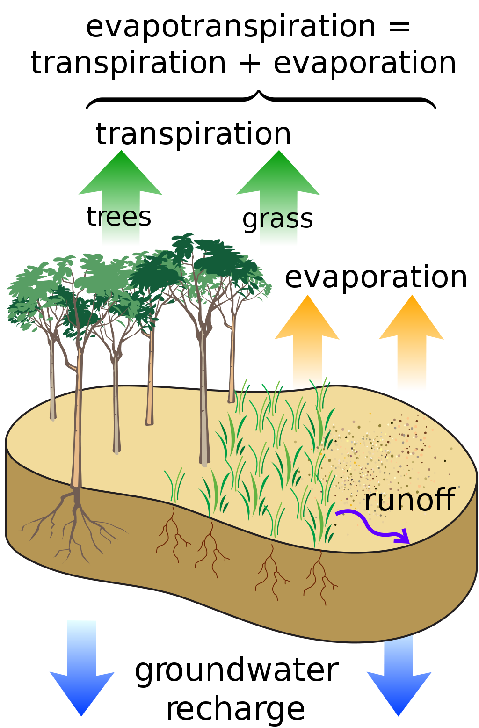
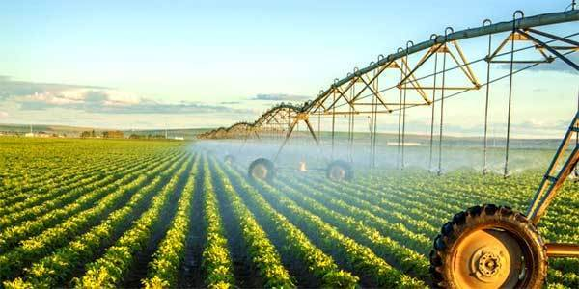
Introduction
Human activity influences evapotranspiration
Evapotranspiration (ET) is the second largest flux in the water cycle.
Irrigation is the largest user of fresh water globally (80%) (Gordon et al., 2005)
Irrigation locally increases ET, with implications for the local energy balance and temperature (Douglas et al., 2006; 2009).
Quantifying human impact on water cycle is critical for water resource management, particularly in arid regions.
Source: www.agfax.com

Slide 3
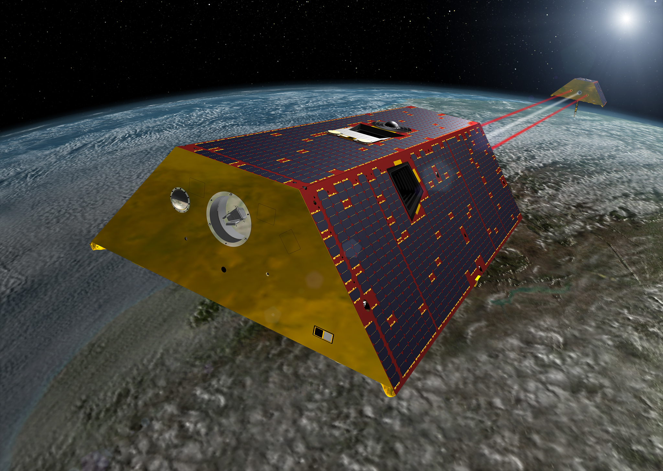
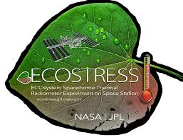
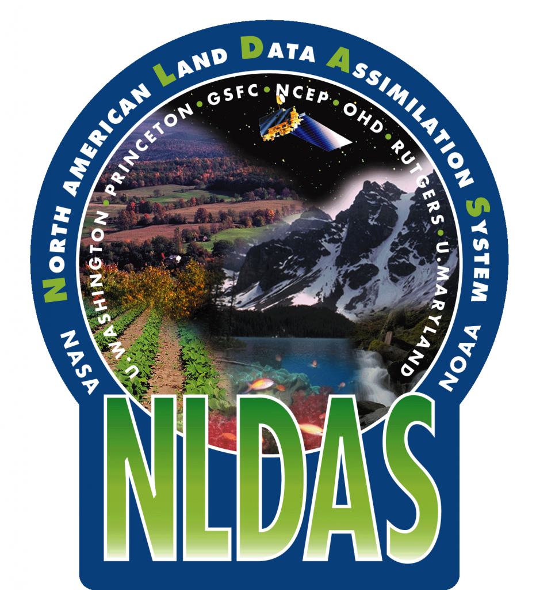
Problem Description
Observed ET, Modeled ET
No existing framework to directly quantify the human impact on ET
GRACE has been shown to diverge from state-of-the-art land hydrology assimilation models in semi-arid/arid areas—why?
We hypothesize that these models miss fine-resolution irrigation that impact large-scale water budgets, which GRACE sees, but this has not been confirmed.
AIM:
Can we quantify the impact of humans on the water cycle?
Source: ecostress.jpl.nasa.gov
Source: ldas.gsfc.nasa.gov
Source: gracefo.jpl.nasa.gov

Slide 4
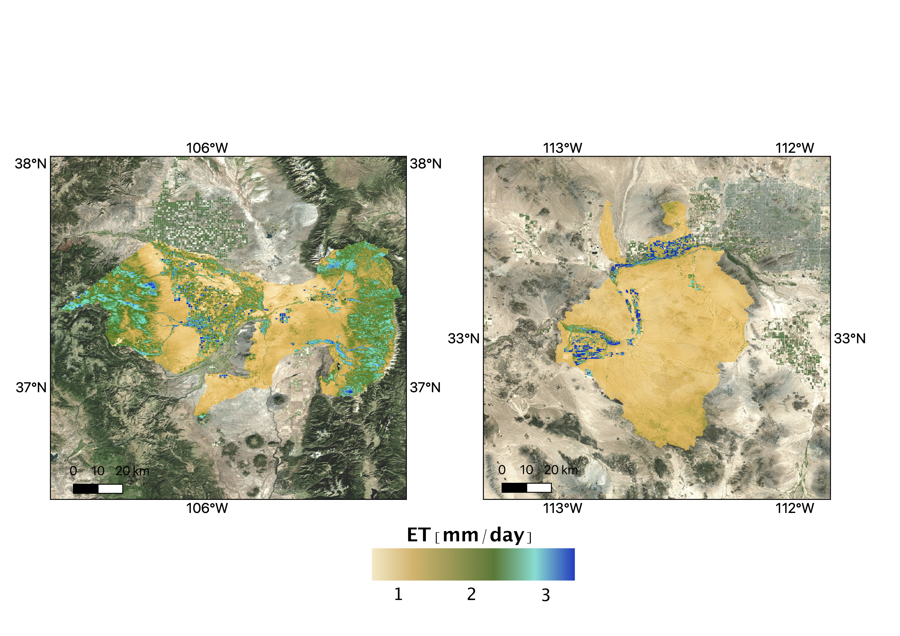
Methodology
Study region & data sets
We focus on IRRIGATED BASINS in an ARID REGION of the North American west and southwest
OBSERVED ET
GRACE-FO change total water storage (dS/dt) to close water balance (ET = P – Q - dS/dt)
High spatial resolution ET from ECOSTRESS (70m), MODIS-PTJPL (1km)
LAND SURFACE MODEL ET
NLDAS-2
Find the %-Area irrigated in each basin

Slide 5
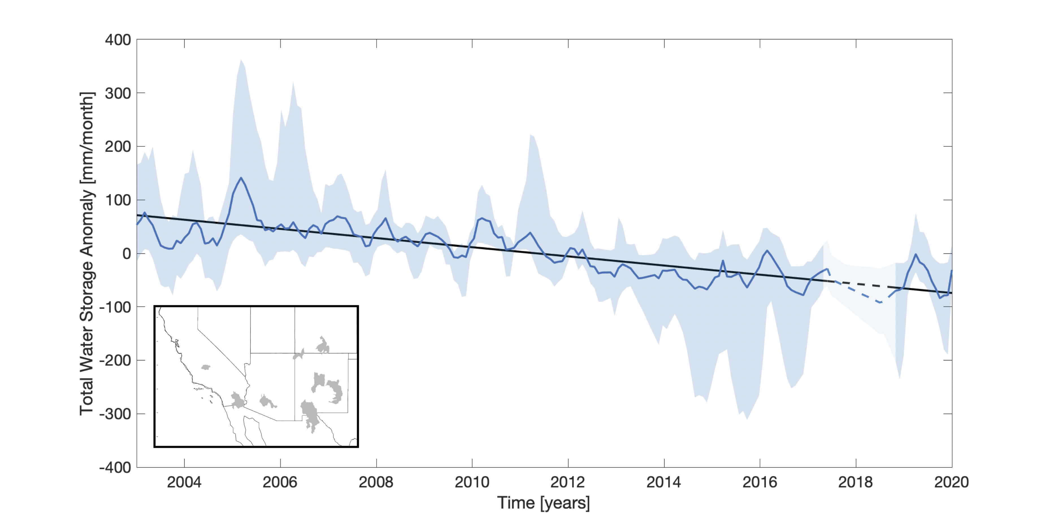
Results
Total water storage anomaly (GRACE and GRACE-FO)
Negative trend in total water storage anomaly over 2003 -2019 (GRACE, GRACE-FO)

Slide 6
Results
%-Area irrigated explains bias between OBSERVED and MODELED ET
Basins with the most irrigation have larger bias between observed and modeled ET
Difference is greatest during irrigation months (JJAS)
Irrigation accounts for 34% of ET in JJAS

Slide 7
Summary
Our results provide a new framework to directly quantify human impacts on the water cycle via remote sensing
GRACE/GRACE-FO identify human activity as they measure all changes in the water column, including groundwater extraction and irrigation
ECOSTRESS captures the fine-scale water use at the scale of individual farms
%-Area irrigated explains the bias between observations and models
Future research will extend these results to other climates and regions
+
GRACE-FO

