Slide 1
Full Covariance Information in GRACE-FO Processing
Matthias Ellmer
Organization: 392R
Advisor: David Wiese (392R)
Postdoc Program: JPL

Slide 2
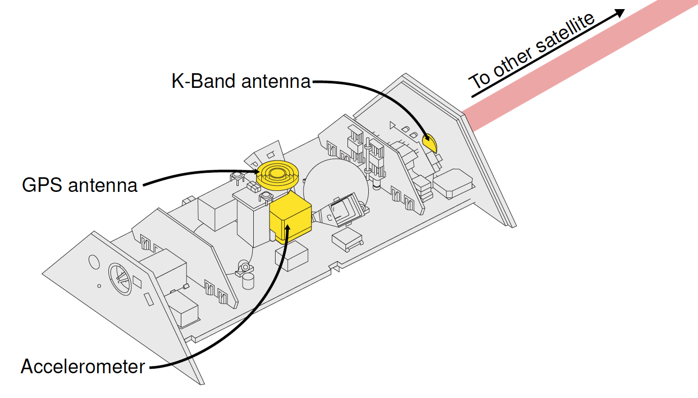
Introduction
GRACE data is degraded by complex noise.
We are switching from a white noise model to a full spectrum estimate.
This improves solutions in two major ways:
The signal to noise ratio in recovered gravity fields is higher.
The formal errors associated with these fields are more realistic.
Notes:
Processing GRACE and GRACE-FO satellite tracking data to produce gravity field maps works better when you understand the noise structure in the observations.
So far, JPL has processed these data under the simplifying assumption of white noise. We applied a method of noise spectrum estimation to real observation data to recover true spectra, and used these in the estimation procedure for gravity field maps.
We could show that this improves on JPL’s previously released results in two major ways: The signal to noise ratio in recovered gravity fields is higher. The formal errors associated with these fields are more realistic.
These data find use in applications in observations of large scale mass transport signals such as sea level rise, droughts and floods, and glacier and ice shield mass loss and gain.
The problem of processing these data appropriately is an interesting one, as it combines these important applications in climate science with complex approaches in adjustment theory and their implementation in scalable software. This allows me to have my feet firmly planted in both worlds, combining my scientific curiosity with enjoyment in building complex and performant software systems.

Slide 3
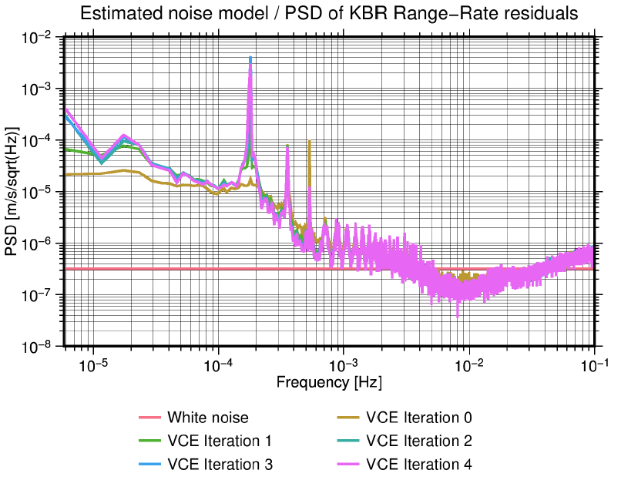
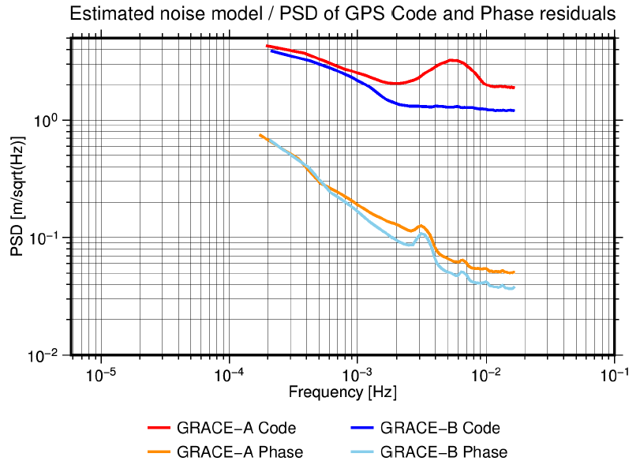
Methodology
We employed Variance Component Estimation (VCE) to estimate stochastic models for K-Band range-rate and GPS observations.
Here, each ${\hat{σ_{j}}}^{2}$ represents the power at a specific frequency, that is estimated for each iteration.
This is the first application to GPS Pseudorange Code and Phase observations.
First implementation within GRACE-FO Science Data System Team.

Slide 4
Results
We set out to make better gravity field maps.
The new maps show less noise.
This allows scientists to recover more geophysical signal.
We want to verify this with longer time series.
We want to test this with different parametrizations.

