Slide 1

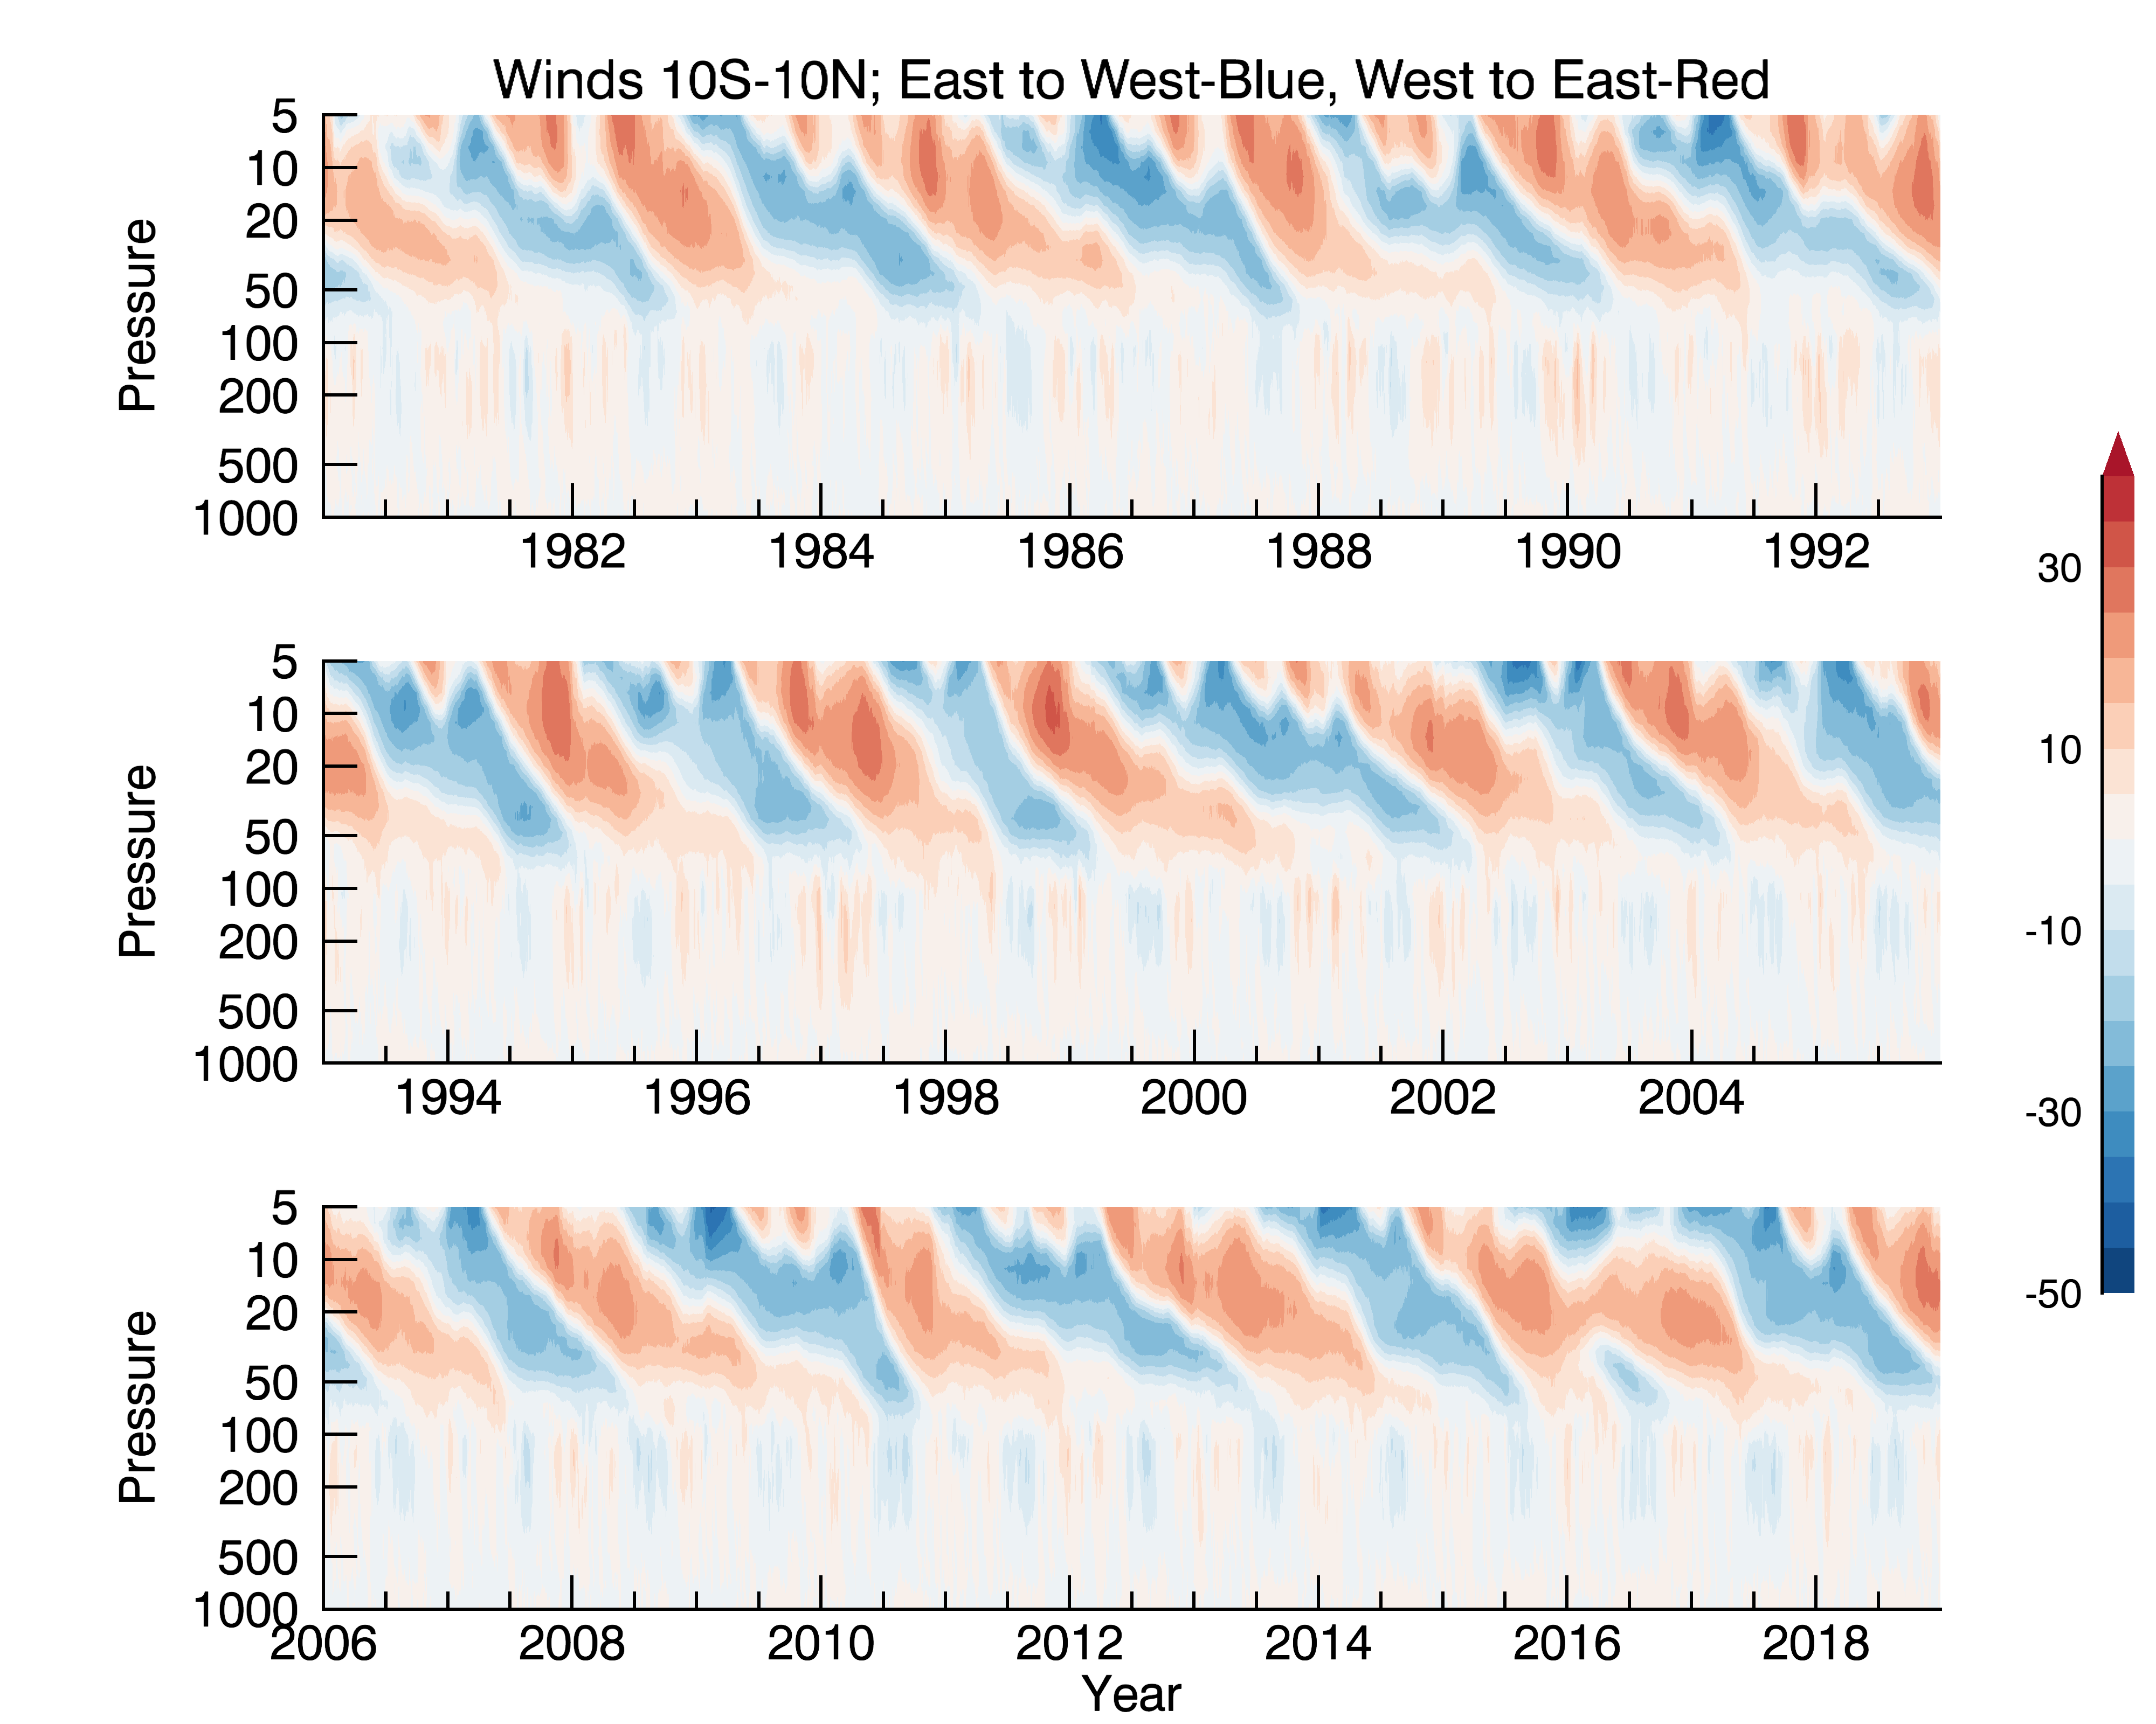
Influence of the Madden-Julian Oscillation on Stratospheric Equatorial Waves during different Quasi-Biennial Oscillation states
Jennifer Gahtan
Organization: 329E
Advisor: Baijun Tian (329E)
Postdoc Program: NPP
© 2020 California Institute of Technology. Government sponsorship acknowledged.

Slide 2
Interactions between 3 different types of tropical variability
QBO
Quasi-Biennial Oscillation- QBO
Alternating descending easterlies and westerlies in the tropical stratosphere with average period of 28 months
Driven by upward transfers of momentum from equatorial and gravity waves
Stratospheric equatorial waves:
Trapped waves that occur due to gravity, the pressure gradient, and Coriolis, with timescales ranging from ~2-30 days
Madden-Julian Oscillation (MJO)
Eastward moving large-scale convection in the tropics coupled to global winds on ~3 week to 3 month timescales

Slide 3
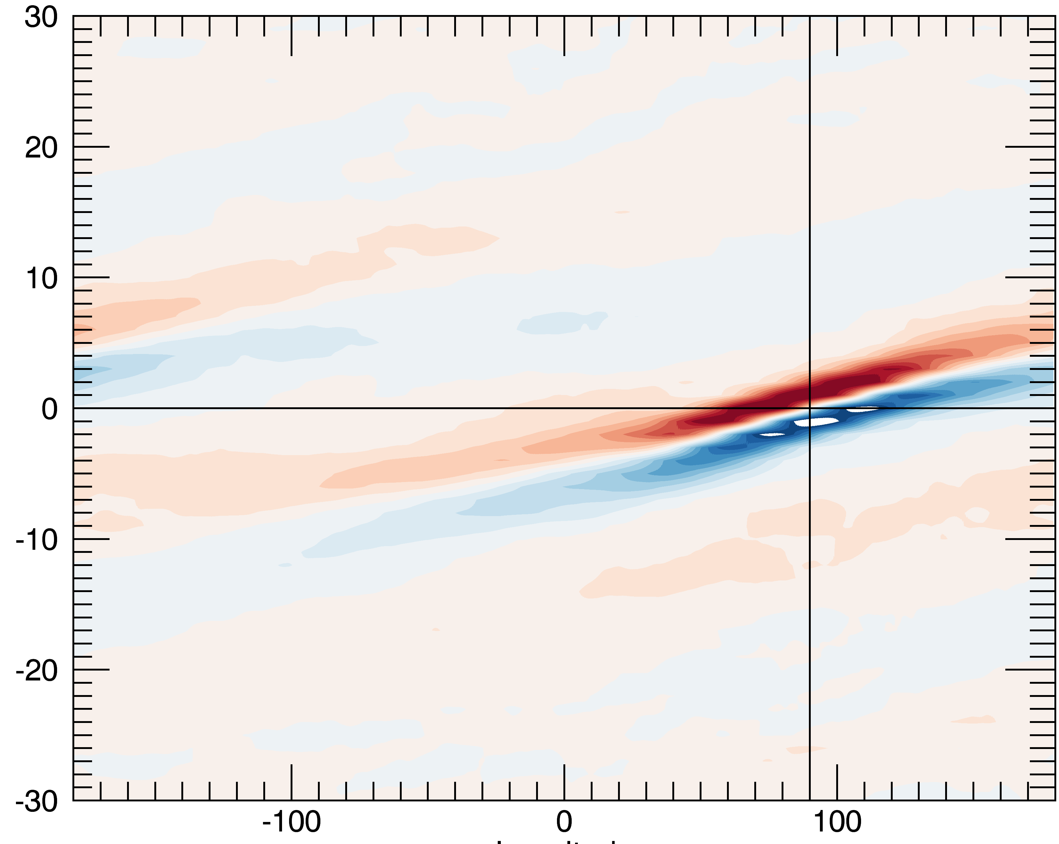
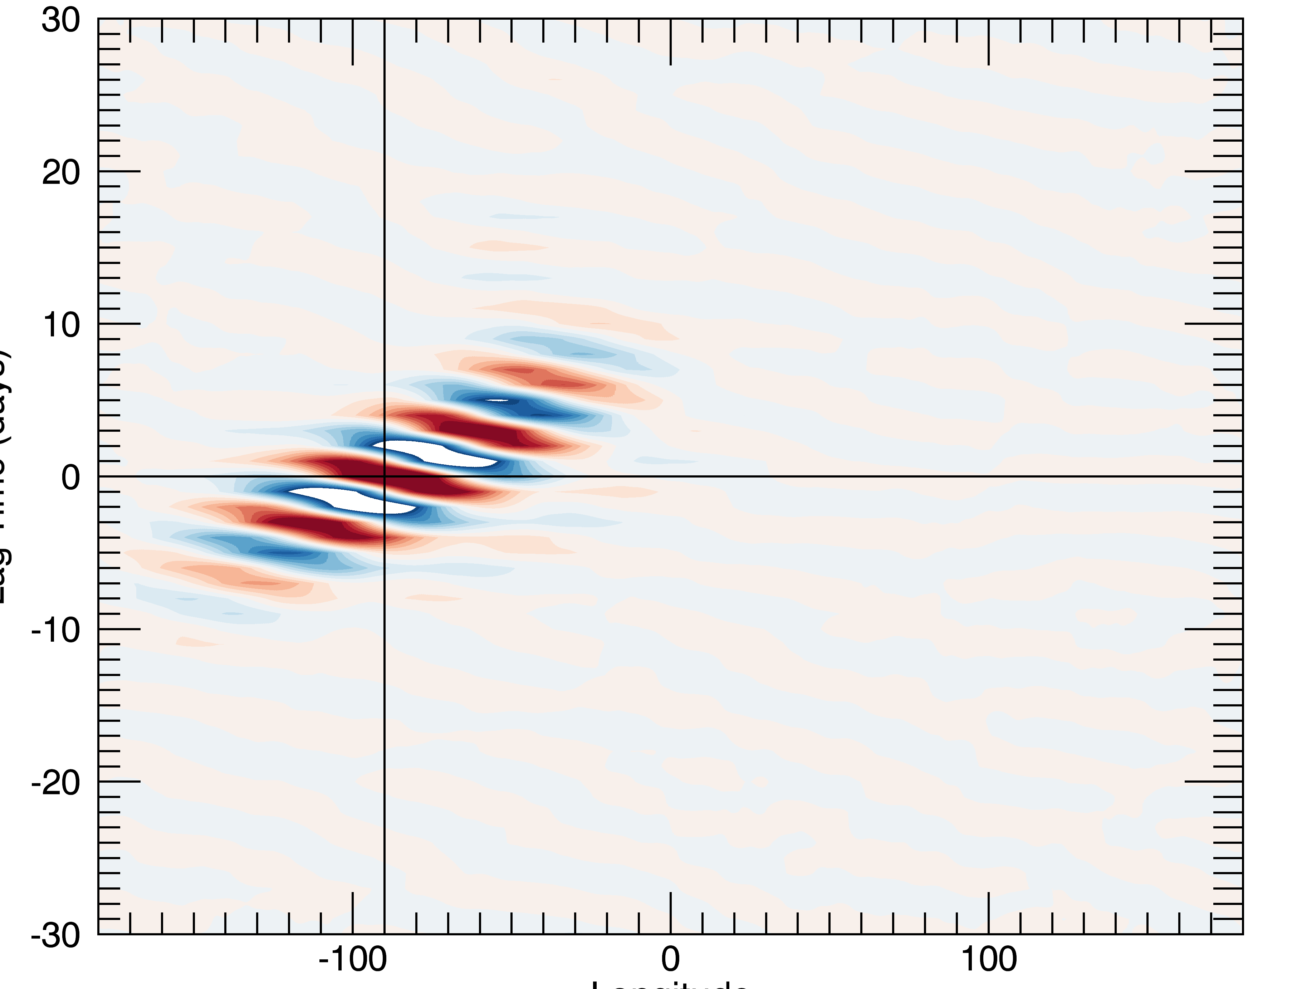
Interactions between 3 different types of tropical variability
Kelvin wave - U
Quasi-Biennial Oscillation- QBO
Alternating descending easterlies and westerlies in the tropical stratosphere with average period of 28 months
Driven by upward transfers of momentum from equatorial and gravity waves
Stratospheric equatorial waves:
Trapped waves that occur due to gravity, the pressure gradient, and Coriolis, with timescales ranging from ~2-30 days
Madden-Julian Oscillation (MJO)
Eastward moving large-scale convection in the tropics coupled to global winds on ~3 week to 3 month timescales
Lag Time (days)
Mixed Rossby-gravity wave - V
Lag Time (days)
Longitude

Slide 4
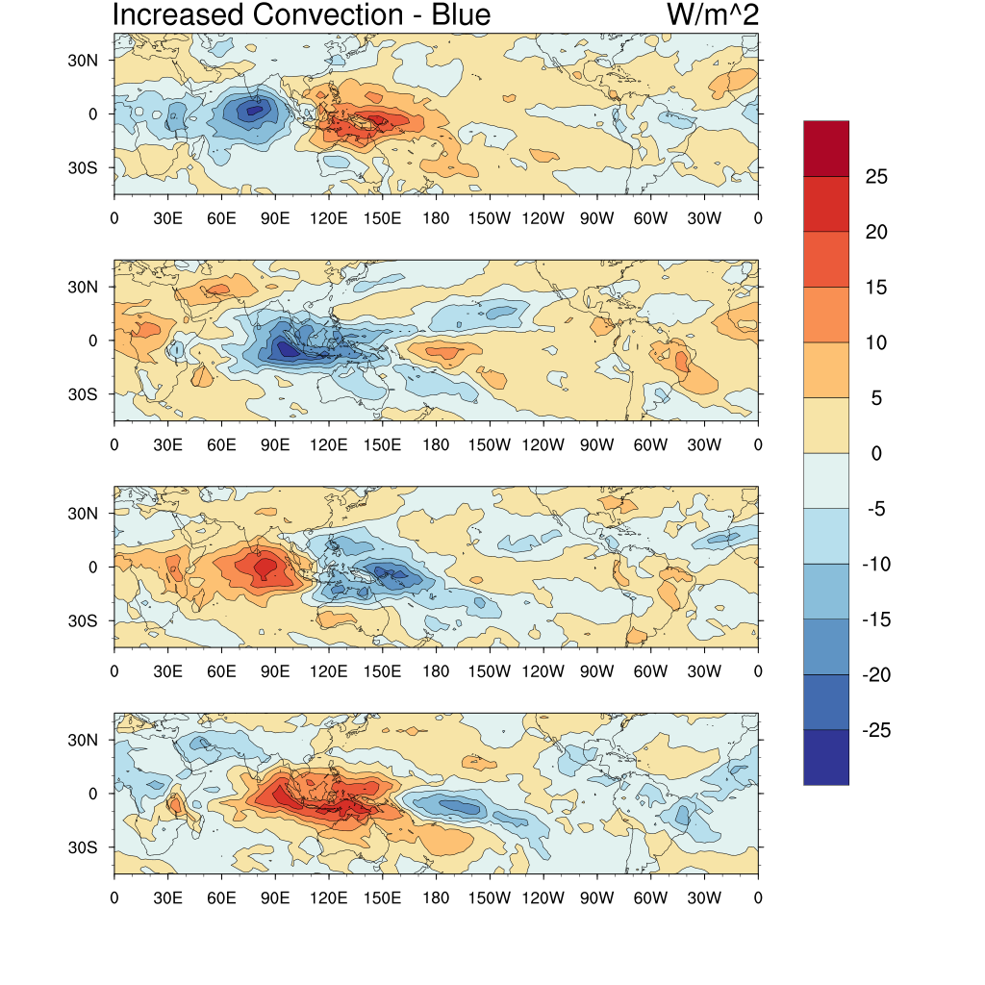
Interactions between 3 different types of tropical variability
MJO
Quasi-Biennial Oscillation- QBO
Alternating descending easterlies and westerlies in the tropical stratosphere with average period of 28 months
Driven by upward transfers of momentum from equatorial and gravity waves
Stratospheric equatorial waves:
Trapped waves that occur due to gravity, the pressure gradient, and Coriolis, with timescales ranging from ~2-30 days
Madden-Julian Oscillation (MJO)
Eastward moving large-scale convection in the tropics coupled to global winds on ~3 week to 3 month timescales
~10-15 day timesteps

Slide 5
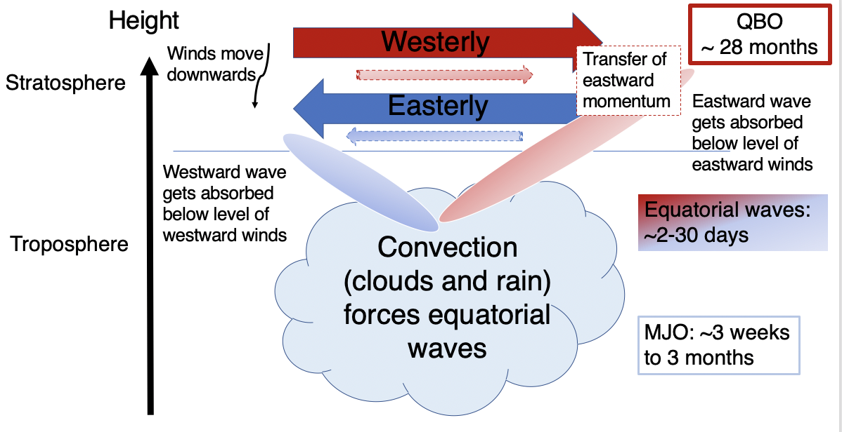
Hypothesis: MJO convection can force equatorial waves and MJO upper tropospheric winds can influence wave propagation, leading to differences in stratospheric equatorial waves which are then modulated by and transfer momentum to the QBO
Significance: QBO influences radiation budget and chemistry in stratosphere and interaction of tropics with higher latitudes

Slide 6
Methodology
Atmospheric Infrared Sounder (AIRS) and MERRA-2 data
Zonal wavenumber-frequency partial Morlet wavelets are used to calculate power spectra and identify stratospheric equatorial waves
QBO identified via leading patterns of vertical zonal wind structure
MJO identified via different indices (RMM, OMI) based on convection and/or winds

Slide 7
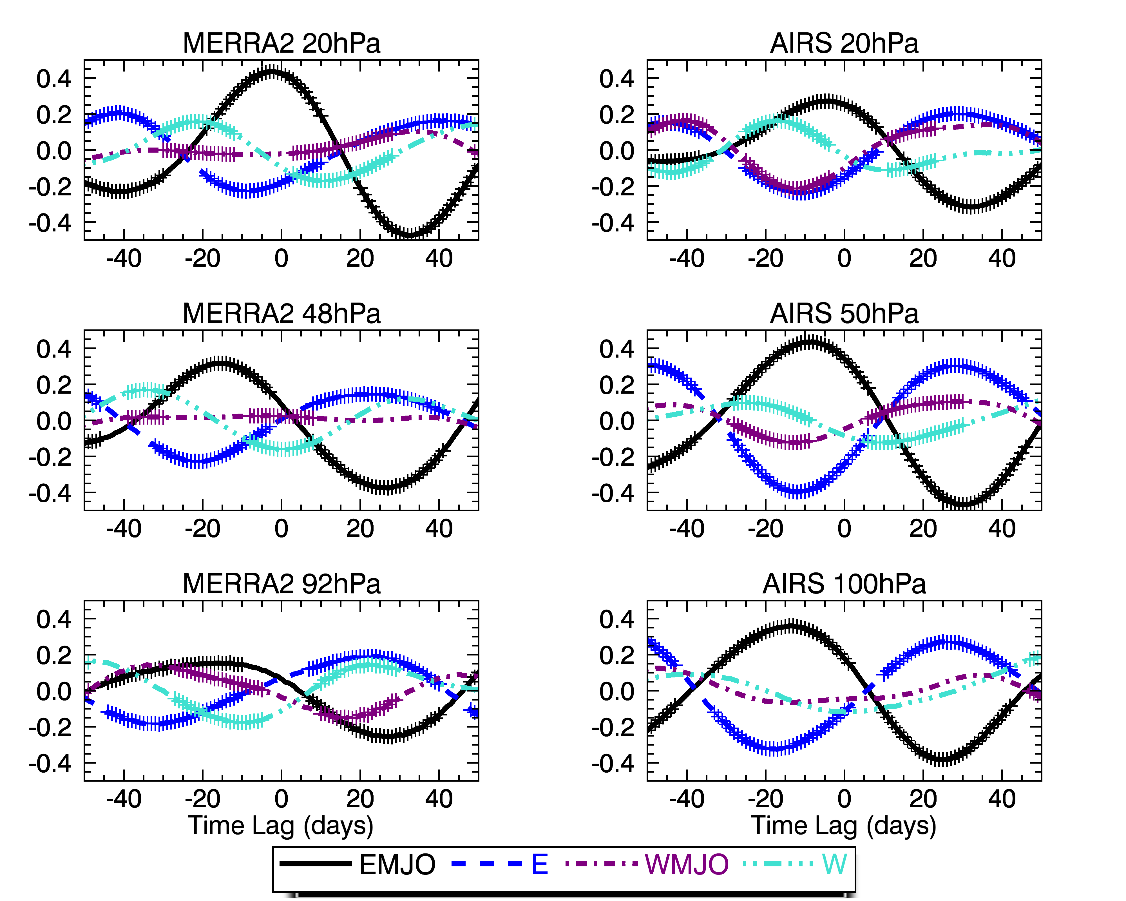
Eastward Kelvin wave activity
Results
Analysis suggests that increased MJO activity alters stratospheric equatorial wave activity, but net impacts have yet to be determined
Next steps:
  Quantification of Momentum Fluxes
  Determination of influence of convection versus changes in the winds

Slide 8
Publications and Acknowledgements
A paper on this topic is currently in preparation
Other papers:
Gahtan, J. and P. Roundy, 2020: Meridional movement of geopotential height anomalies in the subtropics and the relationship to the base state flow. Q. J. Royal Meteorol. Soc., https://doi.org/10.1002/qj.3937
Gahtan, J. and P. Roundy, 2020: Wavelet isolation of meridionally moving geopotential height perturbations near the subtropics of eastern Africa and their relationship with the Madden-Julian Oscillation. Q. J. Royal Meteorol. Soc., 146, 380-400, https://doi.org/10.1002/qj.3681
Gahtan, J. and P. Roundy, 2019: Extratropical Influence on 200-hPa Easterly Acceleration over the Western Indian Ocean Preceding Madden–Julian Oscillation Convective Onset. J. Atmos. Sci., 76, 265–284, https://doi.org/10.1175/JAS-D-18-0069.1
I’d like to thank my advisor Baijun Tian and the NASA Postdoctoral Program for funding me.
Thanks for listening!

